Slide 1
inst.eecs.berkeley.edu/~cs61c CS61C : Machine Structures Lecture #20 Introduction to Synchronous Digital Systems 2008-3-12
Scott Beamer, Guest Lecturer
Wifi in Air Coast to Coast
www.aircell.com
Notes:
Greet class

Slide 2
Review
C program: foo.c
Compiler
Assembly program: foo.s
Assembler
Object(mach lang module): foo.o
Linker
lib.o
Executable(mach lang pgm): a.out
Loader
Memory

Slide 3
What are “Machine Structures”?
Application (Netscape)
61C
Operating
Compiler
System
(MacOS X)
Software
Assembler
Instruction Set
Architecture
Hardware
Processor
Memory
I/O system
Datapath & Control
Digital Design
Circuit Design
transistors
Coordination of many levels of abstraction
ISA is an important abstraction level: contract between HW & SW

Slide 4
Below the Program
High-level language program (in C)
swap int v[], int k){
int temp;
temp = v[k];
v[k] = v[k+1];
v[k+1] = temp;
}
Assembly language program (for MIPS)
swap: sll $2, $5, 2
add $2, $4,$2
lw $15, 0($2)
lw $16, 4($2)
sw $16, 0($2)
sw $15, 4($2)
jr $31
Machine (object) code (for MIPS)
000000 00000 00101 0001000010000000
000000 00100 00010 0001000000100000 . . .
C compiler
assembler
?
Notes:
For lecture
Computer only understands zeros and ones – instructions of 0’s and 1’s
Early programmers found representing machine instructions in a symbolic notation – assembly language
And developed programs that translate from assembler to machine code
Eventually, programmers found working even in assembler too tedious so migrated to higher-level languages and developed compilers that would translate from the higher-level languages to assembler

Slide 5
Synchronous Digital Systems
The hardware of a processor, such as the MIPS, is an example of a Synchronous Digital System
Synchronous:
Means all operations are coordinated by a central clock.
It keeps the “heartbeat” of the system!
Digital:
Mean all values are represented by discrete values
Electrical signals are treated as 1’s and 0’s and grouped together to form words.

Slide 6
Logic Design
Next 4 weeks: we’ll study how a modern processor is built; starting with basic elements as building blocks.
Why study hardware design?
Understand capabilities and limitations of hardware in general and processors in particular.
What processors can do fast and what they can’t do fast (avoid slow things if you want your code to run fast!)
Background for more detailed hardware courses (CS 150, CS 152)
There is just so much you can do with processors. At some point you may need to design your own custom hardware.

Slide 7
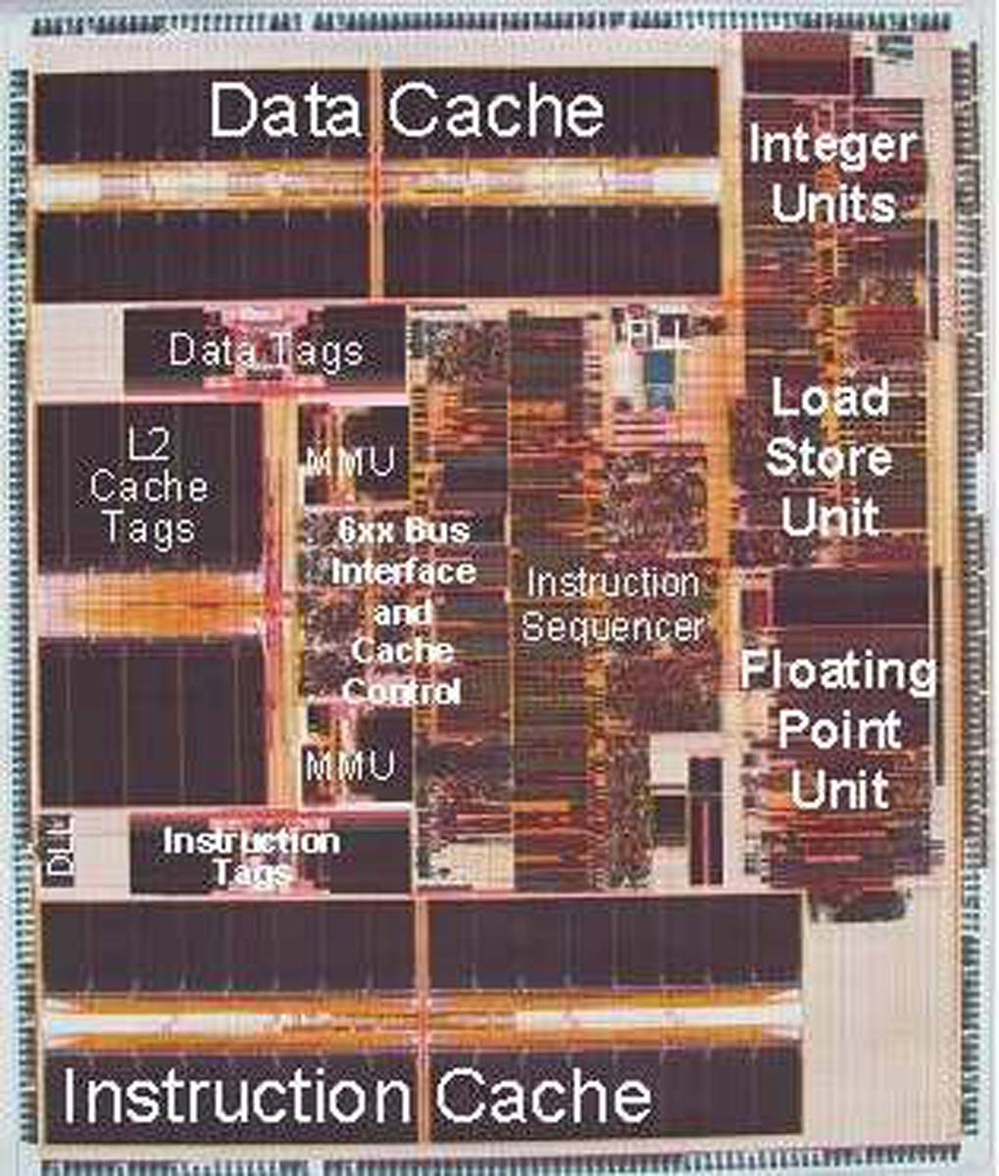
PowerPC Die Photograph
Let’s look closer…

Slide 8
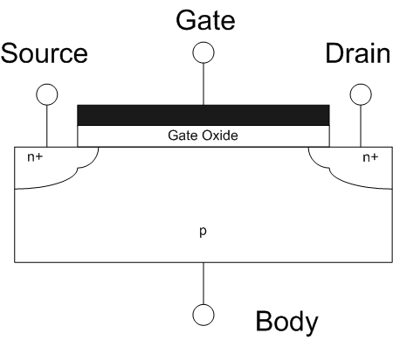
Transistors 101
D
S
MOSFET
Metal-Oxide-Semiconductor Field-Effect Transistor
Come in two types:
n-type NMOSFET
p-type PMOSFET
For n-type (p-type opposite)
If voltage not enough between G & S, transistor turns “off” (cut-off) and Drain-Source NOT connected
If the G & S voltage is high enough, transistor turns “on” (saturation) and Drain-Source ARE connected
G
G
S
D
n-type
p-type
Side view
www.wikipedia.org/wiki/Mosfet

Slide 9
Transistor Circuit Rep. vs. Block diagram
Chips is composed of nothing but transistors and wires.
Small groups of transistors form useful building blocks.
Block are organized in a hierarchy to build higher-level blocks: ex: adders.
“1” (voltage source)
a
b
c
0
0
1
0
1
1
1
0
1
1
1
0
“0” (ground)

Slide 10
Signals and Waveforms: Clocks
Signals
When digital is only treated as 1 or 0
Is transmitted over wires continuously
Transmission is effectively instant
Implies that any wire only contains 1 value at a time

Slide 11
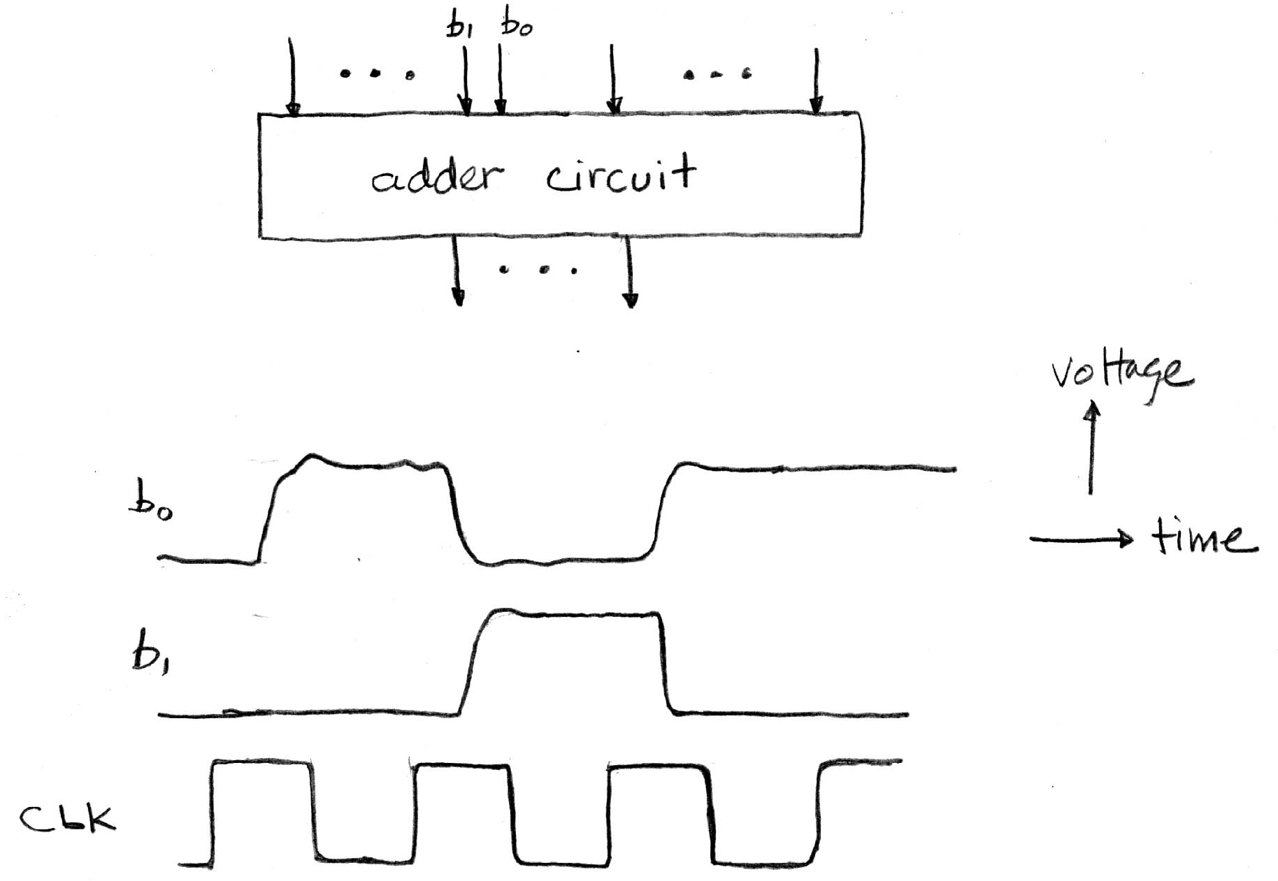
Signals and Waveforms

Slide 12
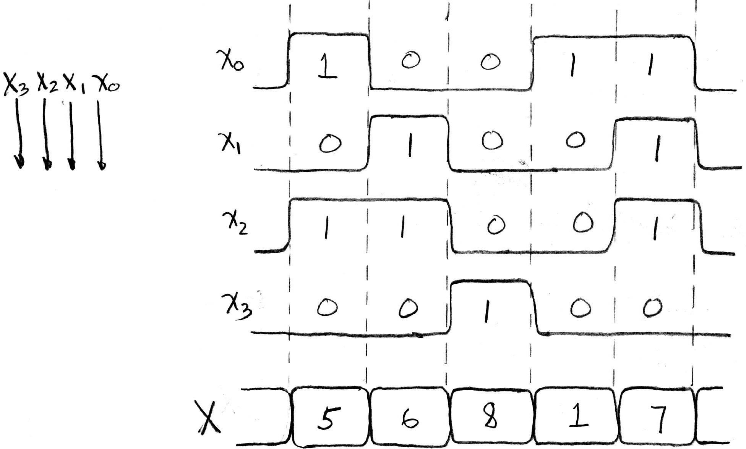
Signals and Waveforms: Grouping

Slide 13
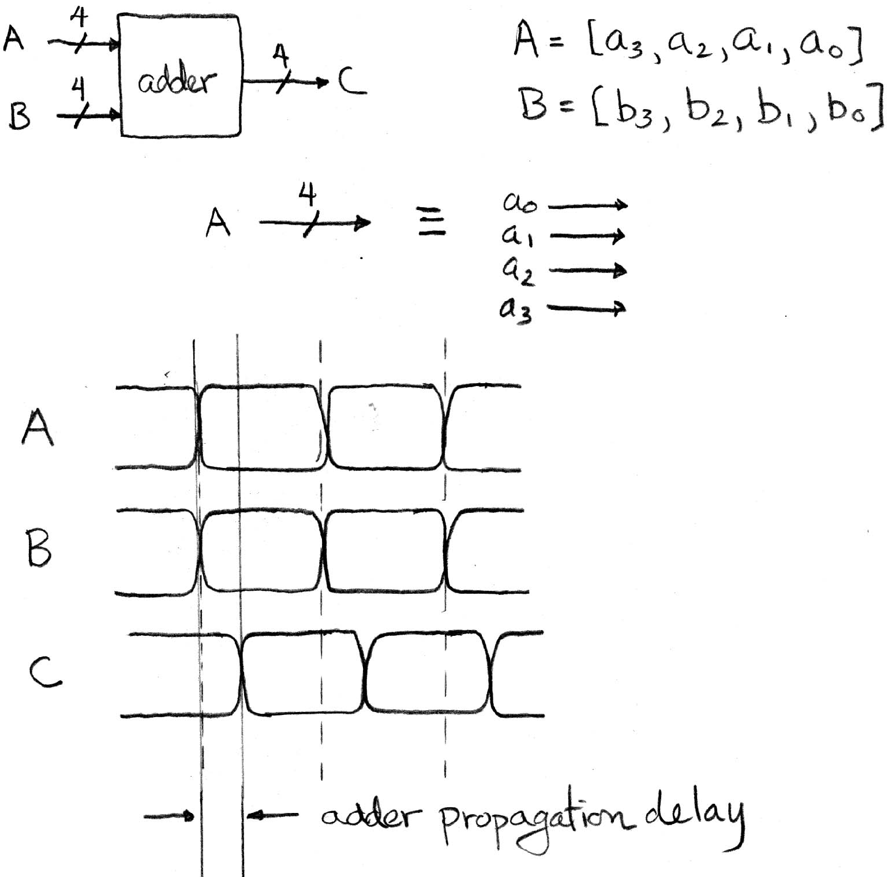
Signals and Waveforms: Circuit Delay
2
3
4
5
3
4
5
6
5
7
9
11

Slide 14
Type of Circuits
Synchronous Digital Systems are made up of two basic types of circuits:
Combinational Logic (CL) circuits
Our previous adder circuit is an example.
Output is a function of the inputs only.
Similar to a pure function in mathematics, y = f(x). (No way to store information from one invocation to the next. No side effects)
State Elements: circuits that store information.

Slide 15
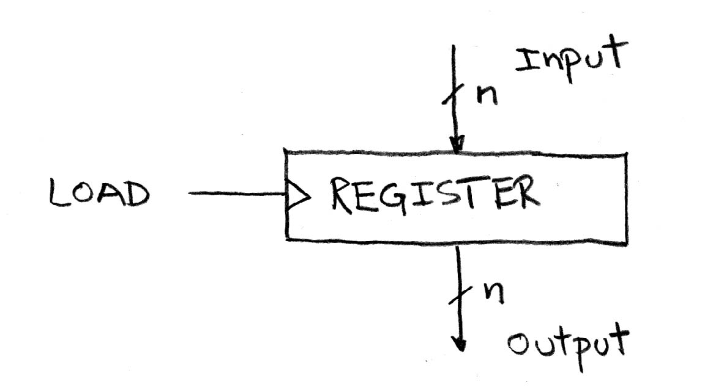
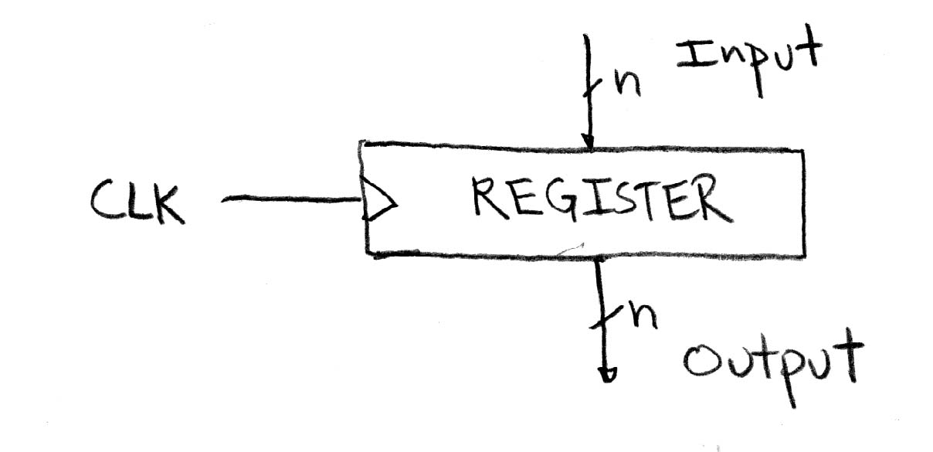
Circuits with STATE (e.g., register)

Slide 16
Peer Instruction
SW can peek at HW (past ISA abstraction boundary) for optimizations
SW can depend on particular HW implementation of ISA
Timing diagrams serve as a critical debugging tool in the EE toolkit
ABC
0: FFF
1: FFT
2: FTF
3: FTT
4: TFF
5: TFT
6: TTF
7: TTT
Notes:
Answer: [correct=5, TFF] Individual (6, 3, 6, 3, 34, 37, 7, 4)% & Team (9, 4, 4, 4, 39, 34, 0, 7)%
A: T [18/82 & 25/75] (The game breaks up very quickly into separate, independent games -- big win to solve separated & put together)
B: F [80/20 & 86/14] (The game tree grows exponentially! A better static evaluator can make all the difference!)
C: F [53/57 & 52/48] (If you're just looking for the best move, just keep theBestMove around [ala memoizing max])

Slide 17
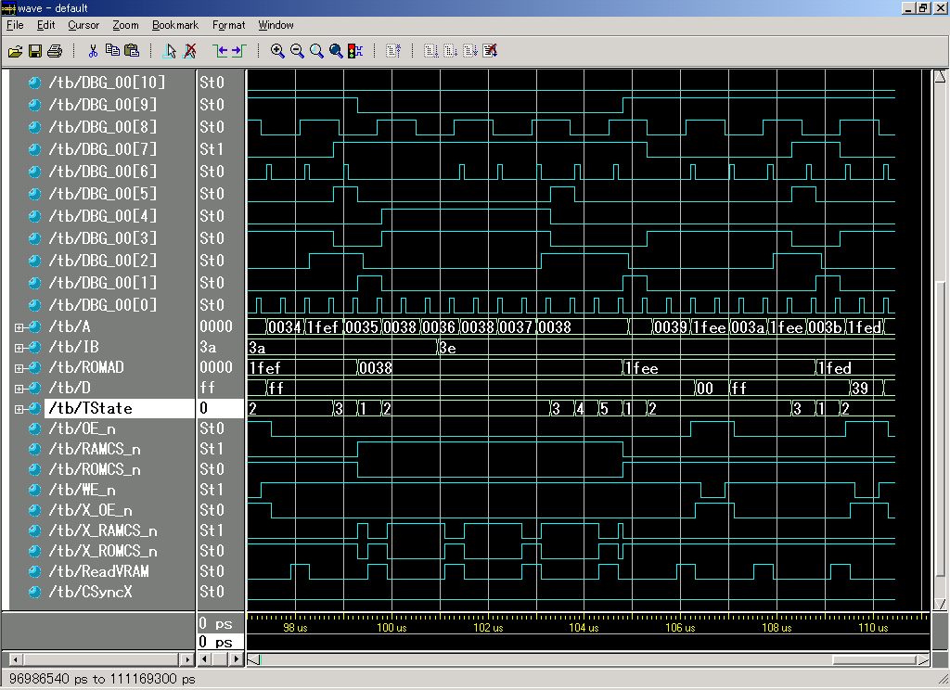
Sample Debugging Waveform

Slide 18
And in conclusion…
ISA is very important abstraction layer
Contract between HW and SW
Clocks control pulse of our circuits
Voltages are analog, quantized to 0/1
Circuit delays are fact of life
Two types of circuits:
Stateless Combinational Logic (&,|,~)
State circuits (e.g., registers)

