Slide 1
CS 61C: Great Ideas in Computer Architecture (Machine Structures)
Course Introduction
Instructors:
Randy H. Katz
David A. Patterson
http://inst.eecs.Berkeley.edu/~cs61c/sp11

Slide 2
Agenda
Great Ideas in Computer Architecture
Administrivia
PostPC Era: From Phones to Datacenters
Technology Break
Warehouse Scale Computers in Depth

Slide 3
Agenda
Great Ideas in Computer Architecture
Administrivia
PostPC Era: From Phones to Datacenters
Technology Break
Warehouse Scale Computers in Depth

Slide 4
CS61c is NOT really about C Programming
It is about the hardware-software interface
  What does the programmer need to know to achieve the highest possible performance
Languages like C are closer to the underlying hardware, unlike languages like Scheme!
  Allows us to talk about key hardware features in higher level terms
  Allows programmer to explicitly harness underlying hardware parallelism for high performance

Slide 5
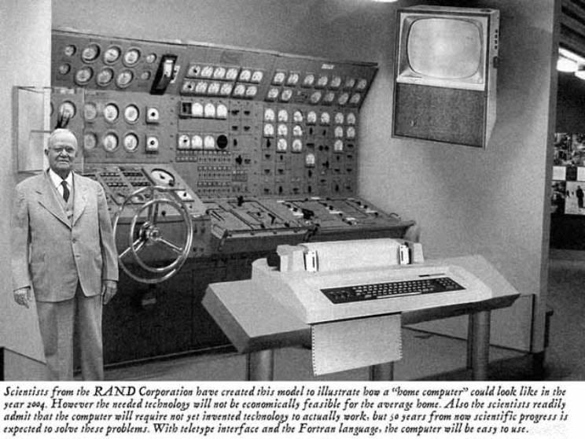
Old School CS61c

Slide 6

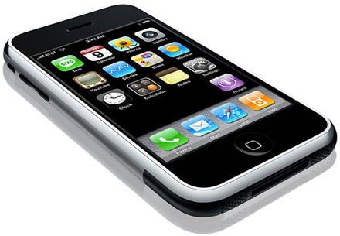
New School CS61c
Personal Mobile Devices

Slide 7
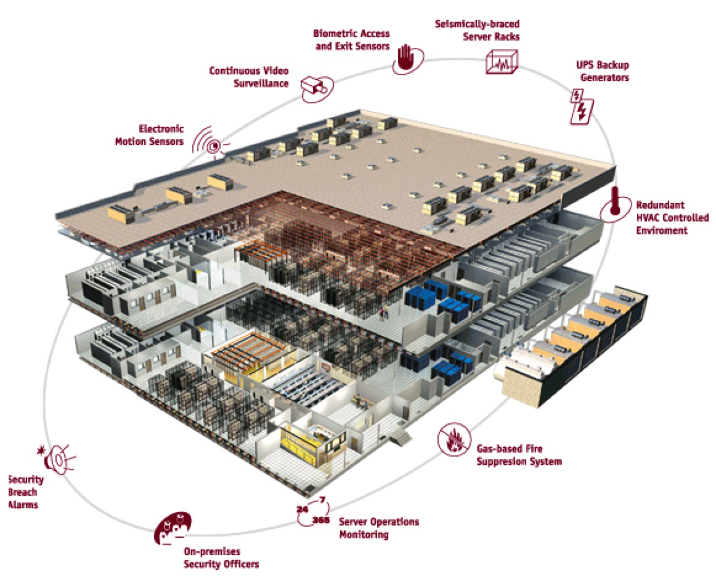
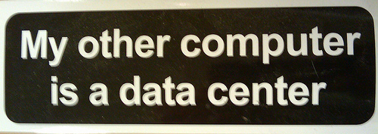
Warehouse
Scale
Computer

Slide 8
Old-School Machine Structures
Application (ex: browser)
CS61c
Operating
Compiler
System
(Mac OSX)
Software
Assembler
Instruction Set
Architecture
Hardware
Processor
Memory
I/O system
Datapath & Control
Digital Design
Circuit Design
transistors

Slide 9
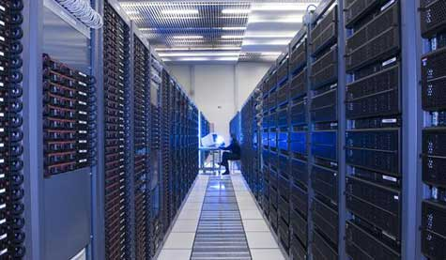


New-School Machine Structures
(It’s a bit more complicated!)
Project 1
Software Hardware
Parallel Requests
  Assigned to computer
  e.g., Search “Katz”
Parallel Threads
  Assigned to core
  e.g., Lookup, Ads
Parallel Instructions
  >1 instruction @ one time
  e.g., 5 pipelined instructions
Parallel Data
  >1 data item @ one time
  e.g., Add of 4 pairs of words
Hardware descriptions
  All gates functioning in parallel at same time
Warehouse Scale Computer
Smart
Phone
Harness
Parallelism &
Achieve High
Performance
Project 2
Computer
Core
…
Core
Memory (Cache)
Project 3
Input/Output
Core
Instruction Unit(s)
Functional
Unit(s)
A₀+B₀
A₁+B₁
A₂+B₂
A₃+B₃
Main Memory
Logic Gates
Project 4

Slide 10
6 Great Ideas in Computer Architecture
Layers of Representation/Interpretation
Moore’s Law
Principle of Locality/Memory Hierarchy
Parallelism
Performance Measurement & Improvement
Dependability via Redundancy

Slide 11

Great Idea #1: Levels of Representation/Interpretation
High Level Language
Program (e.g., C)
temp = v[k];
v[k] = v[k+1];
v[k+1] = temp;
Compiler
Anything can be represented
as a number,
i.e., data or instructions
lw $t0, 0($2)
lw $t1, 4($2)
sw $t1, 0($2)
sw $t0, 4($2)
Assembly Language Program (e.g., MIPS)
Assembler
0000 1001 1100 0110 1010 1111 0101 1000
1010 1111 0101 1000 0000 1001 1100 0110
1100 0110 1010 1111 0101 1000 0000 1001
0101 1000 0000 1001 1100 0110 1010 1111
Machine Language Program (MIPS)
Machine Interpretation
Hardware Architecture Description
(e.g., block diagrams)
Architecture Implementation
Logic Circuit Description
(Circuit Schematic Diagrams)

Slide 12
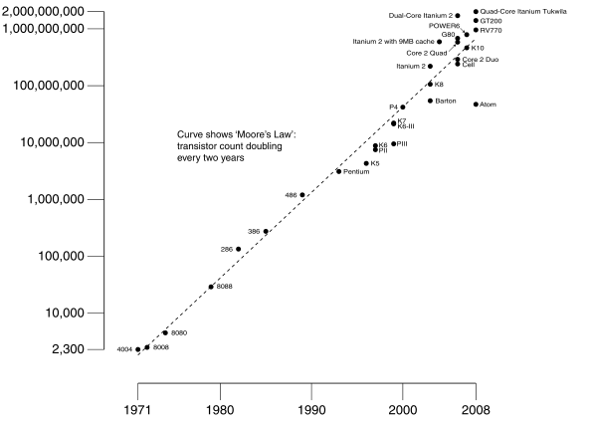
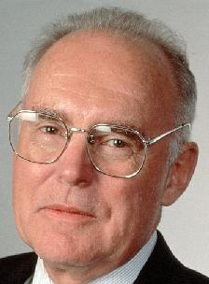
#2: Moore’s Law
Predicts: 2X Transistors / chip every 2 years
# of transistors on an integrated circuit (IC)
Gordon Moore
Intel Cofounder
B.S. Cal 1950!
Year

Slide 13
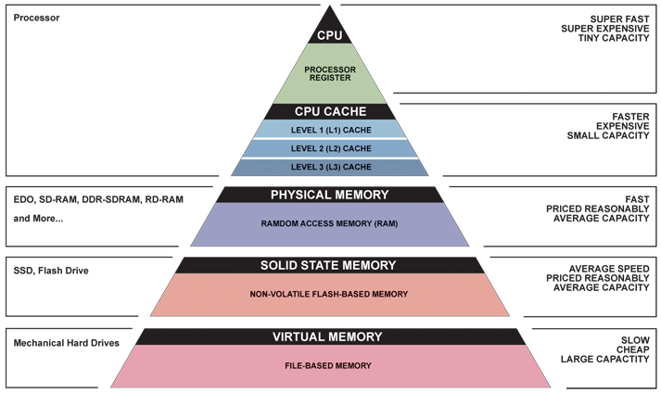
Great Idea #3: Principle of Locality/
Memory Hierarchy

Slide 14
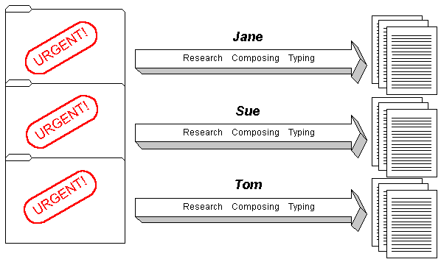
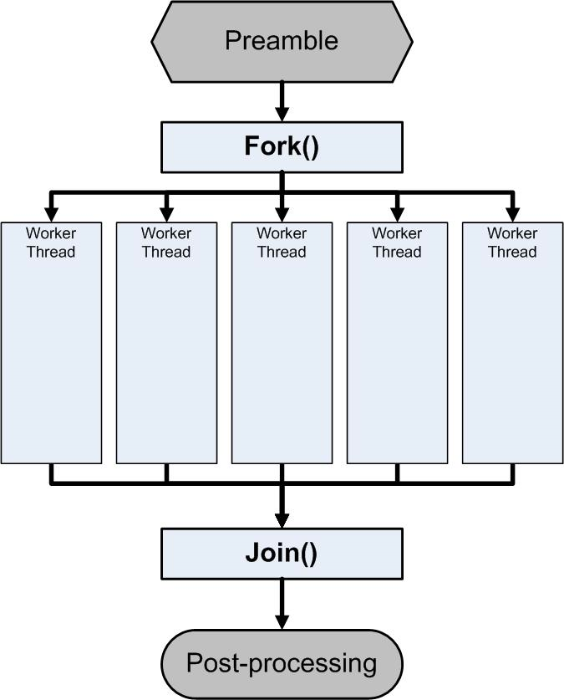
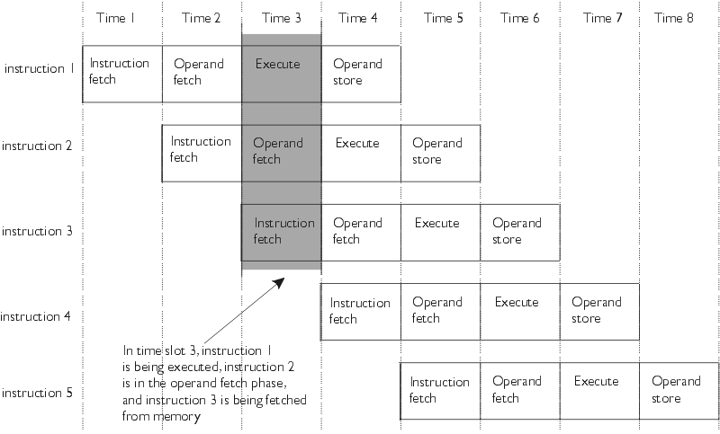
Great Idea #4: Parallelism

Slide 15
Great Idea #5: Performance Measurement and Improvement
Matching application to underlying hardware to exploit:
  Locality
  Parallelism
  Special hardware features, like specialized instructions (e.g., matrix manipulation)
Latency
  How long to set the problem up
  How much faster does it execute once it gets going
  It is all about time to finish

Slide 16
Great Idea #6:
Dependability via Redundancy
Redundancy so that a failing piece doesn’t make the whole system fail
1+1=2
2 of 3 agree
1+1=2
1+1=2
1+1=1
FAIL!
Increasing transistor density reduces the cost of redundancy

Slide 17
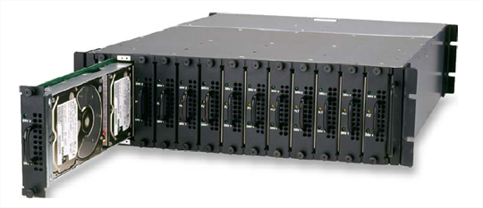
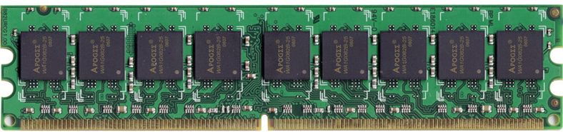
Great Idea #6:
Dependability via Redundancy
Applies to everything from datacenters to storage to memory
  Redundant datacenters so that can lose 1 datacenter but Internet service stays online
  Redundant disks so that can lose 1 disk but not lose data (Redundant Arrays of Independent Disks/RAID)
  Redundant memory bits of so that can lose 1 bit but no data (Error Correcting Code/ECC Memory)

Slide 18
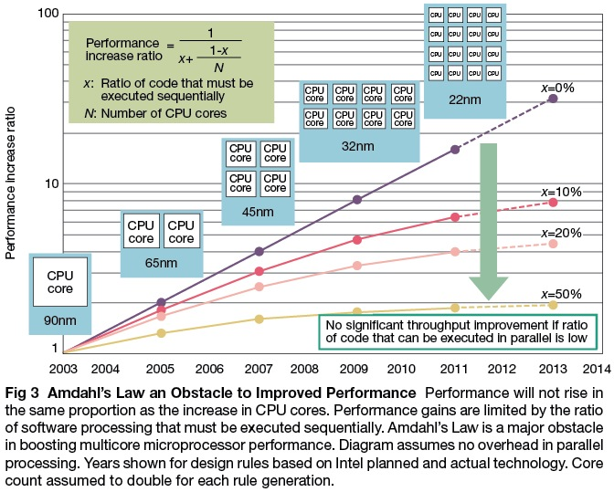

Slide 19
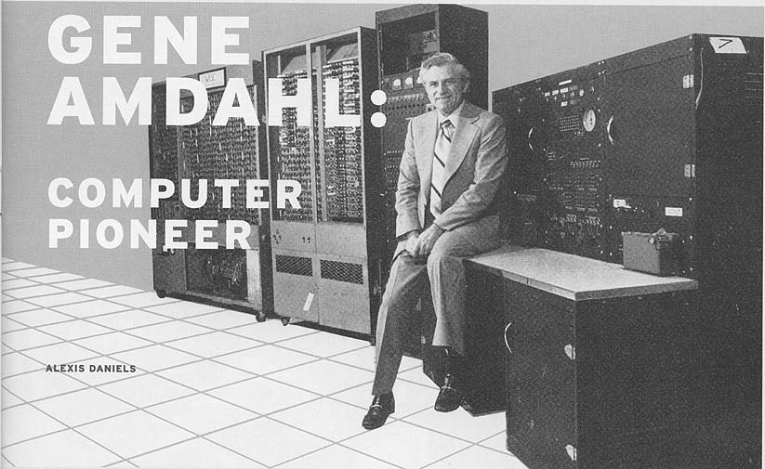

Slide 20
Agenda
Great Ideas in Computer Architecture
Administrivia
Technology Break
From Phones to Datacenters

Slide 21
Course Information
Course Web: http://inst.eecs.Berkeley.edu/~cs61c/sp11
Instructors:
  Randy Katz, Dave Patterson
Teaching Assistants:
  Andrew Gearhart, Conor Hughes, Yunsup Lee, Ari Rabkin, Charles Reiss, Andrew Waterman, Vasily Volkov
Textbooks: Average 15 pages of reading/week
  Patterson & Hennessey, Computer Organization and Design,
  4th Edition (not ≤3rd Edition, not Asian version 4th edition)
  Kernighan & Ritchie, The C Programming Language, 2nd Edition
  Barroso & Holzle, The Datacenter as a Computer, 1st Edition
Google Group:
  61CSpring2011UCB-announce: announcements from staff
  61CSpring2011UCB-disc: Q&A, discussion by anyone in 61C
  Email Andrew Gearhart agearh@gmail.com to join

Slide 22
Reminders
Discussions and labs will be held this week
  Switching Sections: if you find another 61C student willing to swap discussion AND lab, talk to your TAs
  Partner (only project 3 and extra credit): OK if partners mix sections but have same TA
First homework assignment due this Sunday January 23rd by 11:59:59 PM
  There is reading assignment as well on course page

Slide 23
Course Organization
Grading
  Participation and Altruism (5%)
  Homework (5%)
  Labs (20%)
  Projects (40%)
    Data Parallelism (Map-Reduce on Amazon EC2)
    Computer Instruction Set Simulator (C)
    Performance Tuning of a Parallel Application/Matrix Multiply using cache blocking, SIMD, MIMD (OpenMP, due with partner)
    Computer Processor Design (Logisim)
  Extra Credit: Matrix Multiply Competition, anything goes
  Midterm (10%): 6-9 PM Tuesday March 8
  Final (20%): 11:30-2:30 PM Monday May 9

Slide 24
EECS Grading Policy
http://www.eecs.berkeley.edu/Policies/ugrad.grading.shtml
“A typical GPA for courses in the lower division is 2.7. This GPA would result, for example, from 17% A's, 50% B's, 20% C's, 10% D's, and 3% F's. A class whose GPA falls outside the range 2.5 - 2.9 should be considered atypical.”
Fall 2010: GPA 2.81
26% A's, 47% B's, 17% C's,
3% D's, 6% F's
Job/Intern Interviews: They grill
you with technical questions, so
it’s what you say, not your GPA
(New 61c gives good stuff to say)
 | Fall | Spring
2010 | 2.81 | 2.81
2009 | 2.71 | 2.81
2008 | 2.95 | 2.74
2007 | 2.67 | 2.76

Slide 25
Late Policy
Assignments due Sundays at 11:59:59 PM
Late homeworks not accepted (100% penalty)
Late projects get 20% penalty, accepted up to Tuesdays at 11:59:59 PM
  No credit if more than 48 hours late
  No “slip days” in 61C
    Used by Dan Garcia and a few faculty to cope with 100s of students who often procrastinate without having to hear the excuses, but not widespread in EECS courses
    More late assignments if everyone has no-cost options; better to learn now how to cope with real deadlines

Slide 26
Policy on Assignments and Independent Work
With the exception of laboratories and assignments that explicitly permit you to work in groups, all homeworks and projects are to be YOUR work and your work ALONE.
You are encouraged to discuss your assignments with other students, and extra credit will be assigned to students who help others, particularly by answering questions on the Google Group, but we expect that what you hand is yours.
It is NOT acceptable to copy solutions from other students.
It is NOT acceptable to copy (or start your) solutions from the Web.
We have tools and methods, developed over many years, for detecting this. You WILL be caught, and the penalties WILL be severe.
At the minimum a ZERO for the assignment, possibly an F in the course, and a letter to your university record documenting the incidence of cheating.
(We caught people last semester!)

Slide 27
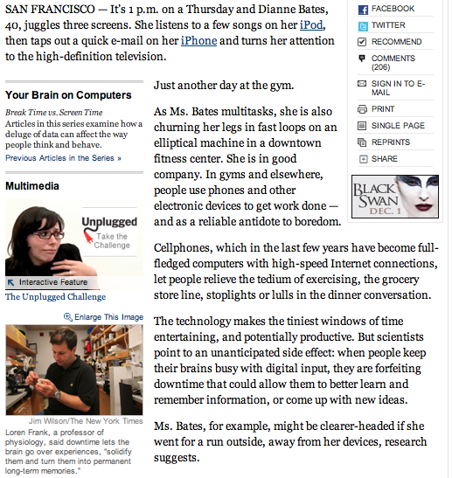
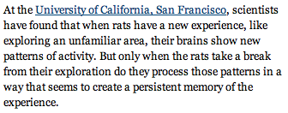

Slide 28

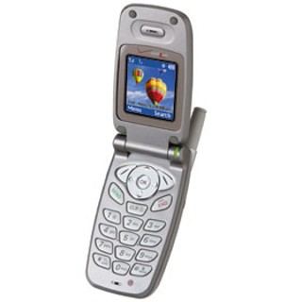
The Rules
(and we really mean it!)

Slide 29
Architecture of a Lecture
Full
Administrivia
Tech
break
“And in
conclusion…”
Attention
0
20
25
50
53
78
80
Time (minutes)

Slide 30
Agenda
Great Ideas in Computer Architecture
Administrivia
PostPC Era: From Phones to Datacenters
Technology Break
Warehouse Scale Computer in Depth

Slide 31
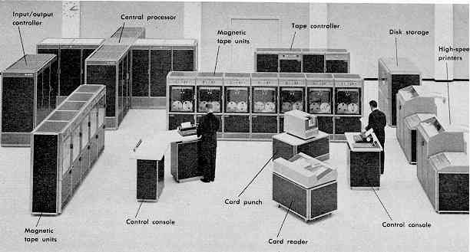
Computer Eras: Mainframe 1950s-60s
Processor (CPU)
I/O
  “Big Iron”: IBM, UNIVAC, … build $1M computers
  for businesses => COBOL, Fortran, timesharing OS

Slide 32
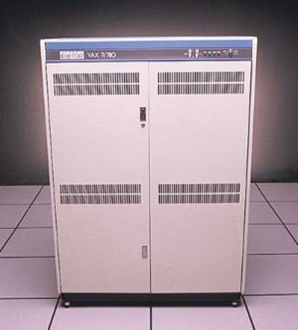
Minicomputer Eras: 1970s
  Using integrated circuits, Digital, HP… build $10k computers for labs, universities => C, UNIX OS

Slide 33
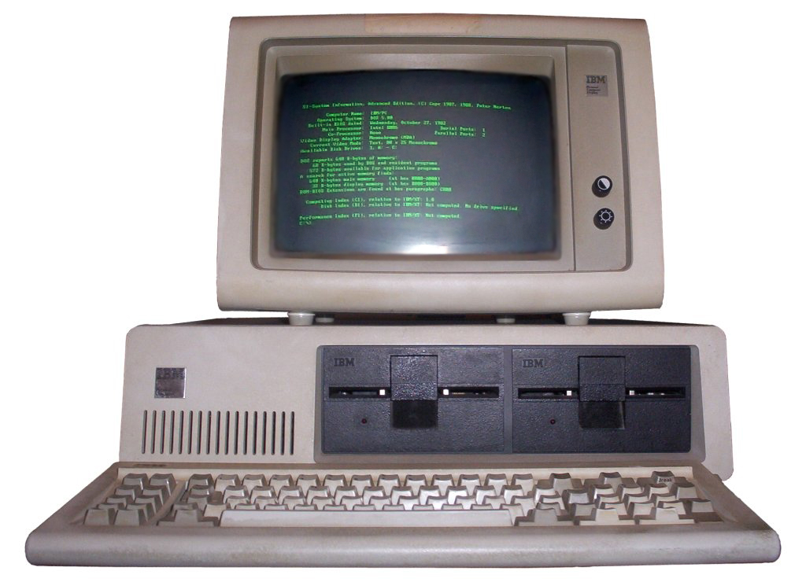
PC Era: Mid 1980s - Mid 2000s
  Using microprocessors, Apple, IBM, … build $1k computer for 1 person => Basic, Java, Windows OS

Slide 34
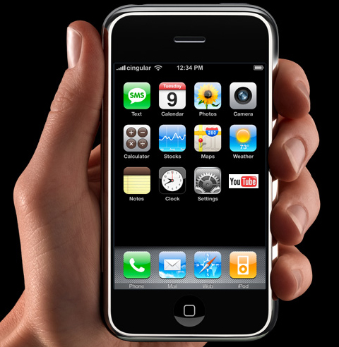
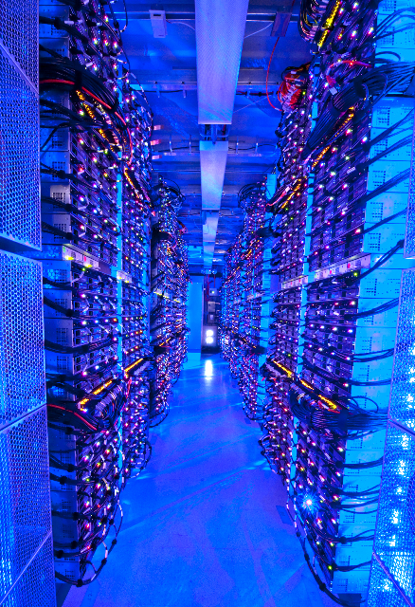
PostPC Era: Late 2000s - ??
  Personal Mobile Devices (PMD): Relying on wireless networking, Apple, Nokia, … build $500 smartphone and tablet computers for individuals
  => Objective C, Android OS
  Cloud Computing:
  Using Local Area Networks, Amazon, Google, … build $200M Warehouse Scale Computers
  with 100,000 servers for
  Internet Services for PMDs
  => MapReduce, Ruby on Rails

Slide 35
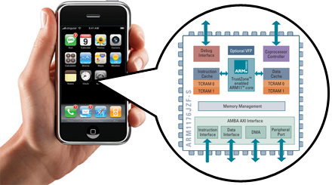
Advanced RISC Machine (ARM) instruction set inside the iPhone
You will how to design and program a related RISC computer: MIPS

Slide 36
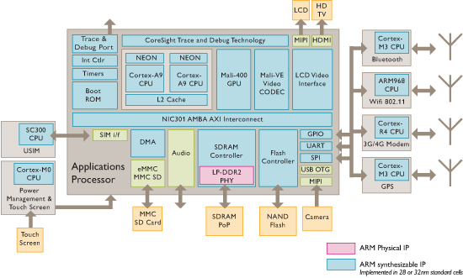
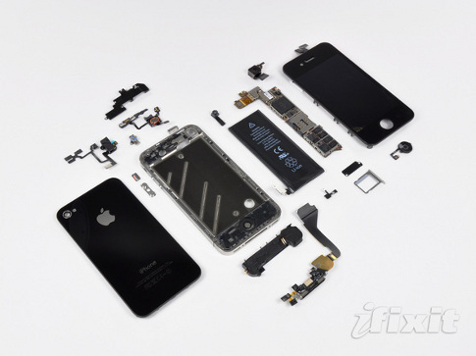
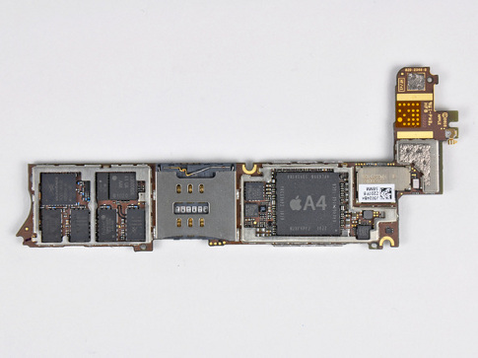
iPhone Innards
I/O
Processor
1 GHz ARM Cortex A8
I/O
I/O
Memory
You will about multiple processors, data level parallelism, caches in 61C

Slide 37

The Big Switch: Cloud Computing
“A hundred years ago, companies stopped generating their own power with steam engines and dynamos and plugged into the newly built electric grid. The cheap power pumped out by electric utilities didn’t just change how businesses operate. It set off a chain reaction of economic and social transformations that brought the modern world into existence. Today, a similar revolution is under way. Hooked up to the Internet’s global computing grid, massive information-processing plants have begun pumping data and software code into our homes and businesses. This time, it’s computing that’s turning into a utility.”

Slide 38
Why Cloud Computing Now?
“The Web Space Race”: Build-out of extremely large datacenters (10,000’s of commodity PCs)
  Build-out driven by growth in demand (more users)
  Infrastructure software and Operational expertise
Discovered economy of scale: 5-7x cheaper than provisioning a medium-sized (1000 servers) facility
More pervasive broadband Internet so can access remote computers efficiently
Commoditization of HW & SW
  Standardized software stacks

Slide 39
Coping with Failures
4 disks/server, 50,000 servers
Failure rate of disks: 2% to 10% / year
  Assume 4% annual failure rate
On average, how often does a disk fail?
  1 / month
  1 / week
  1 / day
  1 / hour

Slide 40
Agenda
Great Ideas in Computer Architecture
Administrivia
PostPC Era: From Phones to Datacenters
Technology Break
Warehouse Scale Computers in Depth

Slide 41
Coping with Failures
4 disks/server, 50,000 servers
Failure rate of disks: 2% to 10% / year
  Assume 4% annual failure rate
On average, how often does a disk fails?
  1 / month
  1 / week
  1 / day
  1 / hour
50,000 x 4 = 200,000 disks
200,000 x 4% = 8000 disks fail
365 days x 24 hours = 8760 hours

Slide 42
Warehouse Scale Computers
Massive scale datacenters: 10,000 to 100,000 servers + networks to connect them together
  Emphasize cost-efficiency
  Attention to power: distribution and cooling
Homogeneous hardware/software
Offer small number of very large applications (Internet services): search, social networking, video sharing
Very highly available: <1 hour down/year
  Must cope with failures common at scale

Slide 43
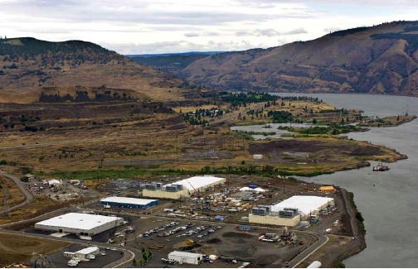
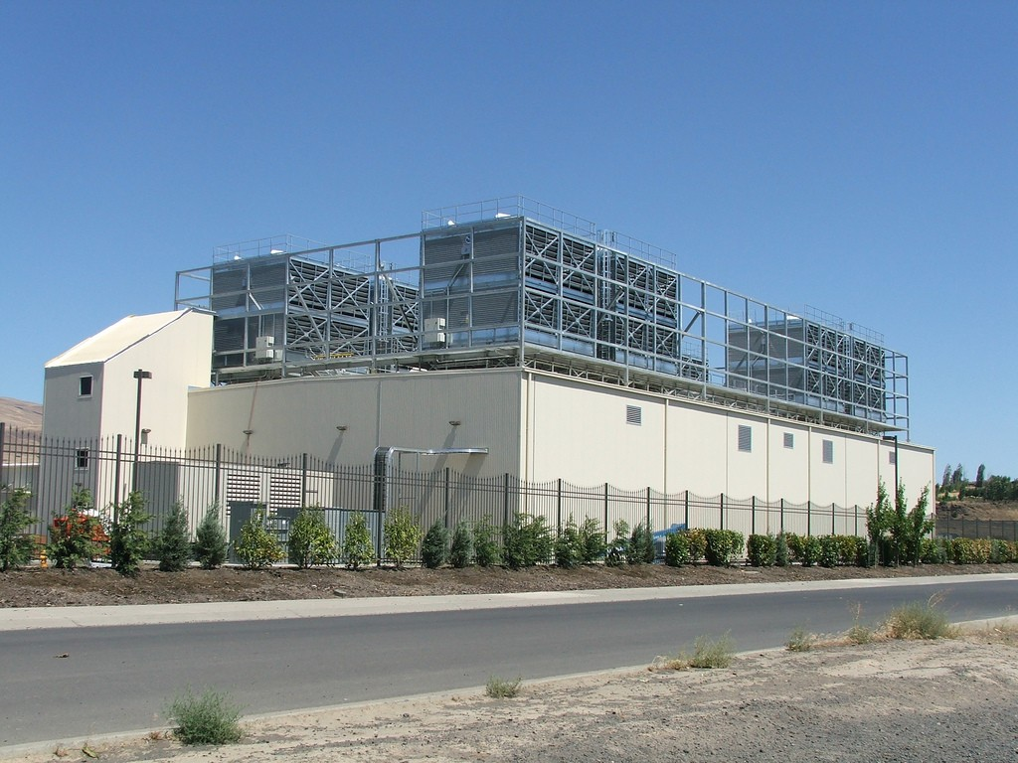
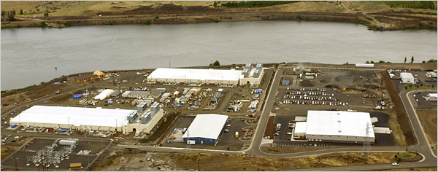
E.g., Google’s Oregon WSC

Slide 44
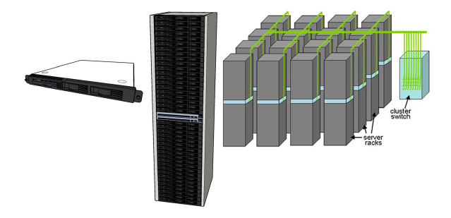
Equipment Inside a WSC
Server (in rack format):
1 ¾ inches high “1U”,
x 19 inches x 16-20 inches: 8 cores, 16 GB DRAM, 4x1 TB disk
Array (aka cluster):
16-32 server racks + larger local area network switch (“array switch”) 10X faster => cost 100X: cost f(N²)
7 foot Rack: 40-80 servers + Ethernet local area network (1-10 Gbps) switch in middle (“rack switch”)

Slide 45
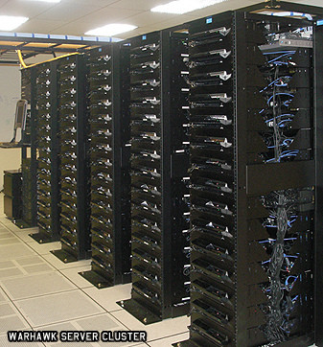
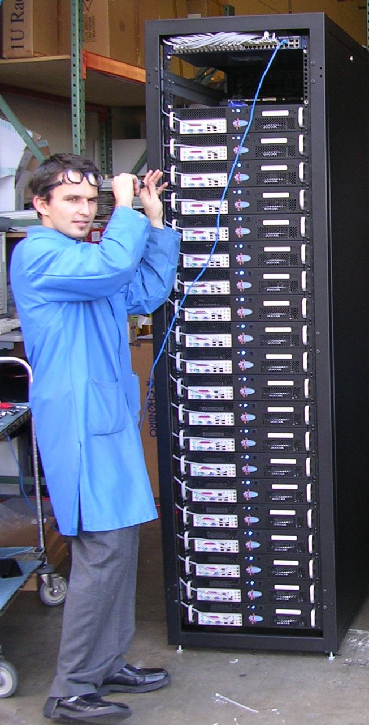
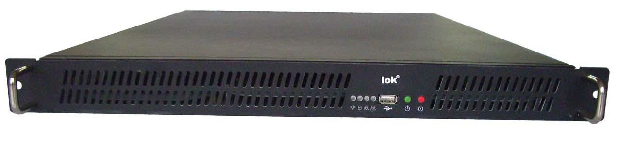
Server, Rack, Array

Slide 46
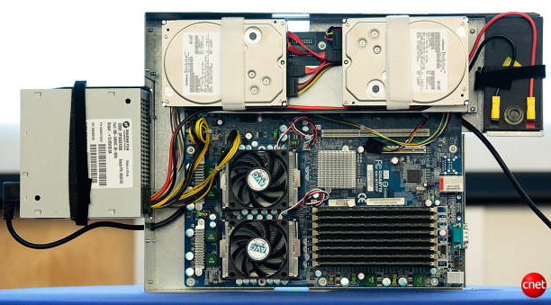
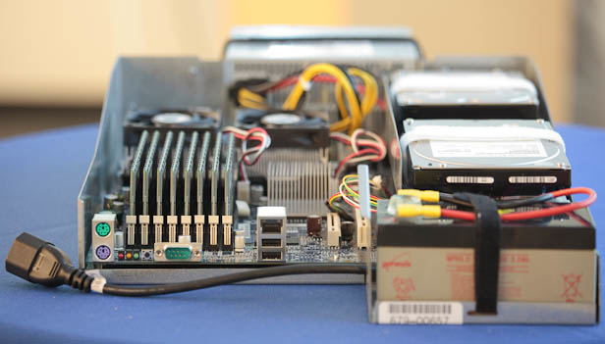
Google Server Internals
Google Server
Notes:
Most companies buy servers from the likes of Dell, Hewlett-Packard, IBM, or Sun Microsystems. But Google, which has hundreds of thousands of servers and considers running them part of its core expertise, designs and builds its own. Ben Jai, who designed many of Google's servers, unveiled a modern Google server before the hungry eyes of a technically sophisticated audience.
Google's big surprise: each server has its own 12-volt battery to supply power if there's a problem with the main source of electricity. The company also revealed for the first time that since 2005, its data centers have been composed of standard shipping containers--each with 1,160 servers and a power consumption that can reach 250 kilowatts.
It may sound geeky, but a number of attendees--the kind of folks who run data centers packed with thousands of servers for a living--were surprised not only by Google's built-in battery approach, but by the fact that the company has kept it secret for years. Jai said in an interview that Google has been using the design since 2005 and now is in its sixth or seventh generation of design.
Read more: http://news.cnet.com/8301-1001_3-10209580-92.html#ixzz0yo8bhTOH

Slide 47
Datacenter Power
Peak
Power %

Slide 48
Coping with Performance in Array
Lower latency to DRAM in another server than local disk
Higher bandwidth to local disk than to DRAM in another server
 | Local | Rack | Array
Racks | -- | 1 | 30
Servers | 1 | 80 | 2400
Cores (Processors) | 8 | 640 | 19,200
DRAM Capacity (GB) | 16 | 1,280 | 38,400
Disk Capacity (GB) | 4,000 | 320,000 | 9,600,000
DRAM Latency (microseconds) | 0.1 | 100 | 300
Disk Latency (microseconds) | 10,000 | 11,000 | 12,000
DRAM Bandwidth (MB/sec) | 20,000 | 100 | 10
Disk Bandwidth (MB/sec) | 200 | 100 | 10

Slide 49
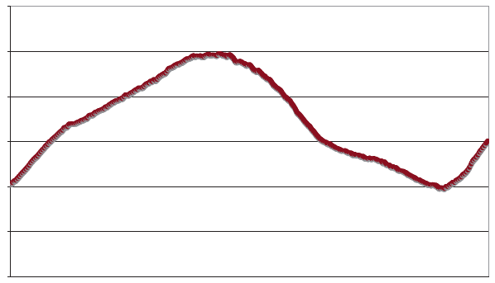
Coping with Workload Variation
Workload
2X
Midnight
Noon
Midnight
Online service: Peak usage 2X off-peak

Slide 50
Impact of latency, bandwidth, failure, varying workload on WSC software?
WSC Software must take care where it places data within an array to get good performance
WSC Software must cope with failures gracefully
WSC Software must scale up and down gracefully in response to varying demand
More elaborate hierarchy of memories, failure tolerance, workload accommodation makes
WSC software development more challenging than software for single computer

Slide 51
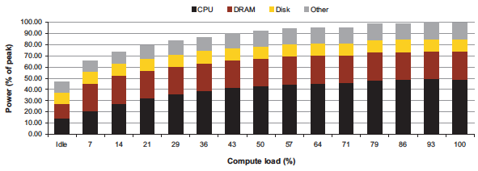
Power vs. Server Utilization
Server power usage as load varies idle to 100%
Uses ½ peak power when idle!
Uses ⅔ peak power when 10% utilized! 90%@ 50%!
Most servers in WSC utilized 10% to 50%
Goal should be Energy-Proportionality:
% peak load = % peak energy

Slide 52
Power Usage Effectiveness
Overall WSC Energy Efficiency: amount of computational work performed divided by the total energy used in the process
Power Usage Effectiveness (PUE):
Total building power / IT equipment power
  An power efficiency measure for WSC, not including efficiency of servers, networking gear
  1.0 = perfection

Slide 53
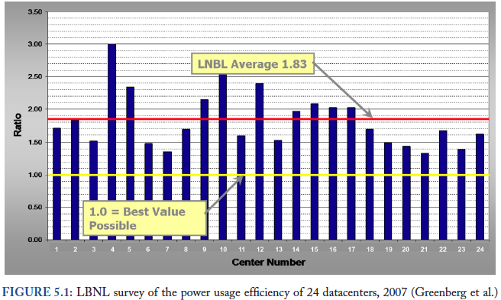
PUE in the Wild (2007)

Slide 54
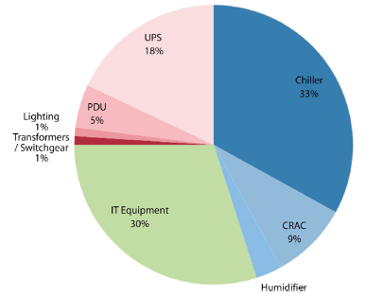
High PUE: Where Does Power Go?
Uninterruptable
Power Supply
(battery)
Chiller cools warm
water from Air
Conditioner
Power
Distribution
Unit
Computer
Room
Air
Conditioner
Servers +
Networking

Slide 55
Google WSC A PUE: 1.24
Careful air flow handling
Don’t mix server hot air exhaust with cold air (separate warm aisle from cold aisle)
Short path to cooling so little energy spent moving cold or hot air long distances
Keeping servers inside containers helps control air flow

Slide 56
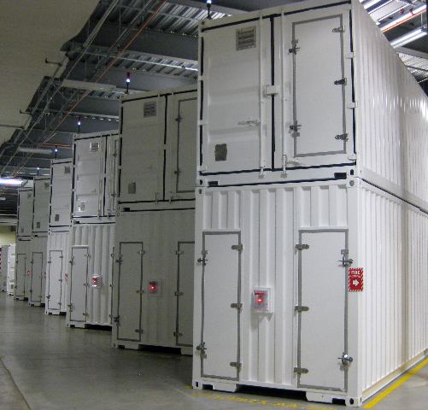
Containers in WSCs
Inside WSC
Inside Container

Slide 57
Google WSC A PUE: 1.24
Elevated cold aisle temperatures
81°F instead of traditional 65°- 68°F
Found reliability OK if run servers hotter
Use of free cooling
Cool warm water outside by evaporation in cooling towers
Locate WSC in moderate climate so not too hot or too cold

Slide 58
Google WSC A PUE: 1.24
Per-server 12-V DC UPS
Rather than WSC wide UPS, place single battery per server board
Increases WSC efficiency from 90% to 99%
Measure vs. estimate PUE, publish PUE, and improve operation

Slide 59
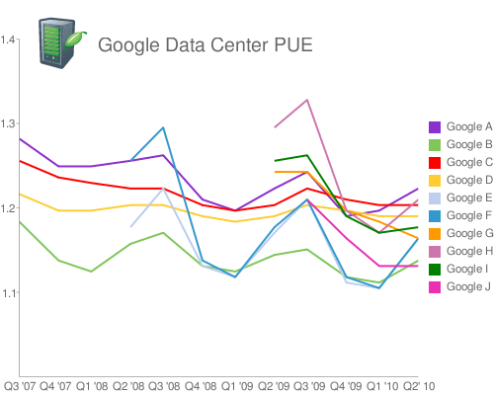
Google WSC PUE: Quarterly Avg
PUE
www.google.com/corporate/green/datacenters/measuring.htm

Slide 60
Summary
CS61c: Learn 6 great ideas in computer architecture to enable high performance programming via parallelism, not just learn C
  Layers of Representation/Interpretation
  Moore’s Law
  Principle of Locality/Memory Hierarchy
  Parallelism
  Performance Measurement and Improvement
  Dependability via Redundancy
Post PC Era: Parallel processing, smart phone to WSC
WSC SW must cope with failures, varying load, varying HW latency bandwidth
WSC HW sensitive to cost, energy efficiency

