Slide 1
CS 61C: Great Ideas in Computer Architecture (Machine Structures)
Performance
Instructors:
Randy H. Katz
David A. Patterson
http://inst.eecs.Berkeley.edu/~cs61c/sp11

Slide 2


Slide 3
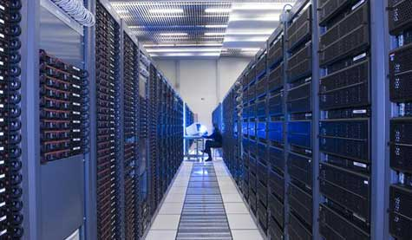
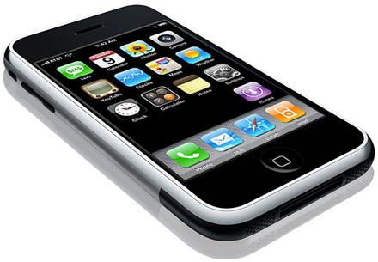


New-School Machine Structures
(It’s a bit more complicated!)
Software Hardware
Parallel Requests
  Assigned to computer
  e.g., Search “Katz”
Parallel Threads
  Assigned to core
  e.g., Lookup, Ads
Parallel Instructions
  >1 instruction @ one time
  e.g., 5 pipelined instructions
Parallel Data
  >1 data item @ one time
  e.g., Add of 4 pairs of words
Hardware descriptions
  All gates @ one time
Warehouse Scale Computer
Smart
Phone
Harness
Parallelism &
Achieve High
Performance
How do
we know?
Computer
Core
…
Core
Memory (Cache)
Input/Output
Core
Instruction Unit(s)
Functional
Unit(s)
A₀+B₀
A₁+B₁
A₂+B₂
A₃+B₃
Main Memory
Logic Gates

Slide 4
Agenda
Defining Performance
Administrivia
Workloads and Benchmarks
Technology Break
Measuring Performance
Summary

Slide 5
Agenda
Defining Performance
Administrivia
Workloads and Benchmarks
Technology Break
Measuring Performance
Summary

Slide 6
What is Performance?
Latency (or response time or execution time)
  Time to complete one task
Bandwidth (or throughput)
  Tasks completed per unit time

Slide 7
Running Systems to 100% Utilization
Implication of the graph at the right?
Can you explain why this happens?
Service Time
aka Latency or
Responsiveness
“Knee”
100%
Utilization
Student Roulette?

Slide 8
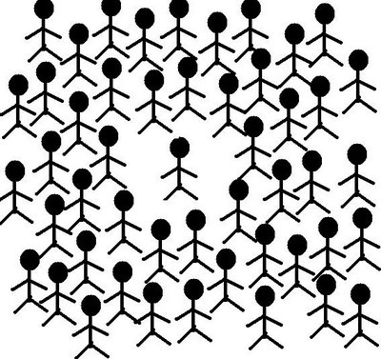
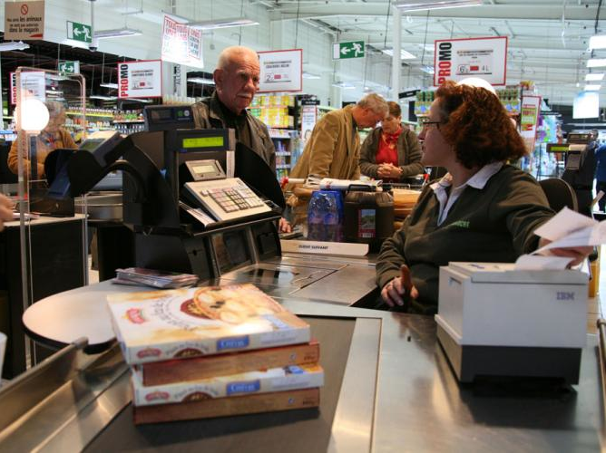

The Iron Law of Queues
(aka Little’s Law)
L = λ W
Average number of customers in system (L) =
average interarrival rate (λ) x average service time (W)

Slide 9
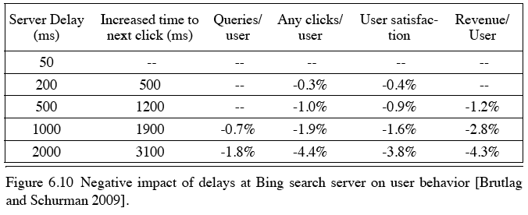
Cloud Performance:
Why Application Latency Matters
Key figure of merit: application responsiveness
  Longer the delay, the fewer the user clicks, the less the user happiness, and the lower the revenue per user

Slide 10
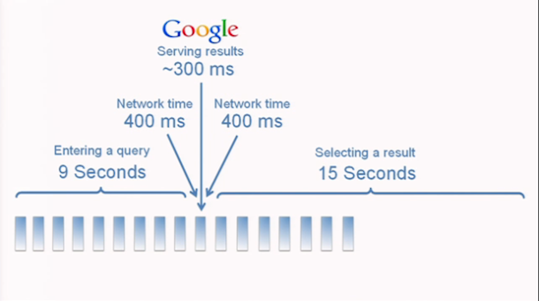
Google Instant Search
“Instant Efficiency”
Typical search takes 24 seconds, Google’s search algorithm is only 300 ms of this
“It’s not search ‘as you type’, but ‘search before you type’!”
“We can predict what you are likely to type and give you those results in real time”

Slide 11
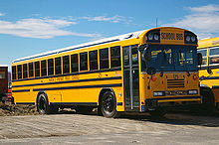
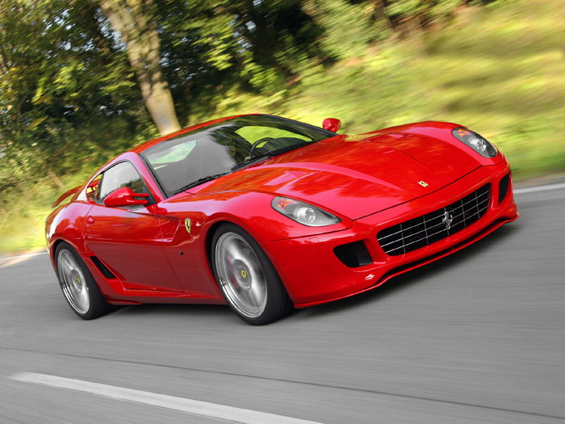
Defining CPU Performance
What does it mean to say
X is faster than Y?
Ferrari vs. School Bus?
2009 Ferrari 599 GTB
  2 passengers, 11.1 secs in quarter mile
2009 Type D school bus
  54 passengers, quarter mile time?
http://www.youtube.com/watch?v=KwyCoQuhUNA
Response Time/Latency: e.g., time to travel ¼ mile
Throughput/Bandwidth: e.g., passenger-mi in 1 hour

Slide 12
Defining Relative CPU Performance
Performance_{X} = 1/Program Execution Time_{X}
Performance_{X} > Performance_{Y} =>
1/Execution Time_{X} > 1/Execution Time_{y} =>
Execution Time_{Y} > Execution Time_{X}
Computer X is N times faster than Computer Y
Performance_{X} / Performance_{Y} = N or
Execution Time_{Y} / Execution Time_{X} = N
Bus is to Ferrari as 12 is to 11.1:
Ferrari is 1.08 times faster than the bus!

Slide 13
Measuring CPU Performance
Computers use a clock to determine when events takes place within hardware
Clock cycles: discrete time intervals
  aka clocks, cycles, clock periods, clock ticks
Clock rate or clock frequency: clock cycles per second (inverse of clock cycle time)
3 GigaHertz clock rate
=> clock cycle time = 1/(3x10⁹) seconds
clock cycle time = 333 picoseconds (ps)

Slide 14
CPU Performance Factors
To distinguish between processor time and I/O, CPU time is time spent in processor
CPU Time/Program
= Clock Cycles/Program
x Clock Cycle Time
Or
CPU Time/Program
= Clock Cycles/Program ÷ Clock Rate

Slide 15
CPU Performance Factors
But a program executes instructions
CPU Time/Program
= Clock Cycles/Program x Clock Cycle Time
= Instructions/Program
x Average Clock Cycles/Instruction
x Clock Cycle Time
1st term called Instruction Count
2nd term abbreviated CPI for average
Clock Cycles Per Instruction
3rd term is 1 / Clock rate

Slide 16
Restating Performance Equation
Time = Seconds
Program
Instructions Clock cycles Seconds
Program Instruction Clock Cycle
=
×
×

Slide 17
What Affects Each Component? Instruction Count, CPI, Clock Rate
Hardware or software component? | Affects What?
Algorithm
Programming Language
Compiler
Instruction Set Architecture
Student Roulette?
Notes:
Algorithm
Instruction count, possibly CPI
The algorithm determines the number of source program instructions executed and hence the number of processor instructions executed. The algorithm may also affect the CPI, by
favoring slower or faster instructions. For example, if the algorithm uses more floating-point operations, it will tend to have a higher CPI.
Programming language
Instruction count, CPI
The programming language certainly affects the instruction count, since statements in the language are translated to processor
instructions, which determine instruction count. The language mayalso affect the CPI because of its features; for example, a language
with heavy support for data abstraction (e.g., Java) will require indirect calls, which will use higher CPI instructions.
Compiler
Instruction count, CPI
The efficiency of the compiler affects both the instruction count and average cycles per instruction, since the compiler determines
the translation of the source language instructions into computer instructions. The compiler’s role can be very complex and affect
the CPI in complex ways.
Instruction set
architecture
Instruction count, clock rate, CPI
The instruction set architecture affects all three aspects of CPU performance, since it affects the instructions needed for a
function, the cost in cycles of each instruction, and the overall clock rate of the processor

Slide 18
What Affects Each Component? Instruction Count, CPI, Clock Rate
Hardware or software component? | Affects What?
Algorithm | Instruction Count, CPI
Programming Language | Instruction Count, CPI
Compiler | Instruction Count, CPI
Instruction Set Architecture | Instruction Count, Clock Rate, CPI
Notes:
Algorithm
Instruction count, possibly CPI
The algorithm determines the number of source program instructions executed and hence the number of processor instructions executed. The algorithm may also affect the CPI, by
favoring slower or faster instructions. For example, if the algorithm uses more floating-point operations, it will tend to have a higher CPI.
Programming language
Instruction count, CPI
The programming language certainly affects the instruction count, since statements in the language are translated to processor
instructions, which determine instruction count. The language mayalso affect the CPI because of its features; for example, a language
with heavy support for data abstraction (e.g., Java) will require indirect calls, which will use higher CPI instructions.
Compiler
Instruction count, CPI
The efficiency of the compiler affects both the instruction count and average cycles per instruction, since the compiler determines
the translation of the source language instructions into computer instructions. The compiler’s role can be very complex and affect
the CPI in complex ways.
Instruction set
architecture
Instruction count, clock rate, CPI
The instruction set architecture affects all three aspects of CPU performance, since it affects the instructions needed for a
function, the cost in cycles of each instruction, and the overall clock rate of the processor

Slide 19
Peer Instruction Question
Computer A clock cycle time 250 ps, CPI_{A} = 2
Computer B clock cycle time 500 ps, CPI_{B} = 1.2
Assume A and B have same instruction set
Which statement is true?
Red. Computer A is ~1.2 times faster than B
Orange. Computer A is ~4.0 times faster than B
Green. Computer B is ~1.7 times faster than A
Yellow. Computer B is ~3.4 times faster than A
Pink. None of the above
Notes:
A is answer

Slide 20
Peer Instruction Answer
Computer A clock cycle time 250 ps, CPI_{A} = 2
Computer B clock cycle time 500 ps, CPI_{B} = 1.2
Assume A and B have same instruction set
Which statement is true?
Red. Computer A is ~1.2 times faster than B
Orange. Computer A is ~4.0 times faster than B
Green. Computer B is ~1.7 times faster than A
Yellow. Computer B is ~3.4 times faster than A
Pink. None of the above
Notes:
A is answer

Slide 21
Agenda
Defining Performance
Administrivia
Workloads and Benchmarks
Technology Break
Measuring Performance
Summary

Slide 22
Administrivia
Lab #5 posted
Project #2.1 Due Sunday @ 11:59:59
HW #4 Due Sunday @ 11:59:59
Midterm in less than three weeks:
  No discussion during exam week
  TA Review: Su, Mar 6, 2-5 PM, 2050 VLSB
  Exam: Tu, Mar 8, 6-9 PM, 145/155 Dwinelle
  Small number of special consideration cases, due to class conflicts, etc.—contact Dave or Randy

Slide 23
Agenda
Defining Performance
Administrivia
Workloads and Benchmarks
Technology Break
Measuring Performance
Summary

Slide 24
Workload and Benchmark
Workload: Set of programs run on a computer
  Actual collection of applications run or made from real programs to approximate such a mix
  Specifies both programs and relative frequencies
Benchmark: Program selected for use in comparing computer performance
  Benchmarks form a workload
  Usually standardized so that many use them

Slide 25
SPEC
(System Performance Evaluation Cooperative)
Computer Vendor cooperative for benchmarks, started in 1989
SPECCPU2006
  12 Integer Programs
  17 Floating-Point Programs
Often turn into number where bigger is faster
SPECratio: reference execution time on old reference computer divide by execution time on new computer to get an effective speed-up

Slide 26
SPECINT2006 on AMD Barcelona
Description | Instruc-tion Count (B) | CPI | Clock cycle time (ps) | Execu-tion Time (s) | Refer-ence Time (s) | SPEC-ratio
Interpreted string processing | 2,118 | 0.75 | 400 | 637 | 9,770 | 15.3
Block-sorting compression | 2,389 | 0.85 | 400 | 817 | 9,650 | 11.8
GNU C compiler | 1,050 | 1.72 | 400 | 724 | 8,050 | 11.1
Combinatorial optimization | 336 | 10.0 | 400 | 1,345 | 9,120 | 6.8
Go game | 1,658 | 1.09 | 400 | 721 | 10,490 | 14.6
Search gene sequence | 2,783 | 0.80 | 400 | 890 | 9,330 | 10.5
Chess game | 2,176 | 0.96 | 400 | 837 | 12,100 | 14.5
Quantum computer simulation | 1,623 | 1.61 | 400 | 1,047 | 20,720 | 19.8
Video compression | 3,102 | 0.80 | 400 | 993 | 22,130 | 22.3
Discrete event simulation library | 587 | 2.94 | 400 | 690 | 6,250 | 9.1
Games/path finding | 1,082 | 1.79 | 400 | 773 | 7,020 | 9.1
XML parsing | 1,058 | 2.70 | 400 | 1,143 | 6,900 | 6.0

Slide 27
Summarizing Performance …
System
Rate (Task 1)
Rate (Task 2)
A
10
20
B
20
10
Which system is faster?
Student Roulette?

Slide 28
… Depends Who’s Selling
System
Rate (Task 1)
Rate (Task 2)
Average
A
10
20
15
B
20
10
15
Average throughput
System
Rate (Task 1)
Rate (Task 2)
Average
A
0.50
2.00
1.25
B
1.00
1.00
1.00
Throughput relative to B
System
Rate (Task 1)
Rate (Task 2)
Average
A
1.00
1.00
1.00
B
2.00
0.50
1.25
Throughput relative to A

Slide 29

Summarizing SPEC Performance
Varies from 6x to 22x faster than reference computer
Geometric mean of ratios:
N-th root of product
of N ratios
  Geometric Mean gives same relative answer no matter what computer is used as reference
Geometric Mean for Barcelona is 11.7

Slide 30
Energy and Power
(Energy = Power x Time)
Energy to complete operation (Joules)
  Corresponds approximately to battery life
Peak power dissipation (Watts = Joules/s)
  Affects heat (and cooling demands)
  IT equipment’s power is in the denominator of the Power Utilization Efficiency (PUE) equation, a WSC figure of merit

Slide 31
Peak Power vs. Lower Energy
(Power x Time = Energy)
Peak A
Peak B
Power
Integrate power curve to get energy
Time
Which system has higher peak power?
Which system has higher energy?
Student Roulette?

Slide 32
Peak Power vs. Lower Energy
(Power x Time = Energy)
Peak A
Peak B
Power
Integrate power curve to get energy
Time
System A has higher peak power, but lower total energy
System B has lower peak power, but higher total energy

Slide 33
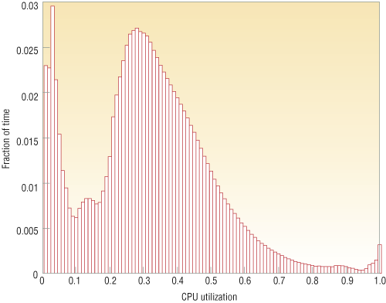
Energy Proportional Computing
“The Case for
Energy-Proportional
Computing,”
Luiz André Barroso,
Urs Hölzle,
IEEE Computer
December 2007
It is surprisingly hard
to achieve high levels
of utilization of typical
servers (and your home
PC or laptop is even
worse)
Figure 1. Average CPU utilization of more than 5,000 servers during a six-month period. Servers
are rarely completely idle and seldom operate near their maximum utilization, instead operating
most of the time at between 10 and 50 percent of their maximum

Slide 34

SPECPower
Increasing importance of power and energy: create benchmark for performance and power
Most servers in WSCs have average utilization between 10% & 50%, so measure power at medium as well as at high load
Measure best performance and power, then step down request rate to measure power for every 10% reduction in performance
Java server benchmark performance is operations per second (ssj_ops), so metric is ssj_ops/Watt

Slide 35
SPECPower on Barcelona
Target Load % | Performance (ssj_ops) | Avg. Power (Watts)
100% | 231,867 | 295
90% | 211,282 | 286
80% | 185,803 | 275
70% | 163,427 | 265
60% | 140,160 | 256
50% | 118,324 | 246
40% | 92,035 | 233
30% | 70,500 | 222
20% | 47,126 | 206
10% | 23,066 | 180
0% | 0 | 141
Sum | 1,283,590 | 2,605
 | ssj_ops/Watt | 493
Energy
Proportionality

Slide 36
Which is Better?
(1 Red Machine vs. 5 Green Machines)
Five machines running at 10% utilization
  Total Power =
One machine running at
50% utilization
  Total Power =
  Two 3.0-GHz Xeons,
  16 GB DRAM, 1 Disk
  One 2.4-GHz Xeon,
  8 GB DRAM, 1 Disk
85% Peak Power@50% utilization
65% Peak Power@10% utilization
Student Roulette?
Notes:
36

Slide 37
Which is Better?
(1 Red Machine vs. 5 Green Machines)
Five machines running at 10% utilization
  Total Power =
  90 x 5 = 450w
One machine running at
50% utilization
  Total Power =
  1 x 230 = 230w
  Two 3.0-GHz Xeons,
  16 GB DRAM, 1 Disk
  One 2.4-GHz Xeon,
  8 GB DRAM, 1 Disk
85% Peak Power@50% utilization
65% Peak Power@10% utilization
Notes:
37

Slide 38
Other Benchmark Attempts
Rather than run a collection of real programs and take their average (geometric mean), create a single program that matches the average behavior of a set of programs
Called a synthetic benchmark
First example called Whetstone in 1972 for floating point intensive programs in Fortran
Second example called Dhrystone in 1985 for integer programs in Ada and C
  Pun on Wet vs. Dry (“Whet” vs. “Dhry”)

Slide 39
Dhystone Shortcomings
Dhrystone features unusual code that is not usually representative of real-life programs
Dhrystone susceptible to compiler optimizations
Dhrystone’s small code size means always fits in caches, so not representative
Yet still used in hand held, embedded CPUs!

Slide 40
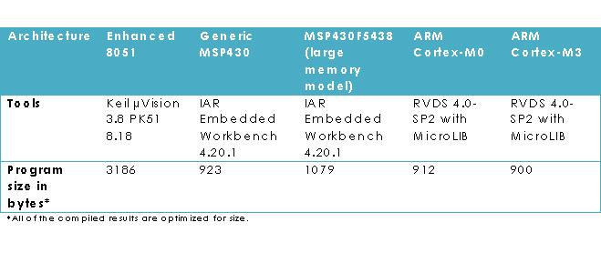
EE Times Articles
“Samsung and Intrinsity announced they have 1st silicon for Humming bird, an ARM Cortex A8 that … delivers more than 2,000 Dhrystone Mips while consuming 640 mW power” 7/24/09
Compiled Size of Dhystone 9/7/2010
8 BIT
16 BIT
16 BIT
32 BIT
32 BIT

Slide 41
Agenda
Defining Performance
Administrivia
Workloads and Benchmarks
Technology Break
Measuring Performance
Summary

Slide 43
Agenda
Defining Performance
Administrivia
Workloads and Benchmarks
Technology Break
Measuring Performance
Summary

Slide 44
Compiler Optimization and Dhrystone
gcc compiler options
  -O1: the compiler tries to reduce code size and execution time, without performing any optimizations that take a great deal of compilation time
  -O2: Optimize even more. GCC performs nearly all supported optimizations that do not involve a space-speed tradeoff. As compared to -O, this option increases both compilation time and the performance of the generated code
  -O3: Optimize yet more. All -O2 optimizations and also turns on the -finline-functions, -funswitch-loops, -fpredictive-commoning, -fgcse-after-reload,
  -ftree-vectorize and -fipa-cp-clone options

Slide 45
Detailed –O1, -O2 Optimizations
-fauto-inc-dec
-fcprop-registers
-fdce
-fdefer-pop
-fdelayed-branch
-fdse
-fguess-branch-probability
-fif-conversion2
-fif-conversion
-fipa-pure-const
-fipa-profile
-fipa-reference
-fmerge-constants
-fsplit-wide-types
-ftree-bit-ccp
-ftree-builtin-call-dce
-ftree-ccp
-ftree-ch
-ftree-copyrename
-ftree-dce
-ftree-dominator-opts
-ftree-dse
-ftree-forwprop
-ftree-fre
-ftree-phiprop
-ftree-sra
-ftree-pta
-ftree-ter
-funit-at-a-time
-fthread-jumps
-falign-functions -falign-jumps
-falign-loops -falign-labels
-fcaller-saves
-fcrossjumping
-fcse-follow-jumps -fcse-skip-blocks
-fdelete-null-pointer-checks
-fexpensive-optimizations
-fgcse -fgcse-lm
-finline-small-functions
-findirect-inlining
-fipa-sra
-foptimize-sibling-calls
-fpartial-inlining
-fpeephole2
-fregmove
-freorder-blocks -freorder-functions
-frerun-cse-after-loop
-fsched-interblock -fsched-spec
-fschedule-insns -fschedule-insns2
-fstrict-aliasing -fstrict-overflow
-ftree-switch-conversion
-ftree-pre
-ftree-vrp
http://gcc.gnu.org/onlinedocs/gcc/Optimize-Options.html

Slide 46
Measuring Time
UNIX time command measures in seconds
Time Stamp Counter
  64-bit counter of clock cycles on Intel 80x86 instruction set computers
  80x86 instruction RDTSC (Read TSC) returns TSC in regs EDX (upper 32 bits) and EAX (lower 32 bits)
  Can read, but can’t set
  How long can measure?
  Measures overall time, not just time for 1 program

Slide 47
How to get RDTSC access in C?
static inline unsigned long long RDTSC(void)
{
unsigned hi, lo;
asm volatile ("rdtsc" : "=a"(lo), "=d"(hi));
return ( (unsigned long long) lo) |
( ((unsigned long long) hi) <<32 );
}

Slide 48
gcc Optimization Experiment
 | BubbleSort.c | Dhrystone.c
No Opt
-O1
-O2
-O3

Slide 49
gcc Optimization Experiment
 | BubbleSort.c | Dhrystone.c
No Opt | 3.215 s | 7.230 s
-O1 | 1.460 s | 2.805 s
-O2 | 1.457 s | 2.711 s
-O3 | 1.458 s | 1.340 s

Slide 50
Where Do You Spend the
Time in Your Program?
Profiling a program (e.g., using, gprof) shows where it spends its time by function, so you can determine which code consumes most of the execution time
Usually a 90/10 rule: 10% of code is responsible for 90% of execution time
  Or 80/20 rule, where 20% of code responsible for 80% of time

Slide 51
gprof
Learn where program spent its time
  Learn functions called while it was executing
  And which functions call other functions
Three steps:
  Compile & link program with profiling enabled
    cc –pg x.c {in addition to other flags use}
  Execute program to generate a profile data file
  Run gprof to analyze the profile data

Slide 52
gprof example
% time | Cumulative (secs) | Self (secs) | calls | Self ms/call | Total ms/call | name
18.18 | 0.06 | 0.06 | 23480 | 0.00 | 0.00 | find_char_unquote
12.12 | 0.10 | 0.04 | 120 | 0.33 | 0.73 | pattern_search
9.09 | 0.13 | 0.03 | 5120 | 0.01 | 0.01 | collapse_continuations
9.09 | 0.16 | 0.03 | 148 | 0.20 | 0.88 | update_file_1
9.09 | 0.19 | 0.03 | 37 | 0.81 | 4.76 | eval
6.06 | 0.21 | 0.02 | 12484 | 0.00 | 0.00 | file_hash_1
6.06 | 0.23 | 0.02 | 6596 | 0.00 | 0.00 | get_next_mword
3.03 | 0.24 | 0.01 | 29981 | 0.00 | 0.00 | hash_find_slot
3.03 | 0.25 | 0.01 | 14769 | 0.00 | 0.00 | next_token
3.03 | 0.26 | 0.01 | 5800 | 0.00 | 0.00 | variable_expand_string
  See http://linuxgazette.net/100/vinayak.html
Notes:
There are 23480 calls to the function find_char_unquote and it makes up more than 1/6th of the program execution time.
However the function eval has only 37 invocations o it's credit still it takes up about 1/11th of the program execution time. There is a possibility that this function is doing a lot of work and is a candidate for splitting up into different functions. Also notice that each call to eval eats up an average of 4.76 milliseconds which is quite huge compared to any of the other functions
Also the functions pattern_search and update_file_1 take up nearly 1/4th of the execution time but share only 268 calls between them. Maybe these functions can also be split into smaller functions.
The source code has to be compiled with the -pg option ( also with -g if you want line-by-line profiling ).

Slide 53
Test Program to Profile with Saturn
#include <math.h>
#define LIMIT 500000000
void exponential()
{
double a;
int i;
for (i=1; i != LIMIT; i++)
a = exp(i/1000.0);
}
void sinFunc()
{
double a;
int i;
for (i=1; i != LIMIT; i++)
a = sin(i/1000.0);
}
int main()
{
exponential();
sinFunc();
return 0;
}
(Unfortunately gprof isn’t supported on my Intel-based mac with mac osx;
I use an alternative tool called saturn)

Slide 54
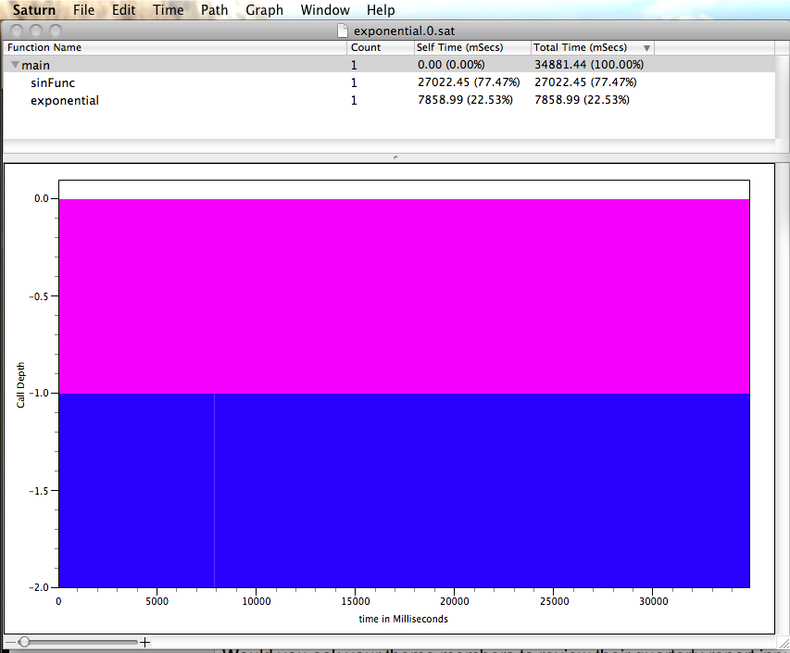

Slide 55
Cautionary Tale
“More computing sins are committed in the name of efficiency (without necessarily achieving it) than for any other single reason - including blind stupidity”
-- William A. Wulf
“We should forget about small efficiencies, say about 97% of the time: premature optimization is the root of all evil”
-- Donald E. Knuth

Slide 56
And In Conclusion, …
Time (seconds/program) is measure of performance
Instructions Clock cycles Seconds
Program Instruction Clock Cycle
Benchmarks stand in for real workloads to as standardized measure of relative performance
Power of increasing concern, and being added to benchmarks
Time measurement via clock cycles, machine specific
Profiling tools as way to see where spending time in your program
Don’t optimize prematurely!
=
×
×

