Slide 1
CS 61C: Great Ideas in Computer Architecture (Machine Structures) Instruction Level Parallelism— The Datapath
Instructors: Randy H. Katz David A. Patterson
http://inst.eecs.Berkeley.edu/~cs61c/fa10

Slide 3
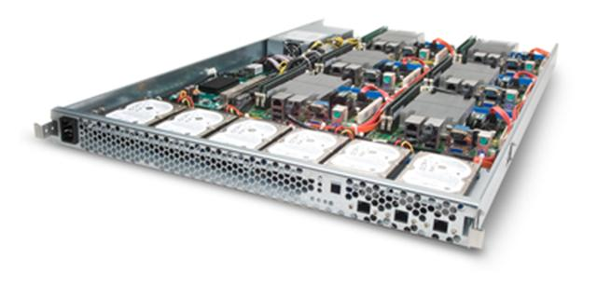
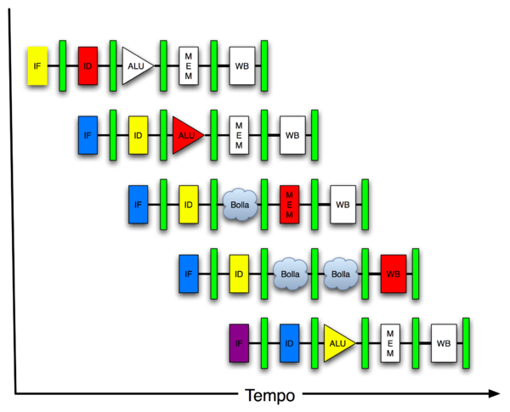
You Are Here!
Software Hardware
Parallel Requests
Assigned to computer
e.g., Search “Katz”
Parallel Threads
Assigned to core
e.g., Lookup, Ads
Parallel Instructions
>1 instruction @ one time
e.g., 5 pipelined instructions
Parallel Data
>1 data item @ one time
e.g., Add of 4 pairs of words
Hardware descriptions
All gates functioning in parallel at same time
Warehouse Scale Computer
Smart Phone
Harness Parallelism &
Achieve High Performance
Computer
Core
…
Core
Memory (Cache)
Input/Output
Core
Today’s Lecture
Instruction Unit(s)
Functional
Unit(s)
A₀+B₀
A₁+B₁
A₂+B₂
A₃+B₃
Main Memory
Logic Gates

Slide 4
Agenda
Pipelined Execution
Administrivia
Pipelined Datapath
Pipeline Hazards
Technology Break
Pipelining and Instruction Set Design
Summary

Slide 5
Agenda
Pipelined Execution
Administrivia
Pipelined Datapath
Pipeline Hazards
Technology Break
Pipelining and Instruction Set Design
Summary

Slide 6
Review: RISC Design Principles
“A simpler core is a faster core”
Reduction in the number and complexity of instructions in the ISA → simplifies pipelined implementation
Common RISC strategies:
Fixed instruction length, generally a single word; Simplifies process of fetching instructions from memory
Simplified addressing modes; Simplifies process of fetching operands from memory
Fewer and simpler instructions in the instruction set; Simplifies process of executing instructions
Simplified memory access: only load and store instructions access memory;
Let the compiler do it. Use a good compiler to break complex high-level language statements into a number of simple assembly language statements

Slide 7
Review: Single-Cycle Processor
Five steps to design a processor:
1. Analyze instruction set → datapath requirements
2. Select set of datapath components & establish clock methodology
3. Assemble datapath meeting the requirements: re-examine for pipelining
4. Analyze implementation of each instruction to determine setting of control points that effects the register transfer.
5. Assemble the control logic
Formulate Logic Equations
Design Circuits
Processor
Input
Control
Memory
Datapath
Output

Slide 8
Single Cycle Performance
Assume time for actions are
100ps for register read or write; 200ps for other events
Clock rate is?
Instr | Instr fetch | Register read | ALU op | Memory access | Register write | Total time
lw | 200ps | 100 ps | 200ps | 200ps | 100 ps | 800ps
sw | 200ps | 100 ps | 200ps | 200ps |  | 700ps
R-format | 200ps | 100 ps | 200ps |  | 100 ps | 600ps
beq | 200ps | 100 ps | 200ps |  |  | 500ps
What can we do to improve clock rate?
Will this improve performance as well?
Want increased clock rate to mean faster programs
Student Roulette?
Notes:
1.25 GHz

Slide 9
Pipeline Analogy: Doing Laundry
Ann, Brian, Cathy, Dave each have one load of clothes to wash, dry, fold, and put away
Washer takes 30 minutes
Dryer takes 30 minutes
“Folder” takes 30 minutes
“Stasher” takes 30 minutes to put clothes into drawers
A
B
C
D

Slide 10
Sequential Laundry
Sequential laundry takes 8 hours for 4 loads
6 PM
7
8
9
10
11
12
1
2 AM
T
a
s
k
O
r
d
e
r
30
30
30
30
30
30
30
30
30
30
30
30
30
30
30
30
Time
A
B
C
D

Slide 11
Pipelined Laundry
Pipelined laundry takes 3.5 hours for 4 loads!
6 PM
7
8
9
10
11
12
1
2 AM
30
30
30
30
30
Time
T
a
s
k
O
r
d
e
r
30
30
A
B
C
D

Slide 12
Pipelining Lessons (1/2)
6 PM
7
8
9
Pipelining doesn’t help latency of single task, it helps throughput of entire workload
Multiple tasks operating simultaneously using different resources
Potential speedup = Number pipe stages
Time to fill pipeline and time to drain it reduces speedup: 2.3X v. 4X in this example
T
a
s
k
O
r
d
e
r
Time
30
30
30
30
30
30
30
A
B
C
D

Slide 13
Pipelining Lessons (2/2)
6 PM
7
8
9
Suppose new Washer takes 20 minutes, new Stasher takes 20 minutes. How much faster is pipeline?
Pipeline rate limited by slowest pipeline stage
Unbalanced lengths of pipe stages reduces speedup
T
a
s
k
O
r
d
e
r
Time
30
30
30
30
30
30
30
A
B
C
D

Slide 14
Agenda
Pipelined Execution
Administrivia
Pipelined Datapath
Pipeline Hazards
Technology Break
Pipelining and Instruction Set Design
Summary

Slide 15
Administrivia
Project 4: Pipelined Cycle Processor in Logicsim
Due Part 1, datapath, due 4/10, Part 2 due 4/17
Face-to-Face grading: Signup for timeslot last week
Extra Credit: Fastest Version of Project 3
Due 4/24 23:59:59
Final Review: TBD
Final: Mon May 9 11AM-2PM (TBD)

Slide 16
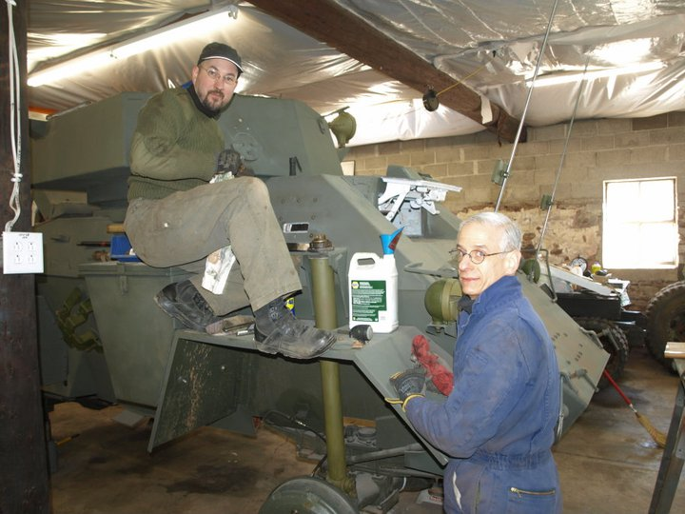
How Randy Spent His Spring Break

Slide 17
Agenda
Pipelined Execution
Administrivia
Pipelined Datapath
Pipeline Hazards
Technology Break
Pipelining and Instruction Set Design
Summary

Slide 18
Review: Single Cycle Datapath
31
26
21
16
0
op
rs
rt
immediate
Data Memory {R[rs] + SignExt[imm16]} = R[rt]
Instruction<31:0>
nPC_sel=
instr
fetch
unit
RegDst=
<21:25>
<16:20>
<0:15>
clk
<11:15>
Rd
Rt
1
0
Rs
Rt
Rd
Imm16
zero
ALUctr=
RegWr=
Rs
Rt
MemtoReg=
5
5
5
busA
32
MemWr=
busW
Rw
Ra
Rb
=
32
32
RegFile
busB
ALU
0
0
clk
32
32
WrEn
Adr
imm16
1
Data In
1
16
Extender
Data
Memory
32
clk
ExtOp=
ALUSrc=
Notes:
The store instruction performs the inverse function of the load. Instead of loading data from memory, the store instruction sends the contents of register specified by Rt to data memory.
Similar to the load instruction, the store instruction needs to read the contents of register Rs (points to Ra port) and add it to the sign extended verion of the immediate filed (Imm16, ExtOp = 1, ALUSrc = 1) to form the data memory address (ALUctr = add).
However unlike the Load instructoion where busB is not used, the store instruction will use busB to send the data to the Data memory.
Consequently, the Rt field of the instruction has to be fed to the Rb port of the register file.
In order to write the Data Memory properly, the MemWr signal has to be set to 1.
Notice that the store instruction does not update the register file. Therefore, RegWr must be set to zero and consequently control signals RegDst and MemtoReg are don’t cares.
And once again we need to set the control signals Branch and Jump to zero to ensure proper Program Counter updataing.
Well, by now, you are probably tied of these boring stuff where Branch and Jump are zero so let’s look at something different--the bracnh instruction.
+3 = 31 min. (Y:11)

Slide 19
Steps in Executing MIPS
1) IF: Instruction Fetch, Increment PC
2) ID: Instruction Decode, Read Registers
3) EX: Mem-ref: Calculate Address Arith-log: Perform Operation
4) Mem: Load: Read Data from Memory Store: Write Data to Memory
5) WB: Write Data Back to Register

Slide 20
Redrawn Single-Cycle Datapath
rd
PC
instruction
memory
registers
rs
Data
memory
rt
ALU
+4
imm
2. Decode/
Register Read
1. Instruction
Fetch
5. Write Back
3. Execute
4. Memory

Slide 21
Pipelined Datapath
rd
PC
instruction
memory
registers
rs
Data
memory
rt
ALU
+4
imm
2. Decode/
Register Read
1. Instruction
Fetch
5. Write Back
3. Execute
4. Memory
Add registers between stages
Hold information produced in previous cycle

Slide 22
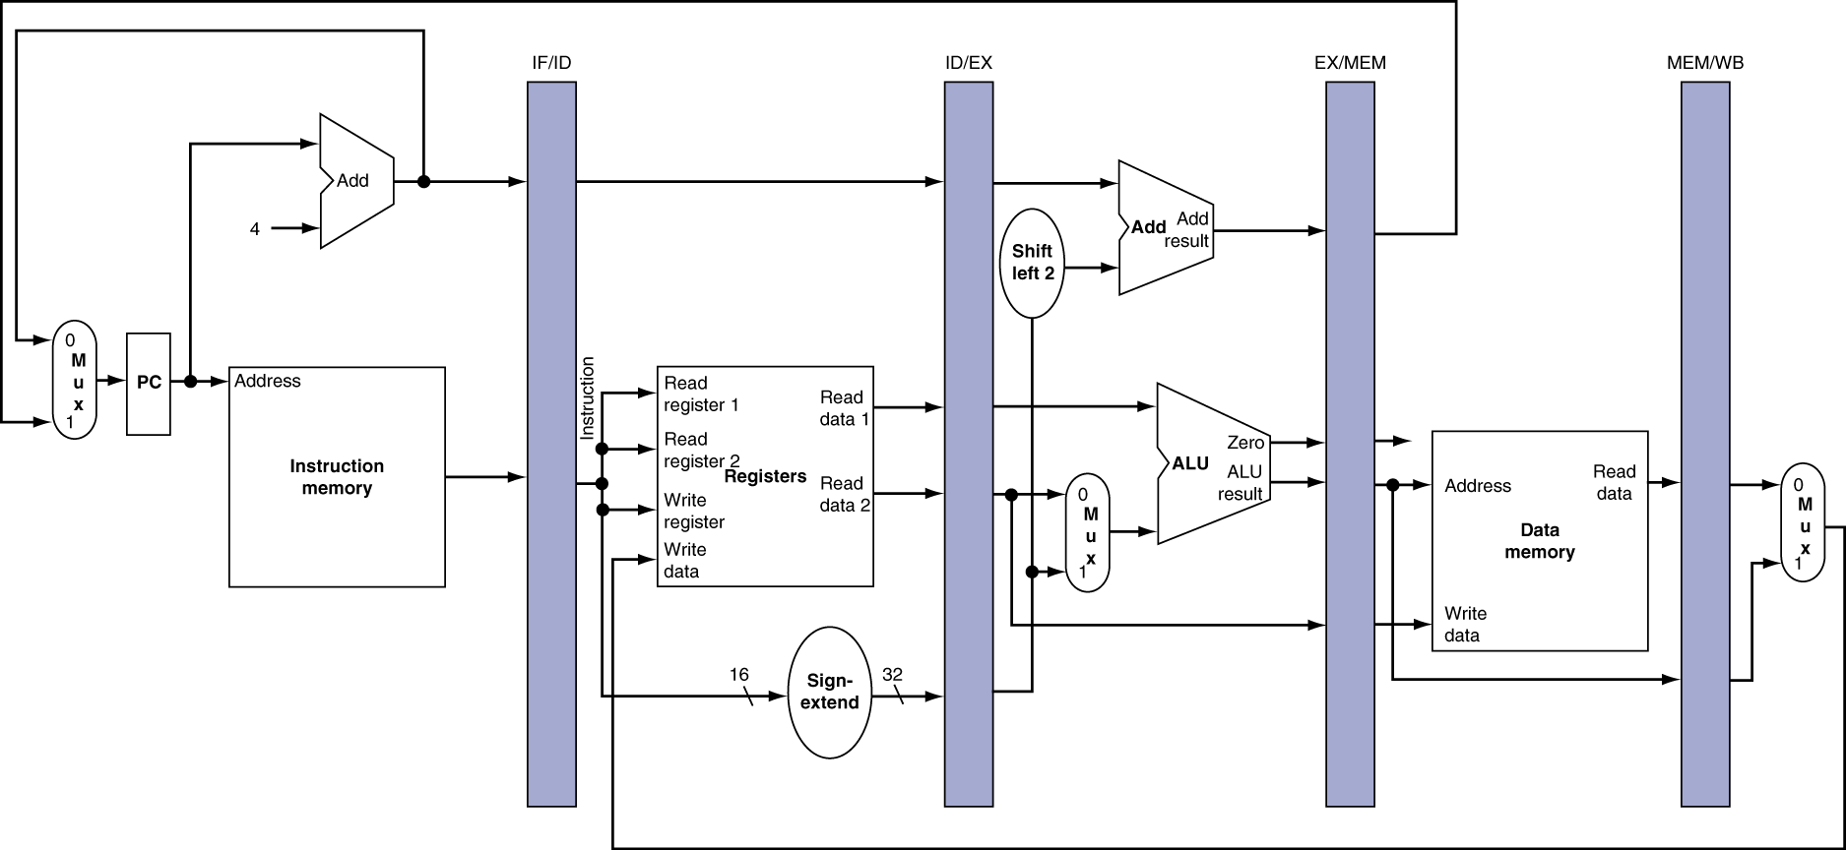
More Detailed Pipeline

Slide 23
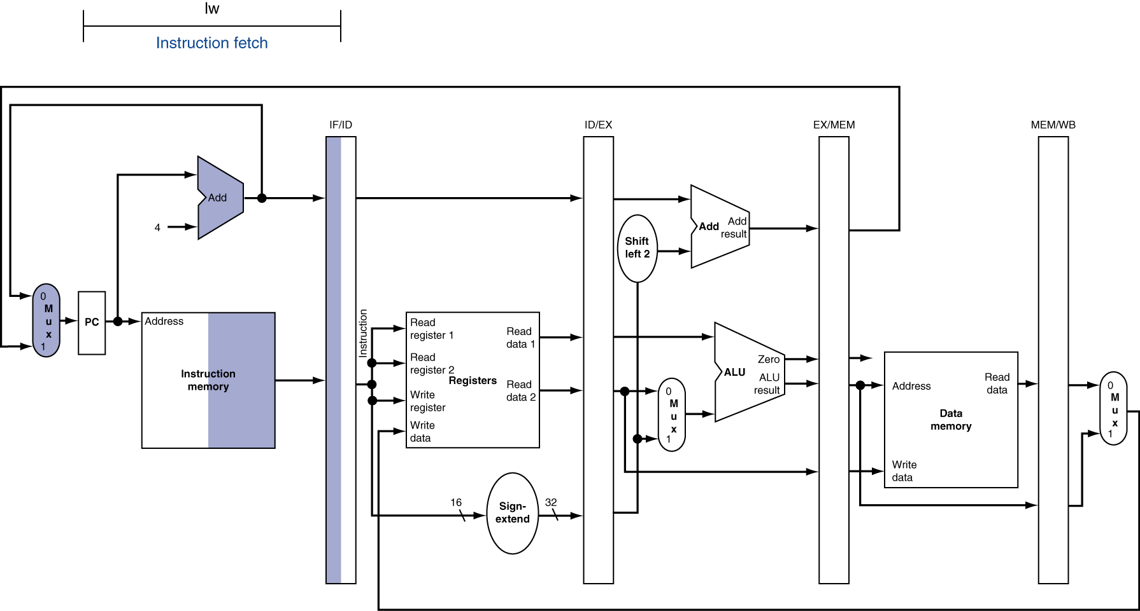
IF for Load, Store, …

Slide 24
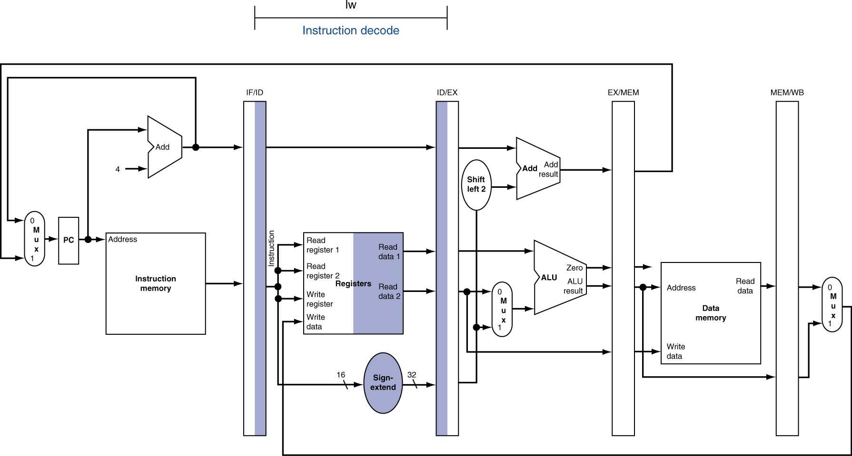
ID for Load, Store, …

Slide 25
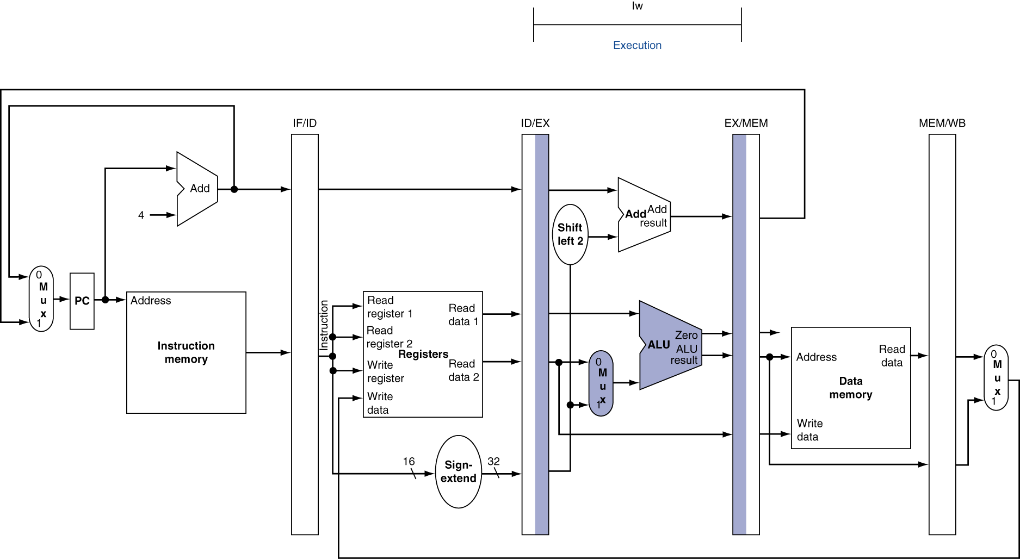
EX for Load

Slide 26
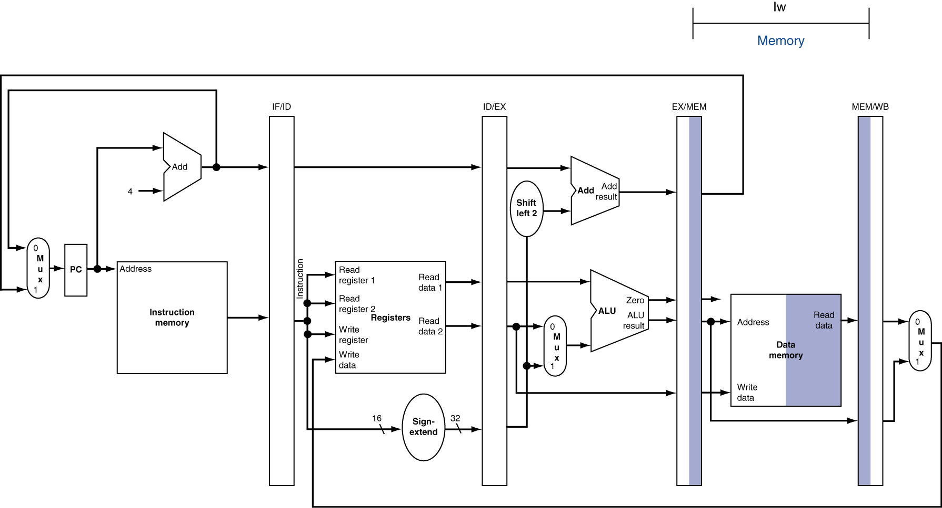
MEM for Load

Slide 27
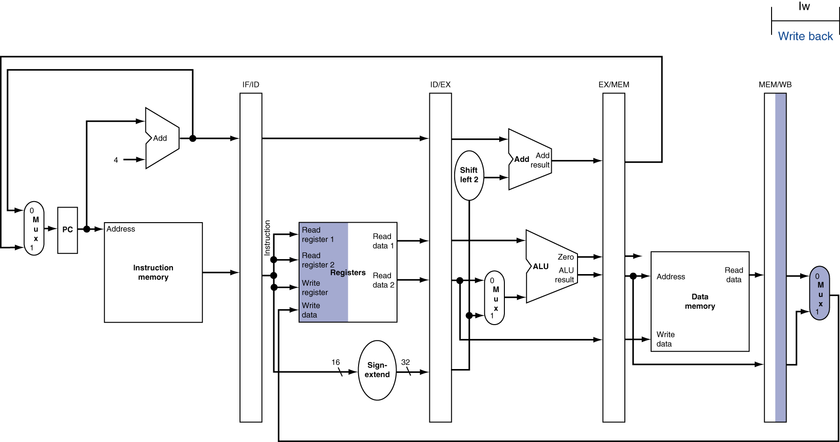
WB for Load
Wrong register number

Slide 28
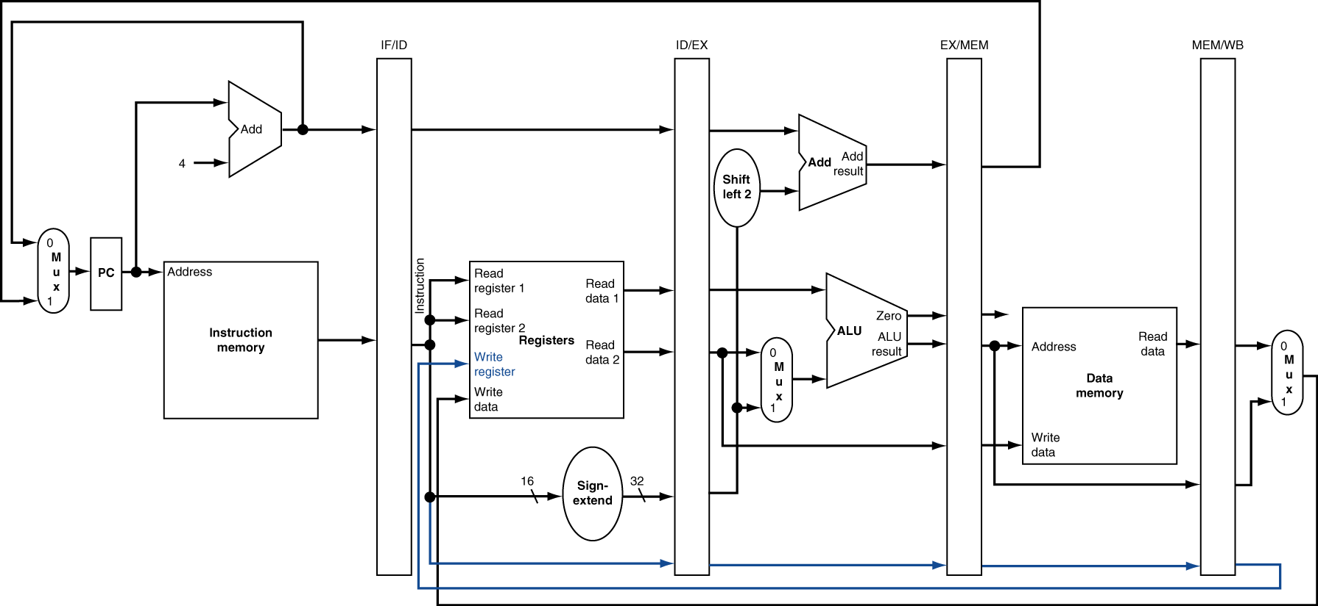
Corrected Datapath for Load

Slide 29
Agenda
Pipelined Execution
Administrivia
Pipelined Datapath
Pipeline Hazards
Technology Break
Pipelining and Instruction Set Design
Summary

Slide 30
Pipelined Execution Representation
Time
IF
ID
EX
Mem
WB
IF
ID
EX
Mem
WB
IF
ID
EX
Mem
WB
IF
ID
EX
Mem
WB
IF
ID
EX
Mem
WB
IF
ID
EX
Mem
WB
Every instruction must take same number of steps, also called pipeline stages, so some will go idle sometimes

Slide 31
Graphical Pipeline Diagrams
rd
PC
instruction
memory
registers
rs
Data
memory
rt
ALU
+4
imm
2. Decode/
Register Read
1. Instruction
Fetch
5. Write Back
3. Execute
4. Memory
Use datapath figure below to represent pipeline
IF
ID
EX
Mem
WB
I$
Reg
ALU
D$
Reg

Slide 32
Graphical Pipeline Representation
(In Reg, right half highlight read, left half write)
Time (clock cycles)
I
n
s
t
r.
O
r
d
e
r
Load
I$
Reg
ALU
D$
Reg
Add
I$
Reg
ALU
D$
Reg
Store
I$
Reg
ALU
D$
Reg
Sub
I$
Reg
ALU
D$
Reg
Or
I$
Reg
ALU
D$
Reg

Slide 33
Pipeline Performance
Assume time for stages is
100ps for register read or write
200ps for other stages
What is pipelined clock rate?
Compare pipelined datapath with single-cycle datapath
Instr | Instr fetch | Register read | ALU op | Memory access | Register write | Total time
lw | 200ps | 100 ps | 200ps | 200ps | 100 ps | 800ps
sw | 200ps | 100 ps | 200ps | 200ps |  | 700ps
R-format | 200ps | 100 ps | 200ps |  | 100 ps | 600ps
beq | 200ps | 100 ps | 200ps |  |  | 500ps
Student Roulette?

Slide 34
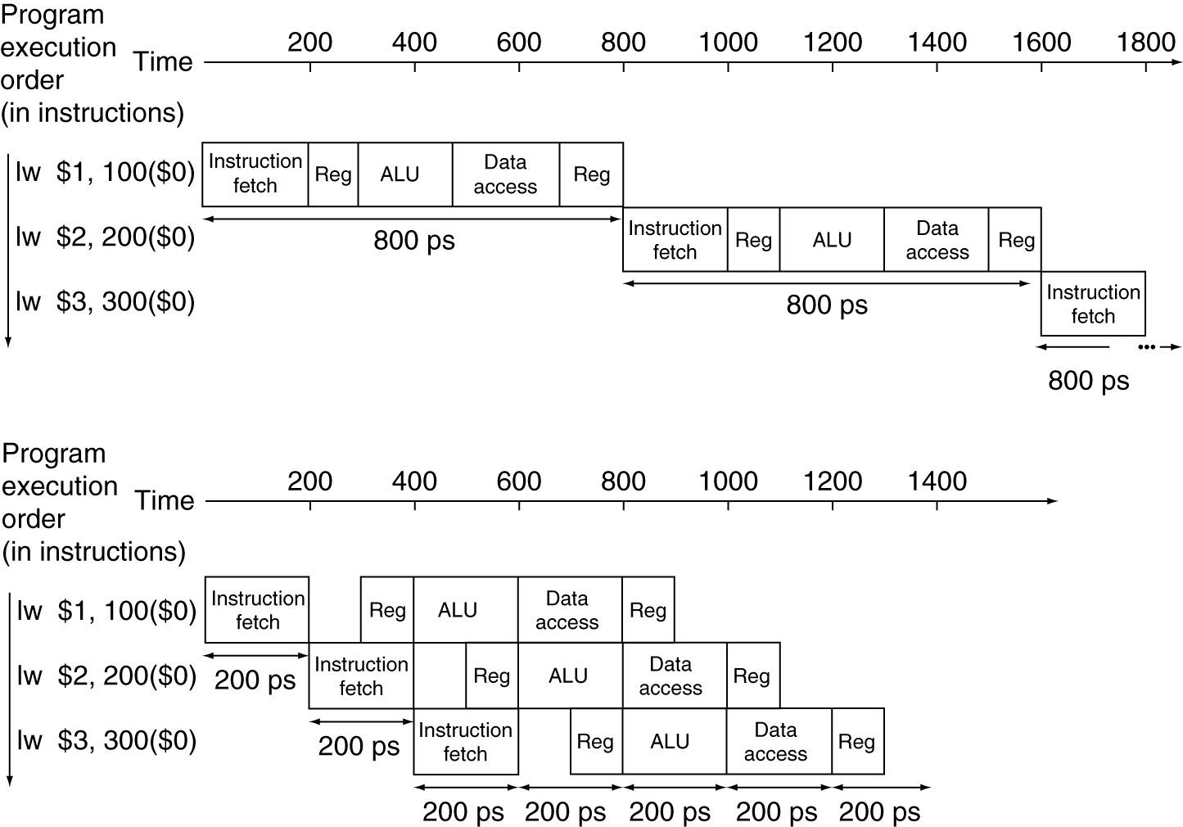
Pipeline Performance
Single-cycle (T_{c}= 800ps)
Pipelined (T_{c}= 200ps)

Slide 35
Pipeline Speedup
If all stages are balanced
i.e., all take the same time
Time between instructions_{pipelined} = Time between instructions_{nonpipelined} Number of stages
If not balanced, speedup is less
Speedup due to increased throughput
Latency (time for each instruction) does not decrease

Slide 36
Instruction Level Parallelism (ILP)
Another parallelism form to go with Request Level Parallelism and Data Level Parallelism
RLP – e.g., Warehouse Scale Computing
DLP – e.g., SIMD, Map-Reduce
ILP – e.g., Pipelined Instruction Execution
5 stage pipeline => 5 instructions executing simultaneously, one at each pipeline stage

Slide 37
Hazards
Situations that prevent starting the next logical instruction in the next clock cycle
Structural hazards
Required resource is busy (e.g., roommate studying)
Data hazard
Need to wait for previous instruction to complete its data read/write (e.g., pair of socks in different loads)
Control hazard
Deciding on control action depends on previous instruction (e.g., how much detergent based on how clean prior load turns out)

Slide 38
1. Structural Hazards
Conflict for use of a resource
In MIPS pipeline with a single memory
Load/Store requires memory access for data
Instruction fetch would have to stall for that cycle
Causes a pipeline “bubble”
Hence, pipelined datapaths require separate instruction/data memories
In reality, provide separate L1 I$ and L1 D$

Slide 39
1. Structural Hazard #1: Single Memory
Time (clock cycles)
I
n
s
t
r.
O
r
d
e
r
Load
I$
Reg
ALU
D$
Reg
Instr 1
I$
Reg
ALU
D$
Reg
Instr 2
I$
Reg
ALU
D$
Reg
Instr 3
I$
Reg
ALU
D$
Reg
Instr 4
I$
Reg
ALU
D$
Reg
Read same memory twice in same clock cycle

Slide 40
1. Structural Hazard #2: Registers (1/2)
I
n
s
t
r.
O
r
d
e
r
Time (clock cycles)
sw
I$
Reg
ALU
D$
Reg
Instr 1
I$
Reg
ALU
D$
Reg
Instr 2
I$
Reg
ALU
D$
Reg
Instr 3
I$
Reg
ALU
D$
Reg
Instr 4
I$
Reg
ALU
D$
Reg
Can we read and write to registers simultaneously?

Slide 41
1. Structural Hazard #2: Registers (2/2)
Two different solutions have been used:
1) RegFile access is VERY fast: takes less than half the time of ALU stage
Write to Registers during first half of each clock cycle
Read from Registers during second half of each clock cycle
2) Build RegFile with independent read and write ports
Result: can perform Read and Write during same clock cycle

Slide 42
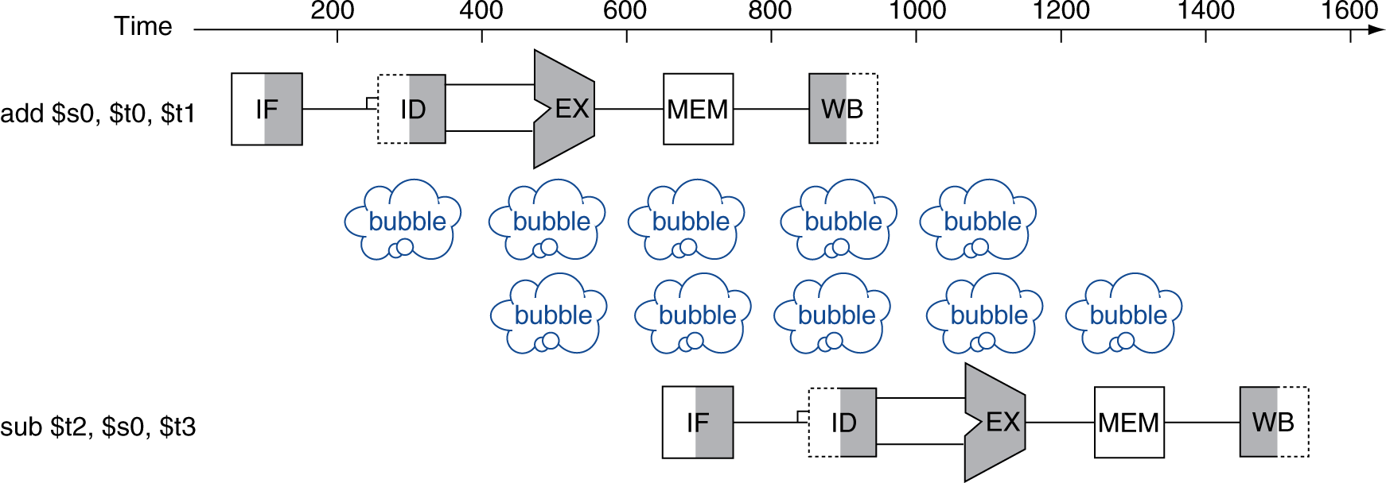
2. Data Hazards
An instruction depends on completion of data access by a previous instruction
add $s0, $t0, $t1 sub $t2, $s0, $t3

Slide 43
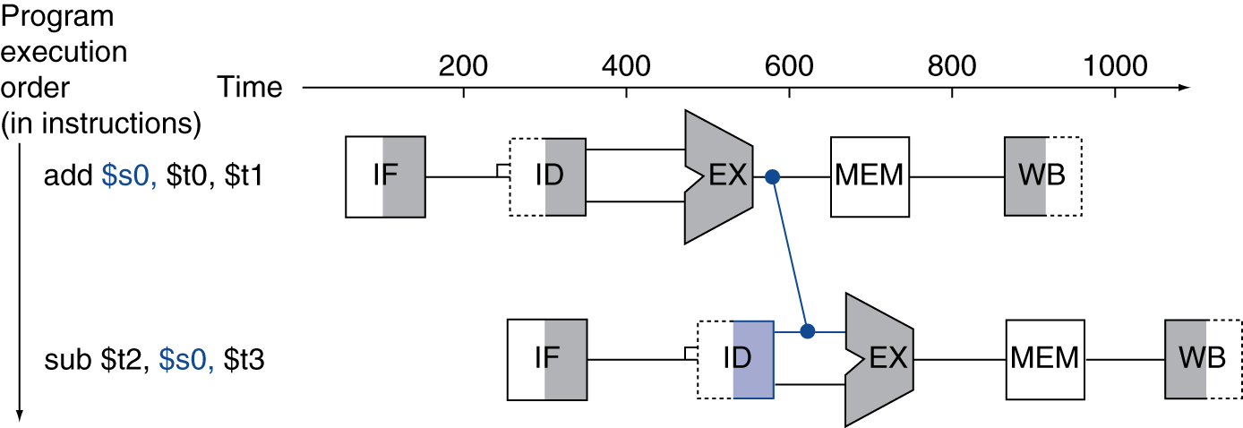
Forwarding (aka Bypassing)
Use result when it is computed
Don’t wait for it to be stored in a register
Requires extra connections in the datapath

Slide 44
Corrected Datapath for Forwarding?
Student Roulette?

Slide 45
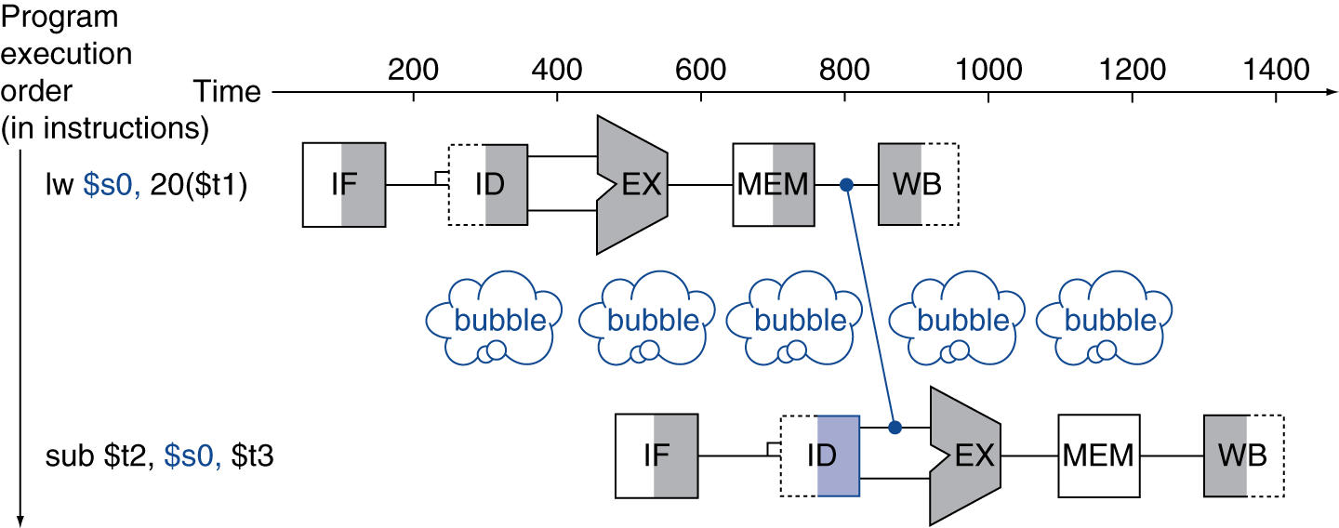
Load-Use Data Hazard
Can’t always avoid stalls by forwarding
If value not computed when needed
Can’t forward backward in time!

Slide 46
Agenda
Pipelined Execution
Administrivia
Pipelined Datapath
Pipeline Hazards
Technology Break
Pipelining and Instruction Set Design
Summary

Slide 48
Agenda
Pipelined Execution
Administrivia
Pipelined Datapath
Pipeline Hazards
Technology Break
Pipelining and Instruction Set Design
Summary

Slide 49
Pipelining and ISA Design
MIPS Instruction Set designed for pipelining
All instructions are 32-bits
Easier to fetch and decode in one cycle
x86: 1- to 17-byte instructions
(x86 HW actually translates to internal RISC instructions!)
Few and regular instruction formats, 2 source register fields always in same place
Can decode and read registers in one step
Memory operands only in Loads and Stores
Can calculate address 3rd stage, access memory 4th stage
Alignment of memory operands
Memory access takes only one cycle

Slide 50
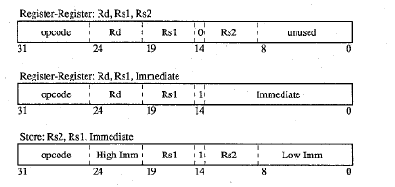
Why Isn’t the Destination Register Always in the Same Field in MIPS ISA?
31
26
21
16
11
6
0
op
rs
rt
rd
shamt
funct
31
6 bits
26
5 bits
21
5 bits
16
5 bits
5 bits
6 bits
0
op
rs
rt
immediate
6 bits
5 bits
5 bits
16 bits
Need to have 2 part immediate if 2 sources and 1 destination always in same place
SPUR processor
(1st project Dave and Randy worked on together)

Slide 51
3. Control Hazards
Branch determines flow of control
Fetching next instruction depends on branch outcome
Pipeline can’t always fetch correct instruction
Still working on ID stage of branch
BEQ, BNE in MIPS pipeline
Simple solution Option 1: Stall on every branch until have new PC value
Would add 2 bubbles/clock cycles for every Branch! (~ 20% of instructions executed)

Slide 52
Stall => 2 Bubbles/Clocks
Time (clock cycles)
I
n
s
t
r.
O
r
d
e
r
beq
I$
Reg
ALU
D$
Reg
Instr 1
I$
Reg
ALU
D$
Reg
Instr 2
I$
Reg
ALU
D$
Reg
Instr 3
I$
Reg
ALU
D$
Reg
Instr 4
I$
Reg
ALU
D$
Reg
Where do we do the compare for the branch?

Slide 53
3. Control Hazard: Branching
Optimization #1:
Insert special branch comparator in Stage 2
As soon as instruction is decoded (Opcode identifies it as a branch), immediately make a decision and set the new value of the PC
Benefit: since branch is complete in Stage 2, only one unnecessary instruction is fetched, so only one no-op is needed
Side Note: means that branches are idle in Stages 3, 4 and 5

Slide 54
Corrected Datapath for BEQ/BNE?
Student Roulette?

Slide 55
One Clock Cycle Stall
Time (clock cycles)
I
n
s
t
r.
O
r
d
e
r
beq
I$
Reg
ALU
D$
Reg
Instr 1
I$
Reg
ALU
D$
Reg
Instr 2
I$
Reg
ALU
D$
Reg
Instr 3
I$
Reg
ALU
D$
Reg
Instr 4
I$
Reg
ALU
D$
Reg
Branch comparator moved to Decode stage.

Slide 56
3. Control Hazards
Option 2: Predict outcome of a branch, fix up if guess wrong
Must cancel all instructions in pipeline that depended on guess that was wrong
Simplest hardware if we predict that all branches are NOT taken
Why?
Student Roulette?

Slide 57
3. Control Hazard: Branching
Option #3: Redefine branches
Old definition: if we take the branch, none of the instructions after the branch get executed by accident
New definition: whether or not we take the branch, the single instruction immediately following the branch gets executed (the branch-delay slot)
Delayed Branch means we always execute inst after branch
This optimization is used with MIPS

Slide 58
3. Control Hazard: Branching
Notes on Branch-Delay Slot
Worst-Case Scenario: put a no-op in the branch-delay slot
Better Case: place some instruction preceding the branch in the branch-delay slot—as long as the changed doesn’t affect the logic of program
Re-ordering instructions is common way to speed up programs
Compiler usually finds such an instruction 50% of time
Jumps also have a delay slot …

Slide 59
Example: Nondelayed vs. Delayed Branch
Nondelayed Branch
Delayed Branch
or $8, $9, $10
add $1, $2,$3
add $1, $2, $3
sub $4, $5, $6
sub $4, $5, $6
beq $1, $4, Exit
beq $1, $4, Exit
or $8, $9, $10
xor $10, $1, $11
xor $10, $1, $11
Exit:
Exit:

Slide 60
Delayed Branch/Jump and MIPS ISA?
Why does JAL put PC+8 in register 31?
Student Roulette?

Slide 61
Delayed Branch/Jump and MIPS ISA?
Why does JAL put PC+8 in register 31?
JAL executes following instruction (PC+4) so should return to PC+8

Slide 62
Code Scheduling to Avoid Stalls
Reorder code to avoid use of load result in the next instruction
C code for A = B + E; C = B + F;
lw $t1, 0($t0)
lw $t2, 4($t0)
add $t3, $t1, $t2
sw $t3, 12($t0)
lw $t4, 8($t0)
add $t5, $t1, $t4
sw $t5, 16($t0)
lw $t1, 0($t0)
lw $t2, 4($t0)
lw $t4, 8($t0)
add $t3, $t1, $t2
sw $t3, 12($t0)
add $t5, $t1, $t4
sw $t5, 16($t0)
stall
stall
13 cycles
11 cycles

Slide 63
And in Conclusion, …
The BIG Picture
Pipelining improves performance by increasing instruction throughput: exploits ILP
Executes multiple instructions in parallel
Each instruction has the same latency
Subject to hazards
Structure, data, control
Stalls reduce performance
But are required to get correct results
Compiler can arrange code to avoid hazards and stalls
Requires knowledge of the pipeline structure

Slide 64
Peer Instruction
Thanks to pipelining, I have reduced the time it took me to wash my one shirt.
Longer pipelines are always a win (since less work per stage & a faster clock).
A)(red) I is True and II is True
B)(orange) I is False and II is True
C)(green) I is True and II is False
D)(yellow) I is False and II is False

Slide 65
Peer Instruction Answer
Throughput better, not latency!
“…longer pipelines do usually mean faster clock rate, but hazards can cause problems!”
F A L S E
Thanks to pipelining, I have reduced the time it took me to wash my one shirt.
Longer pipelines are always a win (since less work per stage & a faster clock).
12
a) FF
b) FT
c) TF
d) TT
F A L S E

