Slide 1
CS 61C: Great Ideas in Computer Architecture (Machine Structures) Instruction Level Parallelism: Multiple Instruction Issue
Instructors: Randy H. Katz David A. Patterson
http://inst.eecs.Berkeley.edu/~cs61c/fa10

Slide 3
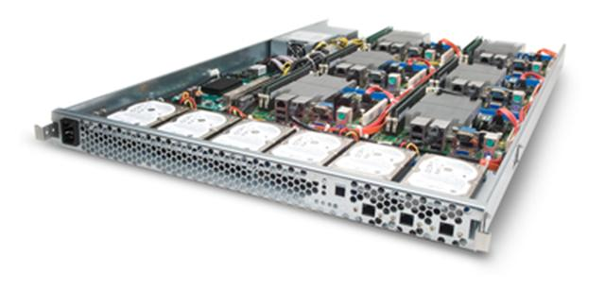
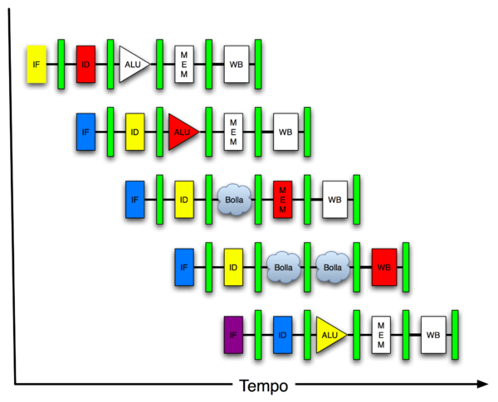
You Are Here!
Software Hardware
Parallel Requests
Assigned to computer
e.g., Search “Katz”
Parallel Threads
Assigned to core
e.g., Lookup, Ads
Parallel Instructions
>1 instruction @ one time
e.g., 5 pipelined instructions
Parallel Data
>1 data item @ one time
e.g., Add of 4 pairs of words
Hardware descriptions
All gates functioning in parallel at same time
Warehouse Scale Computer
Smart Phone
Harness Parallelism &
Achieve High Performance
Computer
Core
…
Core
Memory (Cache)
Input/Output
Core
Today’s Lecture
Instruction Unit(s)
Functional
Unit(s)
A₀+B₀
A₁+B₁
A₂+B₂
A₃+B₃
Main Memory
Logic Gates

Slide 4
Review: Hazards
Situations that prevent starting the next logical instruction in the next clock cycle
Structural hazards
Required resource is busy (e.g., roommate studying)
Data hazard
Need to wait for previous instruction to complete its data read/write (e.g., pair of socks in different loads)
Control hazard
Deciding on control action depends on previous instruction (e.g., how much detergent based on how clean prior load turns out)

Slide 5
Agenda
Control Hazards
Administrivia
Higher Level ILP
Dynamic Scheduling
Technology Break
Example AMD Barcelona
Big Picture: Types of Parallelism
Summary

Slide 6
Agenda
Control Hazards
Administrivia
Higher Level ILP
Dynamic Scheduling
Technology Break
Example AMD Barcelona
Big Picture: Types of Parallelism
Summary

Slide 7
3. Control Hazards
Branch determines flow of control
Fetching next instruction depends on branch outcome
Pipeline can’t always fetch correct instruction
Still working on ID stage of branch
BEQ, BNE in MIPS pipeline
Simple solution Option 1: Stall on every branch until have new PC value
Would add 2 bubbles/clock cycles for every Branch! (~ 20% of instructions executed)

Slide 8
Stall => 2 Bubbles/Clocks
Time (clock cycles)
I
n
s
t
r.
O
r
d
e
r
beq
I$
Reg
ALU
D$
Reg
Instr 1
I$
Reg
ALU
D$
Reg
Instr 2
I$
Reg
ALU
D$
Reg
Instr 3
I$
Reg
ALU
D$
Reg
Instr 4
I$
Reg
ALU
D$
Reg
Where do we do the compare for the branch?

Slide 9
3. Control Hazard: Branching
Optimization #1:
Insert special branch comparator in Stage 2
As soon as instruction is decoded (Opcode identifies it as a branch), immediately make a decision and set the new value of the PC
Benefit: since branch is complete in Stage 2, only one unnecessary instruction is fetched, so only one no-op is needed
Side Note: means that branches are idle in Stages 3, 4 and 5

Slide 10
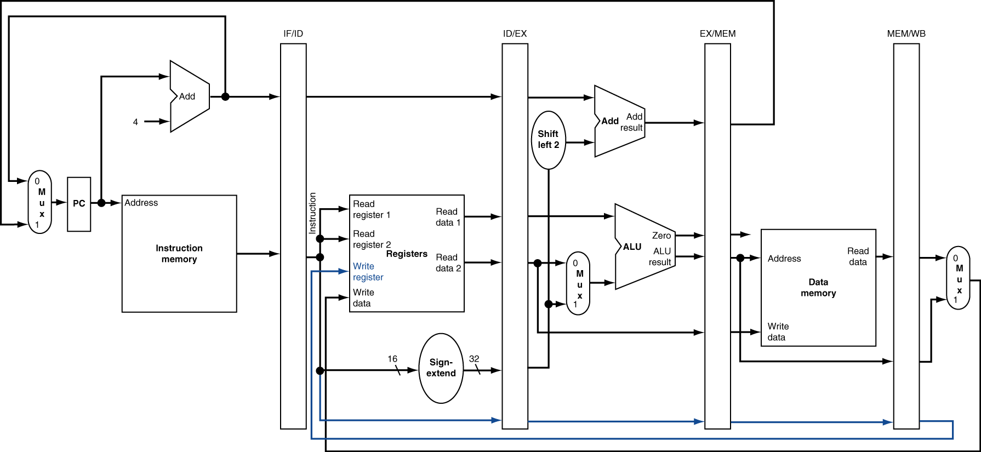
Corrected Datapath for BEQ/BNE?
Student Roulette?

Slide 11
One Clock Cycle Stall
Time (clock cycles)
I
n
s
t
r.
O
r
d
e
r
beq
I$
Reg
ALU
D$
Reg
Instr 1
I$
Reg
ALU
D$
Reg
Instr 2
I$
Reg
ALU
D$
Reg
Instr 3
I$
Reg
ALU
D$
Reg
Instr 4
I$
Reg
ALU
D$
Reg
Branch comparator moved to Decode stage.

Slide 12
3. Control Hazards
Option 2: Predict outcome of a branch, fix up if guess wrong
Must cancel all instructions in pipeline that depended on guess that was wrong
Simplest hardware if we predict that all branches are NOT taken
Why?
Student Roulette?

Slide 13
3. Control Hazard: Branching
Option #3: Redefine branches
Old definition: if we take the branch, none of the instructions after the branch get executed by accident
New definition: whether or not we take the branch, the single instruction immediately following the branch gets executed (the branch-delay slot)
Delayed Branch means we always execute inst after branch
This optimization is used with MIPS

Slide 14
3. Control Hazard: Branching
Notes on Branch-Delay Slot
Worst-Case Scenario: put a no-op in the branch-delay slot
Better Case: place some instruction preceding the branch in the branch-delay slot—as long as the changed doesn’t affect the logic of program
Re-ordering instructions is common way to speed up programs
Compiler usually finds such an instruction 50% of time
Jumps also have a delay slot …

Slide 15
Example: Nondelayed vs. Delayed Branch
Nondelayed Branch
Delayed Branch
or $8, $9, $10
add $1, $2,$3
add $1, $2, $3
sub $4, $5, $6
sub $4, $5, $6
beq $1, $4, Exit
beq $1, $4, Exit
or $8, $9, $10
xor $10, $1, $11
xor $10, $1, $11
Exit:
Exit:

Slide 16
Delayed Branch/Jump and MIPS ISA?
Why does JAL put PC+8 in register 31?
Student Roulette?

Slide 17
Delayed Branch/Jump and MIPS ISA?
Why does JAL put PC+8 in register 31?
JAL executes following instruction (PC+4) so should return to PC+8

Slide 18
Agenda
Control Hazards
Administrivia
Higher Level ILP
Dynamic Scheduling
Technology Break
Example AMD Barcelona
Big Picture: Types of Parallelism
Summary

Slide 19
Administrivia
Project 4: 2 Stage Pipelined Cycle Processor, non-delayed branch, in Logisim
Part 1, Datapath, due 4/10, Part 2 due 4/17
Face-to-Face grading: Signup for timeslot last week
Extra Credit: Fastest Version of Project 3
Due 4/24 23:59:59
Final Review: 2 May, 5-8 PM, 2050 Valley LSB
Final: Mon May 9 11AM-2PM (TBD)

Slide 20
SF Giants!
http://mlb.mlb.com/mlb/ps/y2010/gigapan/index.jsp

Slide 21
Agenda
Control Hazards
Administrivia
Higher Level ILP
Dynamic Scheduling
Technology Break
Example AMD Barcelona
Big Picture: Types of Parallelism
Summary

Slide 22
Greater Instruction-Level Parallelism (ILP)
Deeper pipeline (5 => 10 => 15 stages)
Less work per stage ⇒ shorter clock cycle
Multiple issue superscalar
Replicate pipeline stages ⇒ multiple pipelines
Start multiple instructions per clock cycle
CPI < 1, so use Instructions Per Cycle (IPC)
E.g., 4 GHz 4-way multiple-issue
16 BIPS, peak CPI = 0.25, peak IPC = 4
But dependencies reduce this in practice
§4.10 Parallelism and Advanced Instruction Level Parallelism

Slide 23
Multiple Issue
Static multiple issue
Compiler groups instructions to be issued together
Packages them into “issue slots”
Compiler detects and avoids hazards
Dynamic multiple issue
CPU examines instruction stream and chooses instructions to issue each cycle
Compiler can help by reordering instructions
CPU resolves hazards using advanced techniques at runtime

Slide 24
Superscalar Laundry: Parallel per stage
6 PM
7
8
9
10
11
12
1
2 AM
More resources, HW to match mix of parallel tasks?
30
30
30
30
30
Time
T
a
s
k
O
r
d
e
r
A
(light clothing)
(dark clothing)
B
(very dirty clothing)
C
D
(light clothing)
(dark clothing)
E
(very dirty clothing)
F

Slide 25
Pipeline Depth and Issue Width
Intel Processors over Time
Microprocessor | Year | Clock Rate | Pipeline Stages | Issue width | Cores | Power
i486 | 1989 | 25 MHz | 5 | 1 | 1 | 5W
Pentium | 1993 | 66 MHz | 5 | 2 | 1 | 10W
Pentium Pro | 1997 | 200 MHz | 10 | 3 | 1 | 29W
P4 Willamette | 2001 | 2000 MHz | 22 | 3 | 1 | 75W
P4 Prescott | 2004 | 3600 MHz | 31 | 3 | 1 | 103W
Core 2 Conroe | 2006 | 2930 MHz | 14 | 4 | 2 | 75W
Core 2 Yorkfield | 2008 | 2930 MHz | 16 | 4 | 4 | 95W
Core i7 Gulftown | 2010 | 3460 MHz | 16 | 4 | 6 | 130W

Slide 26
Pipeline Depth and Issue Width

Slide 27
Static Multiple Issue
Compiler groups instructions into issue packets
Group of instructions that can be issued on a single cycle
Determined by pipeline resources required
Think of an issue packet as a very long instruction
Specifies multiple concurrent operations

Slide 28
Scheduling Static Multiple Issue
Compiler must remove some/all hazards
Reorder instructions into issue packets
No dependencies with a packet
Possibly some dependencies between packets
Varies between ISAs; compiler must know!
Pad with nop if necessary

Slide 29
MIPS with Static Dual Issue
Dual-issue packets
One ALU/branch instruction
One load/store instruction
64-bit aligned
ALU/branch, then load/store
Pad an unused instruction with nop
Address | Instruction type | Pipeline Stages
n | ALU/branch | IF | ID | EX | MEM | WB
n + 4 | Load/store | IF | ID | EX | MEM | WB
n + 8 | ALU/branch |  | IF | ID | EX | MEM | WB
n + 12 | Load/store |  | IF | ID | EX | MEM | WB
n + 16 | ALU/branch |  |  | IF | ID | EX | MEM | WB
n + 20 | Load/store |  |  | IF | ID | EX | MEM | WB

Slide 30
Hazards in the Dual-Issue MIPS
More instructions executing in parallel
EX data hazard
Forwarding avoided stalls with single-issue
Now can’t use ALU result in load/store in same packet
add $t0, $s0, $s1 load $s2, 0($t0)
Split into two packets, effectively a stall
Load-use hazard
Still one cycle use latency, but now two instructions
More aggressive scheduling required

Slide 31
Scheduling Example
Schedule this for dual-issue MIPS
Loop: lw $t0, 0($s1) # $t0=array element addu $t0, $t0, $s2 # add scalar in $s2 sw $t0, 0($s1) # store result addi $s1, $s1,–4 # decrement pointer bne $s1, $zero, Loop # branch $s1!=0
 | ALU/branch | Load/store | cycle
Loop: | nop | lw $t0, 0($s1) | 1
 | addi $s1, $s1,–4 | nop | 2
 | addu $t0, $t0, $s2 | nop | 3
 | bne $s1, $zero, Loop | sw $t0, 4($s1) | 4
IPC = 5/4 = 1.25 (c.f. peak IPC = 2)

Slide 32
Loop Unrolling
Replicate loop body to expose more parallelism
Reduces loop-control overhead
Use different registers per replication
Called register renaming
Avoid loop-carried anti-dependencies
Store followed by a load of the same register
Aka “name dependence”
Reuse of a register name

Slide 33
Loop Unrolling Example
 | ALU/branch | Load/store | cycle
Loop: | addi $s1, $s1,–16 | lw $t0, 0($s1) | 1
 | nop | lw $t1, 12($s1) | 2
 | addu $t0, $t0, $s2 | lw $t2, 8($s1) | 3
 | addu $t1, $t1, $s2 | lw $t3, 4($s1) | 4
 | addu $t2, $t2, $s2 | sw $t0, 16($s1) | 5
 | addu $t3, $t4, $s2 | sw $t1, 12($s1) | 6
 | nop | sw $t2, 8($s1) | 7
 | bne $s1, $zero, Loop | sw $t3, 4($s1) | 8
IPC = 14/8 = 1.75
Closer to 2, but at cost of registers and code size

Slide 34
Agenda
Control Hazards
Administrivia
Higher Level ILP
Dynamic Scheduling
Technology Break
Example AMD Barcelona
Big Picture: Types of Parallelism
Summary

Slide 35
Dynamic Multiple Issue
“Superscalar” processors
CPU decides whether to issue 0, 1, 2, … instructions each cycle
Avoiding structural and data hazards
Avoids need for compiler scheduling
Though it may still help
Code semantics ensured by the CPU

Slide 36
Dynamic Pipeline Scheduling
Allow the CPU to execute instructions out of order to avoid stalls
But commit result to registers in order
Example
lw $t0, 20($s2) addu $t1, $t0, $t2 subu $s4, $s4, $t3 slti $t5, $s4, 20
Can start subu while addu is waiting for lw

Slide 37
Why Do Dynamic Scheduling?
Why not just let the compiler schedule code?
Not all stalls are predicable
e.g., cache misses
Can’t always schedule around branches
Branch outcome is dynamically determined
Different implementations of an ISA have different latencies and hazards

Slide 38
Speculation
“Guess” what to do with an instruction
Start operation as soon as possible
Check whether guess was right
If so, complete the operation
If not, roll-back and do the right thing
Common to static and dynamic multiple issue
Examples
Speculate on branch outcome (Branch Prediction)
Roll back if path taken is different
Speculate on load
Roll back if location is updated

Slide 39
Pipeline Hazard: Matching socks in later load
6 PM
7
8
9
10
11
12
1
2 AM
A depends on D; stall since folder tied up;
30
30
30
30
30
Time
T
a
s
k
O
r
d
e
r
30
30
A
bubble
B
C
D
E
F

Slide 40
Out-of-Order Laundry: Don’t Wait
6 PM
7
8
9
10
11
12
1
2 AM
A depends on D; rest continue; need more resources to allow out-of-order
30
30
30
30
30
Time
T
a
s
k
O
r
d
e
r
30
30
A
bubble
B
C
D
E
F

Slide 41
Out-of-Order Execution (1/2)
Basically, unroll loops in hardware
Fetch instructions in program order (≤4/clock)
Predict branches as taken/untaken
To avoid hazards on registers, rename registers using a set of internal registers (~80 registers)
Collection of renamed instructions might execute in a window (~60 instructions)
Execute instructions with ready operands in 1 of multiple functional units (ALUs, FPUs, Ld/St)

Slide 42
Out-of-Order Execution (2/2)
Basically, unroll loops in hardware
Buffer results of executed instructions until predicted branches are resolved in reorder buffer
If predicted branch correctly, commit results in program order
If predicted branch incorrectly, discard all dependent results and start with correct PC

Slide 43
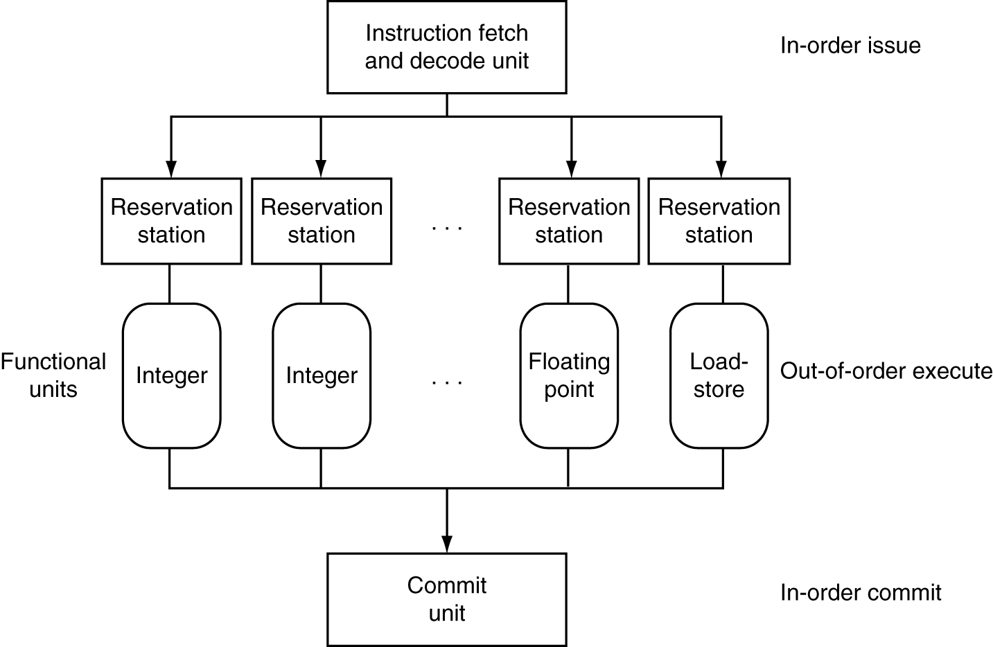
Dynamically Scheduled CPU
Preserves dependencies
Hold pending operands
Results also sent to any waiting reservation stations
Reorders buffer for register writes
Can supply operands for issued instructions

Slide 44
Out Of Order Intel
All use OOO since 2001
Microprocessor | Year | Clock Rate | Pipeline Stages | Issue width | Out-of-order/ Speculation | Cores | Power
i486 | 1989 | 25MHz | 5 | 1 | No | 1 | 5W
Pentium | 1993 | 66MHz | 5 | 2 | No | 1 | 10W
Pentium Pro | 1997 | 200MHz | 10 | 3 | Yes | 1 | 29W
P4 Willamette | 2001 | 2000MHz | 22 | 3 | Yes | 1 | 75W
P4 Prescott | 2004 | 3600MHz | 31 | 3 | Yes | 1 | 103W
Core | 2006 | 2930MHz | 14 | 4 | Yes | 2 | 75W
Core 2 Yorkfield | 2008 | 2930 MHz | 16 | 4 | Yes | 4 | 95W
Core i7 Gulftown | 2010 | 3460 MHz | 16 | 4 | Yes | 6 | 130W

Slide 45
Agenda
Control Hazards
Administrivia
Higher Level ILP
Dynamic Scheduling
Technology Break
Example AMD Barcelona
Big Picture: Types of Parallelism
Summary

Slide 47
Agenda
Control Hazards
Administrivia
Higher Level ILP
Dynamic Scheduling
Technology Break
Example AMD Barcelona
Big Picture: Types of Parallelism
Summary

Slide 48
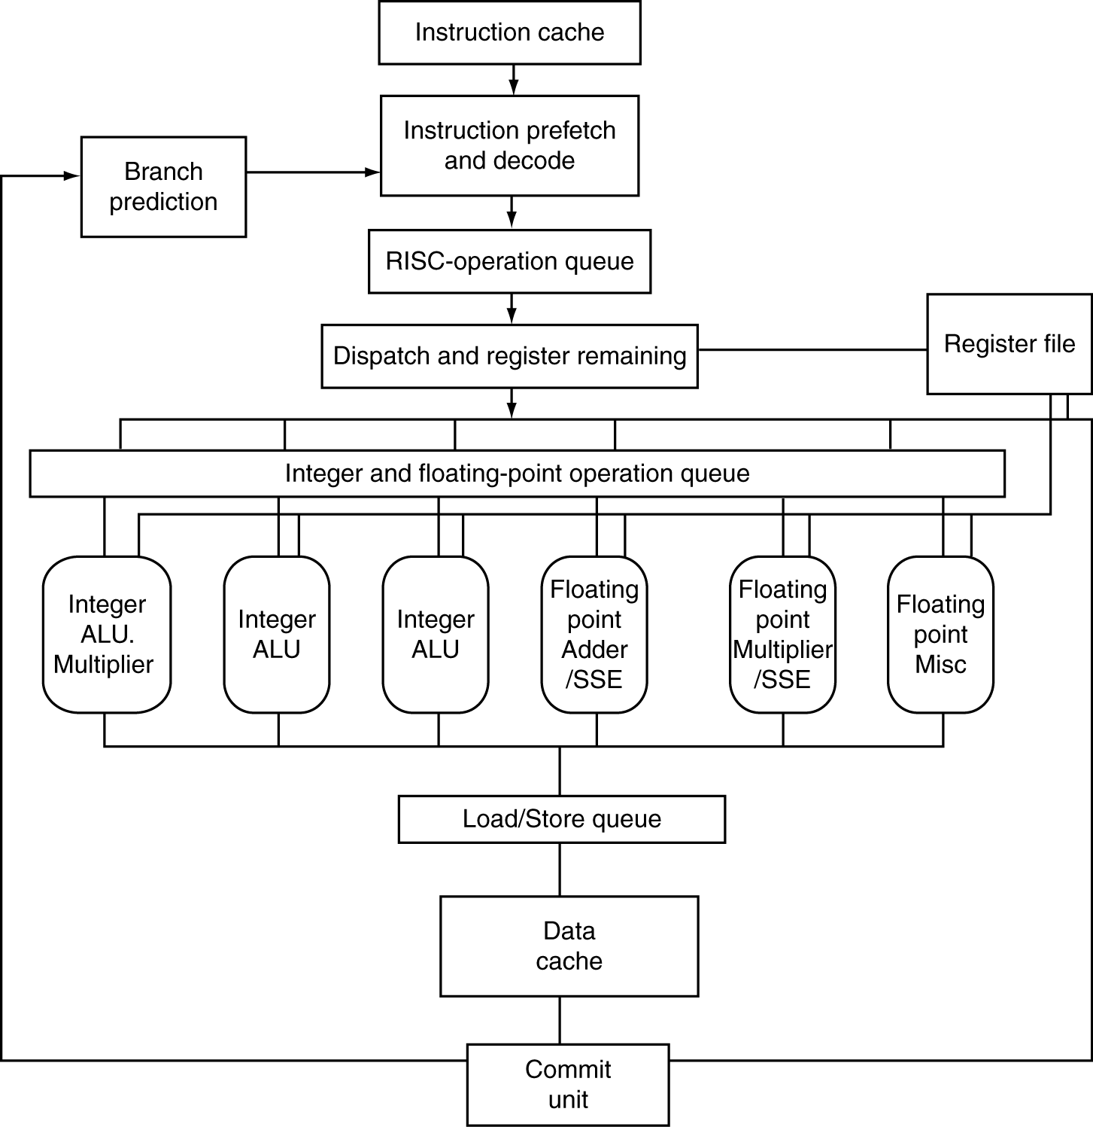
AMD Opteron X4 Microarchitecture
72 physical registers
§4.11 Real Stuff: The AMD Opteron X4 (Barcelona) Pipeline

Slide 49
AMD Opteron X4 Pipeline Flow
For integer operations
12 stages (Floating Point is 17 stages)
Up to 106 RISC-ops in progress
Intel Nehalem is 16 stages for integer operations, details not revealed, but likely similar to above+
Intel calls RISC operations “Micro operations” or “μops”

Slide 50
Does Multiple Issue Work?
The BIG Picture
Yes, but not as much as we’d like
Programs have real dependencies that limit ILP
Some dependencies are hard to eliminate
e.g., pointer aliasing
Some parallelism is hard to expose
Limited window size during instruction issue
Memory delays and limited bandwidth
Hard to keep pipelines full
Speculation can help if done well

Slide 51
Agenda
Higher Level ILP
Administrivia
Dynamic Scheduling
Example AMD Barcelona
Technology Break
Big Picture: Types of Parallelism
Summary

Slide 52
New-School Machine Structures (It’s a bit more complicated!)
Project 1
Software Hardware
Parallel Requests
Assigned to computer
e.g., Search “Katz”
Parallel Threads
Assigned to core
e.g., Lookup, Ads
Parallel Instructions
>1 instruction @ one time
e.g., 5 pipelined instructions
Parallel Data
>1 data item @ one time
e.g., Add of 4 pairs of words
Hardware descriptions
All gates functioning in parallel at same time
Warehouse Scale Computer
Smart Phone
Harness Parallelism &
Achieve High Performance
Project 2
Computer
Core
…
Core
Memory (Cache)
Project 3
Input/Output
Core
Instruction Unit(s)
Functional
Unit(s)
A₀+B₀
A₁+B₁
A₂+B₂
A₃+B₃
Main Memory
Logic Gates
Project 4

Slide 53
Big Picture on Parallelism
Two types of parallelism in applications
Data-Level Parallelism (DLP): arises because there are many data items that can be operated on at the same time
Task-Level Parallelism (TLP): arises because tasks of work are created that can operate largely in parallel

Slide 54
Big Picture on Parallelism
Hardware can exploit app Data LP and Task LP in 4 ways:
Instruction-Level Parallelism: Hardware exploits application DLP using ideas like pipelining and speculative execution
SIMD architectures: exploit app DLP by applying a single instruction to a collection of data in parallel
Thread-Level Parallelism: exploits either app DLP or TLP in a tightly-coupled hardware model that allows for interaction among parallel threads
Request-Level Parallelism: exploits parallelism among largely decoupled tasks and is specified by the programmer of the operating system

Slide 55
Peer Instruction
Instr LP, SIMD, Thread LP, Request LP are examples of
Parallelism above the Instruction Set Architecture
Parallelism explicitly at the level of the ISA
Parallelism below the level of the ISA
 | Inst. LP | SIMD | Thr. LP | Req. LP
Red | = | = | = | ∧
Orange | ∨ | = | = | ∧
Green | = | = | ∧ | ∧
Yellow | ∨ | = | ∧ | ∧
Pink | = | ∧ | ∧ | ∧
Blue | ∧ | ∧ | ∧ | ∧

Slide 56
Peer Answer
Instr LP, SIMD, Thread LP, Request LP are examples of
Parallelism above the Instruction Set Architecture
Parallelism explicitly at the level of the ISA
Parallelism below the level of the ISA
 | Inst. LP | SIMD | Thr. LP | Req. LP
Red | = | = | = | ∧
Orange | ∨ | = | = | ∧
Green | = | = | ∧ | ∧
Yellow | ∨ | = | ∧ | ∧
Pink | = | ∧ | ∧ | ∧
Blue | ∧ | ∧ | ∧ | ∧

Slide 57
Peer Question: Stall, Forward, OK?
For each code sequence, chose whether I. It must stall II. It can avoid stalls using only forwarding III. It can execute without stalling or forwarding
1: lw $t0,0($t0) add $t1,$t0,$t0 | 2: add $t1,$t0,$t0 addi $t2,$t0,#5 addi $t4,$t1,#5 | 3: addi $t1,$t0,#1 addi $t2,$t0,#2 addi $t3,$t0,#2 addi $t3,$t0,#4 addi $t5,$t1,#5
Red: All I (stall) | Pink: 1 I, 2 II, 3 II
Orange: 1 I, 2 I, 3 II | Blue: 1 II, 2 II, 3 III
Green: 1 I, 2 I, 3 III | Purple: All II (must forward)
Yellow: 1 I, 2 II, 3 III | Teal: All III (no stall, no fwd)
Notes:
D, 1 must stall due to load-use; 2 must forward on t1 since result not written for a few stages; 3 no dependencies

Slide 58
Sequence 1
Time (clock cycles)
I
n
s
t
r.
O
r
d
e
r
lw
I$
Reg
ALU
D$
Reg
add
I$
Reg
ALU
D$
Reg
instr
I$
Reg
ALU
D$
Reg
instr
I$
Reg
ALU
D$
Reg
instr
I$
Reg
ALU
D$
Reg

Slide 59
Sequence 2
Time (clock cycles)
I
n
s
t
r.
O
r
d
e
r
add
I$
Reg
ALU
D$
Reg
addi
I$
Reg
ALU
D$
Reg
addi
I$
Reg
ALU
D$
Reg
instr
I$
Reg
ALU
D$
Reg
instr
I$
Reg
ALU
D$
Reg

Slide 60
Sequence 3
Time (clock cycles)
I
n
s
t
r.
O
r
d
e
r
addi
I$
Reg
ALU
D$
Reg
addi
I$
Reg
ALU
D$
Reg
addi
I$
Reg
ALU
D$
Reg
addi
I$
Reg
ALU
D$
Reg
addi
I$
Reg
ALU
D$
Reg

Slide 61
Peer Question: Stall, Forward, OK?
For each code sequence, chose whether I. It must stall II. It can avoid stalls using only forwarding III. It can execute without stalling or forwarding
1: lw $t0,0($t0) add $t1,$t0,$t0 | 2: add $t1,$t0,$t0 addi $t2,$t0,#5 addi $t4,$t1,#5 | 3: addi $t1,$t0,#1 addi $t2,$t0,#2 addi $t3,$t0,#2 addi $t3,$t0,#4 addi $t5,$t1,#5
Red: All I (stall) | Pink: 1 I, 2 II, 3 II
Orange: 1 I, 2 I, 3 II | Blue: 1 II, 2 II, 3 III
Green: 1 I, 2 I, 3 III | Purple: All II (must forward)
Yellow: 1 I, 2 II, 3 III | Teal: All III (no stall, no fwd)
Notes:
D, 1 must stall due to load-use; 2 must forward on t1 since result not written for a few stages; 3 no dependencies

Slide 62
Peer Question
Not all instructions are active in every stage of the 5-stage pipeline. Ignoring the effects of hazards, which of the following are true?
1. Allowing jumps, branches, and ALU instructions to take fewer stages than the 5 required by the load instruction will increase pipeline performance for most programs.
2. Trying to allow some instructions to take fewer cycles does not help, since the throughput is determined by the clock cycle; the number of pipe stages per instruction affects latency, not throughput.
3. You cannot make ALU instructions take fewer cycles because of the write back of the result, but branches and jumps can take fewer cycles, so there is some opportunity for improvement.
4. Instead of trying to make instructions take fewer cycles, we should explore making the pipeline longer, so that instructions take more cycles, but the cycles are shorter. This could improve performance.
Red: All false | Pink: 1 T, 2 F, 3 F, 4 F
Orange: 1 F, 2 F, 3 F, 4 T | Blue: 1 F, 2 T, 3 F, 4 T
Green: 1 F, 2 F, 3 T, 4 F | Purple: 1 F, 2 T, 3 T, 4 T
Yellow: 1 F, 2 T, 3 F, 4 F | Teal: All true
Notes:
F) Statements 2 and 4 are correct; the rest are incorrect

Slide 63
Peer Answer
Not all instructions are active in every stage of the 5-stage pipeline. Ignoring the effects of hazards, which of the following are true?
1. Allowing jumps, branches, and ALU instructions to take fewer stages than the 5 required by the load instruction will increase pipeline performance for most programs.
2. Trying to allow some instructions to take fewer cycles does not help, since the throughput is determined by the clock cycle; the number of pipe stages per instruction affects latency, not throughput.
3. You cannot make ALU instructions take fewer cycles because of the write back of the result, but branches and jumps can take fewer cycles, so there is some opportunity for improvement.
4. Instead of trying to make instructions take fewer cycles, we should explore making the pipeline longer, so that instructions take more cycles, but the cycles are shorter. This could improve performance.
Red: All false | Pink: 1 T, 2 F, 3 F, 4 F
Orange: 1 F, 2 F, 3 F, 4 T | Blue: 1 F, 2 T, 3 F, 4 T
Green: 1 F, 2 F, 3 T, 4 F | Purple: 1 F, 2 T, 3 T, 4 T
Yellow: 1 F, 2 T, 3 F, 4 F | Teal: All true
Notes:
F) Statements 2 and 4 are correct; the rest are incorrect

Slide 64
Peer Question
State if following techniques are associated primarily with a software- or hardware-based approach to exploiting ILP (in some cases, the answer may be both): Superscalar, Out-of-Order execution, Speculation, Register Renaming
 | Super-scalar | Out of Order | Specu-lation | Register Renaming
Red | HW | HW | HW | HW
Orange | SW | SW | SW | SW
Green | Both | Both | Both | Both
Yellow | HW | HW | Both | Both
Pink | HW | HW | HW | Both
Blue | HW | HW | HW | SW

Slide 65
Peer Answer
State if following techniques are associated primarily with a software- or hardware-based approach to exploiting ILP (in some cases, the answer may be both): Superscalar, Out-of-Order execution, Speculation, Register Renaming
 | Super-scalar | Out of Order | Specu-lation | Register Renaming
Red | HW | HW | HW | HW
Orange | SW | SW | SW | SW
Green | Both | Both | Both | Both
Yellow | HW | HW | Both | Both
Pink | HW | HW | HW | Both
Blue | HW | HW | HW | SW

Slide 66
Peer Question
Thanks to pipelining, I have reduced the time it took me to wash my one shirt.
Longer pipelines are always a win (since less work per stage & a faster clock).
Red I is True and II is True
Orange I is False and II is True
Green I is True and II is False
Yellow I is False and II is False

Slide 67
Peer Answer
Thanks to pipelining, I have reduced the time it took me to wash my one shirt.
Longer pipelines are always a win (since less work per stage & a faster clock).
Red I is True and II is True
Orange I is False and II is True
Green I is True and II is False
Yellow I is False and II is False

Slide 68
Peer Answer
Throughput better, not latency!
“…longer pipelines do usually mean faster clock rate, but hazards can cause problems!”
F A L S E
Thanks to pipelining, I have reduced the time it took me to wash my one shirt.
Longer pipelines are always a win (since less work per stage & a faster clock).
F A L S E

Slide 69
“And in Conclusion, …”
Big Ideas of Instruction Level Parallelism
Pipelining, Hazards, and Stalls
Forwarding, Speculation to overcome Hazards
Multiple issue to increase performance
IPC instead of CPI
Dynamic Execution: Superscalar in-order issue, branch prediction, register renaming, out-of-order execution, in-order commit
“unroll loops in HW”, hide cache misses

