Slide 1
CS 61C: Great Ideas in Computer Architecture (Machine Structures) More Cache: Set Associativity
Instructors: Randy H. Katz David A. Patterson
Guest Lecture: Krste Asanovic
http://inst.eecs.Berkeley.edu/~cs61c/fa10

Slide 3
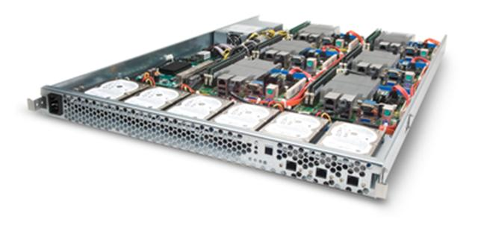
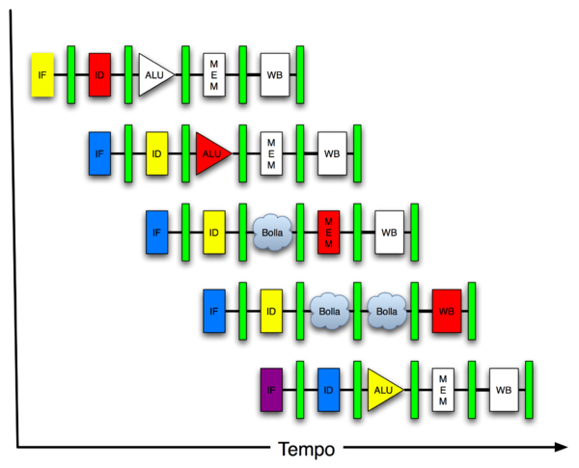
New-School Machine Structures (It’s a bit more complicated!)
Software Hardware
Parallel Requests
Assigned to computer
e.g., Search “Katz”
Parallel Threads
Assigned to core
e.g., Lookup, Ads
Parallel Instructions
>1 instruction @ one time
e.g., 5 pipelined instructions
Parallel Data
>1 data item @ one time
e.g., Add of 4 pairs of words
Hardware descriptions
All gates @ one time
Warehouse Scale Computer
Smart Phone
Harness Parallelism &
Achieve High Performance
Computer
Today’s
Lecture
Core
…
Core
Memory (Cache)
Input/Output
Core
Instruction Unit(s)
Functional
Unit(s)
A₀+B₀
A₁+B₁
A₂+B₂
A₃+B₃
Main Memory
Logic Gates

Slide 4
Review
Big Ideas of Instruction-Level Parallelism
Pipelining, Hazards, and Stalls
Forwarding, Speculation to overcome Hazards
Multiple issue to increase performance
IPC instead of CPI
Dynamic Execution: Superscalar in-order issue, branch prediction, register renaming, out-of-order execution, in-order commit
“unroll loops in HW”, hide cache misses

Slide 5
Agenda
Cache Memory Recap
Administrivia
Set-Associative Caches
Technology Break
AMAT and Multilevel Cache Review

Slide 6
Recap: Components of a Computer
Processor
Devices
Control
Memory
Input
Datapath
Output
Cache
Main Memory
Secondary Memory
(Disk)

Slide 7
Recap: Typical Memory Hierarchy
Take advantage of the principle of locality to present the user with as much memory as is available in the cheapest technology at the speed offered by the fastest technology
On-Chip Components
Control
Instr
Cache
Second
Level
Cache
(SRAM)
Secondary
Memory
(Disk)
ITLB
Main
Memory
(DRAM)
Datapath
DTLB
Data
Cache
RegFile
Speed (%cycles): ½’s 1’s 10’s 100’s 10,000’s
Size (bytes): 100’s 10K’s M’s G’s T’s
Cost: highest lowest
Notes:
Instead, the memory system of a modern computer consists of a series of black boxes ranging from the fastest to the slowest.
Besides variation in speed, these boxes also varies in size (smallest to biggest) and cost.
What makes this kind of arrangement work is one of the most important principle in computer design. The principle of locality. The principle of locality states that programs access a relatively small portion of the address space at any instant of time.
The design goal is to present the user with as much memory as is available in the cheapest technology (points to the disk).
While by taking advantage of the principle of locality, we like to provide the user an average access speed that is very close to the speed that is offered by the fastest technology.
(We will go over this slide in detail in the next lectures on caches).

Slide 8
Recap: Cache Performance and Average Memory Access Time (AMAT)
CPU time = IC × CPI × CC = IC × (CPI_{ideal} + Memory-stall cycles) × CC Memory-stall cycles = Read-stall cycles + Write-stall cycles
AMAT is the average time to access memory considering both hits and misses
AMAT = Time for a hit + Miss rate x Miss penalty
CPI_{stall}
Read-stall cycles = reads/program × read miss rate × read miss penalty
Write-stall cycles = (writes/program × write miss rate × write miss penalty)
+ write buffer stalls
Notes:
Reasonable write buffer depth (e.g., four or more words) and a memory capable of accepting writes at a rate that significantly exceeds the average write frequency means write buffer stalls are small

Slide 9
Improving Cache Performance
Reduce the time to hit in the cache
E.g., Smaller cache, direct-mapped cache, special tricks for handling writes
Reduce the miss rate
E.g., Bigger cache, larger blocks
More flexible placement (increase associativity)
Reduce the miss penalty
E.g., Smaller blocks or critical word first in large blocks, special tricks for handling writes, faster/higher bandwidth memories
Use multiple cache levels

Slide 10
Sources of Cache Misses: The 3Cs
Compulsory (cold start or process migration, 1st reference):
First access to block impossible to avoid; small effect for long running programs
Solution: increase block size (increases miss penalty; very large blocks could increase miss rate)
Capacity:
Cache cannot contain all blocks accessed by the program
Solution: increase cache size (may increase access time)
Conflict (collision):
Multiple memory locations mapped to the same cache location
Solution 1: increase cache size
Solution 2: increase associativity (may increase access time)
Notes:
(Capacity miss) That is the cache misses are due to the fact that the cache is simply not large enough to contain all the blocks that are accessed by the program.
The solution to reduce the Capacity miss rate is simple: increase the cache size.
Here is a summary of other types of cache miss we talked about.
First is the Compulsory misses. These are the misses that we cannot avoid. They are caused when we first start the program.
Then we talked about the conflict misses. They are the misses that caused by multiple memory locations being mapped to the same cache location.
There are two solutions to reduce conflict misses. The first one is, once again, increase the cache size. The second one is to increase the associativity.
For example, say using a 2-way set associative cache instead of directed mapped cache.
But keep in mind that cache miss rate is only one part of the equation. You also have to worry about cache access time and miss penalty. Do NOT optimize miss rate alone.
Finally, there is another source of cache miss we will not cover today. Those are referred to as invalidation misses caused by another process, such as IO , update the main memory so you have to flush the cache to avoid inconsistency between memory and cache.
+2 = 43 min. (Y:23)

Slide 11
Reducing Cache Misses
Allow more flexible block placement
Direct mapped $: memory block maps to exactly one cache block
Fully associative $: allow a memory block to be mapped to any cache block
Compromise: divide $ into sets, each of which consists of n “ways” (n-way set associative) to place memory block
Memory block maps to unique set determined by index field and is placed in any of the n-ways of that set
Calculation: (block address) modulo (# sets in the cache)
Notes:
All of the tags of all of the elements of the set must be searched for a match.

Slide 12
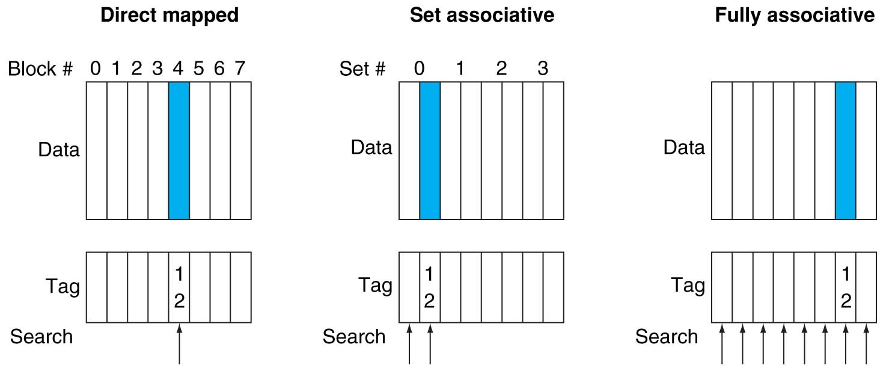
Alternative Block Placement Schemes
DM placement: mem block 12 in 8 block cache: only one cache block where mem block 12 can be found—(12 modulo 8) = 4
SA placement: four sets x 2-ways (8 cache blocks), memory block 12 in set (12 mod 4) = 0; either element of the set
FA placement: mem block 12 can appear in any cache blocks

Slide 13
Agenda
Cache Memory Recap
Administrivia
Set-Associative Caches
Technology Break
AMAT and Multilevel Cache Review

Slide 14
Administrivia
Project 4, Part 2 due Sunday 4/17
Design a 16-bit pipelined computer in Logisim
Extra Credit due 4/24 – Fastest Matrix Multiply
Final Review: Mon 5/2 5 – 8PM, 2050 VLSB
Final Exam: Mon 5/9 11:30-2:30PM 100 Haas Pavilion

Slide 15
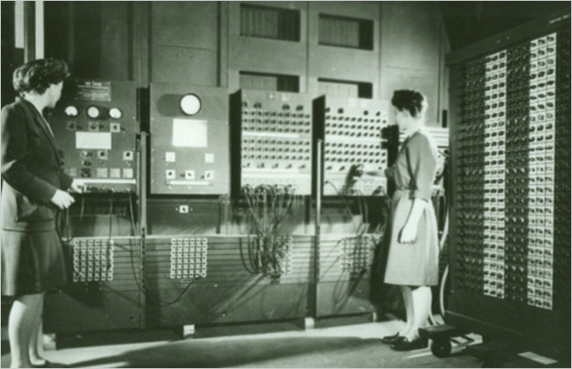
61c in the News: Jean Bartik, dies age 86 A Pioneer Programmer
“When the Eniac was shown off at the University of Pennsylvania in February 1946, it generated headlines in newspapers across the country. But the attention was all on the men and the machine. The women were not even introduced at the event.”
[NY Times, 4/7/2011]
Last survivor of group of women programmers of ENIAC, the first all-electronic digital calculator
Used for calculating artillery tables, but completed in 1946 too late for WWII

Slide 16
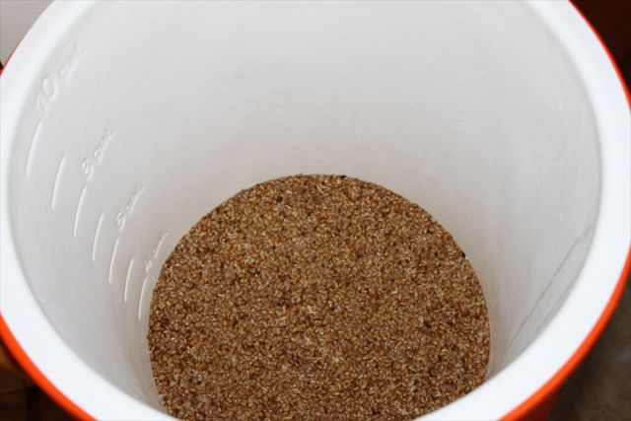
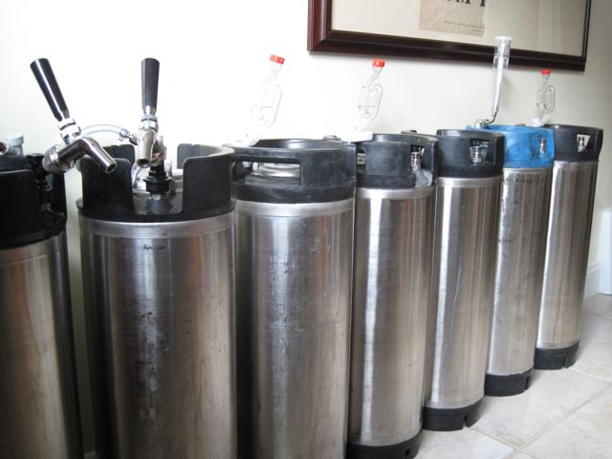
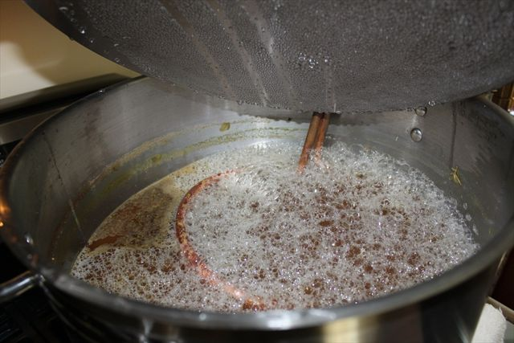
Getting to Know Your Prof
Missing the ales I grew up with in England, I learnt how to make beer.
Start from grains, about 5-10 gallons/batch
Brewed over 50 batches so far
Grains are mashed ~45-60 minutes to convert starch to sugar
Need thirsty friends to help consume experiments!
Boil extracted “wort” for 90 minutes, add hops, then cool to add yeast
ESB II ~6% ABV
ESB I ~6% ABV
Ordinary Bitter 4.1%ABV
Belgian Pale II ~5% ABV
Belgian Pale I ~5% ABV
Mixed Cider 7.2%ABV
In cellar:
Ferments for 5-7 days
Condition for 1 week to 2 years
Gravenstein Cider 7.1%ABV
British Barleywine 8% ABV
Belgian Trappist 12% ABV

Slide 17
Example: 4-Word Direct-Mapped $ Worst-Case Reference String
Consider the main memory word reference string
0 4 0 4 0 4 0 4
Start with an empty cache - all blocks initially marked as not valid
0
4
0
4
0
4
0
4
Notes:
For class handout

Slide 18
Example: 4-Word Direct-Mapped $ Worst-Case Reference String
Consider the main memory word reference string
0 4 0 4 0 4 0 4
Start with an empty cache - all blocks initially marked as not valid
0
miss
01
4
miss
00
0
miss
01
4
miss
4
4
0
00 Mem(0)
00 Mem(0)
01 Mem(4)
00 Mem(0)
00
0
miss
0
01
4
miss
4
00
0
miss
0
01
4
miss
4
01 Mem(4)
00 Mem(0)
01 Mem(4)
00 Mem(0)
8 requests, 8 misses
Ping pong effect due to conflict misses - two memory locations that map into the same cache block
Notes:
For class handout

Slide 19
Example: 2-Way Set Associative $ (4 words = 2 sets x 2 ways per set)
Main Memory
0000xx
0001xx
0010xx
0011xx
0100xx
0101xx
0110xx
0111xx
1000xx
1001xx
1010xx
1011xx
1100xx
1101xx
1110xx
1111xx
One word blocks
Two low order bits define the byte in the word (32b words)
Cache
Way
Set
V
Tag
Data
0
0
1
0
1
1
Q: How do we find it?
Use next 1 low order memory address bit to determine which cache set (i.e., modulo the number of sets in the cache)
Q: Is it there?
Compare all the cache tags in the set to the high order 3 memory address bits to tell if the memory block is in the cache
Notes:
For lecture
This picture is as opposed to
Way 0
both red Set 0
Way 1
------------------------------------
Way 0
both green Set 1
Way 1

Slide 20
Example: 4 Word 2-Way SA $ Same Reference String
Consider the main memory word reference string
0 4 0 4 0 4 0 4
Start with an empty cache - all blocks initially marked as not valid
0
4
0
4
Notes:
For class handout

Slide 21
Example: 4-Word 2-Way SA $ Same Reference String
Consider the main memory word reference string
0 4 0 4 0 4 0 4
Start with an empty cache - all blocks initially marked as not valid
0
miss
4
miss
0
hit
4
hit
000 Mem(0)
000 Mem(0)
000 Mem(0)
000 Mem(0)
010 Mem(4)
010 Mem(4)
010 Mem(4)
8 requests, 2 misses
Solves the ping pong effect in a direct mapped cache due to conflict misses since now two memory locations that map into the same cache set can co-exist!
Notes:
For lecture
Another sample string to try 0 1 2 3 0 8 11 0 3

Slide 22
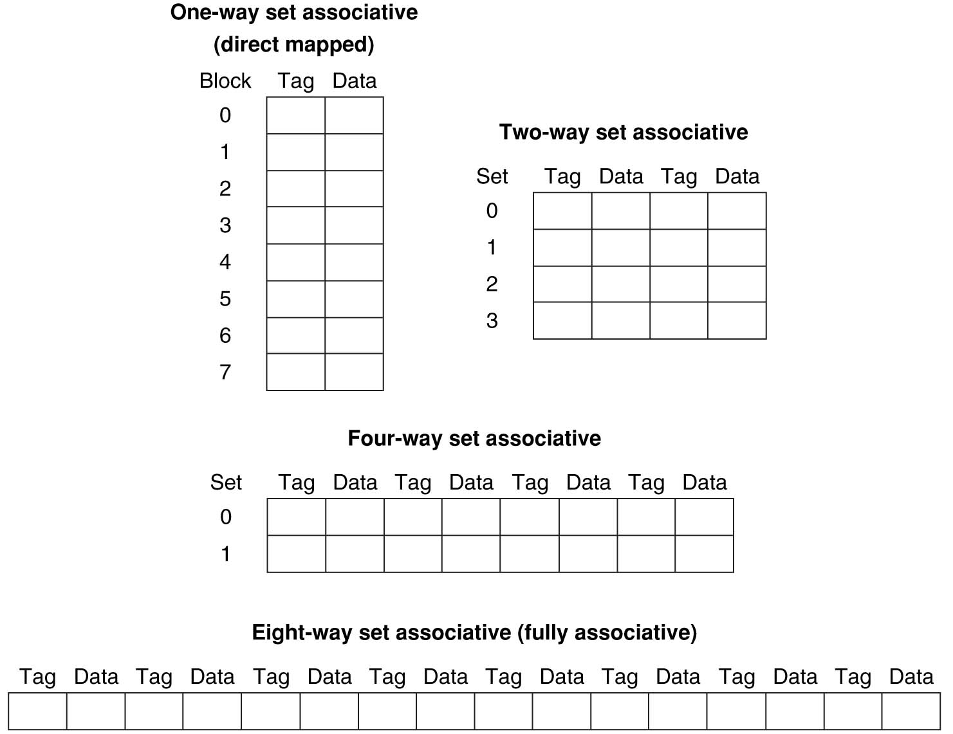
Example: Eight-Block Cache with Different Organizations
Total size of $ in blocks is equal to number of sets x associativity. For fixed $ size, increasing associativity decreases number of sets while increasing number of elements per set. With eight blocks, an 8-way set-associative $ is same as a fully associative $.

Slide 23
Four-Way Set-Associative Cache
2⁸ = 256 sets each with four ways (each with one block)
31 30 . . . 13 12 11 . . . 2 1 0
Byte offset
Tag
22
8
Index
Index
V
Tag
Data
V
Tag
Data
V
Tag
Data
V
Tag
Data
0
1
2
.
.
.
253
254
255
0
1
2
.
.
.
253
254
255
0
1
2
.
.
.
253
254
255
0
1
2
.
.
.
253
254
255
Way 0
Way 1
Way 2
Way 3
32
4x1 select
Hit
Data
Notes:
This is called a 4-way set associative cache because there are four cache entries for each cache index. Essentially, you have four direct mapped cache working in parallel.
This is how it works: the cache index selects a set from the cache. The four tags in the set are compared in parallel with the upper bits of the memory address.
If no tags match the incoming address tag, we have a cache miss.
Otherwise, we have a cache hit and we will select the data from the way where the tag matches occur.
This is simple enough. What is its disadvantages?
+1 = 36 min. (Y:16)

Slide 24
Range of Set-Associative Caches
For a fixed-size cache, each increase by a factor of two in associativity doubles the number of blocks per set (i.e., the number or ways) and halves the number of sets – decreases the size of the index by 1 bit and increases the size of the tag by 1 bit
Tag
Index
Block offset
Byte offset
Notes:
For class handout

Slide 25
Range of Set-Associative Caches
For a fixed-size cache, each increase by a factor of two in associativity doubles the number of blocks per set (i.e., the number or ways) and halves the number of sets – decreases the size of the index by 1 bit and increases the size of the tag by 1 bit
Used for tag compare
Selects the set
Selects the word in the block
Tag
Index
Block offset
Byte offset
Increasing associativity
Decreasing associativity
Fully associative
(only one set)
Tag is all the bits except
block and byte offset
Direct mapped
(only one way)
Smaller tags, only a single comparator
Notes:
For lecture
In 2008, the greater size and power consumption of CAMs generally leads to 2-way and 4-way set associativity being built from standard SRAMs with comparators with 8-way and above being built using CAMs

Slide 26
Costs of Set-Associative Caches
When miss occurs, which way’s block selected for replacement?
Least Recently Used (LRU): one that has been unused the longest
Must track when each way’s block was used relative to other blocks in the set
For 2-way SA $, one bit per set → set to 1 when a block is referenced; reset the other way’s bit (i.e., “last used”)
N-way set-associative cache costs
N comparators (delay and area)
MUX delay (set selection) before data is available
Data available after set selection (and Hit/Miss decision). DM $: block is available before the Hit/Miss decision
In Set-Associative, not possible to just assume a hit and continue and recover later if it was a miss
Notes:
First of all, a N-way set associative cache will need N comparators instead of just one comparator (use the right side of the diagram for direct mapped cache).
A N-way set associative cache will also be slower than a direct mapped cache because of this extra multiplexer delay.
Finally, for a N-way set associative cache, the data will be available AFTER the hit/miss signal becomes valid because the hit/mis is needed to control the data MUX.
For a direct mapped cache, that is everything before the MUX on the right or left side, the cache block will be available BEFORE the hit/miss signal (AND gate output) because the data does not have to go through the comparator.
This can be an important consideration because the processor can now go ahead and use the data without knowing if it is a Hit or Miss. Just assume it is a hit.
Since cache hit rate is in the upper 90% range, you will be ahead of the game 90% of the time and for those 10% of the time that you are wrong, just make sure you can recover.
You cannot play this speculation game with a N-way set-associative cache because as I said earlier, the data will not be available to you until the hit/miss signal is valid.
+2 = 38 min. (Y:18)

Slide 27
Cache Block Replacement Policies
Random Replacement
Hardware randomly selects a cache item and throw it out
Least Recently Used
Hardware keeps track of access history
Replace the entry that has not been used for the longest time
For 2-way set-associative cache, need one bit for LRU replacement
Example of a Simple “Pseudo” LRU Implementation
Assume 64 Fully Associative entries
Hardware replacement pointer points to one cache entry
Whenever access is made to the entry the pointer points to:
Move the pointer to the next entry
Otherwise: do not move the pointer
Entry 0
Entry 1
Replacement
:
Pointer
Entry 63

Slide 28
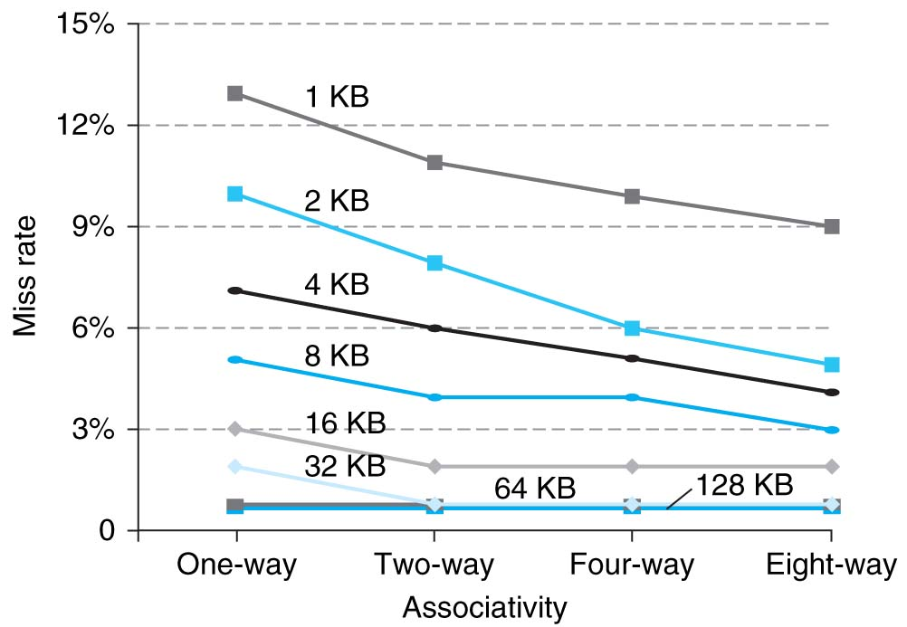
Benefits of Set-Associative Caches
Choice of DM $ or SA $ depends on the cost of a miss versus the cost of implementation
Largest gains are in going from direct mapped to 2-way (20%+ reduction in miss rate)
Notes:
As cache sizes grow, the relative improvement from associativity increases only slightly; since the overall miss rate of a larger cache is lower, the opportunity for improving the miss rate decreases and the absolute improvement in miss rate from associativity shrinks significantly.

Slide 29
How to Calculate 3C’s using Cache Simulator
Compulsory: set cache size to infinity and fully associative, and count number of misses
Capacity: Chance cache size from infinity, usually in powers of 2, and count misses for each reduction in size
16 MB, 8 MB, 4 MB, … 128 KB, 64 KB, 16 KB
Conflict: Change from fully associative to n-way set associative while counting misses
Fully associative, 16-way, 8-way, 4-way, 2-way, 1-way

Slide 30
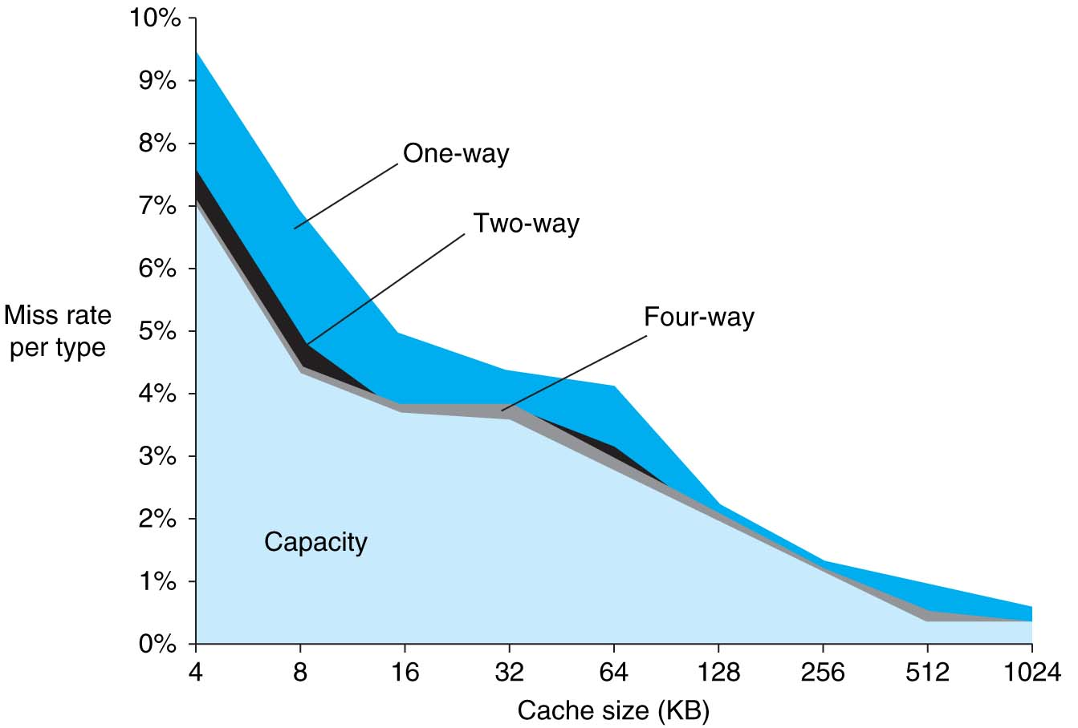
3Cs Revisted
Three sources of misses (SPEC2000 integer and floating-point benchmarks)
Compulsory misses 0.006%; not visible
Capacity misses, function of cache size
Conflict portion depends on associativity and cache size

Slide 31
Reduce AMAT
Use multiple levels of cache
As technology advances, more room on IC die for larger L1$ or for additional levels of cache (e.g., L2$ and L3$)
Normally the higher cache levels are unified, holding both instructions and data
Notes:
Also reduces cache miss penalty

Slide 32
AMAT Revisited
For a 2nd-level cache, L2 Equations:
AMAT = Hit Time_{L1} + Miss Rate_{L1} x Miss Penalty_{L1}
Miss Penalty_{L1} = Hit Time_{L2} + Miss Rate_{L2} x Miss Penalty_{L2}
AMAT = Hit Time_{L1} + Miss Rate_{L1} x (Hit Time_{L2} + Miss Rate_{L2} × Miss Penalty_{L2})
Definitions:
Local miss rate: misses in this $ divided by the total number of memory accesses to this $ (Miss rate_{L2})
Global miss rate: misses in this $ divided by the total number of memory accesses generated by the CPU (Miss Rate_{L1} x Miss Rate_{L2})
Global miss rate is what matters to overall performance
Local miss rate is factor in evaluating the effectiveness of L2 cache

Slide 33
CPI_{stalls} Calculation
Assume
CPI_{ideal} of 2
100 cycle miss penalty to main memory
25 cycle miss penalty to Unified L2$
36% of instructions are load/stores
2% L1 I$ miss rate; 4% L1 D$ miss rate
0.5% U(nified)L2$ miss rate
CPI_{stalls} = 2 + 1x.02×25 + .36×.04×25 + 1x.005×100 + .36×.005×100 = 3.54 (vs. 5.44 with no L2$)
IFetch
Ld/St
L1
L2
Notes:
Also reduces cache miss penalty

Slide 34
Memory Hierarchy with Two Cache Levels
1000 mem refs
40 mem refs
20 mem refs
CPU
L1$
L2$
MM
1 cycle
10 cycles
100 cycles
For every 1000 CPU to memory references
40 will miss in L1$; what is the miss rate?
20 will miss in L2$; what is the miss rate?
Global vs. local miss rate?
If 1.5 mem refs per instruction, how do we normalize these numbers to # instructions? Ave. Mem Stalls/Instruction

Slide 35
AMAT Calculations Local vs. Global Miss Rates
Example:
For 1000 memory refs: 40 misses in L1$ (miss rate 4%) 20 misses in L2$ (miss rate 2%)
L1$ hits 1 cycle, L2$ hits in 10 cycles Miss to MM costs 100 cycles
1.5 memory references per instruction (i.e., 50% ld/st) 1000 mem refs = 667 instrs OR 1000 instrs = 1500 mem refs
Ask: Local miss rate AMAT Stall cycles per instruction with and without L2$
With L2$
Local miss rate =
AMAT =
Ave Mem Stalls/Ref =
Ave Mem Stalls/Instr=
Without L2$
AMAT=
Ave Mem Stalls/Ref=
Ave Mem Stalls/Instr=
Assume ideal CPI=1.0, performance improvement =

Slide 36
AMAT Calculations Local vs. Global Miss Rates
Example:
For 1000 memory refs: 40 misses in L1$ (miss rate 4%) 20 misses in L2$ (miss rate 2%)
L1$ hits 1 cycle, L2$ hits in 10 cycles Miss to MM costs 100 cycles
1.5 memory references per instruction (i.e., 50% ld/st) 1000 mem refs = 667 instrs OR 1000 instrs = 1500 mem refs
Ask: Local miss rate AMAT Stall cycles per instruction with and without L2$
With L2$
Local miss rate = 50% (20/40)
AMAT = 1+4%x(10+50%x100)=3.4
Ave Mem Stalls/Ref = (3.4-1.0)=2.4
Ave Mem Stalls/Instr=2.4x1.5=3.6
Without L2$
AMAT=1+4%x100=5
Ave Mem Stalls/Ref=(5-1.0)=4
Ave Mem Stalls/Instr=4x1.5=6
Assume ideal CPI=1.0, performance improvement = (6+1)/(3.6+1)=52%

Slide 37
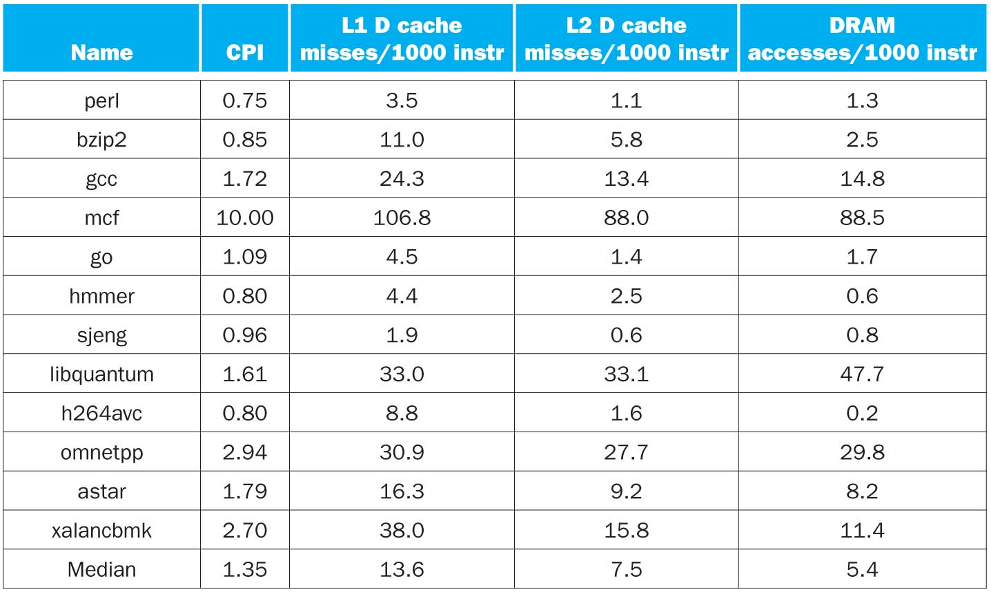
CPI/Miss Rates/DRAM Access SpecInt2006

Slide 38
Design Considerations
Different design considerations for L1$ and L2$
L1$ focuses on fast access: minimize hit time to achieve shorter clock cycle, e.g., smaller $
L2$, L3$ focus on low miss rate: reduce penalty of long main memory access times: e.g., Larger $ with larger block sizes/higher levels of associativity
Miss penalty of L1$ is significantly reduced by presence of L2$, so can be smaller/faster even with higher miss rate
For the L2$, fast hit time is less important than low miss rate
L2$ hit time determines L1$’s miss penalty
L2$ local miss rate >> than the global miss rate
Notes:
Global miss rate – the fraction of references that miss in all levels of a multilevel cache. The global miss rate dictates how often we must access the main memory.
Local miss rate – the fraction of references to one level of a cache that miss

Slide 39
Improving Cache Performance
Reduce the time to hit in the cache
E.g., Smaller cache, direct-mapped cache, special tricks for handling writes
Reduce the miss rate (in L2$, L3$)
E.g., Bigger cache, larger blocks
More flexible placement (increase associativity)
Reduce the miss penalty (in L1$)
E.g., Smaller blocks or critical word first in large blocks, special tricks for handling for writes, faster/higher bandwidth memories
Use multiple cache levels

Slide 40
Sources of Cache Misses: 3Cs for L2$, L3$
Compulsory (cold start or process migration, 1st reference):
First access to block impossible to avoid; small effect for long running programs
Solution: increase block size (increases miss penalty; very large blocks could increase miss rate)
Capacity:
Cache cannot contain all blocks accessed by the program
Solution: increase cache size (may increase access time)
Conflict (collision):
Multiple memory locations mapped to the same cache location
Solution 1: increase cache size
Solution 2: increase associativity (may increase access time)
Notes:
(Capacity miss) That is the cache misses are due to the fact that the cache is simply not large enough to contain all the blocks that are accessed by the program.
The solution to reduce the Capacity miss rate is simple: increase the cache size.
Here is a summary of other types of cache miss we talked about.
First is the Compulsory misses. These are the misses that we cannot avoid. They are caused when we first start the program.
Then we talked about the conflict misses. They are the misses that caused by multiple memory locations being mapped to the same cache location.
There are two solutions to reduce conflict misses. The first one is, once again, increase the cache size. The second one is to increase the associativity.
For example, say using a 2-way set associative cache instead of directed mapped cache.
But keep in mind that cache miss rate is only one part of the equation. You also have to worry about cache access time and miss penalty. Do NOT optimize miss rate alone.
Finally, there is another source of cache miss we will not cover today. Those are referred to as invalidation misses caused by another process, such as IO , update the main memory so you have to flush the cache to avoid inconsistency between memory and cache.
+2 = 43 min. (Y:23)

Slide 41
Two Machines’ Cache Parameters
 | Intel Nehalem | AMD Barcelona
L1 cache organization & size | Split I$ and D$; 32KB for each per core; 64B blocks | Split I$ and D$; 64KB for each per core; 64B blocks
L1 associativity | 4-way (I), 8-way (D) set assoc.; ~LRU replacement | 2-way set assoc.; LRU replacement
L1 write policy | write-back, write-allocate | write-back, write-allocate
L2 cache organization & size | Unified; 256KB (0.25MB) per core; 64B blocks | Unified; 512KB (0.5MB) per core; 64B blocks
L2 associativity | 8-way set assoc.; ~LRU | 16-way set assoc.; ~LRU
L2 write policy | write-back | write-back
L2 write policy | write-back, write-allocate | write-back, write-allocate
L3 cache organization & size | Unified; 8192KB (8MB) shared by cores; 64B blocks | Unified; 2048KB (2MB) shared by cores; 64B blocks
L3 associativity | 16-way set assoc. | 32-way set assoc.; evict block shared by fewest cores
L3 write policy | write-back, write-allocate | write-back; write-allocate

Slide 42
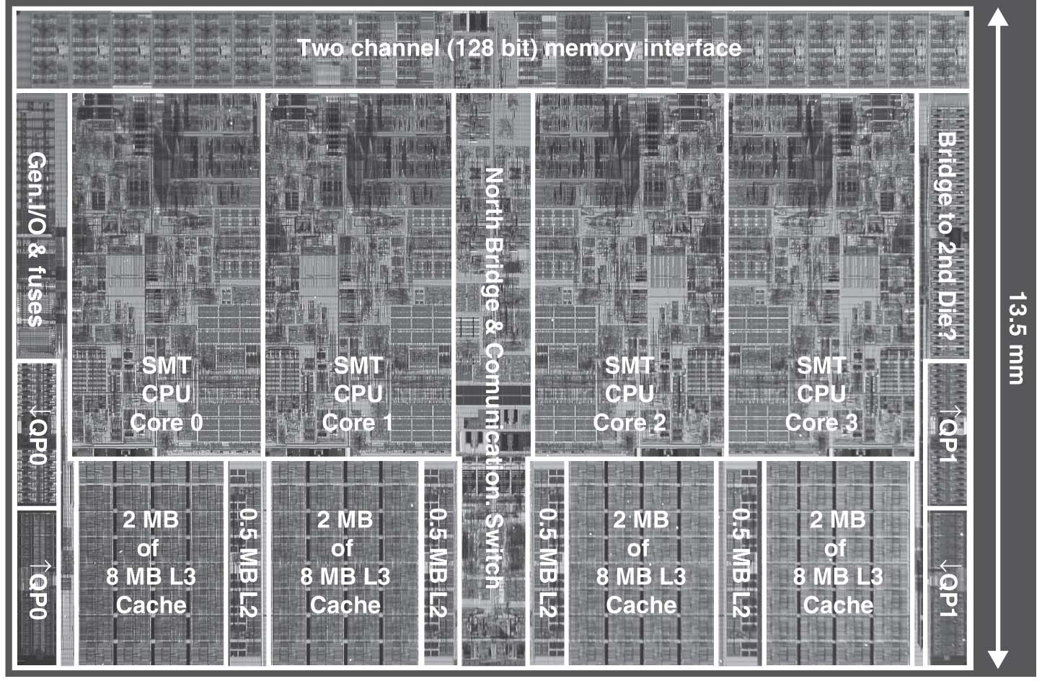
Intel Nehalem Die Photo
4 cores, 32KB I$/32-KB D$, 512KB L2$
Share one 8-MB L3$

Slide 43
Cache Design Space
Several interacting dimensions
Cache size
Block size
Associativity
Replacement policy
Write-through vs. write-back
Write allocation
Optimal choice is a compromise
Depends on access characteristics
Workload
Use (I-cache, D-cache)
Depends on technology / cost
Simplicity often wins
Cache Size
Associativity
Block Size
Bad
Good
Factor A
Factor B
Less
More
Notes:
No fancy replacement policy is needed for the direct mapped cache.
As a matter of fact, that is what cause direct mapped trouble to begin with: only one place to go in the cache--causes conflict misses.
No fancy replacement policy is needed for the direct mapped cache.
As a matter of fact, that is what cause direct mapped trouble to begin with: only one place to go in the cache--causes conflict misses.
Besides working at Sun, I also teach people how to fly whenever I have time.
Statistic have shown that if a pilot crashed after an engine failure, he or she is more likely to get killed in a multi-engine light airplane than a single engine airplane.
The joke among us flight instructors is that: sure, when the engine quit in a single engine stops, you have one option: sooner or later, you land. Probably sooner.
But in a multi-engine airplane with one engine stops, you have a lot of options. It is the need to make a decision that kills those people.

Slide 44
Summary
Name of the Game: Reduce Cache Misses
2 memory blocks mapping to same block knock each other out as program bounces from 1 memory location to next
One way to do it: set-associativity
Memory block maps into more than 1 cache block
N-way: n possible places in cache to hold a memory block
N-way Cache of 2^{N+M} blocks: 2^{N} ways x 2^{M} sets
Multi-level caches
Optimize first level to be fast!
Optimize 2nd and 3rd levels to minimize the memory access penalty

