Slide 1
CS 61C: Great Ideas in Computer Architecture (Machine Structures) Dependability
Instructors:
Randy H. Katz
David A. Patterson
http://inst.eecs.Berkeley.edu/~cs61c/sp11

Slide 3
Review
Name of the Game: Reduce Cache Misses
2 memory blocks mapping to same block knock each other out as program bounces from 1 memory location to next
One way to do it: set-associativity
Memory block maps into more than 1 cache block
N-way: n possible places in cache to hold a memory block
N-way Cache of 2^{N+M} blocks: 2^{N} ways x 2^{M} sets
Multi-level caches
Optimize first level to be fast!
Optimize 2nd and 3rd levels to minimize the memory access penalty

Slide 4
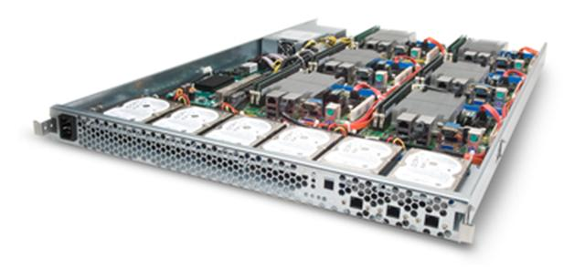
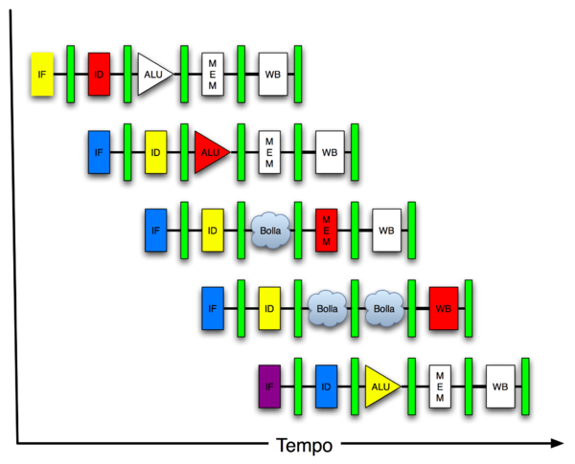
New-School Machine Structures (It’s a bit more complicated!)
Today’s
Lecture
Software Hardware
Parallel Requests
Assigned to computer
e.g., Search “Katz”
Parallel Threads
Assigned to core
e.g., Lookup, Ads
Parallel Instructions
>1 instruction @ one time
e.g., 5 pipelined instructions
Parallel Data
>1 data item @ one time
e.g., Add of 4 pairs of words
Hardware descriptions
All gates @ one time
Warehouse Scale Computer
Smart Phone
Harness Parallelism &
Achieve High Performance
Computer
Core
…
Core
Memory (Cache)
Input/Output
Core
Instruction Unit(s)
Functional
Unit(s)
A₀+B₀
A₁+B₁
A₂+B₂
A₃+B₃
Main Memory
Logic Gates

Slide 5
Review - 6 Great Ideas in Computer Architecture
Layers of Representation/Interpretation
Moore’s Law
Principle of Locality/Memory Hierarchy
Parallelism
Performance Measurement & Improvement
Dependability via Redundancy

Slide 6
Review - Great Idea #6: Dependability via Redundancy
Redundancy so that a failing piece doesn’t make the whole system fail
1+1=2
2 of 3 agree
1+1=2
1+1=2
1+1=1
FAIL!
Increasing transistor density reduces the cost of redundancy

Slide 7
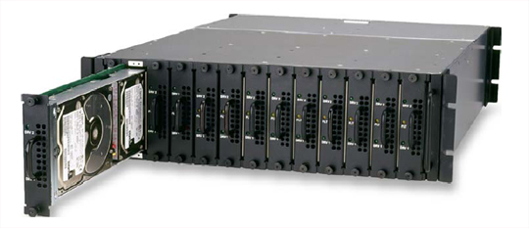
Review - Great Idea #6: Dependability via Redundancy
Applies to everything from datacenters to memory
Redundant datacenters so that can lose 1 datacenter but Internet service stays online
Redundant routes so can lose nodes but Internet doesn’t fail
Redundant disks so that can lose 1 disk but not lose data (Redundant Arrays of Independent Disks/RAID)
Redundant memory bits of so that can lose 1 bit but no data (Error Correcting Code/ECC Memory)
Today

Slide 8
Explain a lot of buzzwords
Parity (even, odd)
ECC
SEC/DED
Hamming Distance
CRC codes
Reed Solomon codes
MTTF
MTBF
MTTR
Nines of availability
Hot Spares

Slide 9
Agenda
Definition of Dependability, Reliability, Availability and metrics to evaluate them
Codes for Redundancy
Administrivia
Error Detection in Memory (Parity)
Error Correction in Memory: Encoding
Technology Break
Error Correction in Memory: Correcting

Slide 10
Dependability
Service accomplishment
Service delivered as specified
Fault: failure of a component
May or may not lead to system failure
Restoration
Failure
Service interruption
Deviation from specified service

Slide 11
Dependability Measures
Reliability: Mean Time To Failure (MTTF)
Service interruption: Mean Time To Repair (MTTR)
Mean time between failures (MTBF)
MTBF = MTTF + MTTR
Availability = MTTF / (MTTF + MTTR)
Improving Availability
Increase MTTF: More reliable hardware/software + Fault Tolerance
Reduce MTTR: improved tools and processes for diagnosis and repair

Slide 12
Reliability Measures
MTTF, MTBF usually measured in hours
E.g., average MTTF is 100,000 hours
Another measure is average number of failures per year
E.g., 1000 disks with 100,000 hour MTTF
365 days * 24 hours == 8760 hours
(1000 disks * 8760 hrs/year) / 100,000 = 87.6 failed disks per year on aveage
87.6/1000 = 8.76% annual failure rate

Slide 13
Availability Measures
Availability = MTTF / (MTTF + MTTR) as %
Since hope rarely down, shorthand is “number of 9s of availability per year”
1 nine: 90% => 36 days of repair/year
2 nines: 99% => 3.6 days of repair/year
3 nines: 99.9% => 526 minutes of repair/year
4 nines: 99.99% => 53 minutes of repair/year
5 nines: 99.999% => 5 minutes of repair/year

Slide 14
Dependability Design Principle
Design Principle: No single points of failure
“Chain is only as strong as its weakest link”
Dependability Corollary of Amdahl’s Law
Doesn’t matter how dependable you make one portion of system
Dependability limited by part you do not improve

Slide 15
Error Detection/Correction Codes
Memory systems generate errors (accidentally flipped-bits)
DRAMs store very little charge per bit
“Soft” errors occur occasionally when cells are struck by alpha particles or other environmental upsets
“Hard” errors can occur when chips permanently fail.
Problem gets worse as memories get denser and larger
Memories protected against failures with EDC/ECC
Extra bits are added to each data-word
used to detect and/or correct faults in the memory system
in general, each possible data word value is mapped to a unique “code word”. A fault changes a valid code word to an invalid one - which can be detected.

Slide 16
Detecting/Correcting Code Concept
Space of possible bit patterns (2^{N})
Error changes bit pattern to
non-code
Sparse population of code words (2^{M} << 2^{N})
- with identifiable signature
Detection: bit pattern fails codeword check
Correction: map to nearest valid code word

Slide 17
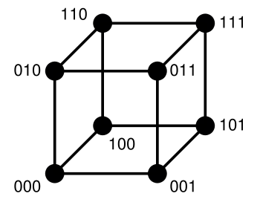
Hamming Distance: 8 code words

Slide 18
Hamming Distance 2: Detection
No 1 bit error goes to another valid code
½ codes are valid

Slide 19
Hamming Distance 3: Correction
Nearest 111
(one 0)
Nearest 000
(one 1)
No 2 bit error goes to another valid code; 1 bit error near
1/8 codes are valid

Slide 20
Administrivia
Project 4, Part 2 due Sunday 4/17
Design a 16-bit pipelined computer in Logisim
Extra Credit due 4/24 – Fastest Matrix Multiply
Final Review: Mon 5/2, 5 – 8PM, 2050 VLSB
Final Exam: Mon 5/9, 11:30-2:30PM, 100 Haas Pavilion

Slide 21
Average performance across matrix sizes
Slowdown in nearly every code, often large.

Slide 22
Average performance across matrix sizes
Math Library
93% got less than 10 Gflop/s

Slide 23
Lines of code to handle all sizes
Most codes are longer, but some are shorter

Slide 24
Performance of OpenMP codes
Many teams got speedup using OpenMP

Slide 25
Average OpenMP performance
95% got less than 60 Gflop/s

Slide 26
Lines of code to use OpenMP
Most codes did not require many changes

Slide 27
Project 4 Part 1 Scores

Slide 28
61C in the News
Intel, on the Outside, Takes Aim at Smartphones
As long as PCs were dominant, Intel was dominant. But it’s now a new world in which tiny hand-held computers, more commonly known as smartphones, are outselling personal computers.
And usually, there is no Intel inside. The difficulty has been to get its chips’ power consumption down to a level reasonable for a phone.
Paul Otellini vowed recently that Intel-powered smartphones would be on the market before the year is out.
Intel’s competitors are also hoping that a recent decision by Nokia to use Windows Phone 7 rather than the Symbian operating system, will help them fend off Intel, given that it is optimized for ARM-based cellphones.
NY Times, April 10, 2011

Slide 29
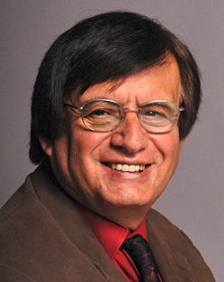
Get To Know Your Prof: Connections between Tapia & me?
Math vs. CS? Private vs. Public University? Texas vs. California?
Notes:
Elephant in the room: Hair?

Slide 30
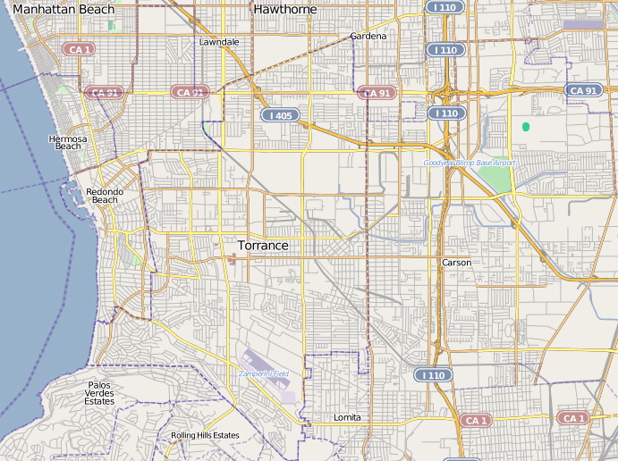
Tapia and Patterson – Connections
DP & RT MS
DP & RT BA
DP & RT PhD
Oldest of large church-going family (5 / 4 kids)
DP JC
Married at 20/19
UCLA BA Math @ 22/21
1st college graduate
DP 1st Home
7
10
Father at 21
2nd child in grad school
1st son has our 1st names
RT 1st Home
RT 2nd Home
DP High School
3
5
UCLA PhD @ 28/29
Full Prof 10 years later
NAE in 1992/1993
RT High School
DP 2nd Home
RT JC

Slide 31
Tapia and Patterson – Connections
DP & RT MS
DP & RT BA
DP & RT PhD
Oldest of large church-going family (5 / 4 kids)
DP JC
Married at 20/19
UCLA BA Math @ 22/21
1st college graduate
DP 1st Home
7
10
Father at 21
2nd child in grad school
1st son has our 1st names
RT 1st Home
RT 2nd Home
DP High School
3
5
UCLA PhD @ 28/29
Full Prof 10 years later
NAE in 1992/1993
RT High School
DP 2nd Home
RT JC

Slide 32
Tapia and Patterson – Connections
1970 Chevy Chevelle, V8 Corvette LT1 Engine
1938 Ford, V8 454 Corvette
Notes:
SoCal are car culture since invented cars – 1m ford Model Ts in SoCal in 1920s
SoCal invented Hot Rods and drag racing in 1950s – “American Graffiti”
Cars we wish we had when we were in high school

Slide 33
Tapia & Patterson: Connections
Best in Show Award, 2005 National Super Chevy Show & magazine centerfold
Our “woody” centerfold in Motor Trend car magazine
On Drag Racing Team that set World Record: 1968, 1969, 1970
Top Fund Raiser, MS 125 mile bike ride “Waves to Wine”: 2006, 2007, 2008, 2009, 2010
Notes:
Don’t have a car record, but I’ve got a bike record

Slide 34
Tapia’s Lost Twin?
Hitting The Beach
with Dr. David Patterson
Notes:
I was hard-pressed to find a photo to go with with one,. This is the closest I could find

Slide 35
Agenda
Definition of Dependability, Reliability, Availability and metrics to evaluate them
Codes for Redundancy
Administrivia
Error Detection in Memory (Parity)
Error Correction in Memory: Encoding
Technology Break
Error Correction in Memory: Correcting

Slide 36
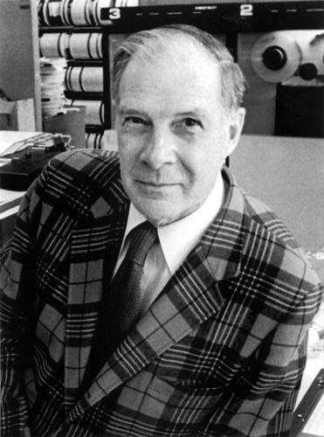
Block Code Principles
Hamming distance = difference in # of bits
p = 011011, q = 001111, Ham. distance (p,q) = 2
p = 011011, q = 110001, distance (p,q) = ?
Can think of extra bits as creating a code with the data
What if minimum distance between members of code is 2 and get a 1 bit error?
Student Roulette
Richard Hamming, 1915-98
Turing Award Winner

Slide 37
Parity: Simple Error Detection Coding
Each data value, before it is written to memory is “tagged” with an extra bit to force the stored word to have even parity:
Each word, as it is read from memory is “checked” by finding its parity (including the parity bit).
b₇b₆b₅b₄b₃b₂b₁b₀p
b₇b₆b₅b₄b₃b₂b₁b₀p
+
+
c
Minimum Hamming distance of parity code is 2
A non-zero parity indicates an error occurred:
2 errors (on different bits) is not detected (nor any even number of errors)
odd numbers of errors are detected.

Slide 38
Parity Example
Data 0101 0101
4 ones, even parity now
Write to memory: 0101 0101 0 to keep parity even
Data 0101 0111
5 ones, odd parity now
Write to memory: 0101 0111 1 to make parity even
Read from memory 0101 0101 0
4 ones => even parity, so no error
Read from memory 1101 0101 0
5 ones => odd parity, so error
What if error in parity bit?

Slide 39
Suppose want to Correct 1 Error?
Can we correct if minimum distance is 2?
What must minimum Hamming Distance be?
Richard Hamming came up with simple to understand mapping to allow Error Correction at minimum distance of 3
Called Hamming ECC for Error Correction Code

Slide 40
Hamming Error Correction Code
Use of extra parity bits to allow the position identification of a single error
Mark all bit positions that are powers of 2 as parity bits. (positions 1, 2, 4, 8, 16, …)
Start numbering bits at 1 at left, not at 0 on right
2. All other bit positions are for the data to be encoded. (positions 3, 5, 6, 7, 9, 10, 11, 12, 13, 14, 15, …)

Slide 41
Hamming ECC
3. Each parity bit calculates the parity for some of the bits in the code word
The position of parity bit determines sequence of bits that it checks
Bit 1 (0001₂): checks bits (1,3,5,7,9,11,...)
Bit 2 (0010₂): checks bits (2,3,6,7,10,11,14,15,...)
Bit 4 (0100₂): checks bits (4-7, 12-15, 20-23, ...)
Bit 8 (1000₂): checks bits (8-15, 24-31, 40-47 ,...)

Slide 42
Hamming ECC
4. Set parity bits to create even parity for each group
A byte of data: 10011010
Create the coded word, leaving spaces for the parity bits:
_ _ 1 _ 0 0 1 _ 1 0 1 0
0 0 0 0 0 0 0 0 0 1 1 1 1 2 3 4 5 6 7 8 9 0 1 2
Calculate the parity bits

Slide 43
Hamming ECC
Student Roulette
Position 1 checks bits 1,3,5,7,9,11: ? _ 1 _ 0 0 1 _ 1 0 1 0. set position 1 to a _: _ _ 1 _ 0 0 1 _ 1 0 1 0
Position 2 checks bits 2,3,6,7,10,11: 0 ? 1 _ 0 0 1 _ 1 0 1 0. set position 2 to a _: 0 _ 1 _ 0 0 1 _ 1 0 1 0
Position 4 checks bits 4,5,6,7,12: 0 1 1 ? 0 0 1 _ 1 0 1 0. set position 4 to a _: 0 1 1 _ 0 0 1 _ 1 0 1 0
Notes:
Bit 1 is 0
Bit 2 is 1
Bit 4 is 1

Slide 44
Hamming ECC
Position 1 checks bits 1,3,5,7,9,11: ? _ 1 _ 0 0 1 _ 1 0 1 0. set position 1 to a 0: 0 _ 1 _ 0 0 1 _ 1 0 1 0
Position 2 checks bits 2,3,6,7,10,11: 0 ? 1 _ 0 0 1 _ 1 0 1 0. set position 2 to a 1: 0 1 1 _ 0 0 1 _ 1 0 1 0
Position 4 checks bits 4,5,6,7,12: 0 1 1 ? 0 0 1 _ 1 0 1 0. set position 4 to a 1: 0 1 1 1 0 0 1 _ 1 0 1 0

Slide 45
Hamming ECC
Position 8 checks bits 8,9,10,11,12: 0 1 1 1 0 0 1 ? 1 0 1 0. set position 8 to a _: 0 1 1 1 0 0 1 0 1 _ 1 0
Final code word: 011100101010
Data word: 1 001 1010
Notes:
Bit 8 set to 0

Slide 46
Hamming ECC
Position 8 checks bits 8,9,10,11,12: 0 1 1 1 0 0 1 ? 1 0 1 0. set position 8 to a 0: 0 1 1 1 0 0 1 0 1 0 1 0
Final code word: 011100101010.
Notes:
Bit 8 set to 0

Slide 47
Agenda
Definition of Dependability, Reliability, Availability and metrics to evaluate them
Codes for Redundancy
Administrivia
Error Detection in Memory (Parity)
Error Correction in Memory: Encoding
Technology Break
Error Correction in Memory: Correcting

Slide 48
Hamming ECC
Finding and fixing a corrupted bit:
Suppose receive 011100101110 123456789012
Parity 1_, Parity 2_, Parity 4_, Parity 8_
Bits numbers xxx1_{two}, xx1x_{two}, x1xx_{two}, 1xxx_{two})
Parity bits 2 and 8 incorrect. As 2 + 8 = 10, bit position 10 is location of bad bit: flip value!
Corrected value: 011100101010
Why does Hamming ECC work?
Notes:
Do on the blackboard
Bit 1: 1, 3, 5, 7, 9, 11
Bit 2: 2,3, 6,7, 10,11
Bit 4: 4, 5, 6, 7, 12
Bit 8: 8, 9, 10, 11, 12

Slide 49
Hamming ECC on your own
Test if these Hamming-code words are correct. If one is incorrect, indicate the correct code word. Also, indicate what the original data was.
010101100011
111110001100
000010001010

Slide 50
Hamming Error Correcting Code
Overhead involved in single error correction code
Let p be total number of parity bits and d number of data bits in p + d bit word
If p error correction bits are to point to error bit (p + d cases) + indicate that no error exists (1 case), we need:
2^{p} >= p + d + 1,
thus p >= log(p + d + 1)
for large d, p approaches log(d)
8 bits data => d = 8, 2^{p} = p + 8 + 1 => p = 4
16 data => 5 parity, 32 data => 6 parity, 64 data => 7 parity

Slide 51
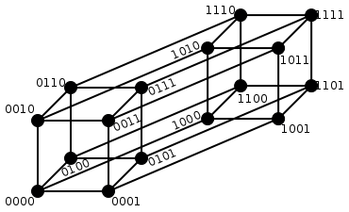
Hamming Single Error Correction + Double Error Detection
1 bit error (one 0) Nearest 1111
2 bit error (two 0s, two 1s) Halfway Between Both
1 bit error (one 1) Nearest 0000
Notes:
1 bit error from 0000, all numbers with one 1
1 bit error from 1111, all numbers with one 0
2 bit error from 0000, all numbers with two 1s and two 0s
2 bit error from 1111, all numbers with two 1s and two 0s

Slide 52
Hamming Single Error Correction, Double Error Detection (SEC/DED)
Adding extra parity bit covering the entire word provides double error detection as well as single error correction
1 2 3 4 5 6 7 8
p₁ p₂ d₁ p₃ d₂ d₃ d₄ p₄
Hamming parity bits H (p₁ p₂ p₃) are computed (even parity as usual) plus the even parity over the entire word, p₄:
H=0 p₄=0, no error
H≠0 p₄=1, correctable single error (odd parity if 1 error => p₄=1)
H≠0 p₄=0, double error occurred (even parity if 2 errors=> p₄=0)
H=0 p₄=1, an error occurred in p₄ bit, not in rest of word
Typical modern codes in DRAM memory systems:
64-bit data blocks (8 bytes) with 72-bit code words (9 bytes).

Slide 53
What if More Than 2 Bit Errors?
Network transmissions, disks, distributed storage common failure mode is bursts of bit errors, not just one or two bit errors
contiguous sequence of B bits in which first, last and any number of intermediate bits are in error
caused by impulse noise or by fading in wireless
effect is greater at higher data rates

Slide 54
Cyclic Redundancy Check
for block of k bits, transmitter generates an n-k bit frame check sequence
Transmits n bits exactly divisible by some number
Receiver divides frame by that number
If no remainder, assume no error
Easy to calculate division for some binary numbers with shift register
Disks detect and correct blocks of 512 bytes with called Reed Solomon codes ≈ CRC (see last slide)

Slide 55
(In More Depth: Code Types)
Linear Codes: Code is generated by G and in null-space of H
Hamming Codes: Design the H matrix
d = 3 ⇒ Columns nonzero, Distinct
d = 4 ⇒ Columns nonzero, Distinct, Odd-weight
Reed-solomon codes:
Based on polynomials in GF(2^{k}) (I.e. k-bit symbols)
Data as coefficients, code space as values of polynomial:
P(x)=a₀+a₁x¹+… a_{k-1}x^{k-1}
Coded: P(0),P(1),P(2)….,P(n-1)
Can recover polynomial as long as get any k of n
Alternatively: as long as no more than n-k coded symbols erased, can recover data.
Side note: Multiplication by constant in GF(2^{k}) can be represented by k×k matrix: a⋅x
Decompose unknown vector into k bits: x=x₀+2x₁+…+2^{k-1}x_{k-1}
Each column is result of multiplying a by 2^{i}

Slide 56
Summary
Great Idea: Redundancy to Get Dependability
Reliability: MTTF & Annual failure rate
Availability: % uptime (MTTF-MTTR/MTTF)
Memory:
Hamming distance 2 Parity for Single Error Detect
Hamming distance 3 Single Error Correction Code + encode bit position of error
Hamming distance 4 SEC/Double Error Detection
CRC for many bit detection, Reed Solomon per disk sector for many bit error detection/corrects

