Slide 1
CS 61C:
Great Ideas in Computer Architecture (formerly called Machine Structures)
Course Introduction
Instructor:
David A. Patterson
http://inst.eecs.Berkeley.edu/~cs61c/sp12

Slide 2
Agenda
Great Ideas in Computer Architecture
Administrivia
PostPC Era: From Phones to Datacenters
Software as a Service
Cloud Computing
Technology Break
Warehouse Scale Computers in Depth

Slide 3
CS61c is NOT really about C Programming
It is about the hardware-software interface
  What does the programmer need to know to achieve the highest possible performance
Languages like C are closer to the underlying hardware, unlike languages like Python!
  Allows us to talk about key hardware features in higher level terms
  Allows programmer to explicitly harness underlying hardware parallelism for high performance

Slide 4
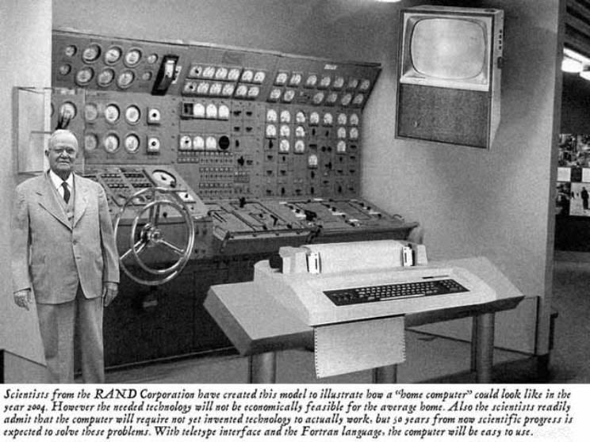
Old School CS61c

Slide 5

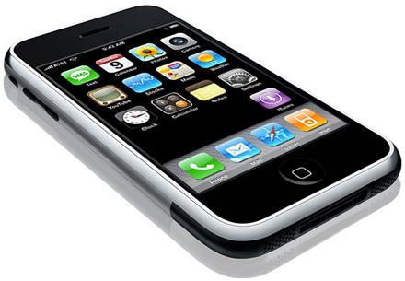
New School CS61c
Personal Mobile Devices

Slide 6
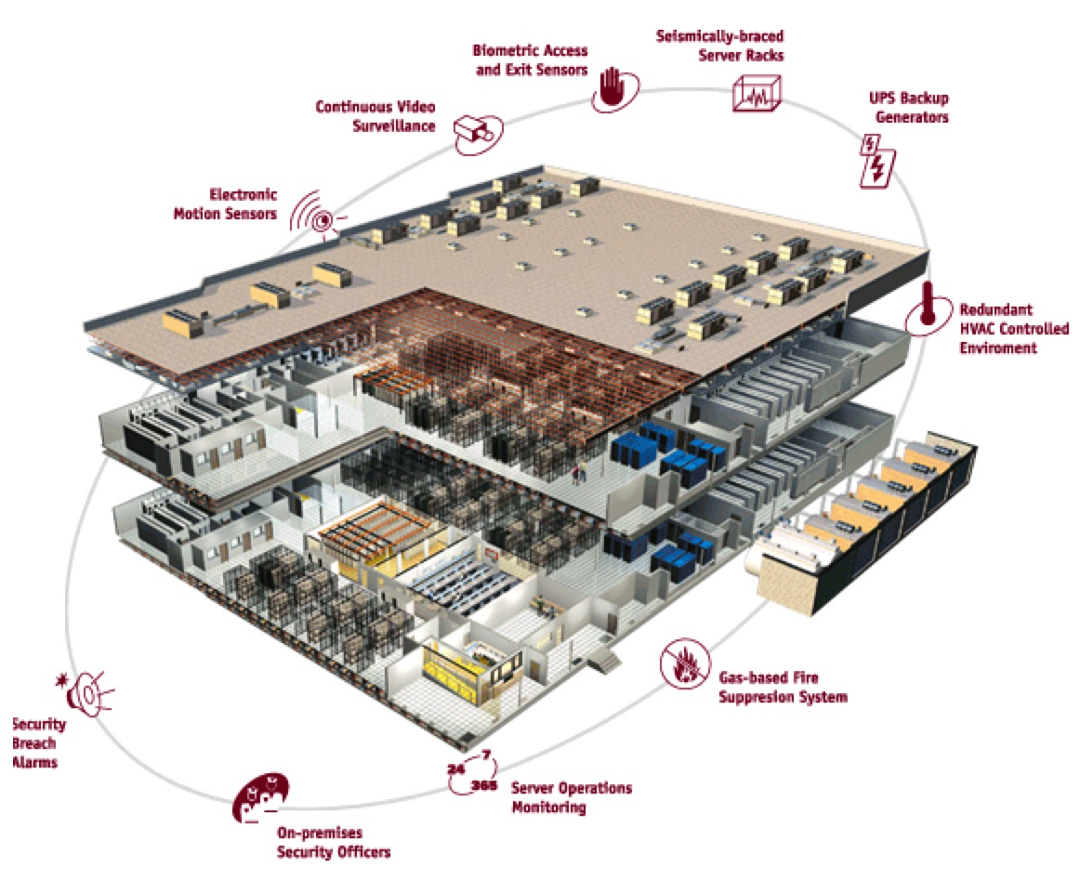
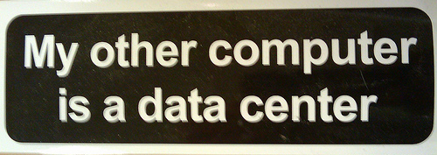
Warehouse
Scale
Computer

Slide 7
Old-School Machine Structures
Application (ex: browser)
CS61c
Operating
Compiler
System
(Mac OSX)
Software
Assembler
Instruction Set
Architecture
Hardware
Processor
Memory
I/O system
Datapath & Control
Digital Design
Circuit Design
transistors

Slide 8
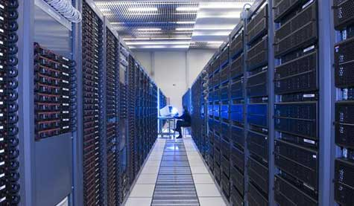


New-School Machine Structures
(It’s a bit more complicated!)
Project 1
Software Hardware
Parallel Requests
  Assigned to computer
  e.g., Search “Katz”
Parallel Threads
  Assigned to core
  e.g., Lookup, Ads
Parallel Instructions
  >1 instruction @ one time
  e.g., 5 pipelined instructions
Parallel Data
  >1 data item @ one time
  e.g., Add of 4 pairs of words
Hardware descriptions
  All gates functioning in parallel at same time
Programming Languages
Warehouse Scale Computer
Smart
Phone
Leverage
Parallelism &
Achieve High
Performance
Project 2
Computer
Core
…
Core
Memory
Project 3
Input/Output
Core
Instruction Unit(s)
Functional
Unit(s)
A₀+B₀
A₁+B₁
A₂+B₂
A₃+B₃
Cache Memory
Logic Gates
Project 4

Slide 9
6 Great Ideas in Computer Architecture
Layers of Representation/Interpretation
Moore’s Law
Principle of Locality/Memory Hierarchy
Parallelism
Performance Measurement & Improvement
Dependability via Redundancy

Slide 10

Great Idea #1: Levels of Representation/Interpretation
High Level Language
Program (e.g., C)
temp = v[k];
v[k] = v[k+1];
v[k+1] = temp;
Compiler
Anything can be represented
as a number,
i.e., data or instructions
lw $t0, 0($2)
lw $t1, 4($2)
sw $t1, 0($2)
sw $t0, 4($2)
Assembly Language Program (e.g., MIPS)
Assembler
0000 1001 1100 0110 1010 1111 0101 1000
1010 1111 0101 1000 0000 1001 1100 0110
1100 0110 1010 1111 0101 1000 0000 1001
0101 1000 0000 1001 1100 0110 1010 1111
Machine Language Program (MIPS)
Machine Interpretation
Hardware Architecture Description
(e.g., block diagrams)
Architecture Implementation
Logic Circuit Description
(Circuit Schematic Diagrams)

Slide 11
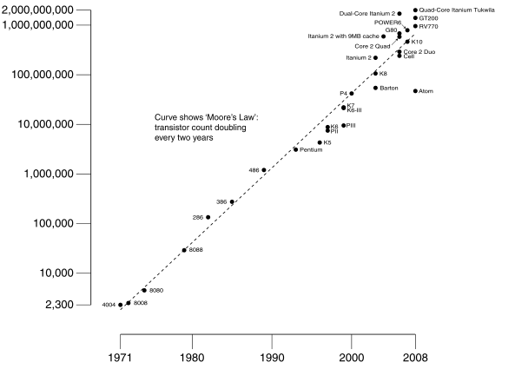
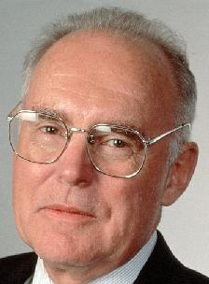
#2: Moore’s Law
Predicts: 2X Transistors / chip every 2 years
# of transistors on an integrated circuit (IC)
Gordon Moore, Intel Cofounder
B.S. Cal 1950
Cal Alumni of Year 1997
Year

Slide 12
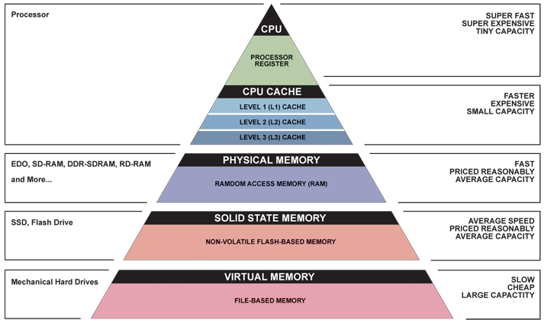
Great Idea #3: Principle of Locality/
Memory Hierarchy

Slide 13
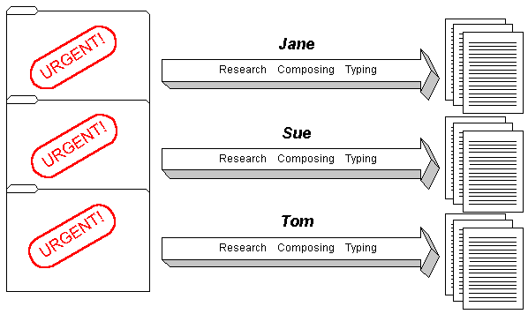
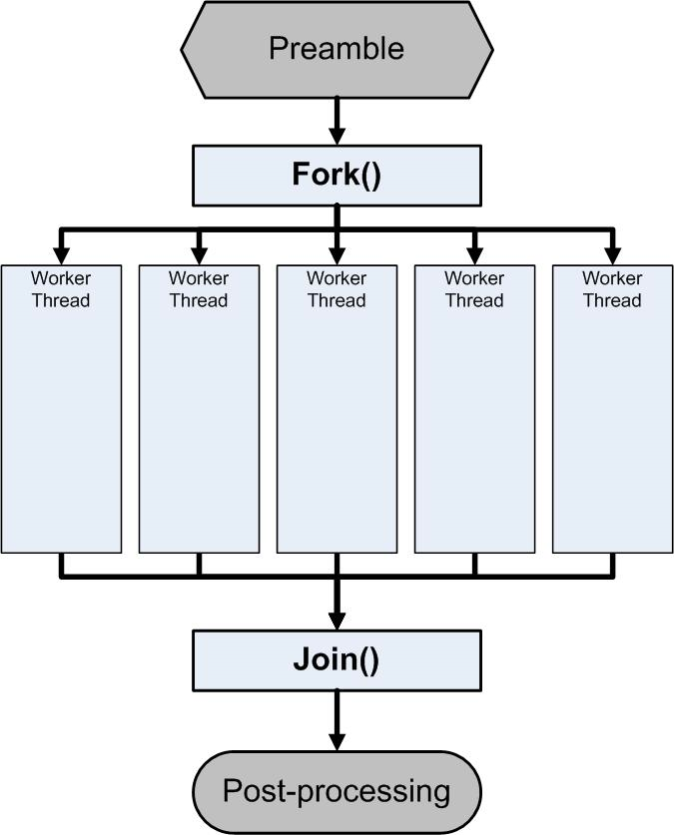
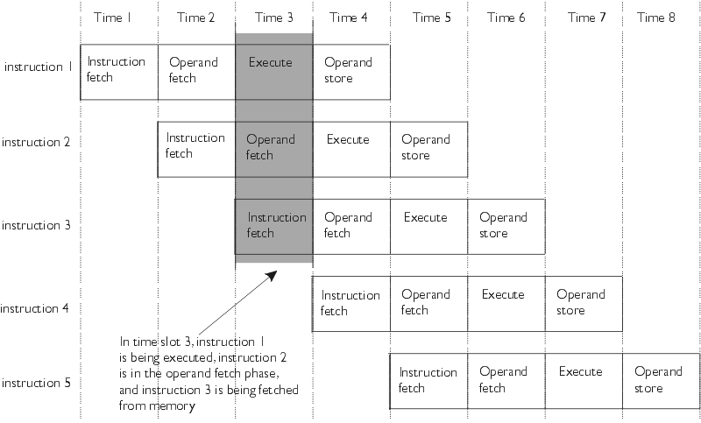
Great Idea #4: Parallelism

Slide 14
Great Idea #5: Performance Measurement and Improvement
Matching application to underlying hardware to exploit:
  Locality
  Parallelism
  Special hardware features, like specialized instructions (e.g., matrix manipulation)
Latency
  How long to set the problem up
  How much faster does it execute once it gets going
  It is all about time to finish

Slide 15
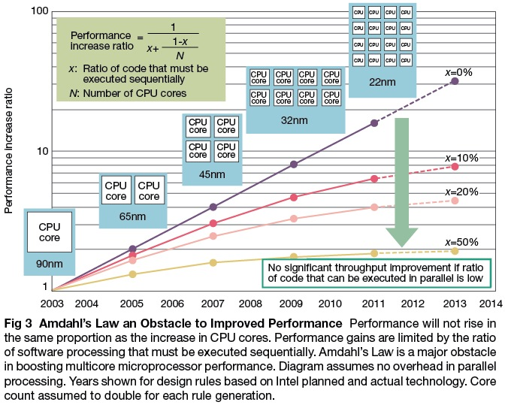

Slide 16
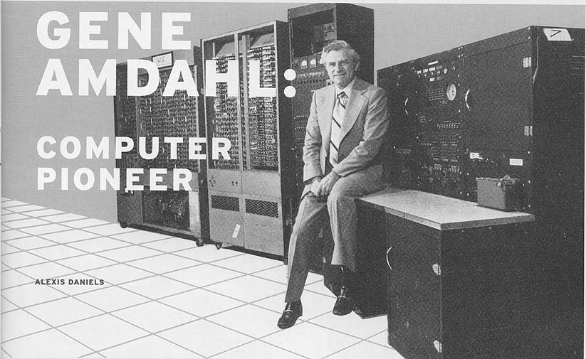

Slide 17
Great Idea #6:
Dependability via Redundancy
Redundancy so that a failing piece doesn’t make the whole system fail
1+1=2
2 of 3 agree
1+1=2
1+1=2
1+1=1
FAIL!
Increasing transistor density reduces the cost of redundancy

Slide 18
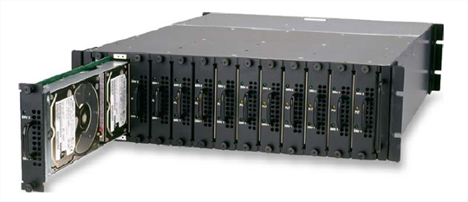
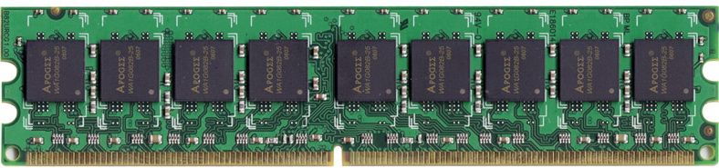
Great Idea #6:
Dependability via Redundancy
Applies to everything from datacenters to storage to memory
  Redundant datacenters so that can lose 1 datacenter but Internet service stays online
  Redundant disks so that can lose 1 disk but not lose data (Redundant Arrays of Independent Disks/RAID)
  Redundant memory bits of so that can lose 1 bit but no data (Error Correcting Code/ECC Memory)

Slide 19
Question: Which statement is TRUE about Big Ideas in Computer Architecture?
☐
To offer a dependable system, you must use components that almost never fail
☐
Memory hierarchy goal: look ≈as fast as most expensive memory, ≈ as big as cheapest
☐
Moore’s Law means computers get twice as fast every ≈ 1.5 years
☐
The goal of levels of interpretation is to build the most efficient hardware and software
Notes:
VertLeftWhiteCheck1

Slide 20
Agenda
Great Ideas in Computer Architecture
Administrivia
PostPC Era: From Phones to Datacenters
Software as a Service
Cloud Computing
Technology Break
Warehouse Scale Computers in Depth

Slide 21
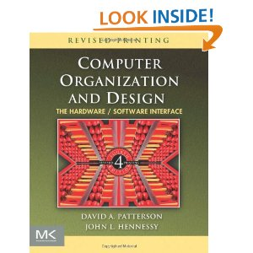
Course Information
Course Web: http://inst.eecs.Berkeley.edu/~cs61c/sp12sp
Instructor:
  Dave Patterson
Teaching Assistants:
  Rimas Avizienis, Scott Beamer, Alan Christopher,
  Eric Liang, Paul Ruan, Ian Vonseggern
Textbooks: Average 15 pages of reading/week
  Barroso & Holzle, The Datacenter as a Computer
  (free download from web page)
  Patterson & Hennessey, Computer Organization and Design,
  Revised 4th Edition (not ≤3rd Edition, not Asian 4th edition)
  Kernighan & Ritchie, The C Programming Language, 2nd Edition
Piazza for class announcements, Q&A:
  Just go to Piazza web page and add yourself to the class
  Staff reads them all; please keep it class related and professional

Slide 22
Reminders
Discussions and labs will be held this week
  Switching Sections: if you find another 61C student willing to swap discussion AND lab, talk to your TAs
  Partner (projects 1, 3, and extra credit):
  OK if partners mix sections but have same TA
First homework assignment due this Sunday January 22rd by 11:59:59 PM
  There is reading assignment as well on course page

Slide 23
Course Organization
Grading
  Participation and Altruism (5%)
  Homework (5%)
  Labs (20%)
  Projects (40%)
    Data Parallelism (Map-Reduce on Amazon EC2, with partner)
    Computer Instruction Set Simulator (C)
    Performance Tuning of a Parallel Application/Matrix Multiply using cache blocking, SIMD, MIMD (OpenMP, with partner)
    Computer Processor Design (Logisim)
  Extra Credit: Matrix Multiply Competition, anything goes
  Midterm (10%): 6-9 PM Tuesday March 6, 155 Dwinelle
  Final (20%): 11:30-2:30 PM Wednesday May 9

Slide 24
EECS Grading Policy
http://www.eecs.berkeley.edu/Policies/ugrad.grading.shtml
“A typical GPA for courses in the lower division is 2.7. This GPA would result, for example, from 17% A's, 50% B's, 20% C's, 10% D's, and 3% F's. A class whose GPA falls outside the range 2.5 - 2.9 should be considered atypical.”
Spring 2011: GPA 2.85
24% A's, 49% B's, 18% C's,
6% D's, 3% F's
Job/Intern Interviews: They grill
you with technical questions, so
it’s what you say, not your GPA
(New 61c gives good stuff to say)
 | Fall | Spring
2011 | 2.72 | 2.85
2010 | 2.81 | 2.81
2009 | 2.71 | 2.81
2008 | 2.95 | 2.74
2007 | 2.67 | 2.76

Slide 25
Late Policy
Assignments due Sundays at 11:59:59 PM
Late homeworks not accepted (100% penalty)
Late projects get 20% penalty, accepted up to Tuesdays at 11:59:59 PM
  No credit if more than 48 hours late
  No “slip days” in 61C
    Used by Dan Garcia and a few faculty to cope with 100s of students who often procrastinate without having to hear the excuses, but not widespread in EECS courses
    More late assignments if everyone has no-cost options; better to learn now how to cope with real deadlines

Slide 26
Policy on Assignments and Independent Work
With the exception of laboratories and assignments that explicitly permit you to work in groups, all homeworks and projects are to be YOUR work and your work ALONE.
You are encouraged to discuss your assignments with other students, and extra credit will be assigned to students who help others, particularly by answering questions on the Google Group, but we expect that what you hand is yours.
It is NOT acceptable to copy solutions from other students.
It is NOT acceptable to copy (or start your) solutions from the Web.
We have tools and methods, developed over many years, for detecting this. You WILL be caught, and the penalties WILL be severe.
At the minimum a ZERO for the assignment, possibly an F in the course, and a letter to your university record documenting the incidence of cheating.
(We caught people last time taught 61C!)

Slide 27
YOUR BRAIN ON COMPUTERS; Hooked on Gadgets, and Paying a Mental Price
NY Times, June 7, 2010, by Matt Richtel
SAN FRANCISCO -- When one of the most important e-mail messages of his life landed in his in-box a few years ago, Kord Campbell overlooked it.
Not just for a day or two, but 12 days. He finally saw it while sifting through old messages: a big company wanted to buy his Internet start-up.
''I stood up from my desk and said, 'Oh my God, oh my God, oh my God,' '' Mr. Campbell said. ''It's kind of hard to miss an e-mail like that, but I did.''
The message had slipped by him amid an electronic flood: two computer screens alive with e-mail, instant messages, online chats, a Web browser and the computer code he was writing.
While he managed to salvage the $1.3 million deal after apologizing to his suitor, Mr. Campbell continues to struggle with the effects of the deluge of data. Even after he unplugs, he craves the stimulation he gets from his electronic gadgets. He forgets things like dinner plans, and he has trouble focusing on his family. His wife, Brenda, complains, ''It seems like he can no longer be fully in the moment.''
This is your brain on computers.
Scientists say juggling e-mail, phone calls and other incoming information can change how people think and behave. They say our ability to focus is being undermined by bursts of information.
These play to a primitive impulse to respond to immediate opportunities and threats. The stimulation provokes excitement -- a dopamine squirt -- that researchers say can be addictive. In its absence, people feel bored.
The resulting distractions can have deadly consequences, as when cellphone-wielding drivers and train engineers cause wrecks. And for millions of people like Mr. Campbell, these urges can inflict nicks and cuts on creativity and deep thought, interrupting work and family life.
While many people say multitasking makes them more productive, research shows otherwise. Heavy multitaskers actually have more trouble focusing and shutting out irrelevant information, scientists say, and they experience more stress.
And scientists are discovering that even after the multitasking ends, fractured thinking and lack of focus persist. In other words, this is also your brain off computers.

Slide 28
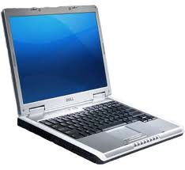
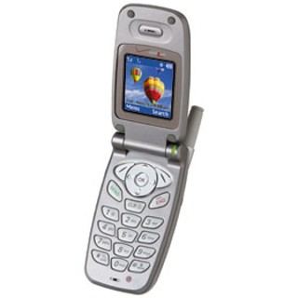
The Rules
(and we really mean it!)

Slide 29
Architecture of a Lecture
Full
Administrivia
Tech
break
“And in
conclusion…”
Attention
0
20
25
50
53
78
80
Time (minutes)

Slide 30
Architecture of a Lecture
Full
Administrivia
Tech
break
“And in
conclusion…”
Attention
0
20
25
50
53
78
80
Time (minutes)

Slide 31


Peer Instruction
Increase real-time learning in lecture, test understanding of concepts vs. details
mazur-www.harvard.edu/education/pi.phtml
As complete a “segment”
ask multiple choice question
  <1 minute: decide yourself, vote
  <2 minutes: discuss in pairs,
  then team vote; flash card to pick answer
    Try to convince partner; learn by teaching
Mark and save flash cards
(get in discussion section)
1
2
3
4

Slide 32
Question: Which statements are TRUE about this class?
☐
The midterm is Tuesday March 6 during class (9:30-11)
☐
The midterm is Tuesday March 6 in the evening (6-9PM) in 155 Dwinelle
☐
It’s OK to book airline tickets before May 9; Patterson will surely let me take final early
☐
I can save money by buying Asian edition of Computer Organization and Design
Notes:
VertLeftWhiteCheck1

Slide 33
Agenda
Great Ideas in Computer Architecture
Administrivia
PostPC Era: From Phones to Datacenters
Software as a Service
Cloud Computing
Technology Break
Warehouse Scale Computers in Depth

Slide 34
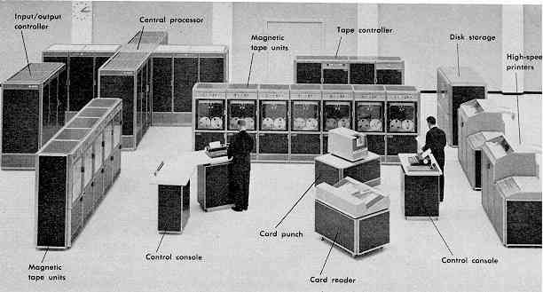
Computer Eras: Mainframe 1950s-60s
Processor (CPU)
I/O
  “Big Iron”: IBM, UNIVAC, … build $1M computers
  for businesses => COBOL, Fortran, timesharing OS

Slide 35
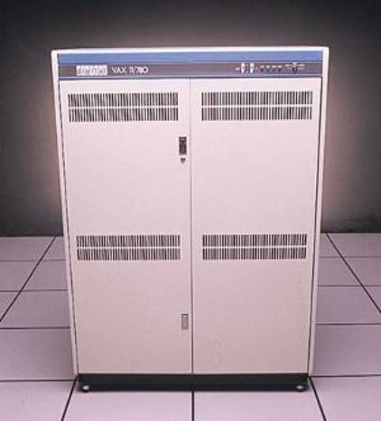
Minicomputer Eras: 1970s
  Using integrated circuits, Digital, HP… build $10k computers for labs, universities => C, UNIX OS

Slide 36
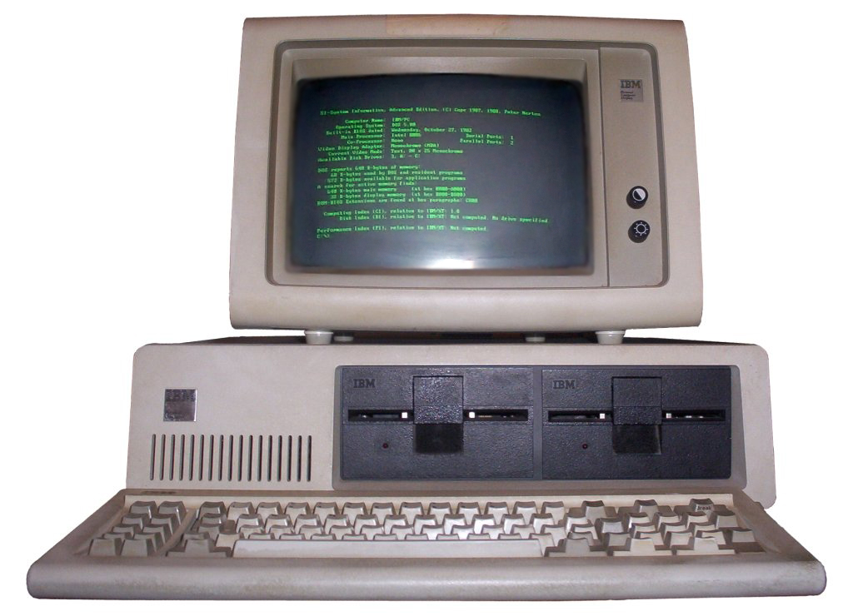
PC Era: Mid 1980s - Mid 2000s
  Using microprocessors, Apple, IBM, … build $1k computer for 1 person => Basic, Java, Windows OS

Slide 37
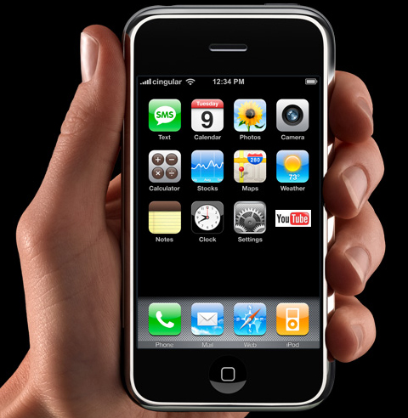
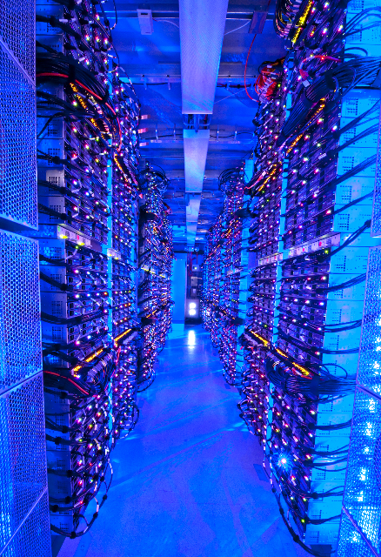
PostPC Era: Late 2000s - ??
  Personal Mobile Devices (PMD): Relying on wireless networking, Apple, Nokia, … build $500 smartphone and tablet computers for individuals
  => Objective C, Android OS
  Cloud Computing:
  Using Local Area Networks, Amazon, Google, … build $200M Warehouse Scale Computers
  with 100,000 servers for
  Internet Services for PMDs
  => MapReduce, Ruby on Rails

Slide 38
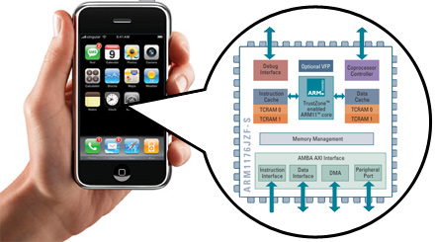
Advanced RISC Machine (ARM) instruction set inside the iPhone
You will how to design and program a related RISC computer: MIPS

Slide 39
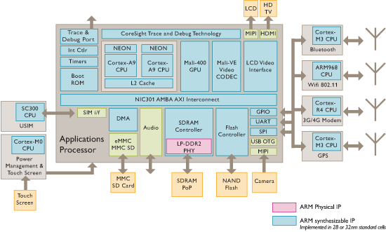
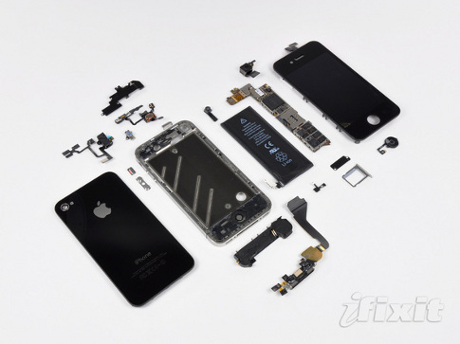
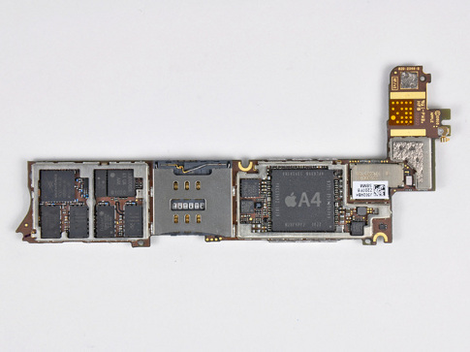
iPhone Innards
I/O
Processor
1 GHz ARM Cortex A8
I/O
I/O
Memory
You will about multiple processors, data level parallelism, caches in 61C

Slide 40
Why Not 80x86 vs. MIPS?
Once learn one, easy to pick up others
80x86 instruction set is not beautiful
  ≈ Full suitcase then add clothes on way to plane
  Class time precious; why spend on minutiae?
MIPS represents energy efficient processor of client (PostPC era) vs. fast processor of desktop (PC era)
MIPS represents more popular instruction set:
  2010: 6.1B ARM, 0.3B 80x86 (20X more)

Slide 41
Agenda
Great Ideas in Computer Architecture
Administrivia
PostPC Era: From Phones to Datacenters
Software as a Service
Cloud Computing
Technology Break
Warehouse Scale Computers in Depth

Slide 42
Software as a Service: SaaS
Traditional SW: binary code installed and runs wholly on client device
SaaS delivers SW & data as service over Internet via thin program (e.g., browser) running on client device
  Search, social networking, video
Now also SaaS version of traditional SW
  E.g., Microsoft Office 365, TurboTax Online

Slide 43
6 Reasons for SaaS
No install worries about HW capability, OS
No worries about data loss (at remote site)
Easy for groups to interact with same data
If data is large or changed frequently, simpler to keep 1 copy at central site
1 copy of SW, controlled HW environment => no compatibility hassles for developers
1 copy => simplifies upgrades for developers and no user upgrade requests

Slide 44
SaaS Infrastructure?
SaaS demands on infrastructure
Communication: allow customers to interact with service
Scalability: fluctuations in demand during + new services to add users rapidly
Dependability: service and communication continuously available 24x7

Slide 45
Clusters
Clusters: Commodity computers connected by commodity Ethernet switches
More scalable than conventional servers
Much cheaper than conventional servers
  20X for equivalent vs. largest servers
Few operators for 1000s servers
  Careful selection of identical HW/SW
  Virtual Machine Monitors simplify operation
Dependability via extensive redundancy

Slide 46
Agenda
Great Ideas in Computer Architecture
Administrivia
PostPC Era: From Phones to Datacenters
Software as a Service
Cloud Computing
Technology Break
Warehouse Scale Computers in Depth

Slide 47
Warehouse Scale Computers
Economies of scale pushed down cost of largest datacenter by factors 3X to 8X
  Purchase, house, operate 100K v. 1K computers
Traditional datacenters utilized 10% - 20%
Make profit offering pay-as-you-go use at less than your costs for as many computers as you need

Slide 48
Utility Computing /
Public Cloud Computing
Offers computing, storage, communication at pennies per hour
No premium to scale:
  1000 computers @ 1 hour
  = 1 computer @ 1000 hours
Illusion of infinite scalability to cloud user
  As many computers as you can afford
Leading examples: Amazon Web Services, Google App Engine, Microsoft Azure

Slide 49
2012 AWS Instances & Prices
Instance | Per Hour | Ratio to Small | Compute Units | Virtual Cores | Compute Unit/ Core | Memory (GB) | Disk (GB) | Address
Standard Small | $0.085 | 1.0 | 1.0 | 1 | 1.00 | 1.7 | 160 | 32 bit
Standard Large | $0.340 | 4.0 | 4.0 | 2 | 2.00 | 7.5 | 850 | 64 bit
Standard Extra Large | $0.680 | 8.0 | 8.0 | 4 | 2.00 | 15.0 | 1690 | 64 bit
High-Memory Extra Large | $0.500 | 5.9 | 6.5 | 2 | 3.25 | 17.1 | 420 | 64 bit
High-Memory Double Extra Large | $1.200 | 14.1 | 13.0 | 4 | 3.25 | 34.2 | 850 | 64 bit
High-Memory Quadruple Extra Large | $2.400 | 28.2 | 26.0 | 8 | 3.25 | 68.4 | 1690 | 64 bit
High-CPU Medium | $0.170 | 2.0 | 5.0 | 2 | 2.50 | 1.7 | 350 | 32 bit
High-CPU Extra Large | $0.680 | 8.0 | 20.0 | 8 | 2.50 | 7.0 | 1690 | 64 bit
Cluster Quadruple Extra Large | $1.300 | 15.3 | 33.5 | 16 | 2.09 | 23.0 | 1690 | 64 bit
Eight Extra Large | $2.400 | 28.2 | 88.0 | 32 | 2.75 | 60.5 | 1690 | 64 bit

Slide 50
Supercomputer for hire
Top 500 supercomputer competition
290 Eight Extra Large (@ $2.40/hour)
= 240 TeraFLOPS
42nd/500 supercomputer @ ~$700 per hour
Credit card => can use 1000s computers
FarmVille on AWS
  Prior biggest online game 5M users
  What if startup had to build datacenter? How big?
  4 days =1M; 2 months = 10M; 9 months = 75M
Notes:
CC2 = Cluster Compute Eight Extra Large

Slide 51
IBM Watson for Hire?
Jeopardy Champion IBM Watson
Hardware: 90 IBM Power 750 servers
  3.5 GHz 8 cores/server
90 @ ~$2.40/hour = ~$200/hour
Cost of human lawyer or account
For what tasks could AI be as good as highly trained person @ $200/hour?
What would this mean for society?

Slide 52
Which statements are NOT true about SaaS and Cloud Computing?
☐
Clusters are collections of commodity servers connected by LAN switches
☐
The Internet supplies the communication for SaaS
☐
Cloud computing uses HW clusters + SW layer using redundancy for dependability
☐
Private datacenters could match cost of Warehouse Scale Computers if they just purchased the same type of hardware
Notes:
VertLeftWhiteCheck1
Private datacenters cannot match cost of Warehouse Scale Computers even if they just purchased the same type of hardware, since they don’t get the economies of scale at 1000 vs 100,000 in purchasing, housing, operators

Slide 53
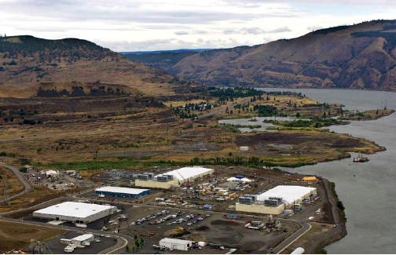
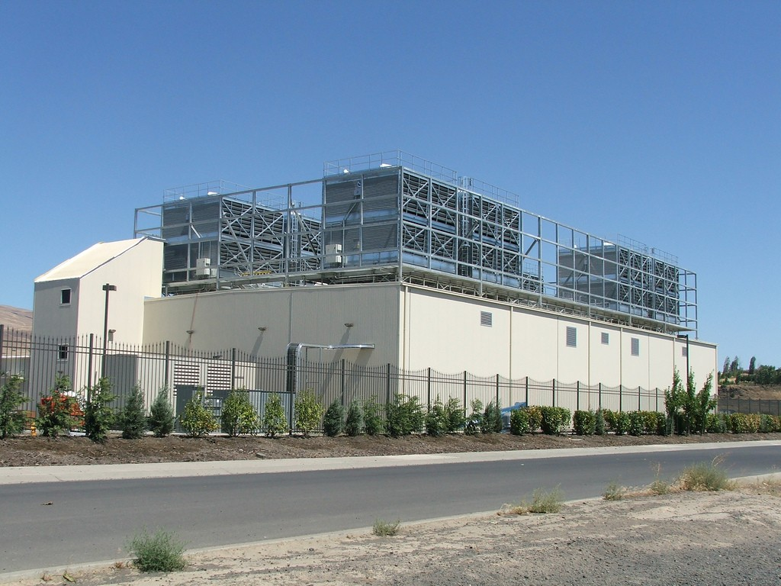
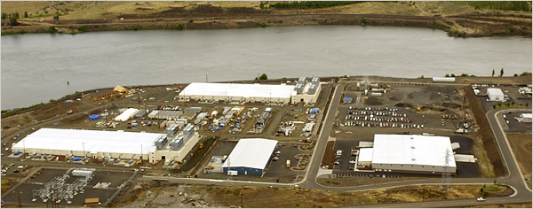
E.g., Google’s Oregon WSC

Slide 54
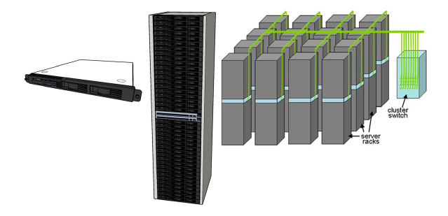
Equipment Inside a WSC
Server (in rack format):
1 ¾ inches high “1U”,
x 19 inches x 16-20 inches: 8 cores, 16 GB DRAM, 4x1 TB disk
Array (aka cluster):
16-32 server racks + larger local area network switch (“array switch”) 10X faster => cost 100X: cost f(N²)
7 foot Rack: 40-80 servers + Ethernet local area network (1-10 Gbps) switch in middle (“rack switch”)

Slide 55
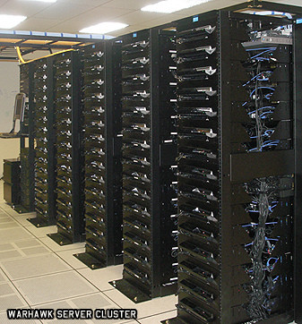
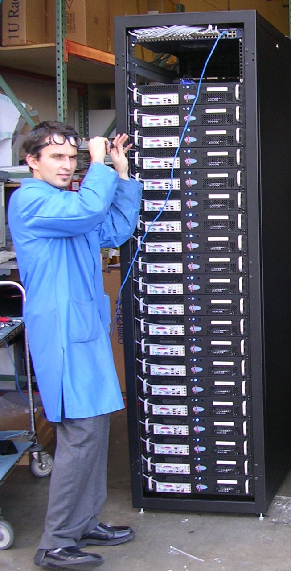
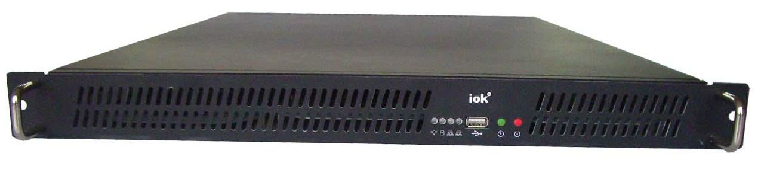
Server, Rack, Array

Slide 56
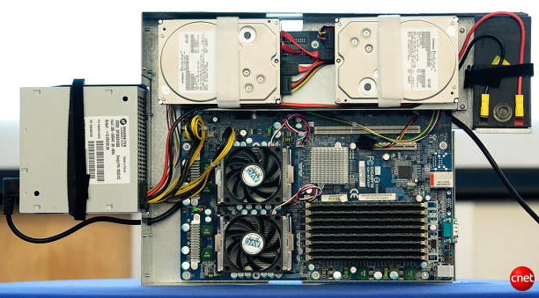
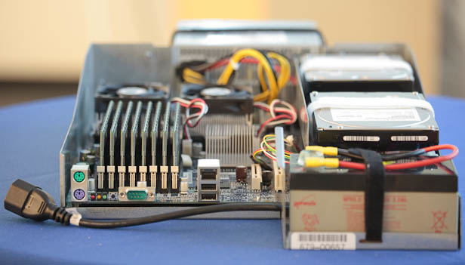
Google Server Internals
Google Server
Notes:
Most companies buy servers from the likes of Dell, Hewlett-Packard, IBM, or Sun Microsystems. But Google, which has hundreds of thousands of servers and considers running them part of its core expertise, designs and builds its own. Ben Jai, who designed many of Google's servers, unveiled a modern Google server before the hungry eyes of a technically sophisticated audience.
Google's big surprise: each server has its own 12-volt battery to supply power if there's a problem with the main source of electricity. The company also revealed for the first time that since 2005, its data centers have been composed of standard shipping containers--each with 1,160 servers and a power consumption that can reach 250 kilowatts.
It may sound geeky, but a number of attendees--the kind of folks who run data centers packed with thousands of servers for a living--were surprised not only by Google's built-in battery approach, but by the fact that the company has kept it secret for years. Jai said in an interview that Google has been using the design since 2005 and now is in its sixth or seventh generation of design.
Read more: http://news.cnet.com/8301-1001_3-10209580-92.html#ixzz0yo8bhTOH

Slide 57
Coping with Performance in Array
Lower latency to DRAM in another server than local disk
Higher bandwidth to local disk than to DRAM in another server
 | Local | Rack | Array
Racks | -- | 1 | 30
Servers | 1 | 80 | 2400
Cores (Processors) | 8 | 640 | 19,200
DRAM Capacity (GB) | 16 | 1,280 | 38,400
Disk Capacity (GB) | 4,000 | 320,000 | 9,600,000
DRAM Latency (microseconds) | 0.1 | 100 | 300
Disk Latency (microseconds) | 10,000 | 11,000 | 12,000
DRAM Bandwidth (MB/sec) | 20,000 | 100 | 10
Disk Bandwidth (MB/sec) | 200 | 100 | 10

Slide 58
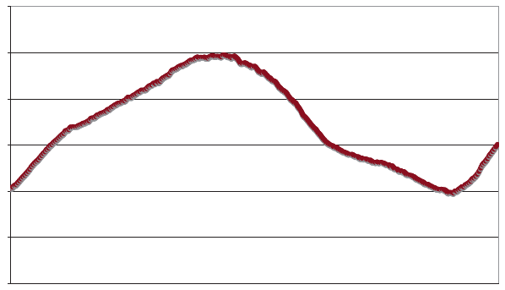
Coping with Workload Variation
Workload
2X
Midnight
Noon
Midnight
Online service: Peak usage 2X off-peak

Slide 59
Impact of latency, bandwidth, failure, varying workload on WSC software?
WSC Software must take care where it places data within an array to get good performance
WSC Software must cope with failures gracefully
WSC Software must scale up and down gracefully in response to varying demand
More elaborate hierarchy of memories, failure tolerance, workload accommodation makes
WSC software development more challenging than software for single computer

Slide 60
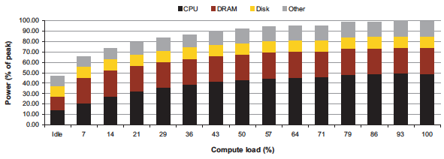
Power vs. Server Utilization
Server power usage as load varies idle to 100%
Uses ½ peak power when idle!
Uses ⅔ peak power when 10% utilized! 90%@ 50%!
Most servers in WSC utilized 10% to 50%
Goal should be Energy-Proportionality:
% peak load = % peak energy

Slide 61
Power Usage Effectiveness
Overall WSC Energy Efficiency: amount of computational work performed divided by the total energy used in the process
Power Usage Effectiveness (PUE):
Total building power / IT equipment power
  An power efficiency measure for WSC, not including efficiency of servers, networking gear
  1.0 = perfection

Slide 62
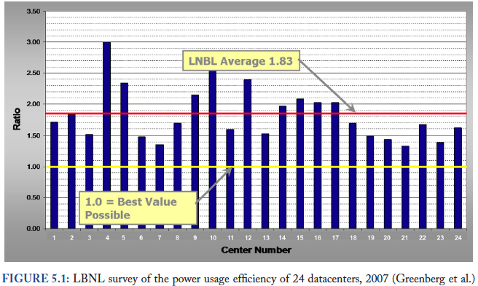
PUE in the Wild (2007)

Slide 63
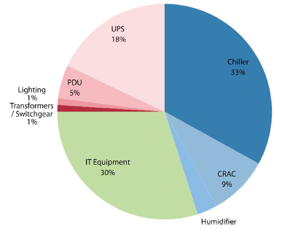
High PUE: Where Does Power Go?
Uninterruptable
Power Supply
(battery)
Chiller cools warm
water from Air
Conditioner
Power
Distribution
Unit
Computer
Room
Air
Conditioner
Servers +
Networking

Slide 64
Servers and Networking Power Only
Peak
Power %

Slide 65
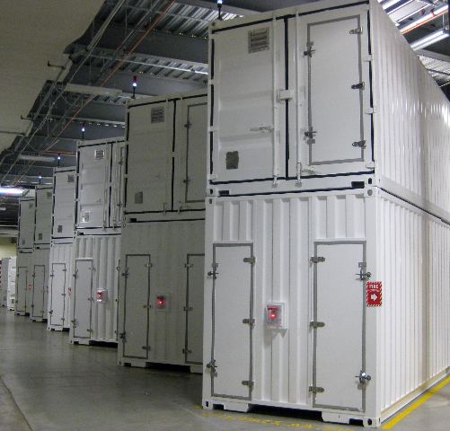
Containers in WSCs
Inside WSC
Inside Container

Slide 66
Google WSC A PUE: 1.24
Careful air flow handling
Don’t mix server hot air exhaust with cold air (separate warm aisle from cold aisle)
Elevated cold aisle temperatures
81°F instead of traditional 65°- 68°F
Measure vs. estimate PUE, publish PUE, and improve operation
Note – subject of marketing
  Average on a good day with artificial load
  (Facebook’s 1.07) or real load for quarter (Google)

Slide 67
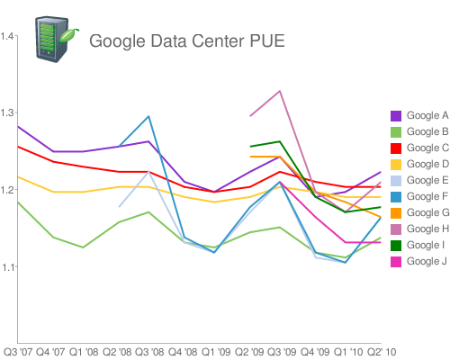
Google WSC PUE: Quarterly Avg
PUE
www.google.com/corporate/green/datacenters/measuring.htm

Slide 68
Which statements are NOT true about Warehouse Scale Computing?
☐
Servers, IT equipment represent less than half of WSC power budget
☐
The Internet supplies the communication for SaaS
☐
Power Usage Effectiveness (PUE) also measures efficiency of the individual servers
☐
The goal of energy proportionality is energy usage should track equipment utilization
Notes:
VertLeftWhiteCheck1
Private datacenters cannot match cost of Warehouse Scale Computers even if they just purchased the same type of hardware, since they don’t get the economies of scale at 1000 vs 100,000 in purchasing, housing, operators

Slide 69
Summary
CS61c: Learn 6 great ideas in computer architecture to enable high performance programming via parallelism, not just learn C
  Layers of Representation/Interpretation
  Moore’s Law
  Principle of Locality/Memory Hierarchy
  Parallelism
  Performance Measurement and Improvement
  Dependability via Redundancy
Post PC Era: Parallel processing, smart phone to WSC
WSC SW must cope with failures, varying load, varying HW latency bandwidth
WSC HW sensitive to cost, energy efficiency

