Slide 1
CS 61C: Great Ideas in Computer Architecture (Machine Structures) Introduction to Machine Language
TA: Scott Beamer
http://inst.eecs.Berkeley.edu/~cs61c/sp12

Slide 2
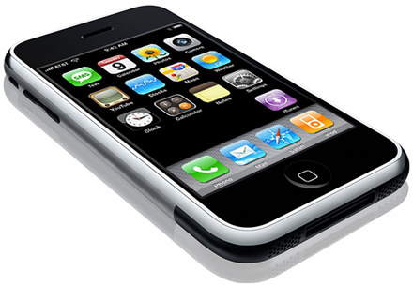
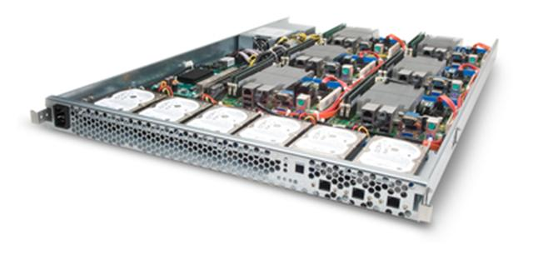
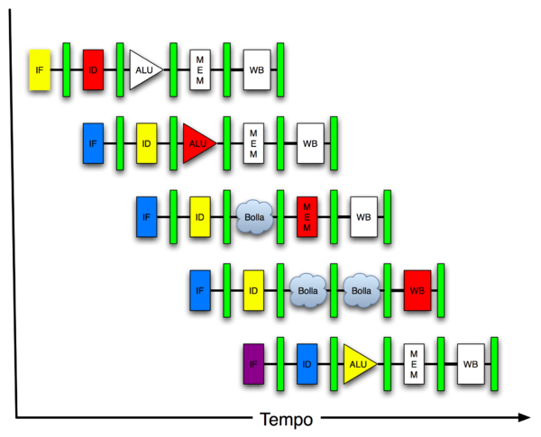
New-School Machine Structures (It’s a bit more complicated!)
Software Hardware
Parallel Requests
Assigned to computer
e.g., Search “Katz”
Parallel Threads
Assigned to core
e.g., Lookup, Ads
Parallel Instructions
>1 instruction @ one time
e.g., 5 pipelined instructions
Parallel Data
>1 data item @ one time
e.g., Add of 4 pairs of words
Hardware descriptions
All gates @ one time
Programming Languages
Warehouse Scale Computer
Smart Phone
Harness Parallelism &
Achieve High Performance
Computer
Core
…
Core
Memory (Cache)
Input/Output
Core
Instruction Unit(s)
Functional
Unit(s)
A₀+B₀
A₁+B₁
A₂+B₂
A₃+B₃
Cache Memory
Today’s Lecture
Logic Gates

Slide 3
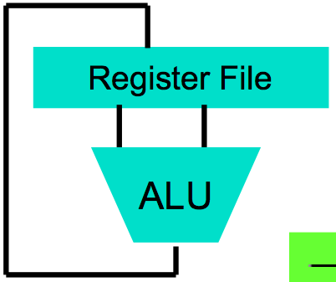
Levels of Representation/Interpretation
High Level Language Program (e.g., C)
temp = v[k];
v[k] = v[k+1];
v[k+1] = temp;
Compiler
Anything can be represented as a number, i.e., data or instructions
lw $t0, 0($2)
lw $t1, 4($2)
sw $t1, 0($2)
sw $t0, 4($2)
Assembly Language Program (e.g., MIPS)
Assembler
0000 1001 1100 0110 1010 1111 0101 1000
1010 1111 0101 1000 0000 1001 1100 0110
1100 0110 1010 1111 0101 1000 0000 1001
0101 1000 0000 1001 1100 0110 1010 1111
Machine Language Program (MIPS)
Machine Interpretation
Hardware Architecture Description (e.g., block diagrams)
Architecture Implementation
Logic Circuit Description (Circuit Schematic Diagrams)

Slide 4
Agenda
Machine Language
Administrivia
Operands
Technology Break
Decisions
Summary

Slide 5
Agenda
Machine Language
Administrivia
Operands
Technology Break
Decisions
Summary

Slide 6
The Language a Computer Understands
Word a computer understands: instruction
Vocabulary of all words a computer understands: instruction set (aka instruction set architecture or ISA)
Different computers may have different vocabularies (i.e., different ISAs)
iPhone not same as Macbook
Or the same vocabulary (i.e., same ISA)
iPhone and iPad computers have same instruction set

Slide 7
The Language a Computer Understands
Why not all the same? Why not all different? What might be pros and cons?

Slide 8
The Language a Computer Understands
Why not all the same? Why not all different? What might be pros and cons?
Single ISA (to rule them all):
Leverage common compilers, operating systems, etc.
BUT fairly easy to retarget these for different ISAs (e.g., Linux, gcc)
Multiple ISAs:
Specialized instructions for specialized applications
Different tradeoffs in resources used (e.g., functionality, memory demands, complexity, power consumption, etc.)
Competition and innovation is good, especially in emerging environments (e.g., mobile devices)

Slide 9
Instruction Set in CS 61C
MIPS
Invented by John Hennessy @ Stanford
(Why not Berkeley/Sun RISC invented by Dave Patterson? Ask him!)
MIPS is a real world ISA
Standard instruction set for networking equipment
Elegant example of Reduced Instruction Set Computer (RISC) instruction set

Slide 10
RISC Design Principles
Basic RISC principle: “A simpler CPU (the hardware that interprets machine language) is a faster CPU” (CPU → Core)
Focus of the RISC design is reduction of the number and complexity of instructions in the ISA
A number of the more common strategies include:
Fixed instruction length, generally a single word; Simplifies process of fetching instructions from memory
Simplified addressing modes; Simplifies process of fetching operands from memory
Fewer and simpler instructions in the instruction set; Simplifies process of executing instructions
Only load and store instructions access memory; E.g., no add memory to register, add memory to memory, etc.
Let the compiler do it. Use a good compiler to break complex high-level language statements into a number of simple assembly language statements

Slide 11
Mainstream ISAs
ARM (Advanced RISC Machine) is most popular RISC
In every smart phone-like device (e.g., iPhone, iPad, iPod, …)
Intel 80x86 is another popular ISA and is used in Macbook and PCs in Core i3, Core i5, Core i7, …
20x ARM as 80x86 (i.e., 5 billion vs. 0.3 billion)

Slide 12
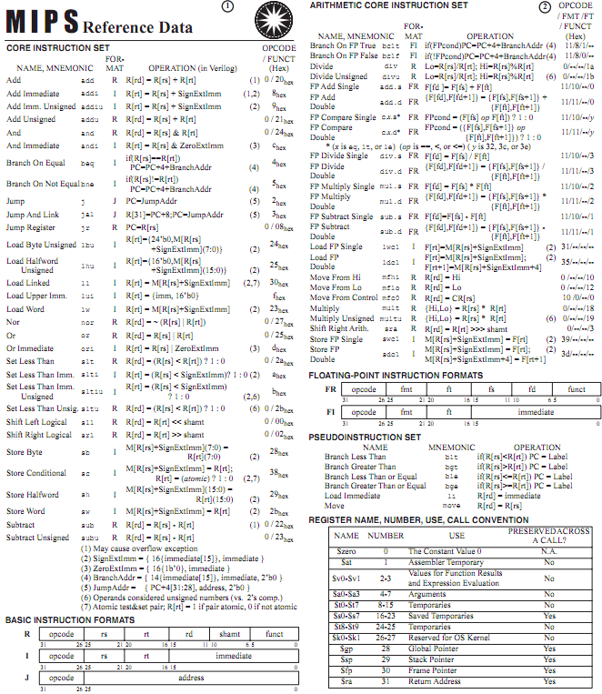
MIPS Green Card

Slide 13
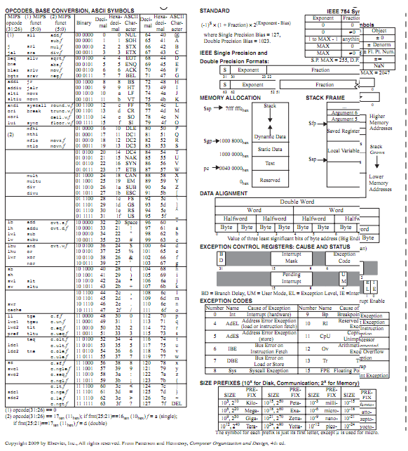
MIPS Green Card

Slide 14
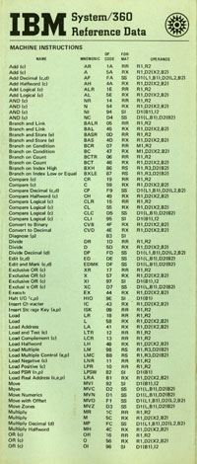
Inspired by the IBM 360 “Green Card”

Slide 15
MIPS Instructions
Every computer does arithmetic
Instruct a computer to do addition:
add a, b, c
Add b to c and put sum into a
3 operands: 2 sources + 1 destination for sum
One operation per MIPS instruction
How do you write the same operation in C?

Slide 16
Guess More MIPS instructions
Subtract c from b and put difference in a?
Multiply b by c and put product in a?
Divide b by c and put quotient in a?

Slide 17
Guess More MIPS instructions
Subtract c from b and put difference in a?
sub a, b, c
Multiply b by c and put product in a?
mul a, b, c
Divide b by c and put quotient in a? div a, b, c

Slide 18
Guess More MIPS instructions
Subtract c from b and put difference in a?
sub a, b, c
Multiply b by c and put product in a?
mul a, b, c
Divide b by c and put quotient in a? div a, b, c

Slide 19
Guess More MIPS instructions
C operator &: c & b with result in a?
C operator |: c | b with result in a?
C operator <<: c << b with result in a?
C operator >>: c >> b with result in a?

Slide 20
Guess More MIPS instructions
C operator &: c & b with result in a?
and a, b, c
C operator |: c | b with result in a?
or a, b, c
C operator <<: b << c with result in a?
sll a, b, c
C operator >>: b >> c with result in a? srl a, b, c

Slide 21
Guess More MIPS instructions
C operator &: c & b with result in a?
and a, b, c
C operator |: c | b with result in a?
or a, b, c
C operator <<: b << c with result in a?
sll a, b, c
C operator >>: b >> c with result in a? srl a, b, c

Slide 22
Example Instructions
How write this C expression in MIPS?
a = b + c + d + e
add t1, d, e
add t2, c, t1
add a, b, t2

Slide 23
Example Instructions
MIPS instructions are inflexible, rigid:
Just one arithmetic operation per instruction
Always with three operands
How write this C expression in MIPS?
a = b + c + d + e
add t1, d, e
add t2, c, t1
add a, b, t2

Slide 24
Example Instructions
MIPS instructions are inflexible, rigid:
Just one arithmetic operation per instruction
Always with three operands
How write this C expression in MIPS?
a = b + c + d + e
add t1, d, e
add t2, c, t1
add a, b, t2

Slide 25
Comments in MIPS
Can add comments to MIPS instruction by putting # that continues to end of line of text
add a, b, c # b + c is placed in a
add a, a, d # b + c + d is now in a
add a, a, e # b + c + d + e is in a
Are extremely useful!

Slide 26
C to MIPS
Operators almost identical
What is MIPS code that performs same as?
a = b + c;
d = a – e;
What is MIPS code that performs same as?
f = (g + h) – (i + j);
Notes:
add a, b, c
sub d, a, e
add t0,g,h # temporary variable t0 contains g + h
# Although the next operation is subtract, we need to calculate the sum of i and j before we can subtract.
add t1,i,j # temporary variable t1 contains i + j
# Thus, the second instruction places the sum of i and j in another temporary variable created by the compiler, called t1:
code:sub f,t0,t1 # f gets t0 – t1, which is (g + h) – (i + j)
# Finally, the subtract instruction subtracts the second sum from the first and places the difference in the variable f, completing the compiled

Slide 27
C to MIPS
What is MIPS code that performs same as?
a = b + c; add a, b, c
d = a – e; sub d, a, e
What is MIPS code that performs same as?
f = (g + h) – (i + j);
add t1, i, j
add t2, g, h
sub f, t2, t1
Notes:
add a, b, c
sub d, a, e
add t0,g,h # temporary variable t0 contains g + h
# Although the next operation is subtract, we need to calculate the sum of i and j before we can subtract.
add t1,i,j # temporary variable t1 contains i + j
# Thus, the second instruction places the sum of i and j in another temporary variable created by the compiler, called t1:
code:sub f,t0,t1 # f gets t0 – t1, which is (g + h) – (i + j)
# Finally, the subtract instruction subtracts the second sum from the first and places the difference in the variable f, completing the compiled

Slide 28
C to MIPS
What is MIPS code that performs same as?
a = b + c; add a, b, c
d = a – e; sub d, a, e
What is MIPS code that performs same as?
f = (g + h) – (i + j);
add t1, i, j
add t2, g, h
sub f, t2, t1
Notes:
add a, b, c
sub d, a, e
add t0,g,h # temporary variable t0 contains g + h
# Although the next operation is subtract, we need to calculate the sum of i and j before we can subtract.
add t1,i,j # temporary variable t1 contains i + j
# Thus, the second instruction places the sum of i and j in another temporary variable created by the compiler, called t1:
code:sub f,t0,t1 # f gets t0 – t1, which is (g + h) – (i + j)
# Finally, the subtract instruction subtracts the second sum from the first and places the difference in the variable f, completing the compiled

Slide 29
For a given function, which programming language likely takes the most lines of code? (most to least)
☐
Scheme, MIPS, C
☐
C, Scheme, MIPS
☐
MIPS, Scheme, C
☐
MIPS, C, Scheme
Notes:
VertLeftWhiteCheck1
B: Print 4 …because ints in this system are 4-bytes long and the actual address increments by 4 even though it appears to only incrememt 1.

Slide 30
Agenda
Machine Language
Administrivia
Operands
Technology Break
Decisions
Summary

Slide 31
Administrivia
This week in lab and homework:
Project #1 posted
Note: intermediate checkpoint due Sunday
Find a partner (optional), tell TA who in section
HW #3 Posted (due a week from Sunday)
Lab #3 EC2 to be posted soon
TAs say it is more doable than last week

Slide 32
Agenda
Machine Language
Administrivia
Operands
Technology Break
Decisions
Summary

Slide 33
Computer Hardware Operands
High-Level Programming languages: could have millions of variables
Instruction sets have fixed, smaller number
Called registers
“Bricks” of computer hardware
Fastest way to store data in computer hardware
Visible to (the “assembly language”) programmer
MIPS Instruction Set has 32 registers

Slide 34
Why Just 32 Registers?
RISC Design Principle: Smaller is faster
But you can be too small …
Hardware would likely be slower with 64, 128, or 256 registers
32 is enough for compiler to translate typical C programs, and not run out of registers very often
ARM instruction set has only 16 registers
May be faster, but compiler may run out of registers too often (aka “spilling registers to memory”)

Slide 35
Names of MIPS Registers
For registers that hold programmer variables:
$s0, $s1, $s2, …
For registers that hold temporary variables:
$t0, $t1, $t2, …
Notes:
add $so, $s1, $s2
add $t0, $s3, $s4
sub $s0, $s0, $t0

Slide 36
Names of MIPS Registers
Suppose variables f, g, h, i, and j are assigned to the registers $s0, $s1, $s2, $s3, and $s4, respectively. What is MIPS for
f = (g + h) – (i + j);
add $t1, $s3, $s4
add $t2, $s1, $s2
sub $s0, $t2, $t1
Notes:
add $so, $s1, $s2
add $t0, $s3, $s4
sub $s0, $s0, $t0
Talk about conventions

Slide 37
Names of MIPS Registers
Suppose variables f, g, h, i, and j are assigned to the registers $s0, $s1, $s2, $s3, and $s4, respectively. What is MIPS for
f = (g + h) – (i + j);
add $t1, $s3, $s4
add $t2, $s1, $s2
sub $s0, $t2, $t1
Notes:
add $so, $s1, $s2
add $t0, $s3, $s4
sub $s0, $s0, $t0
Talk about conventions

Slide 38
Size of Registers
Bit is the atom of Computer Hardware: contains either 0 or 1
True “alphabet” of computer hardware is 0, 1
Will eventually express MIPS instructions as combinations of 0s and 1s (in Machine Language)
MIPS registers are 32 bits wide
MIPS calls this quantity a word
Some computers use 16-bit or 64-bit wide words
E.g., Intel 80x86, MIPS64

Slide 39
Data Structures vs. Simple Variables
In addition to registers, a computer also has memory that holds millions / billions of words
Memory is a single dimension array, starting at 0
To access memory, need an address (like an array index)
But MIPS instructions only operate on registers!
Solution: instructions specialized to transfer words (data) between memory and registers
Called data transfer instructions
…
3
2
1
0

Slide 40
Transfer from Memory to Register
MIPS instruction: Load Word, abbreviated lw
Assume A is an array of 100 words, variables g and h map to registers $s1 and $s2, the starting address/base address of the array A is in $s3
int A[100];
g = h + A[3];
Becomes:
lw $t0,3($s3) # Temp reg $t0 gets A[3]
add $s1,$s2,$t0 # g = h + A[3]

Slide 41
Memory Addresses are in Bytes
Lots of data is smaller than 32 bits, but rarely smaller than 8 bits – works fine if everything is a multiple of 8 bits
8 bit item is called a byte
(1 word = 4 bytes)
Memory addresses are really in bytes, not words
Word addresses are 4 bytes apart
Word address is same as leftmost byte
Addr of lowest byte in word is addr of word
…
…
…
…
…
12
13
14
15
3
8
9
10
11
2
4
5
6
7
1
0
1
2
3
0

Slide 42
Transfer from Memory to Register
MIPS instruction: Load Word, abbreviated lw
Assume A is an array of 100 words, variables g and h map to registers $s1 and $s2, the starting address/base address of the array A is in $s3
g = h + A[3];
Becomes:
lw $t0, 3($s3) # Temp reg $t0 gets A[3]
add $s1,$s2,$t0 # g = h + A[3]
12
Notes:
Re]lace 8 with 32 on lw

Slide 43
Transfer from Register to Memory
MIPS instruction: Store Word, abbreviated sw
Assume A is an array of 100 words, variables g and h map to registers $s1 and $s2, the starting address, or base address, of the array A is in $s3
A[10] = h + A[3];
Turns into
lw $t0,12($s3) # Temp reg $t0 gets A[3]
add $t0,$s2,$t0 # t0 = h + A[3]
# A[10] = h + A[3]
Notes:
Add
sw $t0, 40($s3) # Stores h+A[3] into A[10]

Slide 44
Transfer from Register to Memory
MIPS instruction: Store Word, abbreviated sw
Assume A is an array of 100 words, variables g and h map to registers $s1 and $s2, the starting address, or base address, of the array A is in $s3
A[10] = h + A[3];
Turns into
lw $t0,12($s3) # Temp reg $t0 gets A[3]
add $t0,$s2,$t0 # t0 = h + A[3]
sw $t0,40($s3) # A[10] = h + A[3]
Notes:
Add
sw $t0, 40($s3) # Stores h+A[3] into A[10]

Slide 45
Speed of Registers vs. Memory
Given that
Registers: 32 words (128 Bytes)
Memory: Billions of bytes (2 GB to 8 GB on laptop)
and the RISC principle is…
Smaller is faster
How much faster are registers than memory??
About 100-500 times faster!

Slide 46
Which of the following is TRUE?
☐
add $t0,$t1,4($t2) is valid MIPS
☐
Can byte address 8GB with a MIPS word
☐
imm must be a multiple of 4 for
lw $t0,imm($s0) to be valid
☐
If MIPS halved the number of registers
available, it would be twice as fast
Notes:
VertLeftWhiteCheck1
B: Print 4 …because ints in this system are 4-bytes long and the actual address increments by 4 even though it appears to only incrememt 1.

Slide 47
Agenda
Machine Language
Administrivia
Operands
Technology Break
Decisions
Summary

Slide 48
Agenda
Machine Language
Administrivia
Operands
Technology Break
Decisions
Summary

Slide 49
Computer Decision Making
Based on computation, do something different
In programming languages: if-statement
Sometimes combined with gotos and labels
MIPS: if-statement instruction is
beq register1,register2,L1
means go to statement labeled L1 if value in register1 = value in register2
(otherwise, go to next statement)
beq stands for branch if equal
Other instruction: bne for branch if not equal

Slide 50
Example If Statement
Assuming translations below, compile if block
f → $s0 g → $s1 h → $s2
i → $s3 j → $s4
if (i == j) bne $s3,$s4,Exit
f = g + h; add $s0,$s1,$s2
Exit:
May need to negate branch condition

Slide 51
Example If Statement
Assuming translations below, compile if block
f → $s0 g → $s1 h → $s2
i → $s3 j → $s4
if (i == j) bne $s3,$s4,Exit
f = g + h; add $s0,$s1,$s2
Exit:
May need to negate branch condition

Slide 52
Types of Branches
Branch – change of control flow
Conditional Branch – change control flow depending on outcome of comparison
branch if equal (beq) or branch if not equal (bne)
Unconditional Branch – always branch
a MIPS instruction for this: jump (j)

Slide 53
Making Decisions in C or Java
if (i == j)
f = g + h;
else
f = g – h;
If false, skip over “then” part to “else” part => use conditional branch bne
Otherwise, (its true) do “then” part and skip over “else” part => use unconditional branch j

Slide 54
Making Decisions in MIPS
Assuming translations below, compile
f → $s0 g → $s1 h → $s2
i → $s3 j → $s4
if (i == j) bne $s3,$s4,Else
f = g + h; add $s0,$s1,$s2
else j Exit
f = g – h; Else: sub $s0,$s1,$s2
Exit:

Slide 55
Making Decisions in MIPS
Assuming translations below, compile
f → $s0 g → $s1 h → $s2
i → $s3 j → $s4
if (i == j) bne $s3,$s4,Else
f = g + h; add $s0,$s1,$s2
else j Exit
f = g – h; Else: sub $s0,$s1,$s2
Exit:

Slide 56
Which of the following is FALSE?
☐
Can make an unconditional branch from a
conditional branch instruction
☐
Can make a loop with j
☐
Can make a loop with beq
☐
Can always return from a function call with j
Notes:
VertLeftWhiteCheck1
B: Print 4 …because ints in this system are 4-bytes long and the actual address increments by 4 even though it appears to only incrememt 1.

Slide 57
Strings: C vs. Java
Recall: a string is just a long sequence of characters (i.e., array of chars)
C: 8-bit ASCII, define strings with end of string character NUL (0 in ASCII)
Java: 16-bit Unicode, first entry gives length of string

Slide 58
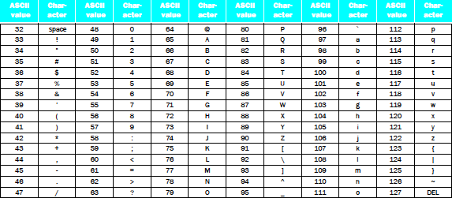
Strings
“Cal” in ASCII in C; How many bytes?
Using 1 integer per byte, what does it look like?
Notes:
Thus, the
string “Cal” is represented in C by the following 4 bytes, shown as decimal numbers:
67, 97, 108, 0.

Slide 59
Strings
“Cal” in ASCII in C; How many bytes?
Using 1 integer per byte, what does it look like?
Notes:
Thus, the
string “Cal” is represented in C by the following 4 bytes, shown as decimal numbers:
67, 97, 108, 0.

Slide 60
Strings
“Cal” in Unicode in Java; How many bytes?
Using 1 integer per byte, what does it look like? (For Latin alphabet, 1st byte is 0, 2nd byte is ASCII)
Notes:
Thus, the
string “Cal” is represented in C by the following 10 bytes, shown as decimal numbers:
0, 0, 0, 3, 0, 67, 0, 97, 0, 108
(32 bit word contains string length)

Slide 61
Strings
“Cal” in Unicode in Java; How many bytes?
Using 1 integer per byte, what does it look like? (For Latin alphabet, 1st byte is 0, 2nd byte is ASCII)
Notes:
Thus, the
string “Cal” is represented in C by the following 10 bytes, shown as decimal numbers:
0, 0, 0, 3, 0, 67, 0, 97, 0, 108
(32 bit word contains string length)

Slide 62
Support for Characters and Strings
Load a word, use andi to isolate byte
lw $s0,0($s1)
andi $s0,$s0,255 # Zero everything but last 8 bits
RISC Design Principle: “Make the Common Case Fast”—Many programs use text: MIPS has load byte instruction (lb)
lb $s0,0($s1)
Also store byte instruction (sb)

Slide 63
Support for Characters and Strings
Load a word, use andi to isolate half of word
lw $s0,0($s1)
andi $s0,$s0,65535 # Zero everything but last 16 bits
RISC Design Principle #3: “Make the Common Case Fast”—Many programs use text, MIPS has load halfword instruction (lh)
lh $s0,0($s1)
Also store halfword instruction (sh)

Slide 64
And In Conclusion …
Computer words and vocabulary are called instructions and instruction set respectively
MIPS is example RISC instruction set in this class
Rigid format: 1 operation, 2 source operands, 1 destination
add, sub, mul, div, and, or, sll, srl
lw, sw to move data to/from registers from/to memory
Simple mappings from arithmetic expressions, array access, if-then-else in C to MIPS instructions

