Slide 1
CS 61C: Great Ideas in Computer Architecture SIMD II, 1st Half Summary
Instructor:
David A. Patterson
http://inst.eecs.Berkeley.edu/~cs61c/sp12

Slide 2
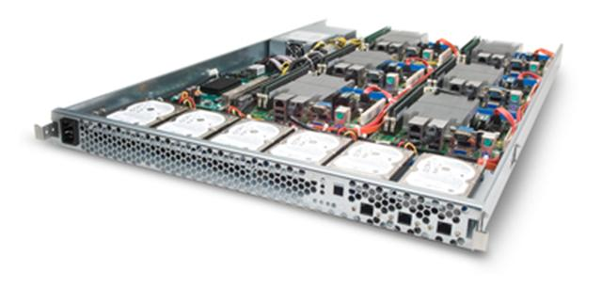
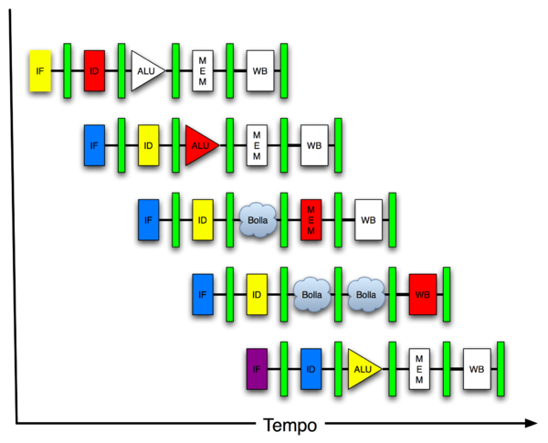
New-School Machine Structures (It’s a bit more complicated!)
Software Hardware
Parallel Requests
Assigned to computer
e.g., Search “Katz”
Parallel Threads
Assigned to core
e.g., Lookup, Ads
Parallel Instructions
>1 instruction @ one time
e.g., 5 pipelined instructions
Parallel Data
>1 data item @ one time
e.g., Add of 4 pairs of words
Hardware descriptions
All gates @ one time
Programming Languages
Warehouse Scale Computer
Smart Phone
Harness Parallelism &
Achieve High Performance
Computer
Core
…
Core
Memory (Cache)
Input/Output
Core
Today’s
Lecture
Instruction Unit(s)
Functional
Unit(s)
A₀+B₀
A₁+B₁
A₂+B₂
A₃+B₃
Cache Memory
Logic Gates

Slide 3
Review
Flynn Taxonomy of Parallel Architectures
SIMD: Single Instruction Multiple Data
MIMD: Multiple Instruction Multiple Data
SISD: Single Instruction Single Data (unused)
MISD: Multiple Instruction Single Data
Intel SSE SIMD Instructions
One instruction fetch that operates on multiple operands simultaneously
128/64 bit XMM registers
SSE Instructions in C
Embed the SSE machine instructions directly into C programs through use of intrinsics
Achieve efficiency beyond that of optimizing compiler

Slide 4
Agenda
Amdahl’s Law
SIMD and Loop Unrolling
Administrivia
Memory Performance for Caches
Review of 1st Half of 61C

Slide 5
Big Idea: Amdahl’s (Heartbreaking) Law
Speedup due to enhancement E is
Exec time w/o E
Speedup w/ E = ----------------------
Exec time w/ E
Suppose that enhancement E accelerates a fraction F (F <1) of the task by a factor S (S>1) and the remainder of the task is unaffected
Execution Time w/o E × [ (1-F) + F/S]
Execution Time w/ E =
1 / [ (1-F) + F/S ]
Speedup w/ E =

Slide 6
Example #1: Amdahl’s Law
Speedup w/ E = 1 / [ (1-F) + F/S ]
Consider an enhancement which runs 20 times faster but which is only usable 25% of the time
Speedup w/ E = 1/(.75 + .25/20) = 1.31
What if its usable only 15% of the time?
Speedup w/ E = 1/(.85 + .15/20) = 1.17
Amdahl’s Law tells us that to achieve linear speedup with 100 processors, none of the original computation can be scalar!
To get a speedup of 90 from 100 processors, the percentage of the original program that could be scalar would have to be 0.1% or less
Speedup w/ E = 1/(.001 + .999/100) = 90.99

Slide 7
Parallel Speed-up Example
Z₀ + Z₁ + … + Z₁₀
X_{1,1}
X_{1,10}
Y_{1,1}
Y_{1,10}
Partition 10 ways and perform on 10 parallel processing units
+
X_{10,1}
X_{10,10}
Y_{10,1}
Y_{10,10}
Non-parallel part
Parallel part
10 “scalar” operations (non-parallelizable)
100 parallelizable operations
110 operations
100/110 = .909 Parallelizable, 10/110 = 0.091 Scalar

Slide 8
Example #2: Amdahl’s Law
Speedup w/ E = 1 / [ (1-F) + F/S ]
Consider summing 10 scalar variables and two 10 by 10 matrices (matrix sum) on 10 processors
Speedup w/ E = 1/(.091 + .909/10) = 1/0.1819 = 5.5
What if there are 100 processors ?
Speedup w/ E = 1/(.091 + .909/100) = 1/0.10009 = 10.0
Get 55% potential from 10, but only 10% potential of 100!
What if the matrices are 33 by 33(or 1019 adds in total) on 10 processors? (increase parallel data by 10x)
Speedup w/ E = 1/(.009 + .991/10) = 1/0.108 = 9.2
What if there are 100 processors ?
Speedup w/ E = 1/(.009 + .991/100) = 1/0.019 = 52.6
Get 92% potential from 10 and 53% potential of 100
Notes:
For lecture
10/110 operations = 0.091
10/10010 operations = 0.000999

Slide 9
Strong and Weak Scaling
To get good speedup on a multiprocessor while keeping the problem size fixed is harder than getting good speedup by increasing the size of the problem.
Strong scaling: when speedup can be achieved on a parallel processor without increasing the size of the problem (e.g., 10x10 Matrix on 10 processors to 100)
Weak scaling: when speedup is achieved on a parallel processor by increasing the size of the problem proportionally to the increase in the number of processors
(e.g., 10x10 Matrix on 10 processors =>33x33 Matrix on 100)
Load balancing is another important factor: every processor doing same amount of work
Just 1 unit with twice the load of others cuts speedup almost in half
Notes:
Add load balancing example here – page 638

Slide 10
Suppose a program spends 80% of its time in a square root routine. How much must you speedup square root to make the program run 5 times faster?
Speedup w/ E = 1 / [ (1-F) + F/S ]
☐
10
☐
20
☐
100
☐
None of the Above
Notes:
VertLeftWhiteCheck1
Answer: 4th
Need infinitely fast to get to 5X
5 = 2.8
10 = 3.6
20 = 4.2
100 = 4.8

Slide 11
Data Level Parallelism and SIMD
SIMD wants adjacent values in memory that can be operated in parallel
Usually specified in programs as loops
for(i=1000; i>0; i=i-1)
x[i] = x[i] + s;
How can reveal more data level parallelism than available in a single iteration of a loop?
Unroll loop and adjust iteration rate

Slide 12
Looping in MIPS
Assumptions:
$t1 is initially the address of the element in the array with the highest address
$f0 contains the scalar value s
8($t2) is the address of the last element to operate on
CODE:
Loop:1. l.d $f2,0($t1) ; $f2=array element
2. add.d $f10,$f2,$f0 ; add s to $f2
3. s.d $f10,0($t1) ; store result
4. addui $t1,$t1,#-8 ; decrement pointer 8 byte
5. bne $t1,$t2,Loop ;repeat loop if $t1 != $t2

Slide 13
Loop Unrolled
Loop: l.d $f2,0($t1)
add.d $f10,$f2,$f0
s.d $f10,0($t1)
l.d $f4,-8($t1)
add.d $f12,$f4,$f0
s.d $f12,-8($t1)
l.d $f6,-16($t1)
add.d $f14,$f6,$f0
s.d $f14,-16($t1)
l.d $f8,-24($t1)
add.d $f16,$f8,$f0
s.d $f16,-24($t1)
addui $t1,$t1,#-32
bne $t1,$t2,Loop
NOTE:
Only 1 Loop Overhead every 4 iterations
This unrolling works if
loop_limit(mod 4) = 0
3. (Different Registers eliminate stalls in pipeline; we’ll see later in course)

Slide 14
Loop Unrolled Scheduled
Loop:l.d $f2,0($t1)
l.d $f4,-8($t1)
l.d $f6,-16($t1)
l.d $f8,-24($t1)
add.d $f10,$f2,$f0
add.d $f12,$f4,$f0
add.d $f14,$f6,$f0
add.d $f16,$f8,$f0
s.d $f10,0($t1)
s.d $f12,-8($t1)
s.d $f14,-16($t1)
s.d $f16,-24($t1)
addui $t1,$t1,#-32
bne $t1,$t2,Loop
4 Loads side-by-side: Could replace with 4 wide SIMD Load
4 Adds side-by-side: Could replace with 4 wide SIMD Add
4 Stores side-by-side: Could replace with 4 wide SIMD Store

Slide 15
Loop Unrolling in C
Instead of compiler doing loop unrolling, could do it yourself in C
for(i=1000; i>0; i=i-1)
x[i] = x[i] + s;
Could be rewritten
for(i=1000; i>0; i=i-4) {
x[i] = x[i] + s;
x[i-1] = x[i-1] + s;
x[i-2] = x[i-2] + s;
x[i-3] = x[i-3] + s;
}
What is downside of doing it in C?

Slide 16
Generalizing Loop Unrolling
A loop of n iterations
k copies of the body of the loop
Assuming (n mod k) ≠ 0
Then we will run the loop with 1 copy of the body (n mod k) times and
with k copies of the body floor(n/k) times
(Will revisit loop unrolling again when get to pipelining later in semester)

Slide 17
Administrivia
Lab #7 posted
Midterm in 5 days:
Exam: Tu, Mar 6, 6:40-9:40 PM, 2050 VLSB
Covers everything through lecture today
Closed book, can bring one sheet notes, both sides
Copy of Green card will be supplied
No phones, calculators, …; just bring pencils & eraser
NO LECTURE DAY OF EXAM, NO DISCUSSION SECTIONS
HKN Review: Sat, March 3, 3-5PM, 306 Soda Hall
TA Review: Sun, Mar 4, Starting 2PM, 2050 VLSB
Will send (anonymous) 61C midway survey before Midterm

Slide 18
Reading Miss Penalty: Memory Systems that Support Caches
The off-chip interconnect and memory architecture affects overall system performance in dramatic ways
on-chip
CPU
One word wide organization (one word wide bus and one word wide memory)
Assume
1 memory bus clock cycle to send address
15 memory bus clock cycles to get the 1st word in the block from DRAM (row cycle time), 5 memory bus clock cycles for 2nd, 3rd, 4th words (subsequent column access time)—note effect of latency!
1 memory bus clock cycle to return a word of data
Memory-Bus to Cache bandwidth
Number of bytes accessed from memory and transferred to cache/CPU per memory bus clock cycle
Cache
32-bit data
&
32-bit addr
per cycle
bus
DRAM
Memory
Notes:
We can reduce the miss penalty if we can increase the bandwidth from the memory to the cache. Allows larger block sizes to be used while still maintaining a low miss penalty.
The clock rate of this bus is usually much slower than the processor which negatively affects the miss penalty

Slide 19
(DDR) SDRAM Operation
Column
Address
+1
After a row is read into the SRAM register
Input CAS as the starting “burst” address along with a burst length
Transfers a burst of data (ideally a cache block) from a series of sequential addresses within that row
Memory bus clock controls transfer of successive words in the burst
N cols
DRAM
Row
Address
N rows
N x M SRAM
M bit planes
Cycle Time
M-bit Output
1st M-bit Access
2nd M-bit
3rd M-bit
4th M-bit
RAS
CAS
Row Address
Col Address
Row Add
Notes:
Double data rate synchronous dynamic random access memory (DDR SDRAM) is a class of memory integrated circuits used in computers.
Compared to single data rate (SDR) SDRAM, the DDR SDRAM interface makes higher transfer rates possible by more strict control of the timing of the electrical data and clock signals. Implementations often have to use schemes such as phase-locked loops and self-calibration to reach the required timing accuracy.[1][2]The interface uses double pumping (transferring data on both the rising and falling edges of the clock signal) to lower the clock frequency. One advantage of keeping the clock frequency down is that it reduces the signal integrity requirements on the circuit board connecting the memory to the controller. The name "double data rate" refers to the fact that a DDR SDRAM with a certain clock frequency achieves nearly twice the bandwidth of a single data rate (SDR) SDRAM running at the same clock frequency, due to this double pumping.
With data being transferred 64 bits at a time, DDR SDRAM gives a transfer rate of (memory bus clock rate) × 2 (for dual rate) × 64 (number of bits transferred) / 8 (number of bits/byte). Thus, with a bus frequency of 100 MHz, DDR SDRAM gives a maximum transfer rate of 1600 MB/s.
"Beginning in 1996 and concluding in June 2000, JEDEC developed the DDR (Double Data Rate) SDRAM specification (JESD79)."[3] JEDEC has set standards for data rates of DDR SDRAM, divided into two parts. The first specification is for memory chips, and the second is for memory modules. DDR SDRAM (sometimes referred to as DDR1 SDRAM) has been superseded by DDR2 SDRAM and DDR3 SDRAM.

Slide 20
Agenda
Amdahl’s Law
SIMD and Loop Unrolling
Administrivia
Memory Performance for Caches
Review of 1st Half of 61C

Slide 21
New-School Machine Structures (It’s a bit more complicated!)
Project 1
Software Hardware
Parallel Requests
Assigned to computer
e.g., Search “Katz”
Parallel Threads
Assigned to core
e.g., Lookup, Ads
Parallel Instructions
>1 instruction @ one time
e.g., 5 pipelined instructions
Parallel Data
>1 data item @ one time
e.g., Add of 4 pairs of words
Hardware descriptions
All gates functioning in parallel at same time
Programming Languages
Warehouse Scale Computer
Smart Phone
Harness Parallelism &
Achieve High Performance
Project 2
Computer
Programming Languages
Core
…
Core
Memory (Cache)
Project 3
Input/Output
Core
Instruction Unit(s)
Functional
Unit(s)
A₀+B₀
A₁+B₁
A₂+B₂
A₃+B₃
Main Memory
Logic Gates
Project 4

Slide 22
6 Great Ideas in Computer Architecture
Layers of Representation/Interpretation
Moore’s Law
Principle of Locality/Memory Hierarchy
Parallelism
Performance Measurement & Improvement
Dependability via Redundancy

Slide 23
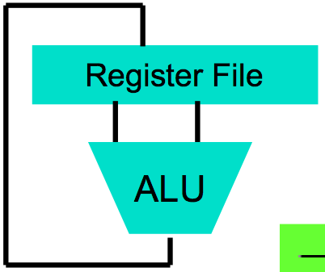
Great Idea #1: Levels of Representation/Interpretation
First half 61C
High Level Language Program (e.g., C)
temp = v[k];
v[k] = v[k+1];
v[k+1] = temp;
Compiler
Anything can be represented as a number, i.e., data or instructions
lw $t0, 0($2)
lw $t1, 4($2)
sw $t1, 0($2)
sw $t0, 4($2)
Assembly Language Program (e.g., MIPS)
Assembler
0000 1001 1100 0110 1010 1111 0101 1000
1010 1111 0101 1000 0000 1001 1100 0110
1100 0110 1010 1111 0101 1000 0000 1001
0101 1000 0000 1001 1100 0110 1010 1111
Machine Language Program (MIPS)
Machine Interpretation
Hardware Architecture Description (e.g., block diagrams)
Architecture Implementation
Logic Circuit Description (Circuit Schematic Diagrams)

Slide 24
Pointers
Pointer is a C version (abstraction) of a data address
* “follows” a pointer to its value
& gets the address of a value
Arrays and strings are implemented as variations on pointers
Pointers are used to point to any kind of data (int, char, a struct, etc.)
Normally a pointer only points to one type (int, char, a struct, etc.).
void * is a type that can point to anything (generic pointer)

Slide 25
If $t1 and $t3 represents the int pointers p and q, and $t2 represents int x, which statements about C compiled to MIPS instructions are true?
☐
x = *p; => lw $t2,0($t1)
☐
p = &q; => addiu $t2,$t3,0
☐
*p = x; => sw $t2,0($t1)
☐
All of the above are true
Notes:
VertLeftWhiteCheck1
All of the above
x=-5,y=6,p=-5

Slide 26
If $t1 and $t3 represents the int pointers p and q, and $t2 represents int x, which statements about C compiled to MIPS instructions are true?
☐
q = p; => mov $t3,$t1
☐
q = p+1; => addiu $t3,$t1,4
☐
x = *(p+1); => lw $t2,4($t1)
☐
All of the above are true
Notes:
VertLeftWhiteCheck1
All of the above
x=-5,y=6,p=-5

Slide 27
What is output?
Int main() { int *p, x=5, y; // init int z;
y = *(p = &x) + 1; flip_sign(p); printf("x=%d,y=%d,*p=%d\n",
x,y,*p); } flip_sign(int *n) {*n = -(*n); }
☐
x=5,y=6,*p=-5
☐
x=-5,y=6,*p=-5
☐
x=-5,y=4,*p=-5
☐
x=-5,y=-6,*p=-5
Notes:
VertLeftWhiteCheck1
B is correct; p points to x
x=-5,y=6,p=-5

Slide 28
Pointers in C
Why use pointers?
If we want to pass a large struct or array, it’s easier / faster / etc. to pass a pointer than the whole thing
In general, pointers allow cleaner, more compact code
So what are the drawbacks?
Pointers are probably the single largest source of bugs in C, so be careful anytime you deal with them
Most problematic with dynamic memory management—which you will to know by the end of the semester, but not for the projects (there will be a lab later in the semester)
Dangling references and memory leaks

Slide 29
Which of the following is TRUE?
☐
addu $t0,$t1,4($t2) is valid MIPS
☐
lw $t0, $t1($t2) is valid MIPS
☐
in addiu $t0,$t1,imm imm is considered an unsigned number that is zero-extended to make it 32 bits wide
☐
Sign extension means replicating the sign bit when converting from an m-bit number to an n-bit number, where n > m
Notes:
VertLeftWhiteCheck1
B: Print 4 …because ints in this system are 4-bytes long and the actual address increments by 4 even though it appears to only incrememt 1.

Slide 30
Which statement is FALSE?
☐
MIPS uses jal to invoke a function and jr to return from a function
☐
jal saves PC+1 in %ra
☐
The callee can use temporary registers (%ti) without saving and restoring them
☐
The caller can rely on save registers (%si) without fear of callee changing them
Notes:
VertLeftWhiteCheck1
B: Print It saves PC+4 …because ints in this system are 4-bytes long and the actual address increments by 4 even though it appears to only incrememt 1.

Slide 31
In MIPS, what is the minimum number of bits does it take to represent -1.0 x 2¹²⁷ ?
☐
16 bits
☐
32 bits
☐
64 bits
☐
128 bits
Notes:
VertLeftWhiteCheck1
B: Print It saves PC+4 …because ints in this system are 4-bytes long and the actual address increments by 4 even though it appears to only incrememt 1.

Slide 32
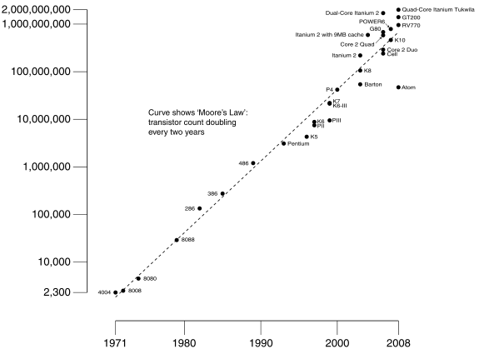
#2: Moore’s Law
Predicts: 2X Transistors / chip every 1.5 years
# of transistors on an integrated circuit (IC)
Gordon Moore Intel Cofounder B.S. Cal 1950!
Year

Slide 33
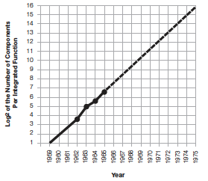
Moore’s Law
“The complexity for minimum component costs has increased at a rate of roughly a factor of two per year. …That means by 1975, the number of components per integrated circuit for minimum cost will be 65,000.” (from 50 in 1965)
Gordon Moore, “Cramming more components onto integrated circuits,” Electronics, Volume 38, Number 8, April 19, 1965
“Integrated circuits will lead to such wonders as home computers--or at least terminals connected to a central computer--automatic controls for automobiles, and personal portable communications equipment. The electronic wristwatch needs only a display to be feasible today.”

Slide 34
P = C V² f
Power is proportional to Capacitance * Voltage² * Frequency of switching
What is the effect on power consumption of:
“Simpler” implementation (fewer transistors)?
Smaller implementation (shrunk down design)?
Reduced voltage?
Increased clock frequency?

Slide 35
Great Ideas #5: Measuring Performance Restating Performance Equation
Time = Seconds Program Instructions Clock cycles Seconds Program Instruction Clock Cycle
=
×
×

Slide 36
What Affects Each Component? Instruction Count, CPI, Clock Rate
Hardware or software component? | Affects What?
Algorithm | Instruction Count, CPI
Programming Language | Instruction Count, CPI
Compiler | Instruction Count, CPI
Instruction Set Architecture | Instruction Count, Clock Rate, CPI
Notes:
Algorithm Instruction count, possibly CPI
The algorithm determines the number of source program instructions executed and hence the number of processor instructions executed. The algorithm may also affect the CPI, by
favoring slower or faster instructions. For example, if the algorithm uses more floating-point operations, it will tend to have a higher CPI.
Programming language
Instruction count, CPI
The programming language certainly affects the instruction count, since statements in the language are translated to processor
instructions, which determine instruction count. The language mayalso affect the CPI because of its features; for example, a language
with heavy support for data abstraction (e.g., Java) will require indirect calls, which will use higher CPI instructions.
Compiler
Instruction count, CPI
The efficiency of the compiler affects both the instruction count and average cycles per instruction, since the compiler determines
the translation of the source language instructions into computer instructions. The compiler’s role can be very complex and affect
the CPI in complex ways.
Instruction set
architecture
Instruction count, clock rate, CPI
The instruction set architecture affects all three aspects of CPU performance, since it affects the instructions needed for a
function, the cost in cycles of each instruction, and the overall clock rate of the processor

Slide 37
Computer A clock cycle time 250 ps, CPI_{A} = 2
Computer B clock cycle time 500 ps, CPI_{B} = 1.2
Assume A and B have same instruction set
Which statement is true?
☐
Computer A is ≈1.2 times faster than B
☐
Computer A is ≈4.0 times faster than B
☐
Computer B is ≈1.7 times faster than A
☐
Computer B is ≈3.4 times faster than A
Notes:
VertLeftWhiteCheck1
Answer: Computer A is ≈1.2 times faster than B

Slide 38
Computer A clock cycle time 250 ps, CPI_{A} = 2
Computer B clock cycle time 500 ps, CPI_{B} = 1.2
Assume A and B have same instruction set
Which statement is true?
☐
Computer A is ≈1.2 times faster than B
☐
Computer A is ≈4.0 times faster than B
☐
Computer B is ≈1.7 times faster than A
☐
Computer B is ≈3.4 times faster than A
Notes:
VertLeftWhiteCheck1
Answer: Computer A is ≈1.2 times faster than B

Slide 39
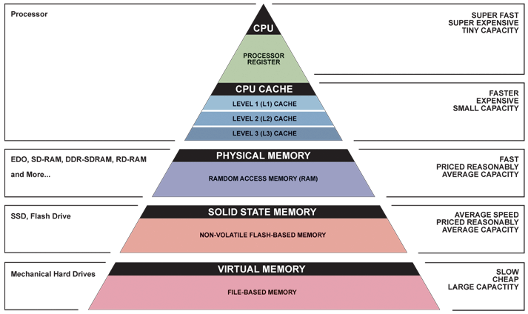
Great Idea #3: Principle of Locality/ Memory Hierarchy
First half 61C

Slide 40
Mapping a 6-bit Memory Address
5
4
3
2
1
0
Mem Block Within Cache Block
Tag
Block Within cache
Index
Byte Offset Within Block (e.g., Word)
In example, block size is 4 bytes/1 word (it could be multi-word)
Memory and cache blocks are the same size, unit of transfer between memory and cache
# Memory blocks >> # Cache blocks
16 Memory blocks/16 words/64 bytes/6 bits to address all bytes
4 Cache blocks, 4 bytes (1 word) per block
4 Memory blocks map to each cache block
Byte within block: low order 2 bits, ignore! (nothing smaller than block)
Memory block to cache block, aka index: middle two bits
Which memory block is in a given cache block, aka tag: top two bits

Slide 41
Mapping a 6-bit Memory Address
5
4
3
2
1
0
Mem Block Within $ Block
Tag
Block Within $
Index
Byte Offset Within Block (e.g., Word)
Note: $ = Cache
In example, block size is 4 bytes/1 word (it could be multi-word)
Memory and cache blocks are the same size, unit of transfer between memory and cache
# Memory blocks >> # Cache blocks
16 Memory blocks/16 words/64 bytes/6 bits to address all bytes
4 Cache blocks, 4 bytes (1 word) per block
4 Memory blocks map to each cache block
Byte within block: low order two bits, ignore! (nothing smaller than a block)
Memory block to cache block, aka index: middle two bits
Which memory block is in a given cache block, aka tag: top two bits

Slide 42
Caching: A Simple Example
Cache
Main Memory
0000xx
0001xx
0010xx
0011xx
0100xx
0101xx
0110xx
0111xx
1000xx
1001xx
1010xx
1011xx
1100xx
1101xx
1110xx
1111xx
Index
Valid
Tag
Data
One word blocks
Two low order bits define the byte in the word (32b words)
00
01
10
11
Q: Where in the cache is the mem block?
Use next 2 low order memory address bits – the index – to determine which cache block (i.e., modulo the number of blocks in the cache)
Q: Is the mem block in cache?
Compare the cache tag to the high order 2 memory address bits to tell if the memory block is in the cache
(block address) modulo (# of blocks in the cache)
Notes:
For class handout

Slide 43
Caching: A Simple First Example
Main Memory
0000xx
0001xx
0010xx
0011xx
0100xx
0101xx
0110xx
0111xx
1000xx
1001xx
1010xx
1011xx
1100xx
1101xx
1110xx
1111xx
One word blocks
Two low order bits define the byte in the word (32b words)
Cache
Index
Valid
Tag
Data
00
01
10
11
Q: Where in the cache is the mem block?
Use next 2 low order memory address bits – the index – to determine which cache block (i.e., modulo the number of blocks in the cache)
Q: Is the mem block in cache?
Compare the cache tag to the high order 2 memory address bits to tell if the memory block is in the cache
(block address) modulo (# of blocks in the cache)
Notes:
For lecture
Valid bit indicates whether an entry contains valid information – if the bit is not set, there cannot be a match for this block

Slide 44
Direct Mapped Cache
Consider the main memory word reference string
Start with an empty cache - all blocks initially marked as not valid
0 1 2 3 4 3 4 15
0000 0001 0010 0011 0100 0011 0100 1111
index
0
miss
1
miss
2
miss
3
miss
00 Mem(0)
00 Mem(0)
00 Mem(0)
00 Mem(1)
00 Mem(0)
00 Mem(1)
00 Mem(2)
00 Mem(1)
00 Mem(2)
00 Mem(3)
4
miss
3
hit
4
hit
15
miss
01
4
00 Mem(0)
00 Mem(1)
00 Mem(2)
00 Mem(3)
01 Mem(4)
00 Mem(1)
00 Mem(2)
00 Mem(3)
01 Mem(4)
00 Mem(1)
00 Mem(2)
00 Mem(3)
01 Mem(4)
00 Mem(1)
00 Mem(2)
00 Mem(3)
11
15
8 requests, 6 misses
Notes:
For lecture
Reference string is word addresses (or block number since we are using one word blocks) – i.e., the low order two bits used to selected the byte in the 32-bit word are ignored

Slide 45
For L1 cache
AMAT = Time for a hit + Miss rate x Miss penalty
What is AMAT for L2 cache?
☐
Time for L2 hit + L2 Miss rate x L2 Miss penalty
☐
Time for L1 hit + L1 Miss rate x L2 Miss rate x Miss penalty
☐
Time for L1 hit + L1 Miss rate x (Time for L2 hit + L2 Miss rate x Miss Penalty)
☐
Time for L1 hit + L1 Miss rate x Miss penalty + Time for L2 hit + L2 Miss rate x Miss penalty
Notes:
VertLeftWhiteCheck1
B: Print It saves PC+4 …because ints in this system are 4-bytes long and the actual address increments by 4 even though it appears to only incrememt 1.

Slide 46
Great Idea #4: Parallelism
Data Level Parallelism in 1st half 61C
Lots of data in memory that can be operated on in parallel (e.g., adding together 2 arrays)
Lots of data on many disks that can be operated on in parallel (e.g., searching for documents)
1st project: DLP across 10s of servers and disks using MapReduce
Next week’s lab, 3rd project: DLP in memory

Slide 47
Flynn Taxonomy
In 2012, SIMD and MIMD most common parallel computers
SIMD (aka hw-level data parallelism): specialized function units, for handling lock-step calculations involving arrays
Scientific computing, signal processing, multimedia (audio/video processing)

Slide 48
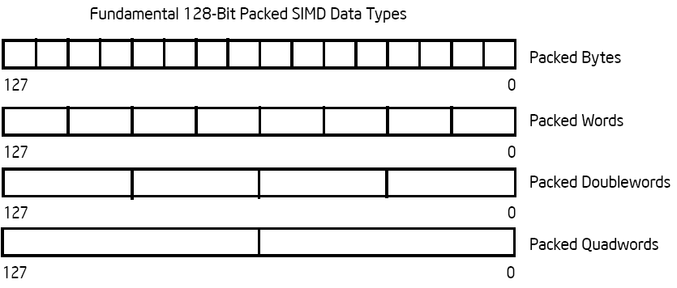
Intel Architecture SSE2+ 128-Bit SIMD Data Types
Note: in Intel Architecture (unlike MIPS) a word is 16 bits
Single precision FP: Double word (32 bits)
Double precision FP: Quad word (64 bits)
122 121
96 95
80 79
64 63
48 47
32 31
16 15
16 / 128 bits
122 121
96 95
80 79
64 63
48 47
32 31
16 15
8 / 128 bits
96 95
64 63
32 31
4 / 128 bits
64 63
2 / 128 bits

Slide 49
Summary
Amdhal’s Cruel Law: Law of Diminishing Returns
Loop Unrolling to Expose Parallelism
Optimize Miss Penalty via Memory system
As the field changes, cs61c has to change too!
Still about the software-hardware interface
Programming for performance via measurement!
Understanding the memory hierarchy and its impact on application performance
Unlocking the capabilities of the architecture for performance: SIMD

