Slide 1
CS 61C: Great Ideas in Computer Architecture Thread Level Parallelism (TLP)
Instructor:
David A. Patterson
http://inst.eecs.Berkeley.edu/~cs61c/sp12

Slide 2
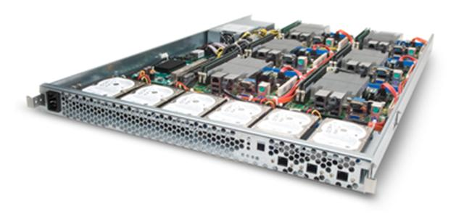
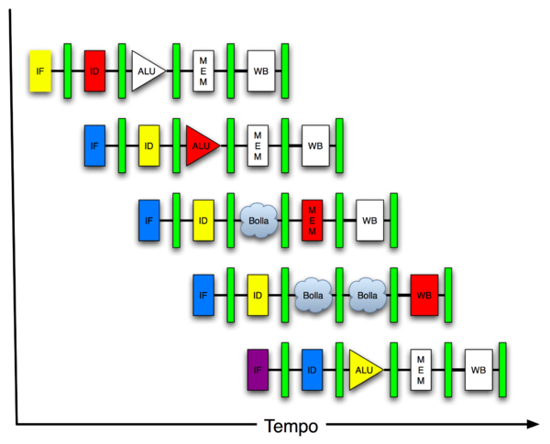
New-School Machine Structures (It’s a bit more complicated!)
Software Hardware
Parallel Requests
Assigned to computer
e.g., Search “Katz”
Parallel Threads
Assigned to core
e.g., Lookup, Ads
Parallel Instructions
>1 instruction @ one time
e.g., 5 pipelined instructions
Parallel Data
>1 data item @ one time
e.g., Add of 4 pairs of words
Hardware descriptions
All gates @ one time
Programming Languages
Warehouse Scale Computer
Smart Phone
Harness Parallelism &
Achieve High Performance
Computer
Core
…
Core
Memory (Cache)
Project 3
Input/Output
Core
Instruction Unit(s)
Functional
Unit(s)
A₀+B₀
A₁+B₁
A₂+B₂
A₃+B₃
Cache Memory
Logic Gates

Slide 3
Review
Amdhal’s Cruel Law: Law of Diminishing Returns
Loop Unrolling to Expose Parallelism
Optimize Miss Penalty via Memory system
As the field changes, cs61c has to change too!
Still about the software-hardware interface
Programming for performance via measurement!
Understanding the memory hierarchy and its impact on application performance
Unlocking the capabilities of the architecture for performance: SIMD

Slide 4
Agenda
MIMD vs. SIMD
Cache Coherency
Threads
Administrivia
OpenMP
Strong vs. Weak Scaling
Parallel Peer Instruction
Summary

Slide 5
Parallel Processing: Multiprocessor Systems (MIMD)
Multiprocessor (MIMD): a computer system with at least 2 processors
Deliver high throughput for independent jobs via job-level parallelism
Improve the run time of a single program that has been specially crafted to run on a multiprocessor - a parallel processing program
Now Use term core for processor (“Multicore”) because “Multiprocessor Microprocessor” too redundant
Processor
Processor
Processor
Cache
Cache
Cache
Interconnection Network
Memory
I/O
Notes:
Power has become the overriding issue for both data centers and microprocessors. Power efficiency has joined scalable performance making the case for multiprocessors. Multiprocessors also improve availability.

Slide 6
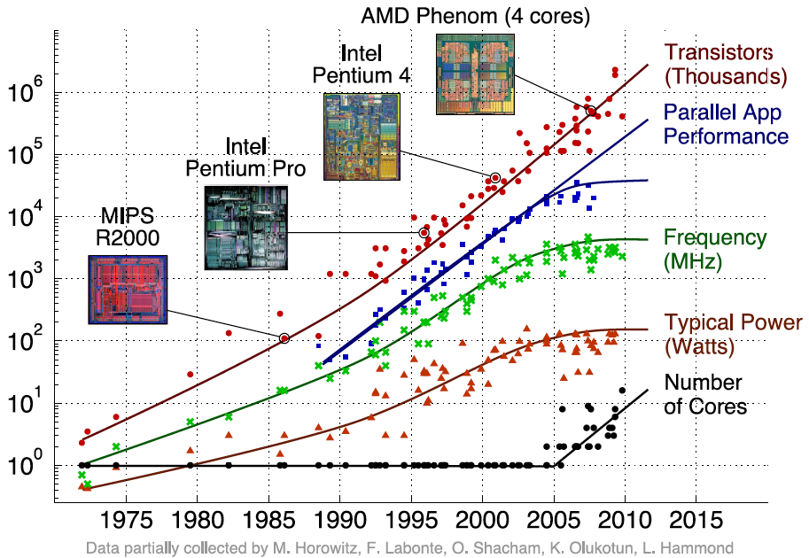
Transition to Multicore
Sequential App Performance

Slide 7
Multiprocessors and You
Only path to performance is parallelism
Clock rates flat or declining
SIMD: 2X width every 3-4 years
128b wide now, 256b 2011, 512b in 2014?, 1024b in 2018?
MIMD: Add 2 cores every 2 years: 2, 4, 6, 8, 10, …
A key challenge is to craft parallel programs that have high performance on multiprocessors as the number of processors increase – i.e., that scale
Scheduling, load balancing, time for synchronization, overhead for communication
Project 3: fastest code on 8 processor computers
2 chips/computer, 4 cores/chip

Slide 8
Potential Parallel Performance (assuming SW can use it)
Year | Cores | SIMD bits /Core | Core * SIMD bits | Peak DP FLOPs
2003 | 2 | 128 | 256 | 4
2005 | 4 | 128 | 512 | 8
2007 | 6 | 128 | 768 | 12
2009 | 8 | 128 | 1024 | 16
2011 | 10 | 256 | 2560 | 40
2013 | 12 | 256 | 3072 | 48
2015 | 14 | 512 | 7168 | 112
2017 | 16 | 512 | 8192 | 128
2019 | 18 | 1024 | 18432 | 288
2021 | 20 | 1024 | 20480 | 320
MIMD
SIMD
MIMD *SIMD
+2/
2yrs
2X/
4yrs
2.5X
8X
20X

Slide 9
Shared Memory and Caches
What if?
Processors 1 and 2 read Memory[1000] (value 20)
0
1
2
Processor
Processor
1000
Processor
1000
Cache
1000
1000
Cache
Cache
Interconnection Network
20
Memory
20
I/O

Slide 10
Shared Memory and Caches
What if?
Processors 1 and 2 read Memory[1000]
Processor 0 writes Memory[1000] with 40
0
Processor 0
Write
Invalidates
Other Copies
Processor
1
2
1000
Processor
Processor
1000 40
1000 20
1000 20
Cache
Cache
Cache
Interconnection Network
1000 40
Memory
I/O

Slide 11
Keeping Multiple Caches Coherent
Architect’s job: shared memory => keep cache values coherent
Idea: When any processor has cache miss or writes, notify other processors via interconnection network
If only reading, many processors can have copies
If a processor writes, invalidate all other copies
Shared written result can “ping-pong” between caches

Slide 12
Cache Coherency and Block Size
Suppose block size is 32 bytes
Suppose Processor 0 reading and writing variable X, Processor 1 reading and writing variable Y
Suppose in X location 4000, Y in 4012
What will happen?
Effect called false sharing
How can you prevent it?

Slide 13
Threads
thread of execution: smallest unit of processing scheduled by operating system
On 1 processor, multithreading occurs by time-division multiplexing:
Processor switched between different threads
Context switching happens frequently enough user perceives threads as running at the same time
On a multiprocessor, threads run at the same time, with each processor running a thread

Slide 14
Multithreading vs. Multicore
Basic idea: Processor resources are expensive and should not be left idle
Long memory latency to memory on cache miss?
Hardware switches threads to bring in other useful work while waiting for cache miss
Cost of thread context switch must be much less than cache miss latency
Put in redundant hardware so don’t have to save context on every thread switch:
PC, Registers, L1 caches?
Attractive for apps with abundant TLP
Commercial multi-user workloads

Slide 15
Multithreading vs. Multicore
Multithreading => Better Utilization
≈1% more hardware, 1.10X better performance?
Share integer adders, floating point adders, caches (L1 I $, L1 D$, L2 cache, L3 cache), Memory Controller
Multicore => Duplicate Processors
≈50% more hardware, ≈2X better performance?
Share lower caches (L2 cache, L3 cache), Memory Controller

Slide 16
Machines in (old) 61C Lab
/usr/sbin/sysctl -a | grep hw\.
hw.model = MacPro4,1
…
hw.physicalcpu: 8
hw.logicalcpu: 16
…
hw.cpufrequency = 2,260,000,000
hw.physmem = 2,147,483,648
hw.cachelinesize = 64
hw.l1icachesize: 32,768
hw.l1dcachesize: 32,768
hw.l2cachesize: 262,144
hw.l3cachesize: 8,388,608
Therefore, should try up to 16 threads to see if performance gain even though only 8 cores

Slide 17
Administrivia
Midterm answers and grading ruberic online
Turn in your written regrade petitions with your exam to your TA by next discussion section
Long term administrivia: Make sure all grades are correct but Project 4 by Friday April 20
Final Exam 11:30-2:30 (TBD) Wed May 9

Slide 18
Did Well on Midterm!
Mean: 77.1
Mode: 75.0
Standard deviation: 14.7
Minimum: 27.0
1st quartile: 68.0
2nd quartile (median): 79.5
3rd quartile: 88.5
Maximum: 99.0
Max possible: 100.0
25.0 - 30.0: 1 * 30.0 - 35.0: 0 35.0 - 40.0: 4 *** 40.0 - 45.0: 4 *** 45.0 - 50.0: 3 ** 50.0 - 55.0: 12 ******* 55.0 - 60.0: 8 ***** 60.0 - 65.0: 16 ********* 65.0 - 70.0: 23 ************* 70.0 - 75.0: 21 ************ 75.0 - 80.0: 37 ******************** 80.0 - 85.0: 34 ******************* 85.0 - 90.0: 33 ****************** 90.0 - 95.0: 31 ***************** 95.0 -100.0:25 **************

Slide 19
Survey
What is going well?
Projects, interesting concepts, course revision, labs, discussions, lecture organization
What would you like to see more of?
More examples, clearer project descriptions
What is the most important thing you have learned?
Study habits (read before lecture), MapReduce, MIPS/assembly language, memory hierarchy, how it all fits together (C->MIPS->Machine)
“MapReduce and pointer manipulation. I've already used them in interviews.”

Slide 20
Survey Cont’d
Which topics that you feel unsure about?
Caches, MapReduce, pointers
Topics you understand really well?
Numbers, MIPS, MapReduce, caches
40% read book before lecture (!)
65% like or OK with student roulette
75% rarely miss a lecture
82% like or OK with Peer Instruction
88% like or OK with 61C in the News
88% like or OK with Get to know your Prof

Slide 21
61c in the News
Today is International Women’s Day
Grace Murray Hopper(1906–1992) one of the first programmers, developed the first compiler, and was referred to as “Amazing Grace.”
Conference in her name
She became a rear admiral in the US Navy, and in 1997 a warship was named for her: the USS Hopper.

Slide 22
OpenMP
OpenMP is an API used for multi-threaded, shared memory parallelism
Compiler Directives
Runtime Library Routines
Environment Variables
Portable
Standardized
Easy to compile: cc –fopenmp name.c

Slide 23
Data Races and Synchronization
2 memory accesses form a data race if from different threads to same location, and at least one is a write, and they occur one after another
If there is a data race, result of program can vary depending on chance (which thread first?)
Avoid data races by synchronizing writing and reading to get deterministic behavior
Synchronization done by user-level routines that rely on hardware synchronization instructions

Slide 24
Simple Parallelization
for (i=0; i<max; i++) zero[i] = 0;
For loop must have canonical shape for OpenMP to parallelize it
Necessary for run-time system to determine loop iterations
No premature exits from the loop allowed
i.e., No break, return, exit, goto statements

Slide 25
OpenMP Extends C with Pragmas
Pragmas are a mechanism C provides for language extensions
Commonly implemented pragmas: structure packing, symbol aliasing, floating point exception modes
Good mechanism for OpenMP because compilers that don't recognize a pragma are supposed to ignore them
Runs on sequential computer even with embedded pragmas

Slide 26
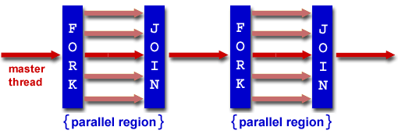
Fork/Join Parallelism
Start out executing the program with one master thread
Master thread forks worker threads as enter parallel code
Worker threads join (die or suspend) at end of parallel code
Image courtesy of http://www.llnl.gov/computing/tutorials/openMP/

Slide 27
The parallel for pragma
#pragma omp parallel for
for (i=0; i<max; i++) zero[i] = 0;
Master thread creates additional threads, each with a separate execution context
All variables declared outside for loop are shared by default

Slide 28
Thread Creation
How many threads will OpenMP create?
Can set via omp_set_num_threads(NUM_THREADS);
Presumably = number of processors in computer running program

Slide 29
Invoking Parallel Threads
#pragma omp parallel
{
int ID = omp_get_thread_num();
foo(ID);
}
Each thread executes a copy of the within the structured structured block
OpenMP intrinsic to get Thread ID number:
omp_get_thread_num()

Slide 30
π
3. 141592653589793238462643383279502884197169399375105820974944592307816406286208998628034825342117067982148086513282306647093844609550582231725359408128481117450284102…
Pi Day is 3-14 (started at SF Exploratorium)

Slide 31
Calculating π

Slide 32
Sequential Calculation of π in C
#include <stdio.h>/* Serial Code */
static long num_steps = 100000; double step;
void main ()
{ int i; double x, pi, sum = 0.0;
step = 1.0/(double) num_steps;
for (i=1;i<= num_steps; i++){
x = (i-0.5)*step;
sum = sum + 4.0/(1.0+x*x);
}
pi = sum/num_steps;
printf ("pi = %6.12f\n", pi);
}

Slide 33
OpenMP Version (with bug)
#include <omp.h>
static long num_steps = 100000; double step;
#define NUM_THREADS 2
void main ()
{ int i; double x, pi, sum[NUM_THREADS];
step = 1.0/(double) num_steps;
#pragma omp parallel private (x)
{ int id = omp_get_thread_num();
for (i=id, sum[id]=0.0; i< num_steps; i=i+NUM_THREADS) {
x = (i+0.5)*step;
sum[id] += 4.0/(1.0+x*x);
}
}
for(i=0, pi=0.0; i<NUM_THREADS; i++)
pi += sum[i] ;
printf ("pi = %6.12f\n", pi / num_steps);
}

Slide 34
Experiment
Run with NUM_THREADS = 1 multiple times
Run with NUM_THREADS = 2 multiple times
What happens?

Slide 35
OpenMP Version (with bug)
#include <omp.h>
static long num_steps = 100000; double step;
#define NUM_THREADS 2
void main ()
{ int i; double x, pi, sum[NUM_THREADS];
step = 1.0/(double) num_steps;
#pragma omp parallel private (x)
{ int id = omp_get_thread_num();
for (i=id, sum[id]=0.0; i< num_steps; i=i+NUM_THREADS) {
x = (i+0.5)*step;
sum[id] += 4.0/(1.0+x*x);
}
}
for(i=0, pi=0.0; i<NUM_THREADS; i++)
pi += sum[i] ;
printf ("pi = %6.12f\n", pi / num_steps);
}
Note: loop index variable i is shared between threads

Slide 36
OpenMP Version 2 (with bug)
#include <omp.h>
static long num_steps = 100000; double step;
#define NUM_THREADS 2
void main ()
{ int i; double x, sum, pi=0.0;
step = 1.0/(double) num_steps;
#pragma omp parallel private (x, sum)
{ int id = omp_get_thread_num();
for (i=id, sum=0.0; i< num_steps; i=i+NUM_THREADS){
x = (i+0.5)*step;
sum += 4.0/(1.0+x*x);
}
#pragma omp critical
pi += sum;
}
printf ("pi = %6.12f,\n”,pi/num_steps);
}

Slide 37
OpenMP Reduction
Reduction: specifies that 1 or more variables that are private to each thread are subject of reduction operation at end of parallel region: reduction(operation:var) where
Operation: operator to perform on the variables (var) at the end of the parallel region
Var: One or more variables on which to perform scalar reduction.
#pragma omp for reduction(+ : nSum) for (i = START ; i <= END ; ++i) nSum += i;

Slide 38
OpenMP Reduction Version
#include <omp.h>
#include <stdio.h>
/static long num_steps = 100000;
double step;
void main ()
{ int i; double x, pi, sum = 0.0;
step = 1.0/(double) num_steps;
#pragma omp parallel for private(x) reduction(+:sum)
for (i=1; i<= num_steps; i++){
x = (i-0.5)*step;
sum = sum + 4.0/(1.0+x*x);
}
pi = sum / num_steps;
printf ("pi = %6.8f\n", pi);
}
Note: Don’t have to declare for loop index variable i private, since that is default

Slide 39
OpenMP Timing
omp_get_wtime – Elapsed wall clock time
double omp_get_wtime(void);
#include <omp.h> // to get function
Elapsed wall clock time in seconds. The time is measured per thread, no guarantee can be made that two distinct threads measure the same time. Time is measured from some "time in the past". On POSIX compliant systems the seconds since the Epoch (00:00:00 UTC, January 1, 1970) are returned.

Slide 40
Matrix Multiply in OpenMP
start_time = omp_get_wtime();
#pragma omp parallel for private(tmp, i, j, k)
for (i=0; i<Ndim; i++){
for (j=0; j<Mdim; j++){
tmp = 0.0;
for(k=0;k<Pdim;k++){
/* C(i,j) = sum(over k) A(i,k) * B(k,j) */
tmp += *(A+(i*Ndim+k)) * *(B+(k*Pdim+j));
}
*(C+(i*Ndim+j)) = tmp;
}
}
run_time = omp_get_wtime() - start_time;
Note: Outer loop spread
across N threads; inner loops inside a thread

Slide 41
Notes on Matrix Multiply Example
More performance optimizations available
Higher compiler optimization (-O2) to reduce number of instructions executed
Cache blocking to improve memory performance
Using SIMD SSE3 Instructions to improve floating point computation rate

Slide 42
Description of 32 Core System
Intel Nehalem Xeon 7550
HW Multithreading: 2 Threads / core
8 cores / chip
4 chips / board
64 Threads / system
2.00 GHz
256 KB L2 cache/ core
18 MB (!) shared L3 cache / chip

Slide 43
Experiment
Try compile and run at NUM_THREADS = 64
Try compile and run at NUM_THREADS = 64 with –O2
Try compile and run at NUM_THREADS = 32, 16, 8, … with –O2

Slide 44
Review: Strong vs Weak Scaling
Strong scaling: problem size fixed
Weak scaling: problem size proportional to increase in number of processors
Speedup on multiprocessor while keeping problem size fixed is harder than speedup by increasing the size of the problem
But a natural use of a lot more performance is to solve a lot bigger problem

Slide 45
32 Core: Speed-up vs. Scale-up
Speed-up
Scale-up: Fl. Pt. Ops = 2 x Size³
Memory Capacity = f(Size²), Compute = f(Size³)

Slide 46
32 Core: Speed-up vs. Scale-up
Scale-up: Fl. Pt. Ops = 2 x Size³
Speed-up
Threads | Time (secs) | Speedup | Time(secs) | Size (Dim) | Fl. Ops x 10^9
1 | 13.75 | 1.00 | 13.75 | 1000 | 2.00
2 | 6.88 | 2.00 | 13.52 | 1240 | 3.81
4 | 3.45 | 3.98 | 13.79 | 1430 | 5.85
8 | 1.73 | 7.94 | 12.55 | 1600 | 8.19
16 | 0.88 | 15.56 | 13.61 | 2000 | 16.00
32 | 0.47 | 29.20 | 13.92 | 2500 | 31.25
64 | 0.71 | 19.26 | 13.83 | 2600 | 35.15
Memory Capacity = f(Size²), Compute = f(Size³)

Slide 47
Strong vs. Weak Scaling

Slide 48
Peer Instruction: Why Multicore?
The switch in ~ 2004 from 1 processor per chip to multiple processors per chip happened because:
The “power wall” meant that no longer get speed via higher clock rates and higher power per chip
There was no other performance option but replacing 1 ineffecient processor with multiple efficient processors
OpenMP was a breakthrough in ~2000 that made parallel programming easy
A)(orange) I only
B)(green) II only
C)(pink) I & II only
D)(yellow) I, II, & III
Notes:
C is answer; not D, because 100s of programming languages

Slide 49
Peer Instruction: Why Multicore?
The switch in ~ 2004 from 1 processor per chip to multiple processors per chip happened because:
The “power wall” meant that no longer get speed via higher clock rates and higher power per chip
There was no other performance option but replacing 1 ineffecient processor with multiple efficient processors
OpenMP was a breakthrough in ~2000 that made parallel programming easy
A)(orange) I only
B)(green) II only
C)(pink) I & II only
D)(yellow) I, II, & III
Notes:
E is answer; not H, because 100s of programming languages

Slide 50
100s of (dead) Parallel Programming Languages
ActorScript | Concurrent Pascal | JoCaml | Orc
Ada | Concurrent ML | Join | Oz
Afnix | Concurrent Haskell | Java | Pict
Alef | Curry | Joule | Reia
Alice | CUDA | Joyce | SALSA
APL | E | LabVIEW | Scala
Axum | Eiffel | Limbo | SISAL
Chapel | Erlang | Linda | SR
Cilk | Fortan 90 | MultiLisp | Stackless Python
Clean | Go | Modula-3 | SuperPascal
Clojure | Io | Occam | VHDL
Concurrent C | Janus | occam-π | XC

Slide 51
False Sharing in OpenMP
{ int i; double x, pi, sum[NUM_THREADS];
#pragma omp parallel private (I,x)
{ int id = omp_get_thread_num();
for (i=id, sum[id]=0.0; i< num_steps; i=i+NUM_THREADS) {
x = (i+0.5)*step;
sum[id] += 4.0/(1.0+x*x);
}
What is problem?
Sum[0] is 8 bytes in memory, Sum[1] is adjacent 8 bytes in memory => false sharing if block size ≥ 16 bytes

Slide 52
Peer Instruction: No False Sharing
{ int i; double x, pi, sum[10000];
#pragma omp parallel private (i,x)
{ int id = omp_get_thread_num(), fix = __________;
for (i=id, sum[id]=0.0; i< num_steps; i=i+NUM_THREADS) {
x = (i+0.5)*step;
sum[id*fix] += 4.0/(1.0+x*x);
}
What is best value to set fix to prevent false sharing?
A)(orange) omp_get_num_threads();
B)(green) Constant for number of blocks in cache
C)(pink) Constant for size of block in bytes
D)(yellow) Constant for size of blocks in doubles
Notes:
D is answer

Slide 53
Peer Instruction: No False Sharing
{ int i; double x, pi, sum[10000];
#pragma omp parallel private (i,x)
{ int id = omp_get_thread_num(), fix = __________;
for (i=id, sum[id]=0.0; i< num_steps; i=i+NUM_THREADS) {
x = (i+0.5)*step;
sum[id*fix] += 4.0/(1.0+x*x);
}
What is best value to set fix to prevent false sharing?
A)(orange) omp_get_num_threads();
B)(green) Constant for number of blocks in cache
C)(pink) Constant for size of block in bytes
D)(yellow) Constant for size of blocks in doubles
Notes:
D is answer

Slide 54
And in Conclusion, …
Sequential software is slow software
SIMD and MIMD only path to higher performance
Multithreading increases utilization, Multicore more processors (MIMD)
Multiprocessor/Multicore uses Shared Memory
Cache coherency implements shared memory even with multiple copies in multiple caches
False sharing a concern; watch block size!
OpenMP as simple parallel extension to C
Threads, Parallel for, private, critical sections, …
≈ C: small so easy to learn, but not very high level and its easy to get into trouble

