Slide 1
CS 61C: Great Ideas in Computer Architecture (Machine Structures)
Performance
Instructor:
Michael Greenbaum

Slide 2
Agenda
Floating Point Review
Defining performance
Administrivia
Workloads and Benchmarks
Break
Measuring Performance

Slide 3
Review: Floating Point Encoding
Note the implicit 1 in front of the Significand.
31
30
23
22
0
S
Exponent
Significand
1 bit
8 bits
23 bits
(-1)^{S} x (1 . Significand) x 2^{(Exponent-127)}

Slide 4
Peer Instruction Question
Suppose Big, Tiny, and NegativeBig are floats in C, with Big initialized to a big number (e.g., age of universe in seconds or 4.32 x 10¹⁷), Tiny to a small number (e.g., seconds/femtosecond or 1.0 x 10⁻¹⁵), NegativeBig = - Big.
Here are two conditionals:
(Big * Tiny) * NegativeBig == (Big * NegativeBig) * Tiny
(Big + Tiny) + NegativeBig == (Big + NegativeBig) + Tiny
Which statement about these is always correct?
Red. I. is false and II. is false
Yellow. I. is false and II. is true
Blue. I. is true and II. is false
Green. I. is true and II. is true

Slide 5
Peer Instruction Answer
Suppose Big, Tiny, and NegativeBig are floats in C, with Big initialized to a big number (e.g., age of universe in seconds or 4.32 x 10¹⁷), Tiny to a small number (e.g., seconds/femtosecond or 1.0 x 10⁻¹⁵), NegativeBig = - Big.
Here are two conditionals:
(Big * Tiny) * NegativeBig == (Big * NegativeBig) * Tiny
(Big + Tiny) + NegativeBig == (Big + NegativeBig) + Tiny
Which statement about these is always correct?
Red. I. is false and II. is false
I. Works ok if no overflow, but because exponents add, if Big * NegBig overflows, then result is overflow, not -1
II. Left hand side is 0, right hand side is tiny

Slide 6
Pitfalls
Floating point addition is NOT associative
Some optimizations can change order of floating point computations, which can change results
Need to ensure that floating point algorithm is correct even with optimizations

Slide 7
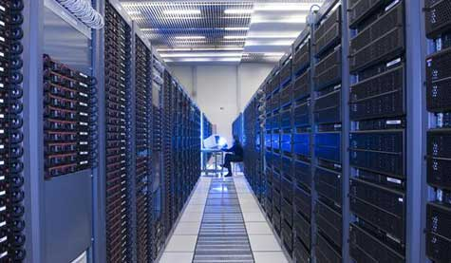
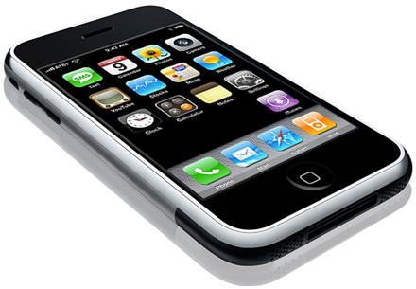


New-School Machine Structures
(It’s a bit more complicated!)
Software Hardware
Parallel Requests
  Assigned to computer
  e.g., Search “Katz”
Parallel Threads
  Assigned to core
  e.g., Lookup, Ads
Parallel Instructions
  >1 instruction @ one time
  e.g., 5 pipelined instructions
Parallel Data
  >1 data item @ one time
  e.g., Add of 4 pairs of words
Hardware descriptions
  All gates @ one time
Warehouse Scale Computer
Smart
Phone
Harness
Parallelism &
Achieve High
Performance
How do
we know?
Computer
Core
…
Core
Memory (Cache)
Input/Output
Core
Instruction Unit(s)
Functional
Unit(s)
A₀+B₀
A₁+B₁
A₂+B₂
A₃+B₃
Main Memory
Logic Gates

Slide 8
Agenda
Floating Point Review
Defining performance
Administrivia
Workloads and Benchmarks
Break
Measuring Performance

Slide 9
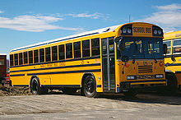
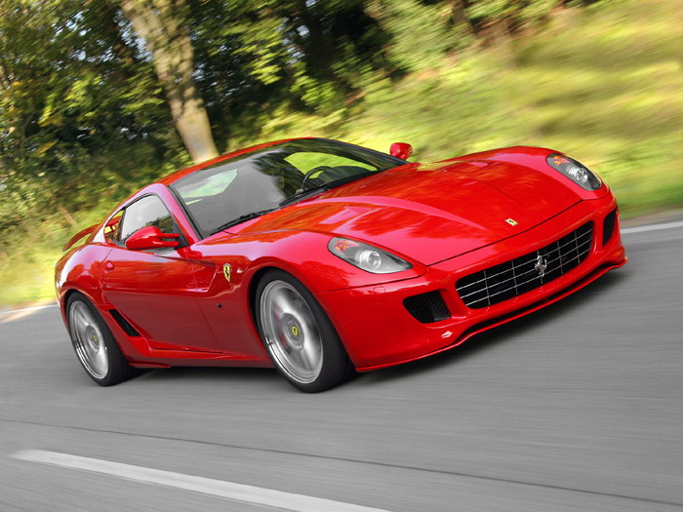
Defining CPU Performance
What does it mean to say
X is faster than Y?
Ferrari vs. School Bus?
2009 Ferrari 599 GTB
  2 passengers, 11.1 secs in quarter mile
2009 Type D school bus
  54 passengers, quarter mile time?
http://www.youtube.com/watch?v=KwyCoQuhUNA
Response Time, Latency: e.g., time to travel ¼ mile
Throughput, Bandwidth: e.g., passenger-mi in 1 hour

Slide 10
What is Performance?
Latency (or response time or execution time)
  Time to complete one task
Bandwidth (or throughput)
  Tasks completed per unit time

Slide 11
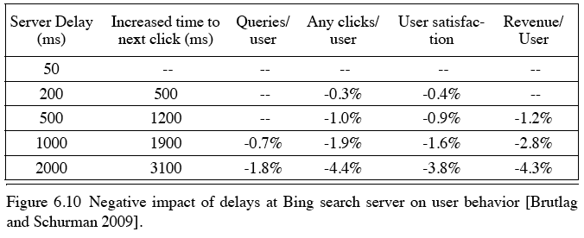
Cloud Performance:
Why Application Latency Matters
Key figure of merit: application responsiveness
  Longer the delay, the fewer the user clicks, the less the user happiness, and the lower the revenue per user

Slide 12
Defining Relative CPU Performance
Performance_{X} = 1/Program Execution Time_{X}
Performance_{X} > Performance_{Y} =>
1/Execution Time_{X} > 1/Execution Time_{y} =>
Execution Time_{Y} > Execution Time_{X}
Computer X is N times faster than Computer Y
Performance_{X} / Performance_{Y} = N or
Execution Time_{Y} / Execution Time_{X} = N
Bus is to Ferrari as 12 is to 11.1:
Ferrari is 1.08 times faster than the bus!

Slide 13
Measuring CPU Performance
Computers use a clock to determine when events take place within hardware
Clock cycles: discrete time intervals
  aka clocks, cycles, clock periods, clock ticks
Clock rate or clock frequency: clock cycles per second (inverse of clock cycle time)
3 GigaHertz clock rate
=> clock cycle time = 1/(3x10⁹) seconds
clock cycle time = 333 picoseconds (ps)

Slide 14
CPU Performance Factors
To distinguish between processor time and I/O, CPU time is time spent in processor
CPU Time/Program
= Clock Cycles/Program
x Clock Cycle Time
Or
CPU Time/Program
= Clock Cycles/Program ÷ Clock Rate

Slide 15
CPU Performance Factors
But a program executes instructions
CPU Time/Program
= Clock Cycles/Program x Clock Cycle Time
= Instructions/Program
x Average Clock Cycles/Instruction
x Clock Cycle Time
1st term called Instruction Count
2nd term abbreviated CPI for average
Clock Cycles Per Instruction
3rd term is 1 / Clock rate

Slide 16
Restating Performance Equation
Time = Seconds
Program
Instructions Clock cycles Seconds
Program Instruction Clock Cycle
=
×
×

Slide 17
What Affects Each Component? Instruction Count, CPI, Clock Rate
Hardware or software component? | Affects What?
Algorithm
Programming Language
Compiler
Instruction Set Architecture
Student Roulette?
Notes:
Algorithm
Instruction count, possibly CPI
The algorithm determines the number of source program instructions executed and hence the number of processor instructions executed. The algorithm may also affect the CPI, by
favoring slower or faster instructions. For example, if the algorithm uses more floating-point operations, it will tend to have a higher CPI.
Programming language
Instruction count, CPI
The programming language certainly affects the instruction count, since statements in the language are translated to processor
instructions, which determine instruction count. The language mayalso affect the CPI because of its features; for example, a language
with heavy support for data abstraction (e.g., Java) will require indirect calls, which will use higher CPI instructions.
Compiler
Instruction count, CPI
The efficiency of the compiler affects both the instruction count and average cycles per instruction, since the compiler determines
the translation of the source language instructions into computer instructions. The compiler’s role can be very complex and affect
the CPI in complex ways.
Instruction set
architecture
Instruction count, clock rate, CPI
The instruction set architecture affects all three aspects of CPU performance, since it affects the instructions needed for a
function, the cost in cycles of each instruction, and the overall clock rate of the processor

Slide 18
What Affects Each Component? Instruction Count, CPI, Clock Rate
Hardware or software component? | Affects What?
Algorithm | Instruction Count, CPI
Programming Language | Instruction Count, CPI
Compiler | Instruction Count, CPI
Instruction Set Architecture | Instruction Count, Clock Rate, CPI
Notes:
Algorithm
Instruction count, possibly CPI
The algorithm determines the number of source program instructions executed and hence the number of processor instructions executed. The algorithm may also affect the CPI, by
favoring slower or faster instructions. For example, if the algorithm uses more floating-point operations, it will tend to have a higher CPI.
Programming language
Instruction count, CPI
The programming language certainly affects the instruction count, since statements in the language are translated to processor
instructions, which determine instruction count. The language mayalso affect the CPI because of its features; for example, a language
with heavy support for data abstraction (e.g., Java) will require indirect calls, which will use higher CPI instructions.
Compiler
Instruction count, CPI
The efficiency of the compiler affects both the instruction count and average cycles per instruction, since the compiler determines
the translation of the source language instructions into computer instructions. The compiler’s role can be very complex and affect
the CPI in complex ways.
Instruction set
architecture
Instruction count, clock rate, CPI
The instruction set architecture affects all three aspects of CPU performance, since it affects the instructions needed for a
function, the cost in cycles of each instruction, and the overall clock rate of the processor

Slide 19
Peer Instruction Question
Computer A clock cycle time 250 ps, CPI_{A} = 2
Computer B clock cycle time 500 ps, CPI_{B} = 1.2
Assume A and B have same instruction set
Which statement is true?
Red. Computer A is ~1.2 times faster than B
Blue. Computer A is ~4.0 times faster than B
Green. Computer B is ~1.7 times faster than A
Yellow. Computer B is ~3.4 times faster than A
Purple. None of the above
Notes:
A is answer

Slide 20
Peer Instruction Answer
Computer A clock cycle time 250 ps, CPI_{A} = 2
Computer B clock cycle time 500 ps, CPI_{B} = 1.2
Assume A and B have same instruction set
Which statement is true?
Red. Computer A is ~1.2 times faster than B
Blue. Computer A is ~4.0 times faster than B
Green. Computer B is ~1.7 times faster than A
Yellow. Computer B is ~3.4 times faster than A
Purple. None of the above
Notes:
A is answer

Slide 21
Agenda
Floating Point Review
Defining performance
Administrivia
Workloads and Benchmarks
Break
Measuring Performance

Slide 22
Administrivia
Project 1 due Sunday.
Midterm, Friday 7/15.
  Time and Location still TBD, will keep you updated
  Closed book. We will supply you with a green sheet.
  You can bring a one-sided, handwritten cheatsheet.
  3 hours long.
Review Session early next week (probably Monday)
“CS Illustrated” slides at bottom of webpage.
  Useful illustrations for understanding number representation, floating point, pointers.

Slide 23
Administrivia
How should we study for the midterm?
  Form study groups…don’t prepare in isolation!
  Attend the review session
  Look over HW, Labs, Projects, class notes!
  Go over old exams – HKN has put them online (link at top of cs61C home page)
  Attend TA office hours, my office hours, work out hard probs
  ASK QUESTIONS!

Slide 24
Agenda
Floating Point Review
Defining performance
Administrivia
Workloads and Benchmarks
Break
Measuring Performance

Slide 25
Workload and Benchmark
Workload: Set of programs run on a computer
  Actual collection of applications run or made from real programs to approximate such a mix
  Specifies both programs and relative frequencies
Benchmark: Program selected for use in comparing computer performance
  Benchmarks form a workload
  Usually standardized so that many use them

Slide 26
SPEC
(System Performance Evaluation Cooperative)
Computer Vendor cooperative for benchmarks, started in 1989
SPECCPU2006
  12 Integer Programs
  17 Floating-Point Programs
Often turn into number where bigger is faster
SPECratio: execution time on old reference computer divide by execution time on new computer to get an effective speed-up

Slide 27
SPECINT2006 on AMD Barcelona
Description | Instruc-tion Count (B) | CPI | Clock cycle time (ps) | Execu-tion Time (s) | Refer-ence Time (s) | SPEC-ratio
Interpreted string processing | 2,118 | 0.75 | 400 | 637 | 9,770 | 15.3
Block-sorting compression | 2,389 | 0.85 | 400 | 817 | 9,650 | 11.8
GNU C compiler | 1,050 | 1.72 | 400 | 724 | 8,050 | 11.1
Combinatorial optimization | 336 | 10.0 | 400 | 1,345 | 9,120 | 6.8
Go game | 1,658 | 1.09 | 400 | 721 | 10,490 | 14.6
Search gene sequence | 2,783 | 0.80 | 400 | 890 | 9,330 | 10.5
Chess game | 2,176 | 0.96 | 400 | 837 | 12,100 | 14.5
Quantum computer simulation | 1,623 | 1.61 | 400 | 1,047 | 20,720 | 19.8
Video compression | 3,102 | 0.80 | 400 | 993 | 22,130 | 22.3
Discrete event simulation library | 587 | 2.94 | 400 | 690 | 6,250 | 9.1
Games/path finding | 1,082 | 1.79 | 400 | 773 | 7,020 | 9.1
XML parsing | 1,058 | 2.70 | 400 | 1,143 | 6,900 | 6.0

Slide 28
Summarizing Performance …
System
Rate (Task 1)
Rate (Task 2)
A
10
20
B
20
10
Which system is faster?
Student Roulette?

Slide 29
… Depends Who’s Selling
System
Rate (Task 1)
Rate (Task 2)
Average
A
10
20
15
B
20
10
15
Average throughput
System
Rate (Task 1)
Rate (Task 2)
Average
A
0.50
2.00
1.25
B
1.00
1.00
1.00
Throughput relative to B
System
Rate (Task 1)
Rate (Task 2)
Average
A
1.00
1.00
1.00
B
2.00
0.50
1.25
Throughput relative to A

Slide 30

Summarizing SPEC Performance
Varies from 6x to 22x faster than reference computer
Geometric mean of ratios:
N-th root of product
of N ratios
  Geometric Mean gives same relative answer no matter what computer is used as reference
Geometric Mean for Barcelona is 11.7

Slide 31
Energy and Power
(Energy = Power x Time)
Energy to complete operation (Joules)
  Sample applications: battery life, total energy costs
Peak power dissipation (Watts = Joules/s)
  Affects heat (and cooling demands)
  IT equipment’s power is a term in the Power Utilization Efficiency (PUE) equation, a Warehouse Scale Computer figure of merit

Slide 32
Peak Power vs. Lower Energy
(Power x Time = Energy)
Peak A
Peak B
Power
Integrate power curve to get energy
Time
Which system has higher peak power?
Which system has higher energy?
Student Roulette?

Slide 33
Peak Power vs. Lower Energy
(Power x Time = Energy)
Peak A
Peak B
Power
Integrate power curve to get energy
Time
System A has higher peak power, but lower total energy
System B has lower peak power, but higher total energy

Slide 34
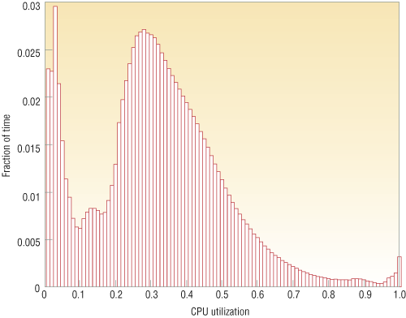
Energy Proportional Computing
“The Case for
Energy-Proportional
Computing,”
Luiz André Barroso,
Urs Hölzle,
IEEE Computer
December 2007
It is surprisingly hard
to achieve high levels
of utilization of typical
servers (and your home
PC or laptop is even
worse)
Figure 1. Average CPU utilization of more than 5,000 servers during a six-month period. Servers
are rarely completely idle and seldom operate near their maximum utilization, instead operating
most of the time at between 10 and 50 percent of their maximum

Slide 35

SPECPower
Increasing importance of power and energy: create benchmark for performance and power
Most servers in WSCs have average utilization between 10% & 50%, so measure power at medium as well as at high load
Measure best performance and power, then step down request rate to measure power for every 10% reduction in performance
Java server benchmark performance is operations per second (ssj_ops), so metric is ssj_ops/Watt

Slide 36
SPECPower on Barcelona
Target Load % | Performance (ssj_ops) | Avg. Power (Watts)
100% | 231,867 | 295
90% | 211,282 | 286
80% | 185,803 | 275
70% | 163,427 | 265
60% | 140,160 | 256
50% | 118,324 | 246
40% | 92,035 | 233
30% | 70,500 | 222
20% | 47,126 | 206
10% | 23,066 | 180
0% | 0 | 141
Sum | 1,283,590 | 2,605
 | ssj_ops/Watt | 493
Energy
Proportionality

Slide 37
Which is Better?
(1 Red Machine vs. 5 Green Machines)
Five machines running at 10% utilization
  Total Power =
One machine running at
50% utilization
  Total Power =
  Two 3.0-GHz Xeons,
  16 GB DRAM, 1 Disk
  One 2.4-GHz Xeon,
  8 GB DRAM, 1 Disk
85% Peak Power@50% utilization
65% Peak Power@10% utilization
Student Roulette?
Notes:
37

Slide 38
Which is Better?
(1 Red Machine vs. 5 Green Machines)
Five machines running at 10% utilization
  Total Power =
  90 x 5 = 450w
One machine running at
50% utilization
  Total Power =
  1 x 230 = 230w
  Two 3.0-GHz Xeons,
  16 GB DRAM, 1 Disk
  One 2.4-GHz Xeon,
  8 GB DRAM, 1 Disk
85% Peak Power@50% utilization
65% Peak Power@10% utilization
Notes:
38

Slide 39
Other Benchmark Attempts
Rather than run a collection of real programs and take their average (geometric mean), create a single program that matches the average behavior of a set of programs
Called a synthetic benchmark
First example called Whetstone in 1972 for floating point intensive programs in Fortran
Second example called Dhrystone in 1985 for integer programs in Ada and C
  Pun on Wet vs. Dry (“Whet” vs. “Dhry”)

Slide 40
Dhystone Shortcomings
Dhrystone features unusual code that is not usually representative of real-life programs
Dhrystone susceptible to compiler optimizations
Dhrystone’s small code size means always fits in caches, so not representative
Yet still used in hand held, embedded CPUs!

Slide 41
Agenda
Floating Point Review
Defining performance
Administrivia
Workloads and Benchmarks
Break
Measuring Performance

Slide 42
Agenda
Floating Point Review
Defining performance
Administrivia
Workloads and Benchmarks
Break
Measuring Performance

Slide 43
Measuring Time
UNIX time command measures in seconds
Time Stamp Counter
  64-bit counter of clock cycles on Intel 80x86 instruction set computers
  80x86 instruction RDTSC (Read TSC) returns TSC in regs EDX (upper 32 bits) and EAX (lower 32 bits)
  Can read, but can’t set
  How long can measure?
  Measures overall time, not just time for 1 program

Slide 44
How to get RDTSC access in C?
static inline unsigned long long RDTSC(void)
{
unsigned hi, lo;
asm volatile ("rdtsc" : "=a"(lo), "=d"(hi));
return ( (unsigned long long) lo) |
( ((unsigned long long) hi) <<32 );
}

Slide 45
gcc Optimization Experiment
 | BubbleSort.c | Dhrystone.c
No Opt
-O1
-O2
-O3

Slide 46
gcc Optimization Experiment
 | BubbleSort.c | Dhrystone.c
No Opt | 3.215 s | 7.230 s
-O1 | 1.460 s | 2.805 s
-O2 | 1.457 s | 2.711 s
-O3 | 1.458 s | 1.340 s

Slide 47
Where Do You Spend the
Time in Your Program?
Profiling a program (e.g., using, gprof) shows where it spends its time by function, so you can determine which code consumes most of the execution time
Usually a 90/10 rule: 10% of code is responsible for 90% of execution time
  Or 80/20 rule, where 20% of code responsible for 80% of time

Slide 48
gprof
Learn where program spent its time
  Learn functions called while it was executing
  And which functions call other functions
Three steps:
  Compile & link program with profiling enabled
    cc –pg x.c {in addition to other flags use}
  Execute program to generate a profile data file
  Run gprof to analyze the profile data

Slide 49
gprof example
% time | Cumulative (secs) | Self (secs) | calls | Self ms/call | Total ms/call | name
18.18 | 0.06 | 0.06 | 23480 | 0.00 | 0.00 | find_char_unquote
12.12 | 0.10 | 0.04 | 120 | 0.33 | 0.73 | pattern_search
9.09 | 0.13 | 0.03 | 5120 | 0.01 | 0.01 | collapse_continuations
9.09 | 0.16 | 0.03 | 148 | 0.20 | 0.88 | update_file_1
9.09 | 0.19 | 0.03 | 37 | 0.81 | 4.76 | eval
6.06 | 0.21 | 0.02 | 12484 | 0.00 | 0.00 | file_hash_1
6.06 | 0.23 | 0.02 | 6596 | 0.00 | 0.00 | get_next_mword
3.03 | 0.24 | 0.01 | 29981 | 0.00 | 0.00 | hash_find_slot
3.03 | 0.25 | 0.01 | 14769 | 0.00 | 0.00 | next_token
3.03 | 0.26 | 0.01 | 5800 | 0.00 | 0.00 | variable_expand_string
  See http://linuxgazette.net/100/vinayak.html
Notes:
There are 23480 calls to the function find_char_unquote and it makes up more than 1/6th of the program execution time.
However the function eval has only 37 invocations o it's credit still it takes up about 1/11th of the program execution time. There is a possibility that this function is doing a lot of work and is a candidate for splitting up into different functions. Also notice that each call to eval eats up an average of 4.76 milliseconds which is quite huge compared to any of the other functions
Also the functions pattern_search and update_file_1 take up nearly 1/4th of the execution time but share only 268 calls between them. Maybe these functions can also be split into smaller functions.
The source code has to be compiled with the -pg option ( also with -g if you want line-by-line profiling ).

Slide 50
Test Program to Profile with Saturn
#include <math.h>
#define LIMIT 500000000
void exponential()
{
double a;
int i;
for (i=1; i != LIMIT; i++)
a = exp(i/1000.0);
}
void sinFunc()
{
double a;
int i;
for (i=1; i != LIMIT; i++)
a = sin(i/1000.0);
}
int main()
{
exponential();
sinFunc();
return 0;
}
(saturn is an alternate tool supported on mac osx)

Slide 51
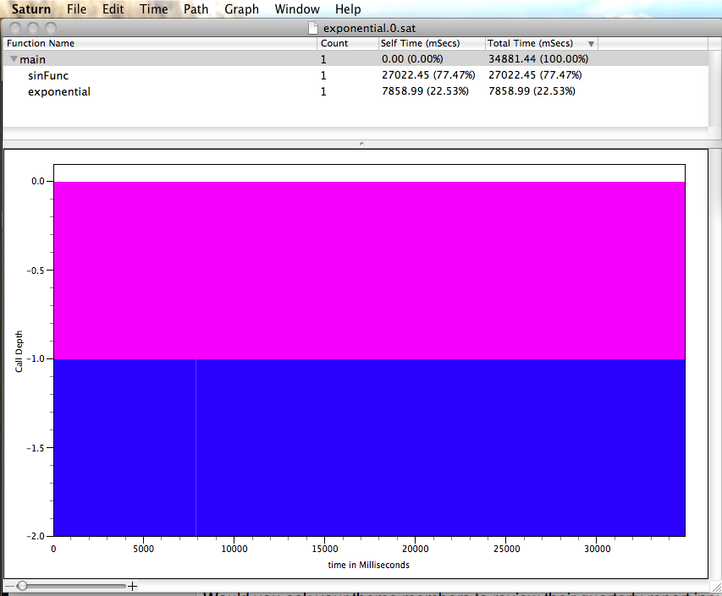

Slide 52
Cautionary Tale
“More computing sins are committed in the name of efficiency (without necessarily achieving it) than for any other single reason - including blind stupidity”
-- William A. Wulf
“We should forget about small efficiencies, say about 97% of the time: premature optimization is the root of all evil”
-- Donald E. Knuth

Slide 53
And In Conclusion, …
Time (seconds/program) is measure of performance
Instructions Clock cycles Seconds
Program Instruction Clock Cycle
Benchmarks stand in for real workloads to as standardized measure of relative performance
Power of increasing concern, and being added to benchmarks
Time measurement via clock cycles, machine specific
Profiling tools as way to see where spending time in your program
Don’t optimize prematurely!
=
×
×

