Slide 1
CS 61C: Great Ideas in Computer Architecture (Machine Structures) Thread Level Parallelism: OpenMP
Instructor: Michael Greenbaum

Slide 2
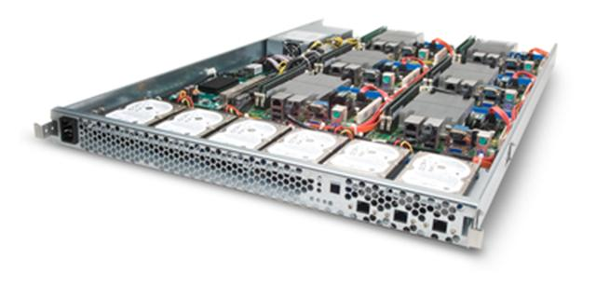
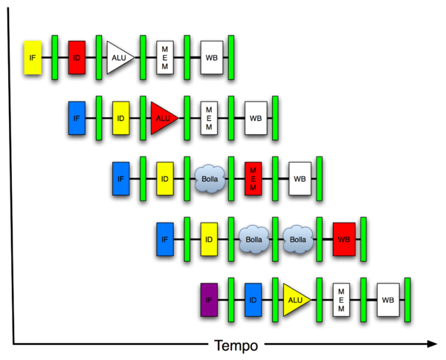
You Are Here!
Software Hardware
Parallel Requests
Assigned to computer
e.g., Search “Katz”
Parallel Threads
Assigned to core
e.g., Lookup, Ads
Parallel Instructions
>1 instruction @ one time
e.g., 5 pipelined instructions
Parallel Data
>1 data item @ one time
e.g., Add of 4 pairs of words
Hardware descriptions
All gates functioning in parallel at same time
Warehouse Scale Computer
Smart Phone
Harness Parallelism &
Achieve High Performance
Computer
Core
…
Core
Memory (Cache)
Project 3
Input/Output
Core
Instruction Unit(s)
Functional
Unit(s)
A₀+B₀
A₁+B₁
A₂+B₂
A₃+B₃
Main Memory
Logic Gates

Slide 3
Peer Instruction: Synchronization
Consider the following code when executed concurrently by two threads:
lw $t0,0($s0)
addi $t0,$t0,1
sw $t0,0($s0)
(Mem[$s0] contains value 100)
What possible values can result in Mem[$s0]?
Green) 100, 101, or 102
Blue) 101 or 102
Yellow) 100 or 102
Red) 100 or 101
Purple) 102

Slide 4
Peer Instruction: Synchronization, Answer
Consider the following code when executed concurrently by two threads:
lw $t0,0($s0)
addi $t0,$t0,1
sw $t0,0($s0)
(Mem[$s0] contains value 100)
What possible values can result in Mem[$s0]?
Green) 100, 101, or 102
Blue) 101 or 102
Yellow) 100 or 102
Red) 100 or 101
Purple) 102
- 102 if one thread starts executing after the other completely finishes.
- 101 if both threads execute the lw
before either thread executes the
sw. One thread will see “stale data”

Slide 5
Lock and Unlock Synchronization
Lock used to create region (critical section) where only one thread can operate
Given shared memory, use memory location as synchronization point: the lock
Processors read lock to see if must wait, or OK to go into critical section (and set to locked)
0 => lock is free / open / unlocked / lock off
1 => lock is set / closed / locked / lock on
Set the lock
Critical section (only one thread gets to execute this section of code at a time)
e.g., change shared variables
Unset the lock

Slide 6
Synchronization in MIPS
Load linked: ll rt,offset(rs)
Store conditional: sc rt,offset(rs)
Succeeds if location not changed since the ll
Returns 1 in rt (clobbers register value being stored)
Fails if location has changed
Returns 0 in rt (clobbers register value being stored)
Example: atomic swap (to test/set lock variable)
Exchange contents of reg and mem: $s4 ←→ ($s1)
try: add $t0,$zero,$s4 ;copy exchange value
ll $t1,0($s1) ;load linked
sc $t0,0($s1) ;store conditional
beq $t0,$zero,try ;branch store fails
add $s4,$zero,$t1 ;put load value in $s4

Slide 7
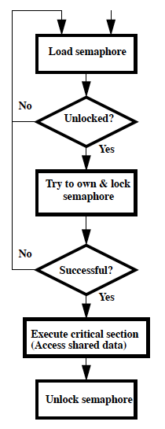
Test-and-Set
In a single atomic operation:
Test to see if a memory location is set (contains a 1)
Set it (to 1) If it isn’t (it contained a zero when tested)
Otherwise indicate that the Set failed, so the program can try again
No other instruction can modify the memory location, including another Test-and-Set instruction
Useful for implementing lock operations

Slide 8
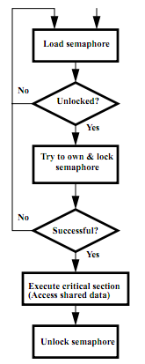
Test-and-Set in MIPS
Example: MIPS sequence for implementing a T&S at ($s1)
Try: addiu $t0,$zero,1
ll $t1,0($s1)
bne $t1,$zero,Try
sc $t0,0($s1)
beq $t0,$zero,try
Locked:
critical section
sw $zero,0($s1)

Slide 9
Agenda
OpenMP Introduction
Administrivia
OpenMP Examples
Break
Common Pitfalls
Summary

Slide 10
Agenda
OpenMP Introduction
Administrivia
OpenMP Examples
Break
Common Pitfalls
Summary

Slide 11
What is OpenMP?
API used for multi-threaded, shared memory parallelism
Compiler Directives
Runtime Library Routines
Environment Variables
Portable
Standardized
See http://www.openmp.org/, http://computing.llnl.gov/tutorials/openMP/

Slide 12
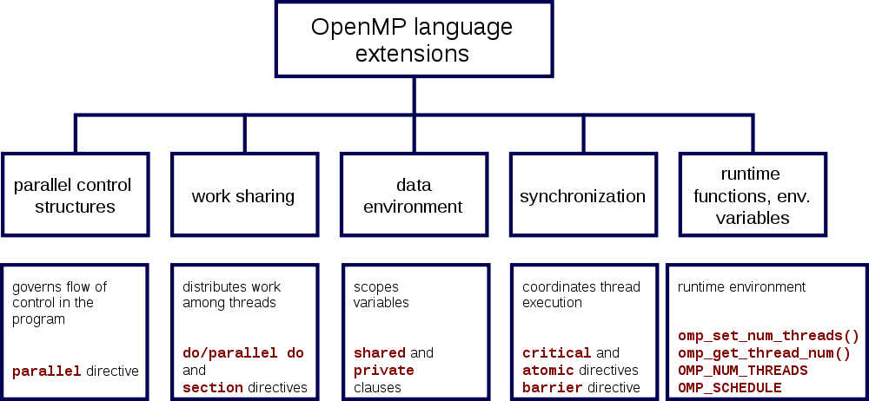
OpenMP Specification

Slide 13
Shared Memory Model with Explicit Thread-based Parallelism
Multiple threads in a shared memory environment, explicit programming model with full programmer control over parallelization
Pros:
Takes advantage of shared memory, programmer need not worry (that much) about data placement
Programming model is “serial-like” and thus conceptually simpler than alternatives (e.g., message passing/MPI)
Compiler directives are generally simple and easy to use
Legacy serial code does not need to be rewritten
Cons:
Code can only be run in shared memory environments!
Compiler must support OpenMP (e.g., gcc 4.2)

Slide 14
OpenMP Built On C’s “pragma” Mechanism
Pragmas are a preprocessor mechanism that C provides for language extensions
Many different uses: structure packing, symbol aliasing, floating point exception modes, …
Example: #pragma omp parallel for
Good for OpenMP because compilers that don't recognize a pragma are supposed to ignore them
Runs on sequential computer even with embedded pragmas

Slide 15
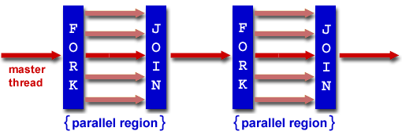
OpenMP Programming Model
Fork - Join Model:
OpenMP programs begin as single process: master thread; Executes sequentially until the first parallel region construct is encountered
FORK: the master thread then creates a team of parallel threads
Statements in program that are enclosed by the parallel region construct are executed in parallel among the various team threads
JOIN: When the team threads complete the statements in the parallel region construct, they synchronize and terminate, leaving only the master thread

Slide 16
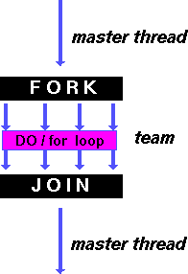
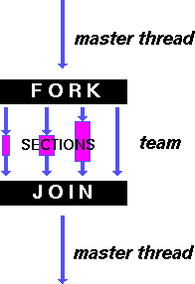
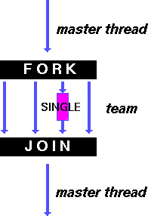
OpenMP Directives
shares iterations of a loop across the team
each section executed by a separate thread
serializes the execution of a thread

Slide 17
Example: C for loop
for (i=0; i<max; i++) zero[i] = 0;
Break for loop into chunks, and allocate each to a separate thread
E.g., if max = 100, with two threads, assign 0-49 to thread 0, 50-99 to thread 1
Must have relatively simple “shape” for an OpenMP-aware compiler to be able to parallelize it
Necessary for the run-time system to be able to determine how many of the loop iterations to assign to each thread
No premature exits from the loop allowed
i.e., No break, return, exit, goto statements

Slide 18
OpenMP: Parallel for pragma
#pragma omp parallel for
for (i=0; i<max; i++) zero[i] = 0;
Master thread creates additional threads, each with a separate execution context
All variables declared outside for loop are shared by default, except for loop index which is private per thread (Why?)
Implicit synchronization at end of for loop
Divide index regions sequentially per thread
Thread 0 gets 0, 1, …, (max/n)-1;
Thread 1 gets max/n, max/n+1, …, 2*(max/n)-1
Why?
Student Roulette?

Slide 19
Thread Creation
How many threads will OpenMP create?
Defined by OMP_NUM_THREADS environment variable (or in code procedure call)
Set this variable to the maximum number of threads you want OpenMP to use
Usually equals the number of cores in the underlying HW on which the program is run

Slide 20
OMP_NUM_THREADS
Shell command to set number threads:
export OMP_NUM_THREADS=x
Shell command check number threads:
echo $OMP_NUM_THREADS
OpenMP intrinsic to set number of threads:
omp_num_threads(x);
OpenMP intrinsic to get number of threads:
num_th = omp_get_num_threads();
OpenMP intrinsic to get Thread ID number:
th_ID = omp_get_thread_num();

Slide 21
“parallel” Statement and Scope
The general parallel construct: Each thread executes a copy of the code within the block below.
#pragma omp parallel
{
ID = omp_get_thread_num();
foo(ID);
}
OpenMP default is shared variables
To make private, need to declare with pragma
#pragma omp parallel private (x)

Slide 22
Parallel Statement Shorthand
#pragma omp parallel
{
#pragma omp for //This is the only
//directive in the
// parallel section
for(i=0;i<len;i++) { … }
}
can be shortened to
#pragma omp parallel for
for(i=0;i<len;i++) { … }

Slide 23
Agenda
OpenMP Introduction
Administrivia
OpenMP Examples
Break
Common Pitfalls
Summary

Slide 24
Administrivia
Project #2: Matrix Multiply Performance Improvement
Work in groups of two!
Part 1: Due July 24 (this Sunday)
Part 2: Due July 31
HW #3 also due July 27
Closely packed due dates, try to get ahead of schedule for the project.

Slide 25
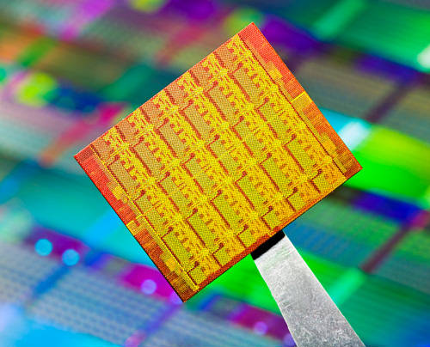
cs61c in the News
Intel reveals new 50 core Knight’s Corner co-processor, to compete with Nvidia’s multi-hundred core “general purpose” Tesla GPU.
“The main advantage that Intel touts vs. Tesla is that because MIC is just a bunch of x86 cores, it's easy for users to port their existing toolchains to it.”
http://arstechnica.com/business/news/2011/06/intel-takes-wraps-off-of-50-core-supercomputing-coprocessor-plans.ars

Slide 26
Agenda
OpenMP Introduction
Administrivia
OpenMP Examples
Break
Common Pitfalls
Summary

Slide 27
OpenMP Examples
Hello World
OMP Get Environment (hidden slides)
For Loop Workshare
Section Workshare
Sequential and Parallel Numerical Calculation of Pi

Slide 28
Hello World in OpenMP
#include <omp.h>
#include <stdio.h>
int main (void) {
int nthreads, tid;
/* Fork team of threads with each having a private tid variable */
#pragma omp parallel private(tid)
{
/* Obtain and print thread id */
tid = omp_get_thread_num();
printf("Hello World from thread = %d\n", tid);
/* Only master thread does this */
if (tid == 0) {
nthreads = omp_get_num_threads();
printf("Number of threads = %d\n", nthreads);
}
} /* All threads join master thread and terminate */
}

Slide 29
Hello World in OpenMP
localhost:OpenMP randykatz$ ./omp_hello
Hello World from thread = 0
Hello World from thread = 1
Number of threads = 2

Slide 30
Get Environment Information in OpenMP
#include <omp.h>
#include <stdio.h>
#include <stdlib.h>
int main (int argc, char *argv[])
{int nthreads, tid, procs, maxt, inpar, dynamic, nested;
#pragma omp parallel private(nthreads, tid)
{
tid = omp_get_thread_num(); /* Obtain thread number */
if (tid == 0) { /* Only master thread does this */
printf("Thread %d getting environment info...\n", tid);
/* Get environment information */
procs = omp_get_num_procs();
nthreads = omp_get_num_threads();
maxt = omp_get_max_threads();
inpar = omp_in_parallel();
dynamic = omp_get_dynamic();
nested = omp_get_nested();

Slide 31
Get Environment Information in OpenMP
/* Print environment information */
printf("Number of processors = %d\n", procs);
printf("Number of threads = %d\n", nthreads);
printf("Max threads = %d\n", maxt);
printf("In parallel? = %d\n", inpar);
printf("Dynamic threads enabled? = %d\n", dynamic);
printf("Nested parallelism supported? = %d\n", nested);
}
} /* Parallel Done */
}

Slide 32
Get Environment Information in OpenMP
Thread 0 getting environment info...
Number of processors = 2
Number of threads = 2
Max threads = 1
In parallel? = 1
Dynamic threads enabled? = 0
Nested parallelism supported? = 0
Executes two threads
Prints information from thread 0 only
At this point just one thread available, hence max threads = 1

Slide 33
Workshare for loop Example #1 in OpenMP
#include <omp.h>
#include <stdio.h>
#include <stdlib.h>
#define CHUNKSIZE 10
#define N 100
int main (int argc, char *argv[])
{ int nthreads, tid, i, chunk;
float a[N], b[N], c[N];
/* Some initializations */
for (i=0; i < N; i++)
a[i] = b[i] = i * 1.0;
chunk = CHUNKSIZE;

Slide 34
Workshare for loop Example #1 in OpenMP
#pragma omp parallel shared(a,b,c,nthreads,chunk) private(i,tid)
{ tid = omp_get_thread_num();
if (tid == 0){
nthreads = omp_get_num_threads();
printf("Number of threads = %d\n", nthreads);
}
printf("Thread %d starting...\n",tid);
#pragma omp for schedule(dynamic,chunk)
for (i=0; i<N; i++){
c[i] = a[i] + b[i];
printf("Thread %d: c[%d]= %f\n",tid,i,c[i]);
}
} /* end of parallel section */
}
The iterations of a loop are scheduled dynamically across the team of threads. A thread will perform CHUNK iterations at a time before being scheduled for the next CHUNK of work.

Slide 35
Workshare for loop Example #1 in OpenMP
Number of threads = 2
Thread 0 starting...
Thread 1 starting...
Thread 0: c[0]= 0.000000
Thread 1: c[10]= 20.000000
Thread 0: c[1]= 2.000000
Thread 1: c[11]= 22.000000
Thread 0: c[2]= 4.000000
Thread 1: c[12]= 24.000000
Thread 0: c[3]= 6.000000
Thread 1: c[13]= 26.000000
Thread 0: c[4]= 8.000000
Thread 1: c[14]= 28.000000
Thread 0: c[5]= 10.000000
Thread 1: c[15]= 30.000000
Thread 0: c[6]= 12.000000
Thread 1: c[16]= 32.000000
Thread 1: c[17]= 34.000000
Thread 1: c[18]= 36.000000
Thread 0: c[7]= 14.000000
Thread 1: c[19]= 38.000000
Thread 0: c[8]= 16.000000
Thread 1: c[20]= 40.000000
Thread 0: c[9]= 18.000000
Thread 1: c[21]= 42.000000
Thread 0: c[30]= 60.000000
Thread 1: c[22]= 44.000000
Thread 0: c[31]= 62.000000
Thread 1: c[23]= 46.000000
. . .
Thread 0: c[78]= 156.000000
Thread 1: c[25]= 50.000000
Thread 0: c[79]= 158.000000
Thread 1: c[26]= 52.000000
Thread 0: c[80]= 160.000000
Thread 1: c[27]= 54.000000
Thread 0: c[81]= 162.000000
Thread 1: c[28]= 56.000000
Thread 0: c[82]= 164.000000
Thread 1: c[29]= 58.000000
Thread 0: c[83]= 166.000000
Thread 1: c[90]= 180.000000
Thread 0: c[84]= 168.000000
Thread 1: c[91]= 182.000000
Thread 0: c[85]= 170.000000
Thread 1: c[92]= 184.000000
Thread 0: c[86]= 172.000000
Thread 1: c[93]= 186.000000
Thread 0: c[87]= 174.000000
Thread 1: c[94]= 188.000000
Thread 0: c[88]= 176.000000
Thread 1: c[95]= 190.000000
Thread 0: c[89]= 178.000000
Thread 1: c[96]= 192.000000
Thread 1: c[97]= 194.000000
Thread 1: c[98]= 196.000000
Thread 1: c[99]= 198.000000

Slide 36
Workshare sections Example #2 in OpenMP
#include <omp.h>
#include <stdio.h>
#include <stdlib.h>
#define N 50
int main (int argc, char *argv[])
{ int i, nthreads, tid;
float a[N], b[N], c[N], d[N];
/* Some initializations */
for (i=0; i<N; i++) {
a[i] = i * 1.5;
b[i] = i + 22.35;
c[i] = d[i] = 0.0;
}

Slide 37
Workshare sections Example #2 in OpenMP
#pragma omp parallel private(i,tid)
{ tid = omp_get_thread_num();
if (tid == 0) {
nthreads = omp_get_num_threads();
printf("Number of threads = %d\n", nthreads);
}
printf("Thread %d starting...\n",tid);
#pragma omp sections nowait
{ #pragma omp section
{
printf("Thread %d doing section 1\n",tid);
for (i=0; i<N; i++){
c[i] = a[i] + b[i];
printf("Thread %d: c[%d]= %f\n",tid,i,c[i]);
}
}
Sections

Slide 38
Workshare sections Example #2 in OpenMP
#pragma omp section
{ printf("Thread %d doing section 2\n",tid);
for (i=0; i<N; i++){
d[i] = a[i] * b[i];
printf("Thread %d: d[%d]= %f\n",tid,i,d[i]);
}
}
} /* end of sections */
printf("Thread %d done.\n",tid);
} /* end of parallel section */
}
}
Sections

Slide 39
Workshare sections Example #2 in OpenMP
Number of threads = 2
Thread 1 starting...
Thread 0 starting...
Thread 1 doing section 1
Thread 0 doing section 2
Thread 1: c[0]= 22.350000
Thread 0: d[0]= 0.000000
Thread 1: c[1]= 24.850000
Thread 0: d[1]= 35.025002
Thread 1: c[2]= 27.350000
Thread 0: d[2]= 73.050003
Thread 1: c[3]= 29.850000
Thread 0: d[3]= 114.075005
Thread 1: c[4]= 32.349998
Thread 0: d[4]= 158.100006
Thread 1: c[5]= 34.849998
Thread 0: d[5]= 205.125000
Thread 1: c[6]= 37.349998
Thread 0: d[6]= 255.150009
Thread 1: c[7]= 39.849998
Thread 0: d[7]= 308.175018
Thread 0: d[8]= 364.200012
Thread 0: d[9]= 423.225006
Thread 0: d[10]= 485.249969
Thread 0: d[11]= 550.274963
Thread 0: d[12]= 618.299988
Thread 0: d[13]= 689.324951
Thread 0: d[14]= 763.349976
Thread 0: d[15]= 840.374939
. . .
Thread 1: c[33]= 104.849998
Thread 0: d[41]= 3896.024902
Thread 1: c[34]= 107.349998
Thread 0: d[42]= 4054.049805
Thread 1: c[35]= 109.849998
Thread 0: d[43]= 4215.074707
Thread 1: c[36]= 112.349998
Thread 0: d[44]= 4379.100098
Thread 1: c[37]= 114.849998
Thread 1: c[38]= 117.349998
Thread 1: c[39]= 119.849998
Thread 1: c[40]= 122.349998
Thread 1: c[41]= 124.849998
Thread 1: c[42]= 127.349998
Thread 1: c[43]= 129.850006
Thread 1: c[44]= 132.350006
Thread 0: d[45]= 4546.125000
Thread 1: c[45]= 134.850006
Thread 0: d[46]= 4716.149902
Thread 1: c[46]= 137.350006
Thread 0: d[47]= 4889.174805
Thread 1: c[47]= 139.850006
Thread 0: d[48]= 5065.199707
Thread 0: d[49]= 5244.225098
Thread 0 done.
Thread 1: c[48]= 142.350006
Thread 1: c[49]= 144.850006
Thread 1 done.
Nowait in sections

Slide 40
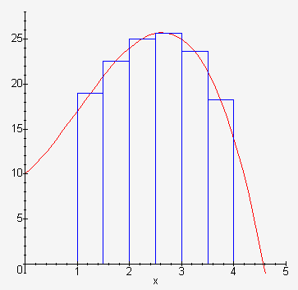
Calculating π using Numerical Integration
Riemann Sum Approximation:
P is a partition of [a, b] into n subintervals, [x₀, x₁ ], [x₁, x₂], . . . , [x_{n - 1}, x_{n}] each of width x.
x_{i}* is in the interval [x_{i} ₋ ₁, x_{i}] for each i.
As || P ||→ 0, n → infinity and x → 0.
x_{i}* to be the midpoint of each subinterval,
i.e. x_{i}* = ½(x_{i-1} + x_{i}), for each i from 1 to n.
http://www.youtube.com/watch?v=H20cKjz-bjw

Slide 41
Sequential Calculation of π in C
#include <stdio.h> /* Serial Code */
static long num_steps = 100000;
double step;
int main (int argc, char *argv[]) {
int i; double x, pi, sum = 0.0;
step = 1.0/(double) num_steps;
for (i=0; i < num_steps; i++){
x = (i+0.5)*step;
sum = sum + 4.0/(1.0+x*x);
}
pi = sum/num_steps;
printf ("pi = %6.12f\n", pi);
}
pi = 3.14159265

Slide 42
OpenMP Version #1
#include <omp.h>
static long num_steps = 100000; double step;
#define NUM_THREADS 2
int main (int argc, char *argv[]){
int i, id; double x, pi, sum[NUM_THREADS];
step = 1.0/(double) num_steps;
#pragma omp parallel private(x)
{
id = omp_get_thread_num();
for (i = id, sum[id] = 0.0; i < num_steps; i = i + NUM_THREADS) { x = (i + 0.5)*step;
sum[id] += 4.0/(1.0+x*x);
}
}
for(i = 0, pi = 0.0; i < NUM_THREADS; i++)
pi += sum[i] ;
printf ("pi = %6.12f\n", pi / num_steps);
}

Slide 43
OpenMP Version #1 (with bug)
pi = 2.187926626214
pi = 3.062113243183
pi = 2.093066397959
pi = 3.141592653598
pi = 2.199725334399
pi = 2.129254580053
pi = 3.298710582772
pi = 2.358075931672
pi = 1.979735213760
pi = 3.134406923694
pi = 3.141592653598
pi = 2.273284475646
pi = 3.141592653598
pi = 1.999849495043
pi = 2.348751552706
pi = 1.858418846828
pi = 3.141592653598
pi = 3.141592653598
pi = 2.425973292566
pi = 3.141592653598
pi = 2.024963879529
pi = 2.357897349032
pi = 2.325699828349
pi = 1.825693174923

Slide 44
OpenMP Version #1
#include <omp.h>
static long num_steps = 100000; double step;
#define NUM_THREADS 2
int main (int argc, char *argv[]){
int i, id; double x, pi, sum[NUM_THREADS];
step = 1.0/(double) num_steps;
#pragma omp parallel private(x)
{
id = omp_get_thread_num();
for (i = id, sum[id] = 0.0; i < num_steps; i = i + NUM_THREADS) { x = (i + 0.5)*step;
sum[id] += 4.0/(1.0+x*x);
}
}
for(i = 0, pi = 0.0; i < NUM_THREADS; i++)
pi += sum[i] ;
printf ("pi = %6.12f\n", pi / num_steps);
}

Slide 45
OpenMP Critical Section
#include <omp.h>
int main(void)
{
int x;
x = 0;
#pragma omp parallel
{
#pragma omp critical
x = x + 1;
} /* end of parallel section */
}
Only one thread executes the following code block at a time
Compiler generates necessary lock/unlock code around the increment of x
Student Roulette?

Slide 46
OpenMP Version #2
#include <omp.h>
static long num_steps = 100000; double step;
#define NUM_THREADS 2
int main (int argc, char *argv[]) {
int i, id; double x, sum, pi=0.0;
step = 1.0/(double) num_steps;
#pragma omp parallel private (x, sum) {
id = omp_get_thread_num();
for (i = id, sum = 0.0; i < num_steps;
i = i + NUM_THREADS){
x = (i + 0.5)*step;
sum += 4.0/(1.0+x*x);
}
#pragma omp critical
pi += sum;
}
printf ("pi = %6.12f,\n", pi/num_steps);
}

Slide 47
OpenMP Version #2 (with bug)
pi = 2.193065170635
pi = 2.094493774172
pi = 2.941181318377
pi = 3.706889160821
pi = 3.146809442180
pi = 2.416534126971
pi = 3.141592653598
pi = 2.880126390443
pi = 2.012071161080
pi = 2.294675684941
pi = 2.769967988388
pi = 2.373218039482
pi = 3.141592653598
pi = 2.446564596856
pi = 2.292319872127
pi = 3.430000515865
pi = 3.650290478614
pi = 1.988308636488
pi = 3.141592653598
pi = 2.516381208613
pi = 3.141592653598
pi = 2.331351828709
pi = 2.245872892167
pi = 1.928775146184

Slide 48
OpenMP Reduction
Reduction: specifies that one or more variables that are private to each thread are subject of reduction operation at end of parallel region: reduction(operation:var) where
Operation: operator to perform on the variables (var) at the end of the parallel region
Var: One or more variables on which to perform scalar reduction
#pragma omp for reduction(+:nSum) for (i = START ; i <= END ; i++) nSum += i;

Slide 49
OpenMP Version #3
Note: Don’t have to declare for loop index variable i private, since that is default
#include <omp.h>
#include <stdio.h>
/static long num_steps = 100000;
double step;
int main (int argc, char *argv[]){
int i; double x, pi, sum = 0.0;
step = 1.0/(double) num_steps;
#pragma omp parallel for private(x) reduction(+:sum)
for (i = 0; i < num_steps; i++){
x = (i+0.5)*step;
sum = sum + 4.0/(1.0+x*x);
}
pi = sum / num_steps;
printf (“pi = %6.8f\n”, pi);
}

Slide 50
OpenMP Timing
omp_get_wtime – Elapsed wall clock time
double omp_get_wtime(void);
#include <omp.h> // to get function
Elapsed wall clock time in seconds. Time is measured per thread, no guarantee can be made that two distinct threads measure the same time. Time is measured from some "time in the past". On POSIX compliant systems the seconds since the Epoch (00:00:00 UTC, January 1, 1970) are returned.

Slide 51
OpenMP Version #3
pi = 3.14159265 in 0.176 seconds
pi = 3.14159265 in 0.190 seconds
pi = 3.14159265 in 0.178 seconds
pi = 3.14159265 in 0.177 seconds
pi = 3.14159265 in 0.182 seconds
pi = 3.14159265 in 0.181 seconds
pi = 3.14159265 in 0.177 seconds
pi = 3.14159265 in 0.178 seconds
pi = 3.14159265 in 0.177 seconds
pi = 3.14159265 in 0.179 seconds
pi = 3.14159265 in 0.180 seconds
pi = 3.14159265 in 0.190 seconds
pi = 3.14159265 in 0.177 seconds
pi = 3.14159265 in 0.178 seconds
pi = 3.14159265 in 0.182 seconds
pi = 3.14159265 in 0.181 seconds
pi = 3.14159265 in 0.176 seconds
pi = 3.14159265 in 0.181 seconds
pi = 3.14159265 in 0.184 seconds
pi = 3.14159265 in 0.177 seconds
pi = 3.14159265 in 0.178 seconds
pi = 3.14159265 in 0.178 seconds
pi = 3.14159265 in 0.183 seconds
pi = 3.14159265 in 0.180 seconds

Slide 52
Agenda
OpenMP Introduction
Administrivia
OpenMP Examples
Break
Common Pitfalls
Summary

Slide 53
OpenMP Version #4
#include <omp.h>
static long num_steps = 100000; double step;
int main (int argc, char *argv[]){
int i, id; double x, pi, sum;
sum = 0.0;
step = 1.0/(double) num_steps;
#pragma omp parallel
{
#pragma omp for
for (i = 0; i < num_steps; i++) { x = (i + 0.5)*step;
sum += 4.0/(1.0+x*x);
}
}
printf ("pi = %6.12f\n", step * sum);
}

Slide 54
OpenMP Version #4 (with bug)
pi = 1.265327037088
pi = 1.961754300795
pi = 1.702630397118
pi = 3.113547769550
pi = 2.491334675594
pi = 1.476785567928
pi = 1.307626664756
pi = 1.303385815200
pi = 3.141592653598
pi = 3.141592653598
pi = 1.155505463020
pi = 1.514950670570
pi = 1.193981730178
pi = 1.311730912439
pi = 3.141592653598
pi = 1.555278403355
pi = 2.135597106908
pi = 1.800509862440
pi = 1.182105369813
pi = 3.141592653598
pi = 1.944801017796
pi = 1.227297673420
pi = 2.487932948250
pi = 1.875190752727

Slide 55
OpenMP Version #5
#include <omp.h>
static long num_steps = 100000; double step;
int main (int argc, char *argv[]){
int i, id; double x, pi, sum, sum0;
sum = 0.0;
step = 1.0/(double) num_steps;
#pragma omp parallel private(x,sum0) shared (step,sum)
{
sum0 = 0.0;
#pragma omp for
for (i = 0; i < num_steps; i++) { x = (i + 0.5)*step;
sum0 += 4.0/(1.0+x*x);
}
sum = sum + sum0;
}
printf ("pi = %6.12f\n", step * sum);
}

Slide 56
OpenMP Version #6
#include <omp.h>
static long num_steps = 100000; double step;
int main (int argc, char *argv[]){
int i, id; double x, pi, sum, sum0;
sum = 0.0;
step = 1.0/(double) num_steps;
#pragma omp parallel private(x,sum0) shared (step,sum)
{
sum0 = 0.0;
#pragma omp for
for (i = 0; i < num_steps; i++) { x = (i + 0.5)*step;
sum0 += 4.0/(1.0+x*x);
}
#pragma omp critical
{
sum = sum + sum0;
}
}
printf ("pi = %6.12f\n", step * sum);
}

Slide 57
OpenMP Version #6
pi = 3.141592653598
pi = 3.141592653598
pi = 3.141592653598
pi = 3.141592653598
pi = 3.141592653598
pi = 3.141592653598
pi = 3.141592653598
pi = 3.141592653598
pi = 3.141592653598
pi = 3.141592653598
pi = 3.141592653598
pi = 3.141592653598
pi = 3.141592653598
pi = 3.141592653598
pi = 3.141592653598
pi = 3.141592653598
pi = 3.141592653598
pi = 3.141592653598
pi = 3.141592653598
pi = 3.141592653598
pi = 3.141592653598
pi = 3.141592653598
pi = 3.141592653598
pi = 3.141592653598

Slide 58
Matrix Multiply in OpenMP
start_time = omp_get_wtime();
#pragma omp parallel for private(tmp, i, j, k)
for (i=0; i<Ndim; i++){
for (j=0; j<Mdim; j++){
tmp = 0.0;
for( k=0; k<Pdim; k++){
/* C(i,j) = sum(over k) A(i,k) * B(k,j)*/
tmp += *(A+(i*Ndim+k)) * *(B+(k*Pdim+j));
}
*(C+(i*Ndim+j)) = tmp;
}
}
run_time = omp_get_wtime() - start_time;
Note: Outer loop spread across N threads; inner loops inside a thread

Slide 59
Notes on Matrix Multiply Example
More performance optimizations available
Higher compiler optimization (-O2, -O3) to reduce number of instructions executed
Cache blocking to improve memory performance
Using SIMD SSE3 Instructions to raise floating point computation rate

Slide 60
OpenMP Pitfall #1: Data Dependencies
Consider the following code:
a[0] = 1;
for(i=1; i<5; i++)
a[i] = i + a[i-1];
There are dependencies between loop iterations
Sections of loops split between threads will not necessarily execute in order
Out of order loop execution will result in undefined behavior

Slide 61
Open MP Pitfall #2: Avoiding Sharing Issues by Using Private Variables
Consider the following loop:
#pragma omp parallel for
{
for(i=0; i<n; i++){
temp = 2.0*a[i];
a[i] = temp;
b[i] = c[i]/temp;
}
}
Threads share common address space: will be modifying temp simultaneously; solution:
#pragma omp parallel for private(temp)
{
for(i=0; i<n; i++){
temp = 2.0*a[i];
a[i] = temp;
b[i] = c[i]/temp;
}
}

Slide 62
OpenMP Pitfall #3: Updating Shared Variables Simultaneously
Now consider a global sum:
for(i=0; i<n; i++)
sum = sum + a[i];
This can be done by surrounding the summation by a critical section, but for convenience, OpenMP also provides the reduction clause:
#pragma omp parallel for reduction(+:sum)
{
for(i=0; i<n; i++)
sum = sum + a[i];
}
Compiler can generate highly efficient code for reduction

Slide 63
OpenMP Pitfall #4: Parallel Overhead
Spawning and releasing threads results in significant overhead
Therefore, you want to make your parallel regions as large as possible
Parallelize over the largest loop that you can (even though it will involve more work to declare all of the private variables and eliminate dependencies)
Coarse granularity is your friend!

Slide 64
OpenMP Pitfall #4: Parallel Overhead
start_time = omp_get_wtime();
for (i=0; i<Ndim; i++){
for (j=0; j<Mdim; j++){
tmp = 0.0;
#pragma omp parallel for reduction(+:tmp)
for( k=0; k<Pdim; k++){
/* C(i,j) = sum(over k) A(i,k) * B(k,j)*/
tmp += *(A+(i*Ndim+k)) * *(B+(k*Pdim+j));
}
*(C+(i*Ndim+j)) = tmp;
}
}
run_time = omp_get_wtime() - start_time;
Way too much overhead in thread generation to have this statement run this frequently

Slide 65
And in Conclusion, …
Synchronization via atomic operations:
MIPS does it with Load Linked + Store Conditional
OpenMP as simple parallel extension to C
Threads, Parallel for, private, critical sections, …

