Slide 1
CS 61C: Great Ideas in Computer Architecture (Machine Structures)
Switches, Transistors, Gates, Flip-Flops
Instructor:
Michael Greenbaum

Slide 2
Review
Sequential software is slow software
  SIMD and MIMD only path to higher performance
Multiprocessor/Multicore uses Shared Memory
  Cache coherency implements shared memory even with multiple copies in multiple caches
  False sharing a concern; watch block size!
Data races lead to subtle parallel bugs
Synchronization via atomic operations:
  MIPS does it with Load Linked + Store Conditional
OpenMP as simple parallel extension to C
  Threads, Parallel for, private, critical sections, …

Slide 3

Levels of Representation/Interpretation
High Level Language
Program (e.g., C)
temp = v[k];
v[k] = v[k+1];
v[k+1] = temp;
Compiler
Anything can be represented
as a number,
i.e., data or instructions
lw $t0, 0($2)
lw $t1, 4($2)
sw $t1, 0($2)
sw $t0, 4($2)
Assembly Language Program (e.g., MIPS)
Assembler
0000 1001 1100 0110 1010 1111 0101 1000
1010 1111 0101 1000 0000 1001 1100 0110
1100 0110 1010 1111 0101 1000 0000 1001
0101 1000 0000 1001 1100 0110 1010 1111
Machine Language Program (MIPS)
Machine Interpretation
Hardware Architecture Description
(e.g., block diagrams)
Architecture Implementation
Logic Circuit Description
(Circuit Schematic Diagrams)

Slide 4
Agenda
Switching Networks, Transistors
Administrivia
Combinational Logic
Break
Combinational Logic (cont'd)
State Elements
Summary

Slide 5
Hardware Design
Next several weeks: we’ll study how a modern processor is built; starting with basic elements as building blocks
Why study hardware design?
  Understand capabilities and limitations of hw in general and processors in particular
  What processors can do fast and what they can’t do fast
  (avoid slow things if you want your code to run fast!)
  Background for more in depth hw courses (CS 150, CS 152)
  There is just so much you can do with standard processors: you may need to design own custom hw for extra performance
    Even some commercial processors today have customizable hardware!

Slide 6
Synchronous Digital Systems
Hardware of a processor, such as the MIPS, is an example of a Synchronous Digital System
Synchronous:
  All operations coordinated by a central clock
    “Heartbeat” of the system!
Digital:
  Represent All values by 2 discrete values
  Electrical signals are treated as 1’s and 0’s
    1 and 0 are complements of each other
  High /low voltage for true / false, 1 / 0

Slide 7
Switches: Basic Element of Physical Implementations
Implementing a simple circuit (arrow shows action if wire changes to “1” or is asserted):
A
Z
Close switch (if A is “1” or asserted)
and turn on light bulb (Z)
Z
A
Open switch (if A is “0” or unasserted)
and turn off light bulb (Z)
Z ≡ A

Slide 8
Switches (cont’d)
Compose switches into more complex ones (Boolean functions):
A
B
AND
Z ≡ A and B
A
OR
Z ≡ A or B
B

Slide 9
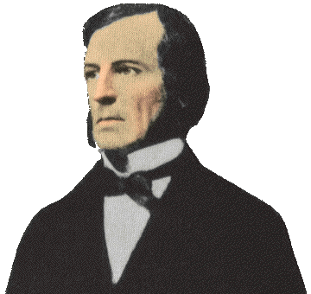
Historical Note
Early computer designers built ad hoc circuits from switches
Began to notice common patterns in their work: ANDs, ORs, …
Master’s thesis (by Claude Shannon) made link between work and 19th Century
Mathematician George Boole
  Called it “Boolean” in his honor
Could apply math to give theory to
hardware design, minimization, …

Slide 10
Transistor Networks
Modern digital systems designed in CMOS
  MOS: Metal-Oxide on Semiconductor
  C for complementary: use pairs of normally-open and normally-closed switches
CMOS transistors act as voltage-controlled switches
  Similar, though easier to work with, than relay switches from earlier era

Slide 11
CMOS Transistors
Gate
Source
Drain
Three terminals: source, gate, and drain
  Switch action:
  if voltage on gate terminal is (some amount) higher/lower than source terminal then conducting path established between drain and source terminals (switch is closed)
Note circle symbol to indicate “NOT” or “complement”
Gate
Gate
Source
Drain
Source
Drain
n-channel transitor
open when voltage at Gate is low
closes when:
voltage(Gate) > voltage (Threshold)
p-channel transistor
closed when voltage at Gate is low
opens when:
voltage(Gate) > voltage (Threshold)
Notes:
From wikipedia:
The field-effect transistor (FET) relies on an electric field to control the shape and hence the conductivity of a channel of one type of charge carrier in a semiconductor material.
The most commonly used FET is the MOSFET. The CMOS (complementary-symmetry metal oxide semiconductor) process technology is the basis for modern digital integrated circuits. This process technology uses an arrangement where the (usually "enhancement-mode") p-channel MOSFET and n-channel MOSFET are connected in series such that when one is on, the other is off.

Slide 12
What’s wrong with this?
A
B
1
Z = A and B
A
B
1
Z = A or B
The output Z can be left “floating,” attached to nothing!
The properties of a “floating” wire are very unstable.

Slide 13
CMOS circuit rules
Never leave a wire undriven (“floating”)
  Make sure there’s always a path to V_{dd} or gnd (ground)
Never create a path from V_{dd} to gnd (short circuit!)
Don’t pass weak values
  N-type transistors pass weak 1’s (V_{dd} - V_{th})
  N-type transistors pass strong 0’s (gnd)
  Use N-type transistors only to pass 0’s (n to negative)
  Conversely for P-type transistors
    Pass weak 0’s (V_{th}), strong 1’s (V_{dd})
    Use P-type transistors only to pass 1’s (p to positive)
  Use pairs of N-type and P-type to get strong values

Slide 14
MOS Networks
p-channel transistor
closed when voltage at Gate is low
opens when:
voltage(Gate) > voltage (Threshold)
X
what is the
relationship
between x and z?
3v
x
z
Y
0 volts
(gnd)
3 volts (Vdd)
0v
3 volts
(Vdd)
0 volts (gnd)
n-channel transitor
open when voltage at Gate is low
closes when:
voltage(Gate) > voltage (Threshold)
Called an invertor or not gate
Notes:
X = 0 implies top switch is closed, so 3V sent Y
X = 0 implies bottom switch is open, so nothing sent to Y
X = 3v implies Top switch is open, so nothing sent to Y
X = 3v implies Bottom switch is closed, so 0V sent Y
The most commonly used FET is the MOSFET. The CMOS (complementary-symmetry metal oxide semiconductor) process technology is the basis for modern digital integrated circuits. This process technology uses an arrangement where the (usually "enhancement-mode") p-channel MOSFET and n-channel MOSFET are connected in series such that when one is on, the other is off.

Slide 15
Agenda
Switching Networks, Transistors
Administrivia
Combinational Logic
Break
Combinational Logic (cont'd)
State Elements
Summary

Slide 16
Administrivia
Midterm rubric is posted
Project #2: Matrix Multiply Performance Improvement
  Work in groups of two!
  Part 1: Due July 24 (this Sunday)
  Part 2: Due July 31
HW #3 also due July 27

Slide 17
Agenda
Switching Networks, Transistors
Administrivia
Combinational Logic
Break
Combinational Logic (cont'd)
State Elements
Summary

Slide 18
Two Input Networks
what is the
relationship between x, y and z?
X
Y
x
y
z
3v
0 volts
0 volts
0 volts
3 volts
Z
3 volts
0 volts
0v
3 volts
3 volts
X
Y
x
y
z
0 volts
0 volts
3v
0 volts
3 volts
Z
3 volts
0 volts
3 volts
3 volts
0v
Notes:
Top
X = 0v Y = 0V both closed on top, so Z = 3v
X = 0v Y = 0V both open bottom
X = 0v Y = 3V 2nd closed on top, so Z = 3v
X = 0v Y = 3V 2nd in series open
X = 3v Y = 0V 1st closed on top, so Z = 3v
X = 3v Y = 0V 1st in series open
X = 3v Y = 3V both open on top
X = 3v Y = 0V both closed, so Z = 0v

Slide 19
Two Input Networks: Peer Instruction
what is the
relationship between x, y and z?
X
Y
x
y
z
Called NAND gate (NOT AND)
3v
0 volts
3 volts
0 volts
0 volts
3 volts
3 volts
Z
3 volts
3 volts
0 volts
0v
3 volts
3 volts
0 volts
X
Y
x
y
z
A B C D
0 volts
0 volts
0 0 3 3
volts
3v
0 volts
3 volts
0 3 0 3
volts
Z
3 volts
0 volts
0 3 0 3
volts
3 volts
3 volts
3 3 0 0
volts
0v
Notes:
Top
X = 0v Y = 0V both closed on top, so Z = 3v
X = 0v Y = 0V both open bottom
X = 0v Y = 3V 2nd closed on top, so Z = 3v
X = 0v Y = 3V 2nd in series open
X = 3v Y = 0V 1st closed on top, so Z = 3v
X = 3v Y = 0V 1st in series open
X = 3v Y = 3V both open on top
X = 3v Y = 0V both closed, so Z = 0v

Slide 20
Two Input Networks
what is the
relationship between x, y and z?
X
Y
x
y
z
Called NAND gate (NOT AND)
3v
0 volts
3 volts
0 volts
0 volts
3 volts
3 volts
Z
3 volts
3 volts
0 volts
0v
3 volts
3 volts
0 volts
X
Y
Called NOR gate (NOT OR)
x
y
z
3v
0 volts
0 volts
3 volts
0 volts
3 volts
0 volts
Z
3 volts
0 volts
0 volts
3 volts
3 volts
0 volts
0v
Notes:
Bottom
X = 0v Y = 0V both closed on top in series, so Z = 3v
X = 0v Y = 0V both open bottom
X = 0v Y = 3V 1st open on top,
X = 0v Y = 3V 2nd in series closed, so Z = 0v
X = 3v Y = 0V 2nd open on top
X = 3v Y = 0V 2nd in series closed, so Z = 0v
X = 3v Y = 3V both open on top
X = 3v Y = 3V both closed, so Z = 0v

Slide 21
Type of Circuits
Synchronous Digital Systems consist of two basic types of circuits:
  Combinational Logic (CL) circuits
    Output is a function of the inputs only, not the history of its execution
    E.g., circuits to add A, B (ALUs)
  Sequential Logic (SL)
    Circuits that “remember” or store information
    aka “State Elements”
    E.g., memories and registers (Registers)

Slide 22
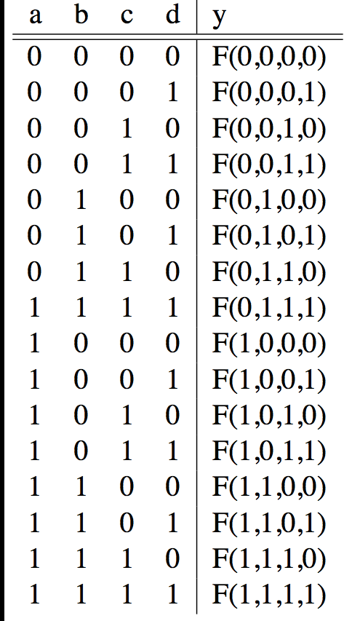
CL: General Form
A
F
B
Y
C
0
D
If N inputs, how many distinct functions F
do we have?
Answer: N inputs => 2^{N} rows in truth table.
A function is a mapping of 0’s and 1’s for each row => 2^(2^{N}) different possible functions!

Slide 23
CL: Multiple Outputs
A
F
X
B
Y
C
Z
D
For 3 outputs, just three separate functions: X(A,B,C,D), Y(A,B,C,D), Z(A,B,C,D)

Slide 24
Logic Gates
A few of the functions on 1 and 2 inputs are given names and special symbols when drawn out:

Slide 25
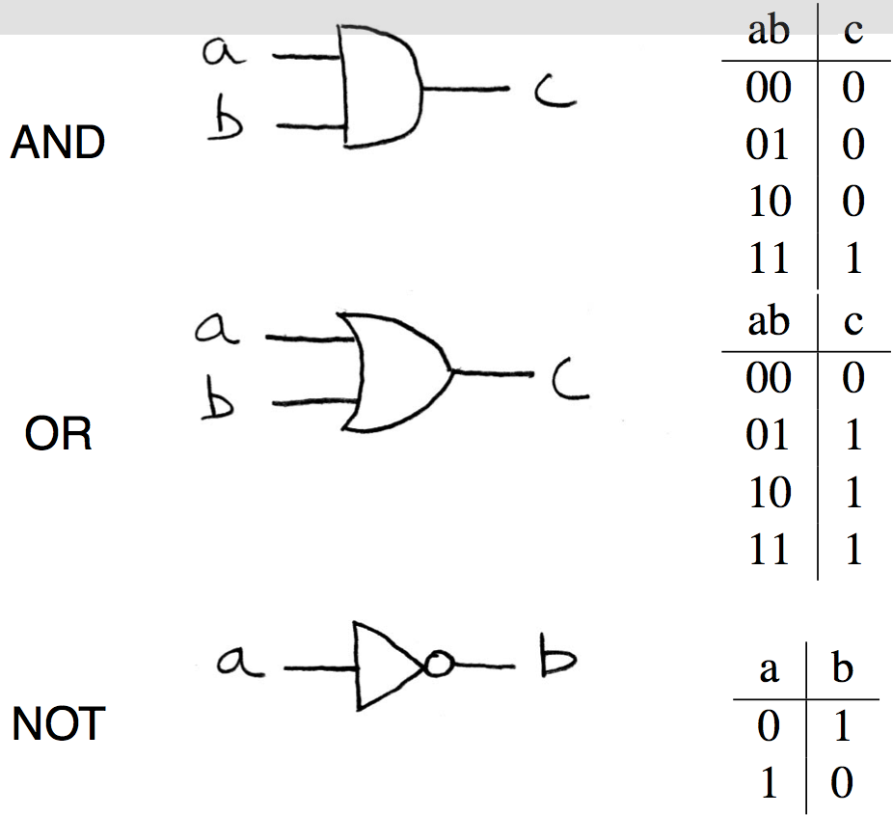
Logic Gates (1/2)

Slide 26
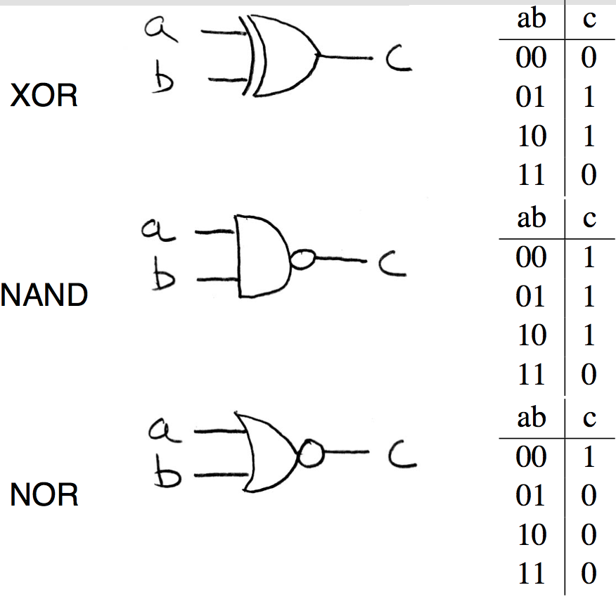
Logic Gates (2/2)

Slide 27
And vs. Or– A mnemonic
AND Gate
Symbol
Definition
^{AN}D
A
C
B

Slide 28
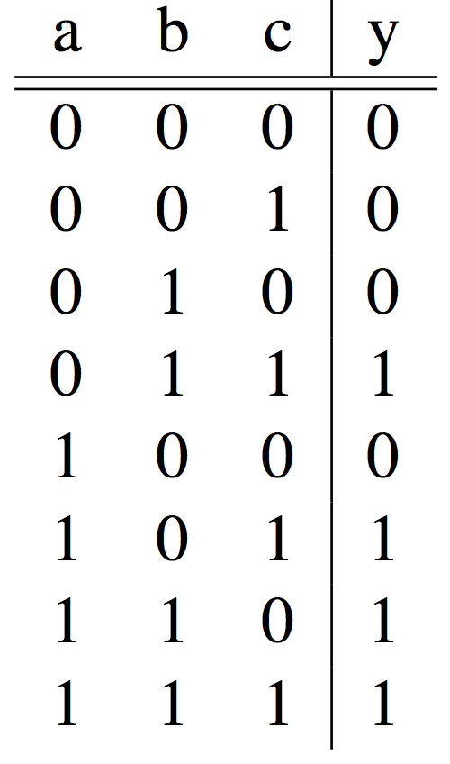
Truth Table Example #1:
3-input Majority Circuit
Y = A B C + A B C + A B C + A B C
This is called Sum of Products form;
Just another way to represent the TT
as a logical expression
Y = B C + A (B C + B C)
Y = B C + A (B + C)
More simplified forms
(fewer gates and wires)
We’ll see how to do this in a bit…

Slide 29
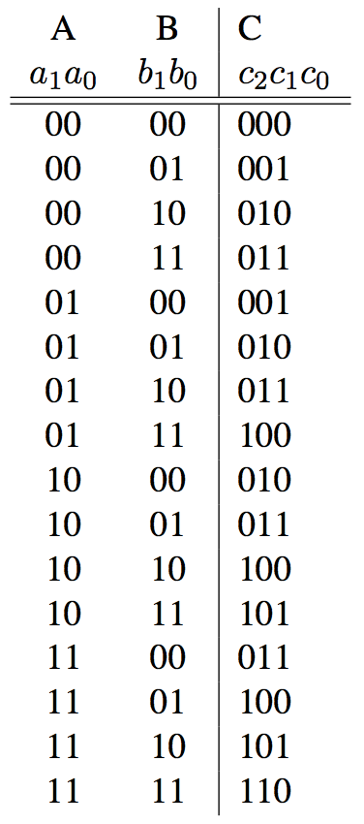
Truth Table Example #2:
2-bit Adder
How
Many
Rows?
A1
+
C2
A0
C1
B1
C0
B0

Slide 30
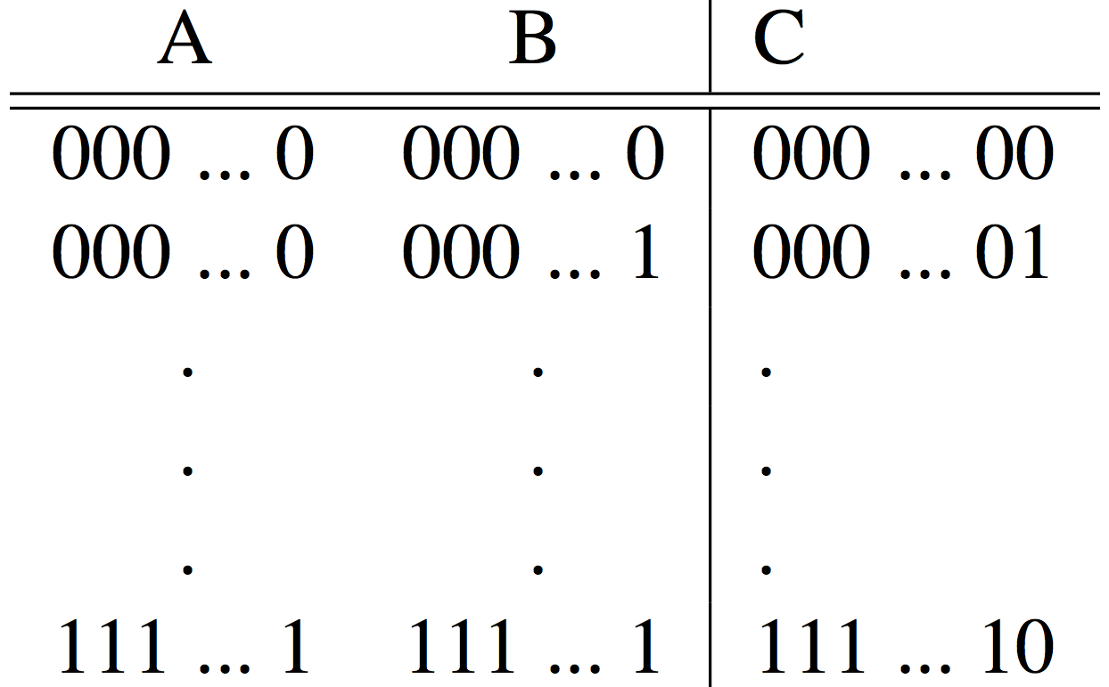
Truth Table Example #3:
32-bit Unsigned Adder
How
Many
Rows?

Slide 31
Agenda
Switching Networks, Transistors
Administrivia
Combinational Logic
Break
Combinational Logic (cont'd)
State Elements
Summary

Slide 32
Boolean Algebra
Use plus for OR
  “logical sum”
Use product for AND (a•b or implied via ab)
  “logical product”
“Hat” to mean complement (NOT)
Thus
ab + a + c
= a•b + a + c
= (a AND b) OR a OR (NOT c )

Slide 33
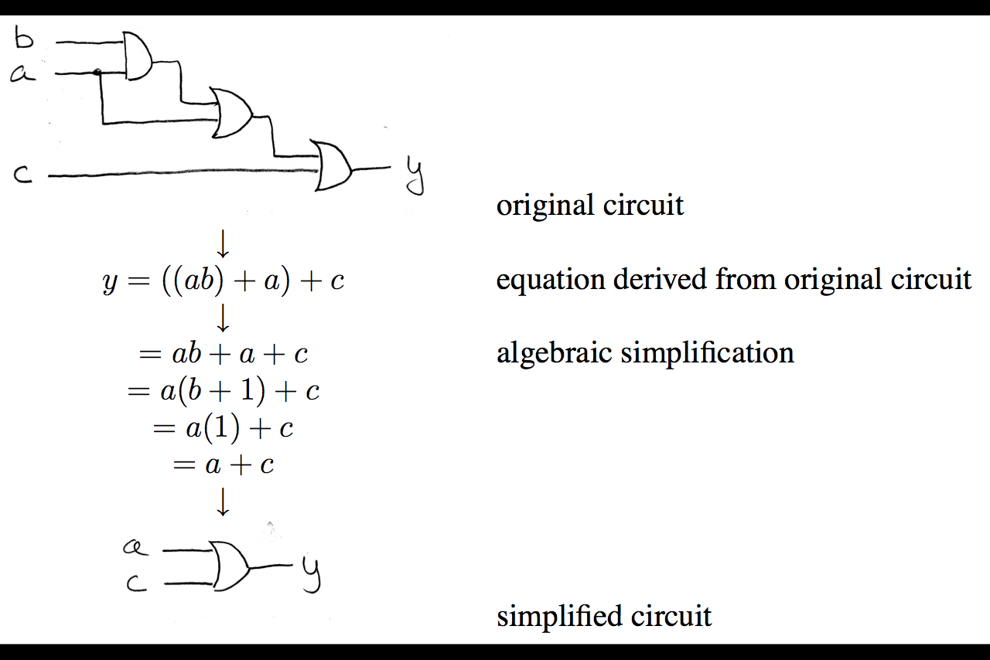
Boolean Algebra: Circuit & Algebraic Simplification

Slide 34
Laws of Boolean Algebra

Slide 35
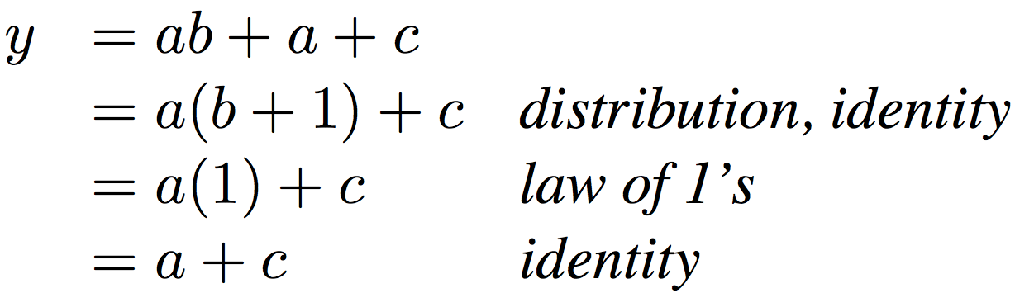
Boolean Algebraic Simplification Example
Notes:
Do on black board
From distribution: a(b +1) + c
Froms laws of 0s and 1s: b+1 = b
= ab + c
Truth Table
a b c y
0 0 0 0
0 0 1 1
0 0 1 1

Slide 36
Different Representations of CL
Truth Table
Boolean Expression
Circuit Diagram
Can go from any one of these representations to another:
  TT => Expression, Sum Of Products
  Expression <=> Circuit Diagram, Just read it off
  Expression/Diagram => TT, Try all the inputs

Slide 37
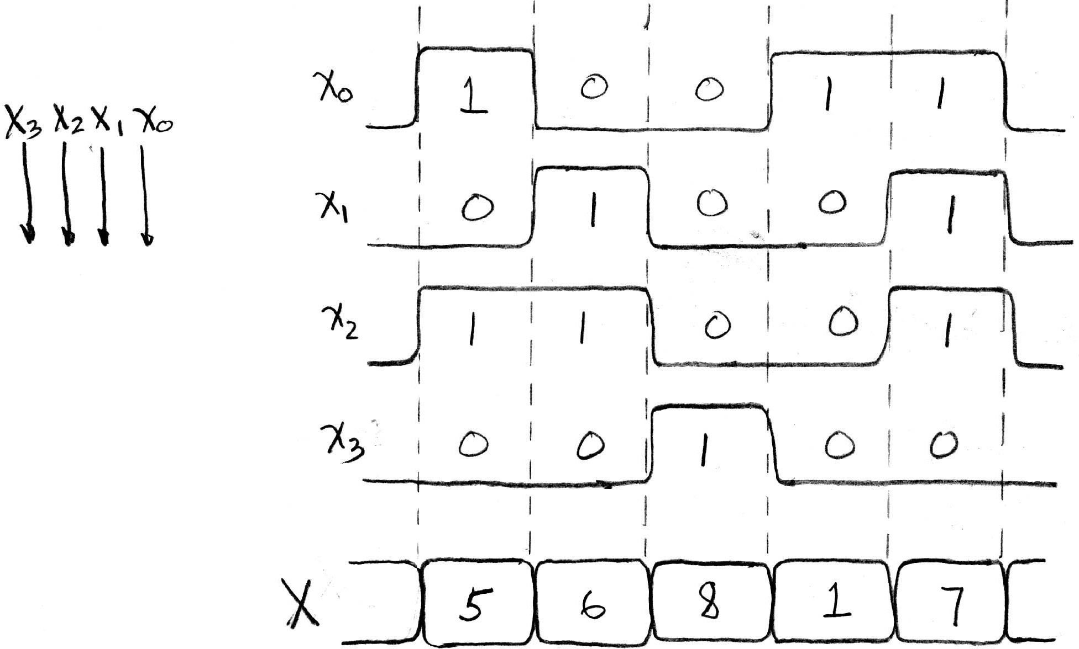
Signals and Timing Diagrams
A group of wires when interpreted as a bit field is called a Bus.

Slide 38
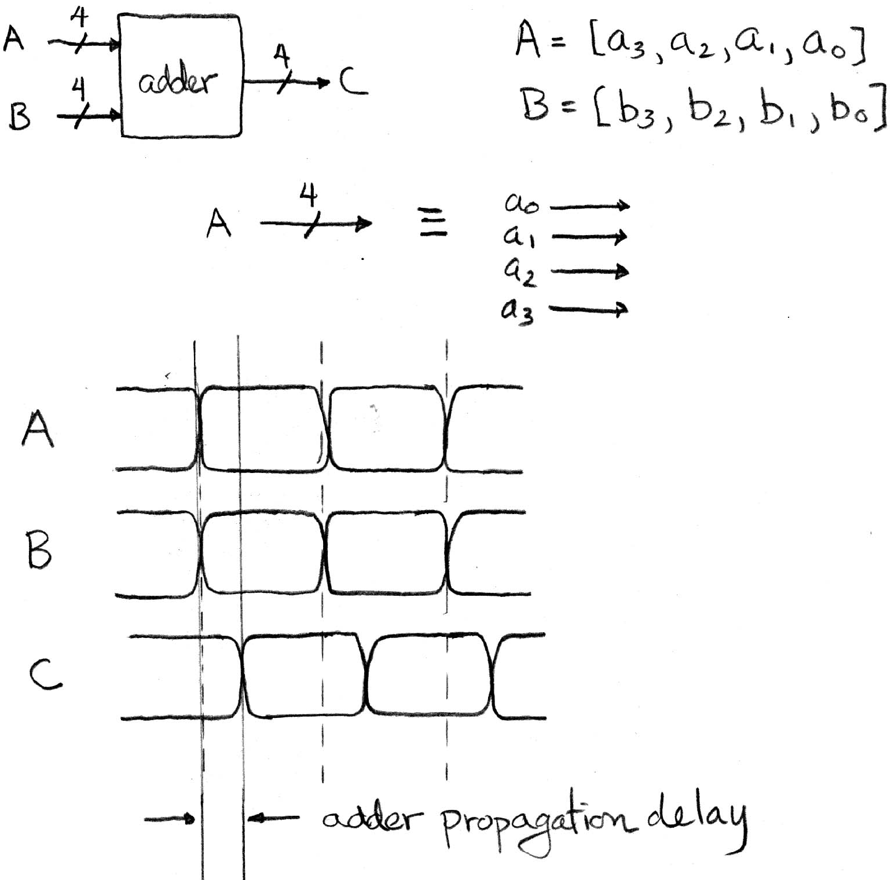
Combinational Logic Circuit Delay
2
3
4
5
There is always some delay before a Combinational Logic’s output updates to reflect the inputs.
3
10
0
1
5
13
4
6

Slide 39
Type of Circuits
Synchronous Digital Systems consist of two basic types of circuits:
  Combinational Logic (CL) circuits
    Output is a function of the inputs only, not the history of its execution
    E.g., circuits to add A, B (ALUs)
  Sequential Logic (SL)
    Circuits that “remember” or store information
    aka “State Elements”
    E.g., memories and registers (Registers)

Slide 40
Uses for State Elements
Place to store values for some amount of time:
  Register files (like $1-$31 on the MIPS)
  Memory (caches, and main memory)
Help control flow of information between combinational logic blocks
  State elements are used to hold up the movement of information at the inputs to combinational logic blocks and allow for orderly passage

Slide 41
Accumulator Example
Why do we need to control the flow of information?
SUM
X_{i}
S
Want: S=0;
For X₁,X₂,X₃ over time...
S = S + X_{i}
Assume:
  Each X value is applied in succession, one per cycle
  The sum since time 1 is present on S

Slide 42
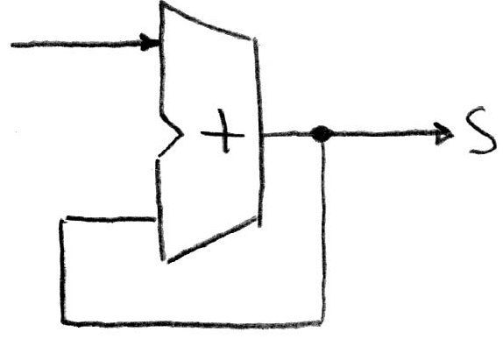
First Try: Does this work?
X
Feedback
No!
Reason #1: How to control the next iteration of the ‘for’ loop?
Reason #2: How do we say: ‘S=0’?

Slide 43
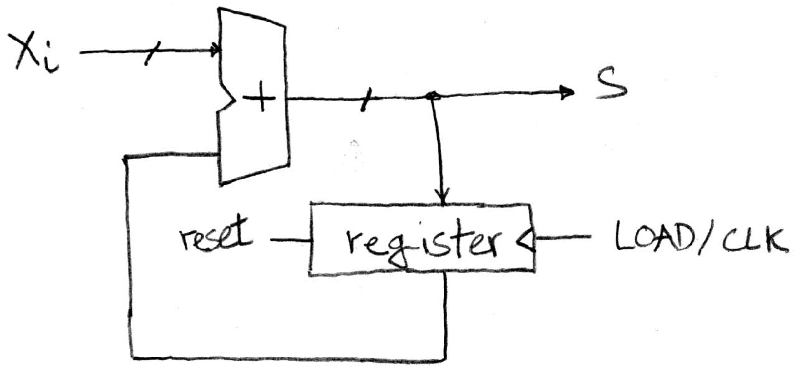
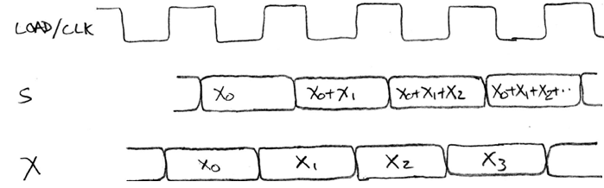
Second Try: How About This?
Register is used to
hold up the transfer
of data to adder
Rough
timing …
Time

Slide 44
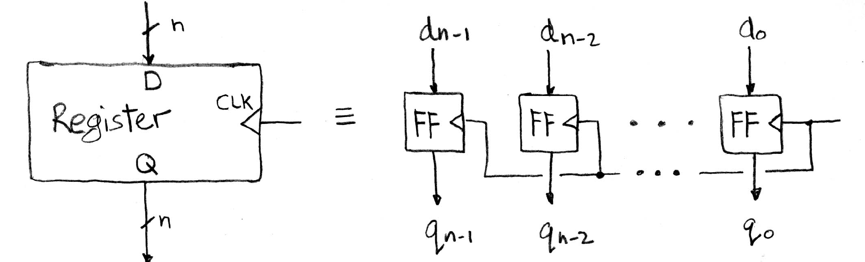
Register Internals
n instances of a “Flip-Flop”
Flip-flop name because the output flips and flops between 0 and 1
D is “data input”, Q is “data output”
Also called “D-type Flip-Flop”

Slide 45
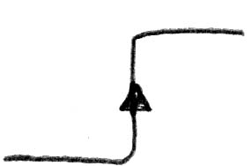
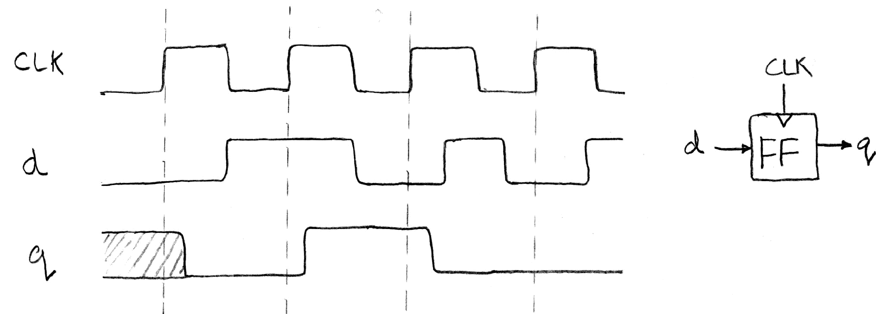
Flip-Flop Timing Behavior (1/2)
Edge-triggered d-type flip-flop
  This one is “positive edge-triggered”
“On the rising edge of the clock, input d is sampled and transferred to the output. At other times, the input d is ignored and the previously sampled value is retained.”
Example waveforms:

Slide 46
Camera Analogy
Want to take a portrait – timing right before and after taking picture
Set up time – don’t move since about to take picture (open camera shutter)
Hold time – need to hold still after shutter opens until camera shutter closes
Time to data – time from open shutter until can see image on output (viewfinder)

Slide 47
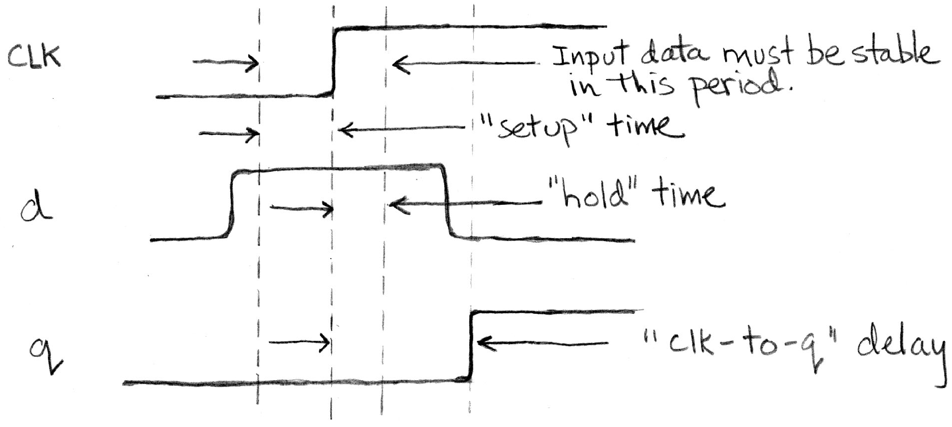
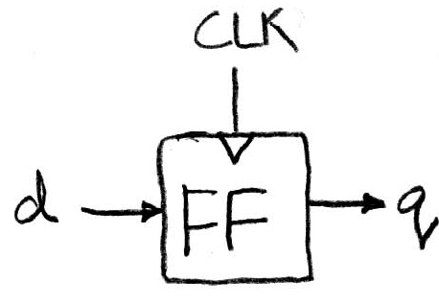
Flip-Flop Timing Behavior (2/2)
Edge-triggered d-type flip-flop
  This one is “positive edge-triggered”
“On the rising edge of the clock, input d is sampled and transferred to the output. At other times, the input d is ignored and the previously sampled value is retained.”

Slide 48
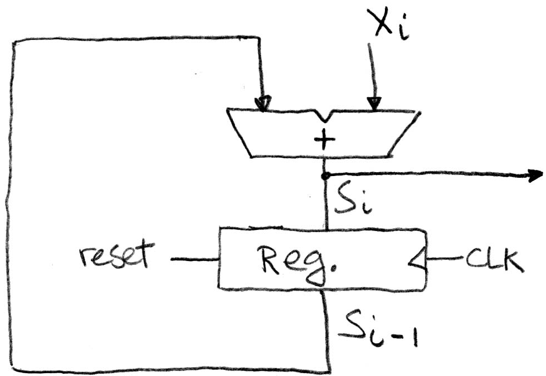
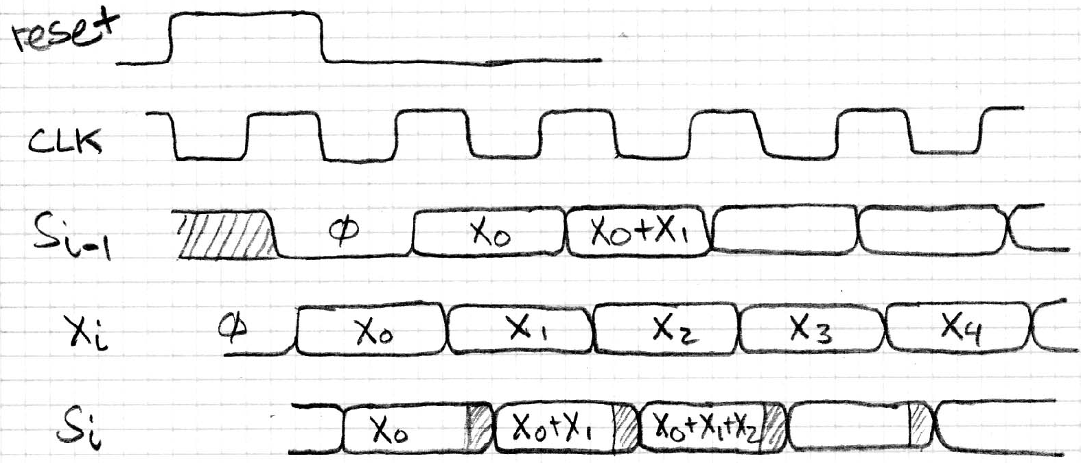
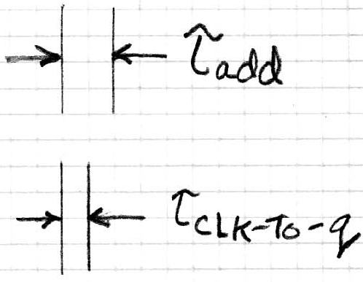
Accumulator Revisited
Proper Timing (2/2)
reset signal shown
Also, in practice X might not arrive to the adder at the same time as S_{i-1}
S_{i} temporarily is wrong, but register always captures correct value
In good circuits, instability never happens around rising edge of clk

Slide 49
“And In Conclusion..”
Hardware systems are constructed from Stateless Combinational Logic and Stateful “Memory” Logic (Registers)
Real world voltages are analog, but are quantized to represent logic 0 and logic 1
Alternate representations for Combinational Logic: Truth table, boolean expression, gates
Boolean Algebra allows minimization of gates
State registers implemented from Flip-flops

