Slide 1
CS 61C: Great Ideas in Computer Architecture (Machine Structures)
Dependability
Instructor:
Michael Greenbaum

Slide 2




New-School Machine Structures
(It’s a bit more complicated!)
Software Hardware
Parallel Requests
  Assigned to computer
  e.g., Search “Katz”
Parallel Threads
  Assigned to core
  e.g., Lookup, Ads
Parallel Instructions
  >1 instruction @ one time
  e.g., 5 pipelined instructions
Parallel Data
  >1 data item @ one time
  e.g., Add of 4 pairs of words
Hardware descriptions
  All gates @ one time
Warehouse Scale Computer
Smart
Phone
Harness
Parallelism &
Achieve High
Performance
Computer
Core
…
Core
Memory (Cache)
Input/Output
Core
Instruction Unit(s)
Functional
Unit(s)
A₀+B₀
A₁+B₁
A₂+B₂
A₃+B₃
Main Memory
Logic Gates

Slide 3
Agenda
Disks
Reliability
Administrivia
RAID
Error Correcting Codes (If time)

Slide 4
Magnetic Disks
A kind of memory
  Information stored by magnetizing ferrite material on surface of rotating disk
Nonvolatile storage
  retains its value without applying power to disk.
  Main memory is volatile - only stores data when power is applied.
Two Types
  Floppy disks – slower, less dense, removable, non-existent today
  Hard Disk Drives (HDD) – faster, more dense, non-removable.
Purpose in computer systems (Hard Drive):
  Long-term, inexpensive storage for files.
  Layer in the memory hierarchy beyond main memory.

Slide 5
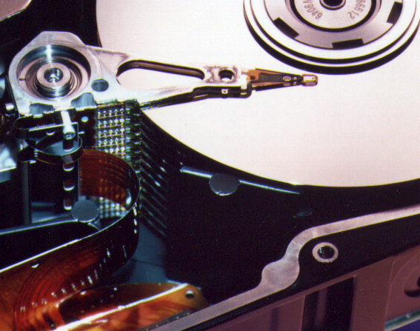
Photo of Disk Head, Arm, Actuator
Spindle
Arm
Head
Actuator
{
Platters (1-12)

Slide 6
Disk Device Terminology
Inner
Track
Several platters, with information recorded magnetically on both surfaces (usually)
Bits recorded in tracks, which in turn divided into sectors (e.g., 512 Bytes)
Actuator moves head (end of arm) over track (“seek”), wait for sector rotate under head, then read or write
Arm
Head
Sector
Outer
Track
Platter
Actuator

Slide 7
Disk Device Performance (1/2)
Inner
Track
Disk Latency = Seek Time + Rotation Time + Transfer Time + Controller Overhead
  Seek Time? depends on no. tracks to move arm, speed of actuator
  Rotation Time? depends on speed disk rotates, how far sector is from head
  Transfer Time? depends on data rate (bandwidth)
  of disk (f(bit density,rpm)), size of request
Outer
Track
Sector
Head
Controller
Spindle
Arm
Platter
Actuator
Notes:
Use analogy to records

Slide 8
Disk Device Performance (2/2)
Average distance of sector from head?
1/2 time of a rotation
  7200 Revolutions Per Minute ⇒ 120 Rev/sec
  1 revolution = 1/120 sec ⇒ 8.33 milliseconds
  1/2 rotation (revolution) ⇒ 4.17 ms
Average no. tracks to move arm?
  Disk industry standard benchmark:
    Sum all time for all possible seek distances
    from all possible tracks / # possible
    Assumes average seek distance is random
Size of Disk cache can strongly affect perf!
  Cache built into disk system, OS knows nothing

Slide 9
Disk Drive Performance Example
7200 RPM drive, 4 ms seek time, 20 MB/sec transfer rate. Negligible controller overhead. Latency to read 100 KB file?
Rotation time = 4.17 ms (from last slide)
Transfer time = .1 MB / 20 (MB/sec) = 5 ms
Latency = 4 + 4.17 + 5 = 13.17 ms.
Throughput = 100 KB / 13.17 ms = 7.59 MB / sec
How do numbers change when reading bigger/smaller file? File fragmented across multiple locations?

Slide 10
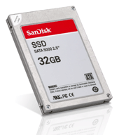
Where does Flash memory come in?
Microdrives and Flash memory (e.g., CompactFlash) are going head-to-head
  Both non-volatile (no power, data ok)
  Flash benefits: durable & lower power
  (no moving parts, need to spin µdrives up/down)
  Flash limitations: finite number of write cycles (wear on the insulating oxide layer around the charge storage mechanism). Most ≥ 100K, some ≥ 1M W/erase cycles.
How does Flash memory work?
  NMOS transistor with an additional conductor between gate and source/drain which “traps” electrons. The presence/absence is a 1 or 0.
en.wikipedia.org/wiki/Flash_memory

Slide 11
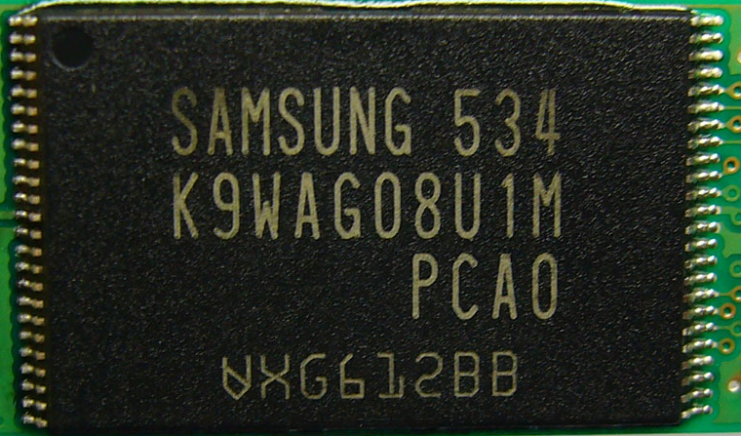
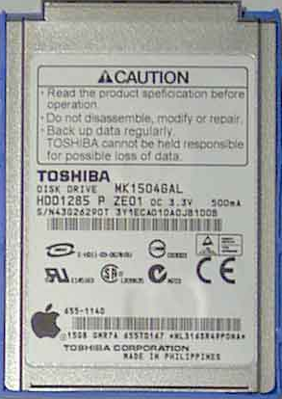
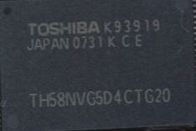
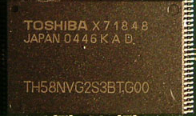

What does Apple put in its iPods?
Toshiba flash
1, 2GB
Samsung flash
4, 8GB
Toshiba 1.8-inch HDD
80, 160GB
Toshiba flash
8, 16, 32GB
shuffle, nano, classic, touch

Slide 12
Agenda
Disks
Reliability
Administrivia
RAID
Error Correcting Codes (If time)

Slide 13
Review - 6 Great Ideas in
Computer Architecture
Layers of Representation/Interpretation
Moore’s Law
Principle of Locality/Memory Hierarchy
Parallelism
Performance Measurement & Improvement
Dependability via Redundancy

Slide 14
Great Idea #6:
Dependability via Redundancy
Redundancy so that a failing piece doesn’t make the whole system fail
1+1=2
2 of 3 agree
1+1=2
1+1=2
1+1=1
FAIL!
Increasing transistor density reduces the cost of redundancy

Slide 15
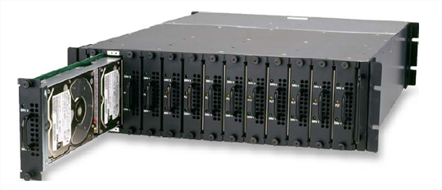
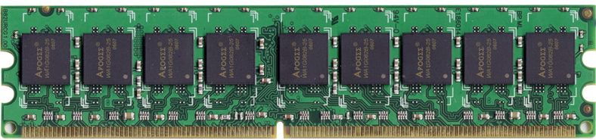
Great Idea #6:
Dependability via Redundancy
Applies to everything from datacenters to memory
  Redundant datacenters so that can lose 1 datacenter but Internet service stays online
  Redundant routes so can lose nodes but Internet doesn’t fail
  Redundant disks so that can lose 1 disk but not lose data (Redundant Arrays of Independent Disks/RAID)
  Redundant memory bits of so that can lose 1 bit but no data (Error Correcting Code/ECC Memory)

Slide 16
Explain a lot of buzzwords
Parity (even, odd)
ECC
SEC/DED
Hamming Distance
MTTF
MTBF
MTTR
Nines of availability
Hot Spares

Slide 17
Dependability
Service accomplishment
Service delivered
as specified
Fault: failure of a component
  May or may not lead to system failure
Restoration
Failure
Service interruption
Deviation from
specified service

Slide 18
Dependability Measures
Reliability: Mean Time To Failure (MTTF)
Service interruption: Mean Time To Repair (MTTR)
Mean time between failures (MTBF)
  MTBF = MTTF + MTTR
Availability = MTTF / (MTTF + MTTR)
Improving Availability
  Increase MTTF: More reliable hardware/software + Fault Tolerance
  Reduce MTTR: improved tools and processes for diagnosis and repair

Slide 19
Reliability Measures
MTTF, MTBF usually measured in hours
  E.g., average MTTF is 100,000 hours
Another measure is average number of failures per year
  E.g., 1000 disks with 100,000 hour MTTF
  365 days * 24 hours == 8760 hours
  (1000 disks * 8760 hrs/year) / 100,000 = 87.6 failed disks per year on average
  87.6/1000 = 8.76% annual failure rate

Slide 20
Availability Measures
Availability = MTTF / (MTTF + MTTR) as %
Since hope rarely down, shorthand is
“number of 9s of availability per year”
1 nine: 90% => 36 days of repair/year
2 nines: 99% => 3.6 days of repair/year
3 nines: 99.9% => 526 minutes of repair/year
4 nines: 99.99% => 53 minutes of repair/year
5 nines: 99.999% => 5 minutes of repair/year

Slide 21
Dependability Design Principle
Design Principle: No single points of failure
“Chain is only as strong as its weakest link”
Dependability Corollary of Amdahl’s Law
  Doesn’t matter how dependable you make one portion of system
  Dependability limited by part you do not improve

Slide 22
Administrivia
No lab Thursday - Work on project, study for final, etc. TAs will be there.
Sign up for Project 3 face-to-face grading at: http://inst.eecs.berkeley.edu/~cs61c/su11/signups/signup.cgi
  Scheduled for Wednesday, 8/10 in 200 SD
HKN will be conducting course survey Tuesday, 8/9.

Slide 23
Cs61c in … Social Media
Are C’s null-terminated strings the costliest mistake in CS history?
Performance costs: “If the source string is NUL terminated, however, attempting to access it in units larger than bytes risks attempting to read characters after the NUL. “
Security costs: “Despite 15 years of attention, over- and under-running string buffers is still a preferred attack vector for criminals”
What are the pros/cons of storing a String as a length/data vector instead?
http://queue.acm.org/detail.cfm?id=2010365

Slide 24
Agenda
Disks
Reliability
Administrivia
RAID
Error Correcting Codes (If time)

Slide 25
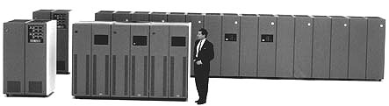
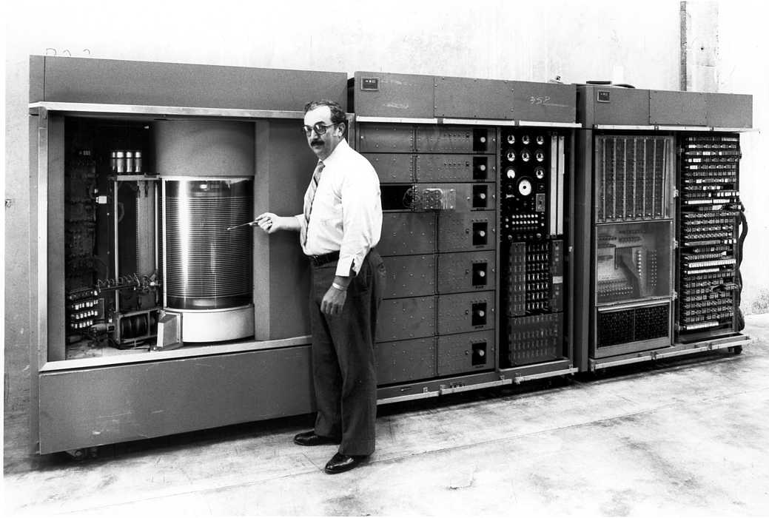
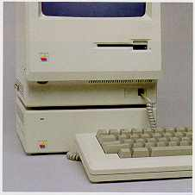
Evolution of the Disk Drive
IBM 3390K, 1986
IBM RAMAC 305, 1956
Apple SCSI, 1986

Slide 26
Arrays of Small Disks
  Can smaller disks be used to close gap in performance between disks and CPUs?
Conventional: 4 disk types
3.5”
5.25”
10”
14”
Low End
High End
Disk Array:
1 disk type
3.5”

Slide 27
Replace Small Number of Large Disks with Large Number of Small Disks! (1988 Disks)
IBM 3390K
20 GBytes
97 cu. ft.
3 KW
15 MB/s
600 I/Os/s
250 KHrs
$250K
IBM 3.5" 0061
320 MBytes
0.1 cu. ft.
11 W
1.5 MB/s
55 I/Os/s
50 KHrs
$2K
x70
23 GBytes
11 cu. ft.
1 KW
120 MB/s
3900 IOs/s
??? Hrs
$150K
Capacity
Volume
Power
Data Rate
I/O Rate
MTTF
Cost
9X
3X
8X
6X
Disk Arrays have potential for large data and I/O rates, high MB per cu. ft., high MB per KW, but what about reliability?

Slide 28
Replace Small Number of Large Disks with Large Number of Small Disks! (1988 Disks)
IBM 3390K
20 GBytes
97 cu. ft.
3 KW
15 MB/s
600 I/Os/s
250 KHrs
$250K
IBM 3.5" 0061
320 MBytes
0.1 cu. ft.
11 W
1.5 MB/s
55 I/Os/s
50 KHrs
$2K
x70
23 GBytes
11 cu. ft.
1 KW
120 MB/s
3900 IOs/s
~700 Hrs
$150K
Capacity
Volume
Power
Data Rate
I/O Rate
MTTF
Cost
9X
3X
8X
6X
Disk Arrays have potential for large data and I/O rates, high MB per cu. ft., high MB per KW, but what about reliability?

Slide 29
RAID: Redundant Arrays of (Inexpensive) Disks
Files are "striped" across multiple disks
Redundancy yields high data availability
  Availability: service still provided to user, even if some components failed
Disks will still fail
Contents reconstructed from data redundantly stored in the array
  Capacity penalty to store redundant info
  Bandwidth penalty to update redundant info

Slide 30
Redundant Arrays of Inexpensive Disks
RAID 1: Disk Mirroring/Shadowing
recovery
group
• Each disk is fully duplicated onto its “mirror”
Very high availability can be achieved
• Bandwidth sacrifice on write:
Logical write = two physical writes
  Reads may be optimized
• Most expensive solution: 100% capacity overhead

Slide 31
Redundant Array of Inexpensive Disks RAID 3: Parity Disk
10010011
11001101
10010011
. . .
X
Y
Z
P
1
0
1
0
0
0
1
1
1
1
0
0
1
1
0
1
1
0
1
0
0
0
1
1
1
1
0
0
1
1
0
1
logical record
Striped physical
records
P contains sum of
other disks per stripe
mod 2 (“parity”)
If disk fails, subtract
P from sum of other
disks to find missing information
X + Y + Z = P
-Y = X + Z - P

Slide 32
Redundant Arrays of Inexpensive Disks RAID 4: High I/O Rate Parity
D0
D1
D2
D3
Increasing
Logical
Disk
Address
P
Insides of 5 disks
D4
D5
D6
D7
P
D8
D9
D10
D11
P
Example: small read D0 & D5, large write D12-D15
D12
D13
D14
D15
P
Stripe
D16
D17
D18
D19
P
D20
D21
D22
D23
P
.
.
.
.
.
.
.
.
.
.
.
.
.
.
.
Disk Columns

Slide 33
Inspiration for RAID 5
When writing to a disk, need to update Parity Disk:
  Option 1: read other data disks, create new sum and write to Parity Disk
  Option 2: since P has old sum, compare old data to new data, add the difference to P
Small writes are bottlenecked by Parity Disk: Write to D0, D5 both also write to P disk
D0
D1
D2
D3
P
D4
D5
D6
D7
P

Slide 34
RAID 5: High I/O Rate Interleaved Parity
D0
D1
D2
D3
P
Increasing
Logical
Disk
Addresses
Independent writes
possible because of
interleaved parity
D4
D5
D6
P
D7
D8
D9
P
D10
D11
D12
P
D13
D14
D15
P
D16
D17
D18
D19
Example: write to D0, D5 uses disks 0, 1, 3, 4
D20
D21
D22
D23
P
.
.
.
.
.
.
.
.
.
.
.
.
.
.
.
Disk Columns

Slide 35
Problems of Disk Arrays: Small Writes
RAID-5: Small Write Algorithm
1 Logical Write = 2 Physical Reads + 2 Physical Writes
D0'
D0
D1
D2
D3
P
new
data
old
data
old
parity
(1. Read)
(2. Read)
+
XOR
+
XOR
(3. Write)
(4. Write)
D0'
D1
D2
D3
P'

Slide 36
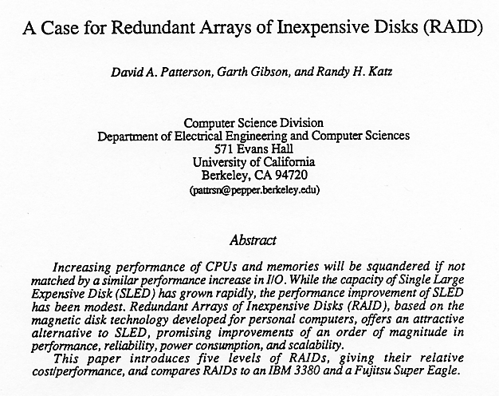
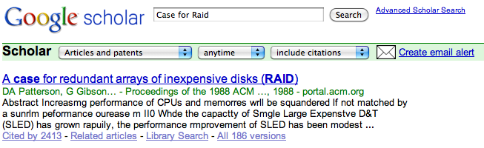
Tech Report Read ‘Round the World
(December 1987)

Slide 37
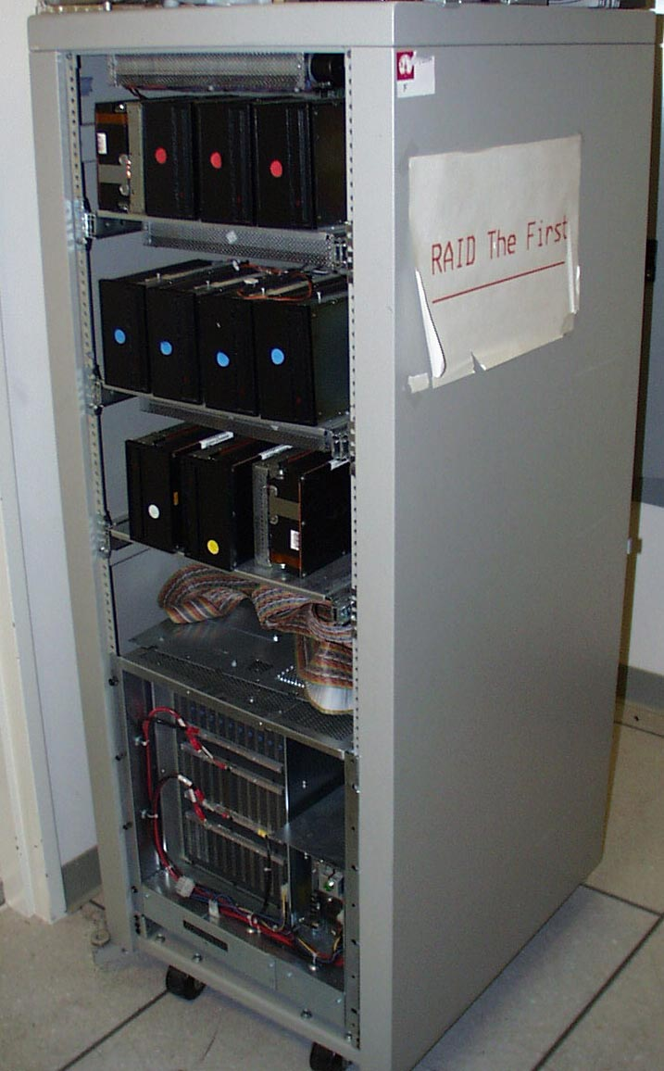
RAID-I
RAID-I (1989)
  Consisted of a Sun 4/280 workstation with 128 MB of DRAM, four dual-string SCSI controllers, 28 5.25-inch SCSI disks and specialized disk striping software

Slide 38
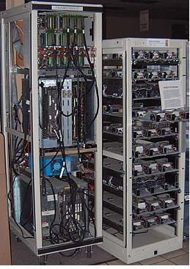
RAID II
1990-1993
Early Network Attached Storage (NAS) System running a Log Structured File System (LFS)
Impact:
  $25 Billion/year in 2002
  Over $150 Billion in RAID device sold since 1990-2002
  200+ RAID companies (at the peak)
  Software RAID a standard component of modern OSs

Slide 39
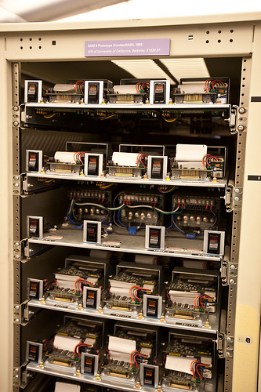
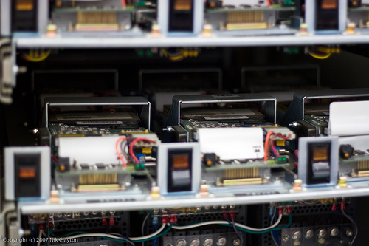
RAID II

Slide 40
RAID Summary
Logical-to-physical block mapping, parity striping, read-modify-write processing
Orchestrating data staging between network interfaces, parity hardware, and file server interfaces
Failed disk replacement, hot spares, background copies and backup
Embedded log-structured file systems, compression on the fly
Software complexity dominates hardware!

Slide 41
Agenda
Disks
Reliability
Administrivia
RAID
Error Correcting Codes

Slide 42
Error Detection/Correction Codes
Memory systems generate errors (accidentally flipped-bits)
  DRAMs store very little charge per bit
  “Soft” errors occur occasionally when cells are struck by alpha particles or other environmental upsets
  “Hard” errors can occur when chips permanently fail.
  Problem gets worse as memories get denser and larger

Slide 43
Error Detection/Correction Codes
Memories protected against failures with EDC/ECC
Extra bits are added to each data-word
  Extra bits are a function of the data
  In general, each possible data word value is mapped to a special “code word”. A fault changes a valid code word to an invalid one - which can be detected.

Slide 44
Detecting/Correcting Code Concept
Space of possible bit patterns (2^{N})
Error changes bit pattern to
non-code
Sparse population of code words (2^{M} << 2^{N})
- with identifiable signature
Detection: bit pattern fails codeword check
Correction: map to nearest valid code word

Slide 45
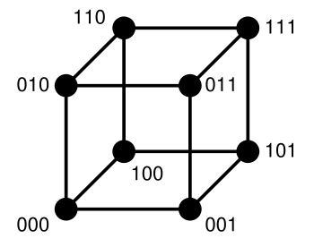
3 Bit Example
Hamming Distance: Number of bits that differ between two values.

Slide 46
Hamming Distance 2: Detection
No 1 bit error goes to another valid code
½ codes are valid

Slide 47
Hamming Distance 3: Correction
Nearest
111
(one 0)
Nearest
000
(one 1)
No 2 bit error goes to another valid code; 1 bit error near
1/4 codes are valid

Slide 48
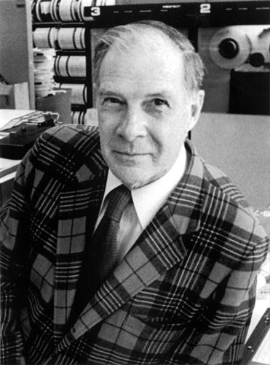
Block Code Principles
Hamming distance = difference in # of bits
p = 011011, q = 001111, Ham. distance (p,q) = 2
p = 011011,
q = 110001,
distance (p,q) = ?
Can think of extra bits as creating
a code with the data
What if minimum distance
between members of code is 2
and get a 1 bit error?
Richard Hamming, 1915-98
Turing Award Winner

Slide 49
Parity: Simple Error Detection Coding
Each data value, before it is written to memory is “tagged” with an extra bit to force the stored word to have even parity:
Each word, as it is read from memory is “checked” by finding its parity (including the parity bit).
b₇b₆b₅b₄b₃b₂b₁b₀p
b₇b₆b₅b₄b₃b₂b₁b₀p
+
+
c
Minimum Hamming distance of parity code is 2
A non-zero parity indicates an error occurred:
  2 errors (on different bits) is not detected (nor any even number of errors)
  odd numbers of errors are detected.

Slide 50
Parity Example
Data 0101 0101
4 ones, even parity now
Write to memory:
0101 0101 0
to keep parity even
Data 0101 0111
5 ones, odd parity now
Write to memory:
0101 0111 1
to make parity even
Read from memory
0101 0101 0
4 ones => even parity, so no error
Read from memory
1101 0101 0
5 ones => odd parity,
so error
What if error in parity bit?

Slide 51
Suppose want to Correct 1 Error?
Can we correct if minimum distance is 2?
What must minimum Hamming Distance be?
Richard Hamming came up with simple to understand mapping to allow Error Correction at minimum distance of 3
Called Hamming ECC for Error Correction Code
We won’t go over the details during lecture, check bonus slides at end.

Slide 52
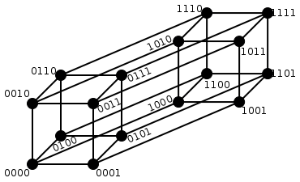
Hamming Single
Error Correction
+ Double
Error Detection:
Hamming Distance 4
1 bit error (one 0)
Nearest 1111
2 bit error
(two 0s, two 1s)
Halfway
Between Both
1 bit error (one 1)
Nearest 0000
Notes:
1 bit error from 0000, all numbers with one 1
1 bit error from 1111, all numbers with one 0
2 bit error from 0000, all numbers with two 1s and two 0s
2 bit error from 1111, all numbers with two 1s and two 0s

Slide 53
“In Conclusion..”
Disks - Work by positioning head over spinning platters. Very slow relative to CPU.
Great Idea: Redundancy to Get Dependability
Reliability: MTTF & Annual failure rate
Availability: % uptime (MTTF-MTTR/MTTF)
RAID: Redundant Arrays of Inexpensive Disks
Memory:
  Hamming distance 2 Parity for Single Error Detect
  Hamming distance 3 Single Error Correction Code + encode bit position of error
  Hamming distance 4 SEC/Double Error Detection

Slide 54
Additional Slides
You are NOT responsible for knowing the material on the following slides.
They are here to provide more detail on some of the topics we’ve covered.

Slide 55
Hamming Error Correction Code
Use of extra parity bits to allow the position identification of a single error
Mark all bit positions that are powers of 2 as parity bits. (positions 1, 2, 4, 8, 16, …)
  Start numbering bits at 1 at left, not at 0 on right
2. All other bit positions are for the data to be encoded. (positions 3, 5, 6, 7, 9, 10, 11, 12, 13, 14, 15, …)

Slide 56
Hamming ECC
3. Each parity bit calculates the parity for some of the bits in the code word
The position of parity bit determines sequence of bits that it checks
Bit 1 (0001₂): checks bits (1,3,5,7,9,11,...)
Bit 2 (0010₂): checks bits (2,3,6,7,10,11,14,15,...)
Bit 4 (0100₂): checks bits (4-7, 12-15, 20-23, ...)
Bit 8 (1000₂): checks bits (8-15, 24-31, 40-47 ,...)

Slide 57
Hamming ECC
4. Set parity bits to create even parity for each group
A byte of data: 10011010
Create the coded word, leaving spaces for the parity bits:
_ _ 1 _ 0 0 1 _ 1 0 1 0
0 0 0 0 0 0 0 0 0 1 1 1
1 2 3 4 5 6 7 8 9 0 1 2
Calculate the parity bits

Slide 58
Hamming ECC
Student Roulette
Position 1 checks bits 1,3,5,7,9,11:
? _ 1 _ 0 0 1 _ 1 0 1 0. set position 1 to a _:
_ _ 1 _ 0 0 1 _ 1 0 1 0
Position 2 checks bits 2,3,6,7,10,11:
0 ? 1 _ 0 0 1 _ 1 0 1 0. set position 2 to a _:
0 _ 1 _ 0 0 1 _ 1 0 1 0
Position 4 checks bits 4,5,6,7,12:
0 1 1 ? 0 0 1 _ 1 0 1 0. set position 4 to a _:
0 1 1 _ 0 0 1 _ 1 0 1 0
Notes:
Bit 1 is 0
Bit 2 is 1
Bit 4 is 1

Slide 59
Hamming ECC
Position 1 checks bits 1,3,5,7,9,11:
? _ 1 _ 0 0 1 _ 1 0 1 0. set position 1 to a 0:
0 _ 1 _ 0 0 1 _ 1 0 1 0
Position 2 checks bits 2,3,6,7,10,11:
0 ? 1 _ 0 0 1 _ 1 0 1 0. set position 2 to a 1:
0 1 1 _ 0 0 1 _ 1 0 1 0
Position 4 checks bits 4,5,6,7,12:
0 1 1 ? 0 0 1 _ 1 0 1 0. set position 4 to a 1:
0 1 1 1 0 0 1 _ 1 0 1 0

Slide 60
Hamming ECC
Position 8 checks bits 8,9,10,11,12:
0 1 1 1 0 0 1 ? 1 0 1 0. set position 8 to a _:
0 1 1 1 0 0 1 0 1 _ 1 0
Final code word: 011100101010
Data word: 1 001 1010
Notes:
Bit 8 set to 0

Slide 61
Hamming ECC
Position 8 checks bits 8,9,10,11,12:
0 1 1 1 0 0 1 ? 1 0 1 0. set position 8 to a 0:
0 1 1 1 0 0 1 0 1 0 1 0
Final code word: 011100101010.
Notes:
Bit 8 set to 0

Slide 62
Agenda
Definition of Dependability, Reliability, Availability and metrics to evaluate them
Codes for Redundancy
Administrivia
Error Detection in Memory (Parity)
Error Correction in Memory: Encoding
Technology Break
Error Correction in Memory: Correcting

Slide 63
Hamming ECC
Finding and fixing a corrupted bit:
Suppose receive 011100101110
123456789012
Parity 1_, Parity 2_, Parity 4_, Parity 8_
Bits numbers xxx1_{two}, xx1x_{two}, x1xx_{two}, 1xxx_{two})
Parity bits 2 and 8 incorrect. As 2 + 8 = 10,
bit position 10 is location of bad bit: flip value!
Corrected value: 011100101010
Why does Hamming ECC work?
Notes:
Do on the blackboard
Bit 1: 1, 3, 5, 7, 9, 11
Bit 2: 2,3, 6,7, 10,11
Bit 4: 4, 5, 6, 7, 12
Bit 8: 8, 9, 10, 11, 12

Slide 64
Hamming ECC on your own
Test if these Hamming-code words are correct. If one is incorrect, indicate the correct code word. Also, indicate what the original data was.
010101100011
111110001100
000010001010

Slide 65
Hamming Error Correcting Code
Overhead involved in single error correction code
Let p be total number of parity bits and d number of data bits in p + d bit word
If p error correction bits are to point to error bit (p + d cases) + indicate that no error exists (1 case), we need:
  2^{p} >= p + d + 1,
  thus p >= log(p + d + 1)
  for large d, p approaches log(d)
8 bits data => d = 8, 2^{p} = p + 8 + 1 => p = 4
16 data => 5 parity, 32 data => 6 parity,
64 data => 7 parity

Slide 66
Hamming Single Error Correction,
Double Error Detection (SEC/DED)
Adding extra parity bit covering the entire word provides double error detection as well as single error correction
1 2 3 4 5 6 7 8
p₁ p₂ d₁ p₃ d₂ d₃ d₄ p₄
Hamming parity bits H (p₁ p₂ p₃) are computed (even parity as usual) plus the even parity over the entire word, p₄:
H=0 p₄=0, no error
H≠0 p₄=1, correctable single error (odd parity if 1 error => p₄=1)
H≠0 p₄=0, double error occurred (even parity if 2 errors=> p₄=0)
H=0 p₄=1, an error occurred in p₄ bit, not in rest of word
Typical modern codes in DRAM memory systems:
64-bit data blocks (8 bytes) with 72-bit code words (9 bytes).

Slide 67
What if More Than 2 Bit Errors?
Network transmissions, disks, distributed storage common failure mode is bursts of bit errors, not just one or two bit errors
  contiguous sequence of B bits in which first, last and any number of intermediate bits are in error
  caused by impulse noise or by fading in wireless
  effect is greater at higher data rates

Slide 68
Cyclic Redundancy Check
for block of k bits, transmitter generates an
n-k bit frame check sequence
Transmits n bits exactly divisible by some number
Receiver divides frame by that number
  If no remainder, assume no error
  Easy to calculate division for some binary numbers with shift register
Disks detect and correct blocks of 512 bytes with called Reed Solomon codes ≈ CRC (see last slide)

Slide 69
(In More Depth: Code Types)
Linear Codes:
Code is generated by G and in null-space of H
Hamming Codes: Design the H matrix
  d = 3 ⇒ Columns nonzero, Distinct
  d = 4 ⇒ Columns nonzero, Distinct, Odd-weight
Reed-solomon codes:
  Based on polynomials in GF(2^{k}) (I.e. k-bit symbols)
  Data as coefficients, code space as values of polynomial:
  P(x)=a₀+a₁x¹+… a_{k-1}x^{k-1}
  Coded: P(0),P(1),P(2)….,P(n-1)
  Can recover polynomial as long as get any k of n
  Alternatively: as long as no more than n-k coded symbols erased, can recover data.
Side note: Multiplication by constant in GF(2^{k}) can be represented by k×k matrix: a⋅x
  Decompose unknown vector into k bits: x=x₀+2x₁+…+2^{k-1}x_{k-1}
  Each column is result of multiplying a by 2^{i}

