Slide 1
CS 61C: Great Ideas in
Computer Architecture
Combinational and Sequential Logic,
Boolean Algebra
Instructor: Justin Hsia

Slide 2
Review of Last Lecture
OpenMP as simple parallel extension to C
  During parallel fork, be aware of which variables should be shared vs. private among threads
  Work-sharing accomplished with for/sections
  Synchronization accomplished with critical/atomic/reduction
Hardware is made up of transistors and wires
  Transistors are voltage-controlled switches
  Building blocks of all higher-level blocks

Slide 3
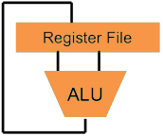
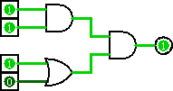
Great Idea #1: Levels of Representation/Interpretation
Higher-Level Language
Program (e.g. C)
temp = v[k];
v[k] = v[k+1];
v[k+1] = temp;
Compiler
lw $t0, 0($2)
lw $t1, 4($2)
sw $t1, 0($2)
sw $t0, 4($2)
Assembly Language Program (e.g. MIPS)
Assembler
0000 1001 1100 0110 1010 1111 0101 1000
1010 1111 0101 1000 0000 1001 1100 0110
1100 0110 1010 1111 0101 1000 0000 1001
0101 1000 0000 1001 1100 0110 1010 1111
Machine Language Program (MIPS)
We are here
Machine Interpretation
Hardware Architecture Description
(e.g. block diagrams)
Architecture Implementation
Logic Circuit Description
(Circuit Schematic Diagrams)

Slide 4
Synchronous Digital Systems
Hardware of a processor, such as the MIPS, is an example of a Synchronous Digital System
Synchronous:
  All operations coordinated by a central clock
    “Heartbeat” of the system!
Digital:
  Represent all values with two discrete values
  Electrical signals are treated as 1’s and 0’s
    1 and 0 are complements of each other
  High/Low voltage for True/False, 1/0

Slide 5
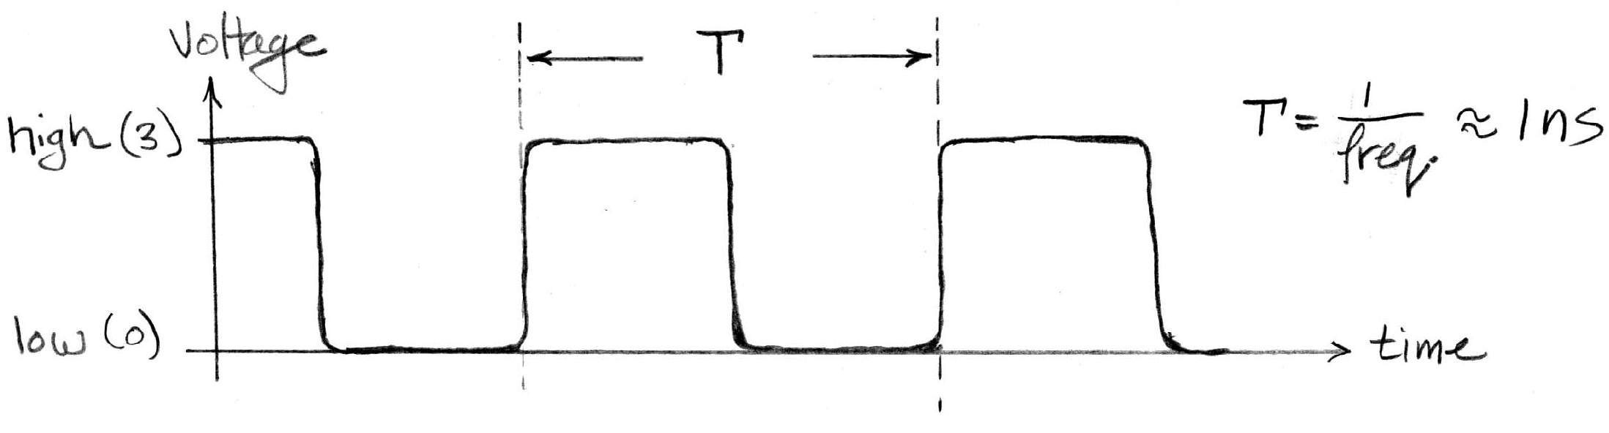
Signals and Waveforms: Clocks
Clock period (CPU cycle time)
Rising Edge
Falling Edge
Signals transmitted over wires continuously
Transmission is effectively instantaneous
  Implies that any wire only contains one value at any given time

Slide 6
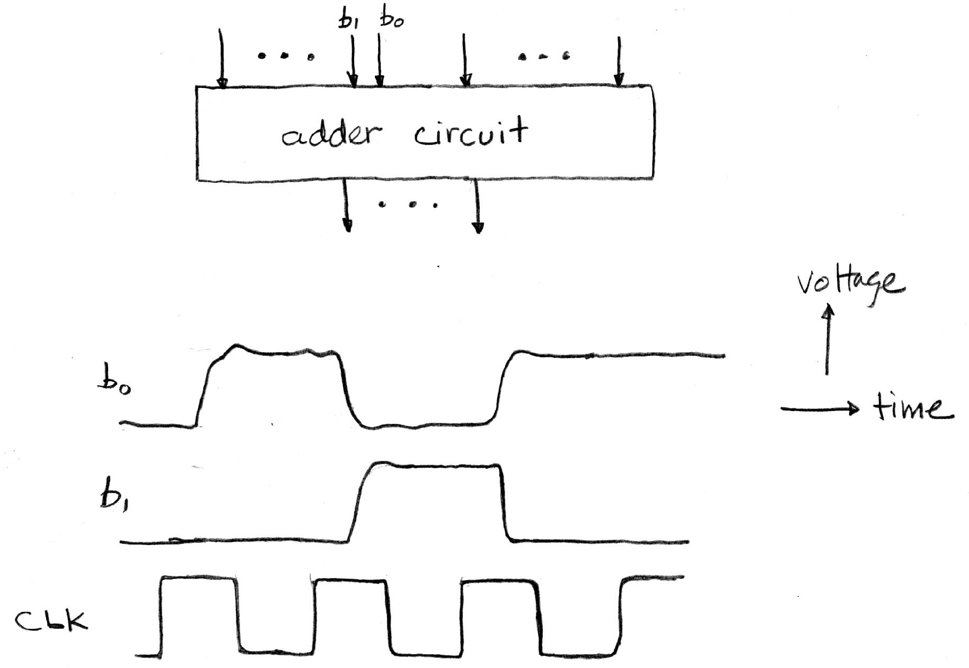
Signals and Waveforms
Stack signals on top of each other
  All signals change after clock “triggers”

Slide 7
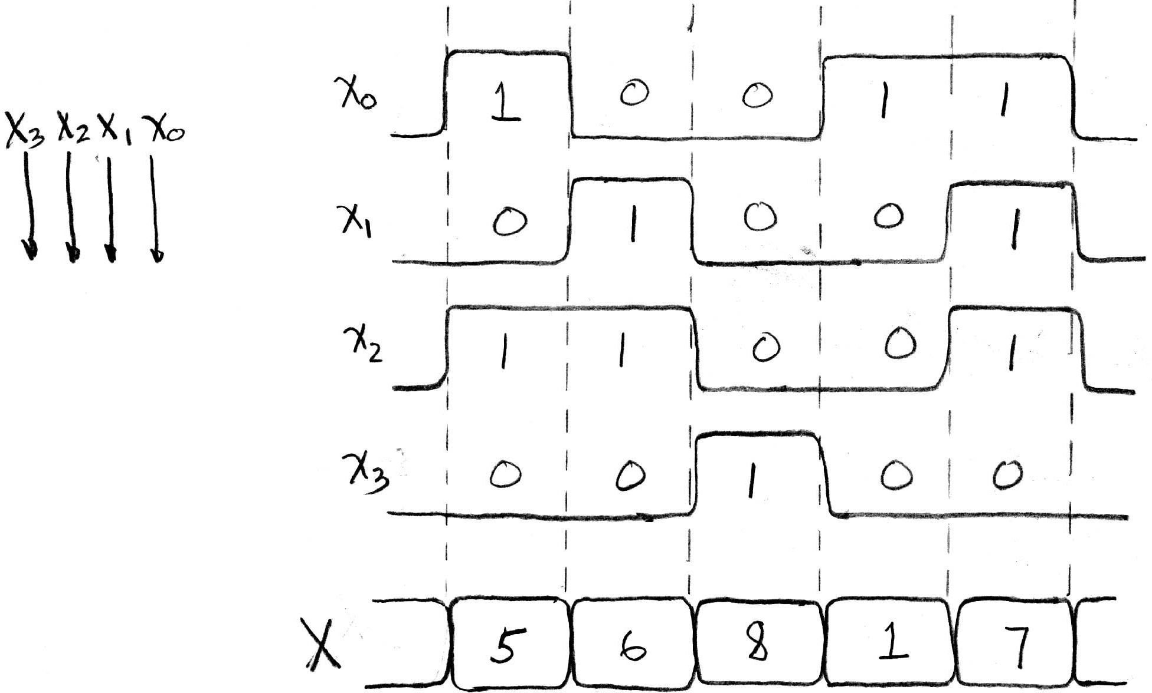
Signals and Waveforms: Grouping
Clock triggers
X
A group of wires when interpreted as a bit field is called a Bus

Slide 8
Hardware Design Hierarchy
system
datapath
control
code
registers
state
registers
combinational
logic
multiplexer
comparator
register
logic
Today
switching
networks

Slide 9
Agenda
Combinational Logic
  Truth Tables and Logic Gates
Administrivia
Boolean Algebra
Sequential Logic
  State Elements
  Bonus: Karnaugh Maps (Optional)

Slide 10
Type of Circuits
Synchronous Digital Systems consist of two basic types of circuits:
  Combinational Logic (CL)
    Output is a function of the inputs only, not the history of its execution
    e.g. circuits to add A, B (ALUs)
  Sequential Logic (SL)
    Circuits that “remember” or store information
    a.k.a. “State Elements”
    e.g. memory and registers (Registers)

Slide 11
Representations of
Combinational Logic
Circuit Diagram
  Transistors and wires (Lec 17)
  Logic Gates (Lec 18)
Truth Table (Lec 18)
Boolean Expression (Lec 18)
All are equivalent
Right Now!

Slide 12
Truth Tables
Table that relates the inputs to a CL circuit to its output
  Output only depends on current inputs
  Use abstraction of 0/1 instead of source/ground
  Shows output for every possible combination of inputs
How big?
  0 or 1 for each of N inputs
, so 2^{N} rows

Slide 13
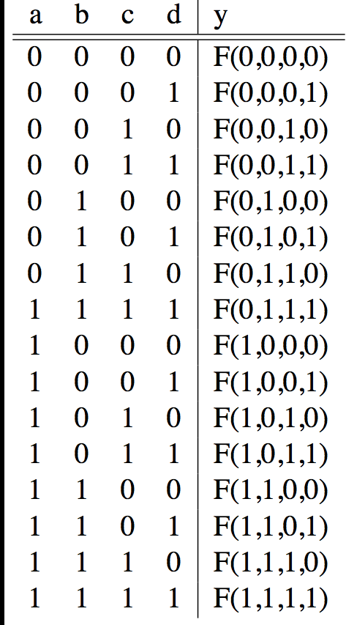
CL: General Form
A
F
B
Y
C
D
0
If N inputs, how many distinct functions F do we have?
Function maps each row to 0 or 1, so 2^(2^{N}) possible functions

Slide 14
CL: Multiple Outputs
A
F
X
B
Y
C
D
Z
For 3 outputs, just three separate functions:
X(A,B,C,D), Y(A,B,C,D), and Z(A,B,C,D)
  Can show functions in separate columns without
  adding any rows!

Slide 15



Logic Gates (1/2)
Special names and symbols:
Circle means NOT!
a | c
0 | 1
1 | 0
NOT
a | b | c
0 | 0 | 0
0 | 1 | 0
1 | 0 | 0
1 | 1 | 1
AND
a | b | c
0 | 0 | 0
0 | 1 | 1
1 | 0 | 1
1 | 1 | 1
OR

Slide 16



Logic Gates (2/2)
Special names and symbols:
a | b | c
0 | 0 | 1
0 | 1 | 1
1 | 0 | 1
1 | 1 | 0
NAND
a | b | c
0 | 0 | 1
0 | 1 | 0
1 | 0 | 0
1 | 1 | 0
NOR
a | b | c
0 | 0 | 0
0 | 1 | 1
1 | 0 | 1
1 | 1 | 0
XOR

Slide 17
More Complicated Truth Tables
3-Input Majority
2-bit Adder
a | b | c | y
0 | 0 | 0 | 0
0 | 0 | 1 | 0
0 | 1 | 0 | 0
0 | 1 | 1 | 1
1 | 0 | 0 | 0
1 | 0 | 1 | 1
1 | 1 | 0 | 1
1 | 1 | 1 | 1
a₁
+
c₂
a₀
c₁
b₁
b₀
c₀
3 separate functions
A |  | B |  | C
a₁ | a₀ | b₁ | b₀ | c₂ | c₁ | c₀
 |  |  | .
 |  |  | .
 |  |  | .
How many
rows?

Slide 18
Question: Convert the following statements into
a Truth Table assuming the output D is whether Justin is comfortable (1) or uncomfortable (0).
Input A: Justin wears light (0) or heavy (1) clothing
Input B: It is cold (0) or hot (1) outside
Input C: Justin spends the day indoors (0) or outdoors (1)
A | B | C | D | D | D | D
0 | 0 | 0 | 1 | 1 | 1 | 1
0 | 0 | 1 | 0 | 0 | 0 | 0
0 | 1 | 0 | 1 | 1 | 1 | 1
0 | 1 | 1 | 1 | 1 | 1 | 1
1 | 0 | 0 | 0 | 1 | 1 | 1
1 | 0 | 1 | 1 | 1 | 0 | 1
1 | 1 | 0 | 1 | 1 | 1 | 0
1 | 1 | 1 | 1 | 0 | 1 | 1

Slide 19
My Hand Hurts…
Truth tables are huge
  Write out EVERY combination of inputs and outputs (thorough, but inefficient)
  Finding a particular combination of inputs involves scanning a large portion of the table
There must be a shorter way to represent combinational logic
  Boolean Algebra to the rescue!

Slide 20
Agenda
Combinational Logic
  Truth Tables and Logic Gates
Administrivia
Boolean Algebra
Sequential Logic
  State Elements
Bonus: Karnaugh Maps (Optional)

Slide 21
Administrivia
Midterm re-grade requests due tomorrow
Project 2: Matrix Multiply Performance Improvement
  In partners
  Part 1: Due July 22 (this Sunday)
  Part 2: Due July 29
HW 4 also due July 25
  Will be released tonight
Justin moving OH permanently to 200 SDH

Slide 22
Agenda
Combinational Logic
  Truth Tables and Logic Gates
Administrivia
Boolean Algebra
Sequential Logic
  State Elements
  Bonus: Karnaugh Maps (Optional)

Slide 23
Boolean Algebra
Represent inputs and outputs as variables
  Each variable can only take on the value 0 or 1
Overbar is NOT: “logical complement”
  e.g. if A is 0, then‾A is 1 and vice-versa
Plus (+) is 2-input OR: “logical sum”
Product (·) is 2-input AND: “logical product”
  All other gates and logical expressions can be built from combinations of these
  (e.g. A XOR B = ‾AB +‾BA = A’B + AB’)
For slides, will also use A’ for‾A

Slide 24
Truth Table to Boolean Expression
Read off of table
  For 1, write variable name
  For 0, write complement of variable
Sum of Products (SoP)
  Take rows with 1’s in output column,
  sum products of inputs
  c =‾ab +‾ba
Product of Sums (PoS)
  Take rows with 0’s in output column, product the sum of the complements of the inputs
  c = ( a + b ) · (‾a +‾b )
a | b | c
0 | 0 | 0
0 | 1 | 1
1 | 0 | 1
1 | 1 | 0
We can show that these
are equivalent!
Notes:
Choice between the two generally comes down to whether the output function has more 0’s or 1’s. Choosing the conversion (SoP/PoS) with less items will result in a shorter expression!
(This example happens to be balanced: 2 0’s and 2 1’s)

Slide 25
Manipulating Boolean Algebra
SoP and PoS expressions can still be long
  We wanted to have shorter representation than a truth table!
Boolean algebra follows a set of rules that allow for simplification
  Goal will be to arrive at the simplest equivalent expression
  Allows us to build simpler (and faster) hardware

Slide 26
Faster Hardware?
Recall: Everything we are dealing with is just an abstraction of transistors and wires
  Inputs propagating to the outputs are voltage signals passing through transistor networks
  There is always some delay before a CL’s output updates to reflect the inputs
Simpler Boolean expressions ↔ smaller transistor networks ↔ smaller circuit delays ↔ faster hardware

Slide 27
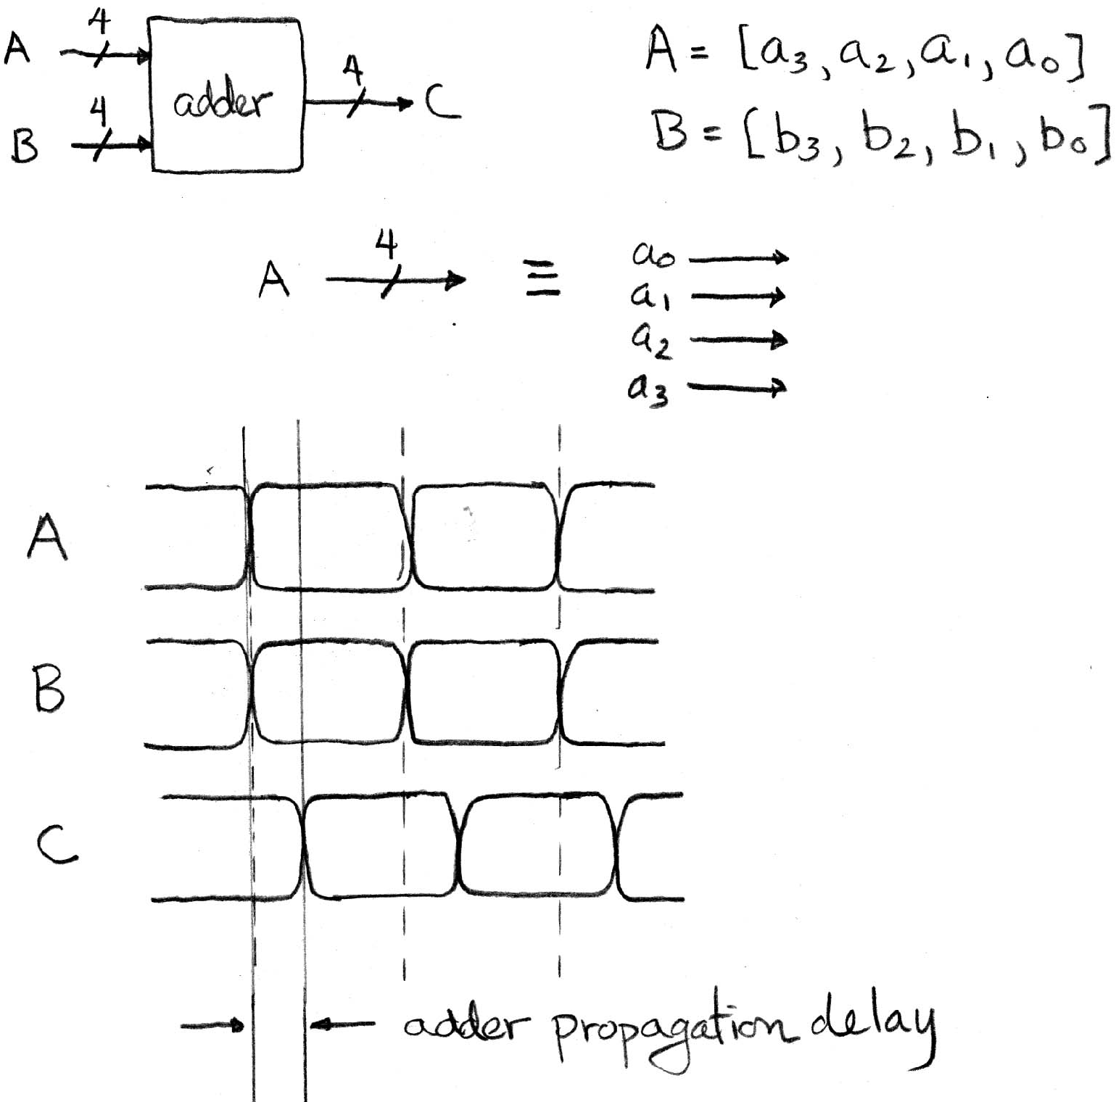
Combinational Logic Circuit Delay
Symbol for
a bus (and width)
2
3
4
5
3
10
0
1
5
13
4
6
Combinational Logic delay

Slide 28
Laws of Boolean Algebra
These laws allow us to perform simplification:

Slide 29
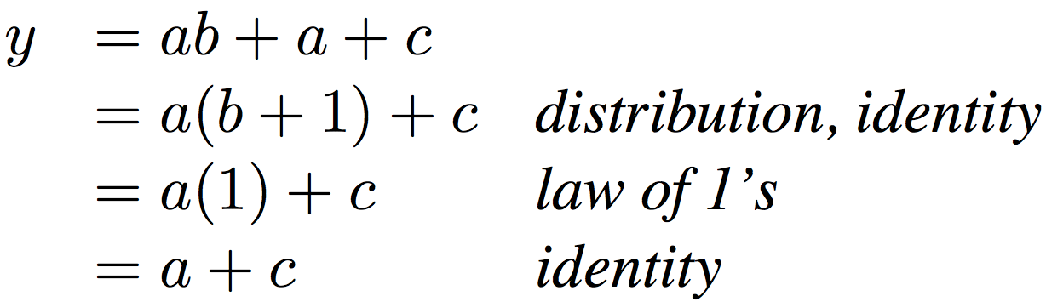
Boolean Algebraic
Simplification Example
Notes:
Do on black board
From distribution: a(b +1) + c
Froms laws of 0s and 1s: b+1 = b
= ab + c
Truth Table
a b c y
0 0 0 0
0 0 1 1
0 0 1 1

Slide 30
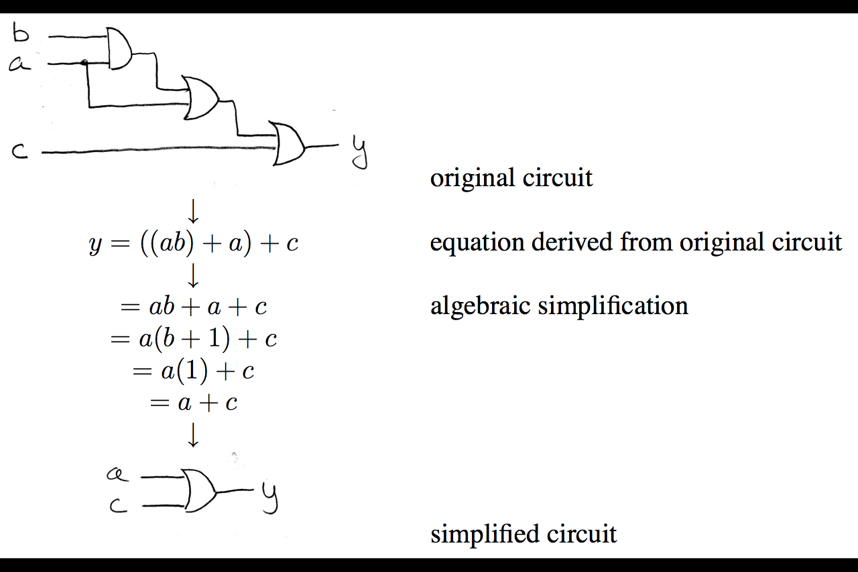
Circuit Simplification
1)
(Transistors and/or Gates)
2)
3)
4)

Slide 31
Converting Combinational Logic
Try all input combinations
Circuit
Diagram
This is difficult to do efficiently!
Truth
Table
Try all input
combinations
Propagate signals
through gates
Wire inputs to proper gates
(easiest to use AND, OR, and NOT)
SoP or PoS
Boolean
Expression

Slide 32
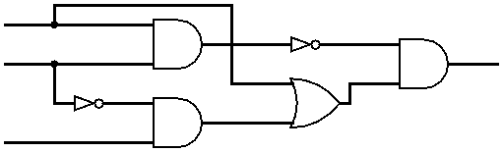
Circuit Simplification Example (1/4)
Simplify the following circuit:
Options:
  Test all combinations of the inputs and build the Truth Table, then use SoP or PoS
  Write out expressions for signals based on gates
    Will show this method here
A
B
D
C

Slide 33
Circuit Simplification Example (2/4)
Simplify the following circuit:
Start from left, propagate signals to the right
Arrive at D = (AB)’(A + B’C)
A
A
AB
(AB)’
B
B
D
A
A+B’C
B’
B’C
C
C

Slide 34
Circuit Simplification Example (3/4)
Simplify Expression:
D = (AB)’(A + B’C)
= (A’ + B’)(A + B’C) DeMorgan’s
= A’A + A’B’C + B’A + B’B’C Distribution
= 0 + A’B’C + B’A + B’B’C Complementarity
= A’B’C + B’A + B’C Idempotent Law
= (A’ + 1)B’C + AB’ Distribution
= B’C + AB’ Law of 1’s
= B’(A + C) Distribution
Which of these
is “simpler”?

Slide 35
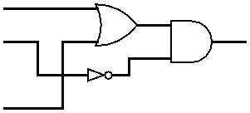
Circuit Simplification Example (4/4)
Draw out final circuit:
  D = B’C + AB’ = B’(A + C)
Simplified Circuit:
  Reduction from 6 gates to 3!
How many gates
do we need for each?
4
3
A
B
D
C
Notes:
Also only has to go through 2 “stages” worth of gates as opposed to 4 previously.
Longest path here is B → NOT → AND → D. Before one of the longest paths was B → NOT → AND → OR → AND → D.

Slide 36
Karnaugh Maps (Optional)
Lots of Boolean Algebra laws for simplification
  Difficult to memorize and spot applications
  When do you know if in simplest form?
Karnaugh Maps (K-maps) are an alternate way to simplify Boolean Algebra
  This technique is normally taught in CS150
  We will never ask you to use a K-map to solve a problem, but you may find it faster/easier if you choose to learn how to use it (see Bonus Slides)

Slide 37
Get To Know Your Staff
Category: Television

Slide 38
Agenda
Combinational Logic
  Truth Tables and Logic Gates
Administrivia
Boolean Algebra
Sequential Logic
  State Elements
  Bonus: Karnaugh Maps (Optional)

Slide 39
Type of Circuits
Synchronous Digital Systems consist of two basic types of circuits:
  Combinational Logic (CL)
    Output is a function of the inputs only, not the history of its execution
    e.g. circuits to add A, B (ALUs)
  Sequential Logic (SL)
    Circuits that “remember” or store information
    a.k.a. “State Elements”
    e.g. memory and registers (Registers)

Slide 40
Uses for State Elements
Place to store values for some amount of time:
  Register files (like in MIPS)
  Memory (caches and main memory)
Help control flow of information between combinational logic blocks
  State elements are used to hold up the movement of information at the inputs to combinational logic blocks and allow for orderly passage

Slide 41
Accumulator Example
An example of why we would need to control
the flow of information.
SUM
X_{i}
S
Want: S=0;
For X₁,X₂,X₃ over time...
S = S + X_{i}
Assume:
  Each X value is applied in succession, one per cycle
  The sum since time 1 (cycle) is present on S

Slide 42
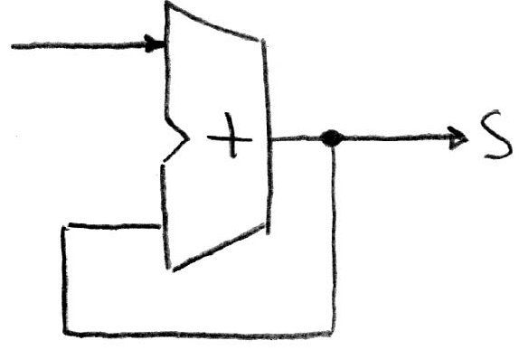
First Try: Does this work?
X
Feedback
No!
How to control the next iteration of the ‘for’ loop?
How do we say: ‘S=0’?

Slide 43
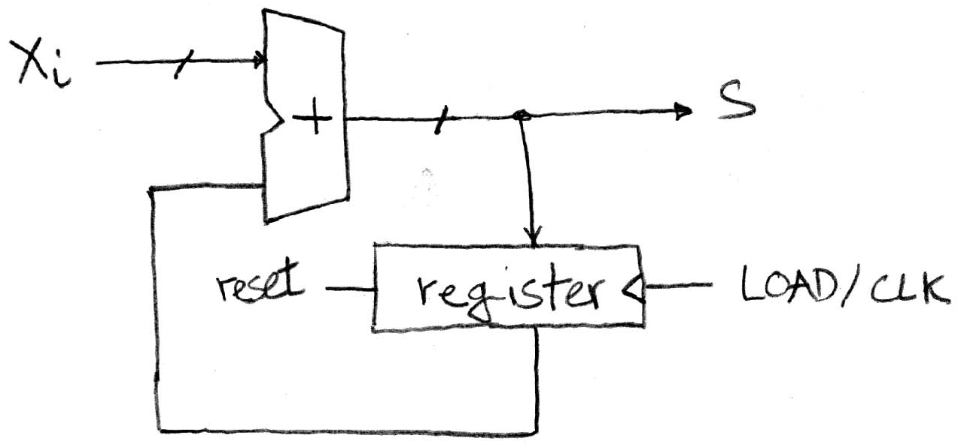
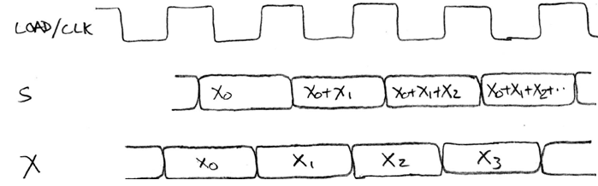
Second Try: How About This?
A Register is the state element that is used here to hold up the transfer
of data to the adder
Delay through Register and Adder
Rough
timing …
Time

Slide 44
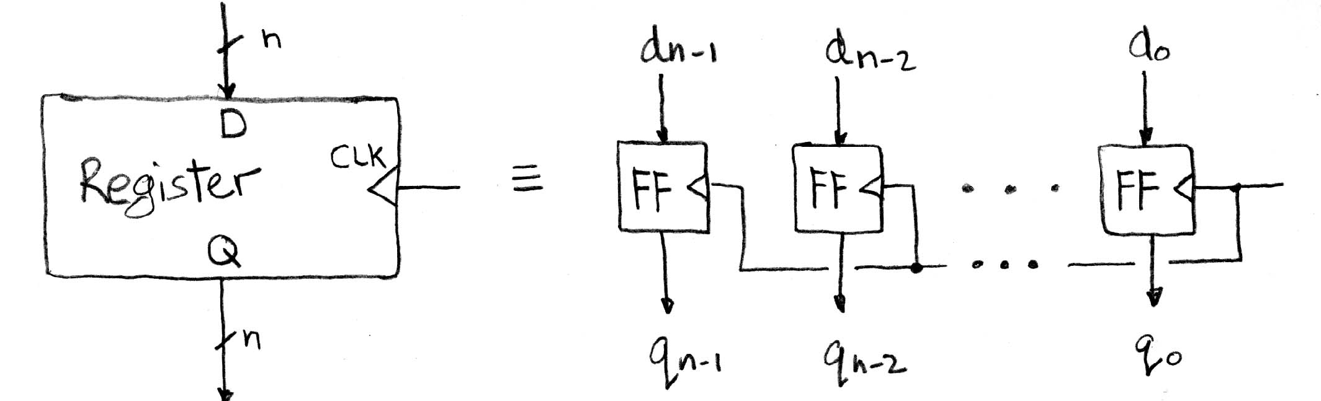
Register Internals
n instances of a “Flip-Flop”
  Output flips and flops between 0 and 1
Specifically this is a “D-type Flip-Flop”
  D is “data input”, Q is “data output”
  In reality, has 2 outputs (Q and‾Q), but we only care about 1
http://en.wikibooks.org/wiki/Practical_Electronics/Flip-flops
Notes:
Can see Wikipedia page for gate internals and other types of flip-flops.

Slide 45
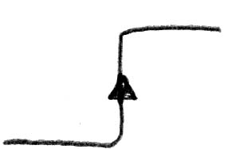
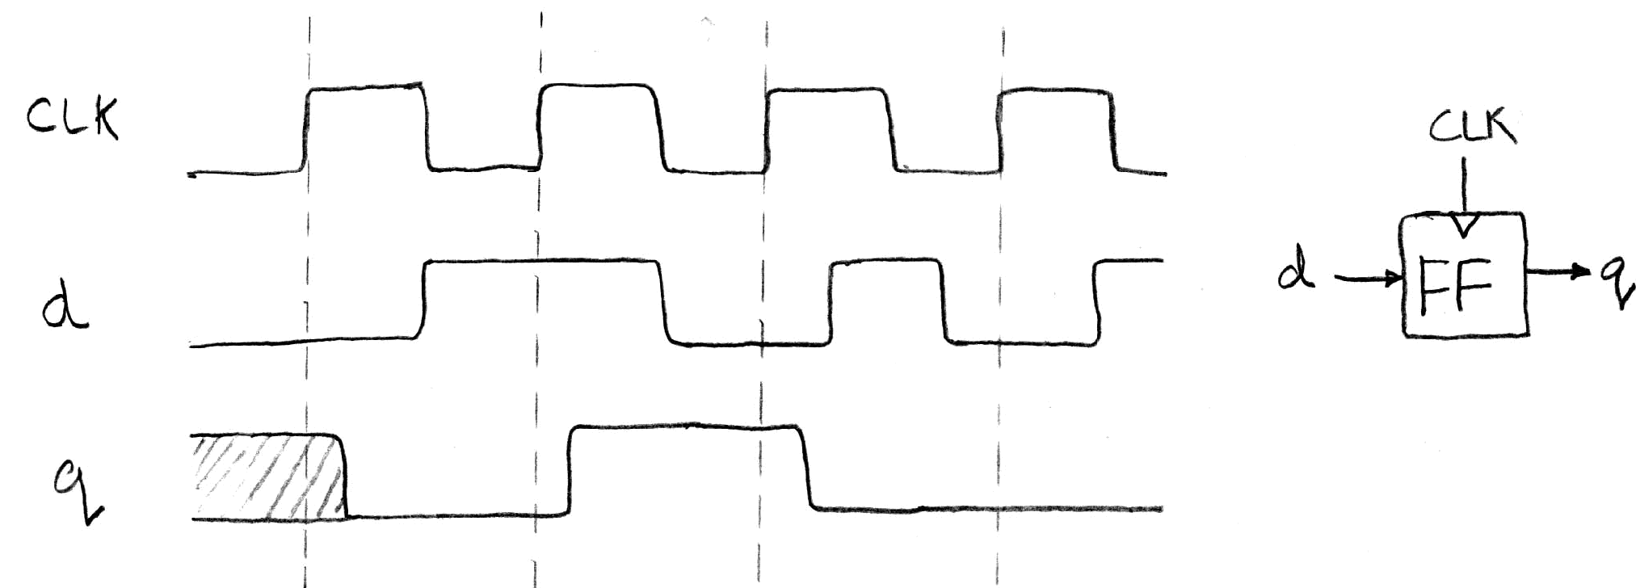
Flip-Flop Timing Behavior (1/2)
Edge-triggered D-type flip-flop
  This one is “positive edge-triggered”
“On the rising edge of the clock, input d is sampled and transferred to the output. At other times, the input d is ignored and the previously sampled value is retained.”
Example waveforms:

Slide 46
Flip-Flop Timing Terminology (1/2)
Camera Analogy: Taking a photo
  Setup time: don’t move since about to take picture (open camera shutter)
  Hold time: need to hold still after shutter opens until camera shutter closes
  Time to data: time from open shutter until image appears on the output (viewfinder)

Slide 47
Flip-Flop Timing Terminology (2/2)
Now applied to hardware:
  Setup Time: how long the input must be stable before the CLK trigger for proper input read
  Hold Time: how long the input must be stable after the CLK trigger for proper input read
  “CLK-to-Q” Delay: how long it takes the output to change, measured from the CLK trigger

Slide 48
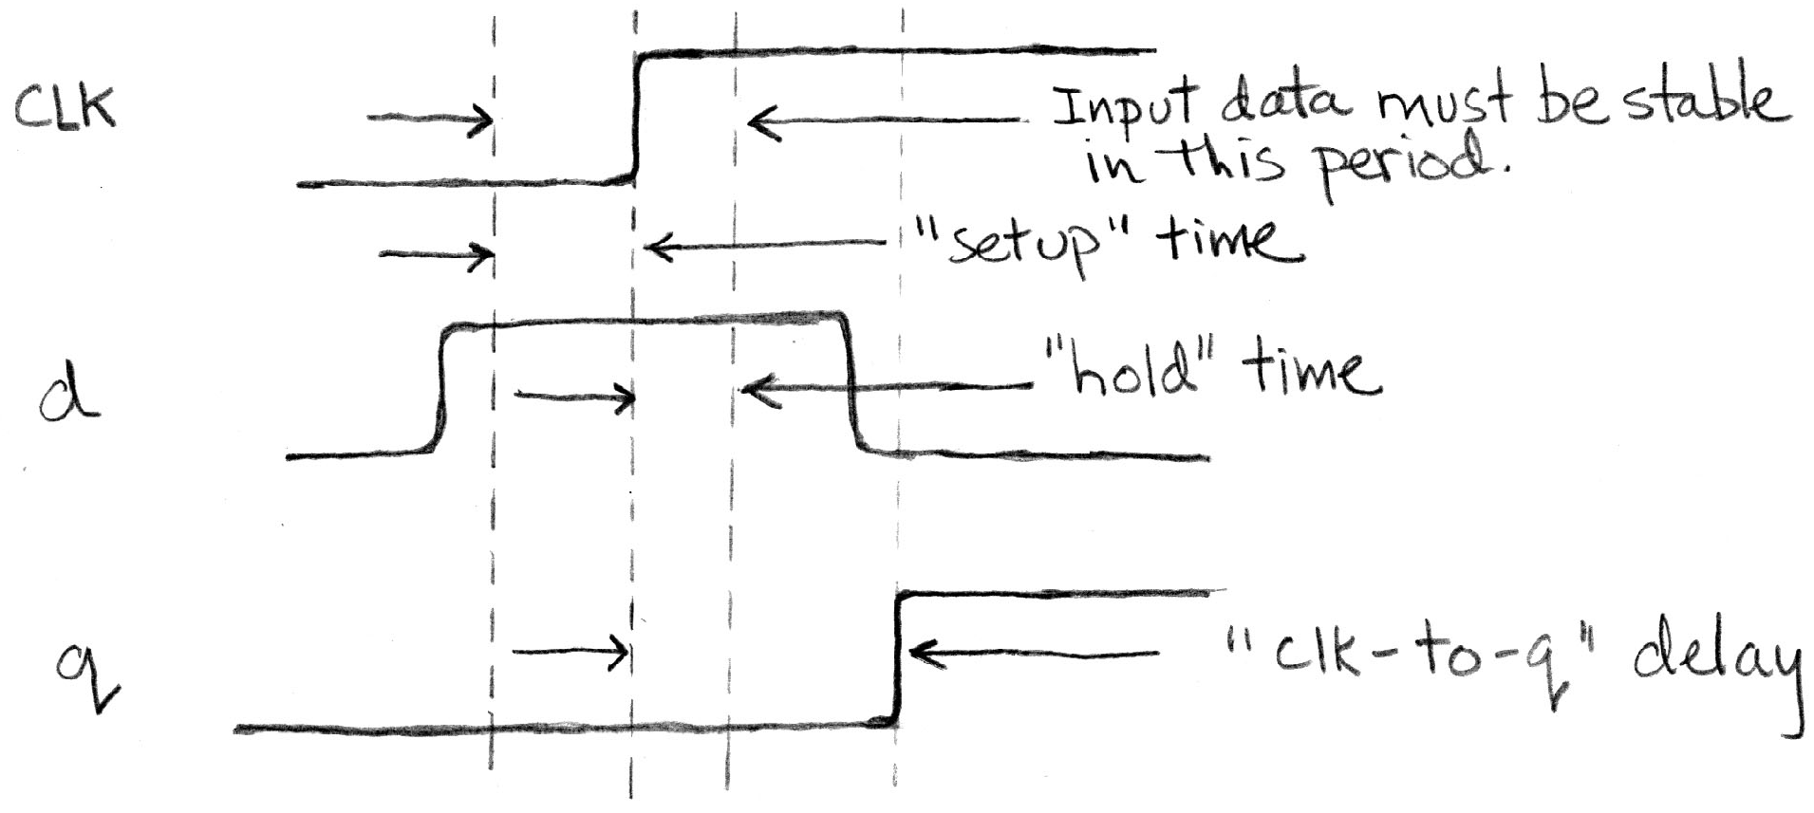
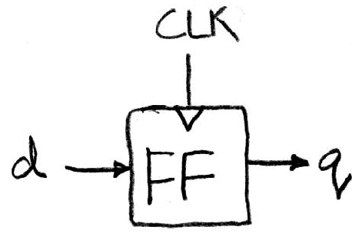
Flip-Flop Timing Behavior (2/2)
Edge-triggered d-type flip-flop
  This one is “positive edge-triggered”
“On the rising edge of the clock, input d is sampled and transferred to the output. At other times, the input d is ignored and the previously sampled value is retained.”

Slide 49
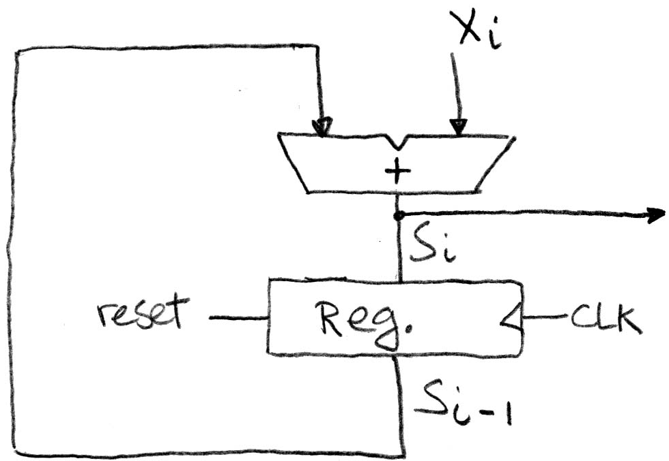
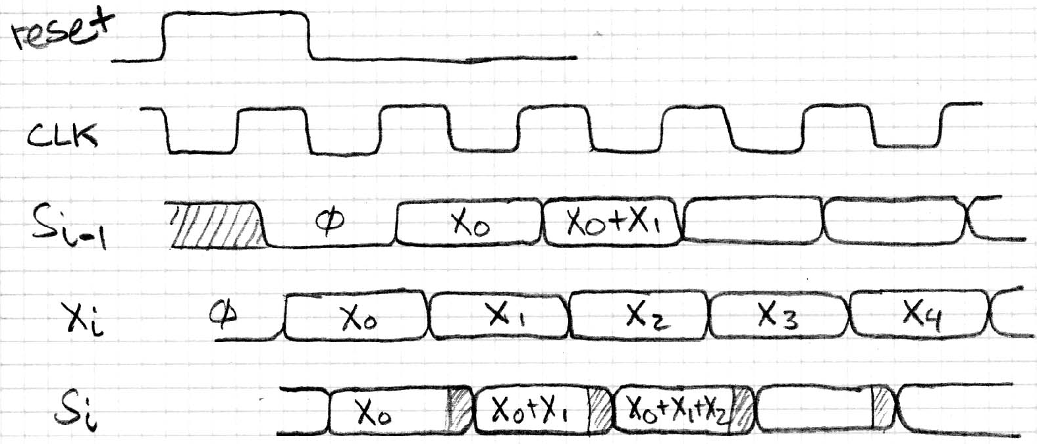
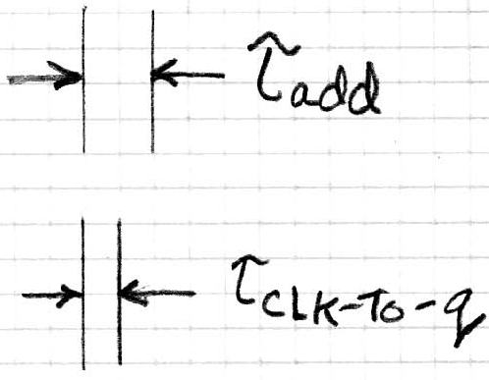
Accumulator Revisited
Proper Timing (2/2)
reset signal shown
Also, in practice X_{i} might not arrive to the adder at the same time as S_{i-1}
S_{i} temporarily is wrong, but register always captures correct value
In good circuits, instability never happens around rising edge of CLK
“Undefined” (unknown) signal

Slide 50
Summary
Hardware systems are constructed from Stateless Combinational Logic and Stateful “Memory” Logic (registers)
Voltages are analog, but quantized to represent logical 0’s and 1’s
Combinational Logic: equivalent circuit diagrams, truth tables, and Boolean expressions
  Boolean Algebra allows minimization of gates
State registers implemented from Flip-flops

Slide 51
BONUS SLIDES
Special Bonus Slides: You are NOT responsible for the material contained on the following slides!!! You may, however, find it useful to read anyway.

Slide 52
Agenda
Combinational Logic
  Truth Tables and Logic Gates
Administrivia
Boolean Algebra
Sequential Logic
  State Elements
  Bonus: Karnaugh Maps (Optional)

Slide 53
Karnaugh Maps (Optional)
Again, this is completely OPTIONAL material
  Recommended you use .pptx to view animations
Karnaugh Maps (K-maps) are an alternate way to simplify Boolean Algebra
  This technique is normally taught in CS150
  We will never ask you to use a K-map to solve a problem, but you may find it faster/easier if you choose to learn how to use it
For more info, see: http://en.wikipedia.org/wiki/Karnaugh_map

Slide 54
Underlying Idea
Using Sum of Products, “neighboring” input combinations simplify
  “Neighboring”: inputs that differ by a single signal
  e.g. ab + a’b = b, a’bc + a’bc’ = a’b, etc.
  Recall: Each product only appears where there is a 1 in the output column
Idea: Let’s write out our Truth Table such that the neighbors become apparent!
  Need a Karnaugh map for EACH output

Slide 55
Reorganizing the Truth Table
Split inputs into 2 evenly-sized groups
  One group will have an extra if an odd # of inputs
Write out all combinations of one group horizontally and all combinations of the other group vertically
  Group of n inputs → 2^{n} combinations
  Successive combinations change only 1 input
2 Inputs: 3 Inputs:
B
AB
 | 00 | 01 | 11 | 10
0
1
 | 0 | 1
0
1
C
A
Notes:
Choice of split is not essential (changes order of how you fill in values from the Truth Table).

Slide 56
K-map: Majority Circuit (1/2)
Filling in the Karnaugh map:
ab
a | b | c | y
0 | 0 | 0 | 0
0 | 0 | 1 | 0
0 | 1 | 0 | 0
0 | 1 | 1 | 1
1 | 0 | 0 | 0
1 | 0 | 1 | 1
1 | 1 | 0 | 1
1 | 1 | 1 | 1
 | 00 | 01 | 11 | 10
0
1
c
0
0
0
1
0
1
1
1
0
0
0
1
1
1
0
1
0
0
0
1
1
1
0
1
Each row of truth table corresponds to ONE cell of Karnaugh map
Recommended you view the animation on this slide on the Powerpoint (pptx)
Note the funny jump when you go from input 011 to 100 (most mistakes made here)

Slide 57
K-map: Majority Circuit (2/2)
Group neighboring 1’s so all are accounted for:
  Each group of
  neighbors becomes
  a product term in
  output
y =
Larger groups become smaller terms
  The single 1 in top row → abc’
  Vertical group of two 1’s → ab
  If entire lower row was 1’s → c
ab
 | 00 | 01 | 11 | 10
0
1
c
0
0
0
1
1
1
0
1
bc
+ ab
+ ac
bc
+ ab
+ ac
Single cell can be part of many groups

Slide 58
General K-map Rules
ab
Only group in powers of 2
  Grouping should be of size 2^{i} × 2^{j}
  Applies for both directions
Wraps around in all directions
  “Corners” case is extreme example
Always choose largest groupings possible
  Avoid single cells whenever possible
y =
 | 00 | 01 | 11 | 10
00 | 1 | 0 | 0 | 1
01 | 0 | 1 | 1 | 0
11 | 0 | 1 | 1 | 1
10 | 1 | 0 | 0 | 1
cd
NOT a valid group
IS a valid group
IS a valid group
“Corners” case
1 of 2 good choices here
(spot the other?)
bd
+ b’d’
+ acd

