Slide 1
CS 61C: Great Ideas in Computer Architecture
Functional Units,
Finite State Machines
Instructor: Justin Hsia

Slide 2
Review of Last Lecture
Synchronous Digital Systems
Pulse of a Clock controls flow of information
All signals are seen as either 0 or 1
Hardware systems are constructed from Stateless Combinational Logic and Stateful “Memory” Logic (registers)
Combinational Logic: equivalent circuit diagrams, truth tables, and Boolean expressions
Boolean Algebra allows minimization of gates
State registers implemented from Flip-flops

Slide 3
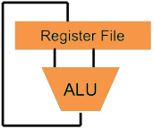
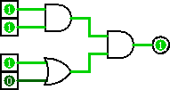
Great Idea #1: Levels of Representation/Interpretation
Higher-Level Language Program (e.g. C)
temp = v[k];
v[k] = v[k+1];
v[k+1] = temp;
Compiler
lw $t0, 0($2)
lw $t1, 4($2)
sw $t1, 0($2)
sw $t0, 4($2)
Assembly Language Program (e.g. MIPS)
Assembler
0000 1001 1100 0110 1010 1111 0101 1000
1010 1111 0101 1000 0000 1001 1100 0110
1100 0110 1010 1111 0101 1000 0000 1001
0101 1000 0000 1001 1100 0110 1010 1111
Machine Language Program (MIPS)
We are here
Machine Interpretation
Hardware Architecture Description (e.g. block diagrams)
Architecture Implementation
Logic Circuit Description (Circuit Schematic Diagrams)

Slide 4
Hardware Design Hierarchy
system
datapath
control
code registers
state registers
combinational logic
multiplexer
comparator
Today
register
logic
switching networks

Slide 5
Agenda
State Elements Continued
Administrivia
Logisim Introduction
Finite State Machines
Multiplexers
ALU Design
Adder/Subtracter

Slide 6
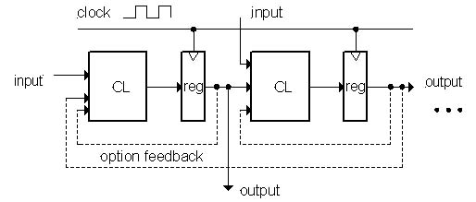
Model for Synchronous Systems
Collection of Combinational Logic blocks separated by registers
Feedback is optional depending on application
Clock (CLK): square wave that synchronizes the system
Clock signal connects only to clock input of registers
Register: several bits of state that samples input on rising edge of CLK

Slide 7
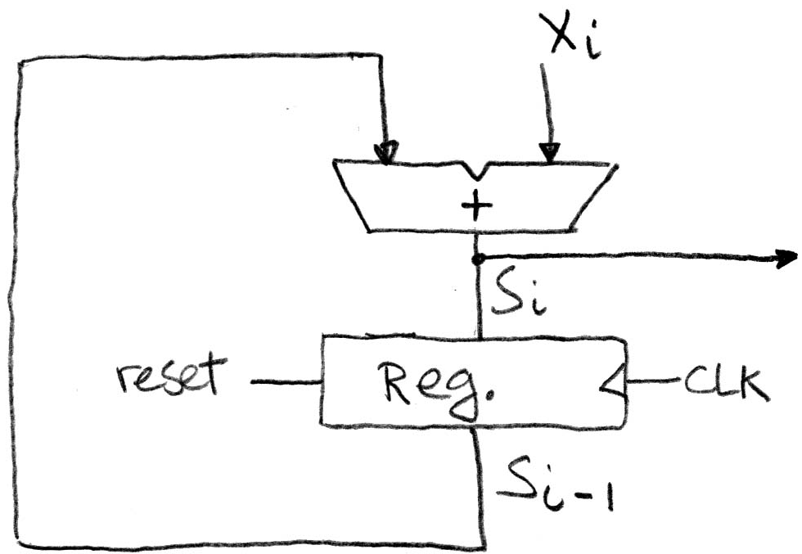
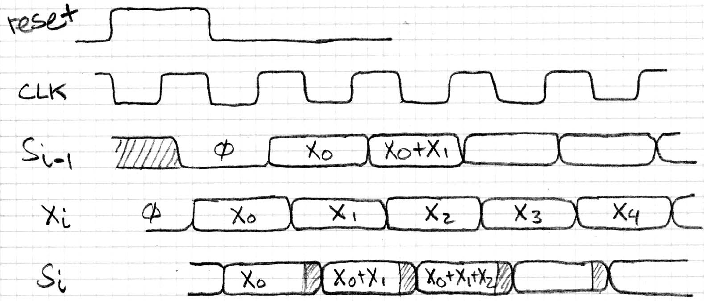
Accumulator Revisited ...Again
reset signal shown
In practice X might not arrive to the adder at the same time as S_{i-1}
S_{i} temporarily is wrong, but register always captures correct value
In good circuits, instability never happens around rising edge of clk

Slide 8
Register Timing Terms (Review)
Setup Time: how long the input must be stable before the CLK trigger for proper input read
Hold Time: how long the input must be stable after the CLK trigger for proper input read
“CLK-to-Q” Delay: how long it takes the output to change, measured from the CLK trigger

Slide 9
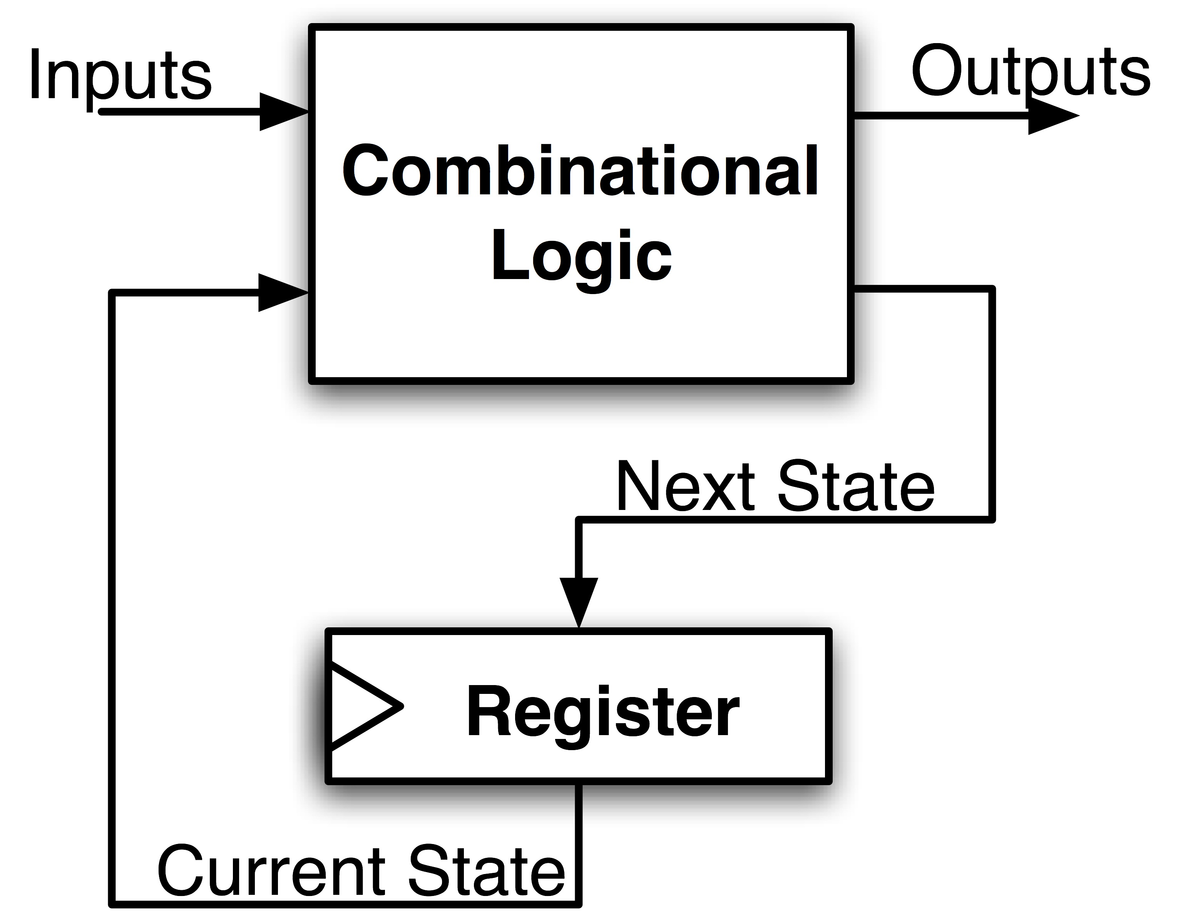
Maximum Clock Frequency
What is the max frequency of this circuit?
Limited by how much time needed to get correct Next State to Register
Max Delay =
Max Freq = 1/Max Delay
Setup Time
+ CLK-to-Q Delay
+ CL Delay
Notes:
Hold time is included in CLK-to-Q delay.

Slide 10
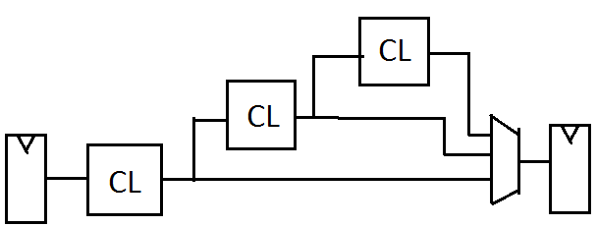
The Critical Path
The critical path is the longest delay between any two registers in a circuit
The clock period must be longer than this critical path, or the signal will not propagate properly to that next register
Critical Path =
CL Delay 1
+ CL Delay 2
+ CL Delay 3
+ Adder Delay
3
2
4
1
+
Reg
Reg

Slide 11
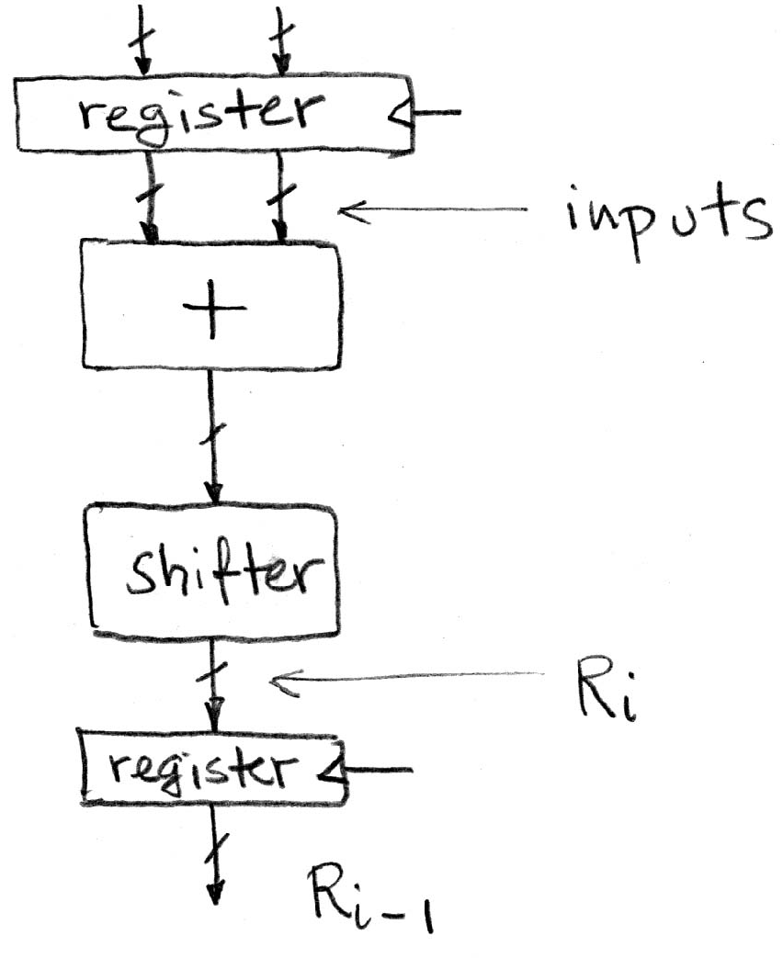
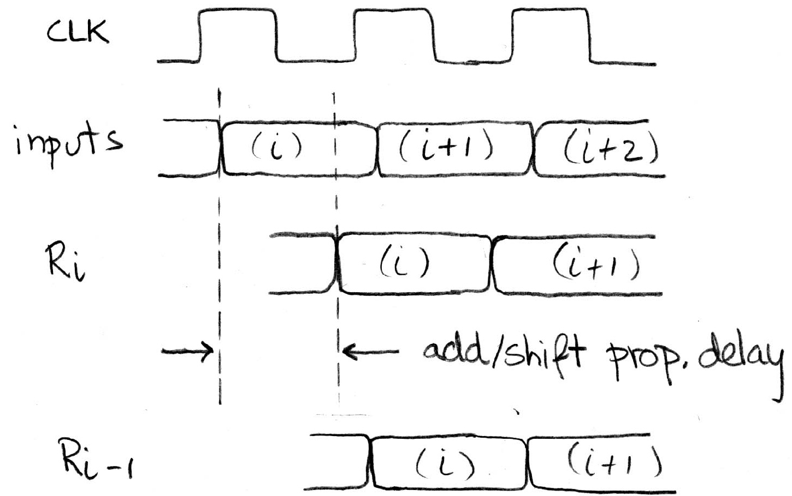
Pipelining and Clock Frequency (1/2)
Clock period limited by propagation delay of adder and shifter
Add an extra register to reduce the critical path!
Timing:

Slide 12
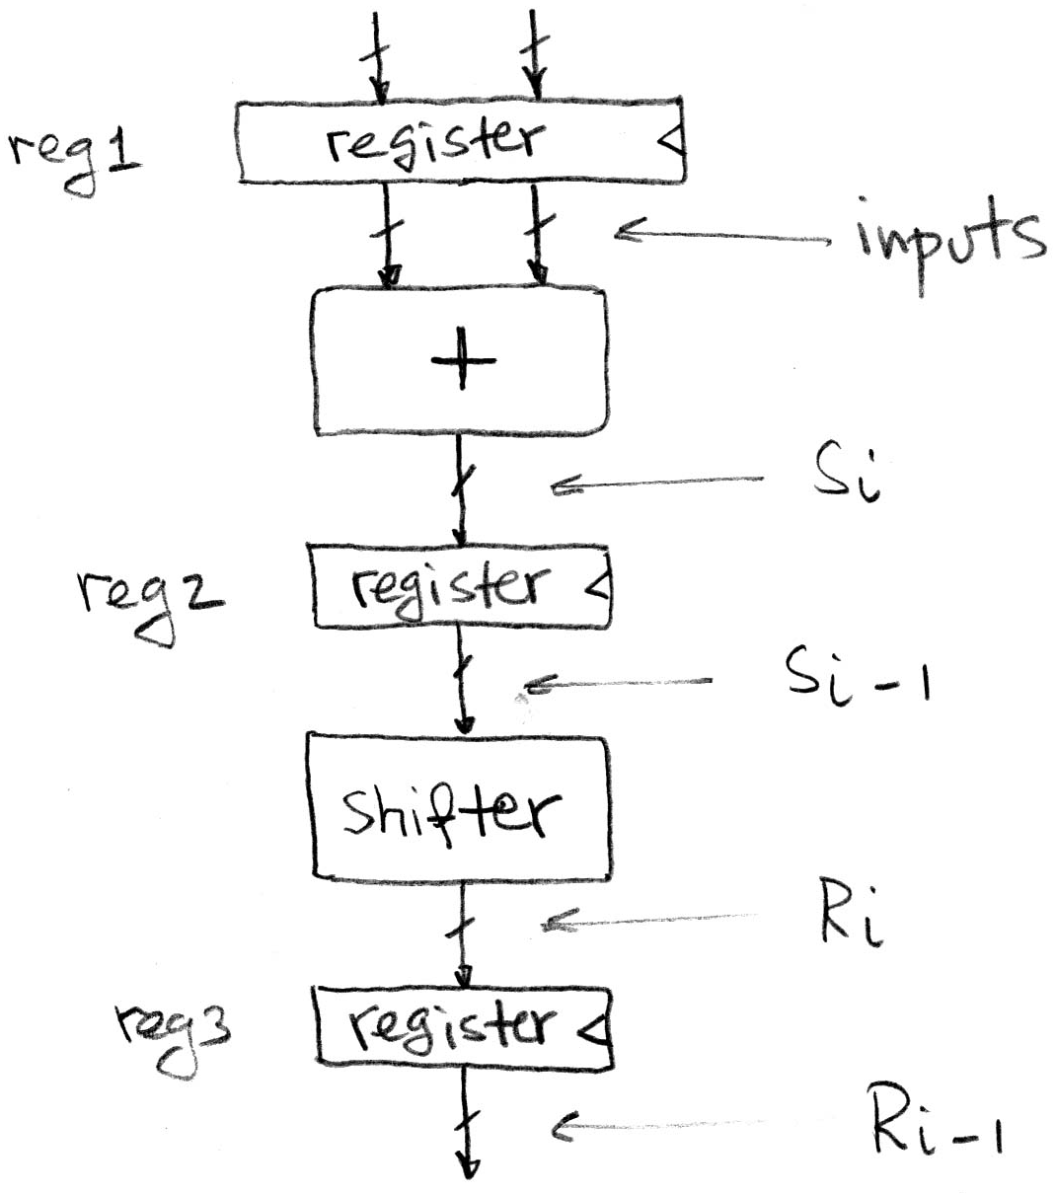
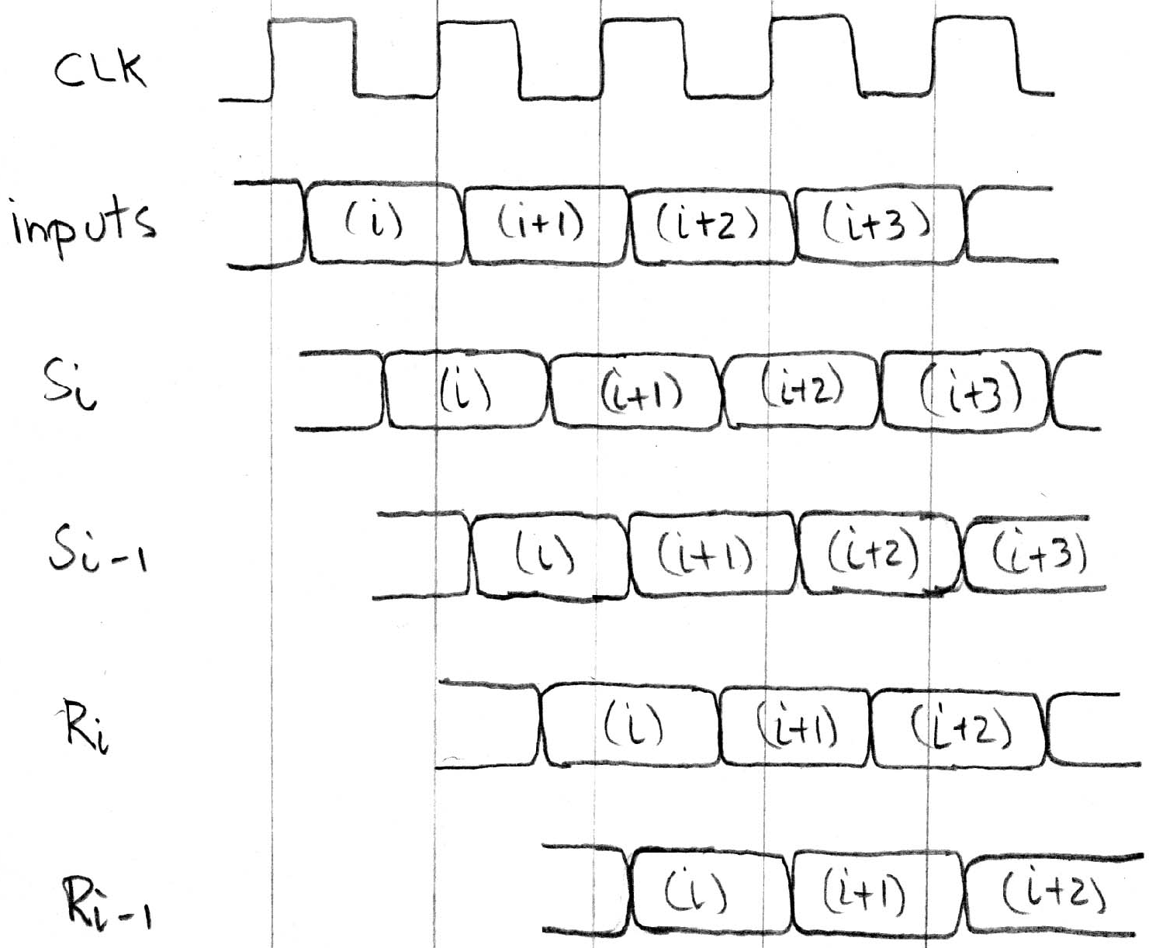
Pipelining and Clock Frequency (2/2)
Extra register allows higher clock freq (more outputs per sec)
However, takes two (shorter) clock cycles to produce first output (higher latency for initial output)
+ CLK-to-Q delay
+ Adder delay
+ setup time
+ CLK-to-Q delay
+ Shifter delay
+ setup time
+ CLK-to-Q delay

Slide 13
Pipelining Basics
By adding more registers, break path into shorter “stages”
Aim is to reduce critical path
Signals take an additional clock cycle to propagate through each stage
New critical path must be calculated
Affected by placement of new pipelining registers
Faster clock rate → higher throughput (outputs)
More stages → higher startup latency
Pipelining tends to improve performance
More on this (application to CPUs) next week

Slide 14
Agenda
State Elements Continued
Administrivia
Logisim Introduction
Finite State Machines
Multiplexers
ALU Design
Adder/Subtracter

Slide 15
Administrivia
Midterm re-grade requests due today
We will re-grade the entire test
Project 2 Part 2 will be posted today

Slide 16
Agenda
State Elements Continued
Administrivia
Logisim Introduction
Finite State Machines
Multiplexers
ALU Design
Adder/Subtracter

Slide 17
Logisim
Open-source (i.e. free!) “graphical tool for designing and simulating logic circuits”
Runs on Java on any computer
Download to your home computer via class login or the Logisim website (we are using version 2.7.1)
No programming involved
Unlike Verilog, which is a hardware description language (HDL)
Click and drag; still has its share of annoying quirks
http://ozark.hendrix.edu/~burch/logisim/

Slide 18
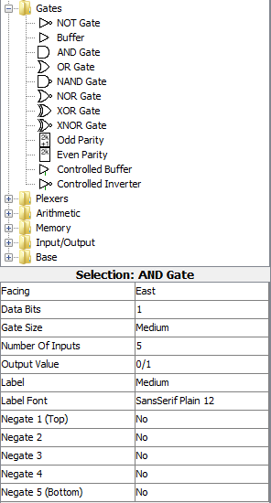
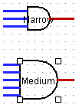
Gates in Logisim
Click gate type, click to place
Can set options before placing or select gate later to change
Types of Gates
Options
bus width n
# inputs
labeling not necessary, but can help

Slide 19
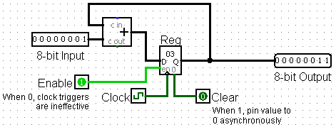
Registers in Logisim
Flip-flops and Registers in “Memory” folder
8-bit accumulator:

Slide 20
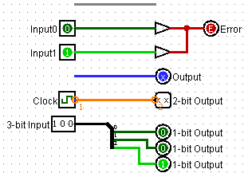
Wires in Logisim
Click and drag on existing port or wire
Color schemes:
Gray: unconnected
Dark Green: low signal (0)
Light Green: high signal (1)
Red: error
Blue: undetermined signal
Orange: incompatible widths
Tunnels: all tunnels with same label are connected
“Splitter” used to adjust bus widths

Slide 21
Common Mistakes in Logisim
Connecting wires together
Crossing wires vs. connected wires
Losing track of which input is which
Mis-wiring a block (e.g. CLK to Enable)
Grabbing wrong wires off of splitter
Errors:

Slide 22
Agenda
State Elements Continued
Administrivia
Logisim Introduction
Finite State Machines
Multiplexers
ALU Design
Adder/Subtracter

Slide 23
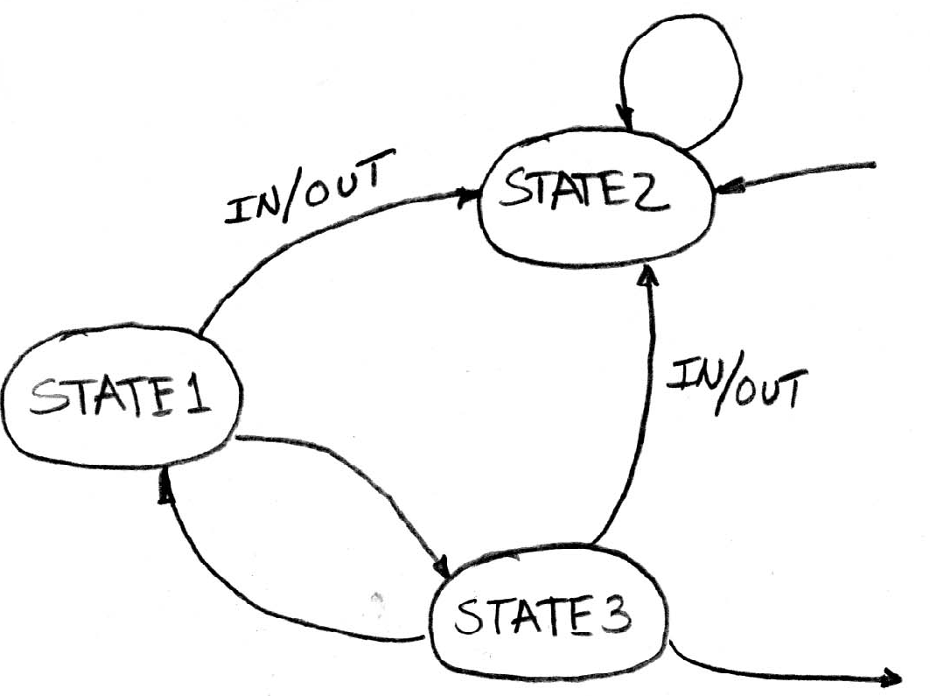
Finite State Machines (FSMs)
You may have seen FSMs in other classes
Function can be represented with a state transition diagram
With combinational logic and registers, any FSM can be implemented in hardware!
. . .

Slide 24
FSM Overview
An FSM (in this class) is defined by:
A set of states S (circles)
An initial state s₀ (only arrow not between states)
A transition function that maps from the current input and current state to the output and the next state (arrows between states)
State transitions are controlled by the clock:
On each clock cycle the machine checks the inputs and generates a new state (could be same) and new output

Slide 25
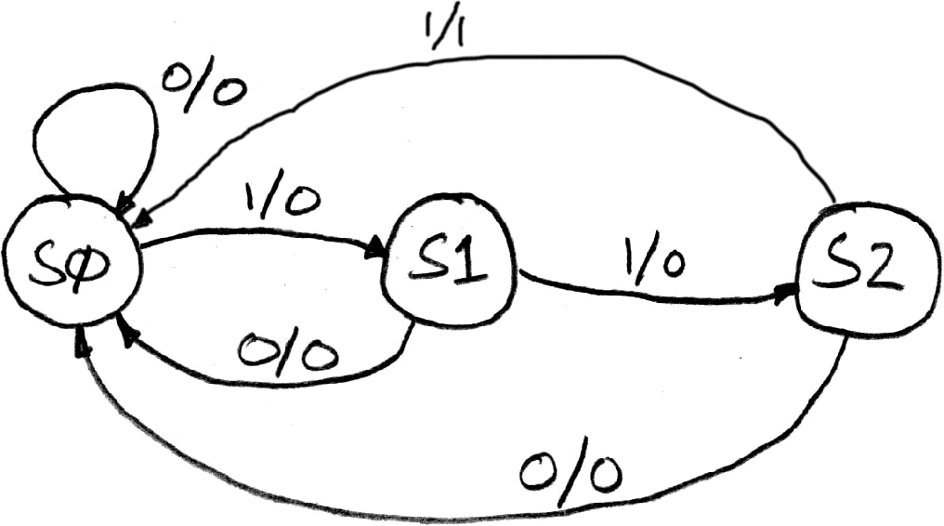
Example: 3 Ones FSM
FSM to detect 3 consecutive 1’s in the Input
States: S0, S1, S2
Initial State: S0
Transitions of form:
input/output

Slide 26
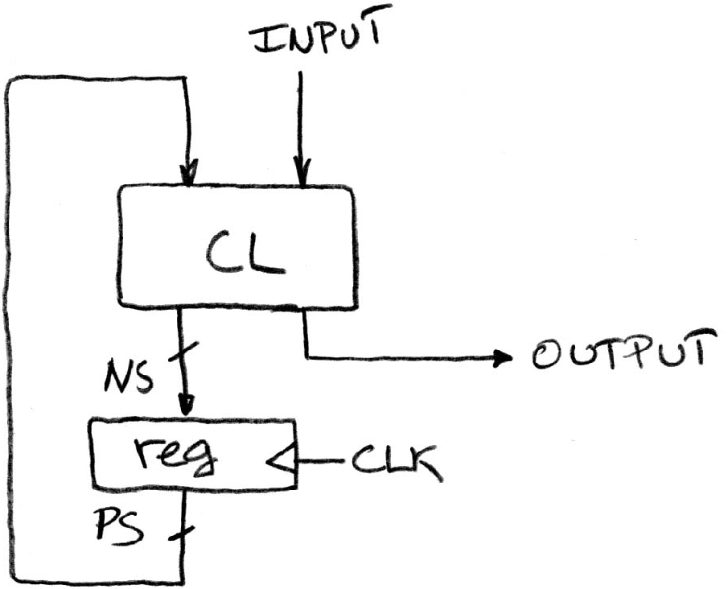
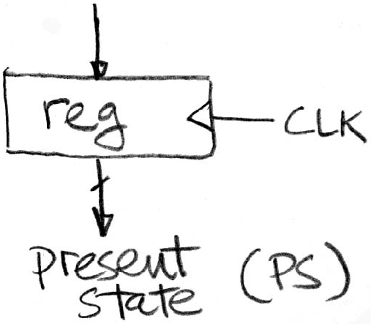
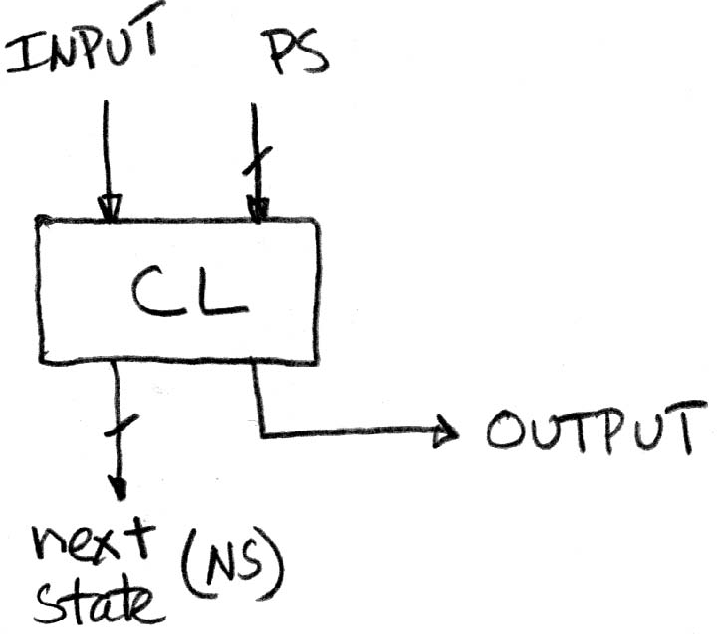
Hardware Implementation of FSM
Register holds a representation of the FSM’s state
Must assign a unique bit pattern for each state
Output is present/current state (PS/CS)
Input is next state (NS)
Combinational Logic implements transition function (state transitions + output)
+
=

Slide 27
FSM: Combinational Logic
Read off transitions into Truth Table!
Inputs: Current State (CS) and Input (In)
Outputs: Next State (NS) and Output (Out)
Implement logic for EACH output (2 for NS, 1 for Out)
CS | In | NS | Out
00 | 0 | 00 | 0
00 | 1 | 01 | 0
01 | 0 | 00 | 0
01 | 1 | 10 | 0
10 | 0 | 00 | 0
10 | 1 | 00 | 1
Notes:
In lecture: Implement logic for Out (1 NOT, 2 AND gates)

Slide 28
Unspecified Output Values (1/2)
Our FSM has only 3 states
2 entries in truth table are undefined/unspecified
Use symbol ‘X’ to mean it can be either a 0 or 1
Make choice to simplify final expression
CS | In | NS | Out
00 | 0 | 00 | 0
00 | 1 | 01 | 0
01 | 0 | 00 | 0
01 | 1 | 10 | 0
10 | 0 | 00 | 0
10 | 1 | 00 | 1
11 | 0 | XX | X
11 | 1 | XX | X

Slide 29
Unspecified Output Values (2/2)
Let’s find expression for NS₁
Recall: 2-bit output is just a 2-bit bus, which is just 2 wires
Boolean algebra:
NS₁ = CS₁’CS₀In + CS₁CS₀In’ + CS₁CS₀In
NS₁ = CS₀In
Karnaugh Map:
NS₁ = CS₀In
CS | In | NS | Out
00 | 0 | 00 | 0
00 | 1 | 01 | 0
01 | 0 | 00 | 0
01 | 1 | 10 | 0
10 | 0 | 00 | 0
10 | 1 | 00 | 1
11 | 0 | XX | X
11 | 1 | XX | X
Differs by 2
Is neighbor
CS
 | 00 | 01 | 11 | 10
0 | 0 | 0 | X | 0
1 | 0 | 1 | X | 0
In

Slide 30
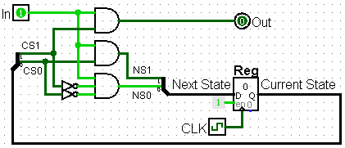
3 Ones FSM in Hardware
2-bit Register needed for state
CL: NS₁ = CS₀In, NS₀ = CS₁’CS₀’In, Out = CS₁In

Slide 31
Agenda
State Elements Continued
Administrivia
Logisim Introduction
Finite State Machines
Multiplexers
ALU Design
Adder/Subtracter

Slide 32
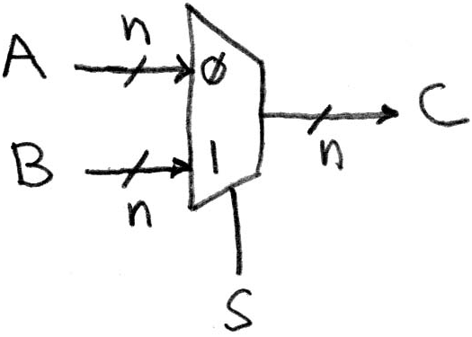
Data Multiplexor
Multiplexor (“MUX”) is a selector
Place one of multiple inputs onto output (N-to-1)
Shown below is an n-bit 2-to-1 MUX
Input S selects between two inputs of n bits each
This input is passed to output if selector bits match shown value

Slide 33
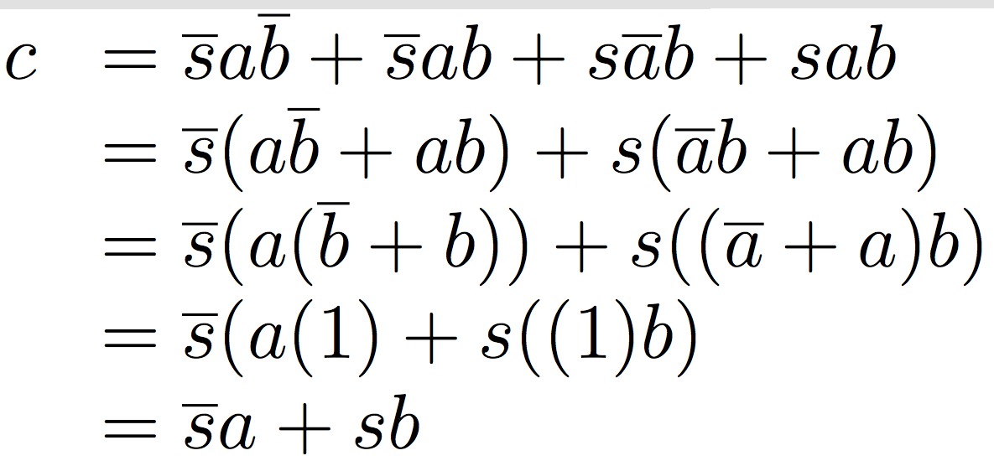
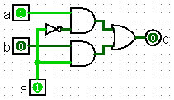
Implementing a 1-bit 2-to-1 MUX
Schematic:
Truth Table:
Boolean Algebra:
Circuit Diagram:
s | a | b | c
0 | 0 | 0 | 0
0 | 0 | 1 | 0
0 | 1 | 0 | 1
0 | 1 | 1 | 1
1 | 0 | 0 | 0
1 | 0 | 1 | 1
1 | 1 | 0 | 0
1 | 1 | 1 | 1

Slide 34
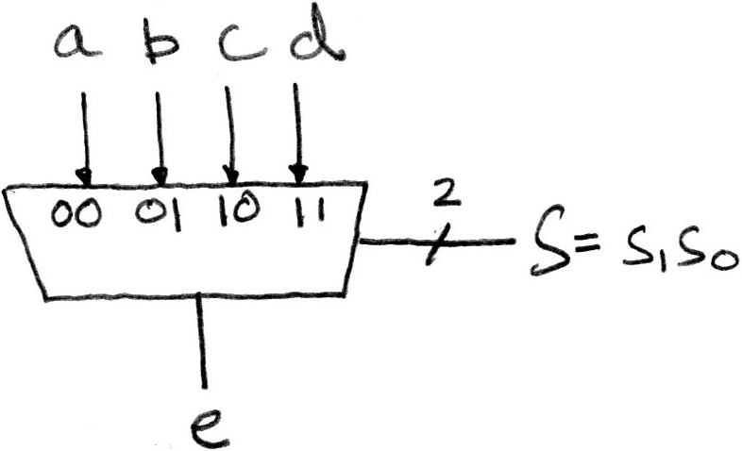
1-bit 4-to-1 MUX (1/2)
Schematic:
Truth Table: How many rows?
Boolean Expression: e = s₁’s₀’a + s₁’s₀b + s₁s₀’c + s₁s₀d

Slide 35
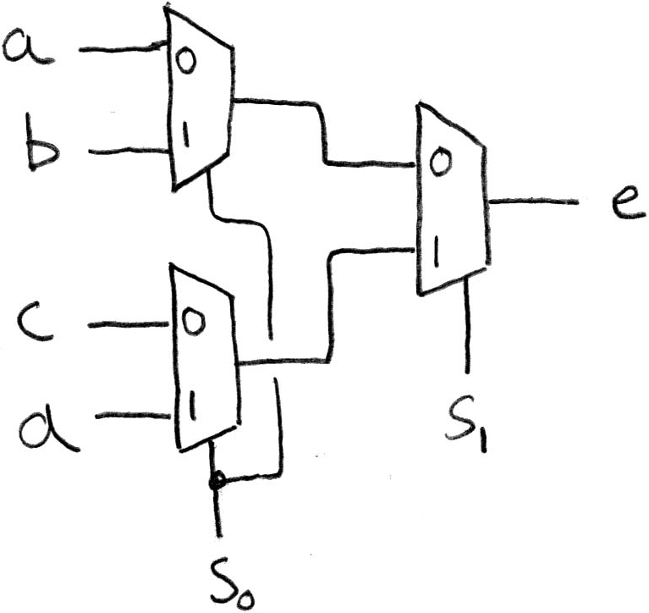
1-bit 4-to-1 MUX (2/2)
Can we leverage what we’ve previously built?
Alternative hierarchical approach:

Slide 36
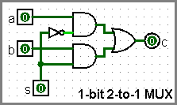
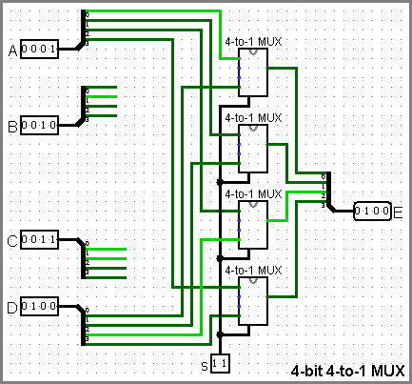
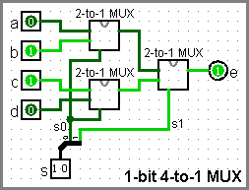
Subcircuits Example
Logisim equivalent of procedure or method
Every project is a hierarchy of subcircuits
Incomplete wiring shown here

Slide 37
Get To Know Your Instructor

Slide 38
Agenda
State Elements Continued
Administrivia
Logisim Introduction
Finite State Machines
Multiplexers
ALU Design
Adder/Subtracter

Slide 39
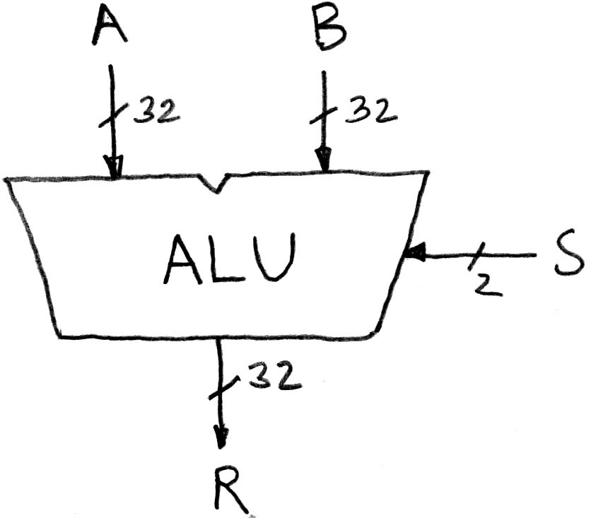
Arithmetic and Logic Unit (ALU)
Most processors contain a special logic block called the “Arithmetic and Logic Unit” (ALU)
We’ll show you an easy one that does ADD, SUB, bitwise AND, and bitwise OR
Schematic:
when S=00, R = A + B
when S=01, R = A – B
when S=10, R = A AND B
when S=11, R = A OR B

Slide 40
Simple ALU Schematic
Notice that 3 values are ALWAYS calculated in parallel, but only 1 makes it to the Result

Slide 41
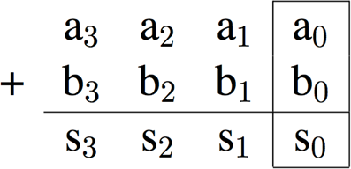
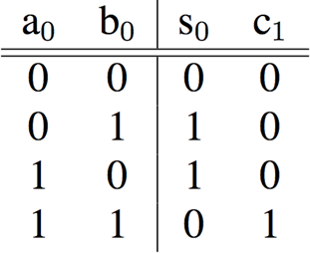
Adder/Subtractor: 1-bit LSB Adder
Carry-out bit

Slide 42
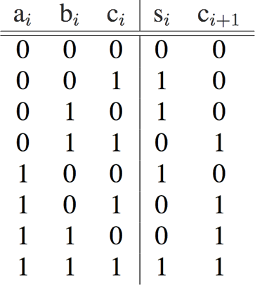
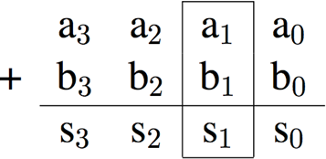
Adder/Subtractor: 1-bit Adder
Possible carry-in c₁
Here defining XOR of many inputs to be 1 when and odd number of inputs are 1

Slide 43
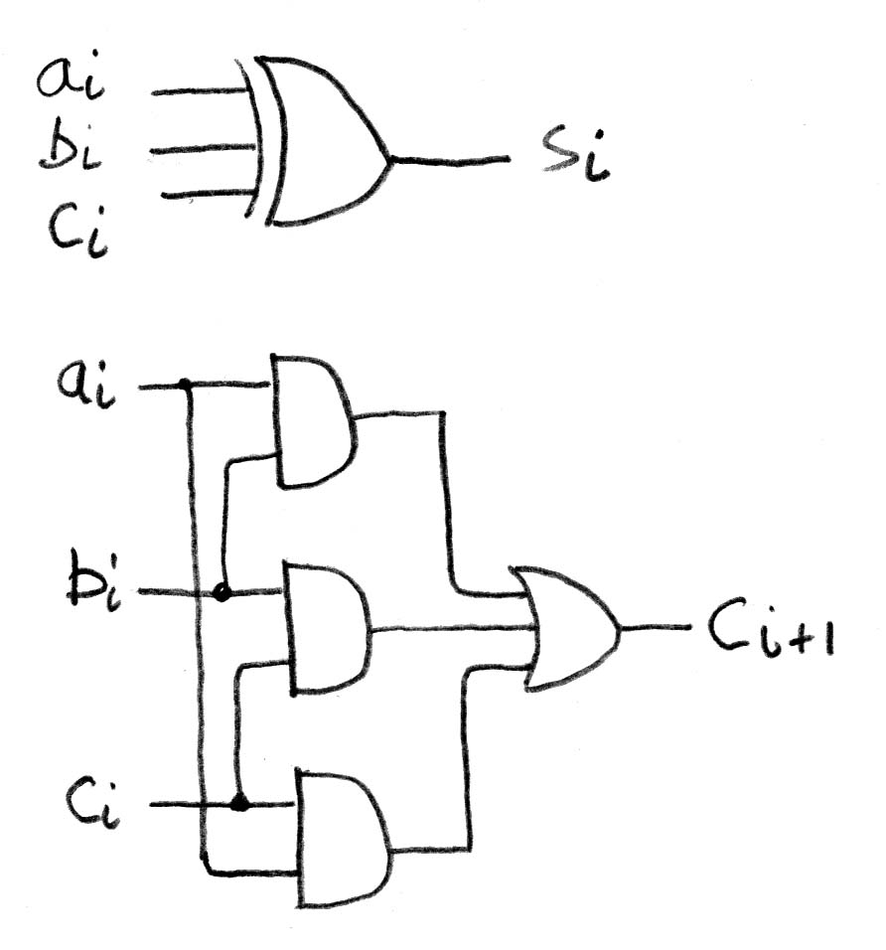
Adder/Subtractor: 1-bit Adder
Circuit Diagrams:

Slide 44
N x 1-bit Adders ◊ N-bit Adder
Connect CarryOut_{i-1} to CarryIn_{i} to chain adders:
b₀
+
+
+

Slide 45
Two’s Complement Adder/Subtractor
Subtraction accomplished by adding negated number:
x ^ 1 = x’
(flips the bits)
Add 1
+
+
+
This signal is only high when you perform subtraction
Where did this come from?

Slide 46
Detecting Overflow
Unsigned overflow
On addition, if carry-out from MSB is 1
On subtraction, if carry-out from MSB is 0
This case is a lot harder to see than you might think
Signed overflow
Overflow from adding “large” positive numbers
Overflow from adding “large” negative numbers

Slide 47
Signed Overflow Examples (4-bit)
Overflow from two positive numbers:
0111 + 0111, 0111 + 0001, 0100 + 0100.
Carry-out from the 2nd MSB (but not MSB)
pos + pos ≠ neg
Overflow from two negative numbers:
1000 + 1000, 1000 + 1111, 1011 + 1011.
Carry-out from the MSB (but not 2nd MSB)
neg + neg ≠ pos
Expression for signed overflow: C_{n} XOR C_{n-1}

Slide 48
Summary
Critical path constrains clock rate
Timing constants: setup, hold, and clk-to-q times
Can adjust with extra registers (pipelining)
Finite State Machines extremely useful
Can implement systems with Register + CL
Use MUXes to select among input
S input bits selects one of 2^{S} inputs
Each input is a bus n-bits wide
Build n-bit adder out of chained 1-bit adders
Can also do subtraction with additional SUB signal

