Slide 1
CS 61C: Great Ideas in Computer Architecture
Course Summary & Review
Instructor: Justin Hsia

Slide 2
Agenda
Course Summary
Administrivia
What’s Next?
Acknowledgements

Slide 3
Six Great Ideas in Computer Architecture
Layers of Representation/Interpretation
Moore’s Law
Principle of Locality/Memory Hierarchy
Parallelism
Performance Measurement & Improvement
Dependability via Redundancy

Slide 4
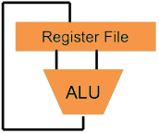
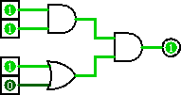
Great Idea #1: Levels of Representation/Interpretation
Higher-Level Language Program (e.g. C)
temp = v[k];
v[k] = v[k+1];
v[k+1] = temp;
Compiler
lw $t0, 0($2)
lw $t1, 4($2)
sw $t1, 0($2)
sw $t0, 4($2)
Assembly Language Program (e.g. MIPS)
Assembler
0000 1001 1100 0110 1010 1111 0101 1000
1010 1111 0101 1000 0000 1001 1100 0110
1100 0110 1010 1111 0101 1000 0000 1001
0101 1000 0000 1001 1100 0110 1010 1111
Machine Language Program (MIPS)
Machine Interpretation
Hardware Architecture Description (e.g. block diagrams)
Architecture Implementation
Logic Circuit Description (Circuit Schematic Diagrams)

Slide 5
Number Representation
Anything can be represented as a number!
With n digits in base B, can represent B^{n} things
IEC (vs. SI) prefixes (2¹⁰ ≈ 10³)
Signed and unsigned integers
Addition, subtraction, overflow, sign extension
Two’s complement (better than 1’s and sign&mag)
Floating point (sign, biased exp, significand)
Inf, NaN, 0, denorms
Precision and truncation

Slide 6
Higher-Level Language (HLL)
We studied C because exposes more of hardware (particularly memory)
Compiled language is machine-dependent
Arrays and strings
Don’t run off the end or forget null terminator
Pointers hold addresses, used to pass by ref
Pointer arithmetic
Array vs. pointer syntax
Structs are padded collections of variables

Slide 7
Assembly Language
Close to the level that a machine understands
ISA in human-readable format
TAL vs. MAL (pseudo-instructions)
RISC vs. CISC and effects
MIPS Instruction Formats: R, I, J
Meaning and limitations of the fields
Relative (branch) vs. absolute (jump) addressing
Register conventions (saved/volatile; caller/callee)
Assembler: instr translation, sym/rel tables

Slide 8
Machine Language
Everything is just 0’s and 1’s!
Usually done by assembler & linker, but can also do manually
At this level, just raw bits! No differentiation between instructions and different types of data
Alignment matters
Executable produced by linker, run by loader
OS creates new process (PT, swap space)
Instructions loaded and run by processor

Slide 9
Hardware Architecture Description
Processor split into Datapath and Control
Datapath components: I$/D$, RegFile, ALU, Extender, MUXes
Datapath Stages: IF, ID, EX, MEM, WB
Controller: Use “AND” and “OR” Logic blocks to determine control signal values for each instruction
Can build/design components hierarchically
Behavior of many circuits/programs can be represented using Finite State Machines
States, transition function, initial state

Slide 10
Logic Circuit Description
Build Synchronous Digital Systems out of combinational and sequential logic
Equivalence between Circuit Diagrams, Truth Tables, and Boolean Expressions
Can convert between all representations
Boolean algebra allows for circuit simplification (Karnaugh maps, too)
FSMs built with registers and CL
In reality, everything wires and transistors
Voltage-controlled switches (1: high, 0: low)

Slide 11
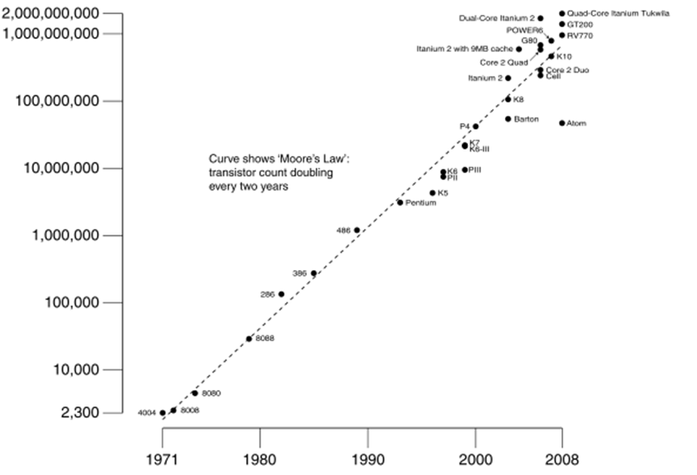
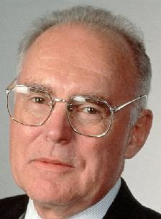
Great Idea #2: Moore’s Law
Predicts: Transistor count
per chip doubles
every 2 years
# of transistors on an integrated circuit (IC)
Gordon Moore
Intel Cofounder B.S. Cal 1950
Year:

Slide 12
Technology Trends
Dynamic power = C × V² × f
Capacitance, voltage, switching frequency
In WSC: Power Usage Effectiveness (PUE) = Total building power / IT equipment power
Technology growth is slowing, processors have hit a power wall
Everywhere: transistor density, CPU speed, disk and memory capacity
Performance improvements now coming from parallelism and multicore processors

Slide 13
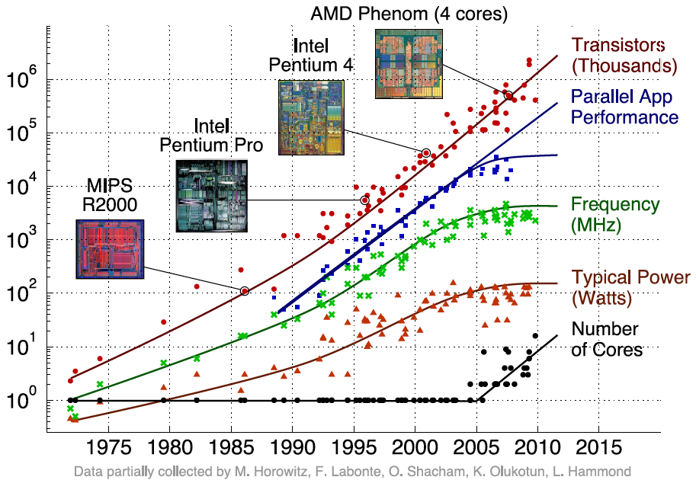
Transition to Multicore
Sequential App Performance

Slide 14
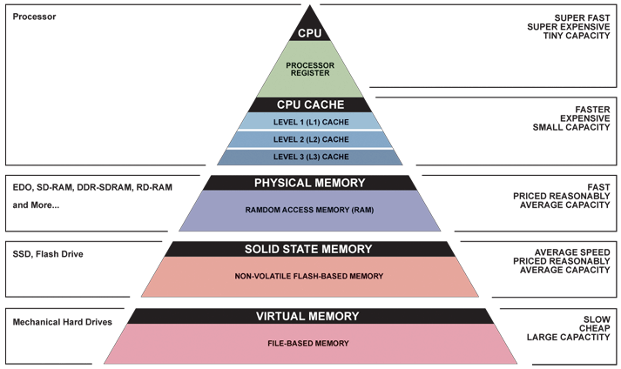
Great Idea #3: Principle of Locality/ Memory Hierarchy
Increasing distance from application/user
Trade-off in speed and cost vs. capacity!

Slide 15
Memory
Programmer treats as one long array
You know that this is just an illusion (VM)!
Memory is byte-addressed
Most data (including instructions) in words and word-aligned, so all word addresses are multiples of 4 (end in 0b00)
Multicore systems use shared memory
Synchronization/cache coherence necessary

Slide 16
Memory Management
Program’s address space contains four regions:
Stack: local variables, grows downward
Heap: space requested for pointers via malloc(); resizes dynamically, grows upward
Static Data: global and static variables, does not grow or shrink
Code: loaded when program starts, does not change size
~ FFFF FFFF_{hex}
stack
heap
static data
code
~ 0_{hex}

Slide 17
Typical Memory Hierarchy
Take advantage of the principle of locality to present the user with as much memory as is available in the cheapest technology at the speed offered by the fastest technology
On-Chip Components
Secondary
Memory
(Disk
or Flash)
Control
Datapath
Main
Memory
(DRAM)
Instr
Cache
Second
Level
Cache
(SRAM)
I TLB
RegFile
D TLB
Data
Cache
Speed: ½’s 1’s 10’s 100’s 1,000,000’s
(cycles)
Size: 100’s 10K’s M’s G’s T’s
(bytes)
Cost/bit: highest lowest

Slide 18
Accessing Data
Check TLB/PT if page is in main memory
Page fault to load from disk (swap space) if not
Check cache for data
Fetch from main memory on cache miss
Return data to processor
hit
miss
CPU
TLB
Cache
Main Memory
VA
PA
data
miss
hit
Page Table

Slide 19
Caching Details (1/2)
Move data in contiguous blocks
Store data in cache, closer to processor
Cache organization
Map data addresses to the limited number of block locations in cache
Set associativity: # of slots per set
TIO breakdown
Tag as block identifier, Index to find set in cache, Offset to find data within block
Also store management bits for each block
Valid bit, (Dirty bit), Tag bits

Slide 20
Caching Details (2/2)
Cache parameters affect performance
Block size, cache size, set associativity
Write-back/write-through policies
Write allocate/no-write allocate policies
Block replacement policy (Least Recently Used)
Source of cache misses: The 3 C’s
Compulsory, capacity, conflict
Multilevel caches reduce miss penalty

Slide 21
Virtual Memory Details (1/3)
Give main memory effective size of disk without major penalty to performance
Move data in contiguous pages from disk to main memory
Assumption is that memory is small compared to both disk and virtual address space (or many processes)
Also provide protection for multiple processes
Requires a lot of work by operating system

Slide 22
Virtual Memory Details (2/3)
Paging requires address translation
Can run programs larger than main memory
Hides variable machine configurations (RAM/HDD)
Solves fragmentation problem
Address mappings stored in page tables in memory
Additional memory access mitigated with TLB, which is a cache for page table
Management bits: Valid, Dirty, Ref, Access Rights

Slide 23
Virtual Memory Details (3/3)
Running multiple processes:
Each process has its own page table and swap space in disk
OS can switch between by saving and loading process states (PC, reg vals, page table address)
On context switch, flush TLB and pipeline

Slide 24
Input/Output
Disk Latency = Seek Time + Rotation Time + Transfer Time + Controller Overhead
Processor must synchronize with I/O devices before use due to difference in data rates:
Polling works, but expensive due to repeated queries
Exceptions are “unexpected” events in processor
Interrupts are asynchronous events that are often used for interacting with I/O devices
In SW, need special handling code

Slide 25
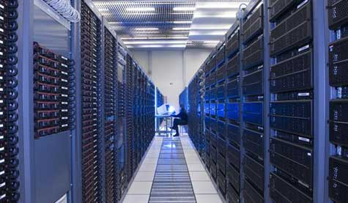
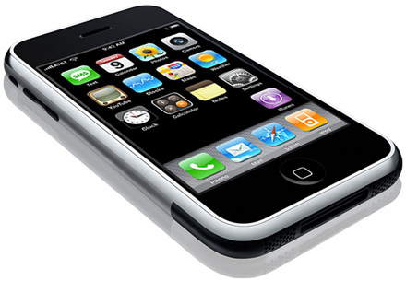
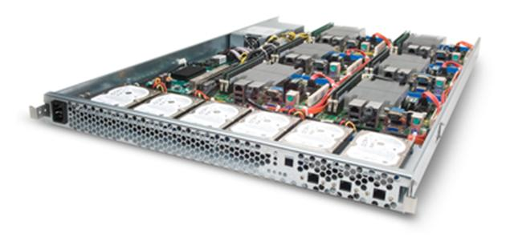
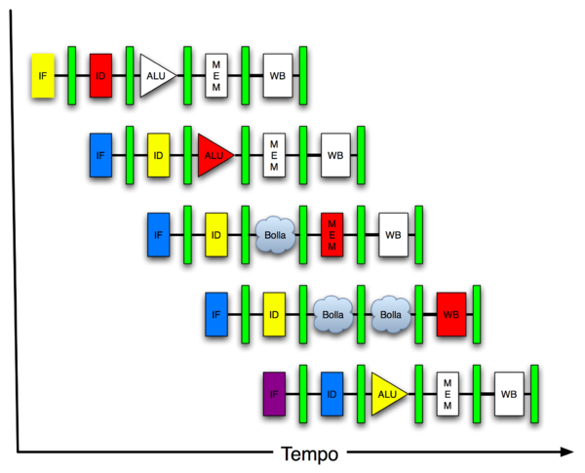
Great Idea #4: Parallelism
Software Hardware
Parallel Requests
Assigned to computer
e.g. search “Katz”
Parallel Threads
Assigned to core
e.g. lookup, ads
Parallel Instructions
> 1 instruction @ one time
e.g. 5 pipelined instructions
Parallel Data
> 1 data item @ one time
e.g. add of 4 pairs of words
Hardware descriptions
All gates functioning in parallel at same time
Warehouse Scale Computer
Smart Phone
Leverage Parallelism &
Achieve High Performance
Computer
Core
…
Core
Memory
Input/Output
Core
Instruction Unit(s)
Functional
Unit(s)
A₀+B₀
A₁+B₁
A₂+B₂
A₃+B₃
Cache Memory
Logic Gates

Slide 26
Types of Parallelism (1/4)
Request-Level Parallelism (RLP)
Handling many requests per second (e.g. web search)
Data-Level Parallelism (DLP)
Operate on many pieces of data at once
SIMD: at the level of single instructions
MapReduce: at the level of programs (split into map and reduce)

Slide 27
Types of Parallelism (2/4)
Thread-Level Parallelism (TLP)
Have many processors, run either different programs or different parts of same program at same time
If same program, need to deal with shared memory (cache coherence and synchronization primitives to prevent data races)
Splitting up work properly is difficult!
Shared vs. private variables in OpenMP
Often requires re-designing your algorithm

Slide 28
Types of Parallelism (3/4)
Thread-Level Parallelism (TLP)
Synchronization requires hardware support
Test-and-set mechanism
ll and sc in MIPS
OpenMP directives
parallel, for, sections, single, etc.
critical, atomic, master

Slide 29
Types of Parallelism (4/4)
Instruction Level Parallelism (ILP)
Pipelining: increase throughput by adding registers
Reduce critical path, increase max frequency
Working on multiple instructions at once introduces hazards (structural, data, control)
Forwarding, delay slots, code reordering
Multiple instruction issue (superscalar)
Register renaming, speculation, out-of-order execution
Loop unrolling

Slide 30
Great Idea #5: Performance Measurement and Improvement
Allows direct comparisons of architectures and quantification of improvements
It is all about time to finish (latency)
Includes both setup and execution.
Match application and hardware to exploit:
Locality
Parallelism
Special hardware features, like specialized instructions (e.g. matrix manipulation)

Slide 31
Performance Measurements
Execution time (latency) and work per time (throughput)
CPU Time = Instructions × CPI × Clock Cycle Time
Memory Access:
AMAT, CPI_{stall} use hit time, miss rate, miss penalty
Definitions recursive back to last level in hierarchy
Amdahl’s Law
Speedup = 1 / [ (1-F) + F/S ]
Why we almost never get max possible speedup

Slide 32
Performance Programming
Key challenge: Craft parallel programs that that scale well (weak/strong scaling)
Scheduling, load balancing, time for synchronization, overhead for communication
Some techniques:
Register/Cache Blocking
Data Parallelism & Loop Unrolling
Multithreading

Slide 33
Dependability Measures
Failure rates and time
MTTF, MTTR, MTBF
Availability = MTTF / (MTTF + MTTR)
Use measures in # of 9s

Slide 34
Great Idea #6: Dependability via Redundancy
Redundancy so that a failing piece doesn’t make the whole system fail
Applies to everything from datacenters to storage to memory
Redundant datacenters so that can lose 1 datacenter but Internet service stays online
Redundant disks so that can lose 1 disk but not lose data (Redundant Arrays of Independent Disks/RAID)
Redundant memory bits of so that can lose 1 bit but no data (Error Correcting Code/ECC Memory)

Slide 35
Redundant Arrays of Inexpensive Disks
Possible to simulate behavior of single larger disk with an array of smaller disks
Cheaper, higher bandwidth, more resistant to failure
RAID 0 – No redundancy
RAID 1 – Mirroring for redundancy
RAID 2 – Bit-level striping
RAID 3 – Parity disks
RAID 4 – Block-level striping with parity disk
RAID 5 – Striped parity

Slide 36
Error Detection & Correction
Even parity using XOR
Hamming Distance
Distance 2 can detect 1-bit error
Distance 3 can correct 1-bit error
Distance 4 can correct 1-bit error and detect 2-bit error
Hamming ECC
Introduce extra parity bits (one per group)
Sum of group errors indicates corrupted bit

Slide 37
Agenda
Course Summary
Administrivia
What’s Next?
Acknowledgements

Slide 38
Administrivia
Last discussion today
Lectures: Old finals problems & “Biological Computing”
Final Exam (Thu) @ 9am-12pm, 245 Li Ka Shing
Two-sided handwritten cheat sheet
Green sheet provided
Extra OH: Justin MW 12-1pm, 411 Soda

Slide 39
Project 2: sgemm-small.c

Slide 40
Project 2: sgemm-small.c

Slide 41
Project 2: sgemm-openmp.c

Slide 42
Project 2 Fastest Submissions
sgemm-small (small):
12.4 Gflop/s Harkiran Bolaria, Andrew Cai
11.0 Gflop/s Yun Jae Cho, Duc Nguyen
10.4 Gflop/s Shawn Park, Tananun Songdechakraiwut
sgemm-small (36×36):
16.4 Gflop/s Luis De Pombo, Steven Roger
16.4 Gflop/s Bryan Cote, Myron Chen
16.1 Gflop/s Chris Buonocore, Ali Jishi

Slide 43
Project 2 Fastest Submissions
sgemm-openmp:
77.2 Gflop/s Chris Buonocore, Ali Jishi
73.0 Gflop/s Shawn Park, Tananun Songdechakraiwut
72.8 Gflop/s Moshe Leon, Ashkon Soroudi

Slide 44
Agenda
Course Summary
Administrivia
What’s Next?
Acknowledgements

Slide 45
What’s Next?
Take classes from great teachers! (teacher > class)
Distinguished Teaching Award (very hard to get)
HKN Course evaluations (≥ 6 is very good)
Upcoming instructors for classes: (CS / EE)
Classes related to CS 61C
CS169 Software Engineering (for SaaS, Fox/Patterson Fall 12)
CS194-15 Engineering Parallel Software
CS164 Programming Languages and Compilers
CS162 Operating Systems and Systems Programming
CS152 Computer Architecture and Engineering (Sp13)
CS150 Components and Design Techniques for Digital Systems

Slide 46
Opportunities in Teaching
Interest in joining the CS staff?
Applies for CS 10, 61A, 61B, 61C
Usual path: Lab Assistant → Reader → TA
Also: Self-Paced Center Tutor
Requirements:
Interest in teaching
Stricter grade requirements based on where you want to jump in
Applying:
Application form (for TA, Reader, or Lab Assistant)
Doesn’t hurt to e-mail professor as well

Slide 47
Opportunities at Cal
Why are we a top university in the WORLD?
Research, research, research!
Classes are just the tip of the iceberg
Whether you want to go to grad school or industry, you need someone to vouch for you
Won’t know if you like it or not until you try
Find out what you like, do lots of web research (read published papers), hit OH of professor, show enthusiasm & initiative

Slide 48
Agenda
Course Summary
Administrivia
What’s Next?
Acknowledgements

Slide 49
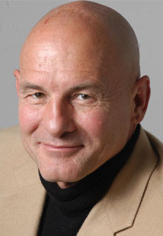
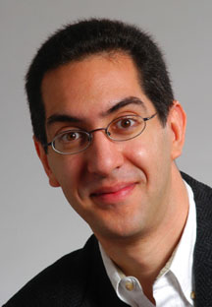
Special Thanks
Professor Randy Katz
Professor David Patterson
Su11 Instructor
Michael Greenbaum
Lecturer SOE Dan Garcia

Slide 50
Special Thanks to the Staff:
TAs: Brandon Lee Paul Ruan Raphael Townshend Sung Roa Yoon
Readers: Allen Xiao Jamie Li Linda Cai Roger Gong
Lab Assistants: Crystal Dou Hoang Nguyen Inderjit Jutla Oscar Bachtiar

