Slide 1
CS 61C: Great Ideas in Computer Architecture
The Flynn Taxonomy,
Data Level Parallelism
Instructor: Justin Hsia

Slide 2
Review of Last Lecture
Performance programming
When possible, loops through arrays in chunks that “fit nicely” in your cache
Cache blocking will improve speed of Matrix Multiply with appropriately-sized blocks
Processors have hit the power wall, the only option is to go parallel
P = C × V² × f

Slide 3
Question: Which statement is TRUE about cache blocking for matrix multiply?
(A)
The same code will have the same performance whether the matrix is row or column major
(B)
All choices of block size will produce a similar amount of speedup vs. naïve algorithm
(C)
Cache blocking helps with both read and write hits in the cache
(D)
For the product of two matrices, we need our cache to fit at least two matrix blocks at a time

Slide 4
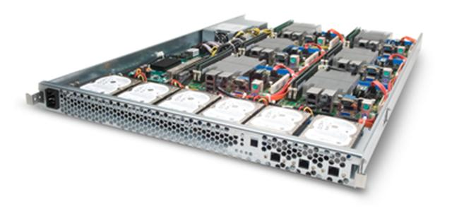
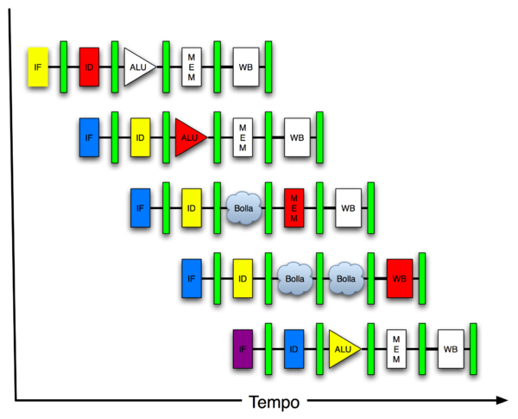
Great Idea #4: Parallelism
Software Hardware
Parallel Requests
Assigned to computer
e.g. search “Garcia”
Parallel Threads
Assigned to core
e.g. lookup, ads
Parallel Instructions
> 1 instruction @ one time
e.g. 5 pipelined instructions
Parallel Data
> 1 data item @ one time
e.g. add of 4 pairs of words
Hardware descriptions
All gates functioning in parallel at same time
Warehouse Scale Computer
Smart Phone
Leverage Parallelism &
Achieve High Performance
Computer
Core
…
Core
Memory
Input/Output
We are here
Core
Instruction Unit(s)
Functional
Unit(s)
A₀+B₀
A₁+B₁
A₂+B₂
A₃+B₃
Cache Memory
Logic Gates

Slide 5
Agenda
Flynn’s Taxonomy
Administrivia
Data Level Parallelism and SIMD
Intel SSE Intrinsics
Loop Unrolling

Slide 6
Hardware vs. Software Parallelism
Choice of hardware and software parallelism are independent
Concurrent software can also run on serial hardware
Sequential software can also run on parallel hardware
Flynn’s Taxonomy is for parallel hardware

Slide 7
Flynn’s Taxonomy
SIMD and MIMD most commonly encountered today
Most common parallel programming style:
Single program that runs on all processors of an MIMD
Cross-processor execution coordination through conditional expressions
SIMD: specialized function units (hardware), for handling lock-step calculations involving arrays
Scientific computing, signal processing, audio/video

Slide 8
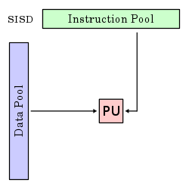
Single Instruction/Single Data Stream
Sequential computer that exploits no parallelism in either the instruction or data streams
Examples of SISD architecture are traditional uniprocessor machines
Processing Unit

Slide 9
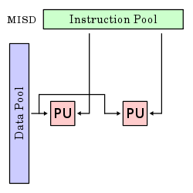
Multiple Instruction/Single Data Stream
Exploits multiple instruction streams against a single data stream for data operations that can be naturally parallelized (e.g. certain kinds of array processors)
MISD no longer commonly encountered, mainly of historical interest only

Slide 10
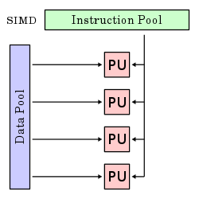
Single Instruction/Multiple Data Stream
Computer that applies a single instruction stream to multiple data streams for operations that may be naturally parallelized (e.g. SIMD instruction extensions or Graphics Processing Unit)

Slide 11
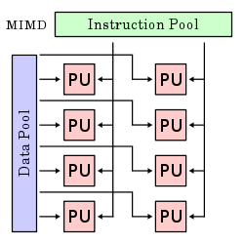
Multiple Instruction/Multiple Data Stream
Multiple autonomous processors simultaneously executing different instructions on different data
MIMD architectures include multicore and Warehouse Scale Computers

Slide 12
Agenda
Flynn’s Taxonomy
Administrivia
Data Level Parallelism and SIMD
Intel SSE Intrinsics
Loop Unrolling

Slide 13
Administrivia
HW4 due Sunday
Midterm
Friday 7/19, 9am-12pm, 1 Pimentel
Double-sided handwritten sheet
MIPS Green Sheet provided
No calculators
Justin’s OH tonight 5-7pm in 200 SDH

Slide 14
Agenda
Flynn’s Taxonomy
Administrivia
Data Level Parallelism and SIMD
Intel SSE Intrinsics
Loop Unrolling

Slide 15
SIMD Architectures
Data-Level Parallelism (DLP): Executing one operation on multiple data streams
Example: Multiplying a coefficient vector by a data vector (e.g. in filtering)
y[i] := c[i] × x[i], 0≤i<n
Sources of performance improvement:
One instruction is fetched & decoded for entire operation
Multiplications are known to be independent
Pipelining/concurrency in memory access as well

Slide 16
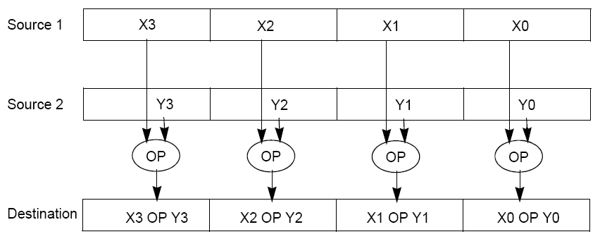
“Advanced Digital Media Boost”
To improve performance, Intel’s SIMD instructions
Fetch one instruction, do the work of multiple instructions
MMX (MultiMedia eXtension, Pentium II processor family)
SSE (Streaming SIMD Extension, Pentium III and beyond)

Slide 17
Example: SIMD Array Processing
for each f in array
f = sqrt(f)
for each f in array {
load f to the floating-point register
calculate the square root
write the result from the register to memory
}
for each 4 members in array {
load 4 members to the SSE register
calculate 4 square roots in one operation
write the result from the register to memory
}
pseudocode
SISD
SIMD

Slide 18
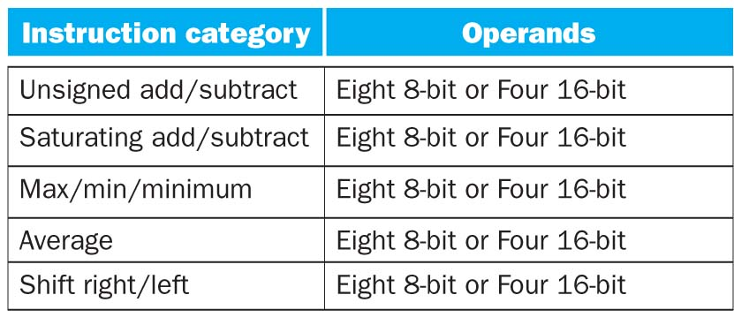
SSE Instruction Categories for Multimedia Support
Intel processors are CISC (complicated instrs)
SSE-2+ supports wider data types to allow 16 × 8-bit and 8 × 16-bit operands
Notes:
64 bits operated on simultaneously!

Slide 19
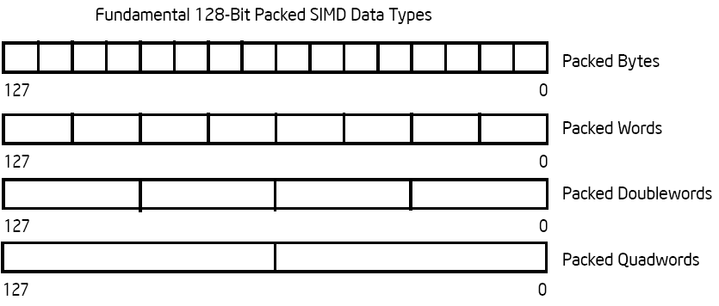
Intel Architecture SSE2+ 128-Bit SIMD Data Types
122 121
96 95
80 79
64 63
48 47
32 31
16 15
16 / 128 bits
122 121
96 95
80 79
64 63
48 47
32 31
16 15
8 / 128 bits
96 95
64 63
32 31
4 / 128 bits
64 63
2 / 128 bits
Note: in Intel Architecture (unlike MIPS) a word is 16 bits
Single precision FP: Double word (32 bits)
Double precision FP: Quad word (64 bits)

Slide 20
XMM Registers
Architecture extended with eight 128-bit data registers
64-bit address architecture: available as 16 64-bit registers (XMM8 – XMM15)
e.g. 128-bit packed single-precision floating-point data type (doublewords), allows four single-precision operations to be performed simultaneously
127
0
XMM7
XMM6
XMM5
XMM4
XMM3
XMM2
XMM1
XMM0
Notes:
Doublewords are the 32-bit chunks of data we’re used to working with.

Slide 21
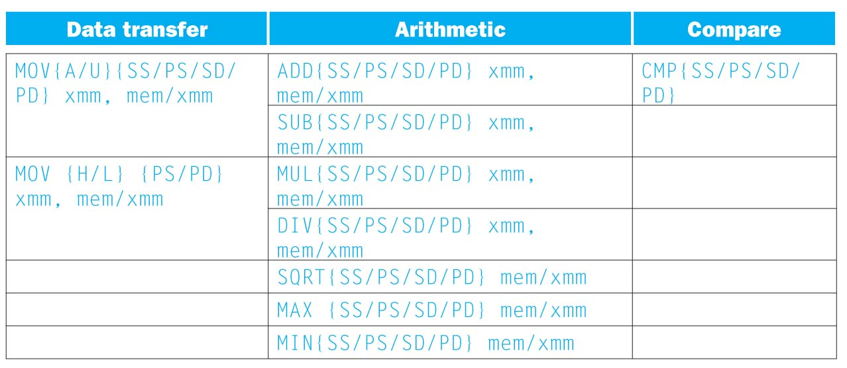
SSE/SSE2 Floating Point Instructions
{SS} Scalar Single precision FP: 1 32-bit operand in a 128-bit register
{PS} Packed Single precision FP: 4 32-bit operands in a 128-bit register
{SD} Scalar Double precision FP: 1 64-bit operand in a 128-bit register
{PD} Packed Double precision FP, or 2 64-bit operands in a 128-bit register

Slide 22
SSE/SSE2 Floating Point Instructions
xmm: one operand is a 128-bit SSE2 register
mem/xmm: other operand is in memory or an SSE2 register
{A} 128-bit operand is aligned in memory
{U} means the 128-bit operand is unaligned in memory
{H} means move the high half of the 128-bit operand
{L} means move the low half of the 128-bit operand

Slide 23
Example: Add Single Precision FP Vectors
Computation to be performed:
vec_res.x = v1.x + v2.x;
vec_res.y = v1.y + v2.y;
vec_res.z = v1.z + v2.z;
vec_res.w = v1.w + v2.w;
SSE Instruction Sequence:
movaps address-of-v1, %xmm0
// v1.w | v1.z | v1.y | v1.x -> xmm0
addps address-of-v2, %xmm0
// v1.w+v2.w | v1.z+v2.z | v1.y+v2.y | v1.x+v2.x -> xmm0
movaps %xmm0, address-of-vec_res
move from mem to XMM register, memory aligned, packed single precision
add from mem to XMM register, packed single precision
move from XMM register to mem, memory aligned, packed single precision

Slide 24
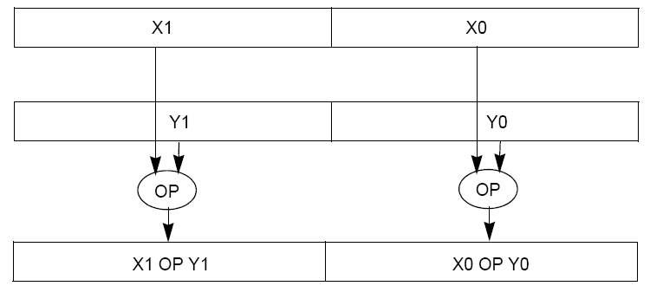
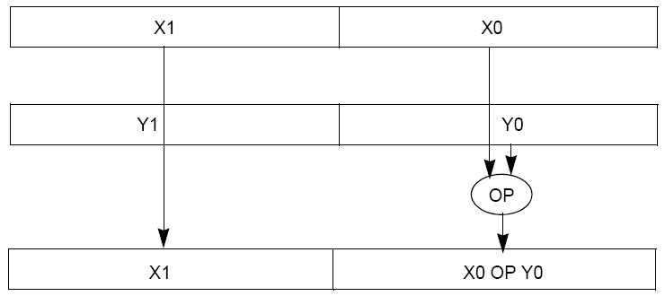
Packed and Scalar Double-Precision Floating-Point Operations
Packed Double (PD)
Scalar Double (SD)

Slide 25
Example: Image Converter (1/5)
Converts BMP (bitmap) image to a YUV (color space) image format:
Read individual pixels from the BMP image, convert pixels into YUV format
Can pack the pixels and operate on a set of pixels with a single instruction
Bitmap image consists of 8-bit monochrome pixels
By packing these pixel values in a 128-bit register, we can operate on 128/8 = 16 values at a time
Significant performance boost
Notes:
BMP File Format, also known as Bitmap Image File
The BMP File Format is capable of storing 2D digital images of arbitrary width, height, and resolution, both monochrome and color, in various color depths, and optionally with data compression, alpha channels, and color profiles.
YUV is a color space typically used as part of a color image pipeline.
The Y'UV model defines a color space in terms of one luma (Y') and two chrominance (UV) components.

Slide 26
Example: Image Converter (2/5)
FMADDPS – Multiply and add packed single precision floating point instruction
One of the typical operations computed in transformations (e.g. DFT or FFT)
CISC Instr!
N
P = ∑ f(n) × x(n)
n = 1

Slide 27
Example: Image Converter (3/5)
FP numbers f(n) and x(n) in src1 and src2; p in dest;
C implementation for N = 4 (128 bits):
for (int i = 0; i < 4; i++)
p = p + src1[i] * src2[i];
Regular x86 instructions for the inner loop:
fmul […]
faddp […]
Instructions executed: 4 * 2 = 8 (x86)
Notes:
http://developer.amd.com/cpu/SSE5/Pages/default.aspx
"DE C0+i FADDP ST(i), ST(0) Add ST(0) to ST(i), store result in ST(i), and pop the register stack".
Destination on right called AT&T format

Slide 28
Example: Image Converter (4/5)
FP numbers f(n) and x(n) in src1 and src2; p in dest;
C implementation for N = 4 (128 bits):
for (int i = 0; i < 4; i++)
p = p + src1[i] * src2[i];
SSE2 instructions for the inner loop:
//xmm0=p, xmm1=src1[i], xmm2=src2[i]
mulps %xmm1,%xmm2 // xmm2 * xmm1 -> xmm2
addps %xmm2,%xmm0 // xmm0 + xmm2 -> xmm0
Instructions executed: 2 (SSE2)
Notes:
http://developer.amd.com/cpu/SSE5/Pages/default.aspx
"DE C0+i FADDP ST(i), ST(0) Add ST(0) to ST(i), store result in ST(i), and pop the register stack".
Destination on right called AT&T format

Slide 29
Example: Image Converter (5/5)
FP numbers f(n) and x(n) in src1 and src2; p in dest;
C implementation for N = 4 (128 bits):
for (int i = 0; i < 4; i++)
p = p + src1[i] * src2[i];
SSE5 accomplishes the same in one instruction:
fmaddps %xmm0, %xmm1, %xmm2, %xmm0
// xmm2 * xmm1 + xmm0 -> xmm0
// multiply xmm1 x xmm2 paired single, // then add product paired single to sum in xmm0
Notes:
http://developer.amd.com/cpu/SSE5/Pages/default.aspx
"DE C0+i FADDP ST(i), ST(0) Add ST(0) to ST(i), store result in ST(i), and pop the register stack".
Destination on right called AT&T format

Slide 30
Agenda
Flynn’s Taxonomy
Administrivia
Data Level Parallelism and SIMD
Intel SSE Intrinsics
Loop Unrolling

Slide 31
Intel SSE Intrinsics
Intrinsics are C functions and procedures that translate to assembly language, including SSE instructions
With intrinsics, can program using these instructions indirectly
One-to-one correspondence between intrinsics and SSE instructions

Slide 32
Sample of SSE Intrinsics
Vector data type:
__m128d
Load and store operations:
_mm_load_pd MOVAPD/aligned, packed double
_mm_store_pd MOVAPD/aligned, packed double
_mm_loadu_pd MOVUPD/unaligned, packed double
_mm_storeu_pd MOVUPD/unaligned, packed double
Load and broadcast across vector
_mm_load1_pd MOVSD + shuffling
Arithmetic:
_mm_add_pd ADDPD/add, packed double
_mm_mul_pd MULPD/multiple, packed double
Notes:
CS267 Lecture 2
32

Slide 33
Example: 2 × 2 Matrix Multiply
Definition of Matrix Multiply:
2
C_{i,j} = (A×B)_{i,j} = ∑ A_{i,k}× B_{k,j}
k = 1
A_{1,1}
A_{1,2}
B_{1,1}
B_{1,2}
C_{1,1}=A_{1,1}B_{1,1} + A_{1,2}B_{2,1}
C_{1,2}=A_{1,1}B_{1,2}+A_{1,2}B_{2,2}
x
=
A_{2,1}
A_{2,2}
B_{2,1}
B_{2,2}
C_{2,1}=A_{2,1}B_{1,1} + A_{2,2}B_{2,1}
C_{2,2}=A_{2,1}B_{1,2}+A_{2,2}B_{2,2}

Slide 34
Example: 2 × 2 Matrix Multiply
Using the XMM registers
64-bit/double precision/two doubles per XMM reg
c₁
C_{1,1}
C_{2,1}
Memory is column major
c₂
C_{1,2}
C_{2,2}
a
A_{1,i}
A_{2,i}
b₁
B_{i,1}
B_{i,1}
b₂
B_{i,2}
B_{i,2}

Slide 35
Example: 2 × 2 Matrix Multiply
Initialization
i = 1
c₁
0
0
c₂
0
0
a
A_{1,1}
A_{2,1}
_mm_load_pd: Stored in memory in Column order
b₁
B_{1,1}
B_{1,1}
_mm_load1_pd: SSE instruction that loads a double word and stores it in the high and low double words of the XMM register
b₂
B_{1,2}
B_{1,2}

Slide 36
Example: 2 × 2 Matrix Multiply
First iteration intermediate result
i = 1
c₁
0+A_{1,1}B_{1,1}
0+A_{2,1}B_{1,1}
c1 = _mm_add_pd(c1,_mm_mul_pd(a,b1));
c2 = _mm_add_pd(c2,_mm_mul_pd(a,b2));
c₂
0+A_{1,1}B_{1,2}
0+A_{2,1}B_{1,2}
a
A_{1,1}
A_{2,1}
_mm_load_pd: Stored in memory in Column order
b₁
B_{1,1}
B_{1,1}
_mm_load1_pd: SSE instruction that loads a double word and stores it in the high and low double words of the XMM register
b₂
B_{1,2}
B_{1,2}

Slide 37
Example: 2 × 2 Matrix Multiply
First iteration intermediate result
i = 2
c₁
0+A_{1,1}B_{1,1}
0+A_{2,1}B_{1,1}
c1 = _mm_add_pd(c1,_mm_mul_pd(a,b1));
c2 = _mm_add_pd(c2,_mm_mul_pd(a,b2));
c₂
0+A_{1,1}B_{1,2}
0+A_{2,1}B_{1,2}
a
A_{1,2}
A_{2,2}
_mm_load_pd: Stored in memory in Column order
b₁
B_{2,1}
B_{2,1}
_mm_load1_pd: SSE instruction that loads a double word and stores it in the high and low double words of the XMM register
b₂
B_{2,2}
B_{2,2}

Slide 38
Example: 2 × 2 Matrix Multiply
Second iteration intermediate result
i = 2
C_{1,1}
C_{2,1}
c₁
A_{1,1}B_{1,1}+A_{1,2}B_{2,1}
A_{2,1}B_{1,1}+A_{2,2}B_{2,1}
c1 = _mm_add_pd(c1,_mm_mul_pd(a,b1));
c2 = _mm_add_pd(c2,_mm_mul_pd(a,b2));
c₂
A_{1,1}B_{1,2}+A_{1,2}B_{2,2}
A_{2,1}B_{1,2}+A_{2,2}B_{2,2}
C_{1,2}
C_{2,2}
a
A_{1,2}
A_{2,2}
_mm_load_pd: Stored in memory in Column order
b₁
B_{2,1}
B_{2,1}
_mm_load1_pd: SSE instruction that loads a double word and stores it in the high and low double words of the XMM register
b₂
B_{2,2}
B_{2,2}

Slide 39
2 x 2 Matrix Multiply Code (1/2)
#include <stdio.h>
// header file for SSE3 compiler intrinsics
#include <nmmintrin.h>
// NOTE: vector registers will be represented in comments as v1 = [ a | b]
// where v1 is a variable of type __m128d and a,b are doubles
int main(void) {
// allocate A,B,C aligned on 16-byte boundaries
double A[4] __attribute__ ((aligned (16)));
double B[4] __attribute__ ((aligned (16)));
double C[4] __attribute__ ((aligned (16)));
int lda = 2;
int i = 0;
// declare a couple 128-bit vector variables
__m128d c1,c2,a,b1,b2;
/* continued on next slide */
/* A = (note column order!)
1 0
0 1
*/
A[0] = 1.0; A[1] = 0.0; A[2] = 0.0; A[3] = 1.0;
/* B = (note column order!)
1 3
2 4
*/
B[0] = 1.0; B[1] = 2.0; B[2] = 3.0; B[3] = 4.0;
/* C = (note column order!)
0 0
0 0
*/
C[0] = 0.0; C[1] = 0.0; C[2] = 0.0; C[3] = 0.0;

Slide 40
2 x 2 Matrix Multiply Code (2/2)
// used aligned loads to set
// c1 = [c_11 | c_21]
c1 = _mm_load_pd(C+0*lda);
// c2 = [c_12 | c_22]
c2 = _mm_load_pd(C+1*lda);
for (i = 0; i < 2; i++) {
/* a =
i = 0: [a_11 | a_21]
i = 1: [a_12 | a_22]
*/
a = _mm_load_pd(A+i*lda);
/* b1 =
i = 0: [b_11 | b_11]
i = 1: [b_21 | b_21]
*/
b1 = _mm_load1_pd(B+i+0*lda);
/* b2 =
i = 0: [b_12 | b_12]
i = 1: [b_22 | b_22]
*/
b2 = _mm_load1_pd(B+i+1*lda);
/* c1 =
i = 0: [c_11 + a_11*b_11 | c_21 + a_21*b_11]
i = 1: [c_11 + a_21*b_21 | c_21 + a_22*b_21]
*/
c1 = _mm_add_pd(c1,_mm_mul_pd(a,b1));
/* c2 =
i = 0: [c_12 + a_11*b_12 | c_22 + a_21*b_12]
i = 1: [c_12 + a_21*b_22 | c_22 + a_22*b_22]
*/
c2 = _mm_add_pd(c2,_mm_mul_pd(a,b2));
}
// store c1,c2 back into C for completion
_mm_store_pd(C+0*lda,c1);
_mm_store_pd(C+1*lda,c2);
// print C
printf("%g,%g\n%g,%g\n",C[0],C[2],C[1],C[3]);
return 0;
}

Slide 41
Inner loop from gcc -O -S
L2: movapd (%rax,%rsi), %xmm1 // Load aligned A[i,i+1]->m1
movddup (%rdx), %xmm0 // Load B[j], duplicate->m0
mulpd %xmm1, %xmm0 // Multiply m0*m1->m0
addpd %xmm0, %xmm3 // Add m0+m3->m3
movddup 16(%rdx), %xmm0 // Load B[j+1], duplicate->m0
mulpd %xmm0, %xmm1 // Multiply m0*m1->m1
addpd %xmm1, %xmm2 // Add m1+m2->m2
addq $16, %rax // rax+16 -> rax (i+=2)
addq $8, %rdx // rdx+8 -> rdx (j+=1)
cmpq $32, %rax // rax == 32?
jne L2 // jump to L2 if not equal
movapd %xmm3, (%rcx) // store aligned m3 into C[k,k+1]
movapd %xmm2, (%rdi) // store aligned m2 into C[l,l+1]

Slide 42
Performance-Driven ISA Extensions
Subword parallelism, used primarily for multimedia applications
Intel MMX: multimedia extension
64-bit registers can hold multiple integer operands
Intel SSE: Streaming SIMD extension
128-bit registers can hold several floating-point operands
Adding instructions that do more work per cycle
Shift-add: two instructions in one (e.g. multiply by 5)
Multiply-add: two instructions in one (x := c + a * b)
Multiply-accumulate: reduce round-off error (s := s + a * b)
Conditional copy: avoid some branches (e.g. if-then-else)

Slide 43
Get To Know Your Instructor

Slide 44
Agenda
Flynn’s Taxonomy
Administrivia
Data Level Parallelism and SIMD
Intel SSE Intrinsics
Loop Unrolling

Slide 45
Data Level Parallelism and SIMD
SIMD wants adjacent values in memory that can be operated in parallel
Usually specified in programs as loops
for(i=0; i<1000; i++)
x[i] = x[i] + s;
How can we reveal more data level parallelism than is available in a single iteration of a loop?
Unroll the loop and adjust iteration rate

Slide 46
Looping in MIPS
Assumptions:
$s0 → initial address (top of array)
$s1 → scalar value s
$s2 → termination address (end of array)
Loop:
lw $t0, 0($s0)
addu $t0,$t0,$s1 # add s to array element
sw $t0,0($s0) # store result
addiu $s0,$s0,4 # move to next element
bne $s0,$s2,Loop # repeat Loop if not done

Slide 47
Loop Unrolled
Loop: lw $t0,0($s0)
addu $t0,$t0,$s1
sw $t0,0($s0)
lw $t1,4($s0)
addu $t1,$t1,$s1
sw $t1,4($s0)
lw $t2,8($s0)
addu $t2,$t2,$s1
sw $t2,8($s0)
lw $t3,12($s0)
addu $t3,$t3,$s1
sw $t3,12($s0)
addiu $s0,$s0,16
bne $s0,$s2,Loop
NOTE:
Using different registers eliminate stalls
Loop overhead encountered only once every 4 data iterations
This unrolling works if
loop_limit mod 4 = 0

Slide 48
Loop Unrolled Scheduled
Note: We just switched from integer instructions to single-precision FP instructions!
Loop: lwc1 $t0,0($s0)
lwc1 $t1,4($s0)
lwc1 $t2,8($s0)
lwc1 $t3,12($s0)
add.s $t0,$t0,$s1
add.s $t1,$t1,$s1
add.s $t2,$t2,$s1
add.s $t3,$t3,$s1
swc1 $t0,0($s0)
swc1 $t1,4($s0)
swc1 $t2,8($s0)
swc1 $t3,12($s0)
addiu $s0,$s0,16
bne $s0,$s2,Loop
4 Loads side-by-side:
Could replace with 4 wide SIMD Load
4 Adds side-by-side:
Could replace with 4 wide SIMD Add
4 Stores side-by-side:
Could replace with 4 wide SIMD Store

Slide 49
Loop Unrolling in C
Instead of compiler doing loop unrolling, could do it yourself in C:
for(i=0; i<1000; i++)
x[i] = x[i] + s;
for(i=0; i<1000; i=i+4) {
x[i] = x[i] + s;
x[i+1] = x[i+1] + s;
x[i+2] = x[i+2] + s;
x[i+3] = x[i+3] + s;
}
Loop Unroll
What is
downside of doing
this in C?

Slide 50
Generalizing Loop Unrolling
Take a loop of n iterations and perform a k-fold unrolling of the body of the loop:
First run the loop with k copies of the body floor(n/k) times
To finish leftovers, then run the loop with 1 copy of the body n mod k times
(Will revisit loop unrolling again when get to pipelining later in semester)

Slide 51
Summary
Flynn Taxonomy of Parallel Architectures
SIMD: Single Instruction Multiple Data
MIMD: Multiple Instruction Multiple Data
SISD: Single Instruction Single Data
MISD: Multiple Instruction Single Data (unused)
Intel SSE SIMD Instructions
One instruction fetch that operates on multiple operands simultaneously
128/64 bit XMM registers
Embed the SSE machine instructions directly into C programs through use of intrinsics
Loop Unrolling: Access more of array in each iteration of a loop

