Slide 1
CS 61C: Great Ideas in Computer Architecture
Multiple Instruction Issue,
Virtual Memory Introduction
Instructor: Justin Hsia

Slide 2
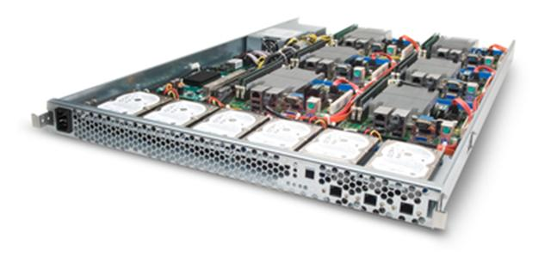
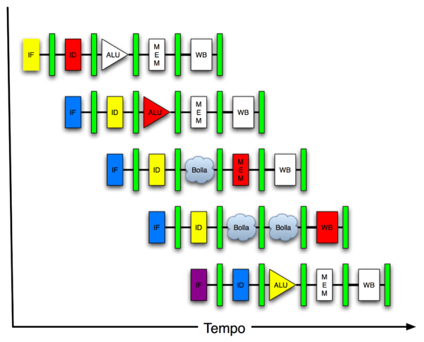
Great Idea #4: Parallelism
Software Hardware
Parallel Requests
Assigned to computer
e.g. search “Garcia”
Parallel Threads
Assigned to core
e.g. lookup, ads
Parallel Instructions
> 1 instruction @ one time
e.g. 5 pipelined instructions
Parallel Data
> 1 data item @ one time
e.g. add of 4 pairs of words
Hardware descriptions
All gates functioning in parallel at same time
Warehouse Scale Computer
Smart Phone
Leverage Parallelism &
Achieve High Performance
Computer
Core
…
Core
Memory
Input/Output
Core
Instruction Unit(s)
Functional
Unit(s)
A₀+B₀
A₁+B₁
A₂+B₂
A₃+B₃
Cache Memory
Logic Gates

Slide 3
Extended Review: Pipelining
Why pipeline?
Increase clock speed by reducing critical path
Increase performance due to ILP
How do we pipeline?
Add registers to delimit and pass information between pipeline stages
Things that hurt pipeline performance
Filling and draining of pipeline
Unbalanced stages
Hazards

Slide 4
Pipelining and the Datapath
rd
Register
File
ALU
PC
instruction
memory
rs
Data
memory
rt
+4
imm
MUX
Registers hold up information between stages
Each stage “starts” on same clock trigger
Each stage is working on a different instruction
Must pass ALL signals needed in any following stage
Stages can still interact by going around registers
e.g. forwarding, hazard detection hardware

Slide 5
Pipelining Hazards (1/3)
Structural, Data, and Control hazards
Structural hazards taken care of in MIPS
Data hazards only when register is written to and then accessed soon after (not necessarily immediately)
Forwarding
Can forward from two different places (ALU, Mem)
Most further optimizations assume forwarding
Delay slots and code reordering
Applies to both branches and jumps
Branch prediction (can be dynamic)

Slide 6
Pipelining Hazards (2/3)
Identifying hazards:
Check system specs (forwarding? delayed branch/jump?)
Check code for potential hazards
Find all loads, branches, and jumps
Anywhere a value is written to and then read in the next two instructions
Draw out graphical pipeline and check if actually a hazard
When is result available? When is it needed?

Slide 7
Pipelining Hazards (3/3)
Solving hazards: (assuming the following were not present already)
Forwarding?
Can remove 1 stall for loads, 2 stalls for everything else
Delayed branch?
Exposes delay slot for branch and jumps
Code reordering?
Find unrelated instruction from earlier to move into delay slot (branch, jump, or load)
Branch prediction?
Depends on exact code execution

Slide 8
Question: Which of the following signals is NOT needed to determine whether or not to forward for the following two instructions?
add $s1, $t0, $t1
ori $s2, $s1, 0xF
WHAT IF:
1) add was lw $s1,0($t0)?
2) random other instruction in-between?
3) ori was sw $s1,0($s0)?
(A)
rd.EX
IF
ID
EX
MEM
WB
(B)
opcode.EX
(C)
rt.ID
I$
Reg
ALU
D$
Reg
(D)
opcode.ID

Slide 9
Agenda
Higher Level ILP
Administrivia
Dynamic Scheduling
Virtual Memory Introduction

Slide 10
Higher Level ILP
Deeper pipeline (5 to 10 to 15 stages)
Less work per stage → shorter clock cycle
Multiple instruction issue
Replicate pipeline stages → multiple pipelines
Can start multiple instructions per clock cycle
CPI < 1 (superscalar), so can use Instructions Per Cycle (IPC) instead
e.g. 4 GHz 4-way multiple-issue can execute 16 billion IPS with peak CPI = 0.25 and peak IPC = 4
But dependencies reduce this in practice

Slide 11
Multiple Issue
Static multiple issue
Compiler groups instructions to be issued together
Packages them into “issue slots”
Compiler detects and avoids hazards
Dynamic multiple issue
CPU examines instruction stream and chooses instructions to issue each cycle
Compiler can help by reordering instructions
CPU resolves hazards using advanced techniques at runtime

Slide 12
Superscalar Laundry: Parallel per stage
6 PM
7
8
9
10
11
12
1
2 AM
30
30
30
30
30
Time
T
a
s
k
O
r
d
e
r
A
(light clothing)
(dark clothing)
B
(very dirty clothing)
C
D
(light clothing)
(dark clothing)
E
(very dirty clothing)
F
More resources, HW to match mix of parallel tasks?

Slide 13
Pipeline Depth and Issue Width
Intel Processors over Time
Microprocessor | Year | Clock Rate | Pipeline Stages | Issue width | Cores | Power
i486 | 1989 | 25 MHz | 5 | 1 | 1 | 5W
Pentium | 1993 | 66 MHz | 5 | 2 | 1 | 10W
Pentium Pro | 1997 | 200 MHz | 10 | 3 | 1 | 29W
P4 Willamette | 2001 | 2000 MHz | 22 | 3 | 1 | 75W
P4 Prescott | 2004 | 3600 MHz | 31 | 3 | 1 | 103W
Core 2 Conroe | 2006 | 2930 MHz | 14 | 4 | 2 | 75W
Core 2 Yorkfield | 2008 | 2930 MHz | 16 | 4 | 4 | 95W
Core i7 Gulftown | 2010 | 3460 MHz | 16 | 4 | 6 | 130W

Slide 14
Pipeline Depth and Issue Width

Slide 15
Static Multiple Issue
Compiler groups instructions into issue packets
Group of instructions that can be issued on a single cycle
Determined by pipeline resources required
Think of an issue packet as a very long instruction word (VLIW)
Specifies multiple concurrent operations

Slide 16
Scheduling Static Multiple Issue
Compiler must remove some/all hazards
Reorder instructions into issue packets
No dependencies within a packet
Possibly some dependencies between packets
Varies between ISAs; compiler must know!
Pad with nops if necessary

Slide 17
MIPS with Static Dual Issue
Dual-issue packets
One ALU/branch instruction
One load/store instruction
64-bit aligned
ALU/branch, then load/store
Pad an unused instruction with nop
This prevents what kind of hazard?
Address | Instruction type | Pipeline Stages
n | ALU/branch | IF | ID | EX | MEM | WB
n + 4 | Load/store | IF | ID | EX | MEM | WB
n + 8 | ALU/branch |  | IF | ID | EX | MEM | WB
n + 12 | Load/store |  | IF | ID | EX | MEM | WB
n + 16 | ALU/branch |  |  | IF | ID | EX | MEM | WB
n + 20 | Load/store |  |  | IF | ID | EX | MEM | WB

Slide 18
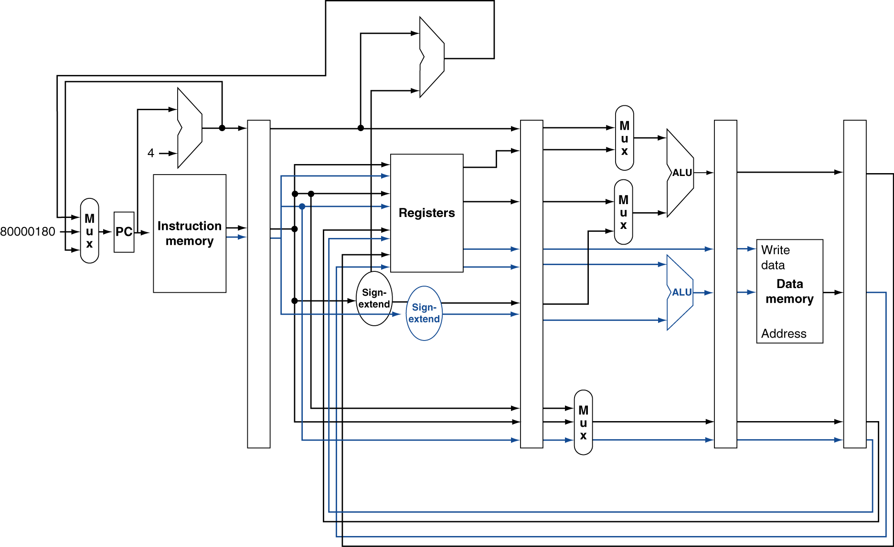
Datapath with Static Dual Issue
1 Extra 32-bit instruction
1 Extra Write Port
2 Extra Reg Read Ports
1 Extra Sign Ext
1 Extra ALU

Slide 19
Hazards in the Dual-Issue MIPS
More instructions executing in parallel
EX data hazard
Forwarding avoided stalls with single-issue
Now can’t use ALU result in load/store in same packet
add $t0, $s0, $s1 load $s2, 0($t0)
Splitting these into two packets is effectively a stall
Load-use hazard
Still one cycle use latency, but now two instructions/cycle
More aggressive scheduling required!

Slide 20
Scheduling Example
Schedule this for dual-issue MIPS
Loop: lw $t0, 0($s1) # $t0=array element addu $t0, $t0, $s2 # add scalar in $s2 sw $t0, 0($s1) # store result addi $s1, $s1,–4 # decrement pointer bne $s1, $zero, Loop # branch $s1!=0
 | ALU/Branch | Load/Store | Cycle
Loop: | nop | lw $t0, 0($s1) | 1
 | addi $s1, $s1,–4 | nop | 2
 | addu $t0, $t0, $s2 | nop | 3
 | bne $s1, $zero, Loop | sw $t0, 4($s1) | 4
This change affects scheduling but not effect
IPC = 5/4 = 1.25 (c.f. peak IPC = 2)

Slide 21
Loop Unrolling
Replicate loop body to expose more instruction level parallelism
Use different registers per replication
Called register renaming
Avoid loop-carried anti-dependencies
Store followed by a load of the same register
a.k.a. “name dependence” (reuse of a register name)

Slide 22
Loop Unrolling Example
 | ALU/branch | Load/store | cycle
Loop: | addi $s1, $s1,–16 | lw $t0, 0($s1) | 1
 | nop | lw $t1, 12($s1) | 2
 | addu $t0, $t0, $s2 | lw $t2, 8($s1) | 3
 | addu $t1, $t1, $s2 | lw $t3, 4($s1) | 4
 | addu $t2, $t2, $s2 | sw $t0, 16($s1) | 5
 | addu $t3, $t4, $s2 | sw $t1, 12($s1) | 6
 | nop | sw $t2, 8($s1) | 7
 | bne $s1, $zero, Loop | sw $t3, 4($s1) | 8
IPC = 14/8 = 1.75
Closer to 2, but at cost of registers and code size

Slide 23
Agenda
Higher Level ILP
Administrivia
Dynamic Scheduling
Virtual Memory Introduction

Slide 24
Administrivia
HW5 due tonight
Project 2 Part 2 (and EC) due Sunday
“Free” lab time today
The TAs will still be there, Lab 10 due Tue
Project 3 will be posted by Friday night
Two-stage pipelined CPU in Logisim

Slide 25
Agenda
Higher Level ILP
Administrivia
Dynamic Scheduling
Virtual Memory Introduction

Slide 26
Dynamic Multiple Issue
Used in “superscalar” processors
CPU decides whether to issue 0, 1, 2, … instructions each cycle
Goal is to avoid structural and data hazards
Avoids need for compiler scheduling
Though it may still help
Code semantics ensured by the CPU

Slide 27
Dynamic Pipeline Scheduling
Allow the CPU to execute instructions out of order to avoid stalls
But commit result to registers in order
Example: lw $t0, 20($s2) addu $t1, $t0, $t2 subu $s4, $s4, $t3 slti $t5, $s4, 20
Can start subu while addu is waiting for lw
Especially useful on cache misses; can execute many instructions while waiting!

Slide 28
Why Do Dynamic Scheduling?
Why not just let the compiler schedule code?
Not all stalls are predicable
e.g. cache misses
Can’t always schedule around branches
Branch outcome is dynamically determined
Different implementations of an ISA have different latencies and hazards

Slide 29
Speculation
“Guess” what to do with an instruction
Start operation as soon as possible
Check whether guess was right and roll back if necessary
Examples:
Speculate on branch outcome (Branch Prediction)
Roll back if path taken is different
Speculate on load
Roll back if location is updated
Can be done in hardware or by compiler
Common to static and dynamic multiple issue

Slide 30
Pipeline Hazard Analogy: Matching socks in later load
6 PM
7
8
9
10
11
12
1
2 AM
30
30
30
30
30
Time
T
a
s
k
O
r
d
e
r
30
30
A
bubble
B
C
D
E
F
A depends on D; stall since folder is tied up

Slide 31
Out-of-Order Laundry: Don’t Wait
6 PM
7
8
9
10
11
12
1
2 AM
30
30
30
30
30
Time
T
a
s
k
O
r
d
e
r
30
30
A
bubble
B
C
D
E
A depends on D; let the rest continue
Need more resources to allow out-of-order (2 folders)

Slide 32
Not a Simple Linear Pipeline
3 major units operating in parallel:
Instruction fetch and issue unit
Issues instructions in program order
Many parallel functional (execution) units
Each unit has an input buffer called a Reservation Station
Holds operands and records the operation
Can execute instructions out-of-order (OOO)
Commit unit
Saves results from functional units in Reorder Buffers
Stores results once branch resolved so OK to execute
Commits results in program order

Slide 33
Out-of-Order Execution (1/2)
Basically, unroll loops in hardware
Fetch instructions in program order (≤ 4/clock)
Predict branches as taken/untaken
To avoid hazards on registers, rename registers using a set of internal registers (≈ 80 registers)
Collection of renamed instructions might execute in a window (≈ 60 instructions)

Slide 34
Out-of-Order Execution (2/2)
Basically, unroll loops in hardware
Execute instructions with ready operands in 1 of multiple functional units (ALUs, FPUs, Ld/St)
Buffer results of executed instructions until predicted branches are resolved in reorder buffer
If predicted branch correctly, commit results in program order
If predicted branch incorrectly, discard all dependent results and start with correct PC

Slide 35
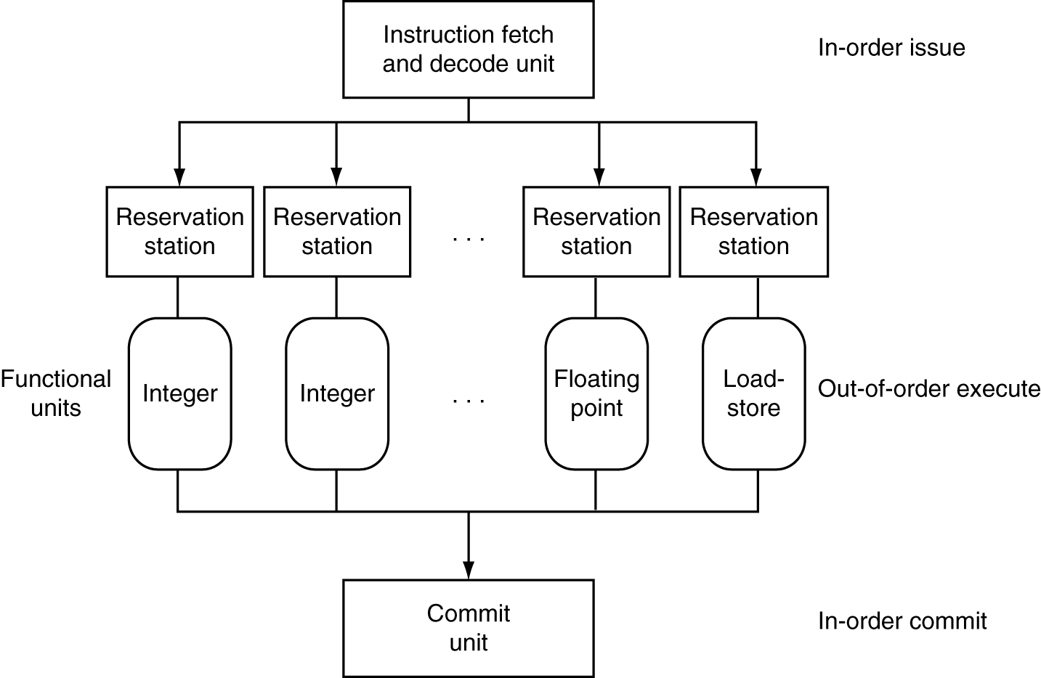
Dynamically Scheduled CPU
Preserves dependencies
Branch prediction,
Register renaming
Wait here until all operands available
Execute…
Results also sent to any waiting reservation stations (think: forwarding!)
… and Hold
Reorder buffer for register and memory writes
Can supply operands for issued instructions

Slide 36
Out-Of-Order Intel
All use O-O-O since 2001
Microprocessor | Year | Clock Rate | Pipeline Stages | Issue width | Out-of-order/ Speculation | Cores | Power
i486 | 1989 | 25MHz | 5 | 1 | No | 1 | 5W
Pentium | 1993 | 66MHz | 5 | 2 | No | 1 | 10W
Pentium Pro | 1997 | 200MHz | 10 | 3 | Yes | 1 | 29W
P4 Willamette | 2001 | 2000MHz | 22 | 3 | Yes | 1 | 75W
P4 Prescott | 2004 | 3600MHz | 31 | 3 | Yes | 1 | 103W
Core | 2006 | 2930MHz | 14 | 4 | Yes | 2 | 75W
Core 2 Yorkfield | 2008 | 2930 MHz | 16 | 4 | Yes | 4 | 95W
Core i7 Gulftown | 2010 | 3460 MHz | 16 | 4 | Yes | 6 | 130W

Slide 37
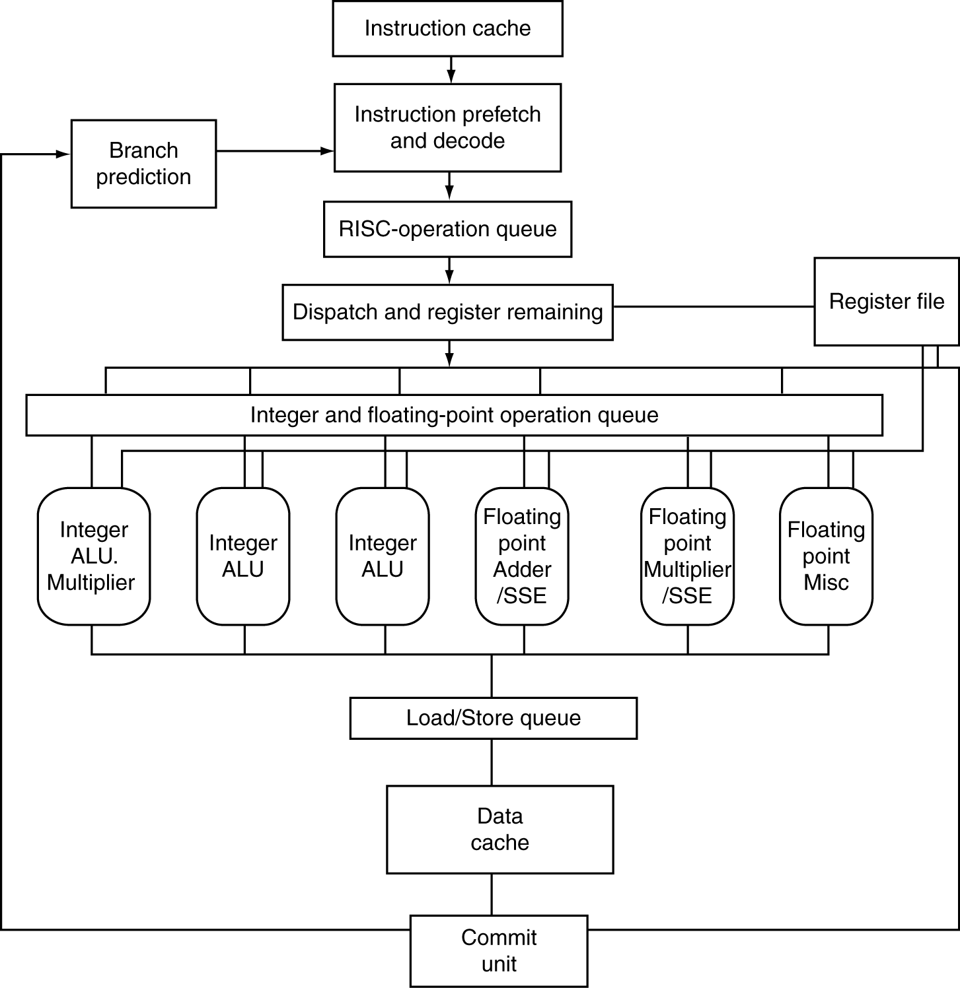
AMD Opteron X4 Microarchitecture
x86 instructions
16 architectural registers
72 physical registers
RISC operations
renaming
Queues:
106 RISC ops
24 integer ops
36 FP/SSE ops
44 ld/st

Slide 38
AMD Opteron X4 Pipeline Flow
For integer operations
12 stages (Floating Point is 17 stages)
Up to 106 RISC-ops in progress
Intel Nehalem is 16 stages for integer operations, details not revealed, but likely similar to above
Intel calls RISC operations “Micro operations” or “μops”

Slide 39
Does Multiple Issue Work?
Yes, but not as much as we’d like
Programs have real dependencies that limit ILP
Some dependencies are hard to eliminate
e.g. pointer aliasing
Some parallelism is hard to expose
Limited window size during instruction issue
Memory delays and limited bandwidth
Hard to keep pipelines full
Speculation can help if done well

Slide 40
Get To Know Your Instructor

Slide 41
Agenda
Higher Level ILP
Administrivia
Dynamic Scheduling
Virtual Memory Introduction

Slide 42
Memory Hierarchy
Upper Level
Regs
Faster
Instr Operands
L1 Cache
Earlier: Caches
Blocks
L2 Cache
Blocks
Next Up:
Virtual Memory
Memory
Pages
Disk
Files
Larger
Tape
Lower Level

Slide 43
Memory Hierarchy Requirements
Principle of Locality
Allows caches to offer (close to) speed of cache memory with size of DRAM memory
Can we use this at the next level to give speed of DRAM memory with size of Disk memory?
What other things do we need from our memory system?

Slide 44
Memory Hierarchy Requirements
Allow multiple processes to simultaneously occupy memory and provide protection
Don’t let programs read from or write to each other’s memories
Give each program the illusion that it has its own private address space
Suppose code starts at address 0x00400000, then different processes each think their code resides at the same address
Each program must have a different view of memory

Slide 45
Virtual Memory
Next level in the memory hierarchy
Provides illusion of very large main memory
Working set of “pages” residing in main memory (subset of all pages residing on disk)
Main goal: Avoid reaching all the way back to disk as much as possible
Additional goals:
Let OS share memory among many programs and protect them from each other
Each process thinks it has all the memory to itself

Slide 46
Virtual to Physical Address Translation
Program operates in its virtual address space
Virtual
Address (VA)
(inst. fetch
load, store)
Physical
Address (PA)
(inst. fetch
load, store)
Physical memory (including caches)
HW mapping
Each program operates in its own virtual address space and thinks it’s the only program running
Each is protected from the other
OS can decide where each goes in memory
Hardware gives virtual → physical mapping

Slide 47
VM Analogy (1/2)
Trying to find a book in the UCB library system
Book title is like virtual address (VA)
What you want/are requesting
Book call number is like physical address (PA)
Where it is actually located
Card catalogue is like a page table (PT)
Maps from book title to call number
Does not contain the actual that data you want
The catalogue itself takes up space in the library

Slide 48
VM Analogy (2/2)
Indication of current location within the library system is like valid bit
Valid if in current library (main memory) vs. invalid if in another branch (disk)
Found on the card in the card catalogue
Availability/terms of use like access rights
What you are allowed to do with the book (ability to check out, duration, etc.)
Also found on the card in the card catalogue

Slide 49
Mapping VM to PM
Virtual Memory
Divide into equal sized chunks (usually 4-8 KiB)
Any chunk of Virtual Memory can be assigned to any chunk of Physical Memory (“page”)
∞
Stack
Physical Memory
64 MB
Heap
Static
Code
0
0

Slide 50
Paging Organization
Here assume page size is 4 KiB
Page is both unit of mapping and unit of transfer between disk and physical memory
Physical
Address
Virtual
Address
0x00000
page 0
4 Ki
0x0000
page 0
4 Ki
Addr
Trans
MAP
0x01000
page 1
4 Ki
0x1000
page 1
4 Ki
...
...
...
0x02000
page 2
4 Ki
...
...
...
0x7000
page 7
4 Ki
0x1F000
page 31
4 Ki
Physical
Memory
Virtual Memory

Slide 51
Virtual Memory Mapping Function
How large is main memory? Disk?
Don’t know! Designed to be interchangeable components
Need a system that works regardless of sizes
Use lookup table (page table) to deal with arbitrary mapping
Index lookup table by # of pages in VM (not all entries will be used/valid)
Size of PM will affect size of stored translation

Slide 52
Address Mapping
Pages are aligned in memory
Border address of each page has same lowest bits
Page size (P bytes) is same in VM and PM, so denote lowest PO = log₂(P) bits as page offset
Use remaining upper address bits in mapping
Tells you which page you want (similar to Tag)
Physical Page #
Page Offset
Virtual Page #
Page Offset
Not necessarily the same size
Same Size

Slide 53
Address Mapping: Page Table
Page Table functionality:
Incoming request is Virtual Address (VA), want Physical Address (PA)
Physical Offset = Virtual Offset (page-aligned)
So just swap Virtual Page Number (VPN) for Physical Page Number (PPN)
Implementation?
Use VPN as index into PT
Store PPN and management bits (Valid, Access Rights)
Does NOT store actual data (the data sits in PM)
Physical Page #
Virtual Page #
Page Offset
Page Offset

Slide 54
Page Table Layout
Virtual Address:
VPN
offset
Page Table
3) Combine PPN and offset
V | AR | PPN
X | XX
+
1) Index into PT using VPN
2) Check Valid and Access Rights bits
Physical
Address
4) Use PA to access memory

Slide 55
Page Table Entry Format
Contains either PPN or indication not in main memory
Valid = Valid page table entry
1 → virtual page is in physical memory
0 → OS needs to fetch page from disk
Access Rights checked on every access to see if allowed (provides protection)
Read Only: Can read, but not write page
Read/Write: Read or write data on page
Executable: Can fetch instructions from page

Slide 56
Page Tables
A page table (PT) contains the mapping of virtual addresses to physical addresses
Where should PT be located?
Physical memory, so faster to access and can be shared by multiple processors
The OS maintains the PTs
Each process has its own page table
“State” of a process is PC, all registers, and PT
OS stores address of the PT of the current process in the Page Table Base Register

Slide 57
Paging/Virtual Memory Multiple Processes
User A: Virtual Memory
User B: Virtual Memory
∞
Physical
Memory
∞
Stack
Stack
64 MB
Heap
Heap
Static
Static
Page
Table A
Page
Table B
Code
0
Code
0
0

Slide 58
Caches vs. Virtual Memory
Caches Virtual Memory
Block Page
Cache Miss Page Fault
Block Size: 32-64B Page Size: 4Ki-8KiB
Placement: Direct Mapped, Fully Associative N-way Set Associative (almost always)
Replacement: LRU or Random LRU
Write Thru or Back Write Back

Slide 59
Summary
More aggressive performance options:
Longer pipelines
Superscalar (multiple issue)
Out-of-order execution
Speculation
Virtual memory bridges memory and disk
Provides illusion of independent address spaces to processes and protects them from each other
VA to PA using Page Table

