Slide 1
CS 61C: Great Ideas in Computer Architecture Multiple Instruction Issue/Virtual Memory Introduction
Guest Lecturer/TA: Andrew Luo

Slide 2
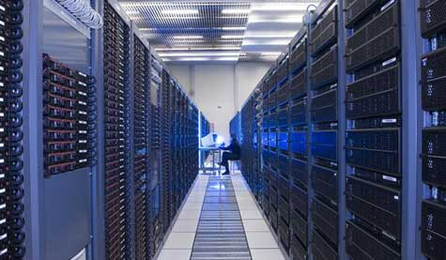
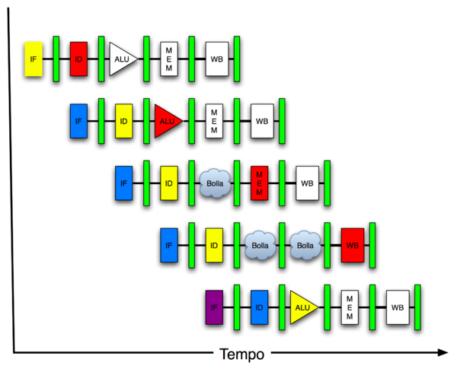
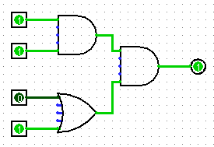
Great Idea #4: Parallelism
Software Hardware
Parallel Requests
Assigned to computer
e.g. search “Garcia”
Parallel Threads
Assigned to core
e.g. lookup, ads
Parallel Instructions
> 1 instruction @ one time
e.g. 5 pipelined instructions
Parallel Data
> 1 data item @ one time
e.g. add of 4 pairs of words
Hardware descriptions
All gates functioning in parallel at same time
Warehouse Scale Computer
Smart Phone
Leverage Parallelism &
Achieve High Performance
Computer
Core
…
Core
Memory
Input/Output
Core
Instruction Unit(s)
Functional
Unit(s)
A₀+B₀
A₁+B₁
A₂+B₂
A₃+B₃
Cache Memory
Logic Gates

Slide 3
Review of Last Lecture (1/2)
A hazard is a situation that prevents the next instruction from executing in the next clock cycle
Structural hazard
A required resource is needed by multiple instructions in different stages
Data hazard
Data dependency between instructions
A later instruction requires the result of an earlier instruction
Control hazard
The flow of execution depends on the previous instruction (ex. jumps, branches)

Slide 4
Review of Last Lecture (2/2)
Hazards hurt the performance of pipelined processors
Stalling can be applied to any hazard, but hurt performance… better solutions?
Structural hazards
Have separate structures for each stage
Data hazards
Forwarding
Control hazards
Branch prediction (mitigates), branch delay slot

Slide 5
Agenda
Multiple Issue
Administrivia
Virtual Memory Introduction

Slide 6
Multiple Issue
Modern processors can issue and execute multiple instructions per clock cycle
CPI < 1 (superscalar), so can use Instructions Per Cycle (IPC) instead
e.g. 4 GHz 4-way multiple-issue can execute 16 billion IPS with peak CPI = 0.25 and peak IPC = 4
But dependencies and structural hazards reduce this in practice

Slide 7
Multiple Issue
Static multiple issue
Compiler reorders independent/commutative instructions to be issued together
Compiler detects and avoids hazards
Dynamic multiple issue
CPU examines pipeline and chooses instructions to reorder/issue
CPU can resolve hazards at runtime

Slide 8
Superscalar Laundry: Parallel per stage
6 PM
7
8
9
10
11
12
1
2 AM
30
30
30
30
30
Time
T
a
s
k
O
r
d
e
r
A
(light clothing)
(dark clothing)
B
(very dirty clothing)
C
D
(light clothing)
(dark clothing)
E
(very dirty clothing)
F
More resources, HW to match mix of parallel tasks?

Slide 9
Pipeline Depth and Issue Width
Intel Processors over Time
Microprocessor | Year | Clock Rate | Pipeline Stages | Issue width | Cores | Power
i486 | 1989 | 25 MHz | 5 | 1 | 1 | 5W
Pentium | 1993 | 66 MHz | 5 | 2 | 1 | 10W
Pentium Pro | 1997 | 200 MHz | 10 | 3 | 1 | 29W
P4 Willamette | 2001 | 2000 MHz | 22 | 3 | 1 | 75W
P4 Prescott | 2004 | 3600 MHz | 31 | 3 | 1 | 103W
Core 2 Conroe | 2006 | 2930 MHz | 12-14 | 4* | 2 | 75W
Core 2 Penryn | 2008 | 2930 MHz | 12-14 | 4* | 4 | 95W
Core i7 Westmere | 2010 | 3460 MHz | 14 | 4* | 6 | 130W
Xeon Sandy Bridge | 2012 | 3100 MHz | 14-19 | 4* | 8 | 150W
Xeon Ivy Bridge | 2014 | 2800 MHz | 14-19 | 4* | 15 | 155W
Notes:
*Intel’s instruction decoders are interesting in that they are assymetric

Slide 10
Pipeline Depth and Issue Width

Slide 11
Static Multiple Issue
Compiler reorders independent/commutative instructions to be issued together (an “issue packet”)
Group of instructions that can be issued on a single cycle
Determined by structural resources required
Specifies multiple concurrent operations

Slide 12
Scheduling Static Multiple Issue
Compiler must remove some/all hazards
Reorder instructions into issue packets
No dependencies within a packet
Possibly some dependencies between packets
Varies between ISAs; compiler must know!
Pad with nops if necessary

Slide 13
Dynamic Multiple Issue
Used in “superscalar” processors
CPU decides whether to issue 0, 1, 2, … instructions each cycle
Goal is to avoid structural and data hazards
Avoids need for compiler scheduling
Though it may still help
Code semantics ensured by the CPU

Slide 14
Dynamic Pipeline Scheduling
Allow the CPU to execute instructions out of order to avoid stalls
But commit result to registers in order
Example: lw $t0, 20($s2) addu $t1, $t0, $t2 subu $s4, $s4, $t3 slti $t5, $s4, 20
Can start subu while addu is waiting for lw
Especially useful on cache misses; can execute many instructions while waiting!

Slide 15
Why Do Dynamic Scheduling?
Why not just let the compiler schedule code?
Not all stalls are predicable
e.g. cache misses
Can’t always schedule around branches
Branch outcome is dynamically determined by I/O
Different implementations of an ISA have different latencies and hazards
Forward compatibility and optimizations

Slide 16
Speculation
“Guess” what to do with an instruction
Start operation as soon as possible
Check whether guess was right and roll back if necessary
Examples:
Speculate on branch outcome (Branch Prediction)
Roll back if path taken is different
Speculate on load
Load into an internal register before instruction to minimize time waiting for memory
Can be done in hardware or by compiler
Common to static and dynamic multiple issue

Slide 17
Not a Simple Linear Pipeline
3 major units operating in parallel:
Instruction fetch and issue unit
Issues instructions in program order
Many parallel functional (execution) units
Each unit has an input buffer called a Reservation Station
Holds operands and records the operation
Can execute instructions out-of-order (OOO)
Commit unit
Saves results from functional units in Reorder Buffers
Stores results once branch resolved so OK to execute
Commits results in program order

Slide 18
Out-of-Order Execution (1/2)
Can also unroll loops in hardware
Fetch instructions in program order (≤ 4/clock)
Predict branches as taken/untaken
To avoid hazards on registers, rename registers using a set of internal registers (≈ 80 registers)
Collection of renamed instructions might execute in a window (≈ 60 instructions)

Slide 19
Out-of-Order Execution (2/2)
Execute instructions with ready operands in 1 of multiple functional units (ALUs, FPUs, Ld/St)
Buffer results of executed instructions until predicted branches are resolved in reorder buffer
If predicted branch correctly, commit results in program order
If predicted branch incorrectly, discard all dependent results and start with correct PC

Slide 20
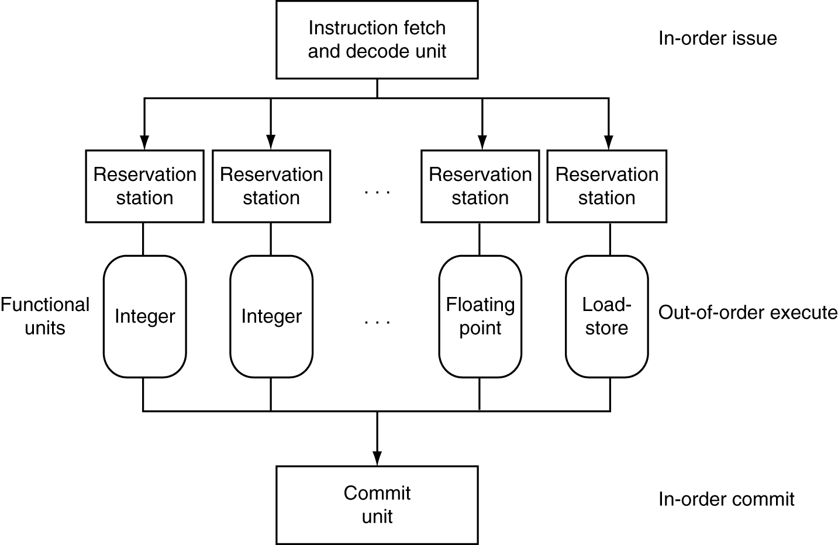
Dynamically Scheduled CPU
Preserves dependencies
Branch prediction,
Register renaming
Wait here until all operands available
Execute…
Results also sent to any waiting reservation stations (think: forwarding!)
… and Hold
Reorder buffer for register and memory writes
Can supply operands for issued instructions

Slide 21
Out-Of-Order Intel
All use O-O-O since 2001
Microprocessor | Year | Clock Rate | Pipeline Stages | Issue width | Out-of-order/ Speculation | Cores | Power
i486 | 1989 | 25 MHz | 5 | 1 | No | 1 | 5W
Pentium | 1993 | 66 MHz | 5 | 2 | No | 1 | 10W
Pentium Pro | 1997 | 200 MHz | 10 | 3 | Yes | 1 | 29W
P4 Willamette | 2001 | 2000 MHz | 22 | 3 | Yes | 1 | 75W
P4 Prescott | 2004 | 3600 MHz | 31 | 3 | Yes | 1 | 103W
Core 2 Conroe | 2006 | 2930 MHz | 12-14 | 4* | Yes | 2 | 75W
Core 2 Penryn | 2008 | 2930 MHz | 12-14 | 4* | Yes | 4 | 95W
Core i7 Westmere | 2010 | 3460 MHz | 14 | 4* | Yes | 6 | 130W
Xeon Sandy Bridge | 2012 | 3100 MHz | 14-19 | 4* | Yes | 8 | 150W
Xeon Ivy Bridge | 2014 | 2800 MHz | 14-19 | 4* | Yes | 15 | 155W

Slide 22
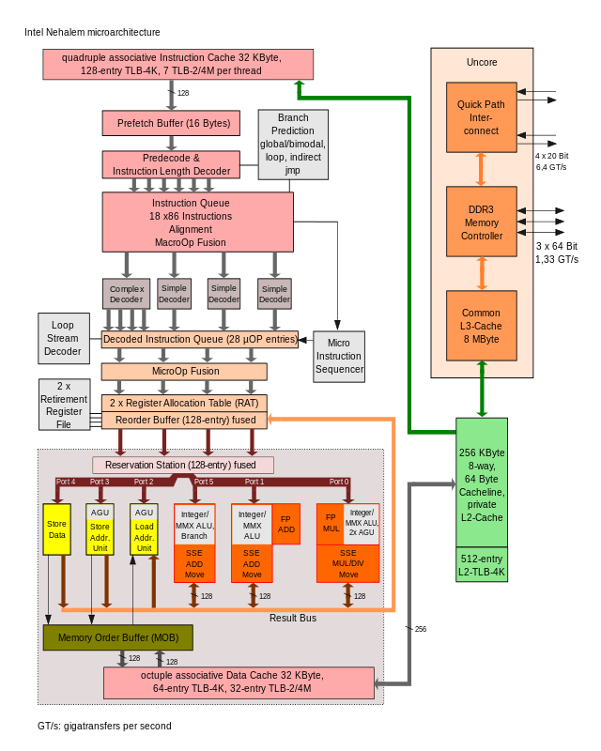
Intel Nehalem Microarchitecture

Slide 23
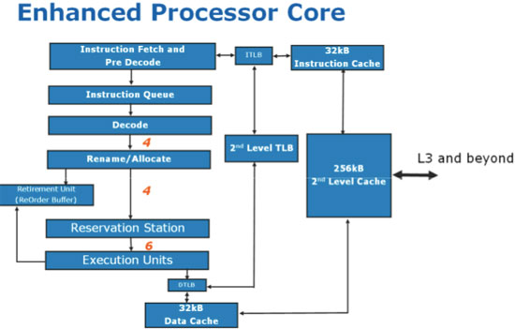
Intel Nehalem Pipeline Flow

Slide 24
Does Multiple Issue Work?
Yes, but not as much as we’d like
Programs have real dependencies that limit ILP
Some dependencies are hard to eliminate
e.g. pointer aliasing (restrict keyword helps)
Some parallelism is hard to expose
Limited window size during instruction issue
Memory delays and limited bandwidth
Hard to keep pipelines full
Speculation can help if done well

Slide 25
Agenda
Multiple Issue
Administrivia
Virtual Memory Introduction

Slide 26
Administrivia
HW5 due tonight
Project 2 (Performance Optimization) due Sunday
No lab today
TAs will be in lab to check-off make up labs
Highly encouraged to make up labs today if you’re behind – treated as Tuesday checkoff for lateness
Project 3 (Pipelined Processor in Logisim) released Friday/Saturday

Slide 27
Agenda
Multiple Issue
Administrivia
Virtual Memory Introduction

Slide 28
Memory Hierarchy
Upper Level
Regs
Faster
Instr Operands
L1 Cache
Earlier: Caches
Blocks
L2 Cache
Blocks
Next Up:
Virtual Memory
Memory
Pages
Disk
Files
Larger
Tape
Lower Level

Slide 29
Memory Hierarchy Requirements
Principle of Locality
Allows caches to offer (close to) speed of cache memory with size of DRAM memory
Can we use this at the next level to give speed of DRAM memory with size of Disk memory?
What other things do we need from our memory system?

Slide 30
Memory Hierarchy Requirements
Allow multiple processes to simultaneously occupy memory and provide protection
Don’t let programs read from or write to each other’s memories
Give each program the illusion that it has its own private address space
Suppose a program has base address 0x00400000, then different processes each think their code resides at the same address
Each program must have a different view of memory

Slide 31
Virtual Memory
Next level in the memory hierarchy
Provides illusion of very large main memory
Working set of “pages” residing in main memory (subset of all pages residing on disk)
Main goal: Avoid reaching all the way back to disk as much as possible
Additional goals:
Let OS share memory among many programs and protect them from each other
Each process thinks it has all the memory to itself

Slide 32
Virtual to Physical Address Translation
Program operates in its virtual address space
Virtual
Address (VA)
(inst. fetch
load, store)
Physical
Address (PA)
(inst. fetch
load, store)
Physical memory (including caches)
HW mapping
Each program operates in its own virtual address space and thinks it’s the only program running
Each is protected from the other
OS can decide where each goes in memory
Hardware gives virtual → physical mapping

Slide 33
VM Analogy (1/2)
Trying to find a book in the UCB library system
Book title is like virtual address (VA)
What you want/are requesting
Book call number is like physical address (PA)
Where it is actually located
Card catalogue is like a page table (PT)
Maps from book title to call number
Does not contain the actual that data you want
The catalogue itself takes up space in the library

Slide 34
VM Analogy (2/2)
Indication of current location within the library system is like valid bit
Valid if in current library (main memory) vs. invalid if in another branch (disk)
Found on the card in the card catalogue
Availability/terms of use like access rights
What you are allowed to do with the book (ability to check out, duration, etc.)
Also found on the card in the card catalogue

Slide 35
Mapping VM to PM
Virtual Memory
Divide into equal sized chunks (usually 4-8 KiB)
Any chunk of Virtual Memory can be assigned to any chunk of Physical Memory (“page”)
∞
Stack
Physical Memory
64 MB
Heap
Static
Code
0
0

Slide 36
Paging Organization
Here assume page size is 4 KiB
Page is both unit of mapping and unit of transfer between disk and physical memory
Physical
Address
Virtual
Address
0x00000
page 0
4 Ki
0x0000
page 0
4 Ki
Addr
Trans
MAP
0x01000
page 1
4 Ki
0x1000
page 1
4 Ki
...
...
...
0x02000
page 2
4 Ki
...
...
...
0x7000
page 7
4 Ki
0x1F000
page 31
4 Ki
Physical
Memory
Virtual Memory

Slide 37
Virtual Memory Mapping Function
How large is main memory? Disk?
Don’t know! Designed to be interchangeable components
Need a system that works regardless of sizes
Use lookup table (page table) to deal with arbitrary mapping
Index lookup table by # of pages in VM (not all entries will be used/valid)
Size of PM will affect size of stored translation

Slide 38
Address Mapping
Pages are aligned in memory
Border address of each page has same lowest bits
Page size (P bytes) is same in VM and PM, so denote lowest PO = log₂(P) bits as page offset
Use remaining upper address bits in mapping
Tells you which page you want (similar to Tag)
Physical Page #
Page Offset
Virtual Page #
Page Offset
Not necessarily the same size
Same Size

Slide 39
Address Mapping: Page Table
Page Table functionality:
Incoming request is Virtual Address (VA), want Physical Address (PA)
Physical Offset = Virtual Offset (page-aligned)
So just swap Virtual Page Number (VPN) for Physical Page Number (PPN)
Implementation?
Use VPN as index into PT
Store PPN and management bits (Valid, Access Rights)
Does NOT store actual data (the data sits in PM)

Slide 40
Page Table Layout
Virtual Address:
VPN
offset
Page Table
3) Combine PPN and offset
V | AR | PPN
X | XX
+
1) Index into PT using VPN
2) Check Valid and Access Rights bits
Physical
Address
4) Use PA to access memory

Slide 41
Page Table Entry Format
Contains either PPN or indication not in main memory
Valid = Valid page table entry
1 → virtual page is in physical memory
0 → OS needs to fetch page from disk
Access Rights checked on every access to see if allowed (provides protection)
Read Only: Can read, but not write page
Read/Write: Read or write data on page
Executable: Can fetch instructions from page

Slide 42
Page Tables
A page table (PT) contains the mapping of virtual addresses to physical addresses
Where should PT be located?
Physical memory, so faster to access and can be shared by multiple processors
The OS maintains the PTs
Each process has its own page table
“State” of a process is PC, all registers, and PT
OS stores address of the PT of the current process in the Page Table Base Register

Slide 43
Paging/Virtual Memory Multiple Processes
User A: Virtual Memory
User B: Virtual Memory
∞
Physical
Memory
∞
Stack
Stack
64 MB
Heap
Heap
Static
Static
Page
Table A
Page
Table B
Code
0
Code
0
0

Slide 44
Caches vs. Virtual Memory
Caches Virtual Memory
Block Page
Cache Miss Page Fault
Block Size: 32-64B Page Size: 4KiB-8KiB
Placement: Direct Mapped, Fully Associative N-way Set Associative (almost always)
Replacement: LRU or Random LRU
Write Thru or Back Write Back

Slide 45
Technology Break

Slide 46
Notes on Page Table
OS must reserve “Swap Space” on disk for each process
To grow a process, ask Operating System
If unused pages, OS uses them first
If not, OS swaps some old pages to disk
(Least Recently Used to pick pages to swap)
Each process has own Page Table
Will add details, but Page Table is essence of Virtual Memory

Slide 47
Why would a process need to “grow”?
~ FFFF FFFF_{hex}
A program’s address space contains 4 regions:
stack: local variables, grows downward
heap: space requested for pointers via malloc() ; resizes dynamically, grows upward
static data: variables declared outside main, does not grow or shrink
code: loaded when program starts, does not change
stack
heap
static data
code
~ 0_{hex}
For now, OS somehow prevents accesses between stack and heap (gray hash lines).

Slide 48
Virtual Memory and Caches
Physical memory is slow, so we cache data
Why not do the same with the page table?
Translation Lookaside Buffer (TLB) is the equivalent of cache for the page table

Slide 49
Virtual to Physical Address Translation
Check TLB
Check page tables (in main memory)
Page fault – OS handles
OS: Check disk
OS: Swap on disk/Segmentation fault

Slide 50
Translation Look-Aside Buffers (TLBs)
TLBs usually small, typically 128 - 256 entries
Like any other cache, the TLB can be direct mapped, set associative, or fully associative
hit
VA
PA
TLB
Lookup
Cache
Main
Memory
Processor
miss
miss
hit
data
Trans-
lation
On TLB miss, get page table entry from main memory

Slide 51
Context Switching and VM
Context Switching now requires that both the TLB and caches be flushed
In reality, TLB entries have a context tag

Slide 52
Peer Instruction
Locality is important yet different for cache and virtual memory (VM): temporal locality for caches but spatial locality for VM
VM helps both with security and cost
12
blue) FF
green) FT
purple) TF
yellow) TT
Notes:
Answer: [correct=5, TFF] Individual (6, 3, 6, 3, 34, 37, 7, 4)% & Team (9, 4, 4, 4, 39, 34, 0, 7)%
A: T [18/82 & 25/75] (The game breaks up very quickly into separate, independent games -- big win to solve separated & put together)
B: F [80/20 & 86/14] (The game tree grows exponentially! A better static evaluator can make all the difference!)
C: F [53/57 & 52/48] (If you're just looking for the best move, just keep theBestMove around [ala memoizing max])

Slide 53
Peer Instruction Answer
F A L S E
Locality is important yet different for cache and virtual memory (VM): temporal locality for caches but spatial locality for VM
VM helps both with security and cost
T R U E
1. No. Both for VM and cache
2. Yes. Protection and a bit smaller memory
12
blue) FF
green) FT
purple) TF
yellow) TT

Slide 54
Summary
More aggressive performance options:
Longer pipelines
Superscalar (multiple issue)
Out-of-order execution
Speculation
Virtual memory bridges memory and disk
Provides illusion of independent address spaces to processes and protects them from each other
VA to PA using Page Table
TLB

