Slide 1
CS 61C: Great Ideas in Computer Architecture Lecture 16: Caches, Part 3
Instructor: Sagar Karandikar
sagark@eecs.berkeley.edu
http://inst.eecs.berkeley.edu/~cs61c

Slide 2
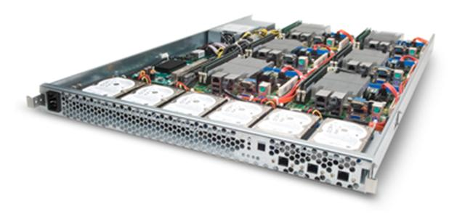
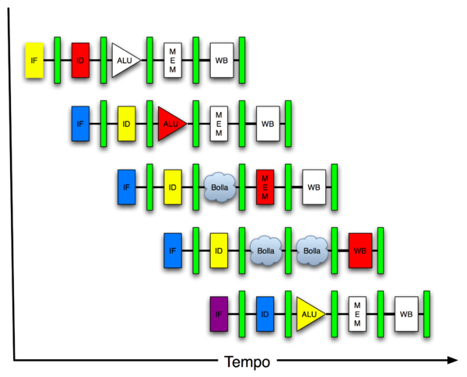
You Are Here!
Software Hardware
Parallel Requests
Assigned to computer
e.g., Search “Katz”
Parallel Threads
Assigned to core
e.g., Lookup, Ads
Parallel Instructions
>1 instruction @ one time
e.g., 5 pipelined instructions
Parallel Data
>1 data item @ one time
e.g., Add of 4 pairs of words
Hardware descriptions
All gates @ one time
Programming Languages
Warehouse Scale Computer
Smart Phone
Harness Parallelism &
Achieve High Performance
Computer
Today’s
Lecture
Core
…
Core
Memory (Cache)
Input/Output
Core
Instruction Unit(s)
Functional
Unit(s)
A₀+B₀
A₁+B₁
A₂+B₂
A₃+B₃
Main Memory
Logic Gates

Slide 3
Caches Review
Processor issues addresses, cache breaks them into Tag/Index/Offset
Direct-Mapped vs. Set-Associative vs. Fully Associative
AMAT = Hit Time + Miss Rate * Miss Penalty
3 Cs of cache misses: Compulsory, Capacity, Conflict
Effect of cache parameters on performance

Slide 4
Review: Processor Address Fields used by Cache Controller
Block Offset: Byte address within block
#bits = log_2(block size in bytes)
Index: Selects which index (set) we want
# bits = log_2(number of sets)
Tag: Remaining portion of processor address
processor address size - offset bits - index bits
Processor Address (32-bits total)
Tag
Set Index
Block offset
Notes:
For class handout

Slide 5
Review: Direct Mapped Cache
One word blocks, cache size = 1Ki words (or 4KiB)
Block offset
31 30 . . . 13 12 11 . . . 2 1 0
Hit
Tag
20
10
Data
Valid bit ensures something useful in cache for this index
Index
Read data from cache instead of memory if a Hit
Index
Valid
Tag
Data
0
1
2
.
.
.
1021
1022
1023
Compare Tag with upper part of Address to see if a Hit
20
32
Comparator
Notes:
Let’s use a specific example with realistic numbers: assume we have a 1 K word (4Kbyte) direct mapped cache with block size equals to 4 bytes (1 word).
In other words, each block associated with the cache tag will have 4 bytes in it (Row 1).
With Block Size equals to 4 bytes, the 2 least significant bits of the address will be used as byte select within the cache block.
Since the cache size is 1K word, the upper 32 minus 10+2 bits, or 20 bits of the address will be stored as cache tag.
The rest of the (10) address bits in the middle, that is bit 2 through 11, will be used as Cache Index to select the proper cache entry
Temporal!

Slide 6
Review: Multiword-Block Direct-Mapped Cache
Four words/block, cache size = 1Ki words
Byte offset
Hit
31 30 . . . 13 12 11 . . . 4 3 2 1 0
Data
Tag
20
8
Block offset
Index
Index
Valid
Tag
Data
0
1
2
.
.
.
253
254
255
20
32
Notes:
to take advantage for spatial locality want a cache block that is larger than word word in size.

Slide 7
Review: Four-Way Set-Associative Cache
2⁸ = 256 sets each with four ways (each with one block)
31 30 . . . 13 12 11 . . . 2 1 0
Byte offset
Tag
22
8
Index
Index
V
Tag
Data
V
Tag
Data
V
Tag
Data
V
Tag
Data
0
1
2
.
.
.
253
254
255
0
1
2
.
.
.
253
254
255
0
1
2
.
.
.
253
254
255
0
1
2
.
.
.
253
254
255
Way 0
Way 1
Way 2
Way 3
32
4x1 select
Hit
Data
Notes:
This is called a 4-way set associative cache because there are four cache entries for each cache index. Essentially, you have four direct mapped cache working in parallel.
This is how it works: the cache index selects a set from the cache. The four tags in the set are compared in parallel with the upper bits of the memory address.
If no tags match the incoming address tag, we have a cache miss.
Otherwise, we have a cache hit and we will select the data from the way where the tag matches occur.
This is simple enough. What is its disadvantages?
+1 = 36 min. (Y:16)

Slide 8
Review: Cache Measurement Terms
Hit rate: fraction of accesses that hit in the cache
Miss rate: 1 – Hit rate
Miss penalty: time to replace a block from lower level in memory hierarchy to cache
Hit time: time to access cache memory (including tag comparison)
These are controlled by the myriad cache parameters we can set…

Slide 9
Primary Cache Parameters
Block size (aka line size)
how many bytes of data in each cache entry?
Associativity
how many ways in each set?
Direct-mapped => Associativity = 1
Set-associative => 1 < Associativity < #Entries
Fully associative => Associativity = #Entries
Capacity (bytes) = Total #Entries * Block size
#Entries = #Sets * Associativity

Slide 10
Other Cache Parameters
Write Policy
Replacement policy

Slide 11
Write Policy Choices
Cache hit:
write through: writes both cache & memory on every access
Generally higher memory traffic but simpler pipeline & cache design
write back: writes cache only, memory `written only when dirty entry evicted
A dirty bit per line reduces write-back traffic
Must handle 0, 1, or 2 accesses to memory for each load/store
Cache miss:
no write allocate: only write to main memory
write allocate (aka fetch on write): fetch into cache
Common combinations:
write through and no write allocate
write back with write allocate

Slide 12
Replacement Policy
In an associative cache, which line from a set should be evicted when the set becomes full?
Random
Least-Recently Used (LRU)
LRU cache state must be updated on every access
True implementation only feasible for small sets (2-way)
Pseudo-LRU binary tree often used for 4-8 way
First-In, First-Out (FIFO) a.k.a. Round-Robin
Used in highly associative caches
Not-Most-Recently Used (NMRU)
FIFO with exception for most-recently used line or lines
This is a second-order effect. Why?
Replacement only happens on misses
Notes:
NLRU used in Alpha TLBs (jse)

Slide 13
Sources of Cache Misses (3 C’s)
Compulsory (cold start, first reference):
1st access to a block in memory, “cold”, fact of life, not a lot you can do about it.
If running billions of instructions, compulsory misses are insignificant
Capacity:
Cache cannot contain all blocks accessed by the program
Misses that would not occur with infinite cache
Conflict (collision):
Multiple memory locations mapped to same cache set
Misses that would not occur with ideal fully associative cache
Notes:
(Capacity miss) That is the cache misses are due to the fact that the cache is simply not large enough to contain all the blocks that are accessed by the program.
The solution to reduce the Capacity miss rate is simple: increase the cache size.
Here is a summary of other types of cache miss we talked about.
First is the Compulsory misses. These are the misses that we cannot avoid. They are caused when we first start the program.
Then we talked about the conflict misses. They are the misses that caused by multiple memory locations being mapped to the same cache location.
There are two solutions to reduce conflict misses. The first one is, once again, increase the cache size. The second one is to increase the associativity.
For example, say using a 2-way set associative cache instead of directed mapped cache.
But keep in mind that cache miss rate is only one part of the equation. You also have to worry about cache access time and miss penalty. Do NOT optimize miss rate alone.
Finally, there is another source of cache miss we will not cover today. Those are referred to as invalidation misses caused by another process, such as IO , update the main memory so you have to flush the cache to avoid inconsistency between memory and cache.
+2 = 43 min. (Y:23)

Slide 14
Rules for Determining Miss Type for a Given Access Pattern in 61C
1) Compulsory: A miss is compulsory if and only if it results from accessing the data for the first time. If you have ever brought the data you are accessing into the cache before, it's not a compulsory miss, otherwise it is.
2) Conflict: A conflict miss is a miss that's not compulsory and that would have been avoided if the cache was fully associative. Imagine you had a cache with the same parameters but fully-associative (with LRU). If that would've avoided the miss, it's a conflict miss.
3) Capacity: This is a miss that would not have happened with an infinitely large cache. If your miss is not a compulsory or conflict miss, it's a capacity miss.
Notes:
In order to determine what kind of miss you are dealing with, you can first check 1, then 2 and then 3. The type of your miss is the first of these definitions that applies. Note that making the capacity infinitely large also eliminates conflict misses, which is why you should check whether it is a conflict miss first.

Slide 15
Impact of Cache Parameters on Performance
AMAT = Hit Time + Miss Rate * Miss Penalty
Note, we assume always first search cache, so must incorporate hit time for both hits and misses!
For misses, characterize by 3Cs

Slide 16
Administrivia
Project 3-1 Out
Last week, we built a CPU together, this week, you start building your own!
HW4 Out - Caches
Guerrilla Section on Pipelining, Caches on Thursday, 5-7pm, Woz

Slide 17
Administrivia
Midterm 2 is one week from tomorrow
In this room, at this time
Two double-sided 8.5”x11” handwritten cheatsheets
We’ll provide a MIPS green sheet
No electronics
Covers up to and including tomorrow’s lecture (07/21)*
Review session is Friday, 7/24 from 1-4pm in HP Aud.
* This is one less lecture than initially indicated

Slide 18
Break

Slide 19
CPU-Cache Interaction (5-stage pipeline)
0x4
Add
E
Decode,
Register
Fetch
M
A
we
Y
addr
bubble
ALU
Y
IR
B
Primary
Data
Cache
rdata
PC
addr
inst
D
R
hit?
wdata
hit?
wdata
PCen
Primary
Instruction
Cache
MD1
MD2
Stall entire CPU on data cache miss
Stall at fetch stage on inst cache miss (but not the whole CPU)
To Memory Control
Cache Refill Data from Lower Levels of Memory Hierarchy
Notes:
How are writes to istream handled?

Slide 20
Increasing Block Size?
Hit time as block size increases?
Hit time unchanged, but might be slight hit-time reduction as number of tags is reduced, so faster to access memory holding tags
Miss rate as block size increases?
Goes down at first due to spatial locality, then increases due to increased conflict misses due to fewer blocks in cache
Miss penalty as block size increases?
Rises with longer block size, but with fixed constant initial latency that is amortized over whole block

Slide 21
Increasing Associativity?
Hit time as associativity increases?
Increases, with large step from direct-mapped to >=2 ways, as now need to mux correct way to processor
Smaller increases in hit time for further increases in associativity
Miss rate as associativity increases?
Goes down due to reduced conflict misses, but most gain is from 1->2->4-way with limited benefit from higher associativities
Miss penalty as associativity increases?
Unchanged, replacement policy runs in parallel with fetching missing line from memory

Slide 22
Increasing #Entries? (Capacity)
Hit time as #entries increases?
Increases, since reading tags and data from larger memory structures
Miss rate as #entries increases?
Goes down due to reduced capacity and conflict misses
Architects rule of thumb: miss rate drops ~2x for every ~4x increase in capacity (only a gross approximation)
Miss penalty as #entries increases?
Unchanged

Slide 23
How to Reduce Miss Penalty?
Could there be locality on misses from a cache?
Use multiple cache levels!
With Moore’s Law, more room on die for bigger L1 caches and for second-level (L2) cache
And in some cases even an L3 cache!
IBM mainframes have ~1GB L4 cache off-chip.

Slide 24
Review: Memory Hierarchy
Processor
Inner
Increasing distance from processor, decreasing speed
Levels in memory hierarchy
Level 1
Level 2
Level 3
Outer
. . .
Level n
Size of memory at each level
As we move to outer levels the latency goes up and price per bit goes down.

Slide 25
Local vs. Global Miss Rates
Local miss rate – the fraction of references to one level of a cache that miss
Local Miss rate L2$ = # $L2 Misses / # L1$ Misses
Global miss rate – the fraction of references that miss in all levels of a multilevel cache
L2$ local miss rate >> than the global miss rate
L2$ Global Miss rate = L2$ Misses / Total Accesses

Slide 26
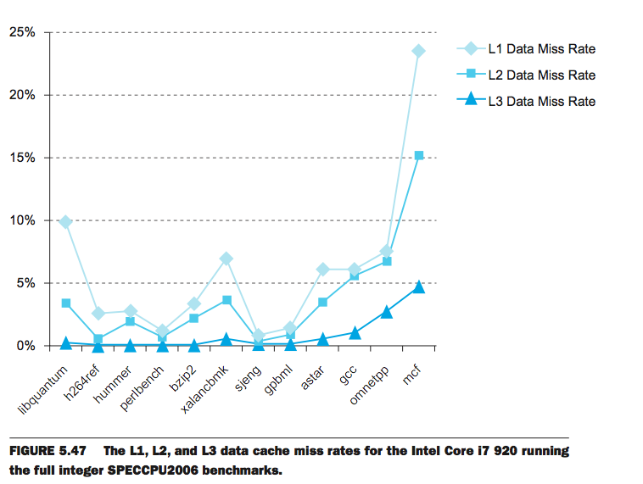
L1 Cache: 32KB I$, 32KB D$
L2 Cache: 256 KB
L3 Cache: 4 MB
Notes:
Global miss rates.
as you keep going, l3 < l2 < l1, as we get lower in the hierarchy, more hit in the caches, fewer miss
numerator = misses at this level
denominator = accesses issued
so a hit at L3 means miss at L1 and miss at L2, so L1, L2 misses must be >= L3 misses

Slide 27
Local vs. Global Miss Rates
Local miss rate – the fraction of references to one level of a cache that miss
Local Miss rate L2$ = $L2 Misses / L1$ Misses
Global miss rate – the fraction of references that miss in all levels of a multilevel cache
L2$ Global Miss rate = L2$ Misses / Total Accesses
= L2$ Misses / L1$ Misses x L1$ Misses / Total Accesses
= Local Miss rate L2$ x Local Miss rate L1$
AMAT = Time for a hit + Miss rate x Miss penalty
AMAT = Time for a L1$ hit + (local) Miss rate L1$ x (Time for a L2$ hit + (local) Miss rate L2$ x L2$ Miss penalty)

Slide 28
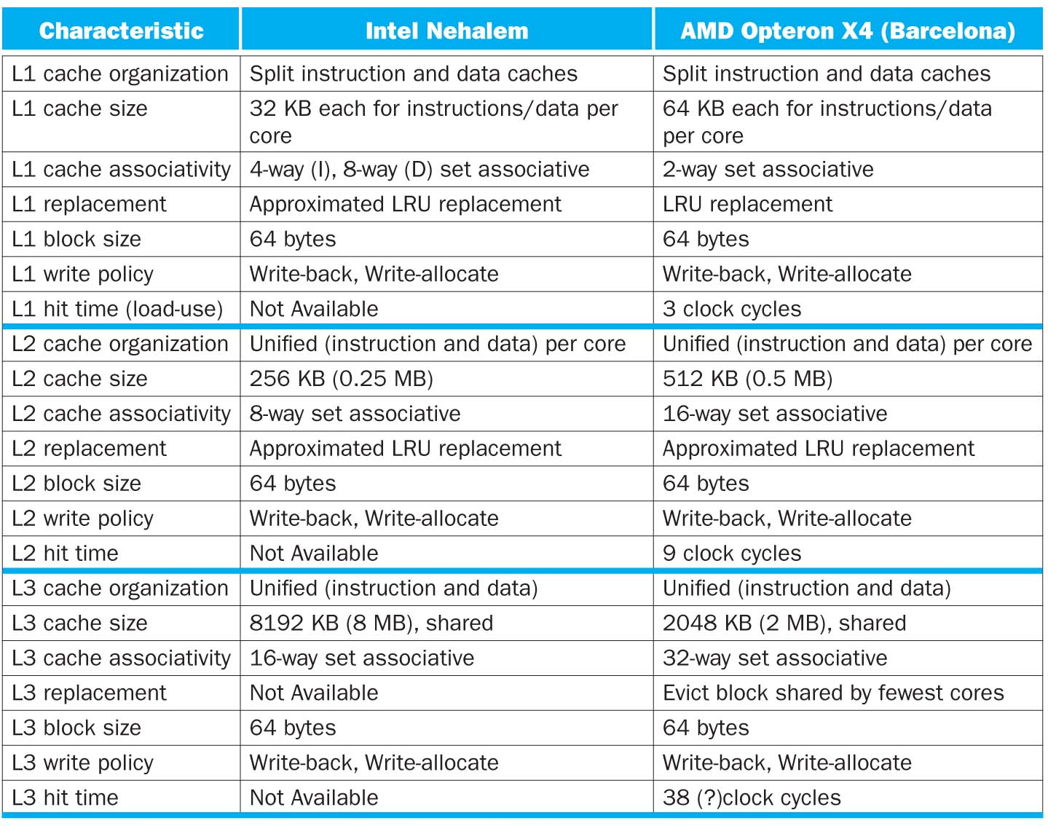

Slide 29
On a 2012 Retina MBP
~ » sudo sysctl -a | grep cache
hw.cachelinesize = 64
hw.l1icachesize = 32768
hw.l1dcachesize = 32768
hw.l2cachesize = 262144
hw.l3cachesize = 6291456
kern.flush_cache_on_write: 0
kern.namecache_disabled: 0
vm.vm_page_filecache_min: 209715
vfs.generic.nfs.client.access_cache_timeout: 60
vfs.generic.nfs.server.reqcache_size: 64
net.inet.ip.rtmaxcache: 128
net.inet6.ip6.rtmaxcache: 128
hw.cacheconfig: 8 2 2 8 0 0 0 0 0 0
hw.cachesize: 17179869184 32768 262144 6291456 0 0 0 0 0
hw.cachelinesize: 64
hw.l1icachesize: 32768
hw.l1dcachesize: 32768
hw.l2cachesize: 262144
hw.l3cachesize: 6291456
machdep.cpu.cache.linesize: 64
machdep.cpu.cache.L2_associativity: 8
machdep.cpu.cache.size: 256
------------------------------------------------------------
On a hive machine, run:
cat /sys/devices/system/cpu/cpu0/cache/index0/*
A cool thing about Unix: you can poke around by reading files

Slide 30
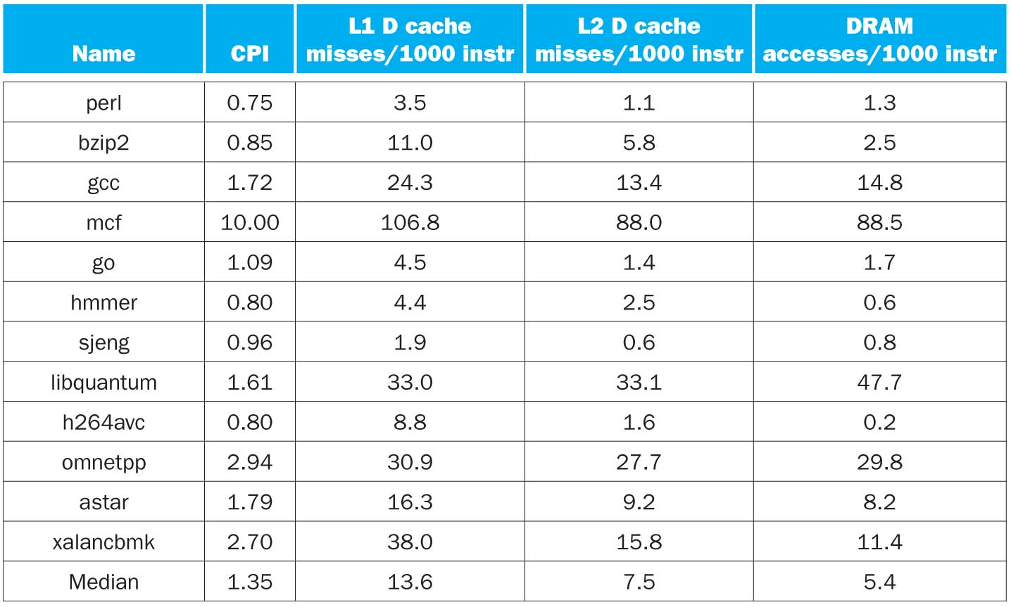
CPI/Miss Rates/DRAM Access SpecInt2006
Data Only
Data Only
Instructions and Data
Notes:
compare L1 to L2
compare inst to data (there’s also an L3, which is why sometimes Inst + Data < Data only L2)

Slide 31
Clickers/Peer Instruction
Overall, what are L2 and L3 local miss rates?
A: L2 > 50%, L3 > 50%
B: L2 < 50%, L3 < 50%
C: L2 ~ 50%, L3 ~ 50%
D: L2 > 50%, L3 < 50%
E: L2 > 50%, L3 ~50%

Slide 32
CS61C In the News
2 “Privacy-respecting” Laptops on the frontpage of Hacker News yesterday:
The Gluglug Libreboot X200
Purism Librem 13/15
Why does it matter?
You can run all the free software you want, but:
1) Who knows what the hardware is really doing?
2) 99.999% of your machines still have proprietary “blobs” of driver/firmware code
(some are even encrypted)
https://news.ycombinator.com/item?id=9912034
https://news.ycombinator.com/item?id=9912863

Slide 33
Break

Slide 34
Analyzing Code Performance on a Cache
Let’s say we’re interested in analyzing program performance with respect to the cache:
#define SZ 2048 // 2^11
int foo() {
int a[SZ];
int sum = 0;
for (int i = 0; i < SZ; i++) {
sum += a[i];
}
return sum;
}

Slide 35
Analyzing Code Performance on a Cache
#define SZ 2048 // 2^11
int foo() {
int a[SZ];
int sum = 0;
for (int i = 0; i < SZ; i++) {
sum += a[i];
}
return sum;
}
1) Assume we only care about D$
2) Assume array is “block aligned”
i.e. First byte of a[0] is the first
byte in a block
3) Assume local vars live in registers
So what do we care about?
The sequence of accesses to array a
Notes:
I$ is fairly predictable. Not too much the programmer could do wrong here.
Probably what will happen anyway. In any-case, won’t have a big effect on the analysis

Slide 36
Analyzing Code Performance on a Cache
Cache specs:
4 KiB Direct-Mapped
16 B Blocks
What’s the miss rate?
#define SZ 2048 // 2^11
int foo() {
int a[SZ];
int sum = 0;
for (int i = 0; i < SZ; i++) {
sum += a[i];
}
return sum;
}
Important first questions:
What does our access pattern look like within a block?
How many cache blocks does our array take up? Does it fit entirely in the cache at once?

Slide 37
Analyzing Code Performance on a Cache
Cache specs:
4 KiB Direct-Mapped
16 B Blocks
What’s the miss rate?
#define SZ 2048 // 2^11
int foo() {
int a[SZ];
int sum = 0;
for (int i = 0; i < SZ; i++) {
sum += a[i];
}
return sum;
}
What does our access pattern look like within a block?
We’re iterating over 2048 ints, each of which are 4 bytes. A block in this cache holds 4 ints: (16 B/block)/(4 B/int) = 4 ints/block

Slide 38
Analyzing Code Performance on a Cache
What does our access pattern look like within a block?
We’re iterating over 2048 ints, each of which are 4 bytes. A block in this cache holds 4 ints: (16 B/block)/(4 B/int) = 4 ints/block
Block as bytes:
Block as ints:
Iteration 0:
Compulsory Miss
Iteration 1:
Hit
Iteration 2:
Hit
Iteration 3:
Hit
a[0] | a[1] | a[2] | a[3]…
This repeats over and over!
25% miss rate

Slide 39
Analyzing Code Performance on a Cache #2
Cache specs:
4 KiB Direct-Mapped
16 B Blocks
What’s the miss rate?
#define SZ 2048 // 2^11
int foo() {
int a[SZ];
int sum = 0;
for (int i = 0; i < SZ; i+=2) sum += a[i];
for (int i = 0; i < SZ; i+=2) sum += a[i];
return sum;
}
What does our access pattern look like within a block?
We’re iterating over an array of 2048 ints (but only accessing 1024 of them), each of which are 4 bytes. A block in this cache holds 4 ints: (16 B/block)/(4 B/int) = 4 ints/block

Slide 40
Analyzing Code Performance on a Cache
What does our access pattern look like within a block? (let’s stick with the first loop)
We’re iterating over 2048 ints 1024 ints, each of which are 4 bytes. A block in this cache holds 4 ints: (16 B/block)/(4 B/int) = 4 ints/block
Block as bytes:
Block as ints:
Iteration 0:
Compulsory Miss
Iteration 1:
Hit
a[0] | a[1] | a[2] | a[3]…
This repeats over and over for the first loop!
50% miss rate

Slide 41
Analyzing Code Performance on a Cache
But now, we have to worry about question 2:
2) How many cache blocks does our array take up?
The array contains 2048 ints. That’s 2048*4 = 8192 B. Cache blocks are 16 B each, so 8192/16 = 512 blocks.
Does it fit entirely in the cache at once?
No. Cache is only 4096 B, contains
only 256 blocks.
Cache specs:
4 KiB Direct-Mapped
16 B Blocks

Slide 42
Analyzing Code Performance on a Cache #2
Cache specs:
4 KiB Direct-Mapped
16 B Blocks
What’s the miss rate?
#define SZ 2048 // 2^11
int foo() {
int a[SZ];
int sum = 0;
for (int i = 0; i < SZ; i+=2) sum += a[i];
for (int i = 0; i < SZ; i+=2) sum += a[i];
return sum;
}
So, to figure out what loop 2’s performance is going to be like, we need to know what’s in the cache at the end of loop 1…

Slide 43
Analyzing Code Performance on a Cache #2
Cache specs:
4 KiB Direct-Mapped
16 B Blocks
What’s the miss rate?
#define SZ 2048 // 2^11
int foo() {
int a[SZ];
int sum = 0;
for (int i = 0; i < SZ; i+=2) sum += a[i];
// what’s the state of the cache here?
}
Say for the sake of argument that our array starts at address 0. Then, halfway through the first loop (between i = 1022 and i = 1024), the first half of the array is in the cache.
a[0] …………………………………………………………………………………………………………………………………………………...............................a[1023]

Slide 44
Analyzing Code Performance on a Cache #2
Cache specs:
4 KiB Direct-Mapped
16 B Blocks
What’s the miss rate?
#define SZ 2048 // 2^11
int foo() {
int a[SZ];
int sum = 0;
for (int i = 0; i < SZ; i+=2) sum += a[i];
// what’s the state of the cache here?
}
Now, when we execute the second half of the accesses in loop one, we replace everything already in the cache:
a[1024] …………………………………………………………………………………………………………………………………………………...............................a[2047]
a[0] …………………………………………………………………………………………………………………………………………………...............................a[1023]

Slide 45
Analyzing Code Performance on a Cache #2
Cache specs:
4 KiB Direct-Mapped
16 B Blocks
What’s the miss rate?
#define SZ 2048 // 2^11
int foo() {
int a[SZ];
int sum = 0;
for (int i = 0; i < SZ; i+=2) sum += a[i];
// what’s the state of the cache here?
}
a[1024] …………………………………………………………………………………………………………………………………………………...............................a[2047]
So, at the end of the first loop, the second half of the array is in the cache.

Slide 46
Analyzing Code Performance on a Cache #2
Cache specs:
4 KiB Direct-Mapped
16 B Blocks
What’s the miss rate?
#define SZ 2048 // 2^11
int foo() {
int a[SZ];
int sum = 0;
for (int i = 0; i < SZ; i+=2) sum += a[i];
for (int i = 0; i < SZ; i+=2) sum += a[i];
return sum;
}
Now, let’s take a look at loop 2. Notice that it’s going to start by accessing the first half of the array, none of which is in the cache.

Slide 47
Analyzing Code Performance on a Cache
What does our access pattern look like within a block? (now, for the second loop)
We’re iterating over 2048 ints 1024 ints, each of which are 4 bytes. A block in this cache holds 4 ints: (16 B/block)/(4 B/int) = 4 ints/block
Block as bytes:
Block as ints:
Iteration 0:
Capacity Miss
a[1024] was in this spot in the cache…
Iteration 1:
Hit
a[0] | a[1] | a[2] | a[3]…
This repeats over and over for the second loop!
50% miss rate

Slide 48
Analyzing Code Performance on a Cache #2
Cache specs:
4 KiB Direct-Mapped
16 B Blocks
What’s the miss rate?
#define SZ 2048 // 2^11
int foo() {
int a[SZ];
int sum = 0;
for (int i = 0; i < SZ; i+=2) sum += a[i];
for (int i = 0; i < SZ; i+=2) sum += a[i];
return sum;
}
So, we got a 50% miss rate for loop #1 and a 50% miss rate for loop #2. Now, we compute a weighted average:
Total miss rate = weighted average of miss rates.
Half the accesses were in loop 1, the other half in loop 2:
Total miss rate = 0.5 * loop1 miss rate + 0.5 * loop2 miss rate
Total miss rate = 0.5 * 50% + 0.5 * 50% = 50%

Slide 49
Clicker Question p1
Cache specs:
1 KiB Direct-Mapped
16 B Blocks
#define SZ 2048 // 2^11
int foo() {
int a[SZ];
int sum = 0;
for (int i = 0; i < SZ; i+=256) sum += a[i];
for (int i = 0; i < SZ; i+=256) sum += a[i];
return sum;
}
What’s the miss rate for the first loop?
A. 0 % B. 25 % C. 50 % D. 75 % E. 100%
Notes:
E

Slide 50
Clicker Question p2
Cache specs:
1 KiB Direct-Mapped
16 B Blocks
#define SZ 2048 // 2^11
int foo() {
int a[SZ];
int sum = 0;
for (int i = 0; i < SZ; i+=256) sum += a[i];
for (int i = 0; i < SZ; i+=256) sum += a[i];
return sum;
}
What’s the miss rate for the second loop?
A. 0 % B. 25 % C. 50 % D. 75 % E. 100%
Notes:
E

Slide 51
Clicker Question p3
Cache specs:
1 KiB Direct-Mapped
16 B Blocks
#define SZ 2048 // 2^11
int foo() {
int a[SZ];
int sum = 0;
for (int i = 0; i < SZ; i+=256) sum += a[i];
for (int i = 0; i < SZ; i+=256) sum += a[i];
return sum;
}
What types of misses do we get in the first/second loops?
A. Capacity/Capacity B. Compulsory/Capacity
C. Compulsory/Conflict D. Conflict/Capacity
E. Compulsory/Compulsory
Notes:
C

Slide 52
In Conclusion, Huge Cache Design Space
Several interacting dimensions
Cache size
Block size
Associativity
Replacement policy
Write-through vs. write-back
Write-allocation
Optimal choice is a compromise
Depends on access characteristics
Workload
Use (I-cache, D-cache)
So we learned how to analyze code performance on a cache
Simplicity often wins
Cache Size
Associativity
Block Size
Bad
Good
Factor A
Factor B
Less
More

