Slide 1

CS 61C: Great Ideas in Computer Architecture
Lecture 25: Dependability and RAID
Instructor: Sagar Karandikar
sagark@eecs.berkeley.edu
http://inst.eecs.berkeley.edu/~cs61c

Slide 2
Last time:
I/O gives computers their 5 senses
I/O speed range is 100-million to one
Polling vs. Interrupts
DMA to avoid wasting CPU time on data transfers
Disks for persistent storage, replaced by flash
Networks: computer-to-computer I/O
  Protocol suites allow networking of heterogeneous components. Abstraction!

Slide 3
Great Idea #6:
Dependability via Redundancy
Redundancy so that a failing piece doesn’t make the whole system fail
1+1=2
2 of 3 agree
1+1=2
1+1=2
1+1=1
FAIL!
Increasing transistor density reduces the cost of redundancy

Slide 4

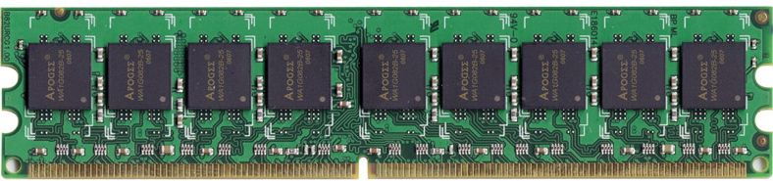
Great Idea #6:
Dependability via Redundancy
Applies to everything from datacenters to memory
  Redundant datacenters so that can lose 1 datacenter but Internet service stays online
  Redundant routes so can lose nodes but Internet doesn’t fail
  Redundant disks so that can lose 1 disk but not lose data (Redundant Arrays of Independent Disks/RAID)
  Redundant memory bits of so that can lose 1 bit but no data (Error Correcting Code/ECC Memory)

Slide 5
Dependability
Service accomplishment
Service delivered
as specified
Fault: failure of a component
  May or may not lead to system failure
Restoration
Failure
Service interruption
Deviation from
specified service

Slide 6
Dependability via Redundancy:
Time vs. Space
Spatial Redundancy – replicated data or check information or hardware to handle hard and soft (transient) failures
Temporal Redundancy – redundancy in time (retry) to handle soft (transient) failures

Slide 7
Dependability Measures
Reliability: Mean Time To Failure (MTTF)
Service interruption: Mean Time To Repair (MTTR)
Mean time between failures (MTBF)
  MTBF = MTTF + MTTR
Availability = MTTF / (MTTF + MTTR)
Improving Availability
  Increase MTTF: More reliable hardware/software + Fault Tolerance
  Reduce MTTR: improved tools and processes for diagnosis and repair

Slide 8
Understanding MTTF
1
Probability
of Failure
Time

Slide 9
Understanding MTTF
1
Probability
of Failure
1/3
2/3
MTTF
Time

Slide 10
Availability Measures
Availability = MTTF / (MTTF + MTTR) as %
  MTTF, MTBF usually measured in hours
Since hope rarely down, shorthand is
“number of 9s of availability per year”
1 nine: 90% => 36 days of repair/year
2 nines: 99% => 3.6 days of repair/year
3 nines: 99.9% => 526 minutes of repair/year
4 nines: 99.99% => 53 minutes of repair/year
5 nines: 99.999% => 5 minutes of repair/year

Slide 11
Reliability Measures
Another is average number of failures per year: Annualized Failure Rate (AFR)
  E.g., 1000 disks with 100,000 hour MTTF
  365 days * 24 hours = 8760 hours
  (1000 disks * 8760 hrs/year) / 100,000 = 87.6 failed disks per year on average
  87.6/1000 = 8.76% annual failure rate
Google’s 2007 study* found that actual AFRs for individual drives ranged from 1.7% for first year drives to over 8.6% for three-year old drives
*research.google.com/archive/disk_failures.pdf

Slide 12
Dependability Design Principle
Design Principle: No single points of failure
  “Chain is only as strong as its weakest link”
Dependability Corollary of Amdahl’s Law
  Doesn’t matter how dependable you make one portion of system
  Dependability limited by part you do not improve

Slide 13
Error Detection/Correction Codes
Memory systems generate errors (accidentally flipped-bits)
  DRAMs store very little charge per bit
  “Soft” errors occur occasionally when cells are struck by alpha particles or other environmental upsets
  “Hard” errors can occur when chips permanently fail.
  Problem gets worse as memories get denser and larger
Memories protected against failures with EDC/ECC
Extra bits are added to each data-word
  Used to detect and/or correct faults in the memory system
  Each data word value mapped to unique code word
  A fault changes valid code word to invalid one, which can be detected

Slide 14
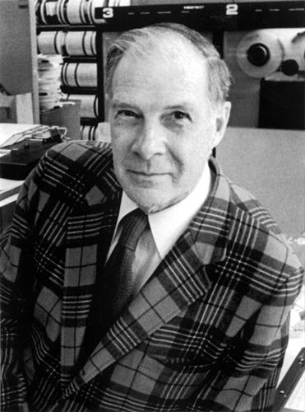
Block Code Principles
Hamming distance = difference in # of bits
p = 011011, q = 001111, Ham. distance (p,q) = 2
p = 011011,
q = 110001,
distance (p,q) = ?
Can think of extra bits as creating
a code with the data
What if minimum distance
between members of code is 2
and get a 1-bit error?
Richard Hamming, 1915-98
Turing Award Winner
Notes:
Distance is 3 of second case

Slide 15
Parity: Simple Error-Detection Coding
Each data value, before it is written to memory is “tagged” with an extra bit to force the stored word to have even parity:
Each word, as it is read from memory is “checked” by finding its parity (including the parity bit).
b₇b₆b₅b₄b₃b₂b₁b₀ p
b₇b₆b₅b₄b₃b₂b₁b₀
+
+
p
c
Minimum Hamming distance of parity code is 2
A non-zero parity indicates an error occurred:
  2 errors (on different bits) are not detected
  nor any even number of errors, just odd numbers of errors are detected

Slide 16
Parity Example
Data 0101 0101
4 ones, even parity now
Write to memory:
0101 0101 0
to keep parity even
Data 0101 0111
5 ones, odd parity now
Write to memory:
0101 0111 1
to make parity even
Read from memory
0101 0101 0
4 ones => even parity, so no error
Read from memory
1101 0101 0
5 ones => odd parity,
so error
What if error in parity bit?

Slide 17
Suppose Want to Correct 1 Error?
Richard Hamming came up with simple to understand mapping to allow Error Correction at minimum distance of 3
  Single error correction, double error detection
Called “Hamming ECC”
  Worked weekends on relay computer with unreliable card reader, frustrated with manual restarting
  Got interested in error correction; published 1950
  R. W. Hamming, “Error Detecting and Correcting Codes,” The Bell System Technical Journal, Vol. XXVI, No 2 (April 1950) pp 147-160.

Slide 18
Detecting/Correcting Code Concept
Space of possible bit patterns (2^{N})
Error changes bit pattern to
non-code
Sparse population of code words (2^{M} << 2^{N})
- with identifiable signature
Detection: bit pattern fails codeword check
Correction: map to nearest valid code word

Slide 19
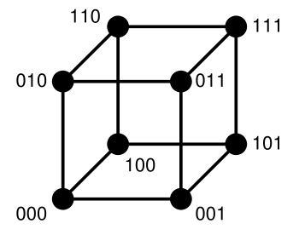
Hamming Distance: 8 code words

Slide 20
Hamming Distance 2: Detection
Detect Single Bit Errors
Invalid
Codes
No 1 bit error goes to another valid code
½ codes are valid

Slide 21
Hamming Distance 3: Correction
Correct Single Bit Errors, Detect Double Bit Errors
Nearest
111
(one 0)
Nearest
000
(one 1)
No 2 bit error goes to another valid code; 1 bit error near
1/4 codes are valid

Slide 22
Administrivia
Project 4 out now - due Monday @ 23:59:59
  Competition for glory + EC, awards during last lecture
    Due Sunday @ 23:59:59
HW6 Out – VM, I/O, Parity, ECC
Guerrilla Section on VM, I/O, ECC, tomorrow from 5-7pm, Woz

Slide 23
Administrivia
Upcoming Lecture Schedule
  8/05: Dependability: Parity, ECC, RAID (today)
    Last day of new material
  8/06: Final Exam Review, Fa14 Final
  8/10: Final Exam Review, Sp15 Final
  8/11: Summary, What’s Next? (+ HKN reviews)
    Project 4 Competition Winners Announced
  8/12: No Lecture, I’ll have OH in this room

Slide 24
Administrivia
Final Exam is next Thursday (8/13)
  9am-12pm, 10 Evans
  Three 8.5”x11”, double-sided, handwritten cheat-sheets
  Broken into MT1 section, MT2 section, and post-MT2 section (so that the clobber can be applied)
  TA Review Session: 08/09, 1-5pm, HP Aud.
  In-class review: 08/06, 08/10

Slide 25
Break

Slide 26
Hamming Error Correction Code
Use of extra parity bits to allow the position identification of a single error
Mark all bit positions that are powers of 2 as parity bits (positions 1, 2, 4, 8, 16, …)
  Start numbering bits at 1 at left (not at 0 on right)
2. All other bit positions are data bits
(positions 3, 5, 6, 7, 9, 10, 11, 12, 13, 14, 15, …)
3. Each data bit is covered by 2 or more parity bits

Slide 27
Hamming ECC
4. The position of parity bit determines sequence of data bits that it checks
Bit 1 (0001₂): checks bits (1,3,5,7,9,11,...)
  Bits with least significant bit of address = 1
Bit 2 (0010₂): checks bits (2,3,6,7,10,11,14,15,…)
  Bits with 2nd least significant bit of address = 1
Bit 4 (0100₂): checks bits (4-7, 12-15, 20-23, ...)
  Bits with 3rd least significant bit of address = 1
Bit 8 (1000₂): checks bits (8-15, 24-31, 40-47 ,...)
  Bits with 4th least significant bit of address = 1

Slide 28
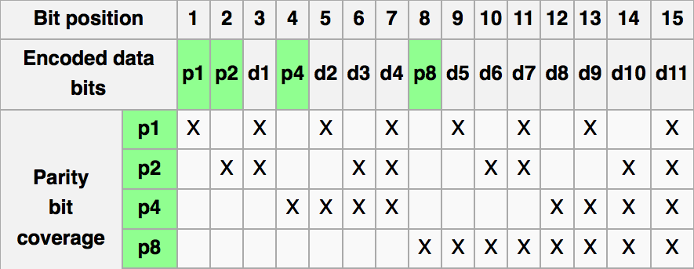
Graphic of Hamming Code
http://en.wikipedia.org/wiki/Hamming_code

Slide 29
Hamming ECC
5. Set parity bits to create even parity for each group
A byte of data: 10011010
Create the coded word, leaving spaces for the parity bits:
_ _ 1 _ 0 0 1 _ 1 0 1 0
0 0 0 0 0 0 0 0 0 1 1 1
1 2 3 4 5 6 7 8 9 0 1 2
Calculate the parity bits
Notes:
Do this on the white board

Slide 30
Hamming ECC
Position 1 checks bits 1,3,5,7,9,11 (bold):
? _ 1 _ 0 0 1 _ 1 0 1 0. set position 1 to a _:
_ _ 1 _ 0 0 1 _ 1 0 1 0
Position 2 checks bits 2,3,6,7,10,11 (bold):
0 ? 1 _ 0 0 1 _ 1 0 1 0. set position 2 to a _:
0 _ 1 _ 0 0 1 _ 1 0 1 0
Position 4 checks bits 4,5,6,7,12 (bold):
0 1 1 ? 0 0 1 _ 1 0 1 0. set position 4 to a _:
0 1 1 _ 0 0 1 _ 1 0 1 0
Position 8 checks bits 8,9,10,11,12:
0 1 1 1 0 0 1 ? 1 0 1 0. set position 8 to a _:
0 1 1 1 0 0 1 _ 1 0 1 0
Notes:
Do this on white board.
Bit 1 is 0
Bit 2 is 1
Bit 4 is 1

Slide 31
Hamming ECC
Position 1 checks bits 1,3,5,7,9,11:
? _ 1 _ 0 0 1 _ 1 0 1 0. set position 1 to a 0:
0 _ 1 _ 0 0 1 _ 1 0 1 0
Position 2 checks bits 2,3,6,7,10,11:
0 ? 1 _ 0 0 1 _ 1 0 1 0. set position 2 to a 1:
0 1 1 _ 0 0 1 _ 1 0 1 0
Position 4 checks bits 4,5,6,7,12:
0 1 1 ? 0 0 1 _ 1 0 1 0. set position 4 to a 1:
0 1 1 1 0 0 1 _ 1 0 1 0
Position 8 checks bits 8,9,10,11,12:
0 1 1 1 0 0 1 ? 1 0 1 0. set position 8 to a 0:
0 1 1 1 0 0 1 0 1 0 1 0

Slide 32
Hamming ECC
Final code word: 011100101010
Data word: 1 001 1010
Notes:
Bit 8 set to 0

Slide 33
Hamming ECC Error Check
Suppose receive
011100101110
0 1 1 1 0 0 1 0 1 1 1 0

Slide 34
Hamming ECC Error Check
Suppose receive
011100101110

Slide 35
Hamming ECC Error Check
Suppose receive
011100101110
0 1 0 1 1 1 √
11 01 11 X-Parity 2 in error
1001 0 √
01110 X-Parity 8 in error
Implies position 8+2=10 is in error
011100101110

Slide 36
Hamming ECC Error Correct
Flip the incorrect bit …
011100101010

Slide 37
Hamming ECC Error Correct
Suppose receive
011100101010
0 1 0 1 1 1 √
11 01 01 √
1001 0 √
01010 √

Slide 38
Hamming ECC
Finding and fixing a corrupted bit:
Suppose receive 011100101110
123456789012
Parity 1_, Parity 2_, Parity 4_, Parity 8_
(Bits numbers xxx1_{two}, xx1x_{two}, x1xx_{two}, 1xxx_{two})
Parity bits 2 and 8 incorrect. As 2 + 8 = 10,
bit position 10 is location of bad bit: flip value!
Corrected value: 011100101010
Why does Hamming ECC work?
Notes:
Do on the blackboard
Bit 8: 8, 9, 10, 11, 12 = 01110 => 1
Bit 4: 4, 5, 6, 7, 12 = 10010 => 0
Bit 2: 2,3, 6,7, 10,11 = 110111 => 1
Bit 1: 1, 3, 5, 7, 9, 11 = 010111 => 0
Bit with error is 1010two =10
Flipping bit 10 should make all groups 0 => no error
Bit 8: 8, 9, 10, 11, 12 = 01010 => 0
Bit 4: 4, 5, 6, 7, 12 = 10010 => 0
Bit 2: 2,3, 6,7, 10,11 = 110101 => 0
Bit 1: 1, 3, 5, 7, 9, 11 = 010111 => 0
Bit with error is 0000two = 0 => no bit has error (bits start at 1)

Slide 39
Hamming Error Correcting Code
Overhead involved in single error-correction code
Let p be total number of parity bits and d number of data bits in p + d bit word
If p error correction bits are to point to error bit (p + d cases) + indicate that no error exists (1 case), we need:
  2^{p} >= p + d + 1,
  thus p >= log(p + d + 1)
  for large d, p approaches log(d)
8 bits data => d = 8, 2^{p} = p + 8 + 1 => p = 4
16 data => 5 parity,
32 data => 6 parity,
64 data => 7 parity

Slide 40
Hamming Single-Error Correction,
Double-Error Detection (SEC/DED)
Adding extra parity bit covering the entire word provides double error detection as well as single error correction
1 2 3 4 5 6 7 8
p₁ p₂ d₁ p₃ d₂ d₃ d₄ p₄
Hamming parity bits H (p₁ p₂ p₃) are computed (even parity as usual) plus the even parity over the entire word, p₄:
H=0 p₄=0, no error
H≠0 p₄=1, correctable single error (odd parity if 1 error => p₄=1)
H≠0 p₄=0, double error occurred (even parity if 2 errors=> p₄=0)
H=0 p₄=1, single error occurred in p₄ bit, not in rest of word
Typical modern codes in DRAM memory systems:
64-bit data blocks (8 bytes) with 72-bit code words (9 bytes).

Slide 41
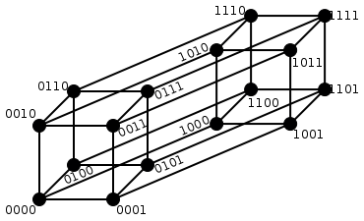
Hamming Single
Error Correction
+ Double
Error Detection
Hamming Distance = 4
1 bit error (one 0)
Nearest 1111
2 bit error
(two 0s, two 1s)
Halfway
Between Both
1 bit error (one 1)
Nearest 0000
Notes:
1 bit error from 0000, all numbers with one 1
1 bit error from 1111, all numbers with one 0
2 bit error from 0000, all numbers with two 1s and two 0s
2 bit error from 1111, all numbers with two 1s and two 0s

Slide 42
What if More Than 2-Bit Errors?
Network transmissions, disks, distributed storage common failure mode is bursts of bit errors, not just one or two bit errors
  Contiguous sequence of B bits in which first, last and any number of intermediate bits are in error
  Caused by impulse noise or by fading in wireless
  Effect is greater at higher data rates

Slide 43
Cyclic Redundancy Check
Simple example: Parity Check Block
Data
10011010
01101100
11110000
00101101
11011100
00111100
11111100
00001100
00111011
10011010
01101100
11110000
00000000
11011100
00111100
11111100
00001100
00111011
Check
00000000
0 = Check!
00101101
Not 0 = Fail!

Slide 44

Cyclic Redundancy Check
Parity codes not powerful enough to detect long runs of errors (also known as burst errors)
Better Alternative: Reed-Solomon Codes
  Used widely in CDs, DVDs, Magnetic Disks
  RS(255,223) with 8-bit symbols: each codeword contains 255 code word bytes (223 bytes are data and 32 bytes are parity)
  For this code: n = 255, k = 223, s = 8, 2t = 32, t = 16
  Decoder can correct any errors in up to 16 bytes anywhere in the codeword

Slide 45
Cyclic Redundancy Check
For block of k bits, transmitter generates an
n-k bit frame check sequence
Transmits n bits exactly divisible by some number
Receiver divides frame by that number
  If no remainder, assume no error
  Easy to calculate division for some binary numbers with shift register
Disks detect and correct blocks of 512 bytes with called Reed Solomon codes ≈ CRC

Slide 46
Cyclic Redundancy Check
14 data bits
3 check bits
17 bits total
11010011101100 000 <--- input right padded by 3 bits
1011 <--- divisor
01100011101100 000 <--- result
1011 <--- divisor
00111011101100 000
1011
00010111101100 000
1011
00000001101100 000 <--- skip leading zeros
1011
00000000110100 000
1011
00000000011000 000
1011
00000000001110 000
1011
00000000000101 000
101 1
-----------------
00000000000000 100 <--- remainder
3 bit CRC using the
polynomial x³ + x + 1
(divide by 1011 to get remainder)

Slide 47
Break

Slide 48

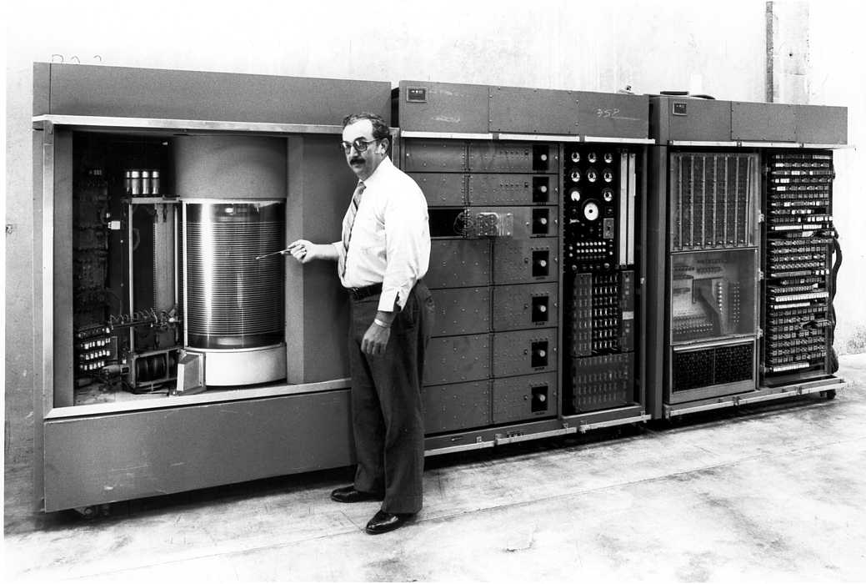
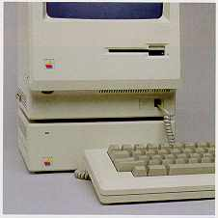
Evolution of the Disk Drive
IBM 3390K, 1986
IBM RAMAC 305, 1956
Apple SCSI, 1986

Slide 49
Arrays of Small Disks
  Can smaller disks be used to close gap in performance between disks and CPUs?
Conventional: 4 disk designs
3.5”
5.25”
10”
14”
Low End
High End
Disk Array:
1 disk design
3.5”

Slide 50
Replace Small Number of Large Disks with Large Number of Small Disks! (1988 Disks)
IBM 3390K
20 GBytes
97 cu. ft.
3 KW
15 MB/s
600 I/Os/s
250 KHrs
$250K
IBM 3.5" 0061
320 MBytes
0.1 cu. ft.
11 W
1.5 MB/s
55 I/Os/s
50 KHrs
$2K
x70
23 GBytes
11 cu. ft.
1 KW
120 MB/s
3900 IOs/s
??? Hrs
$150K
Capacity
Volume
Power
Data Rate
I/O Rate
MTTF
Cost
9X
3X
8X
6X
Disk Arrays have potential for large data and I/O rates, high MB per cu. ft., high MB per KW, but what about reliability?

Slide 51
RAID: Redundant Arrays of (Inexpensive) Disks
Files are "striped" across multiple disks
Redundancy yields high data availability
  Availability: service still provided to user, even if some components failed
Disks will still fail
Contents reconstructed from data redundantly stored in the array
  ⇒ Capacity penalty to store redundant info
  ⇒ Bandwidth penalty to update redundant info

Slide 52
Redundant Arrays of Inexpensive Disks
RAID 1: Disk Mirroring/Shadowing
recovery
group
• Each disk is fully duplicated onto its “mirror”
Very high availability can be achieved
• Bandwidth sacrifice on write:
Logical write = two physical writes
  Reads may be optimized
• Most expensive solution: 100% capacity overhead

Slide 53
Redundant Array of Inexpensive Disks RAID 3: Parity Disk
10010011
11001101
10010011
. . .
P
1
0
1
0
0
0
1
1
1
1
0
0
1
1
0
1
1
0
1
0
0
0
1
1
1
1
0
0
1
1
0
1
logical record
Striped physical
records
P contains sum of
other disks per stripe
mod 2 (“parity”)
If disk fails, subtract
P from sum of other
disks to find missing information

Slide 54
Redundant Arrays of Inexpensive Disks RAID 4: High I/O Rate Parity
D0
D1
D2
D3
Increasing
Logical
Disk
Address
P
Insides of 5 disks
D4
D5
D6
D7
P
D8
D9
D10
D11
P
Example: small read D0 & D5, large write D12-D15
D12
D13
D14
D15
P
Stripe
D16
D17
D18
D19
P
D20
D21
D22
D23
P
.
.
.
.
.
.
.
.
.
.
.
.
.
.
.
Disk Columns

Slide 55
Inspiration for RAID 5
RAID 4 works well for small reads
Small writes (write to one disk):
  Option 1: read other data disks, create new sum and write to Parity Disk
  Option 2: since P has old sum, compare old data to new data, add the difference to P
Small writes are limited by Parity Disk: Write to D0, D5 both also write to P disk
D0
D1
D2
D3
P
D4
D5
D6
D7
P

Slide 56
RAID 5: High I/O Rate Interleaved Parity
D0
D1
D2
D3
P
Increasing
Logical
Disk
Addresses
Independent writes
possible because of
interleaved parity
D4
D5
D6
P
D7
D8
D9
P
D10
D11
D12
P
D13
D14
D15
P
D16
D17
D18
D19
Example: write to D0, D5 uses disks 0, 1, 3, 4
D20
D21
D22
D23
P
.
.
.
.
.
.
.
.
.
.
.
.
.
.
.
Disk Columns

Slide 57
Problems of Disk Arrays: Small Writes
RAID-5: Small Write Algorithm
1 Logical Write = 2 Physical Reads + 2 Physical Writes
D0'
D0
D1
D2
D3
P
new
data
old
data
old
parity
(1. Read)
(2. Read)
+
XOR
+
XOR
(3. Write)
(4. Write)
D0'
D1
D2
D3
P'

Slide 58
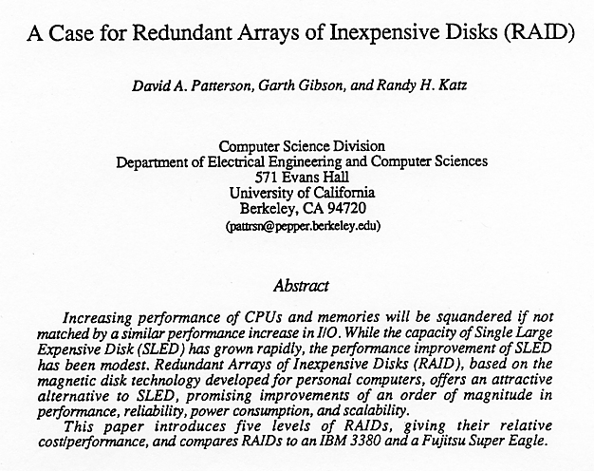
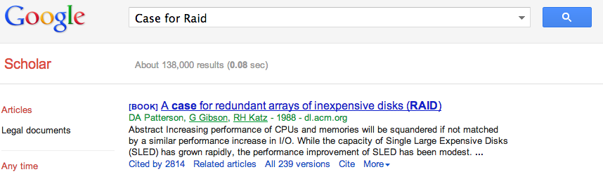
Tech Report Read ‘Round the World
(December 1987)

Slide 59
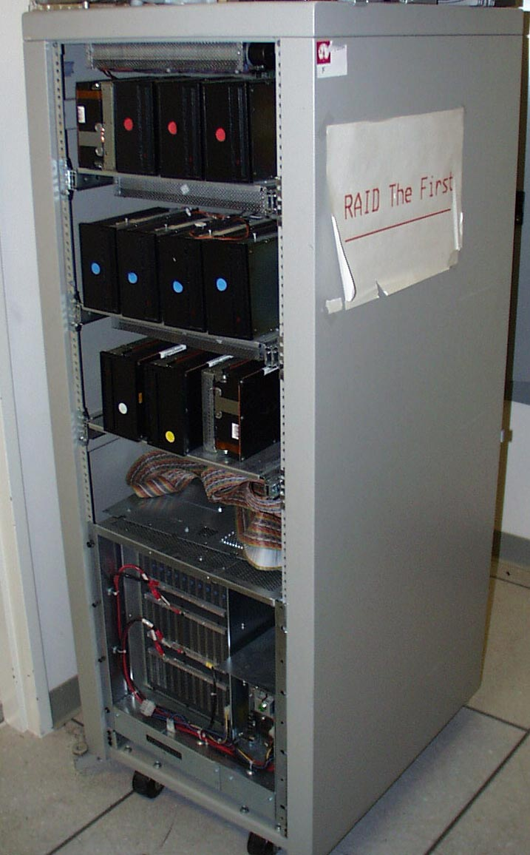
RAID-I
RAID-I (1989)
  Consisted of a Sun 4/280 workstation with 128 MB of DRAM, four dual-string SCSI controllers, 28 5.25-inch SCSI disks and specialized disk striping software

Slide 60
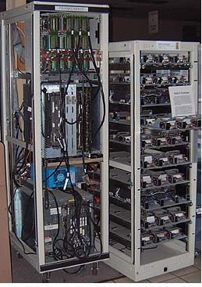
RAID II
1990-1993
Early Network Attached Storage (NAS) System running a Log Structured File System (LFS)
Impact:
  $25 Billion/year in 2002
  Over $150 Billion in RAID device sold since 1990-2002
  200+ RAID companies (at the peak)
  Software RAID a standard component of modern OSs

Slide 61
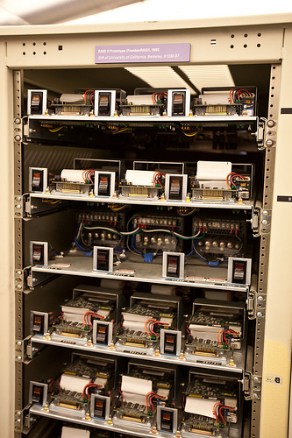
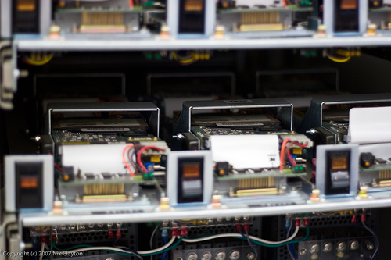
RAID II

Slide 62
iClicker Question
Which of the following is true?
A. As we add more hardware to a datacenter, the probability of individual failures decreases
B. Availability is determined by MTTR only
C. Availability = MTTF / (MTTF + MTTR)
D. An n-bit value encoded with a Hamming code always takes up n+3 bits when encoded
E. Redundancy is a non-issue in datacenter environments

Slide 63
And, in Conclusion, …
Great Idea: Redundancy to Get Dependability
  Spatial (extra hardware) and Temporal (retry if error)
Reliability: MTTF & Annualized Failure Rate (AFR)
Availability: % uptime (MTTF-MTTR/MTTF)
Memory
  Hamming distance 2: Parity for Single Error Detect
  Hamming distance 3: Single Error Correction Code + encode bit position of error
Treat disks like memory, except you know when a disk has failed—erasure makes parity an Error Correcting Code
RAID-2, -3, -4, -5: Interleaved data and parity

