Slide 1
EE130/230A Discussion 1
Peng Zheng

Slide 2
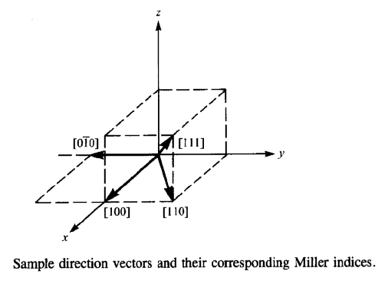
Crystallographic Notation
Miller Indices:
Notation | Interpretation
( h k l ) | crystal plane
{ h k l } | equivalent planes
[ h k l ] | crystal direction
< h k l > | equivalent directions
h: inverse x-intercept of plane
k: inverse y-intercept of plane
l: inverse z-intercept of plane
(Intercept values are in multiples of the lattice constant;
h, k and l are reduced to 3 integers having the same ratio.)
EE130/230A Fall 2013
Lecture 1, Slide 2
Notes:
<100> equivalent directions for [100], [010] and [001]
<110> equivalent directions for [110], [101] and [011]
Give examples of Miller indices for the <100>, <110>, and <111> directions
[ h k l]: projection to each axis.
[h k l ] crystal direction ┴ (h k l) crystal plane

Slide 3
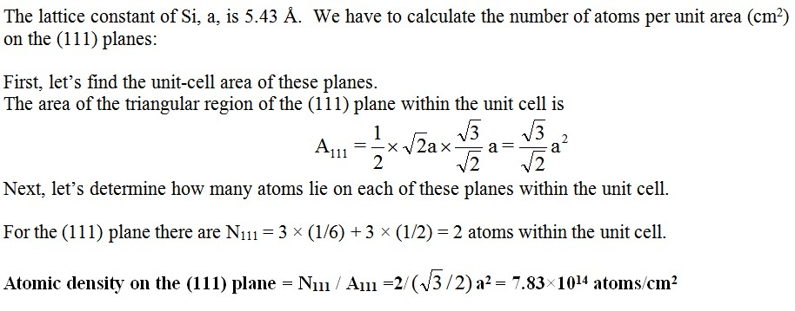
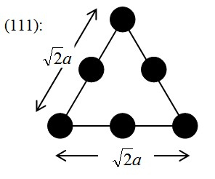
Areal Density of Atoms for the (111) Plane

Slide 4
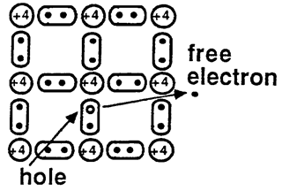
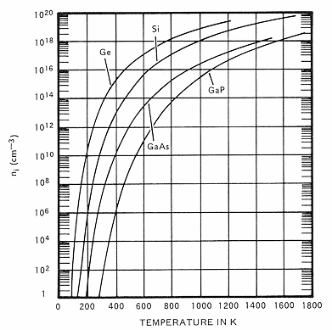
Intrinsic Carrier Concentration, n_{i}
conduction
At temperatures > 0 K, some electrons will be freed from covalent bonds, resulting in electron-hole pairs.
For Si: n_{i} ≅ 10¹⁰ cm⁻³ at room temperature
EE130/230A Fall 2013
Lecture 1, Slide 4

Slide 5
Intrinsic Carrier Concentration
T = 300K, n_{i} = 1.0× 10¹⁰
T = 330K, n_{i} = 7.1× 10¹⁰
T = 270K, n_{i} = 9.2× 10⁸
10% change in T, ~1 order of magnitude change in n_{i.}
n_{i} for Si is a very sensitive function of temperature.
Effective Densities of States at the Band Edges (@ 300K)
 | Si | Ge | GaAs
N_{c} (cm⁻³) | 2.82 × 10¹⁹ | 1.05 × 10¹⁹ | 4.37 × 10¹⁷
N_{v} (cm⁻³) | 1.83 × 10¹⁹ | 3.92 × 10¹⁸ | 8.12 × 10¹⁸
EE130/230A Fall 2013
Lecture 3, Slide 5
Notes:
show that ni for Si is a very sensitive function of temperature, and discuss why this is the case;

