Slide 1
EE130/230A Discussion 10
Peng Zheng

Slide 2
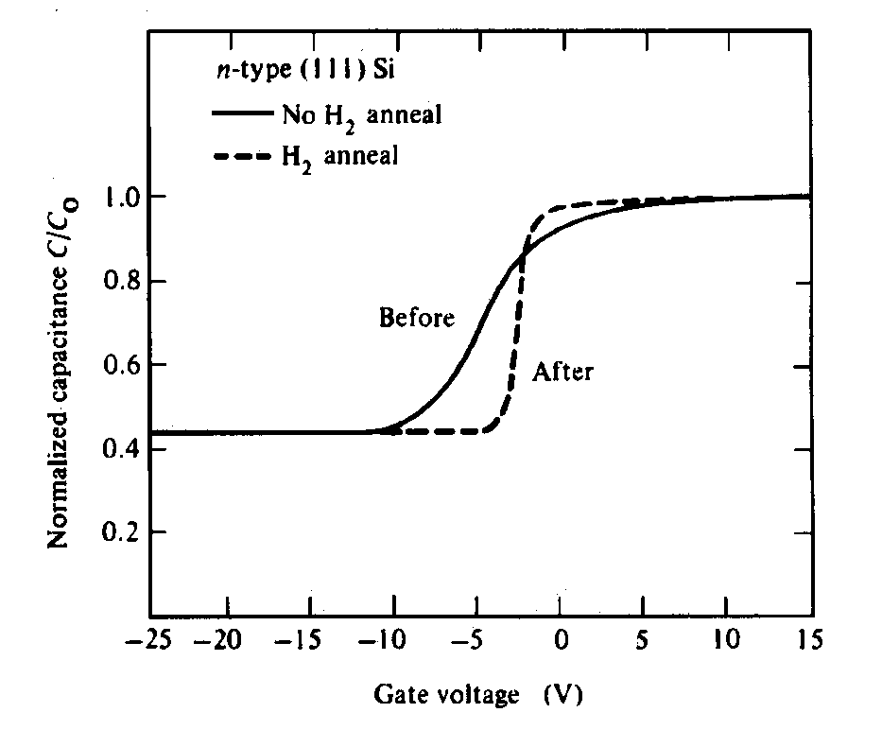
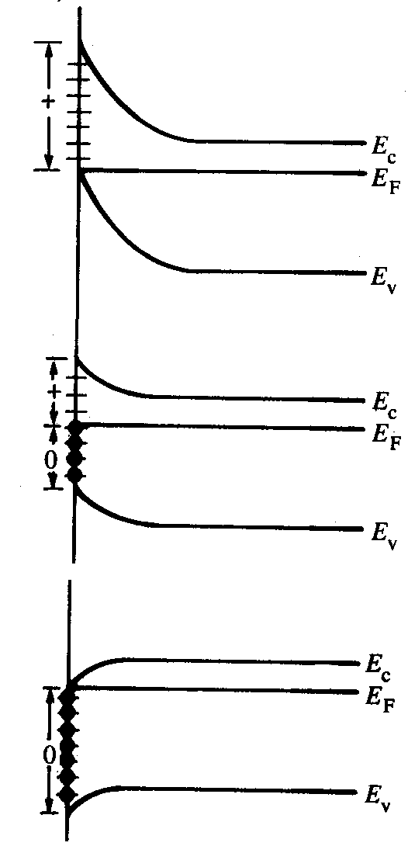
Interface Trap Charge, Q_{IT}
“Donor-like” traps are
charge-neutral when
filled, positively charged
when empty
Positive oxide charge
causes C-V curve to
shift toward left.
As V_{G} decreases, there is more positive interface charge and hence the “ideal C-V curve” is shifted more to the left.
(c)
(a)
(b)
(a)
(b)
R. F. Pierret, Semiconductor Device Fundamentals, Fig. 18.10
(c)
Traps cause “sloppy” C-V and also greatly degrade mobility in channel
(a)→(c) : inversion→depletion→accumulation
EE130/230A Fall 2013
Lecture 18, Slide 2
R. F. Pierret, Semiconductor Device Fundamentals, Fig. 18.12

Slide 3
Poly-Si Gate Technology
A heavily doped film of polycrystalline silicon (poly-Si) is often employed as the gate-electrode material in MOS devices.
There are practical limits to the electrically active dopant concentration (usually less than 1x10²⁰ cm⁻³)
The gate must be considered as a semiconductor, rather than a metal
NMOS
PMOS
n⁺ poly-Si
p⁺ poly-Si
p-type Si
n-type Si
EE130/230A Fall 2013
Lecture 18, Slide 3

Slide 4
MOS Band Diagram w/o Gate Depletion
M
O
S
qV_{ox}
W_{T}
qφ_{F}
E_{c}
qφ_{F}
E_{FS}
qφ_{s}
E_{v}
qV_{G}
E_{c}= E_{FM}
E_{v}
EE130/230A Fall 2013
Lecture 16, Slide 4

Slide 5
MOS Band Diagram w/ Gate Depletion
Si biased to inversion:
W_{T}
V_{G} is effectively reduced:
E_{c}
E_{FS}
qφ_{S}
E_{v}
qV_{poly}
qV_{G}
E_{c}
E_{v}
W_{poly}
How can gate depletion
be minimized?
n+ poly-Si gate
p-type Si
EE130/230A Fall 2013
Lecture 18, Slide 5

Slide 6
Gate Depletion Effect
Gauss’s Law dictates that W_{poly} = ε_{ox}E_{ox} / qN_{poly}
x_{o} is effectively increased:
n+ poly-Si
C_{poly}
+
+
+
+
+
+
+
+
C_{ox}
N+
-
-
-
-
-
-
-
-
-
p-type Si
EE130/230A Fall 2013
Lecture 18, Slide 6

Slide 7
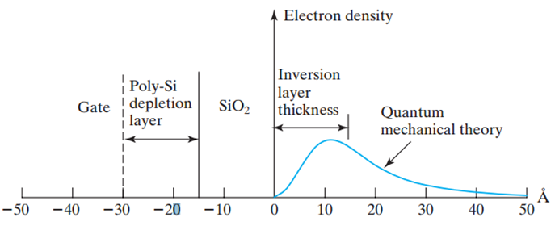
Inversion-Layer Thickness, T_{inv}
The average inversion-layer location below the Si/SiO₂ interface is called the inversion-layer thickness, T_{inv} .
C. C. Hu, Modern Semiconductor Devices for Integrated Circuits, Figure 5-24
EE130/230A Fall 2013
Lecture 18, Slide 7

Slide 8
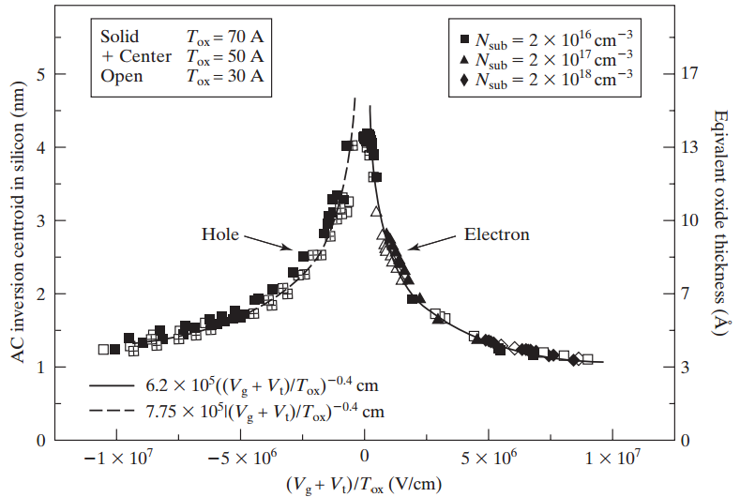
Effective Oxide Thickness, T_{oxe}
(V_{G} + V_{T})/T_{oxe} can be shown to be the average electric field in the inversion layer. T_{inv} of holes is larger than that of electrons due to difference in effective masses.
EE130/230A Fall 2013
Lecture 18, Slide 8
C. C. Hu, Modern Semiconductor Devices for Integrated Circuits, Figure 5-25

Slide 9
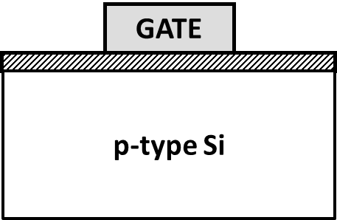
MOS Capacitor vs. MOS Transistor C-V (p-type Si)
C
MOS transistor at any f,
MOS capacitor at low f, or
quasi-static C-V
C_{max}=C_{ox}
C_{FB}
MOS capacitor at high f
C_{min}
V_{G}
accumulation
depletion
inversion
V_{FB}
V_{T}
EE130/230A Fall 2013
Lecture 17, Slide 9

Slide 10
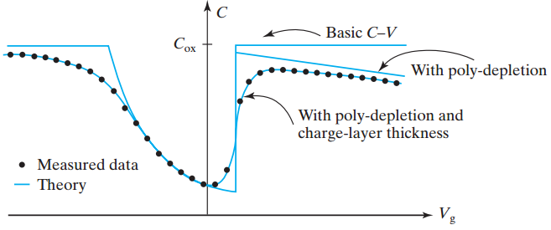
Effective Oxide Capacitance, C_{oxe}
EE130/230A Fall 2013
Lecture 18, Slide 10
C. C. Hu, Modern Semiconductor Devices for Integrated Circuits, Figure 5-26

Slide 11
MOSFET Linear Region of Operation
For small values of V_{DS} (i.e. for V_{DS} << V_{G}−V_{T}),
where μ_{eff} is the effective carrier mobility
Hence the NMOSFET can be modeled as a resistor:
EE130/230A Fall 2013
Lecture 19, Slide 11

Slide 12
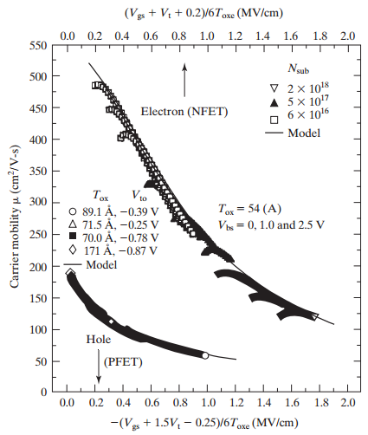
Field-Effect Mobility, μ_{eff}
Scattering mechanisms:
Coulombic scattering
phonon scattering
surface roughness
scattering
EE130/230A Fall 2013
Lecture 19, Slide 12
C. C. Hu, Modern Semiconductor Devices for Integrated Circuits, Figure 6-9

Slide 13
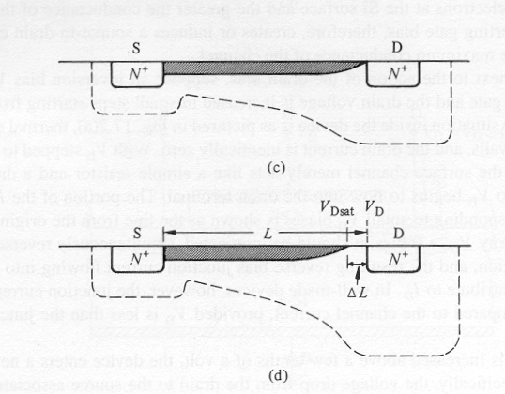
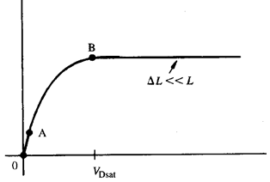
MOSFET Saturation Region of Operation
V_{DS} = V_{GS}-V_{T}
V_{DS} > V_{GS}-V_{T}
When V_{D} is increased to be equal to V_{G}-V_{T}, the inversion-layer charge density at the drain end of the channel equals 0, i.e. the channel becomes “pinched off”
As V_{D} is increased above V_{G}-V_{T}, the length ΔL of the “pinch-off” region increases. The voltage applied across the inversion layer is always V_{Dsat}=V_{GS}-V_{T}, and so the current saturates.
I_{D}
V_{DS}
Lecture 19, Slide 13
R. F. Pierret, Semiconductor Device Fundamentals, Figs. 17.2, 17-3

Slide 14
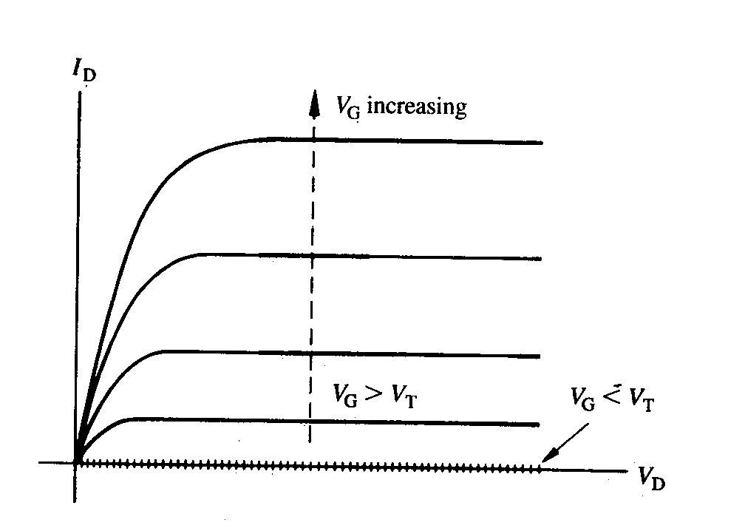
Ideal NMOSFET I-V Characteristics
EE130/230A Fall 2013
Lecture 19, Slide 14
R. F. Pierret, Semiconductor Device Fundamentals, Fig. 17.4

