Slide 1
EE130/230A Discussion 11
Peng Zheng

Slide 2
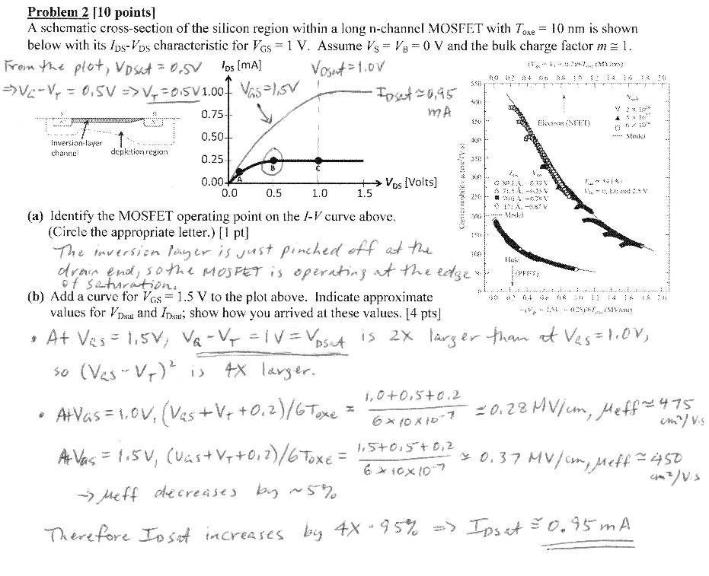
Sample MOSFET I-V problem-Quiz 5 SP2013

Slide 3
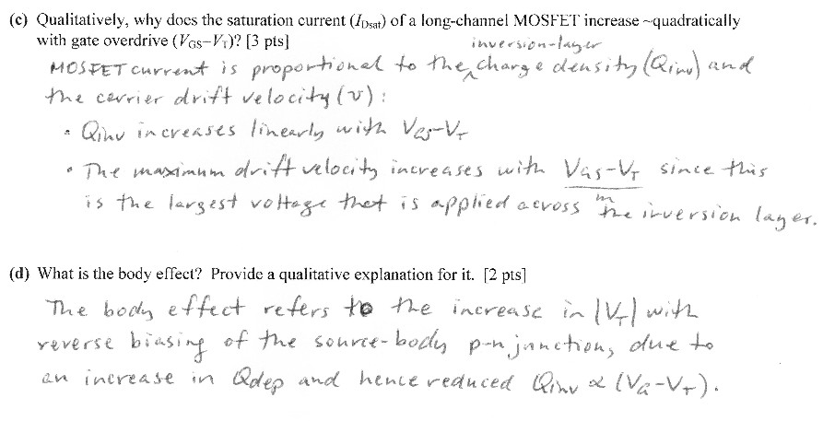
Sample MOSFET I-V problem-Quiz 5 SP2013

Slide 4
Problem with “Square Law Theory”
Ignores variation in depletion width with distance y:
where
EE130/230A Fall 2013
Lecture 20, Slide 4

Slide 5
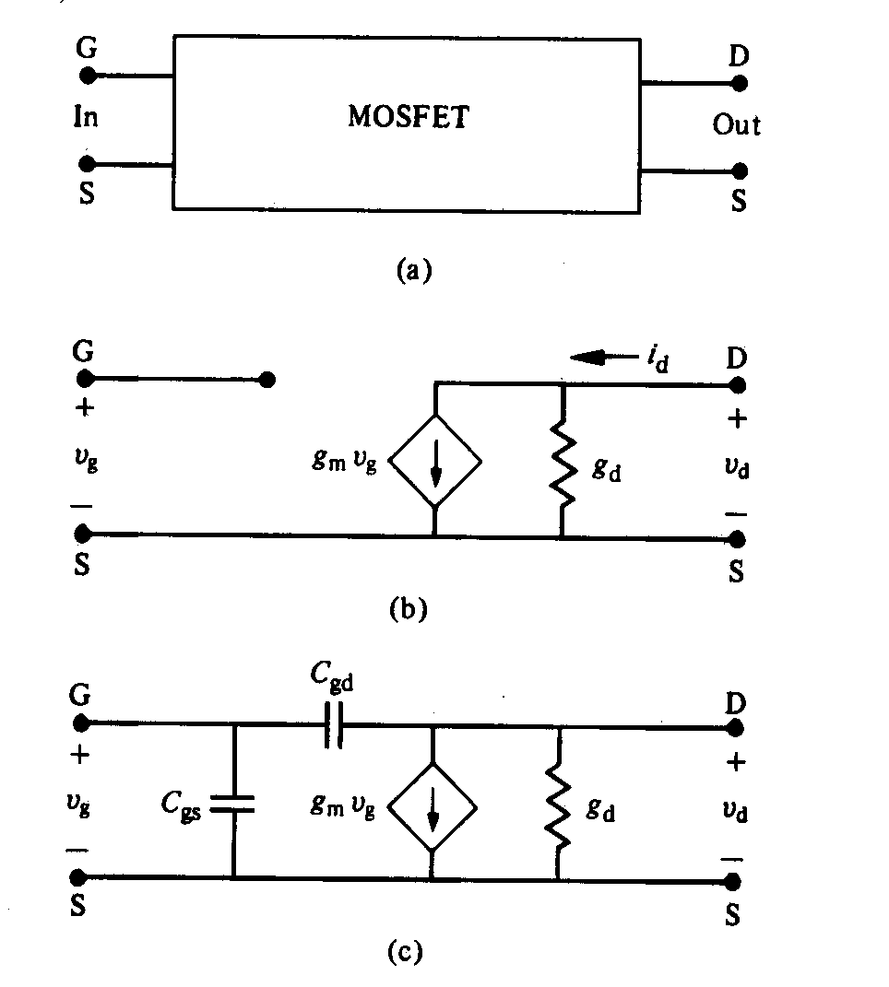
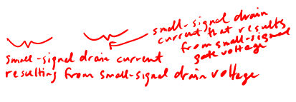
MOSFET Small Signal Model (Saturation Region)
A small change in V_{G} or V_{DS} will result in a small change in I_{D}
Conductance parameters:
low-frequency:
high-frequency:
R. F. Pierret, Semiconductor Device Fundamentals, Fig. 17.12
EE130/230A Fall 2013
Lecture 21, Slide 5

Slide 6
Transconductance and Output Conductance
We hope to maximize transconductance g_{m}
and minimize output conductance g_{d}.
How?
In order to maximize the transconductance g_{m} of an n-channel MOSFET:
The equivalent gate oxide thickness (T_{oxe}) should be decreased to increase the capacitive coupling between the gate and the inversion-layer channel.
Although µ_{eff} decreases with decreasing T_{oxe}, C_{oxe} and (V_{GS} –V_{T}) each increase (since V_{T}
decreases) while m decreases with decreasing T_{oxe}.
The channel/body dopant concentration (N_{A}) should be decreased to increase µ_{eff} and to decrease the capacitive coupling between the inversion-layer channel and the body, i.e. to decrease the body effect, so that (V_{GS} –V_{T}) increases and m decreases.
The channel length (L) should be decreased to increase the saturation bias current and hence the change in saturation current for a given change in gate voltage.
In order to minimize the output conductance g_{d} an n-channel MOSFET:
Channel Length Modulation

Slide 7
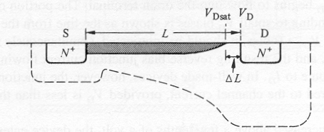
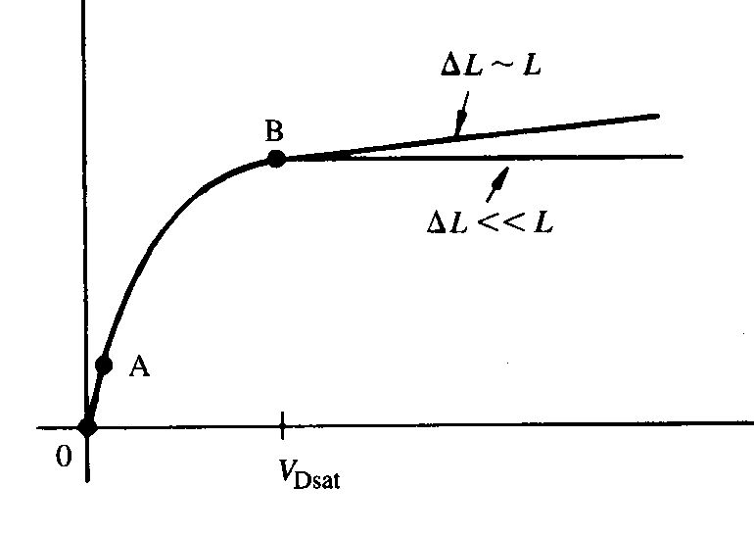
Channel Length Modulation
As V_{DS} is increased above V_{Dsat}, the width ΔL of the depletion region between the pinch-off point and the drain increases, i.e. the inversion layer length decreases.
If ΔL is significant compared to L, then I_{DS} will increase slightly with increasing V_{DS}>V_{Dsat}, due to “channel-length modulation”
I_{DS}
V_{DS}
EE130/230A Fall 2013
Lecture 19, Slide 7
R. F. Pierret, Semiconductor Device Fundamentals, Figs. 17.2, 17-3

Slide 8
Sub-Threshold Current
For |V_{G}| < |V_{T}|, MOSFET current flow is limited by carrier diffusion into the channel region.
The electric potential in the channel region varies linearly with V_{G}, according to the capacitive voltage divider formula:
As the potential barrier to diffusion increases linearly with decreasing V_{G}, the diffusion current decreases exponentially:
EE130/230A Fall 2013
Lecture 21, Slide 8

Slide 9
Sub-Threshold Swing, S
log I_{D}
Inverse slope is subthreshold swing, S
[mV/dec]
NMOSFET Energy Band Profile
V_{GS}
0
V_{T}
n(E) ∝ exp(-E/kT)
increasing E
Source
increasing
V_{GS}
Drain
distance
EE130/230A Fall 2013
Lecture 21, Slide 9

Slide 10
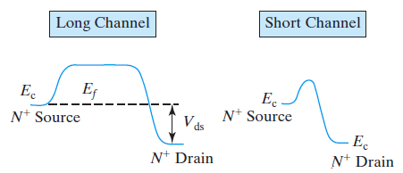
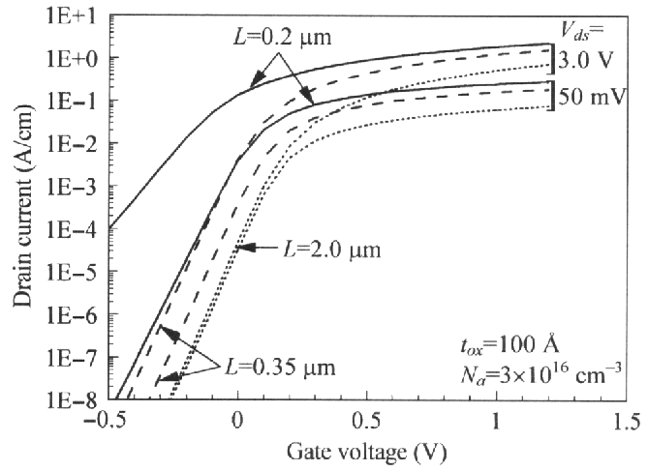
Drain Induced Barrier Lowering (DIBL)
As the source and drain get closer, they become electrostatically coupled, so that the drain bias can affect the potential barrier to carrier diffusion at the source junction.
→ V_{T} decreases (i.e. OFF state leakage current increases)
C. C. Hu, Modern Semiconductor Devices for Integrated Circuits, Figure 7-5
EE130/230A Fall 2013
Lecture 22, Slide 10
Notes:
The extreme case of SCE
Short-channel MOSFET Id-Vg: DIBL & S degradation -> Ioff increasing

Slide 11
Questions regarding project? Good luck to Quiz#5!

