Slide 1
EE130/230A Discussion 12
Peng Zheng

Slide 2
Velocity Saturation
Velocity saturation limits I_{Dsat} in sub-micron MOSFETS
Simple model:
E_{sat} is the electric field at velocity saturation:
for ε < ε _{sat}
for ε ≥ ε_{sat}
EE130/230A Fall 2013
Lecture 22, Slide 2

Slide 3
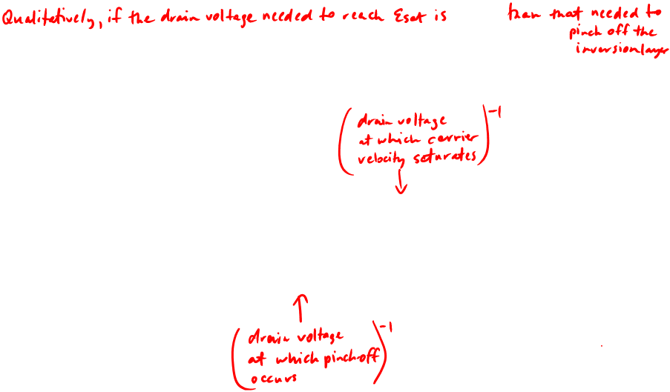
Drain Saturation Voltage, V_{Dsat}
If ε_{sat}L >> V_{GS}-V_{T} then the MOSFET is considered “long-channel”. This condition can be satisfied when
L is large, or
V_{GS} is close to V_{T}
Current saturation is limited by 2 mechanisms:
Pinch-off
Velocity saturation
EE130/230A Fall 2013
Lecture 22, Slide 3

Slide 4
Example: Drain Saturation Voltage
Question: For V_{GS} = 1.8 V, find V_{Dsat} for an NMOSFET with T_{oxe} = 3 nm, V_{T} = 0.25 V, and W_{T} = 45 nm, if L =
(a) 10 μm, (b) 1 μm, (c) 0.1 μm (d) 0.05 μm
Solution: From V_{GS} , V_{T} and T_{oxe}, μ_{eff} is 200 cm²V⁻¹s⁻¹.
E_{sat}= 2v_{sat} / μ_{eff} = 8 ×10⁴ V/cm
m = 1 + 3T_{oxe}/W_{T} = 1.2
EE130/230A Fall 2013
Lecture 22, Slide 4

Slide 5
(a) L = 10 μm: V_{Dsat}= (1/1.3V + 1/80V)⁻¹ = 1.3 V
(b) L = 1 μm: V_{Dsat}= (1/1.3V + 1/8V)⁻¹ = 1.1 V
(c) L = 0.1 μm: V_{Dsat}= (1/1.3V + 1/.8V)⁻¹ = 0.5 V
(d) L = 0.05 μm: V_{Dsat}= (1/1.3V + 1/.4V)⁻¹ = 0.3 V
EE130/230A Fall 2013
Lecture 22, Slide 5

Slide 6
MOSFET I-V with Velocity Saturation
In the linear region:
EE130/230A Fall 2013
Lecture 22, Slide 6

Slide 7
I_{Dsat} with Velocity Saturation
Substituting V_{Dsat} for V_{DS} in the linear-region I_{D} equation gives
For very short L:
I_{Dsat} is proportional to V_{GS}–V_{T} rather than (V_{GS} – V_{T})²
I_{Dsat} is not dependent on L
EE130/230A Fall 2013
Lecture 22, Slide 7

Slide 8
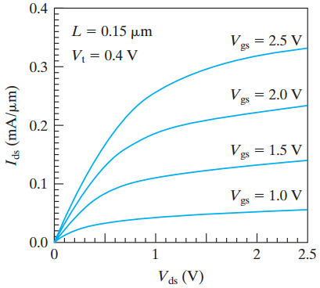
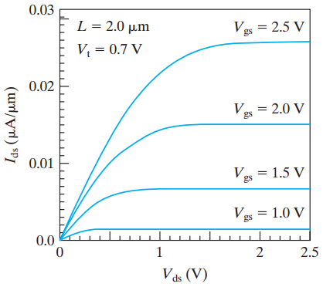
Short- vs. Long-Channel NMOSFET
Short-channel NMOSFET:
I_{Dsat} is proportional to V_{GS}-V_{Tn} rather than (V_{GS}-V_{Tn})²
V_{Dsat} is lower than for long-channel MOSFET
Channel-length modulation is apparent
EE130/230A Fall 2013
Lecture 22, Slide 8
C. C. Hu, Modern Semiconductor Devices for Integrated Circuits, Figure 6-23

Slide 9
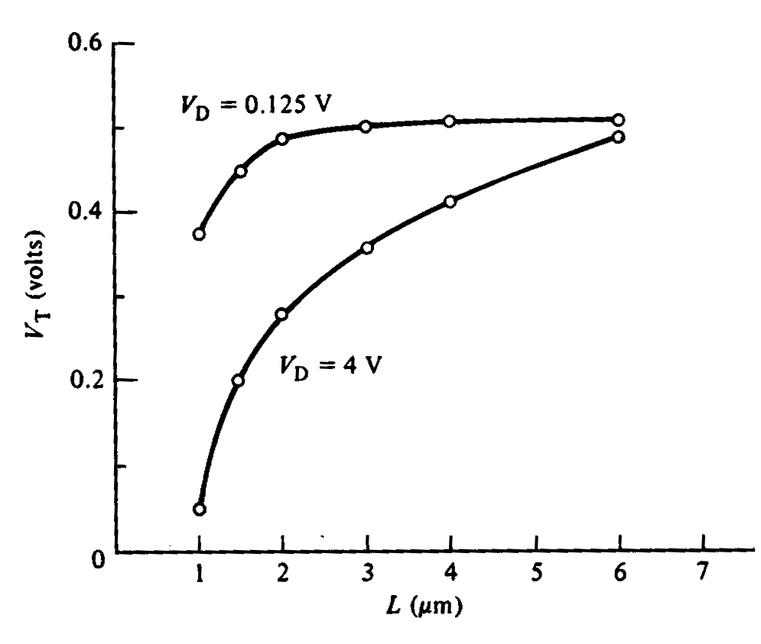
The Short Channel Effect (SCE)
R. F. Pierret, Semiconductor Device Fundamentals, Fig. 19.3
“V_{T} roll-off”
|V_{T}| decreases with L
Effect is exacerbated by
high values of |V_{DS}|
This effect is undesirable (i.e. we want to minimize it!) because circuit designers would like V_{T} to be invariant with transistor dimensions and bias condition
EE130/230A Fall 2013
Lecture 22, Slide 9

Slide 10
The smaller L is, the greater the percentage of depletion charge balanced by the S/D pn junctions:
depletion
charge
supported
by gate
(simplified
analysis)
V_{G}
n⁺
n⁺
r_{j}
p
depletion region
Large L:
Small L:
S
D
S
D
Depletion charge supported by S/D
Depletion charge supported by S/D
EE130/230A Fall 2013
Lecture 22, Slide 10

Slide 11
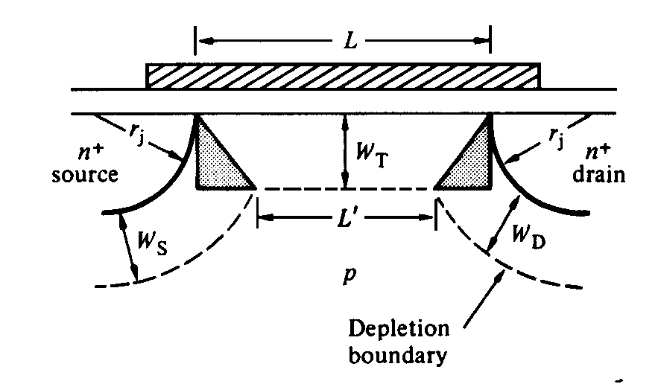
V_{T} Roll-Off: First-Order Model
Minimize ΔV_{T} by
reducing T_{oxe}
reducing r_{j}
increasing N_{A}
(trade-offs: degraded μ_{eff}, m)
R. F. Pierret, Semiconductor Device Fundamentals, Fig. 19.4
MOSFET vertical dimensions should be
scaled along with horizontal dimensions!
EE130/230A Fall 2013
Lecture 22, Slide 11

Slide 12
Questions? 1. CMOS fabrication process / technology? 2. The MOSFET design project?
Good luck to Quiz#5!

