Slide 1
EE130/230A Discussion 13
Peng Zheng

Slide 2
Why New Transistor Structures?
Off-state leakage (I_{OFF}) must be suppressed as L_{g} is scaled down
  allows for reductions in V_{T} and hence V_{DD}
Leakage occurs in the region away from the channel surface
  → Let’s get rid of it!
L_{g}
Thin-Body
MOSFET:
Gate
Gate
Source
Drain
Source
Drain
Buried Oxide
“Silicon-on-Insulator” (SOI)
Wafer
Substrate
2

Slide 3
Thin-Body MOSFETs
I_{OFF} is suppressed by using an adequately thin body region.
  Body doping can be eliminated
  → higher drive current due to higher carrier mobility
Ultra-Thin Body (UTB)
Double-Gate (DG)
L_{g}
Gate
Gate
T_{Si}
Source
Drain
T_{Si}
Source
Drain
Buried Oxide
Gate
Substrate
T_{Si} < (1/4) × L_{g}
T_{Si} < (2/3) × L_{g}
3

Slide 4
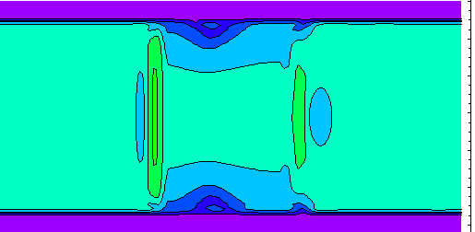
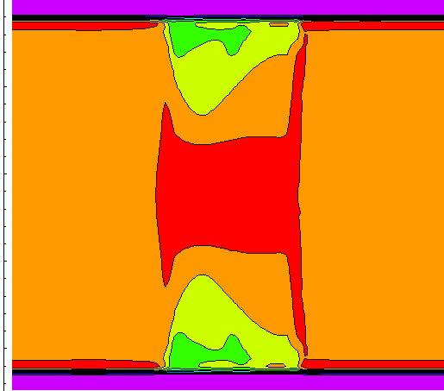
Effect of T_{Si} on OFF-state Leakage
L_{g} = 25 nm; t_{ox,eq} = 12Å
T_{Si} = 10 nm
T_{Si} = 20 nm
10⁶
G
Si Thickness [nm]
G
0.0
S
D
4.0
3x10²
8.0
S
D
G
12.0
16.0
10⁻¹
20.0
G
Leakage Current
Density [A/cm²]
@ V_{DS} = 0.7 V
I_{OFF} = 2.1 nA/μm
I_{OFF} = 19 μA/μm
4

Slide 5
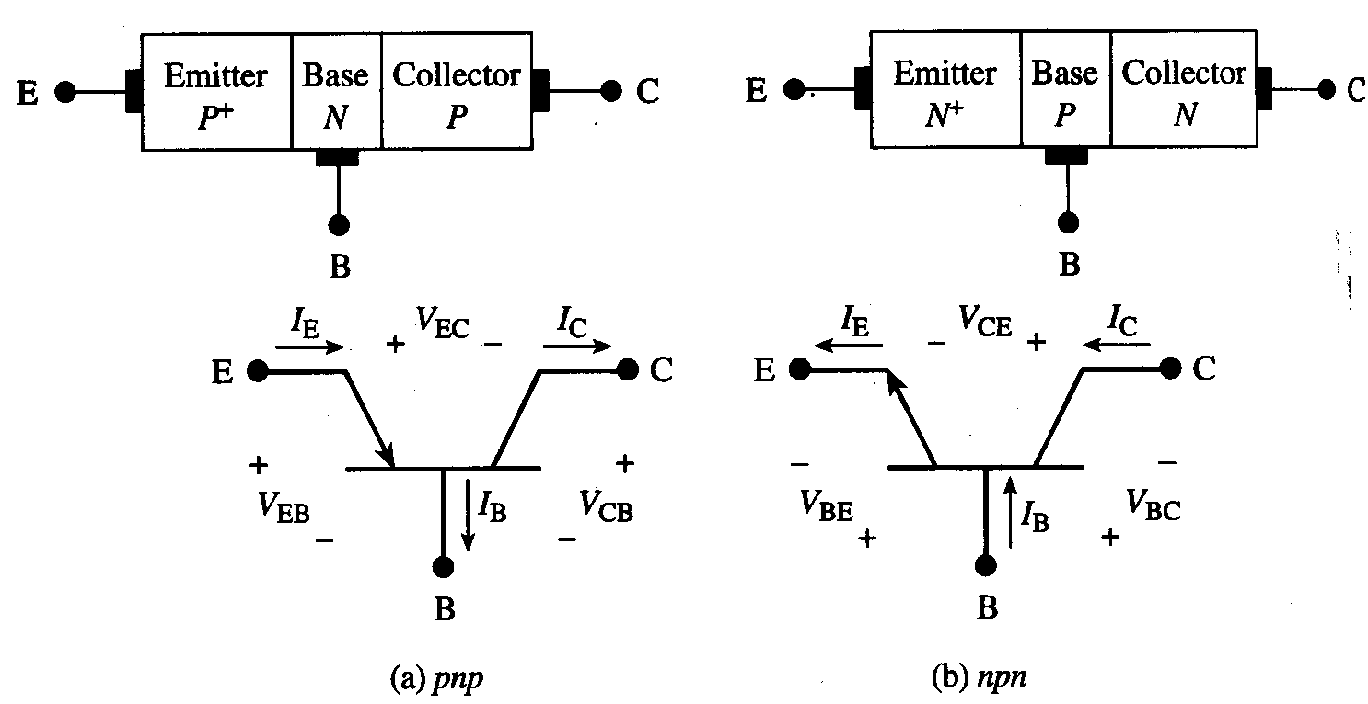
BJT Types and Definitions
The BJT is a 3-terminal device, with two types: PNP and NPN
V_{EB} = V_{E} – V_{B}
V_{CB} = V_{C} – V_{B}
V_{EC} = V_{E} – V_{C}
= V_{EB} - V_{CB}
V_{BE} = V_{B} – V_{E}
V_{BC} = V_{B} – V_{C}
V_{CE} = V_{C} – V_{E}
= V_{CB} - V_{EB}
Electrostatics:
  Under normal operating conditions, the BJT may be viewed electrostatically as two independent pn junctions
EE130/230A Fall 2013
Lecture 25, Slide 5
R. F. Pierret, Semiconductor Device Fundamentals, p. 372

Slide 6
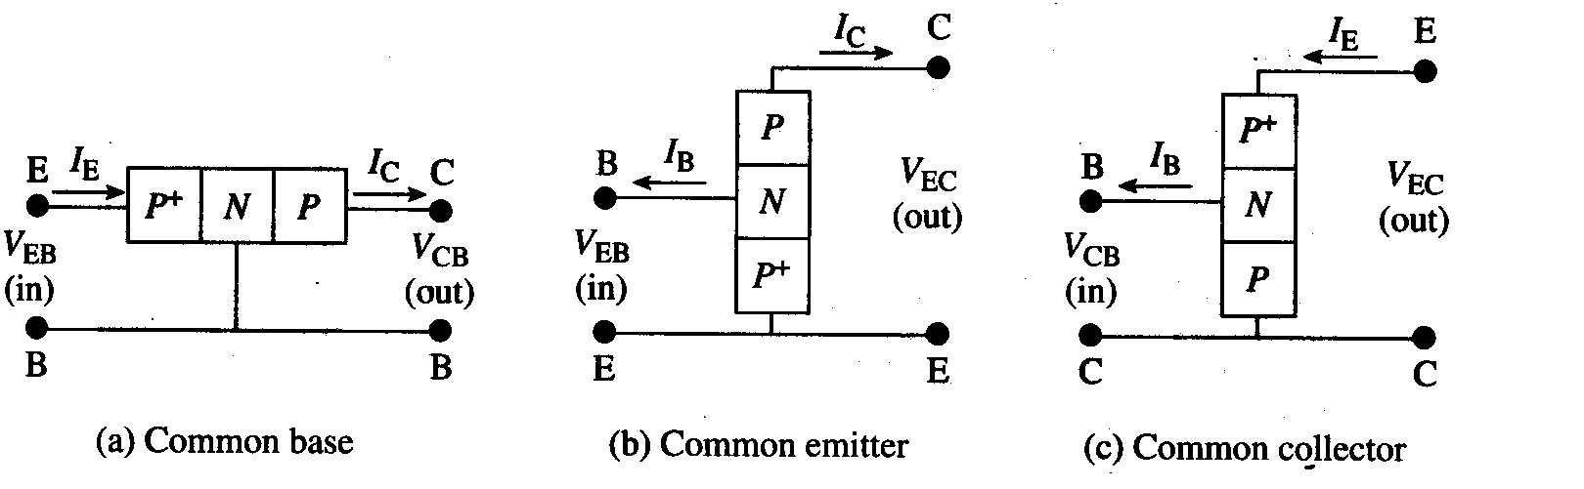
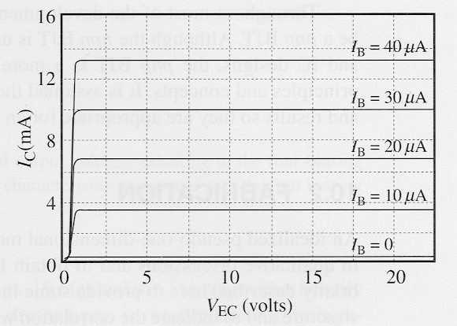
BJT Circuit Configurations
R. F. Pierret, Semiconductor Device Fundamentals, Fig. 10.3
Output Characteristics for Common-Emitter Configuration
EE130/230A Fall 2013
Lecture 25, Slide 6
R. F. Pierret, Semiconductor Device Fundamentals, Fig. 10.4

Slide 7
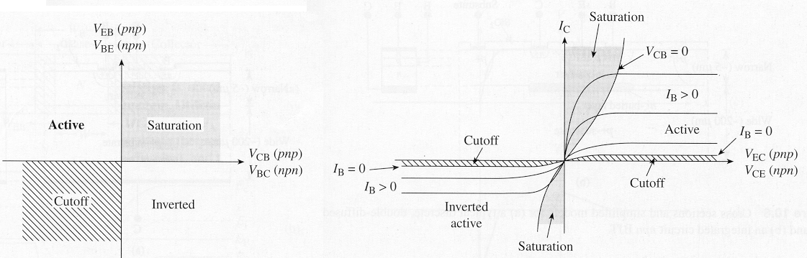
BJT Modes of Operation
R. F. Pierret, Semiconductor Device Fundamentals, Fig. 10.5
Common-emitter output characteristics
(I_{C} vs. V_{CE})
Mode | Emitter Junction | Collector Junction
CUTOFF | reverse bias | reverse bias
Forward ACTIVE | forward bias | reverse bias*
Reverse ACTIVE | reverse bias* | forward bias
SATURATION | forward bias | forward bias
EE130/230A Fall 2013
Lecture 25, Slide 7
*more precisely: not strongly forward biased

Slide 8
Sample Problem

Slide 9
Sample Problem

Slide 10
Questions regarding the MOSFET design project?
Happy Holidays!

