Slide 1
EE130/230A Discussion 15
Peng Zheng

Slide 2
Early Voltage, V_{A}
Output resistance:
A large V_{A} (i.e. a large r_{o} ) is desirable
I_{C}
I_{B3}
I_{B2}
I_{B1}
V_{A}
0
V_{EC}

Slide 3
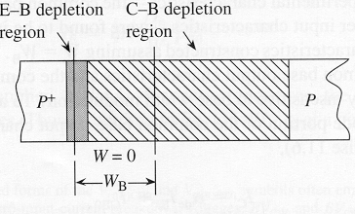
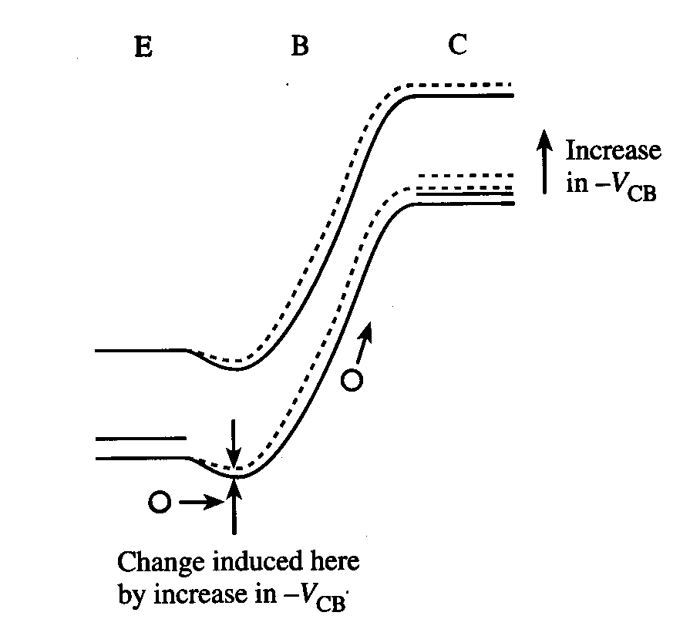
Punch-Through
E-B and E-B depletion regions in the base touch → W = 0
As |V_{CB}| increases, the potential barrier to hole injection decreases and hence I_{C} increases
EE130/230A Fall 2013
Lecture 27, Slide 3
R. F. Pierret, Semiconductor Device Fundamentals, Figs. 11.7-11.8

Slide 4
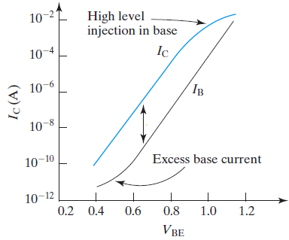
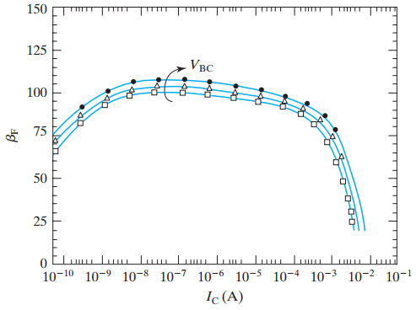
Gummel Plot and β_{dc} vs. I_{C}
β_{dc}
β_{dc}
From top to bottom:
V_{BC} = 2V, 1V, 0V
EE130/230A Fall 2013
Lecture 27, Slide 4
C. C. Hu, Modern Semiconductor Devices for Integrated Circuits, Figures 8-8 & 8-9

Slide 5
Gummel Numbers
For a uniformly doped base with negligible band-gap narrowing, the base Gummel number is
(total integrated “dose” (#/cm²) of majority carriers in the base, divided by D_{B})
Emitter efficiency
G_{E} is the emitter Gummel number
EE130/230A Fall 2013
Lecture 27, Slide 5

Slide 6
Notice that
In practice, N_{B} and N_{E} are not uniform, i.e. they are functions of x
The more general formulas for the Gummel numbers are
EE130/230A Fall 2013
Lecture 27, Slide 6

Slide 7
Charge Control Model
A PNP BJT biased in the forward-active mode has excess
minority-carrier charge Q_{B} stored in the quasi-neutral base:
In steady state,
EE130/230A Fall 2013
Lecture 27, Slide 7

Slide 8
Base Transit Time, τ_{t}
time required for minority carriers to diffuse across the base
sets the switching speed limit of the transistor
EE130/230A Fall 2013
Lecture 27, Slide 8

Slide 9
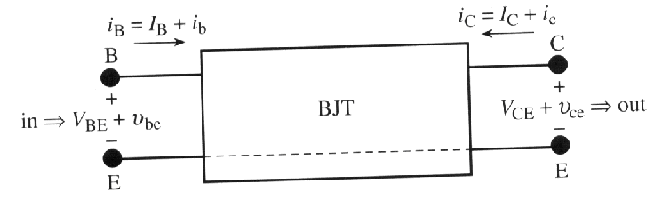
Small-Signal Model
Common-emitter configuration,
forward-active mode:
R. F. Pierret, Semiconductor Device Fundamentals, Fig.12.1(a)
“hybrid pi”
BJT small signal model:
Transconductance:
EE130/230A Fall 2013
Lecture 28, Slide 9

Slide 10
Small-Signal Model (cont.)
where Q_{F} is the magnitude of minority-carrier charge stored in the base and emitter regions
forward transit time
EE130/230A Fall 2013
Lecture 28, Slide 10

Slide 11
Summary: BJT Small Signal Model
Hybrid pi model for the common-emitter configuration, forward-active mode:
EE130/230A Fall 2013
Lecture 28, Slide 11

Slide 12
Thanks very much for your continuous support throughout the semester.
Good luck to the final exam!

