Slide 1
EE130/230A Discussion 3
Peng Zheng

Slide 2
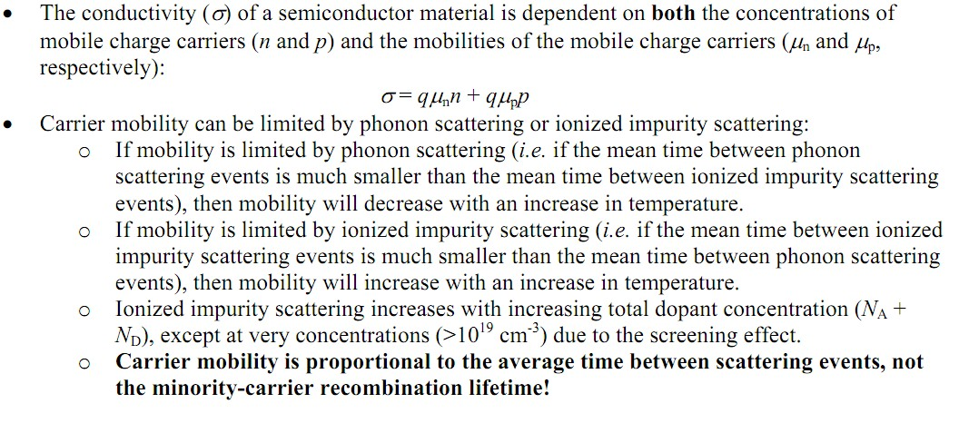
Conductivity of a Semiconductor
μ_{n} ≡ [qτ_{mn} / m_{n}*] is the electron mobility
μ_{p} ≡ [qτ_{mp} / m_{p}*] is the hole mobility
τ_{mn} ≡ average time between electron scattering events
τ_{mp} ≡ average time between hole scattering events
EE130/230A Fall 2013

Slide 3
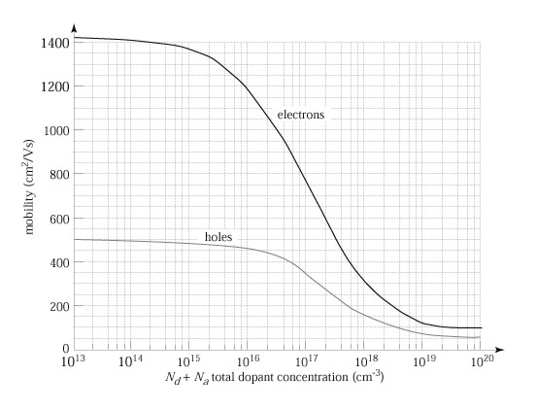
Mobility Dependence on Doping
Carrier mobilities in Si at 300K
EE130/230A Fall 2013
Lecture 4, Slide 3

Slide 4
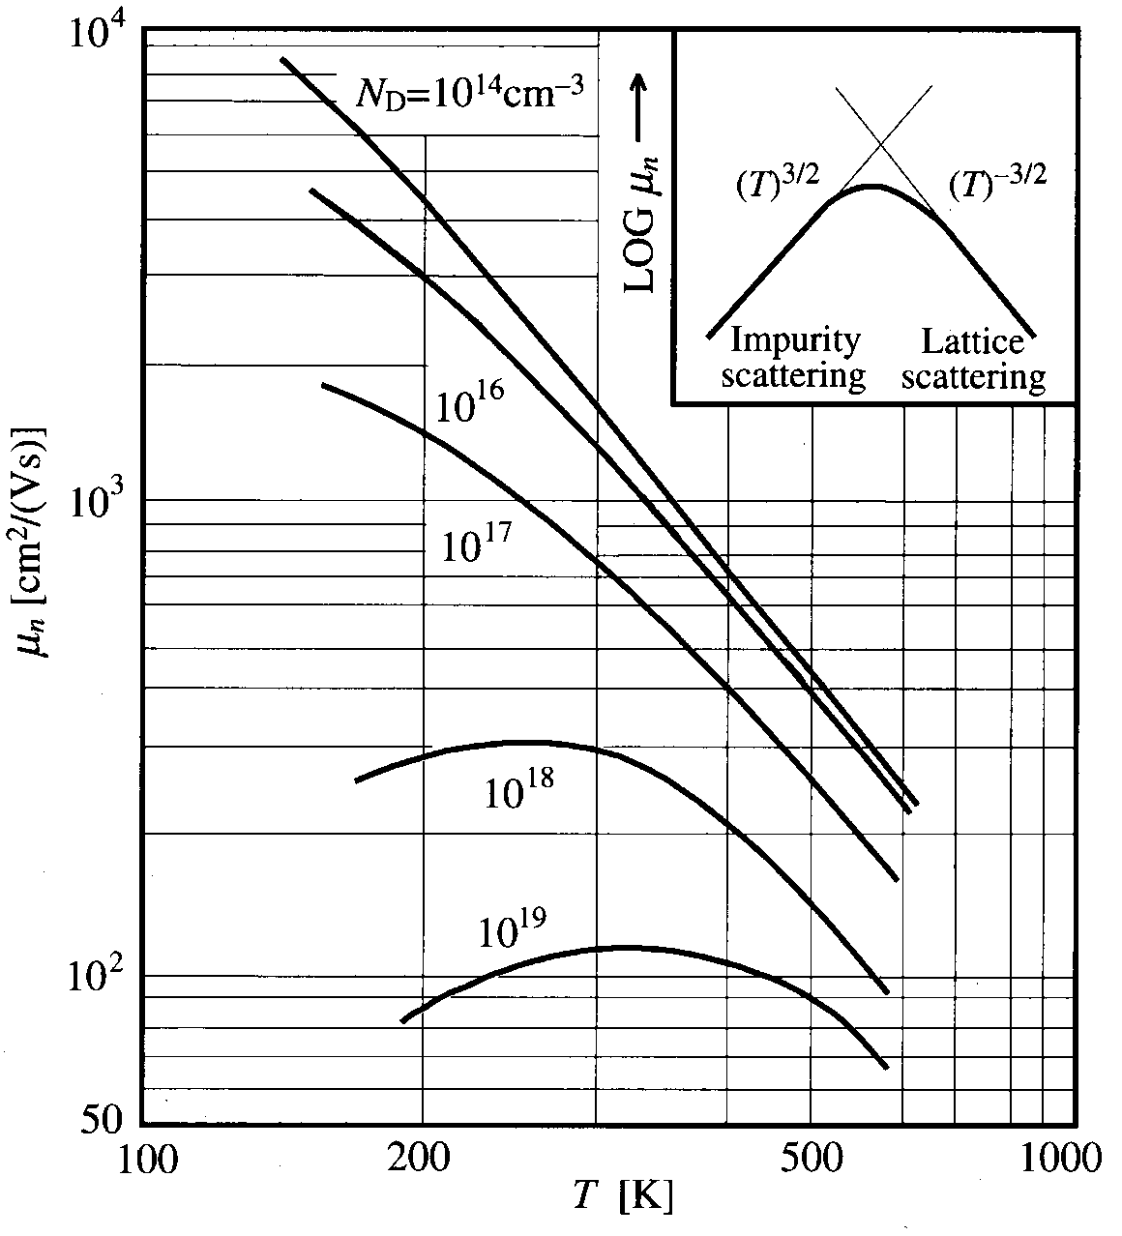
Mobility Dependence on Temperature
EE130/230A Fall 2013
Lecture 4, Slide 4

Slide 5
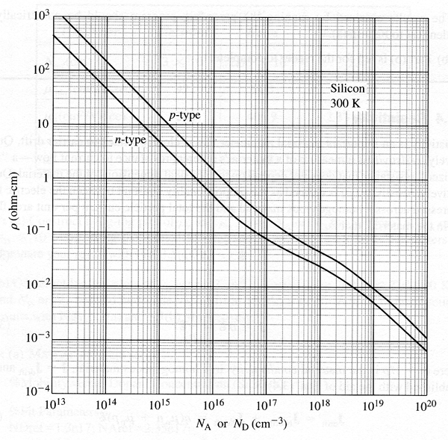
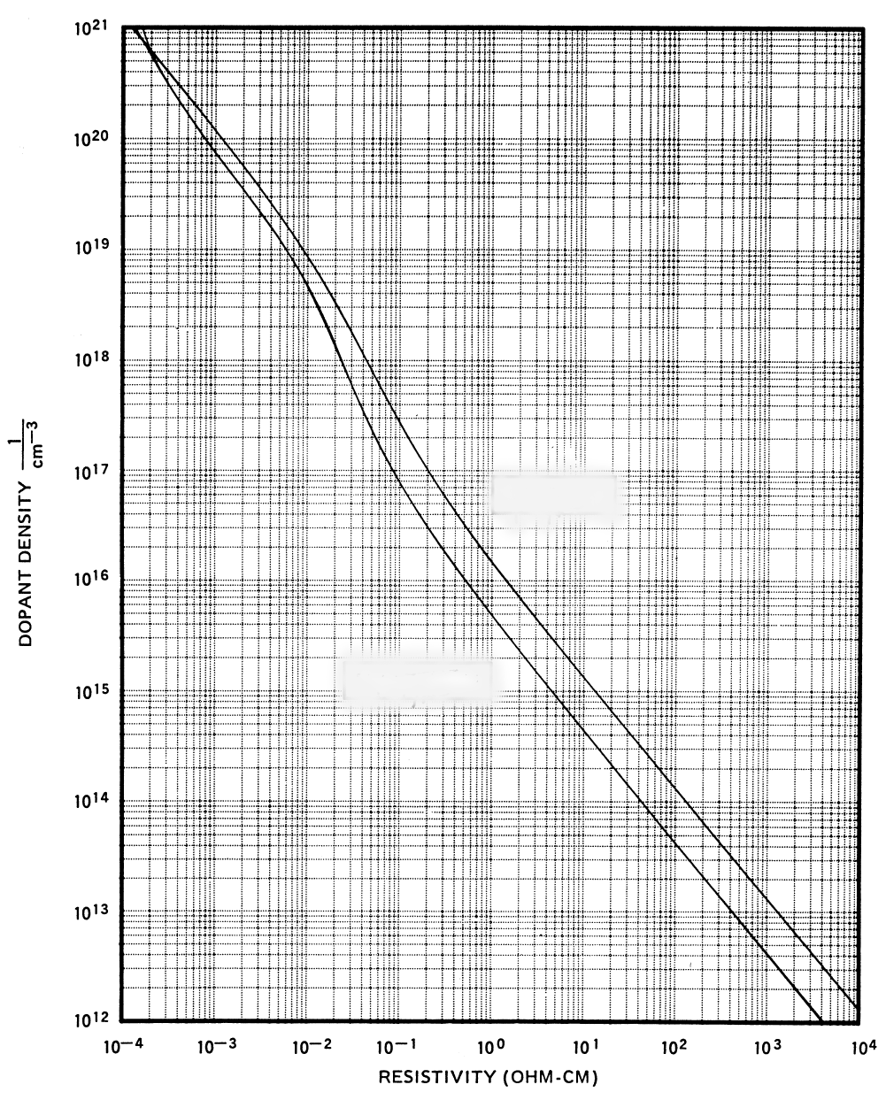
Resistivity Dependence on Doping
R.F. Pierret, Semiconductor Fundamentals, Figure 3.8
For n-type material:
For p-type material:
Note: This plot (for Si) does not apply to compensated material (doped with both acceptors and donors).
EE130/230A Fall 2013
Lecture 4, Slide 5

Slide 6
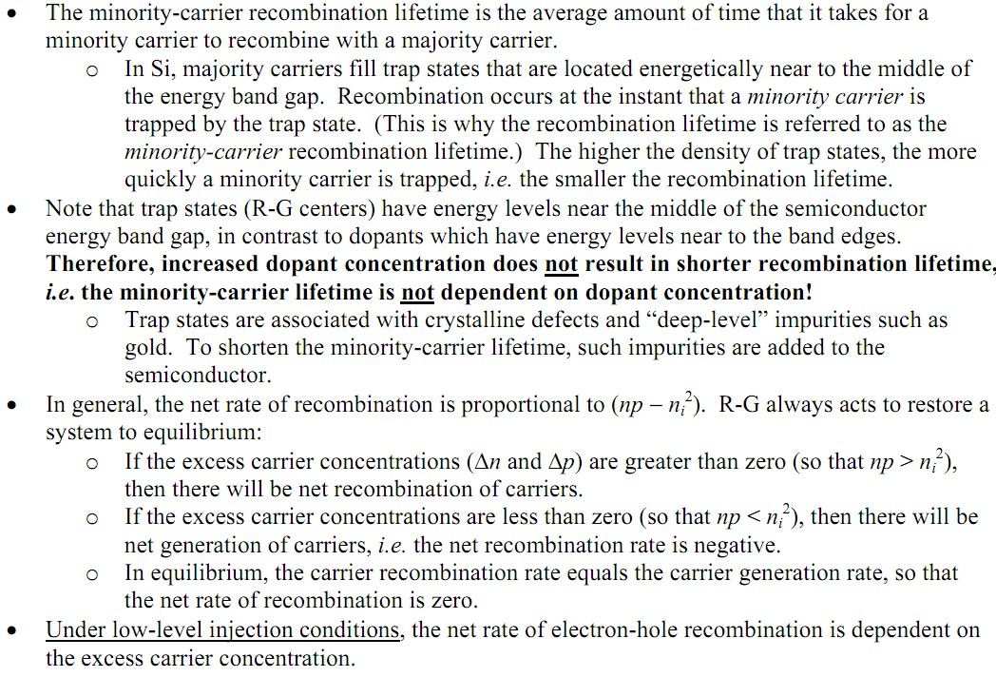
Recombination-Generation (R-G) of Carriers in Silicon
EE130/230A Fall 2013

Slide 7
Recombination Processes
R.F. Pierret, Semiconductor Fundamentals, Figure 3.15
Direct
R-G Center
Auger
Recombination in Si is primarily via R-G centers
EE130/230A Fall 2013
Lecture 5, Slide 7

Slide 8
Net Recombination Rate (General Case)
For arbitrary injection levels, the net rate of carrier recombination is:
EE130/230A Fall 2013
Lecture 5, Slide 8

Slide 9
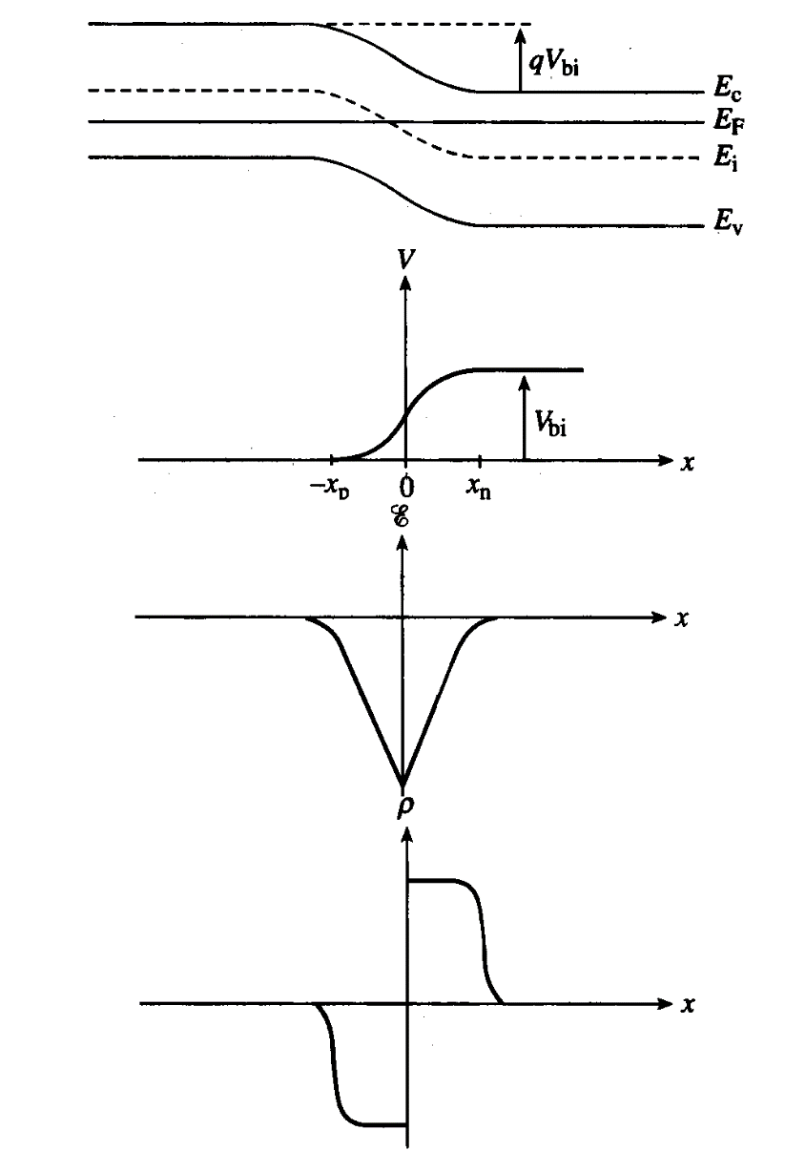
Electrostatics (Step PN Junction)
Band diagram:
Electrostatic potential:
Electric field:

Slide 10
electrostatic potential V(x)
x
electric field ɛ(x)
x
potential energy PE(x)
x
kinetic energy KE(x)
x
Carrier concentration
x
Electron drift-current density and
the electron diffusion-current density
x

