Slide 1
EE130/230A Discussion 4
Peng Zheng

Slide 2
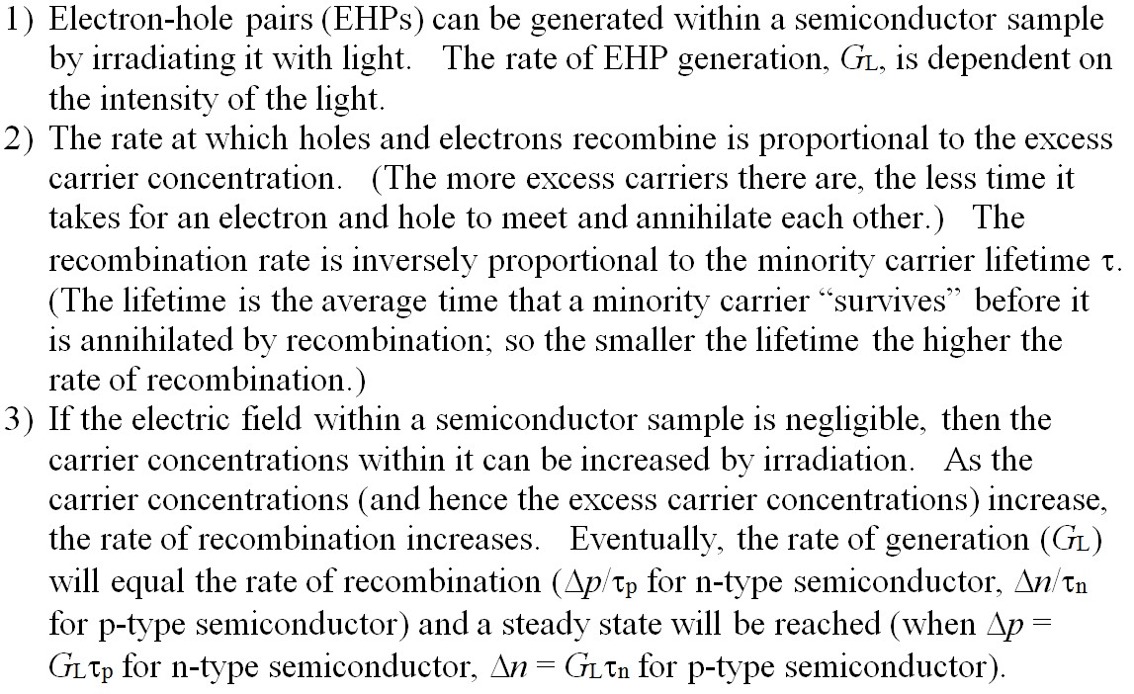
Illumination of a Semiconductor with Light
(Refer to Discussion 3.)
EE130/230A Fall 2013

Slide 3
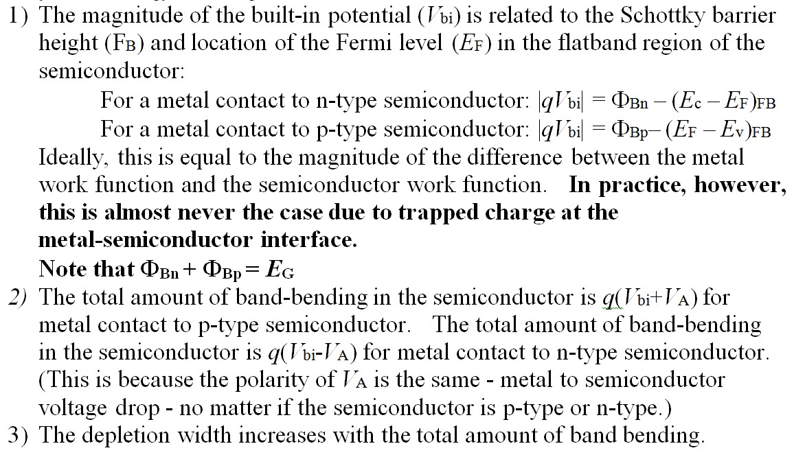
Schottky Contact Energy Band Diagrams:
EE130/230A Fall 2013

Slide 4
Ideal M-S Contact: Φ_{M} > Φ_{S}, n-type
Band diagram instantly
after contact formation:
Equilibrium band diagram:
qV_{bi} = Φ_{Bn}– (E_{c} – E_{F})_{FB}
_{n}
Schottky Barrier Height:
W
EE130/230A Fall 2013

Slide 5
Ideal M-S Contact: Φ_{M} < Φ_{S}, n-type
Band diagram instantly
after contact formation:
Equilibrium band diagram:
EE130/230A Fall 2013

Slide 6
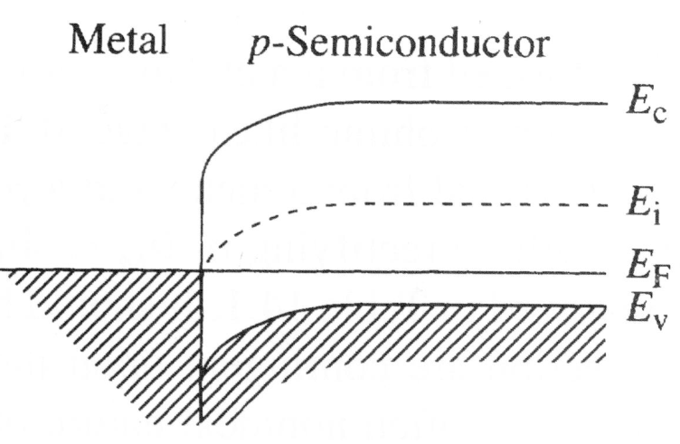
Ideal M-S Contact: Φ_{M} < Φ_{S}, p-type
p-type
semiconductor
Band diagram instantly
after contact formation:
Equilibrium band diagram:
Schottky Barrier Height:
Φ_{Bp}
qV_{bi} = Φ_{Bp}– (E_{F} – E_{v})_{FB}
W
EE130/230A Fall 2013

Slide 7
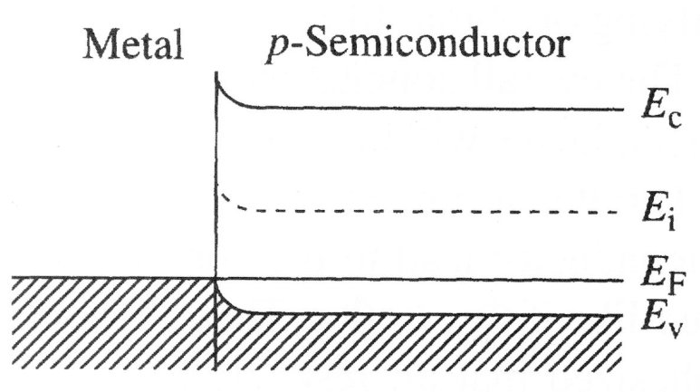
Ideal M-S Contact: Φ_{M} > Φ_{S}, p-type
p-type
semiconductor
Band diagram instantly
after contact formation:
Equilibrium band diagram:
EE130/230A Fall 2013

Slide 8
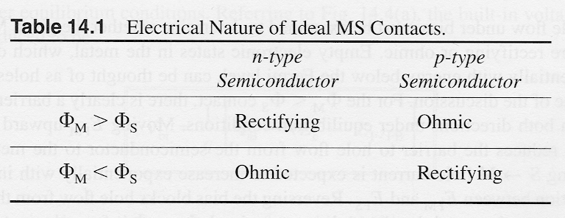
Summary
E_{c}
E_{c}
E_{F}
E_{v}
E_{F}
E_{v}
E_{c}
E_{F}
E_{F}
E_{v}
E_{v}
R.F. Pierret, Semiconductor Fundamentals, p. 481
For rectifying contacts:
small-signal capacitance
EE130/230A Fall 2013

Slide 9
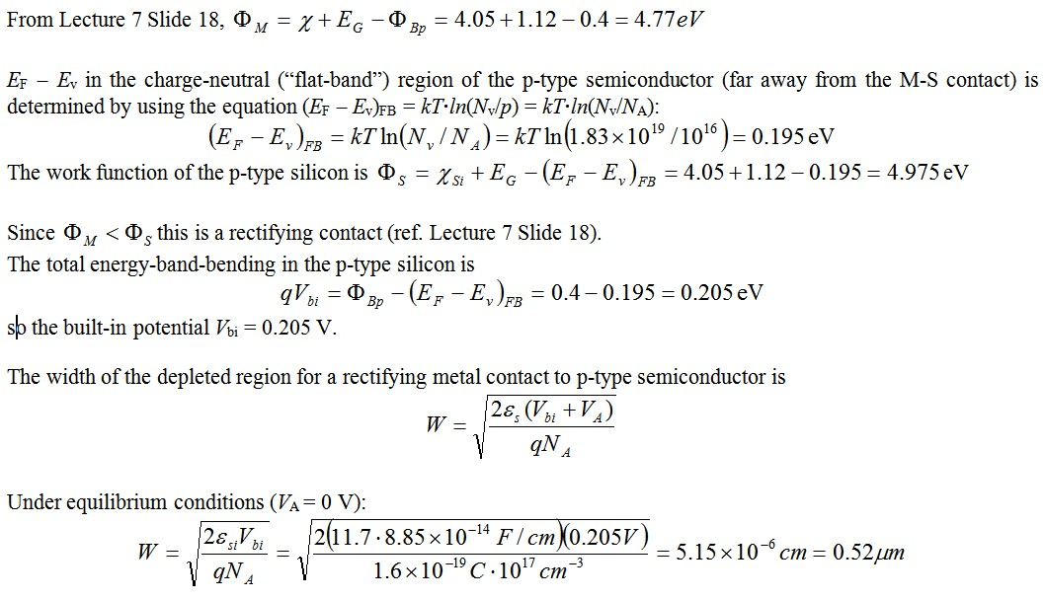
Schottky Contact to p-type Silicon with N_{A} = 10¹⁶ cm⁻³ and F_{Bp} = 0.4 eV, V_{A}=0V
EE130/230A Fall 2013

Slide 10
Schottky Contact to p-type Silicon with N_{A} = 10¹⁶ cm⁻³ and F_{Bp} = 0.4 eV, V_{A}=0V
M
p-type Si
E_{o}
c_{Si}=4.05 eV
F_{M}=4.77 eV
E_{c}
0.4eV=F_{Bp}
0.195 eV
E_{F}
E_{v}
qV_{bi} = F_{Bp}– (E_{F} – E_{v})_{FB}
W
0.52 μm
EE130/230A Fall 2013

Slide 11
Schottky Contact to p-type Silicon with N_{A} = 10¹⁶ cm⁻³ and F_{Bp} = 0.4 eV, V_{A}=-0.2V
EE130/230A Fall 2013

Slide 12
Using C-V Data to Determine Φ_{B}
Once V_{bi} and N_{A} are known, Φ_{Bp} can be determined:
EE130/230A Fall 2013

Slide 13
Good luck to Quiz 1

