Slide 1
EE130/230A Discussion 5
Peng Zheng

Slide 2
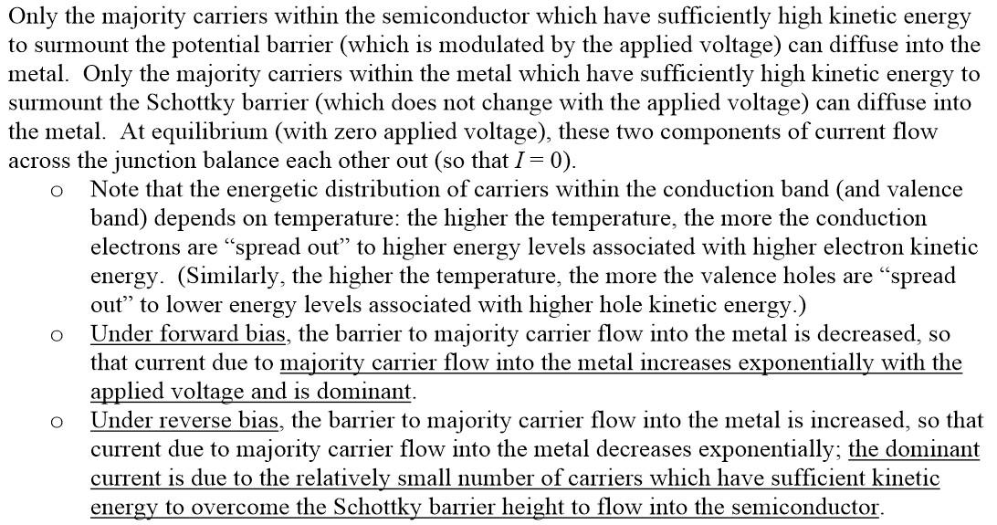
Current Flow in a Schottky Diode
EE130/230A Fall 2013

Slide 3
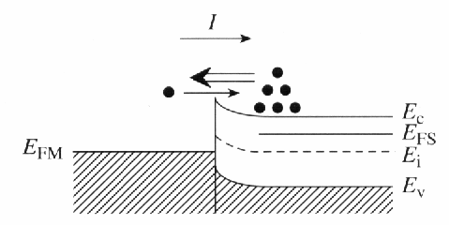
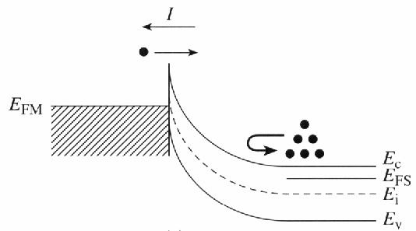
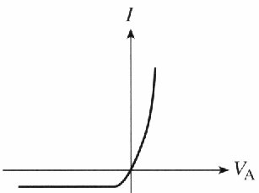
Current Flow
FORWARD BIAS
Current is determined by majority-carrier flow across the M-S junction:
Under forward bias, majority-carrier diffusion from the semiconductor into the metal dominates
Under reverse bias, majority-carrier diffusion from the metal into the semiconductor dominates
REVERSE BIAS
R.F. Pierret, Semiconductor Fundamentals, Fig. 14.3
EE130/230A Fall 2013
Lecture 8, Slide 3

Slide 4
Practical Ohmic Contact
Equilibrium Band Diagram
Band Diagram for V_{A}≠0
qV_{bi}≅Φ_{Bn}
q(V_{bi}-V_{A})
E_{FM}
E_{c}, E_{FS}
E_{FM}
E_{c}, E_{FS}
E_{v}
E_{v}
If the depletion width is sufficiently narrow (<10 nm for silicon), then carriers can quantum-mechanically tunnel through the Schottky/potential barrier in each direction, so that the contact becomes practically ohmic. This is the case when the semiconductor is degenerately doped. Since current flows relatively easily through an ohmic contact, the applied bias across an ohmic contact is very small in practice
EE130/230A Fall 2013
Lecture 8, Slide 4

Slide 5
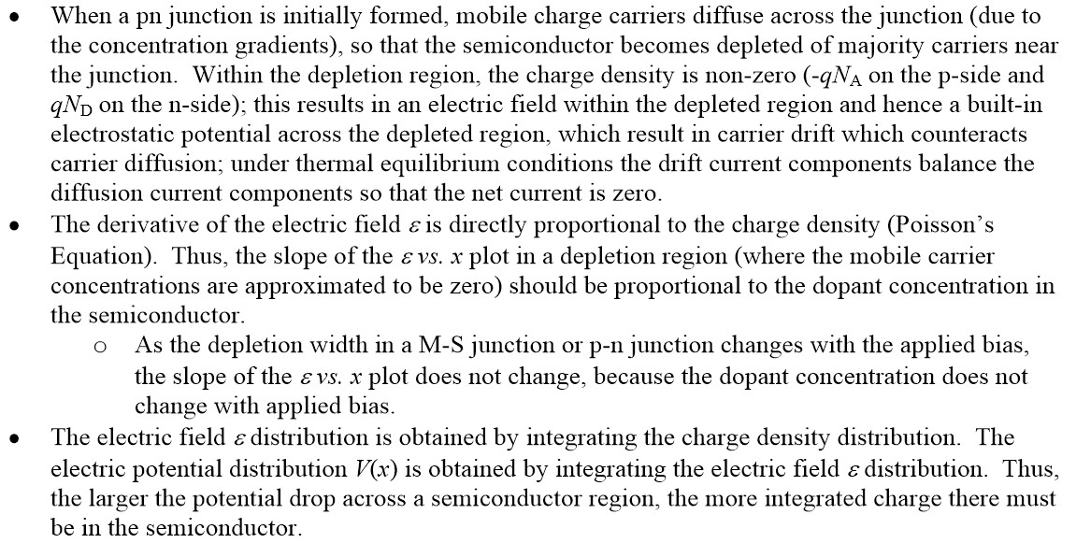
PN Junction Electrostatics
EE130/230A Fall 2013

Slide 6
Fermi level applets
http://jas.eng.buffalo.edu/

Slide 7
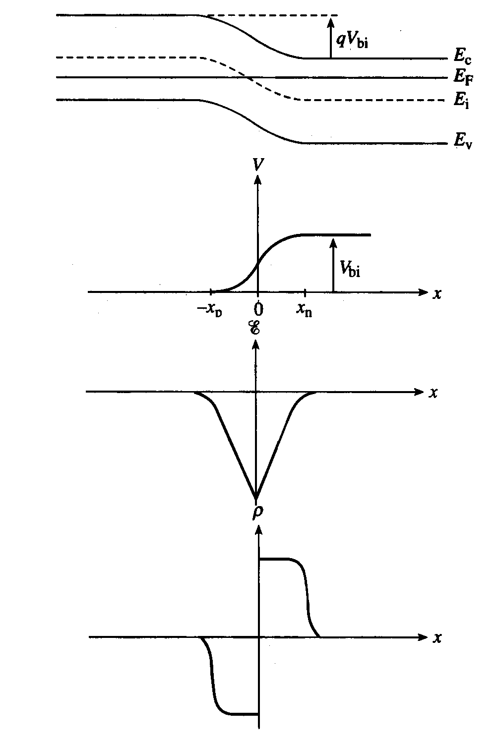
Electrostatics (Step Junction)
Band diagram:
Electrostatic potential:
Electric field:
Charge density:
EE130/230A Fall 2013
Lecture 9, Slide 7
R.F. Pierret, Semiconductor Fundamentals, Figure 5.4

Slide 8
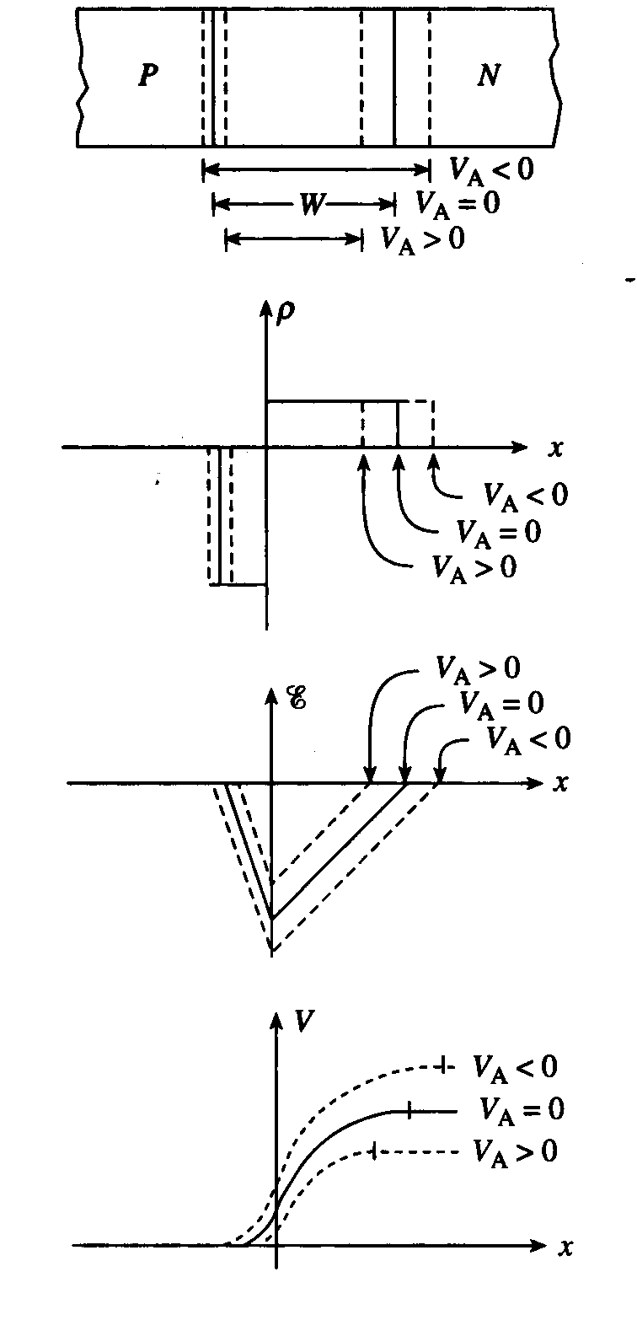
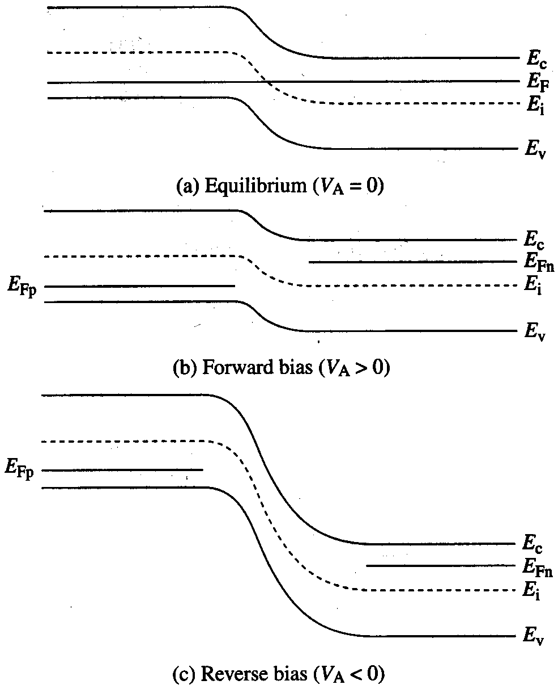
Effect of Applied Voltage
EE130/230A Fall 2013
Lecture 9, Slide 8
R.F. Pierret, Semiconductor Fundamentals, Figure 5.11

Slide 9
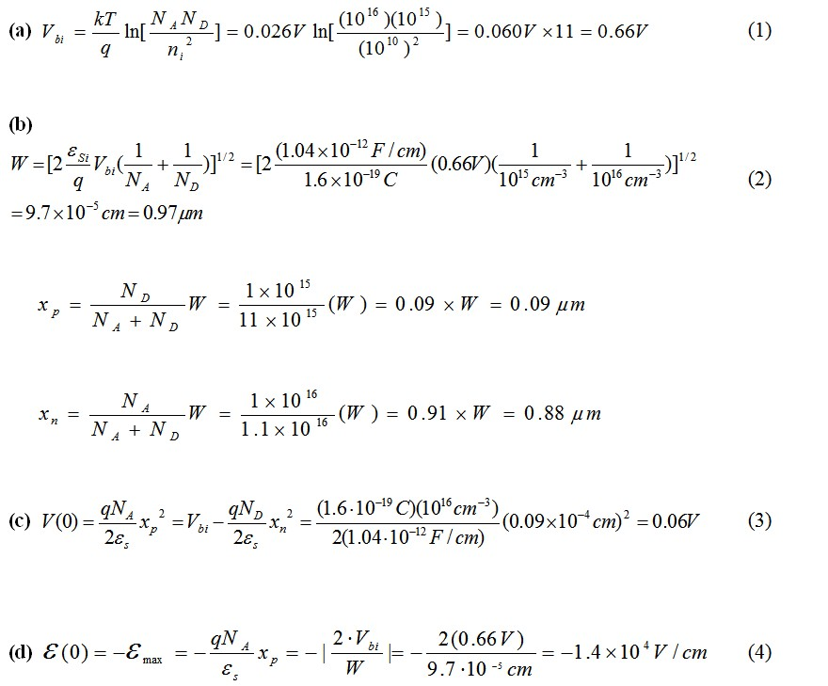
A silicon step junction maintained at T = 300K under equilibrium conditions has a p-side doping of N_{A} = 1×10¹⁶ cm⁻³ and n-side doping of N_{D} = 1×10¹⁵ cm⁻³
EE130/230A Fall 2013

Slide 10
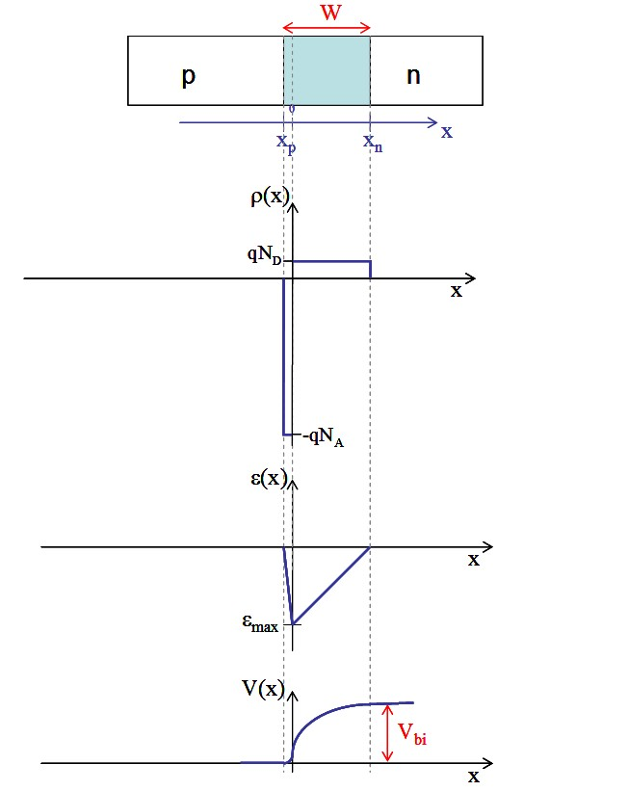
A silicon step junction maintained at T = 300K under equilibrium conditions has a p-side doping of N_{A} = 1×10¹⁶ cm⁻³ and n-side doping of N_{D} = 1×10¹⁵ cm⁻³
EE130/230A Fall 2013

