Slide 1
EE130/230A Discussion 6
Peng Zheng

Slide 2
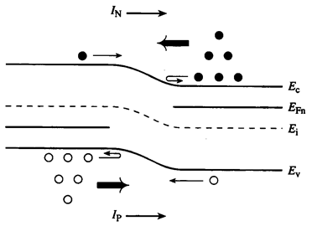
Carrier Action under Forward Bias
When a forward bias (V_{A}>0) is applied, the potential barrier to diffusion across the junction is reduced
Minority carriers are “injected”
into the quasi-neutral regions
=> Δn_{p} > 0, Δp_{n} > 0
Minority carriers diffuse in the quasi-neutral regions, recombining with majority carriers
EE130/230A Fall 2013
Lecture 10, Slide 2

Slide 3
Components of Current Flow
Current density J = J_{n}(x) + J_{p}(x)
J is constant throughout the diode, but J_{n}(x) and J_{p}(x) vary with position:
Example:
p⁺n junction under forward bias:
J
J_{N}
J_{P}
x
-x_{p}
x_{n}
EE130/230A Fall 2013
Lecture 10, Slide 3

Slide 4
Excess Carrier Concentrations at –x_{p}, x_{n}
p side
n side
EE130/230A Fall 2013
Lecture 10, Slide 4

Slide 5
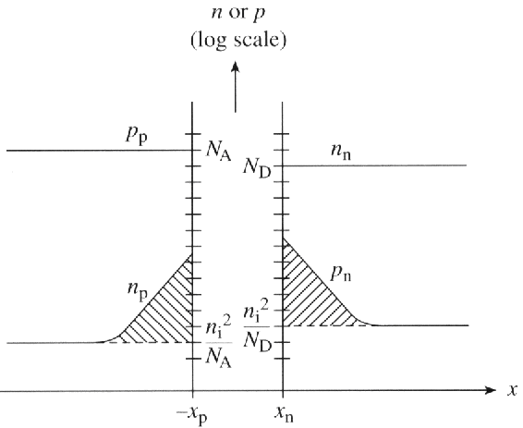
Carrier Concentration Profiles under Forward Bias
EE130/230A Fall 2013
Lecture 10, Slide 5
R. F. Pierret, Semiconductor Device Fundamentals, Fig. 6.8a

Slide 6
Excess Carrier Distribution (n side)
From the minority carrier diffusion equation:
We have the following boundary conditions:
For simplicity, use a new coordinate system:
Then, the solution is of the form:
NEW:
x’’ 0 0 x’
EE130/230A Fall 2013
Lecture 10, Slide 6

Slide 7
From the x = ∞ boundary condition:
From the x = x_{n} boundary condition:
Therefore
Similarly, we can derive
EE130/230A Fall 2013
Lecture 10, Slide 7

Slide 8
Total Current Density
p side:
n side:
EE130/230A Fall 2013
Lecture 10, Slide 8

Slide 9
Summary: Long-Base Diode
Under forward bias (V_{A} > 0), the potential barrier to carrier diffusion is reduced → minority carriers are “injected” into the quasi-neutral regions.
The minority-carrier concentrations at the edges of the depletion region change with the applied bias V_{A}, by the factor
The excess carrier concentrations in the quasi-neutral regions decay to zero away from the depletion region, due to recombination.
pn junction diode current
I₀ can be viewed as the drift current due to minority carriers generated within a diffusion length of the depletion region
EE130/230A Fall 2013
Lecture 10, Slide 9

Slide 10
General Narrow-Base Diode I-V
Define W_{P}‘ and W_{N}’ to be the widths of the quasi-neutral regions.
If both sides of a pn junction are narrow (i.e. much shorter than the minority carrier diffusion lengths in the respective regions):
e.g. if hole injection into the n side is greater than electron injection into the p side:
J
J_{P}
J_{N}
x
-x_{p}
x_{n}
EE130/230A Fall 2013
Lecture 11, Slide 10

Slide 11
Summary: Narrow-Base Diode
If the length of the quasi-neutral region is much shorter than the minority-carrier diffusion length, then there will be negligible recombination within the quasi-neutral region and hence all of the injected minority carriers will “survive” to reach the metal contact.
The excess carrier concentration is a linear function of distance.
For example, within a narrow n-type quasi-neutral region:
The minority-carrier diffusion current is constant within the narrow quasi-neutral region.
Shorter quasi-neutral region → steeper concentration gradient → higher diffusion current
Δp_{n}(x)
location of metal contact
(Δp_{n}=0)
0
x
x_{n}
W_{N}’
EE130/230A Fall 2013
Lecture 11, Slide 11

Slide 12
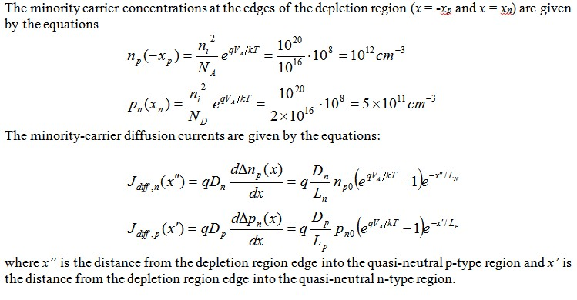
Sample Problem
Consider a Si pn step junction diode maintained at room temperature, with p-side and n-side dopant concentrations N_{A} = 10¹⁶ cm⁻³ and N_{D} = 2×10¹⁶ cm⁻³, respectively. (You may assume that each side is uncompensated.) The minority carrier recombination lifetimes are t_{n} = 10⁻⁶ s and t_{p}=10⁻⁷ s on the p-side and n-side, respectively. Applied bias V_{A} is (kT/q)*ln(10⁸) ≅ 0.48V.

Slide 13
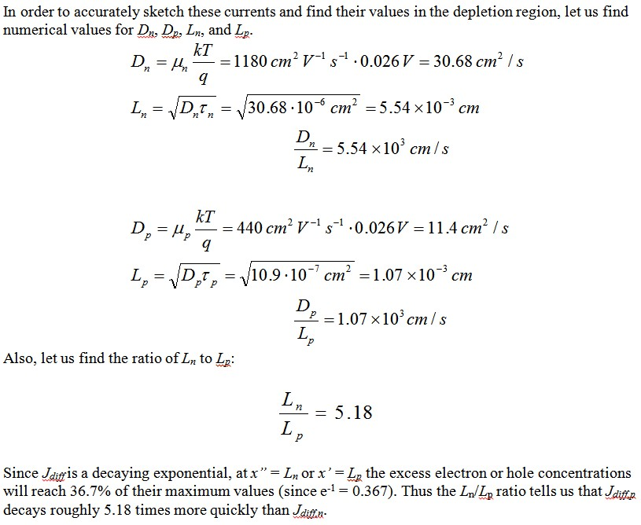

Slide 14
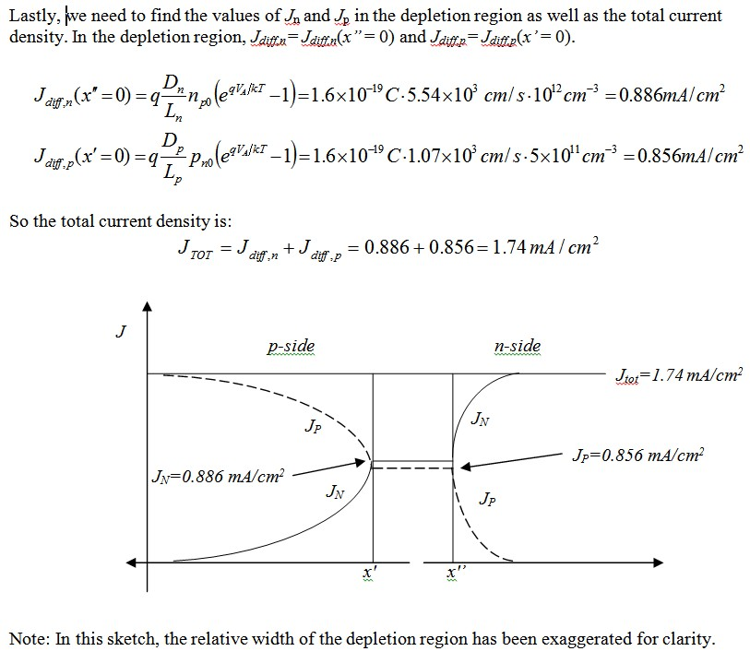

Slide 15
What if the n-side is a short base?
The hole diffusion component of the diode saturation current is calculated using the short-base diode formula:
I_{0,p} = Aqn_{i}²D_{p}/(W_{n}’×N_{D})
ref. slide 10

