Slide 1
EE130/230A Discussion 7
Peng Zheng

Slide 2
Minority-Carrier Charge Storage
Under forward bias (V_{A} > 0), excess minority carriers are stored in the quasi-neutral regions of a pn junction:
EE130/230A Fall 2013
Lecture 13, Slide 2

Slide 3
Charge Control Model Summary
Under forward bias, minority-carrier charge is stored in the quasi-neutral regions of a pn diode.
  Long base:
  Narrow base:
EE130/230A Fall 2013
Lecture 13, Slide 3

Slide 4
The steady-state diode current can be viewed as the charge supply required to compensate for charge loss via recombination (for long base) or collection at the contacts (for narrow base).
  Long base (both sides):
  Narrow base (both sides):
    where and
Note that
EE130/230A Fall 2013
Lecture 13, Slide 4

Slide 5
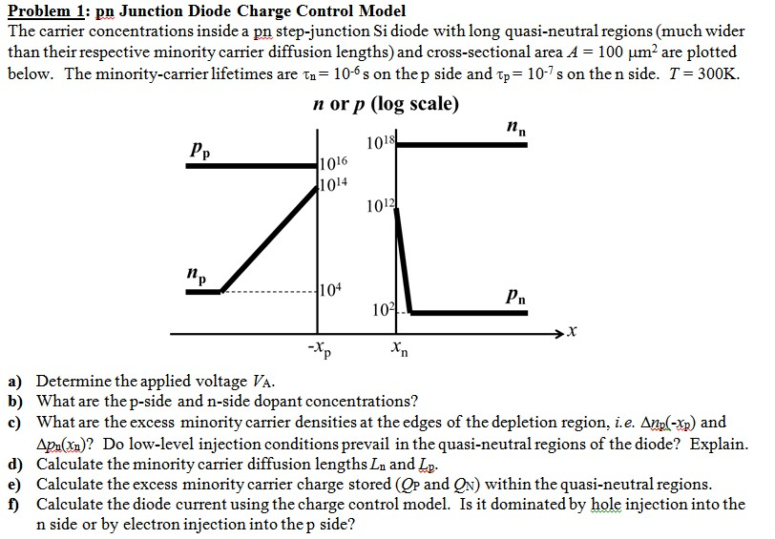
Sample Problem-Charge Control Model

Slide 6
Sample Problem-Charge Control Model

Slide 7
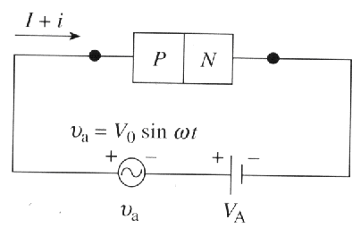
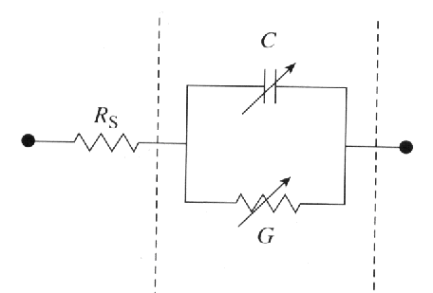
Small-Signal Model Summary
Depletion capacitance
Conductance
Diffusion capacitance
EE130/230A Fall 2013
Lecture 13, Slide 7
R. F. Pierret, Semiconductor Device Fundamentals, p. 302

Slide 8
Sample Problem-Small Signal Model
In your HW, it is not degenerately doped.

Slide 9
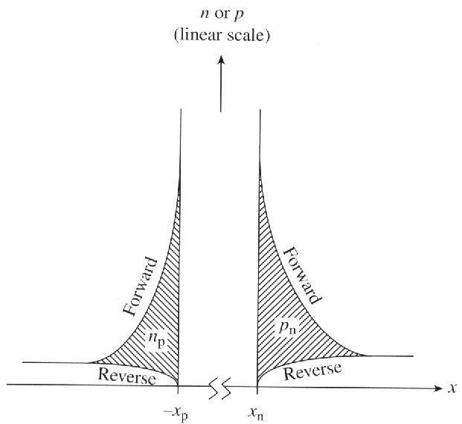
Transient Response of pn Diode
Suppose a pn-diode is forward biased, then suddenly turned off at time t = 0. Because of C_{D}, the voltage across the pn junction depletion region cannot be changed instantaneously.
The time delay in switching between
the FORWARD-bias and REVERSE-bias
states is due to the time required to
change the amount of excess minority
carriers stored in the quasi-neutral regions.
EE130/230A Fall 2013
Lecture 13, Slide 9
R. F. Pierret, Semiconductor Device Fundamentals, Fig. 8.2

Slide 10
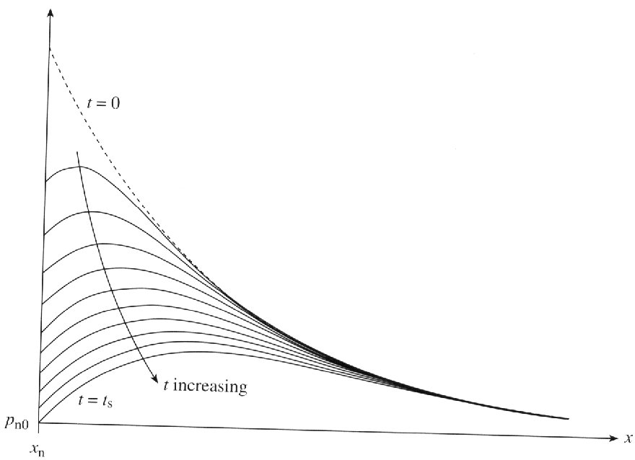
Decay of Stored Charge
Consider a p⁺n diode (Q_{p} >> Q_{n}):
Δp_{n}(x)
i(t)
t_{s}
t
v_{A}(t)
R. F. Pierret, Semiconductor Device Fundamentals, Fig. 8.3
t
For t > 0:
t_{s}
EE130/230A Fall 2013
Lecture 13, Slide 10

Slide 11
Qualitative Examples
Illustrate how the turn-off transient response would change:
Increase I_{F}
Increase I_{R}
Decrease τ_{p}
i(t)
i(t)
i(t)
t_{s}
t_{s}
t_{s}
t
t
t
EE130/230A Fall 2013
Lecture 13, Slide 21

