Slide 1
Orthogonal Matching Pursuit (OMP)
EE16A (Fall 2018)
Discussion 14B
Authored by Grace Kuo

Slide 2
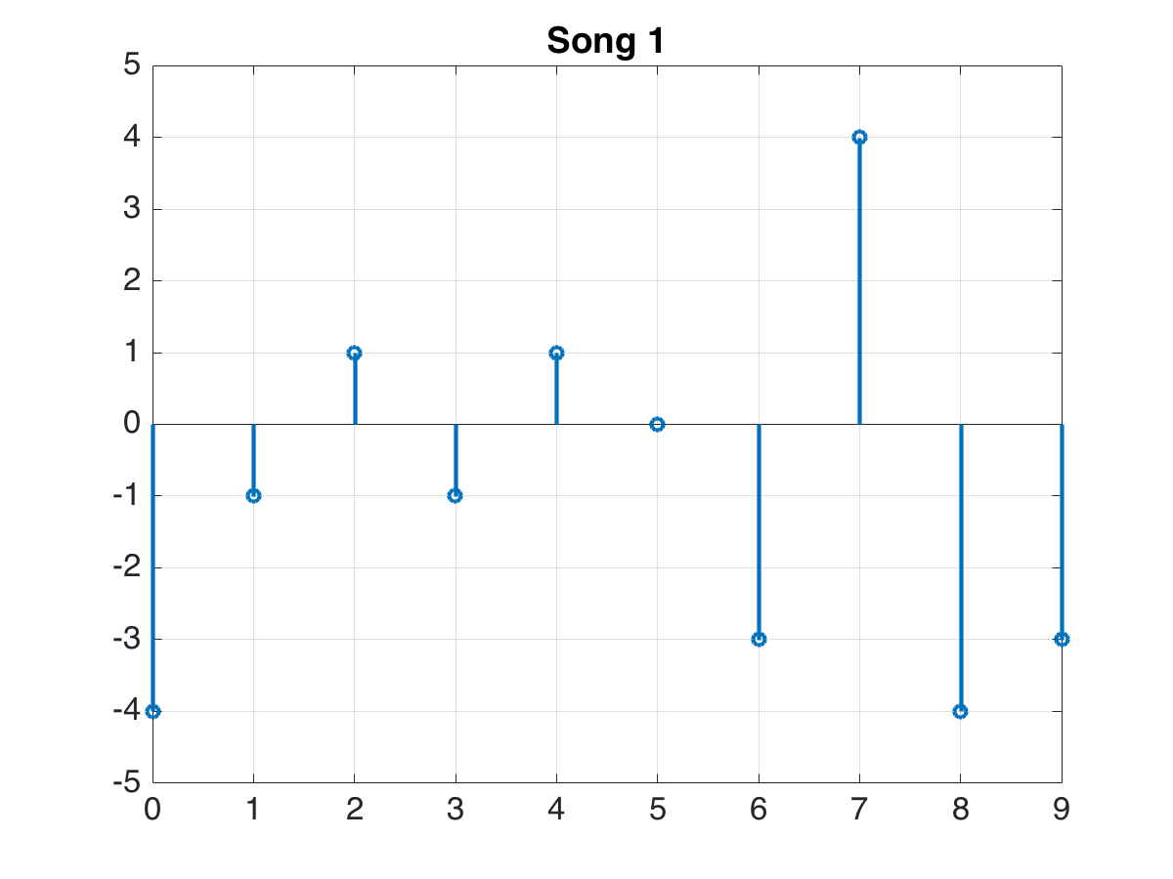
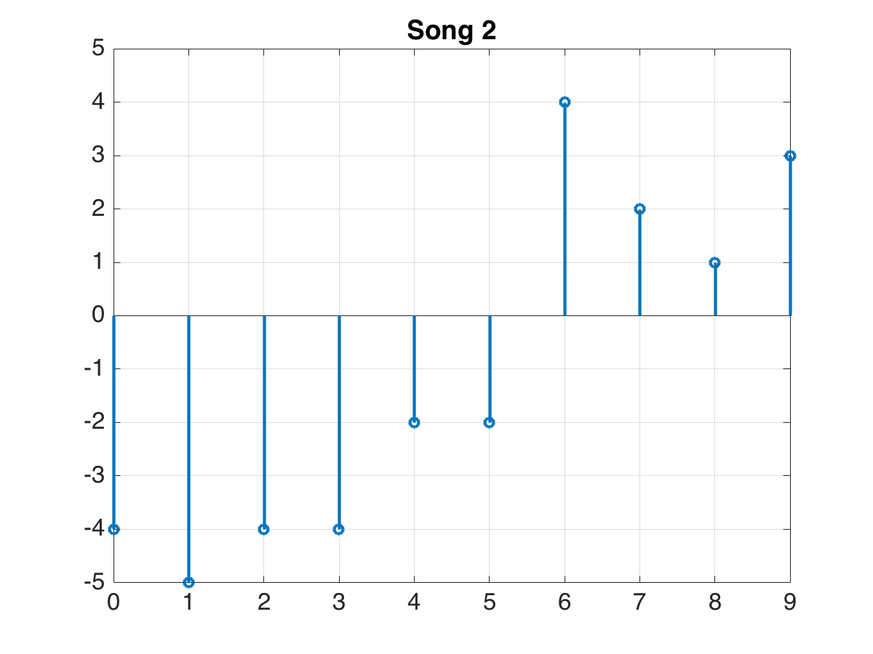
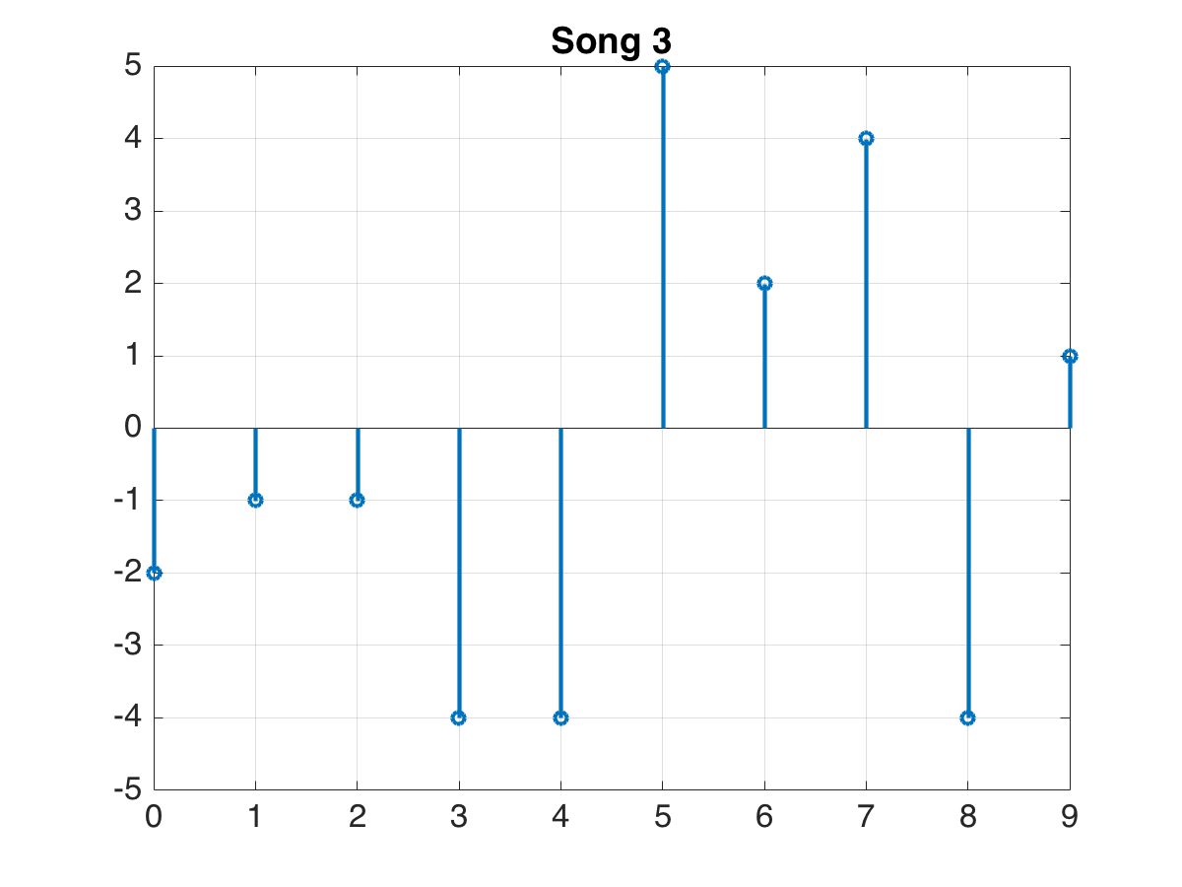
3 transmitters, each with a code
Message 1
Message 2
Message 3

Slide 3
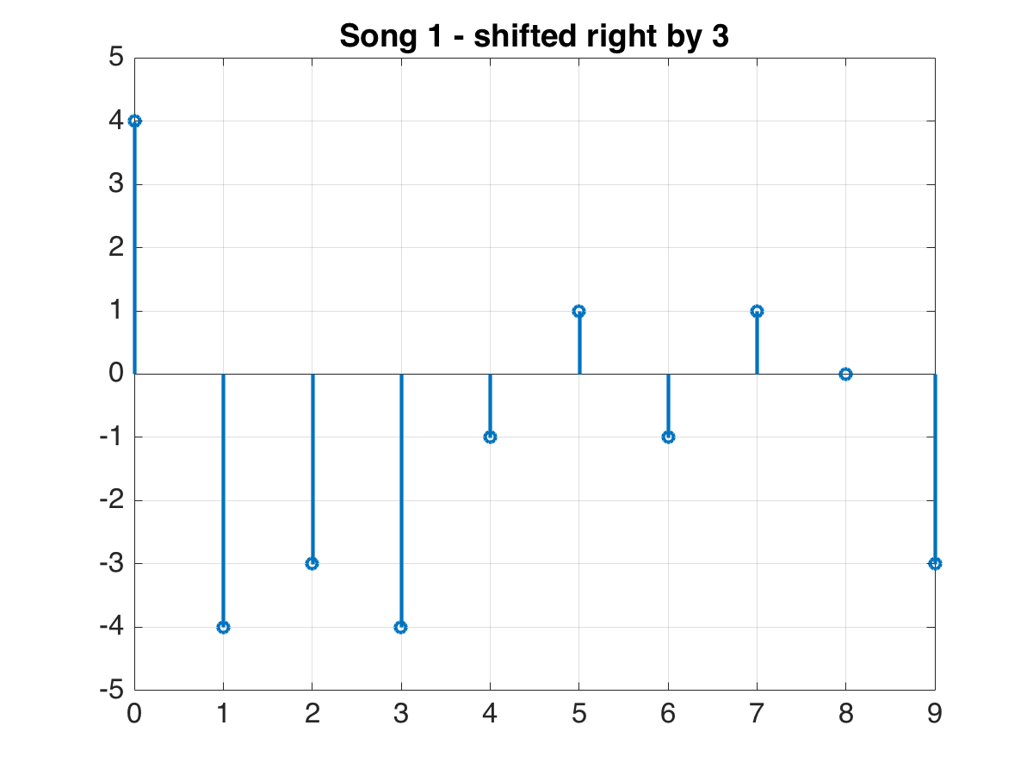
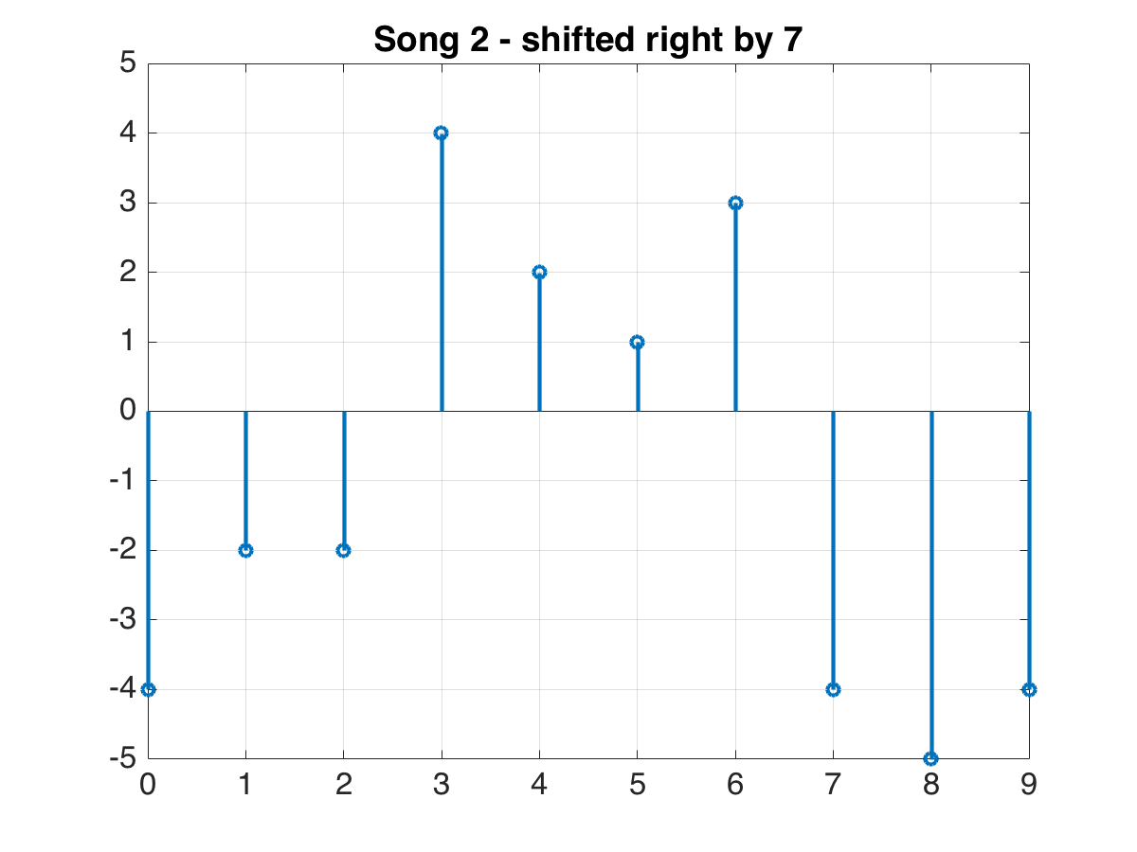
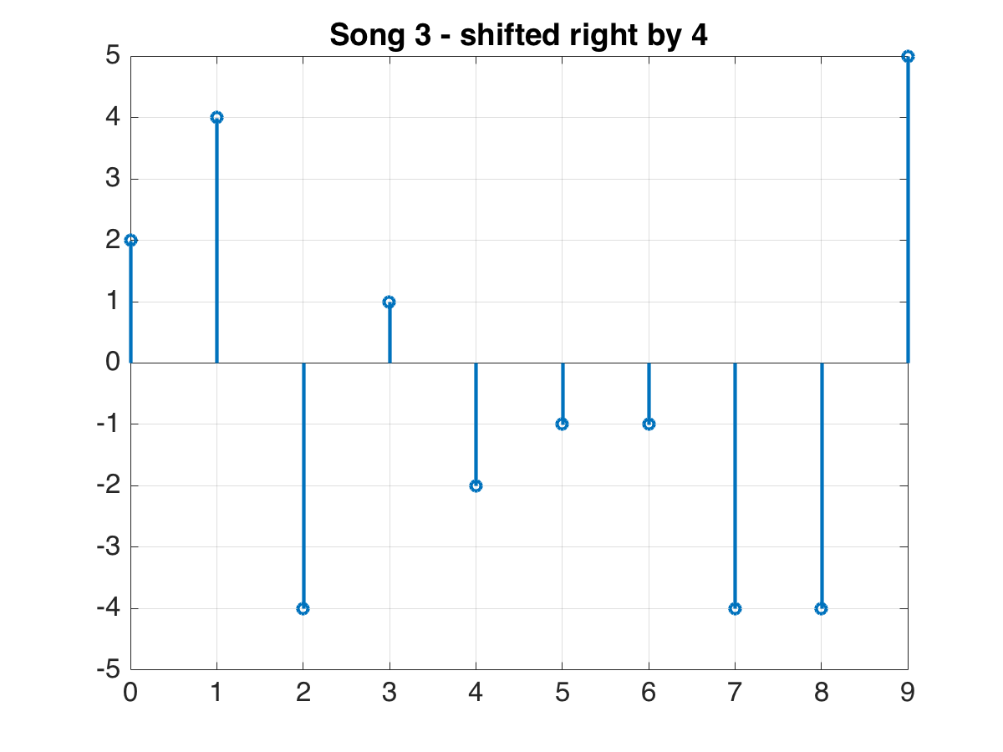
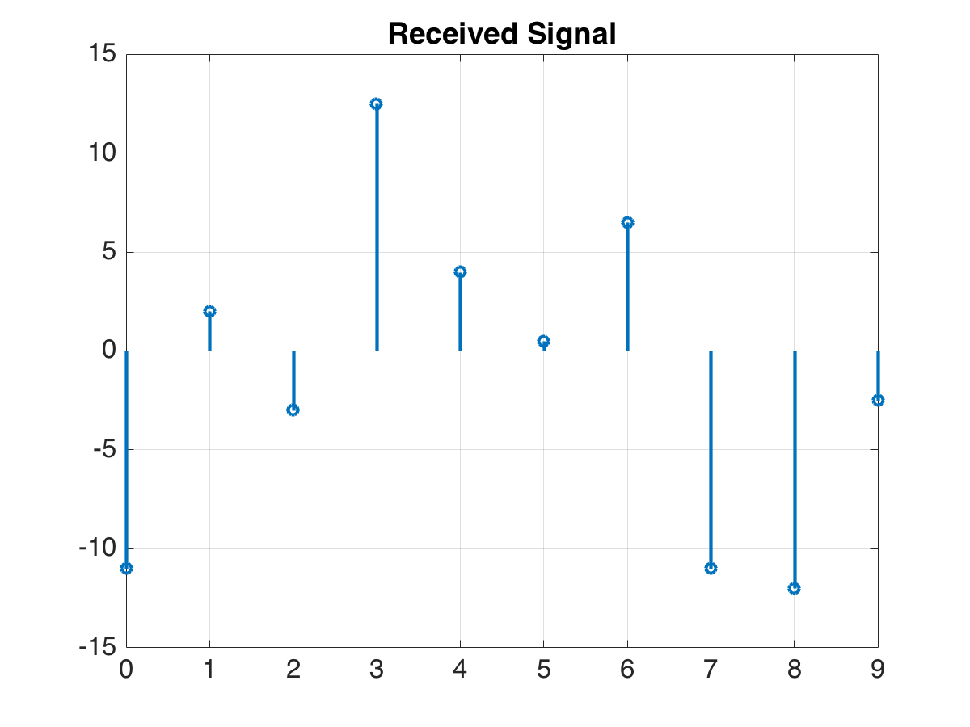
Receiver sees sum of weighted, shifted versions of the codes
-1*
+ 2*
+ 0.5*
From we want to find which songs were received, how they were shifted, and their corresponding weights.

Slide 4
The things we know
The received signal (y)
All possible songs
Sparsity level, k
In this example, k=3

Slide 5
The things we want to know
shifted by how much?
weighted by how much?
which song?
Notes:
we don’t necessarily know that there is one copy of each song

Slide 6
Orthogonal Matching Pursuit (OMP)
(iteration 1)

Slide 7
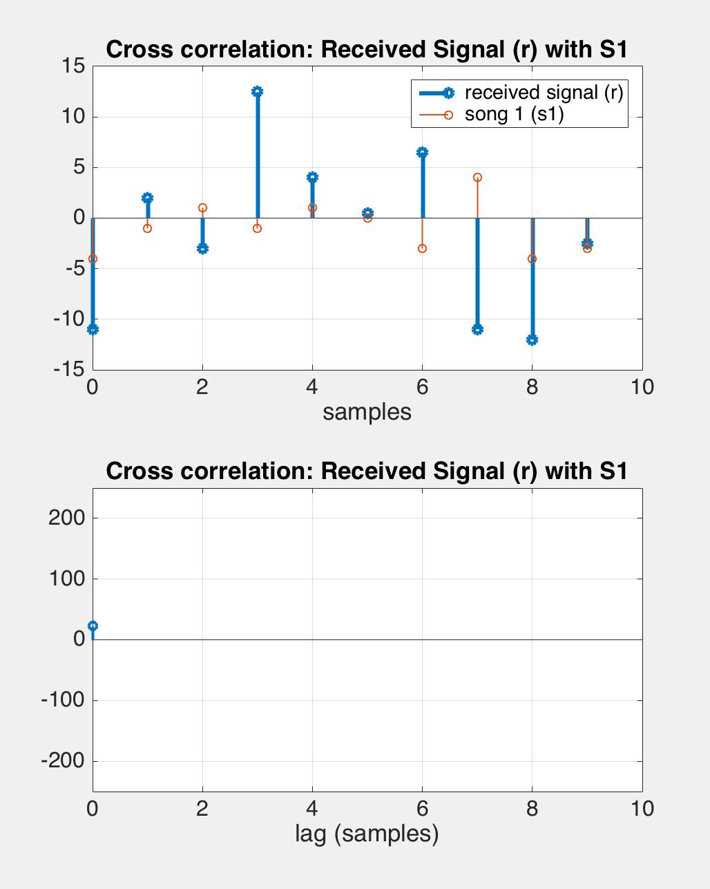
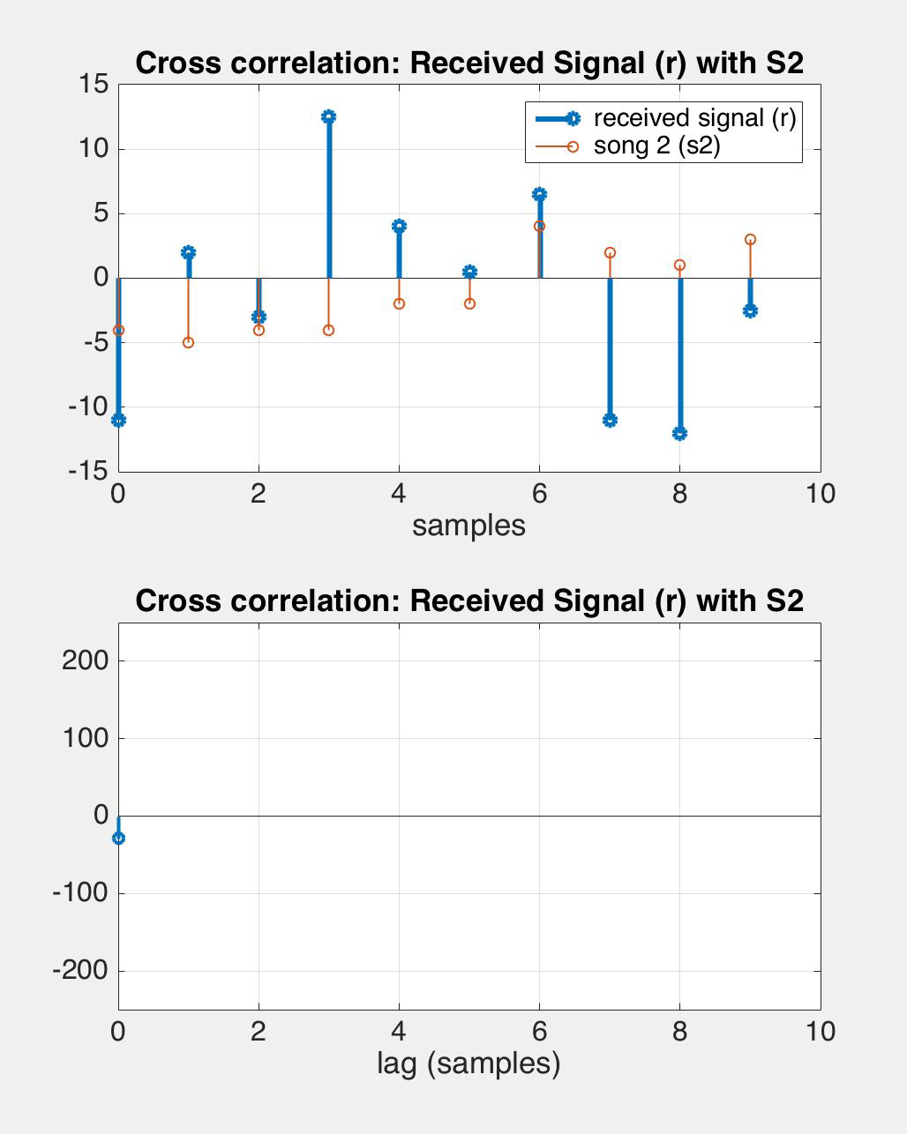
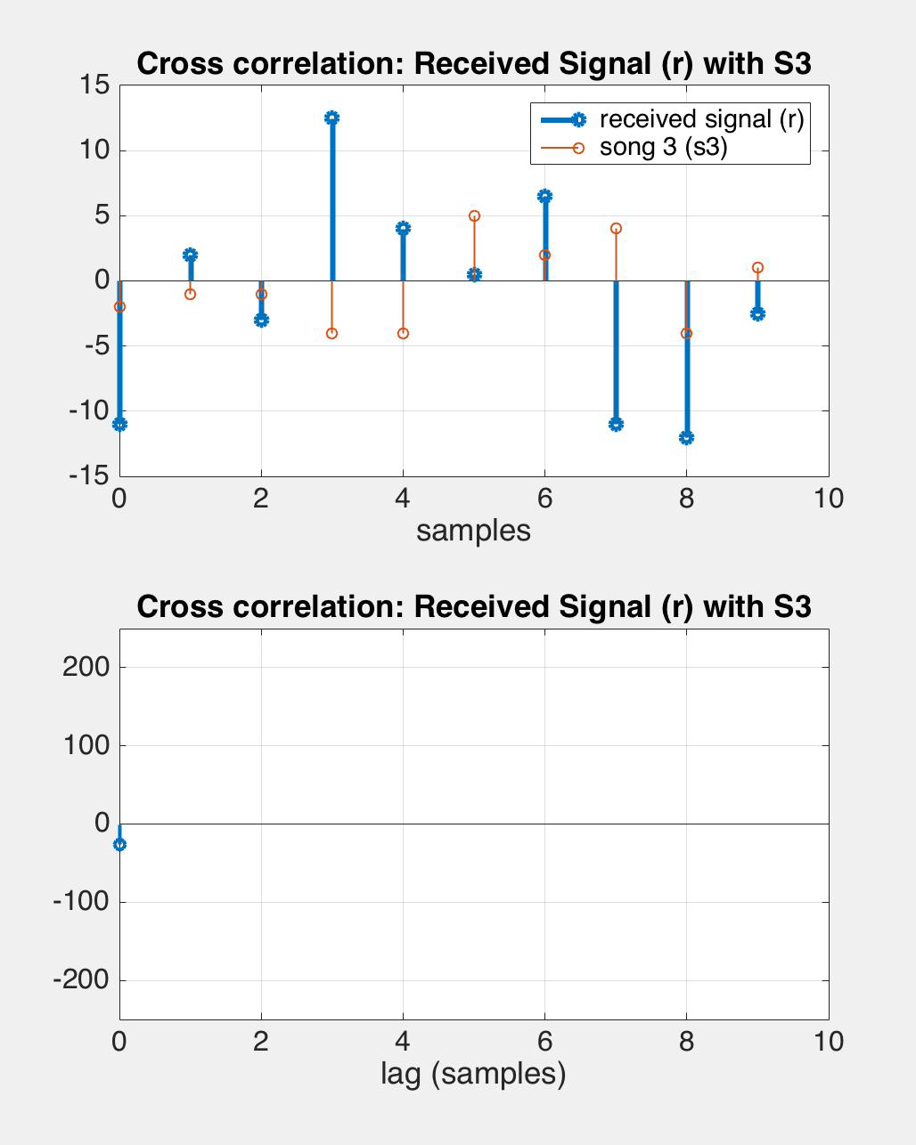
1. Cross-correlate y with all songs

Slide 8
1. Cross-correlate r with the songs

Slide 9
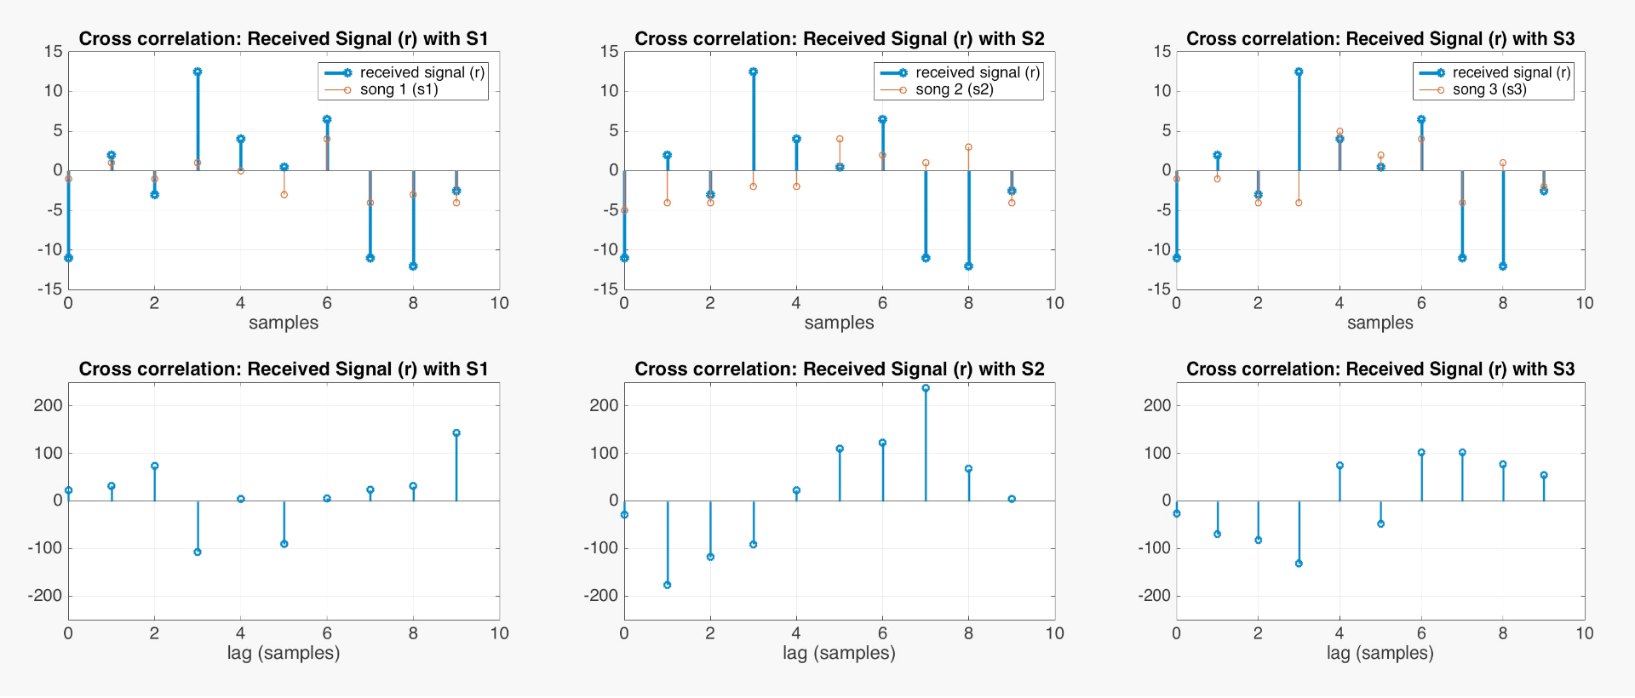
2. Find song/shift combo with max correlation
song 2 with lag = 7

Slide 10
What’s the best approx. of y with only ?
song 2 with lag = 7
received signal y

Slide 11
3. Use least squares to find the weights
song 2 with lag = 7
received signal y
A
= 2.14
(the real coefficient was 2)

Slide 12
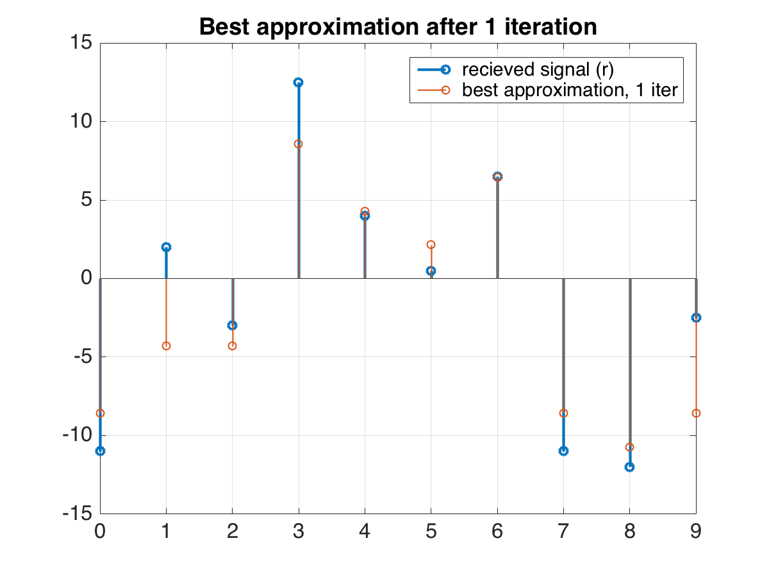
4. How did we do? Find best approx. to r
song 2 with
lag = 7

Slide 13
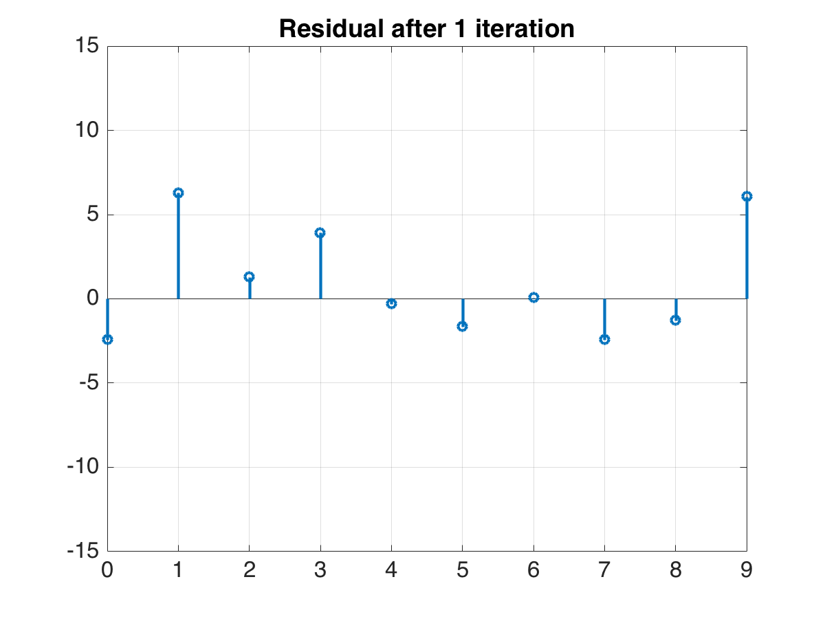
5. Calculate the residual/error e
received signal
best approximation of
received signal

Slide 14
Rinse and repeat
(iteration 2)

Slide 15
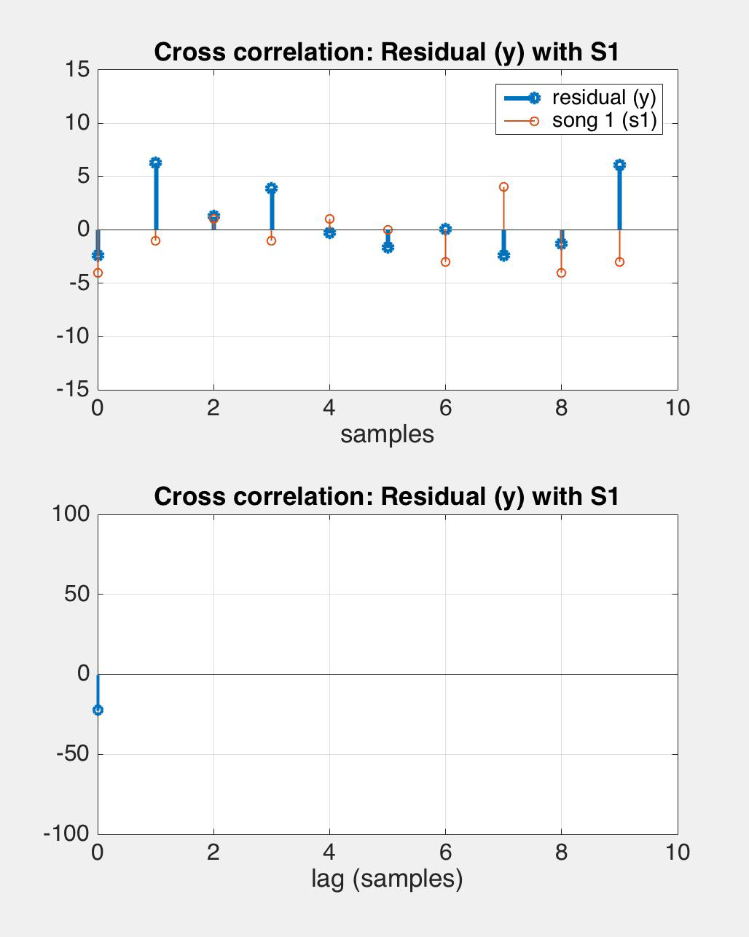
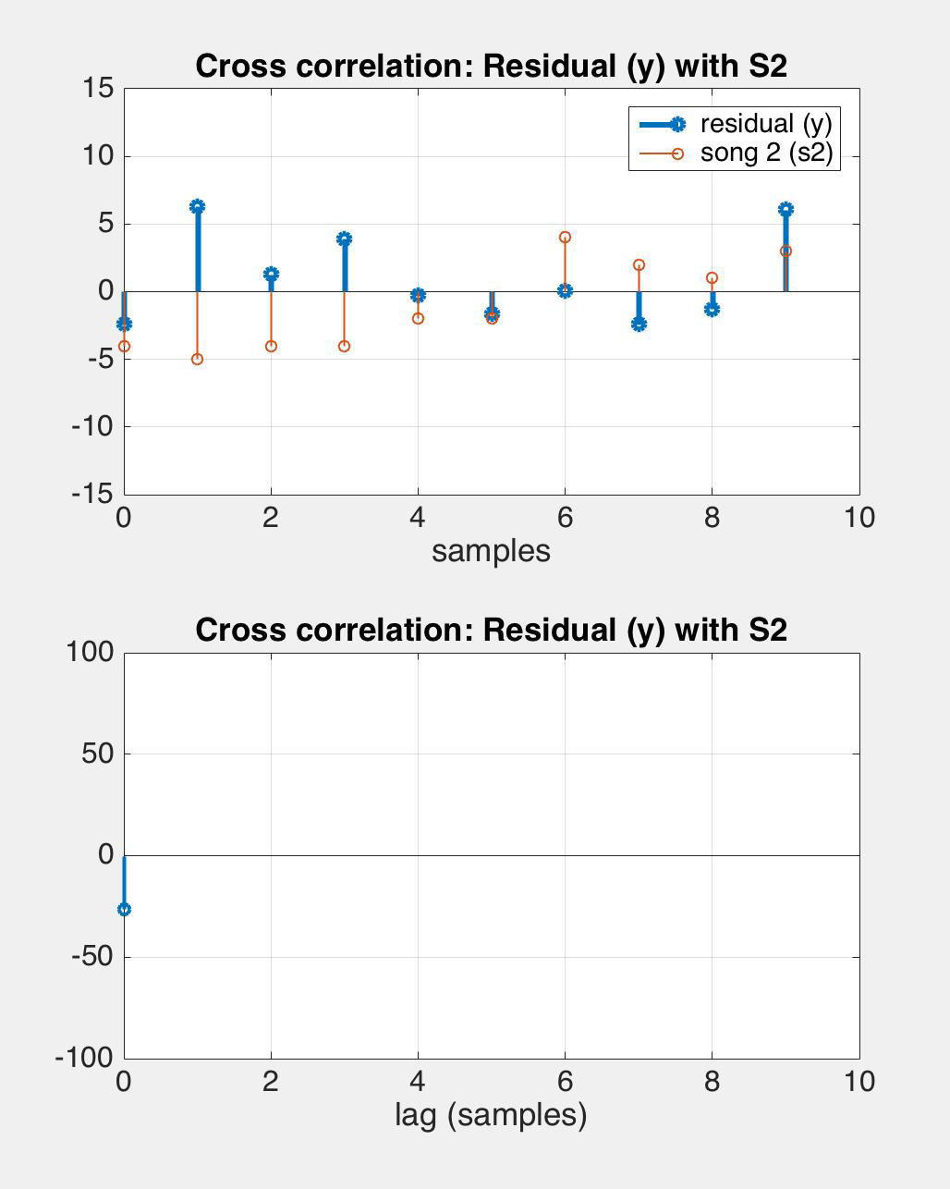
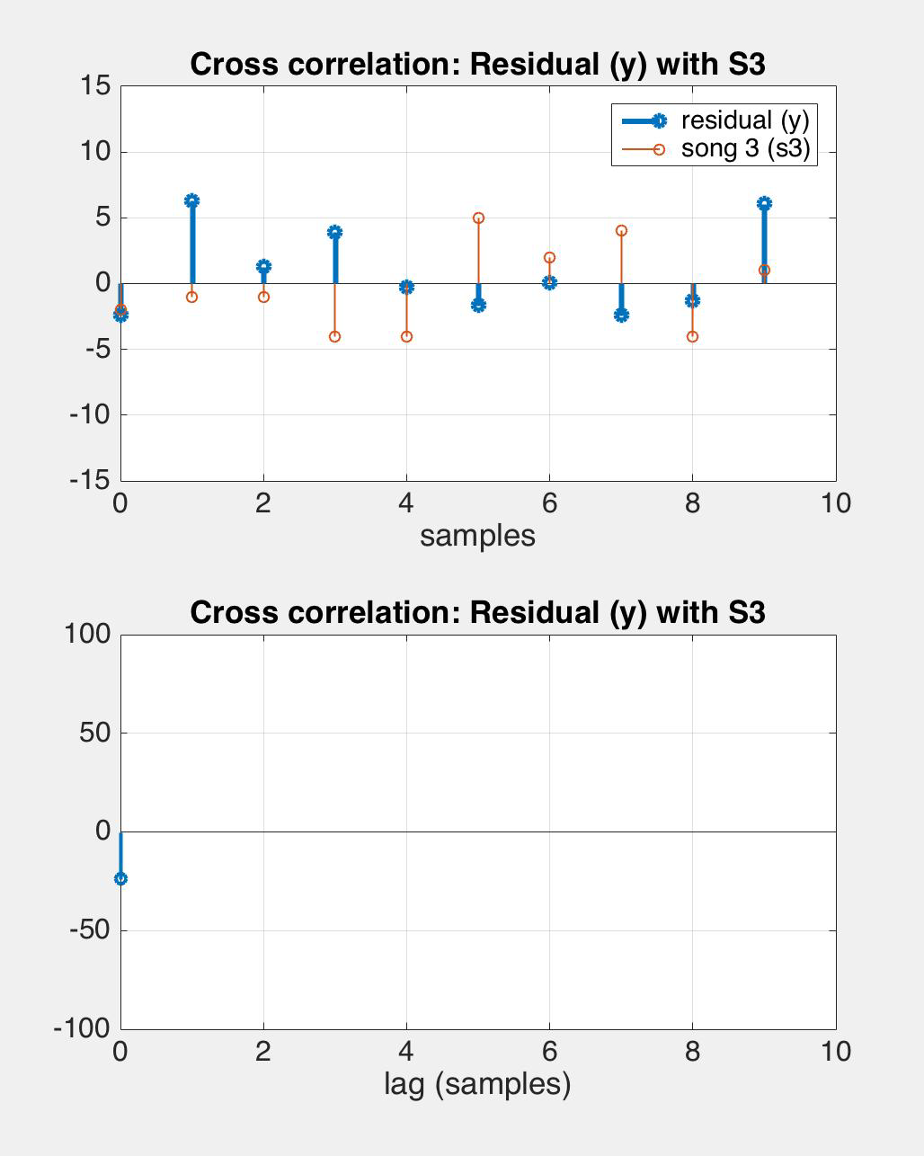
1. Cross-correlate e with all songs

Slide 16
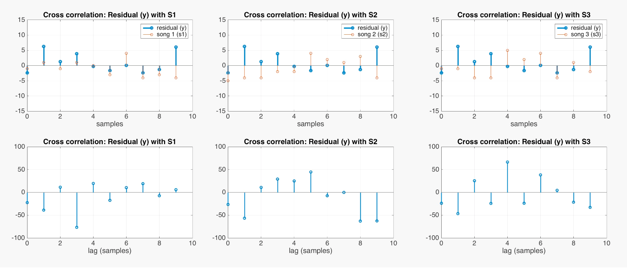
2. Find song/shift combo with max correlation
absolute value
song 1 with lag = 3

Slide 17
What’s the best approx. of y with only , ?
song 1 with lag = 3
song 2 with lag = 7
received signal r

Slide 18
3. Use least squares to find the weights
song 1 with lag = 3
song 2 with lag = 7
received signal y
A

Slide 19
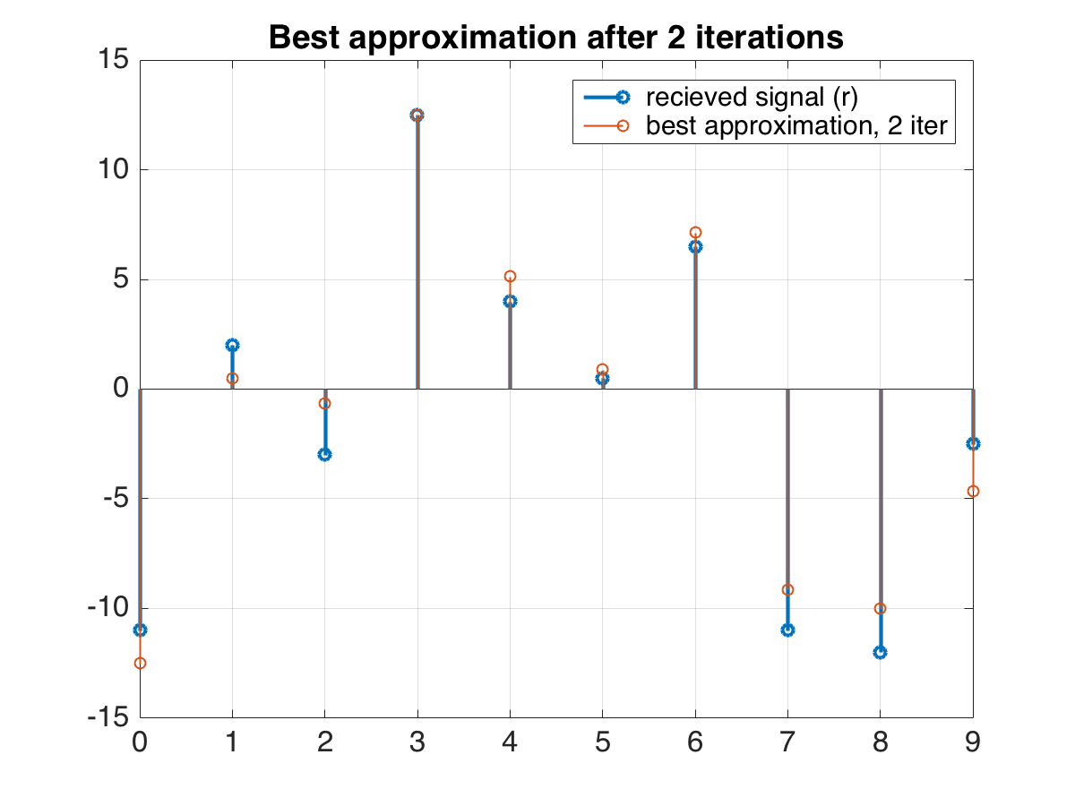
4. How did we do? Find best approx. to y
song 1 with lag = 3
song 2 with lag = 7

Slide 20
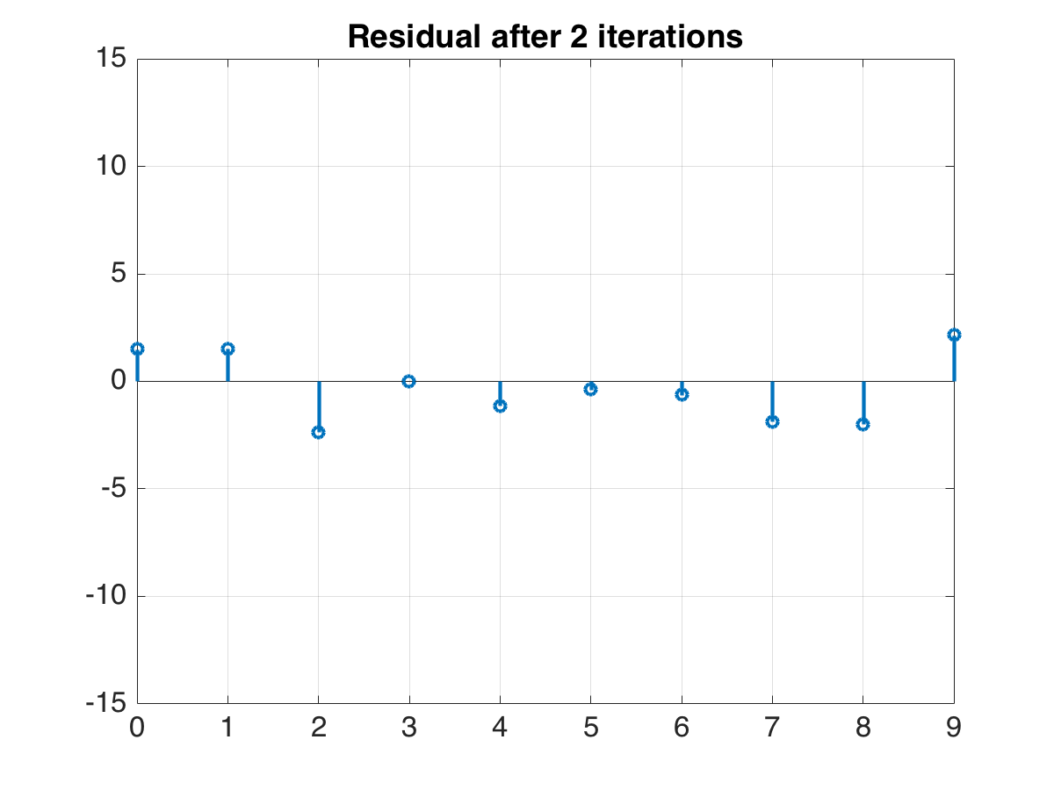
5. Calculate the residual e
received signal
best approximation of
received signal

Slide 21
Iteration 3

Slide 22
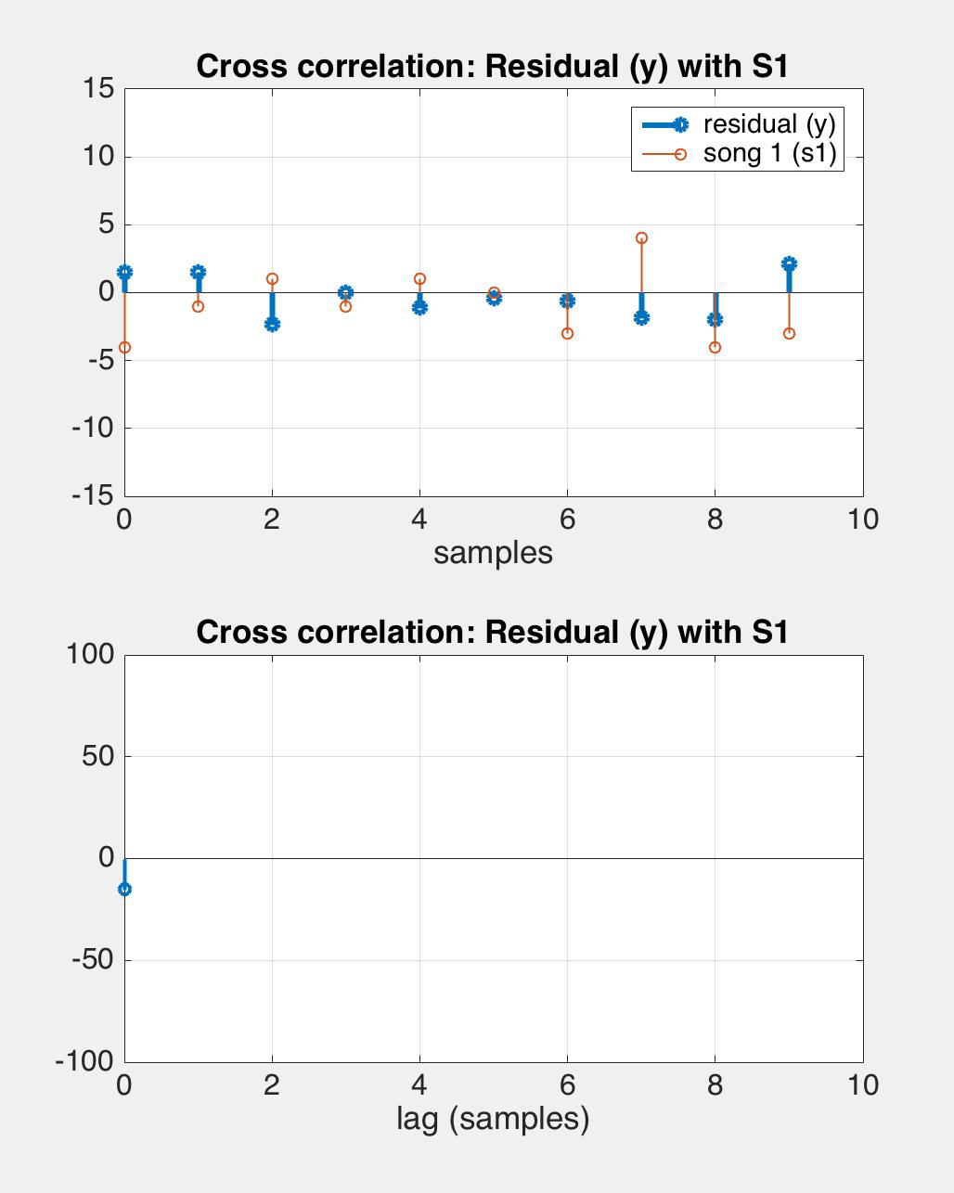
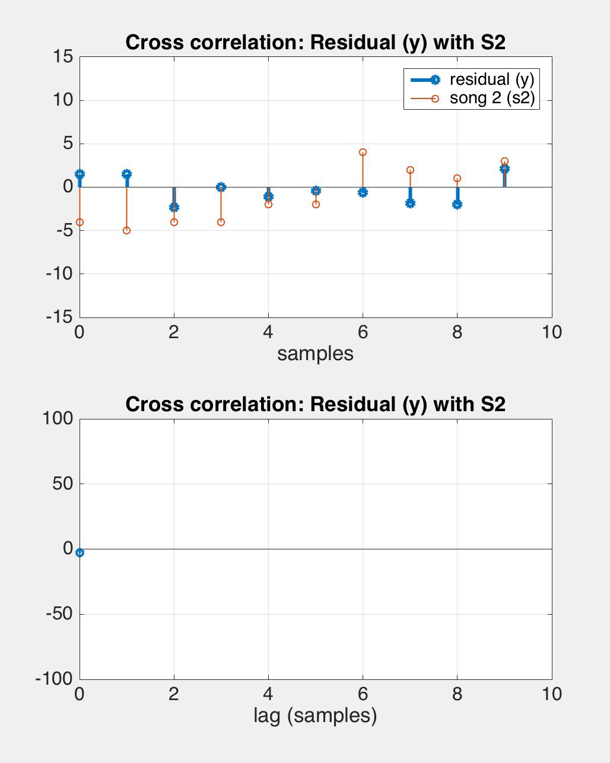
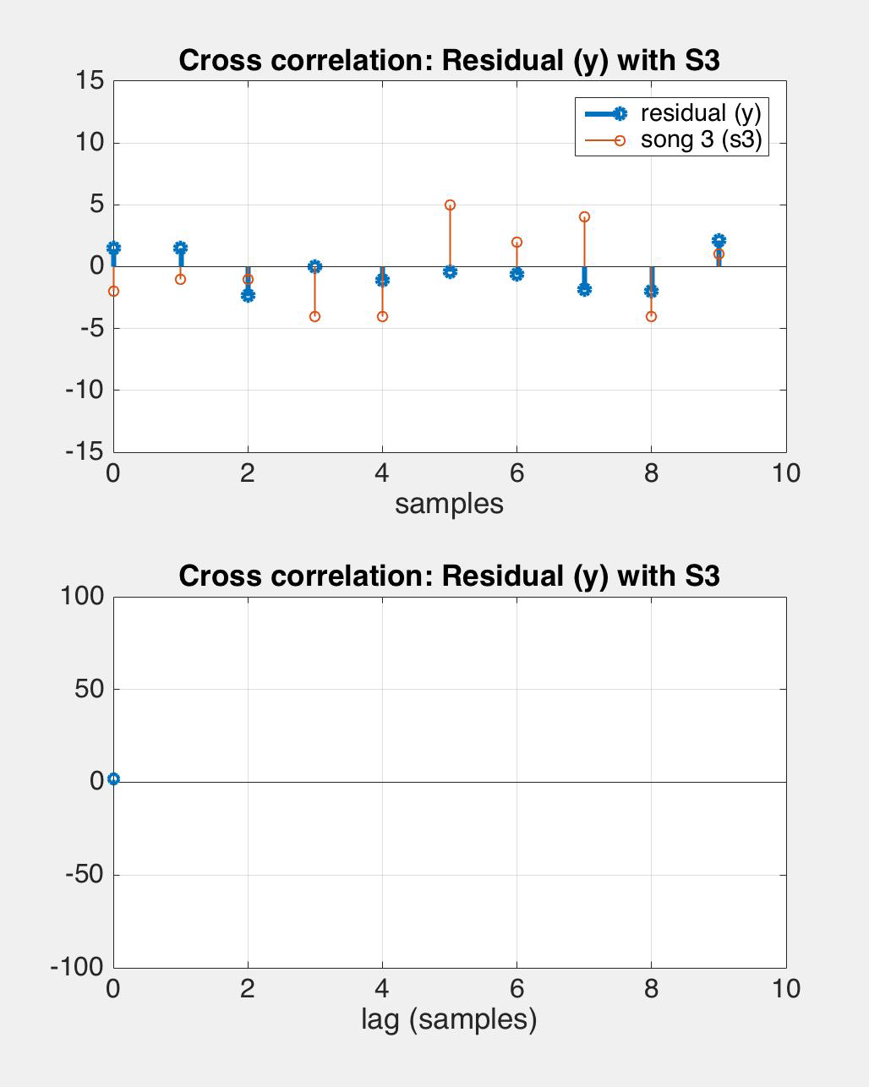
1. Cross-correlate e with all songs

Slide 23
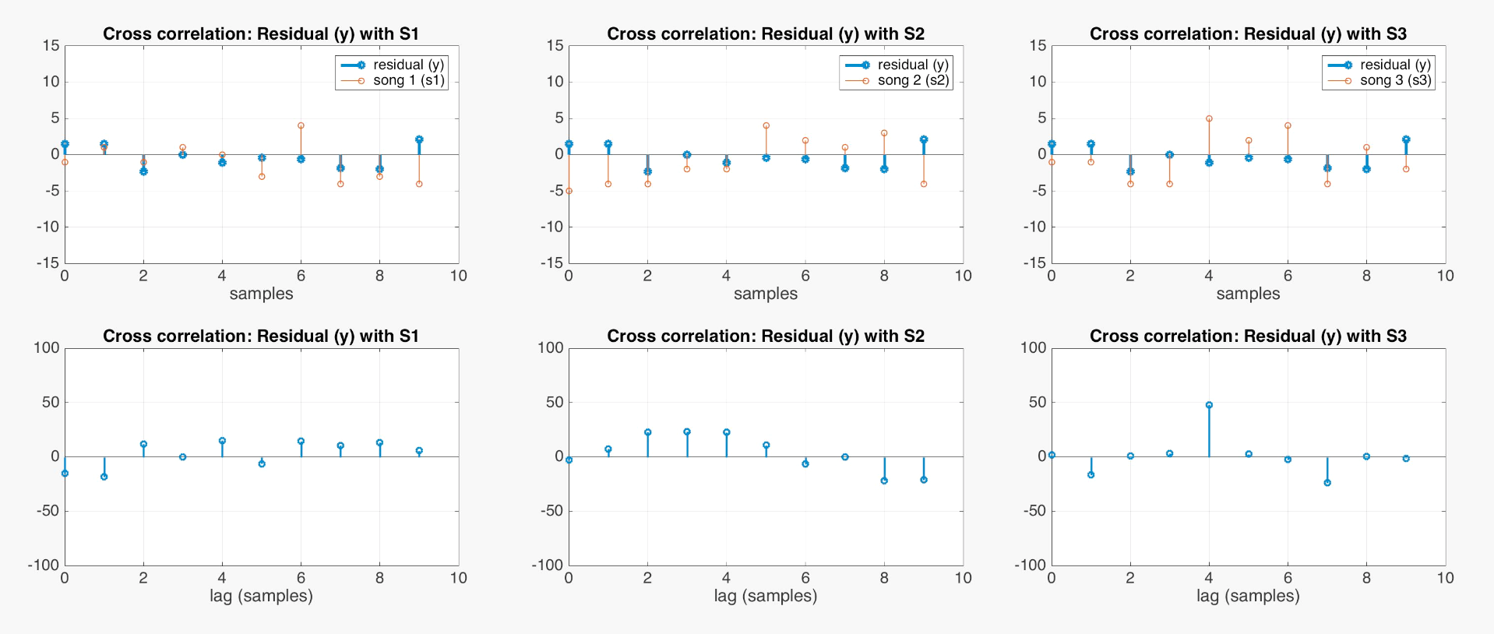
2. Find song/shift combo with max correlation
song 3 with lag = 4

Slide 24
3. Use least squares to find the weights
song 1 with lag = 3
song 2 with lag = 7
song 3 with lag = 4
received signal y
A

Slide 25
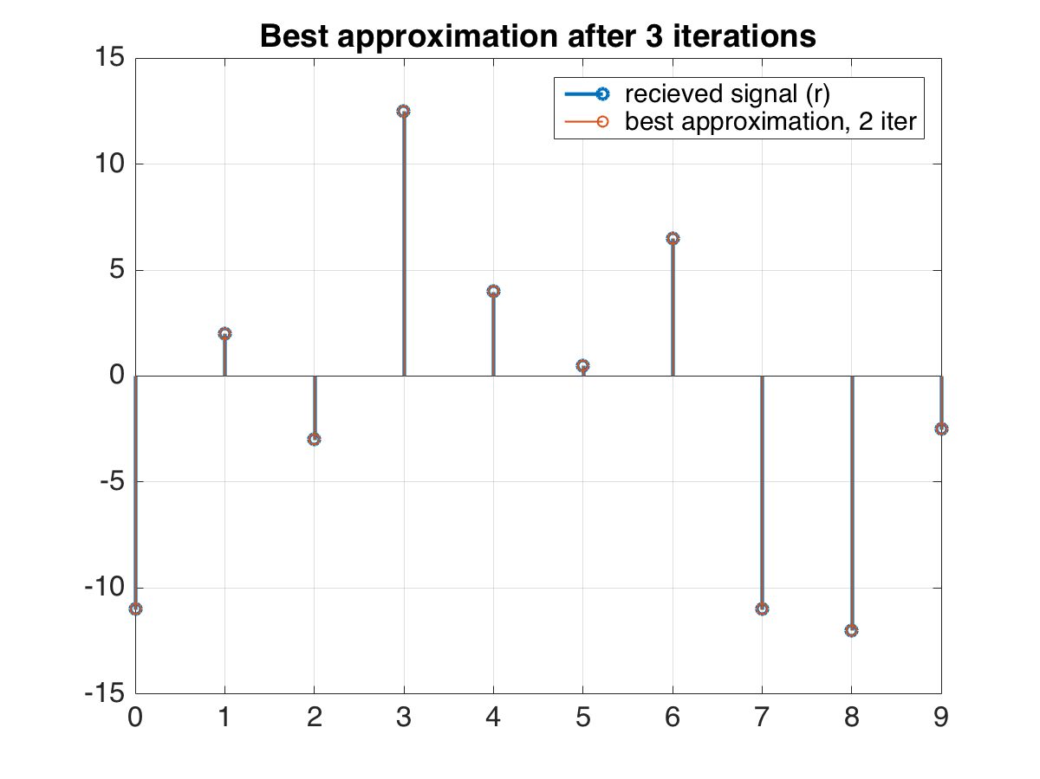
4. How did we do? Find best approx. to y

Slide 26
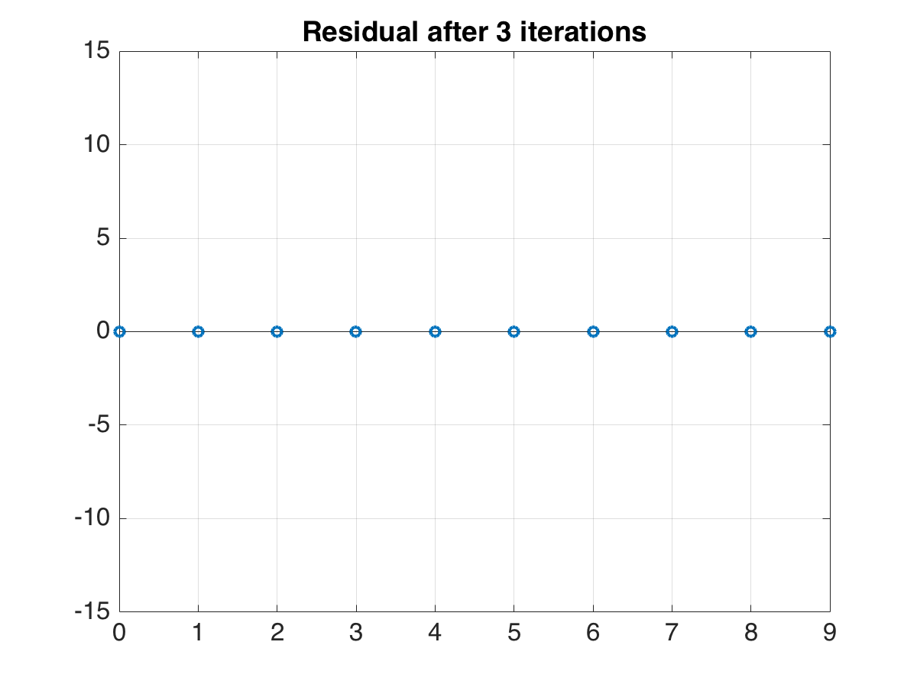
5. Calculate the residual e
No more error! We’re done!
Stop when either:
(1) finished k iterations
OR
(2) norm of residual is lower than th

