Slide 1
Cameras, lenses, and calibration
Camera models
Projection equations
Images are projections of the 3-D world onto a 2-D plane…

Slide 2

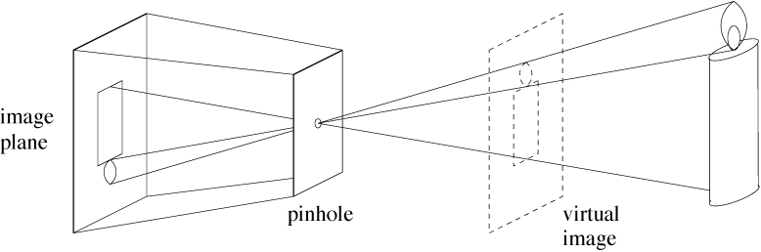
Light rays from many different parts of the scene strike the same point on the paper.
Pinhole camera only allows rays from one point in the scene to strike each point of the paper.
Forsyth&Ponce
Notes:
The point to make here is that each point on the image plane sees light from only
one direction, the one that passes through the pinhole.

Slide 3
Pinhole camera geometry:
Distant objects are smaller

Slide 4
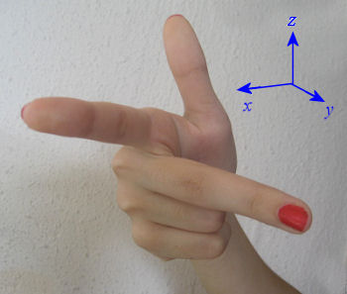
Right - handed system
y
y
left
top
far
z
x
right
bottom
near
x
z
y
z
x
x
z
y

Slide 5
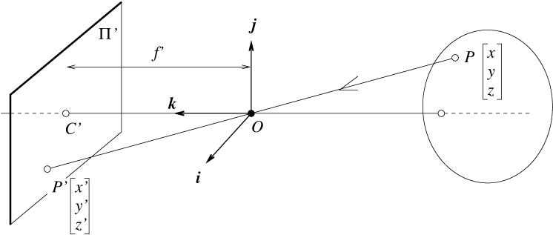
Perspective projection
camera
world
f
y
z
y’
Cartesian coordinates:
  We have, by similar triangles, that (x, y, z) -> (f x/z, f y/z, -f)
  Ignore the third coordinate, and get

Slide 6
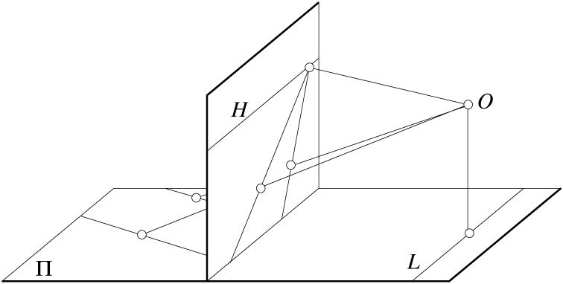
Geometric properties of projection
Points go to points
Lines go to lines
Planes go to whole image or half-planes.
Polygons go to polygons
Degenerate cases
  line through focal point to point
  plane through focal point to line

Slide 7
Perspective projection of that line
Line in 3-space
In the limit as
we have (for ):
This tells us that any set of parallel lines (same a, b, c parameters) project to the same point (called the vanishing point).

Slide 8
Vanishing point
y
camera
z

Slide 9
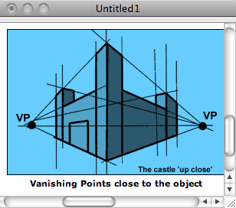
http://www.ider.herts.ac.uk/school/courseware/graphics/two_point_perspective.html

Slide 10
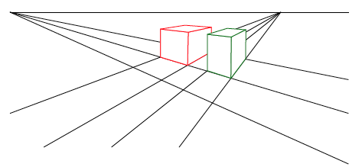
Vanishing points
Each set of parallel lines (=direction) meets at a different point
  The vanishing point for this direction
Sets of parallel lines on the same plane lead to collinear vanishing points.
  The line is called the horizon for that plane

Slide 11
What if you photograph a brick wall head-on?
y
x

Slide 12
Brick wall line in 3-space
Perspective projection of that line
All bricks have same z₀. Those in same row have same y₀
Thus, a brick wall, photographed head-on, gets rendered as set of parallel lines in the image plane.

Slide 13
Other projection models: Orthographic projection

Slide 14
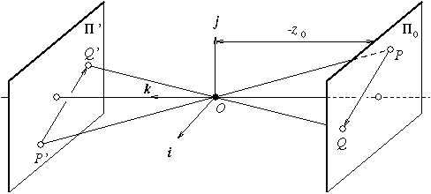
Other projection models:
Weak perspective
Issue
  perspective effects, but not over the scale of individual objects
  collect points into a group at about the same depth, then divide each point by the depth of its group
  Adv: easy
  Disadv: only approximate

Slide 15
Three camera projections
3-d point 2-d image position
(1) Perspective:
(2) Weak perspective:
(3) Orthographic:

Slide 16




Homogeneous coordinates
Is this a linear transformation?
Trick: add one more coordinate:
  no—division by z is nonlinear
homogeneous image
coordinates
homogeneous scene
coordinates
Converting from homogeneous coordinates
Slide by Steve Seitz

Slide 17
Perspective Projection
Projection is a matrix multiply using homogeneous coordinates:
This is known as perspective projection
  The matrix is the projection matrix
Slide by Steve Seitz

Slide 18
Perspective Projection
How does scaling the projection matrix change the transformation?
Slide by Steve Seitz

Slide 19
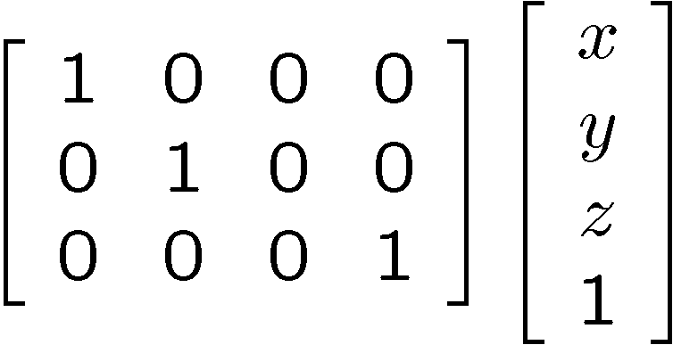
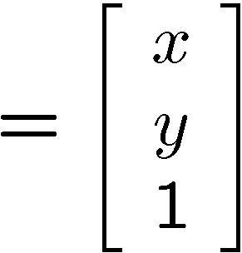

Orthographic Projection
Special case of perspective projection
  Orthography is an approximate model for long focal length (telephoto) lenses and objects whose depth is shallow relative to their distance to the camera
  Also called “parallel projection” . What’s the projection matrix?
Image
World
?
Slide by Steve Seitz

Slide 20
Orthographic Projection
Special case of perspective projection
  Also called “parallel projection”
  What’s the projection matrix?
Image
World
Slide by Steve Seitz

Slide 22
Homogeneous coordinates
2D Points:
2D Lines:
(n_{x}, n_{y})
d

Slide 23
Homogeneous coordinates
Intersection between two lines:

Slide 24
Homogeneous coordinates
Line joining two points:

Slide 25
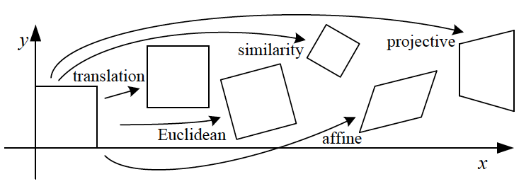
2D Transformations

Slide 26

2D Transformations
Example: translation
tx
ty
=
+

Slide 27

2D Transformations
Example: translation
tx
ty
1 | 0 | tx
0 | 1 | ty
1
=
+
=
.

Slide 28
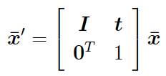
2D Transformations
Example: translation
tx
ty
1 | 0 | tx
0 | 1 | ty
1
=
+
=
.
1 | 0 | tx
0 | 1 | ty
0 | 0 | 1
.
=
Now we can chain transformations

Slide 29
Translation and rotation, written in each set of coordinates
Non-homogeneous coordinates
Homogeneous coordinates
where

Slide 30
Translation and rotation
“as described in the coordinates of frame B”
Let’s write
as a single matrix equation:

Slide 31
Camera calibration
Use the camera to tell you things about the world:
  Relationship between coordinates in the world and coordinates in the image: geometric camera calibration, see Szeliski, section 5.2, 5.3 for references
  (Relationship between intensities in the world and intensities in the image: photometric image formation, see Szeliski, sect. 2.2.)

Slide 32
Intrinsic parameters: from idealized world coordinates to pixel values
Forsyth&Ponce
Perspective projection

Slide 33
Intrinsic parameters
But “pixels” are in some arbitrary spatial units

Slide 34
Intrinsic parameters
Maybe pixels are not square

Slide 35
Intrinsic parameters
We don’t know the origin of our camera pixel coordinates

Slide 36
Intrinsic parameters
May be skew between camera pixel axes

Slide 37
Intrinsic parameters, homogeneous coordinates
Using homogenous coordinates,
we can write this as:
or:
In pixels
In camera-based coords

Slide 38
Extrinsic parameters: translation and rotation of camera frame
Non-homogeneous coordinates
Homogeneous coordinates

Slide 39
Combining extrinsic and intrinsic calibration parameters, in homogeneous coordinates
pixels
Intrinsic
World coordinates
Camera coordinates
Extrinsic
Forsyth&Ponce

Slide 40
Other ways to write the same equation
pixel coordinates
world coordinates
Conversion back from homogeneous coordinates leads to:

Slide 41

Camera parameters
A camera is described by several parameters
  Translation T of the optical center from the origin of world coords
  Rotation R of the image plane
  focal length f, principle point (x’_{c}, y’_{c}), pixel size (s_{x}, s_{y})
  blue parameters are called “extrinsics,” red are “intrinsics”
Projection equation
  The projection matrix models the cumulative effect of all parameters
  Useful to decompose into a series of operations
identity matrix
intrinsics
projection
rotation
translation
  The definitions of these parameters are not completely standardized
    especially intrinsics—varies from one book to another

Slide 42
Projection matrices for Orhographic and scaled orthographic projections
Orthographic projection
(5dof)
Scaled orthographic projection
(6dof)

