Slide 1
EE40 Lecture 11 Josh Hug
7/19/2010

Slide 2
Logistical Things
Lab 4 tomorrow
Lab 5 (active filter lab) on Wednesday
Prototype for future lab for EE40
Prelab is very short, sorry.
Please give us our feedback
Google docs for labs and general class comments now available (link shared via email)
Bring a music player if you have one (if not, you can use the signal generator in the lab)
HW5 due tomorrow at 2PM
HW6 due Friday at 5PM (also short)
Midterm next Wednesday 7/28
Focus is heavily on HW4, 5, 6, and Labs P1, 4, 5
Will reuse concepts from HW 1,2,3

Slide 3
Logistics
No lunch today
Slightly shorter lecture today
Midterm regrade requests due today
Office hours Cory 240 2:30-4PM or so

Slide 4
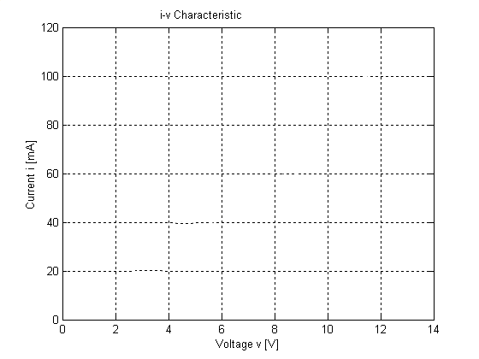
iClicker Question #1
Consider a capacitor with a capacitance of $1nF$. Total resistance of circuit is small $\sim 1Ω$.
If we compile an I-V table in lab with a voltage source and multimeter by:
Applying a set of test voltages
Measuring current through the capacitor for each source
What I-V characteristic will we get?
A. Horizontal line at I=0
B. Vertical line at I=0
C. Line of slope 1/RC
D. Horizontal line at I=V/1Ω
E. Something else

Slide 5
iClicker Question #2
Consider an inductor with an inductance of $1μ$H. Total resistance of circuit is small $\sim 1Ω$.
If we compile an I-V table in lab with a voltage source and multimeter by:
Applying a set of test voltages
Measuring current through the inductor for each source
What I-V characteristic will we get?
A. Horizontal line at I=0
B. Vertical line at I=0
C. Line of slope R/L
D. Line at I=V/1Ω
E. Something else

Slide 6
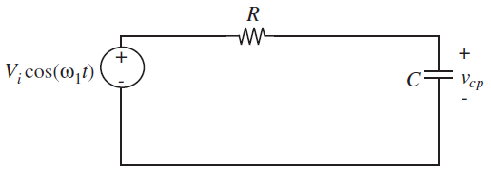
Easy Method for AC Circuits
We want to find the voltage across the capacitor for the following circuit
Homogenous solution is easy, since source is irrelevant
Finding particular solution the usual way (plugging in a guess, finding coefficients that cancel) is painful

Slide 7
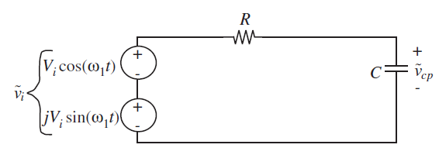
Easy Method for AC Circuits
$\tilde{v_{i}}=V_{i}e^{jwt}$
Guess $v_{cp}=Acos\left(ω_{1}t+φ\right)$
Guess ${\tilde{V}}_{cp}=k_{1}e^{jωt}$
Plug into ODE
Plug into ODE
Solve for A and $φ$ (hard)
Divide by $e^{jωt}$. Now $t$ is gone
$$v_{cp}=Acos\left(ω_{1}t+φ\right)$$
Solve for $k_{1}$ (easy)
$$v_{cp}={Real[k}_{1}e^{jωt}]$$

Slide 8
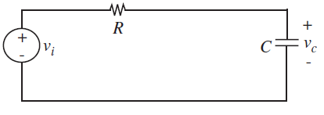
Memory Circuits with Exponential Source
$$v_{I}=V_{i}e^{jwt} t>0$$
$$V_{O}^{′}=−\frac{V_{O}}{RC}+V_{i}\frac{e^{jωt}}{RC}$$
Homogeneous solution is just $Ae^{−t/RC}$
Pick particular solution $V_{O,P}=k_{1}e^{jwt}$, plug in:
$$k_{1}jωe^{jωt}=−k_{1}\frac{e^{jωt}}{RC}+V_{i}\frac{e^{jωt}}{RC}$$
Divide by $e^{jwt}$, and solve for k₁
$$k_{1}=V_{i}\frac{1}{1+jωRC}$$
$$V_{O,P}\left(t\right)=V_{i}\frac{1}{1+jωRC}e^{jwt}$$
Real part of $V_{O,P}$ gives solution for cosine source

Slide 9
Inverse Superposition
Superposition tells us that our output $V_{O,P}\left(t\right)$ will just be the sum of the effect of these two sources
$$V_{O,P}\left(t\right)=V_{i}\frac{1}{1+jωRC}e^{jwt}$$
Luckily for us, all complex numbers are the sum of their real and imaginary parts $x=a+jb$
Just find real part and we’re done!

Slide 10
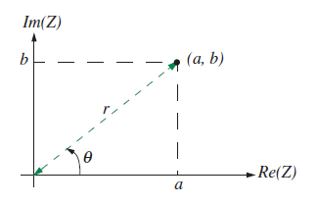
Real Part of Expression
Finding the real part of the expression is easy, it just involves some old school math that you’ve probably forgotten (HW5 has complex number exercises)
$$V_{O,P}\left(t\right)=\frac{1}{1+jωRC}V_{i}e^{jwt}$$
Key thing to remember is that complex numbers have two representations
Rectangular form: $a+jb$
Polar form: $re^{jθ}$
$$r=\sqrt{a^{2}+b^{2}}$$
$$θ=\arctan\left(\frac{b}{a}\right)$$

Slide 11
Real Part of Expression
What we have is basically the product of two complex numbers
Let’s convert the left one to polar form
$$V_{O,P}\left(t\right)=\frac{1}{1+jωRC}V_{i}e^{jwt}$$
$$r=\sqrt{a^{2}+b^{2}}$$
Rectangular form: $a+jb$
Polar form: $re^{jθ}$
$$θ=\arctan\left(\frac{b}{a}\right)$$
$$V_{O,P}\left(t\right)=\frac{1}{Re^{jφ}}V_{i}e^{jwt}=V_{i}\frac{1}{\sqrt{1+{\left(wRC\right)}^{2}}}e^{φj}e^{jwt}$$
$$φ=arctan⁡(ωRC)$$

Slide 12
Real Part of Expression
$$V_{i}\frac{1}{\sqrt{1+{\left(wRC\right)}^{2}}}e^{jφ}e^{jwt}$$
$$V_{i}\frac{1}{\sqrt{1+{\left(wRC\right)}^{2}}}e^{j(φ+ωt)}$$
$$V_{i}\frac{1}{\sqrt{1+{\left(wRC\right)}^{2}}}(cos\left(ωt+φ\right)+jsin(ωt+φ))$$

Slide 13
Real Part of Expression
$$V_{i}\frac{1}{1+{\left(wRC\right)}^{2}}e^{jφ}e^{jwt}$$
Superposition tells us that our output $V_{O,P}\left(t\right)$ will just be the sum of the effect of these two sources
$$V_{O,P}\left(t\right)=\frac{V_{i}}{\sqrt{1+{\left(wRC\right)}^{2}}}(cos\left(ωt+φ\right)+jsin(ωt+φ))$$
Thus, particular solution (forced response) of original cosine source is just the real part
$$V_{O,P}\left(t\right)=\frac{V_{i}}{{\left(1+ωRC\right)}^{2}}cos\left(ωt+φ\right)$$
$$φ=arctan⁡(ωRC)$$

Slide 14
Easy Method for AC Circuits
Write ODE
Just as actually writing the ODE isn’t necessary for DC sources, we can avoid the ODE again in AC circuits:
Impedance Analysis
Guess ${\tilde{V}}_{cp}=k_{1}e^{jωt}$
Plug into ODE
Divide by $e^{jωt}$. Now $t$ is gone
Solve for $k_{1}$ (easy)
$\tilde{v_{i}}=V_{i}e^{jwt}$
$$v_{cp}={Real[k}_{1}e^{jωt}]$$

Slide 15
Impedance
$$v_{I}=V_{i}e^{jωt} t>0$$
For a complex exponential source:
$$V_{C,P}\left(t\right)=\frac{1}{1+jωRC}v_{I}(t)$$
Rewrite as:
$$V_{C,P}\left(t\right)=\frac{1/jwC}{1/jwC+R}v_{I}(t)$$
Let $Z_{c}=1/jwC$
$$V_{C,P}\left(t\right)=\frac{Z_{c}}{Z_{c}+R}v_{I}(t)$$
Looks a lot like…
voltage divider
Real part gives solution for $v_{I}=V_{i}cos⁡(ωt)$

Slide 16
Method of Impedance Analysis (without Phasors)
Replace passive components with equivalent impedance, $Z_{c}=\frac{1}{jωC}$, $Z_{L}=jωL$, $Z_{R}=R$
Replace all sources with complex exponentials
e.g. $v\left(t\right)=A\cos\left(ωt+θ\right)⟹\tilde{v}(t)=Ae^{j(wt+θ) }$
Solve using Ohm’s Law of Impedances for complex exponential sources
$\tilde{v}\left(t\right)=\tilde{i}\left(t\right)Z$
Just like normal node voltage, but with complex numbers
Real part of node voltage ${\tilde{V}}_{a}\left(t\right)$ gives true output $V_{a}\left(t\right)$
Lugging these complex exponential functions is algebraically annoying

Slide 17
Phasors (not in the book!)
Definition: A phasor is a complex number which represents a sinusoid
$f\left(t\right)=Acos\left(ωt+θ\right)$
Three parameters
A: Magnitude
$ω$: Frequency
$θ:$ Phase
The phasor representation of the sinusoid above is$Ae^{jθ}$
In shorthand we write phasor as $A∠θ$

Slide 18
Phasors
If we have a voltage $V\left(t\right)=Acos\left(ωt+θ\right)$
The phasor version of the voltage is $\hat{V}$=$A∠θ$
If we have a phasor $\hat{I}$=$α∠φ$, the time function this phasor represents is $i\left(t\right)=αcos⁡(ωt+φ)$

Slide 19
Why are phasors useful?
Sources that look like $Ae^{t(jω+θ)}$ result in lots of $Ae^{t(jw+θ) }$ terms in our algebra
When you apply a sinusoidal source to a circuit, the amplitude and phase will vary across components, but it will always still be $αe^{t(jω+φ)}$
Important: $ω$ doesn’t change!
Otherwise we’d need REALLY complex numbers
Thus, we’ll just replace our sources with a complex number $A∠φ$ and just keep in mind that this number represents a function throughout

Slide 20
Why are phasors useful?
We know that for complex exponential sources, we have that:
$\tilde{v}\left(t\right)=\tilde{i}\left(t\right)Z$
$real\left[\tilde{v}\left(t\right)\right]=real[\tilde{i}\left(t\right)Z]$
Phasors are complex numbers $\hat{V}$ and $\hat{I}$ which represent cosine functions $v\left(t\right)$ and $i(t)$
Cosine functions are just the real parts of complex exponentials
Thus, in the world of phasors, we can just rewrite Ohm’s Law of Impedances as:
$\hat{V}\text{=}\hat{I}Z$

Slide 21
Method of Impedance Analysis (with Phasors)
Replace passive components with equivalent impedance, $Z_{c}=\frac{1}{jωC}$, $Z_{L}=jωL$, $Z_{R}=R$
Replace all sources with phasor representation: e.g. $v\left(t\right)=A\cos\left(ωt+θ\right)⟹\hat{V}\left(t\right)=A∠θ$
Solve using Ohm’s Law of Impedances:
$\hat{v}=\hat{i}Z$
Just like normal node voltage, but with complex numbers, attaining voltage phasors ${\hat{V}}_{a}$, ${\hat{V}}_{b}, …$
Output $V_{a}(t)$ is just $|{\hat{V}}_{a}|cos(ωt+∠{\hat{V}}_{a})$
Original sources are implicitly represented by phasors
Time is gone completely from our problem

Slide 22
Example
$$v_{I}=V_{i}cos\left(ωt\right), t>0$$
$$R=10,000Ω$$
$$C=1μF$$
$$V_{i}=5V$$
$$ω=100$$
Find $i(t)$ in
steady state
$Z_{R}=10000$, $Z_{C}=\frac{1}{jωC}=−10000j$
$\hat{V}=V_{i}∠0=5∠0$
$Z_{eq}=10000−10000j$
$\hat{I}=\frac{5∠0}{10000−10000j}$

Slide 23
Example
$$v_{I}=V_{i}cos\left(ωt\right), t>0$$
$$R=10,000Ω$$
$$C=1μF$$
$$V_{i}=5V$$
$$ω=100$$
Find $i(t)$ in
steady state
$\hat{I}=\frac{5∠0}{10000−10000j}$
Polar divided by non polar, so convert bottom to polar
$10000−10000j=10000\sqrt{2}∠\frac{−π}{4}$

Slide 24
Example
$$v_{I}=V_{i}cos\left(ωt\right), t>0$$
$$R=10,000Ω$$
$$C=1μF$$
$$V_{i}=5V$$
$$ω=100$$
Find $i(t)$ in
steady state
$\hat{I}=\frac{5∠0}{10000−10000j}$
$10000−10000j=10000\sqrt{2}∠\frac{−π}{4}$
So $\hat{I}=\frac{5∠0}{10000\sqrt{2}∠\frac{−π}{4}}=\frac{1}{2000\sqrt{2}}∠\frac{π}{4}$

Slide 25
Example
$$v_{I}=V_{i}cos\left(ωt\right), t>0$$
$$R=10,000Ω$$
$$C=1μF$$
$$V_{i}=5V$$
$$ω=100$$
Find $i(t)$ in
steady state
$\hat{I}=\frac{1}{2000\sqrt{2}}∠\frac{π}{4}$
$i\left(t\right)=\frac{1}{2000\sqrt{2}}cos⁡(100t+\frac{π}{4})$ [in steady state]

Slide 26
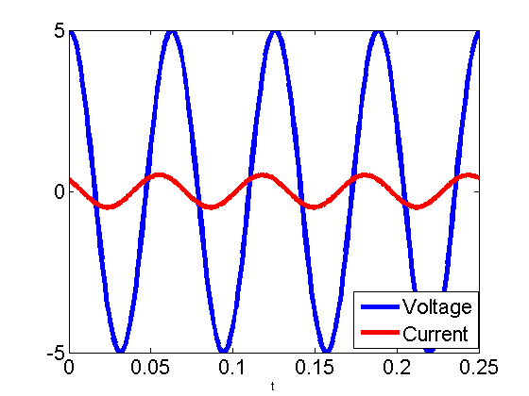
Example
$$v_{I}=V_{i}cos\left(ωt\right), t>0$$
$$i\left(t\right)=\frac{1}{2000\sqrt{2}}cos⁡(100t+\frac{π}{4})$$
Current has same shape as voltage
Current is $10000\sqrt{2}$ times smaller than source voltage
Current leads source voltage by $\frac{π}{4}$ radians or
$\frac{π}{400}$ seconds
Not to scale

Slide 27
Harder Example
On board

Slide 28
Filters
Often, we’ll want to build circuits which react differently based on different signal frequencies, e.g.
Splitting audio signals into low and high portions (for delivery to tweeter and subwoofer)
Removing noise of a particular frequency (e.g. 60 Hz noise or vuvuzela sound)
Removing signals except those at a certain frequency

Slide 29
Example Filter
$$v_{I}=V_{i}cos\left(ωt\right), t>0$$
$$R=10,000Ω$$
$$C=1μF$$
$$V_{i}=5V$$
Find v_{c}$(t)$ in
steady state
$$Z_{C}={−10}^{6}j/ω$$
${\hat{V}}_{C}=\frac{Z_{C}}{Z_{C}+Z_{R}}{\hat{V}}_{I}$
${\hat{V}}_{C}=\frac{−{10}^{6}j/ω}{−{10}^{6}j/w+{10}^{5}}{\hat{V}}_{I}$
${\hat{V}}_{C}=\frac{1}{1+0.1jw}{\hat{V}}_{I}$
$$Z_{R}={10}^{5}$$
- Transfer Function $H(jω)$

Slide 30
Transfer Functions
${\hat{V}}_{C}=\frac{1}{1+0.1jw}{\hat{V}}_{I}=H(jω){\hat{V}}_{I}$
Maps system input signal to system output signal
Plug an input voltage $\operatorname{Acos}\left(ωt+φ\right)$ into ${\hat{V}}_{I}$
Get an output voltage $A\left|H\left(jω\right)\right|\cos\left(ωt+φ+∠H\left(jω\right)\right)$
Output is scaled and shifted in time
Scaling and shifting depend on frequency
Frequency is unchanged (linear system)
Tells you how system will respond to any frequency, a.k.a. frequency response

Slide 31
Using a Transfer Function
${\hat{V}}_{C}=\frac{1}{1+0.1jw}{\hat{V}}_{I}=H(jω){\hat{V}}_{I}$
Suppose $v_{i}(t)$ is $3cos⁡(50t+\frac{π}{4})$
${\hat{V}}_{I}=3∠\frac{π}{4}$
$H\left(j50\right)=\frac{1}{1+5j}$
Output phasor ${\hat{V}}_{C}$ is just ${\hat{V}}_{I}×H\left(j50\right)$
${\hat{V}}_{C}=\frac{3}{\sqrt{26}}∠(\frac{π}{4}−1.37)$
$v_{c}\left(t\right)=\frac{3}{\sqrt{26}}cos⁡(50t+\frac{π}{4}−1.37$)
$$|H\left(j50\right)|=1/\sqrt{26}$$
$$∠H\left(j50\right)=−ArcTan[5/1]$$
$$=−1.37$$

Slide 32
Using a Transfer Function (general)
${\hat{V}}_{C}=\frac{1}{1+0.1jw}{\hat{V}}_{I}=H(jω){\hat{V}}_{I}$
Suppose $v_{i}(t)$ is $3cos⁡(ωt+\frac{π}{4})$
${\hat{V}}_{I}=3∠\frac{π}{4}$
$H\left(jw\right)=\frac{1}{1+0.1jω}$
Output phasor ${\hat{V}}_{C}$ is just ${\hat{V}}_{I}×H\left(j50\right)$
${\hat{V}}_{C}=\frac{3}{\sqrt{1+0.01ω^{2}}}∠(\frac{π}{4}−ArcTan\left[\frac{0.1ω}{1}\right])$
$v_{c}\left(t\right)=\frac{3}{\sqrt{1+0.01ω^{2}}}cos⁡(50t+\frac{π}{4}−ArcTan[\frac{0.1ω}{1}]$)
$$|H\left(jw\right)|=1/\sqrt{1+0.01ω^{2}}$$
$$∠H\left(jω\right)=−ArcTan[0.1ω/1]$$

Slide 33
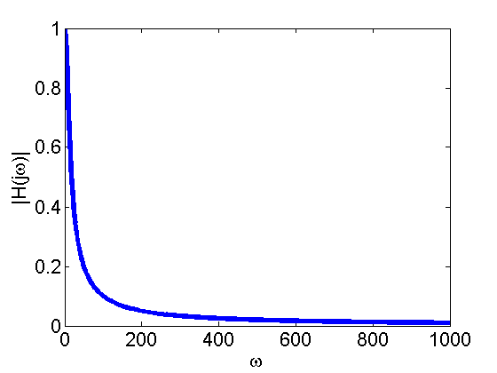
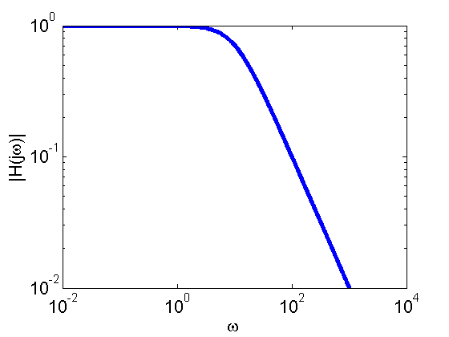
Bode Magnitude Plot
${\hat{V}}_{C}=\frac{1}{1+0.1jw}{\hat{V}}_{I}=H(jω){\hat{V}}_{I}$
Magnitude plot is just a plot of $|H\left(jω\right)|$ as a function of $ω$
$$|H\left(jω\right)|=1/\sqrt{1+0.01ω^{2}}$$
Linear Scale
Log Scale

Slide 34
Bode Magnitude Plot in Context of Circuit
$$v_{I}=V_{i}cos\left(ωt\right), t>0$$
$$R=10,000Ω$$
$$C=1μF$$
$$V_{i}=5V$$
$${\hat{V}}_{C}=\frac{1}{1+0.1jw}{\hat{V}}_{I}=H(jω){\hat{V}}_{I}$$
$$|H\left(jω\right)|=1/\sqrt{1+0.01ω^{2}}$$
All frequencies below $w_{c}=10$ get
through pretty well. Above, that
increasingly attenuated

Slide 35
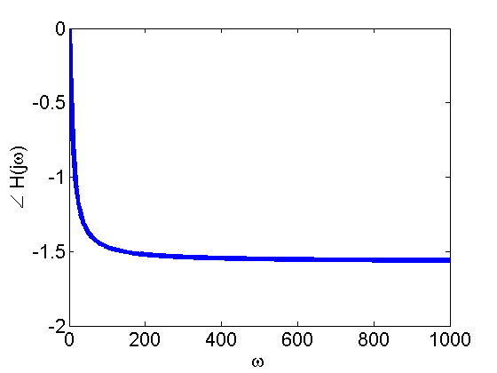
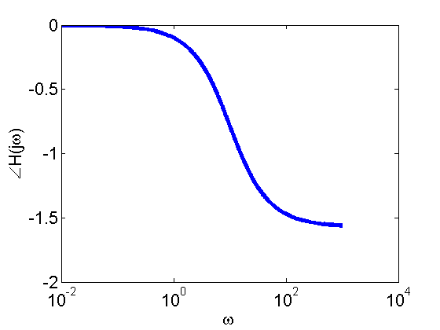
Bode Phase Plot
${\hat{V}}_{C}=\frac{1}{1+0.1jw}{\hat{V}}_{I}=H(jω){\hat{V}}_{I}$
Phase plot is just a plot of$∠H\left(jω\right)$ as a function of $ω$
$$∠H\left(jω\right)=−ArcTan[0.1ω/1]$$
Linear Scale
Semilog Scale

Slide 36
Bode Phase Plot in Context of Circuit
$$v_{I}=V_{i}cos\left(ωt\right), t>0$$
$$R=10,000Ω$$
$$C=1μF$$
$$V_{i}=5V$$
$${\hat{V}}_{C}=\frac{1}{1+0.1jw}{\hat{V}}_{I}=H(jω){\hat{V}}_{I}$$
$$∠H\left(jω\right)=−ArcTan[0.1ω/1]$$
All frequencies below $w_{c}=10$
move in time with the source, above
that, $v_{c}$ gets out of phase

Slide 37
Frequency vs. Time Domain
Almost always, our signals consist of multiple frequencies
Examples:
Sound made when you press a buttons on a phone is two pure sine waves added together (DTMF)
Antennas on radio theoretically pick up ALL frequencies of ALL transmissions
Using a technique known as the Fourier Transform, we can convert any signal into a sum of sinusoids
See EE20 for more details

Slide 38
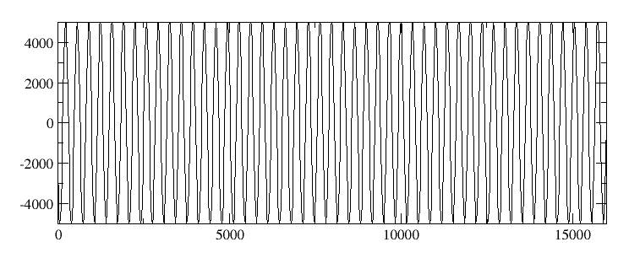
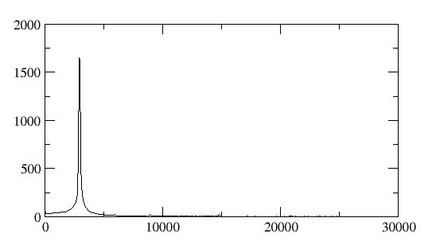
Fourier Transform Example
If someone whistles a signal that is approximately $sin⁡(3000t)$, and we apply the Fourier Transform, then:

Slide 39
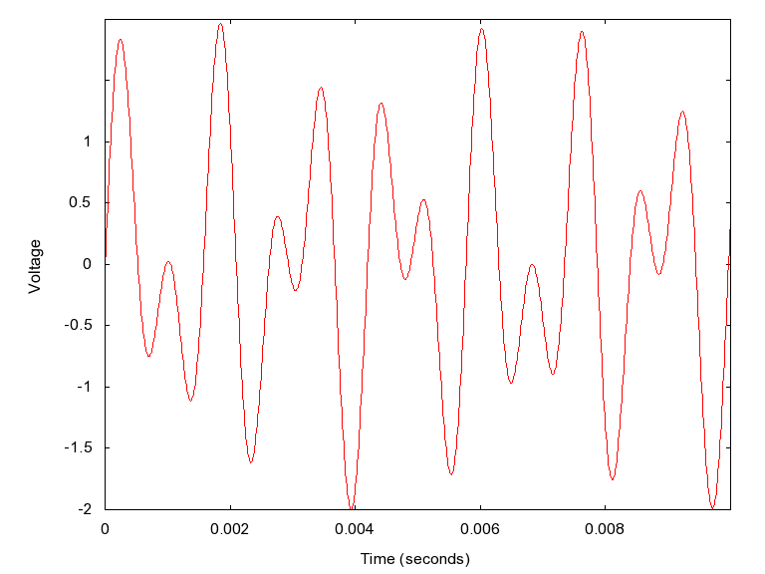
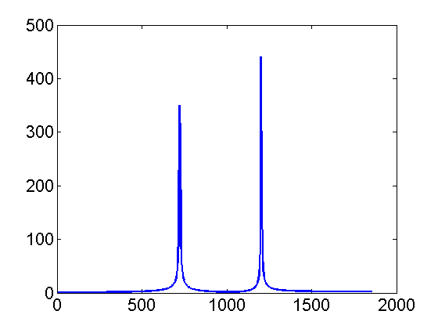
Fourier Transform Example
The 1 button on a phone is just $v\left(t\right)=\sin\left(\frac{697}{2π}t\right)+sin⁡(\frac{1209}{2π}t)$

Slide 40
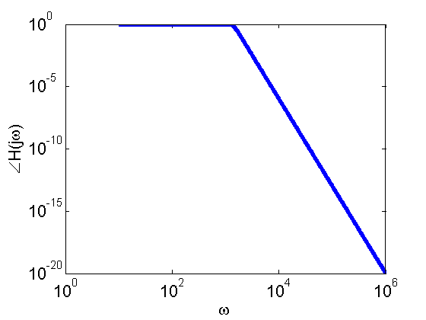
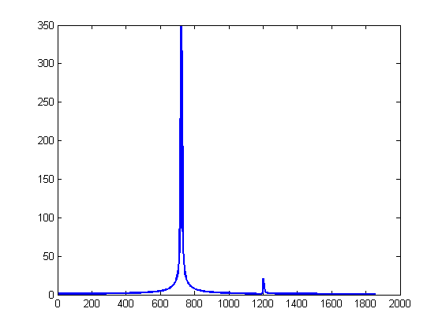
Fourier Transform Example
If we apply a filter with the frequency response on the left to the signal on the right
Then we’ll get:

Slide 41
Types of Filters
Passive Filters
Filters with no sources (i.e. just R, L, and C)
Don’t require power source
Scale to larger signals (no op-amp saturation)
Cheap
Active Filters
Filters with active elements, e.g. op-amps
More complex transfer function
No need for inductors (can be large and expensive, hard to make in integrated circuits)
More easily tunable
Response more independent of load (buffering)

Slide 42
Filter Examples
On board

Slide 43
Manually Plotting
In this day and age, it is rarely necessary to make our Bode plots manually
However, learning how to do this will build your intuition for what a transfer function means
Manual plotting of bode plots is essentially a set of tricks for manually plotting curves on a loglog axis
We will only teach a subset of the full method (see EE20 for a more thorough treatment)

Slide 44
Example Filter
$$v_{I}=V_{i}cos\left(ωt\right), t>0$$
$$R=10,000Ω$$
$$C=1μF$$
$$V_{i}=5V$$
Find v_{c}$(t)$ in
steady state
${\hat{V}}_{C}=\frac{1}{1+0.1jw}{\hat{V}}_{I}$
${\hat{V}}_{C}=\frac{1}{\sqrt{1+0.01ω^{2}}∠ArcTan[0.1ω]}{\hat{V}}_{I}$
${\hat{V}}_{C}=\frac{1}{\sqrt{1+0.01ω^{2}}}∠−ArcTan[0.1ω]$ ${\hat{V}}_{I}$
Intuitive plot on board
More thorough algorithm next time

Slide 45
Extra Slides

Slide 46
Why do equivalent Impedances work?
Components with memory just integrate or take the derivative of $e^{q_{1}t}$, giving scaled versions of the same function
This is unlike forcing functions like $t^{3}$ or $cos⁡(ωt)$
This allows us to divide by the source, eliminating $t$ from the problem completely
Left with an algebra problem
[For those of you who have done integral transforms, this whole process can be thought of as just using Laplace/Fourier transforms]

