Slide 1
EE40 Lecture 12 Josh Hug
7/21/2010

Slide 2
Logistical Things
HW6 due Friday at 5PM (also short)
Midterm next Wednesday 7/28
Focus is heavily on HW4, 5, 6, and Labs P1, 4, 5
Will reuse concepts from HW 1,2,3

Slide 3
Filtering
For the past couple of lectures, we’ve discussed using phasors and impedances to solve circuits
Usually, we’ve assumed we have some single frequency source, and found the resulting output
Last time in lecture, we showed that we could apply two different frequencies at one time using superposition
Each was scaled and shifted by different amounts

Slide 4
Transfer Functions
${\hat{V}}_{out}=H(jω){\hat{V}}_{in}$, e.g. ${\hat{V}}_{out}=\frac{1}{1+0.1jw}{\hat{V}}_{in}$
Maps system input signal to system output signal
Plug an input voltage $\operatorname{Acos}\left(ωt+φ\right)$ into ${\hat{V}}_{I}$
Get an output voltage $A\left|H\left(jω\right)\right|\cos\left(ωt+φ+∠H\left(jω\right)\right)$
Output is scaled and shifted in time
Scaling and shifting depend on frequency
Frequency is unchanged (linear system)
Tells you how system will respond to any frequency, a.k.a. frequency response

Slide 5
Using a Transfer Function
${\hat{V}}_{out}=H\left(jω\right){\hat{V}}_{in}=\frac{1}{1+0.1jw}{\hat{V}}_{in}$
Suppose $v_{in}(t)$ is $3cos⁡(10t+\frac{π}{2})$
${\hat{V}}_{I}=3∠\frac{π}{2}$
$H\left(j10\right)=\frac{1}{1+j}$
Output phasor ${\hat{V}}_{out}$ is just ${\hat{V}}_{in}×H\left(j10\right)$
${\hat{V}}_{out}=\frac{3}{\sqrt{2}}∠(\frac{π}{2}−\frac{π}{4})$
$v_{out}\left(t\right)=\frac{3}{\sqrt{2}}cos⁡(10t+\frac{π}{2}−\frac{π}{4}$)
$$|H\left(j10\right)|=1/\sqrt{2}$$
$$∠H\left(j10\right)=−ArcTan[1/1]$$
$$=−π/4$$

Slide 6
Using a Transfer Function
${\hat{V}}_{out}=H\left(jω\right){\hat{V}}_{in}=\frac{1}{1+0.1jw}{\hat{V}}_{in}$
Suppose $v_{i}(t)$ is $3cos⁡(50t+\frac{π}{4})$
${\hat{V}}_{I}=3∠\frac{π}{4}$
$H\left(j50\right)=\frac{1}{1+5j}$
Output phasor ${\hat{V}}_{C}$ is just ${\hat{V}}_{I}×H\left(j50\right)$
${\hat{V}}_{C}=\frac{3}{\sqrt{26}}∠(\frac{π}{4}−1.37)$
$v_{c}\left(t\right)=\frac{3}{\sqrt{26}}cos⁡(50t+\frac{π}{4}−1.37$)
$$|H\left(j50\right)|=1/\sqrt{26}$$
$$∠H\left(j50\right)=−ArcTan[5/1]$$
$$=−1.37$$

Slide 7
Transfer Function
${\hat{V}}_{out}=H(jω){\hat{V}}_{in}$= $\left|H\left(jω\right)\right|∠H\left(jω\right){\hat{V}}_{in}$
For each frequency, different:
Scaling [magnitude]
Delay [phase shift]
It is useful to graphically depict the magnitude and phase of the transfer function

Slide 8
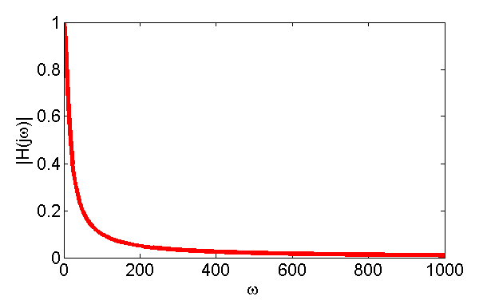
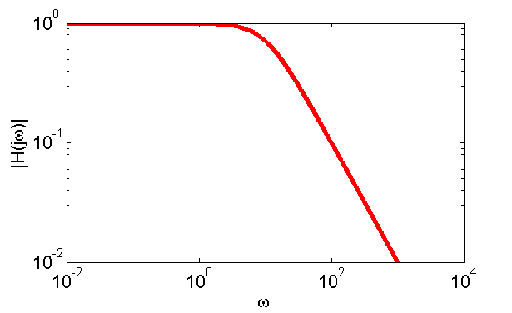
Bode Magnitude Plot
${\hat{V}}_{C}=\frac{1}{1+0.1jw}{\hat{V}}_{I}=H(jω){\hat{V}}_{I}$
Magnitude plot is just a plot of $|H\left(jω\right)|$ as a function of $ω$
$$|H\left(jω\right)|=1/\sqrt{1+0.01ω^{2}}$$
Linear Scale
Log Scale

Slide 9
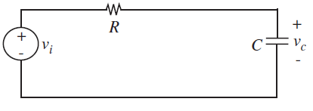
Bode Magnitude Plot in Context of Circuit
$$v_{I}=V_{i}cos\left(ωt\right), t>0$$
$$R=10,000Ω$$
$$C=1μF$$
$$V_{i}=5V$$
$${\hat{V}}_{C}=\frac{1}{1+0.1jw}{\hat{V}}_{I}=H(jω){\hat{V}}_{I}$$
$$|H\left(jω\right)|=1/\sqrt{1+0.01ω^{2}}$$
All frequencies below $w_{c}=10$ get
through pretty well. Above, that
increasingly attenuated

Slide 10
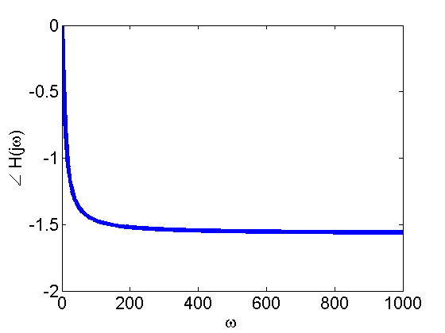
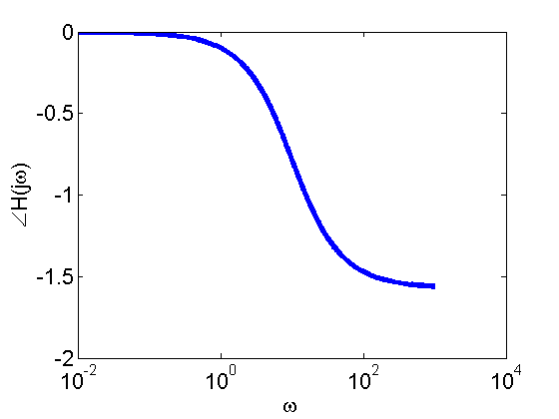
Bode Phase Plot
${\hat{V}}_{C}=\frac{1}{1+0.1jw}{\hat{V}}_{I}=H(jω){\hat{V}}_{I}$
Phase plot is just a plot of$∠H\left(jω\right)$ as a function of $ω$
$$∠H\left(jω\right)=−ArcTan[0.1ω/1]$$
Linear Scale
Semilog Scale

Slide 11
Bode Phase Plot in Context of Circuit
$$v_{I}=V_{i}cos\left(ωt\right), t>0$$
$$R=10,000Ω$$
$$C=1μF$$
$$V_{i}=5V$$
$${\hat{V}}_{C}=\frac{1}{1+0.1jw}{\hat{V}}_{I}=H(jω){\hat{V}}_{I}$$
$$∠H\left(jω\right)=−ArcTan[0.1ω/1]$$
All frequencies below $w_{c}=10$
move in time with the source, above
that, $v_{c}$ gets out of phase

Slide 12
Multiple Frequencies
Real signals are often a combination of a continuum of many frequencies
Radio antenna input
Microphone input
Intuitively:
Thunder contains a bunch of low frequency sounds
Boiling kettles contains a bunch of high frequency sounds
There is a mathematically well defined idea of what it means for a signal to “contain many frequencies”

Slide 13
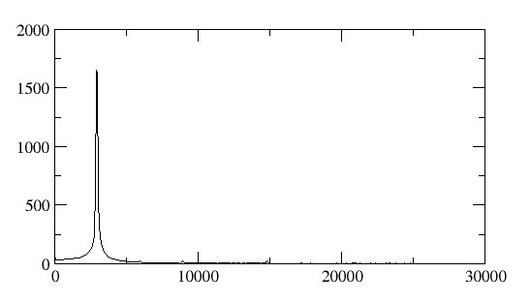
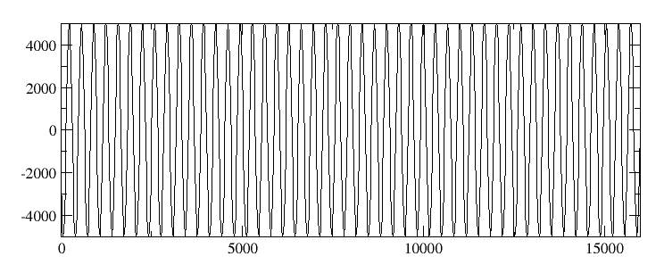
Time vs. Frequency Domain
The Fourier Transform takes a function $f(t)$ and converts it into a function $ℱ(ω)$
Every signal can be made out of a sum of an infinite number of sinusoids
Fourier transform tells you how much of each one to include
$$f\left(t\right)=sin⁡(3000t)$$
$$ℱ\left(ω\right)≈δ(ω−3000)$$

Slide 14
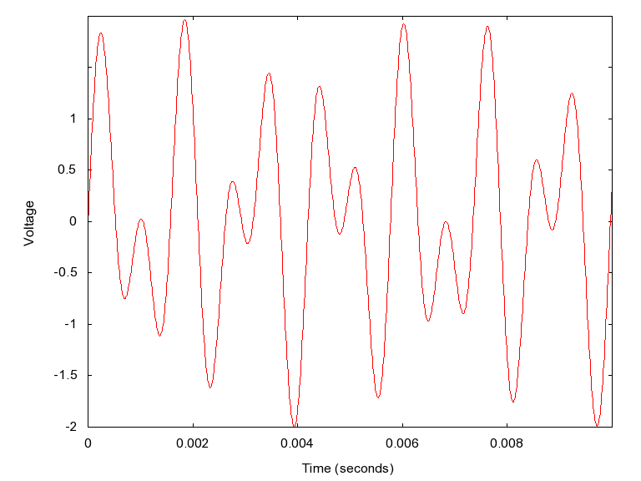
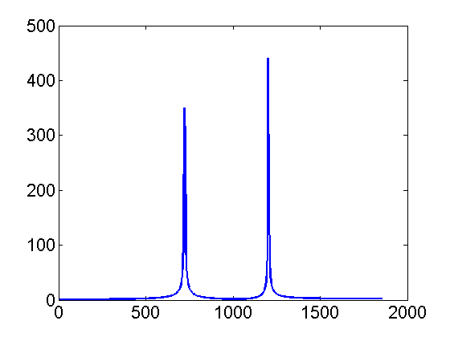
Multiple Frequencies
The “1” button on a phone is a combination of a 697 Hz tone and a 1209 Hz tone
$$f\left(t\right)=\sin\left(2π697t\right)+sin⁡(2π1209t)$$
$$ℱ\left(ω\right)≈δ\left(f−692\right)+δ(f−1209)$$

Slide 15
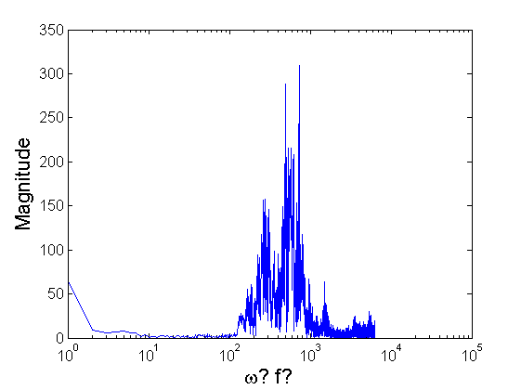
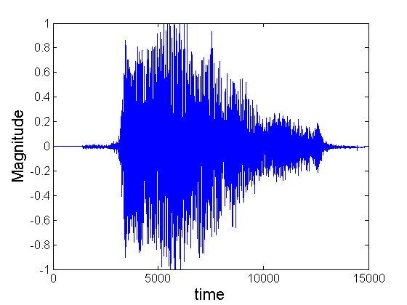
Multiple Frequencies
Bill and Ted saying the word “bogus” is a more complex set of frequencies

Slide 16
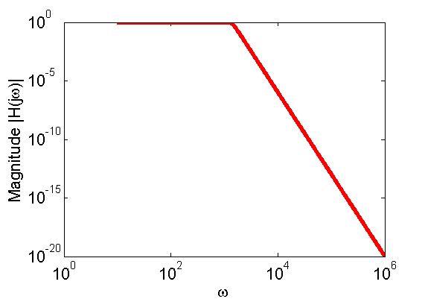
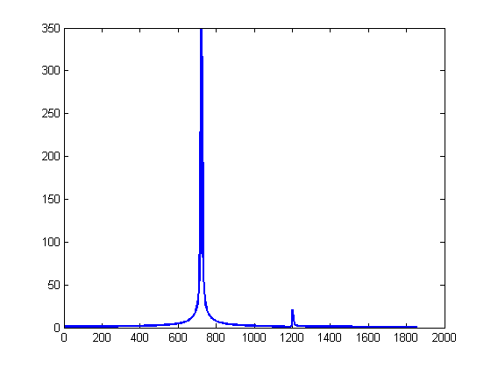
Filtering Example
If we apply a filter with the frequency response on the right to the signal on the left
Then we’ll get:

Slide 17
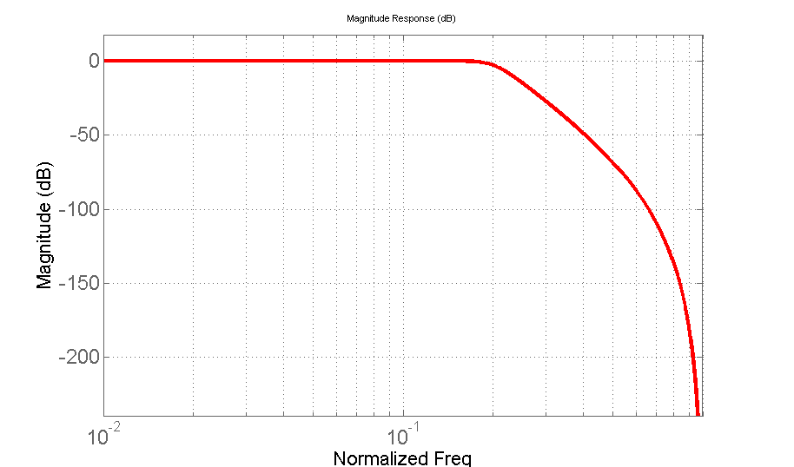
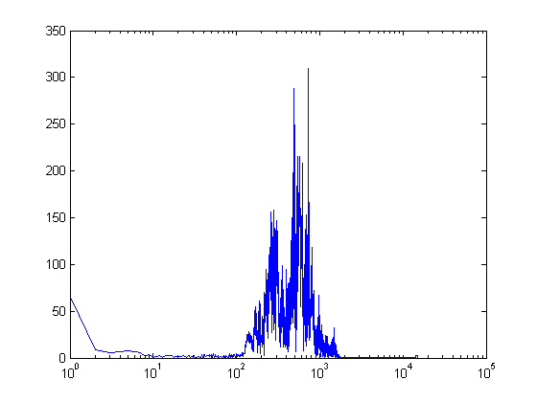
More complex filtering
Each frequency individually scaled

Slide 18
Phase Effects
If we shift the phase of the larger sine, we get
Original “1 button” tone

Slide 19
Magnitude and Phase Demo
Let’s try the ever risky live demo

Slide 20
Bode Plots
Hopefully I’ve convinced you that magnitude and phase plots are useful
Now, the goal will be to draw them straight from the transfer function
First, some reminders on loglog plots

Slide 21
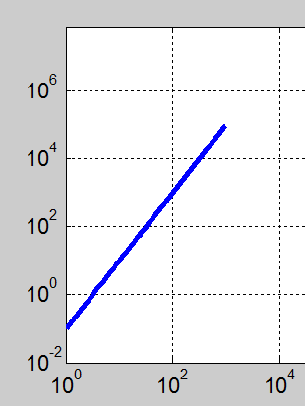
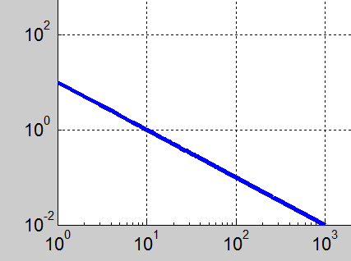
Loglog Plots
On a loglog plot, $f\left(x\right)=Ax^{n}$ looks like a straight line w/slope $n$ and y-offset $A$, because:
$log⁡(y)=nlog\left(x\right)+\log\left(A\right)$
Y-offset – intercept at $x={10}^{0}$
$$f\left(x\right)=0.1x^{2}$$
$$f\left(x\right)=10x^{−1}$$

Slide 22
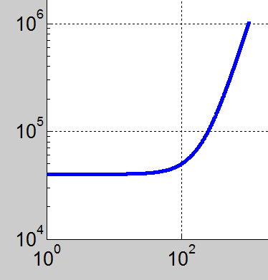
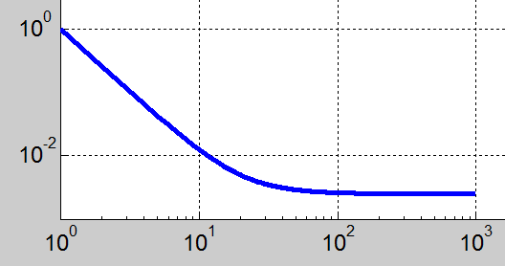
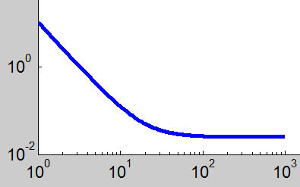
Loglog Plots
On a loglog plot, $f\left(x\right)=x^{n}+k^{n}$ will:
Be flat for values of $x^{n}<k^{n}$
Be a straight line of slope n for values of $x^{n}>k^{n}$
Have a y-offset of ${1+k}^{n}$
$$f\left(x\right)=x^{2}+{200}^{2}$$
$$f\left(x\right)=x^{−2}+{20}^{−2}$$

Slide 23
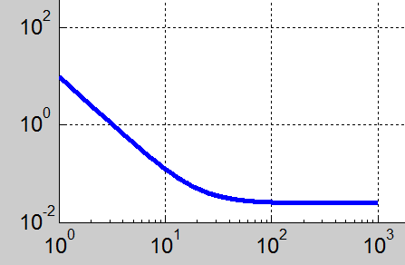
Loglog Plots
On a loglog plot, $f\left(x\right)=A(x^{n}+k^{n})$ will:
Be flat for values of $x^{n}<k^{n}$
Be a straight line of slope n for values of $x^{n}>k^{n}$
Have an y-offset of ${Ak}^{n}$
$$f\left(x\right)=x^{−2}+{20}^{−2}$$
$$f\left(x\right)=10(x^{−2}+{20}^{−2})$$

Slide 24
Manual Bode Plots
On board, using handout

Slide 25
2nd Order Filter Example
Also on board

Slide 26
2nd order Bode Plots
Also on board
This is where we stopped in class

Slide 27
Active filter example
On board

Slide 28
Magnitude Plot Units
So far, we’ve been plotting our Bode plots on where ${10}^{0}$ represents a signal getting through perfectly

Slide 29
Bel and Decibel (dB)
A bel (symbol B) is a unit of measure of ratios of power levels, i.e. relative power levels.
B = log₁₀(P₁/P₂) where P₁ and P₂ are power levels.
The bel is a logarithmic measure
Zero bels corresponds to a ratio of 1:1
One bel corresponds to a ratio of 10:1
Three bels corresponds to a ratio of 1000:1
The bel is too large for everyday use, so the decibel (dB), equal to 0.1B, is more commonly used.
1dB = 10 log₁₀(P₁/P₂)
0 dB corresponds to a ratio of 1:1
10 dB corresponds to a ratio of 10:1
-10 dB corresponds to a ratio of 1:10
dB are used to measure
Electric power, filter magnitude

Slide 30
Logarithmic Measure for Power
To express a power in terms of decibels, one starts by choosing a reference power, P_{reference}, and writing
Power P in decibels = 10 log₁₀(P/P_{reference})
Exercise:
Express a power of 50 mW in decibels relative to 1 watt.
P (dB) =10 log₁₀ (50 x 10⁻³) = - 13 dB
Use logarithmic scale to express power ratios varying over a large range
dB:
Note: dB is not a unit for a physical quantity since
power ratio is unitless. It is just a notation to
remind us we are in the log scale.

Slide 31
Decibels for measuring transfer function magnitude?
Decibels provide a measure of relative power
However, we said they also can be used for transfer functions
The key is in realizing that
Thus, if a voltage gets reduced by a factor of 100, we’d say the power ratio between the output and in the input would be
$10\log_{10}\left(\frac{V_{out}^{2}}{V_{in}^{2}}\right)=10\log_{10}\left({\left(\frac{V_{out}}{V_{in}}\right)}^{2}\right)=20\log_{10}\left(\frac{V_{out}^{}}{V_{in}^{}}\right)$

Slide 32
Transfer Function in dB
Given a transfer function magnitude $\left|H\left(jω\right)\right|$
We can convert this transfer function into dB by:
${\left|H\left(jω\right)\right|}_{in dB}=20\log_{10}\left(|H(jω|\right)$
There’s not that much to this, but it’s common in datasheets

Slide 33
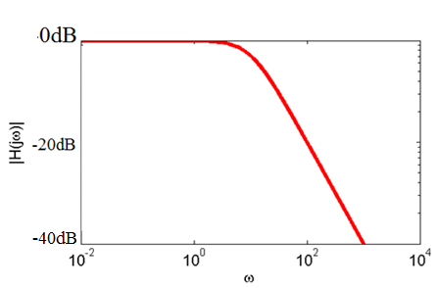
Example
$${\left|H\left(jω\right)\right|}_{in dB}=20\log_{10}\left(|H(jω|\right)$$

