Slide 1
EE40 Lecture 15 Josh Hug
7/30/2010

Slide 2
Logistics
HW7 due Tuesday
HW8 will be due next Friday
Homeworks will be less mathematically intense starting with the second half of HW7
Details on Project 2 demo and Mini-Midterm 3 details on Monday

Slide 3
Midterm 2
I can show you your midterm 2 grade, but problem 5 needs regrading [most people will get 3 to 6 more points]
At the moment, mean is 102 and standard deviation is 24
First midterm was mean 103, standard deviation 20
Some oochness will happen here

Slide 4
Logic Gates and Static Discipline
(On the board before we started)

Slide 5
iClicker Warmup
We’re going to have a ton of iClicker questions today
A quick warmup. Have you played Starcraft 2?
Yes
No
Starwhat?

Slide 6
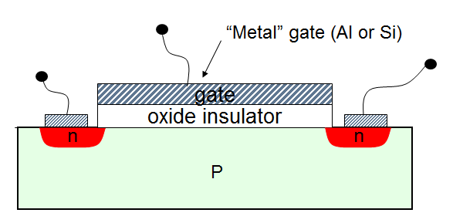
Field Effect Transistor
(Gate)
+
-
(Drain)
C
(Source)
+
–
- - - - - - - - - - - - -
P is (effectively) a high resistance block of material, so current can barely flow from + to –
The n region is a reservoir of extra electrons (we will discuss the role of the n region later)
When C is “on”, i.e. $V_{c}$ is relatively positive, then electrons from inside the P region collect at bottom of insulator, forming a “channel”

Slide 7
Field Effect Transistor
(Gate)
+
-
(Drain)
C
(Source)
+
–
- - - - - - - - - - - - -
When the channel is present, then effective resistance of P region dramatically decreases
Thus:
When C is “off”, switch is open
When C is “on”, switch is closed

Slide 8
Field Effect Transistor
(Gate)
+
-
C
(Source)
(Drain)
+
–
+
-
- - - - - -
If we apply a positive voltage to the plus side
Current begins to flow from + to –
Channel on the + side is weakened
If we applied a different positive voltage to both sides?

Slide 9
Field Effect Transistor Summary
“Switchiness” is due to a controlling voltage which induces a channel of free electrons
Extremely easy to make in unbelievable numbers
Ubiquitous in all computational technology everywhere

Slide 10
Discussion Today
In discussion today, we’ll go over the physics of MOSFETs for those of you who are curious
Time permitting, we’ll discuss at a future date in class as well (so yeah, it will be slightly redundant)

Slide 11
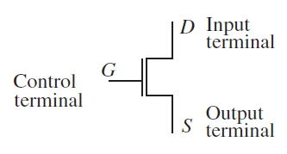
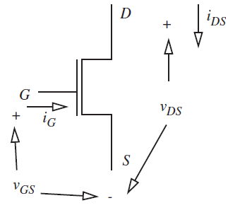
MOSFET Model
Schematically, we represent the MOSFET as a three terminal device
Can represent all the voltages and currents between terminals as shown to the right

Slide 12
MOSFET Model
What do you expect $i_{G}$ to be?
(Gate)
C
(Drain)
(Source)
+
–

Slide 13
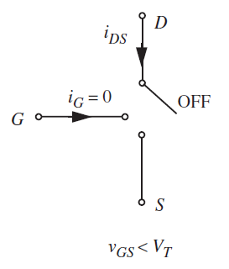
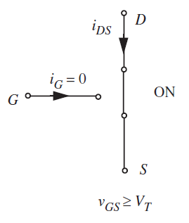
S Model of the MOSFET
The simplest model basically says that the MOSFET is:
Open for $V_{GS}<V_{T}$
Closed for $V_{GS}>V_{T}$

Slide 14
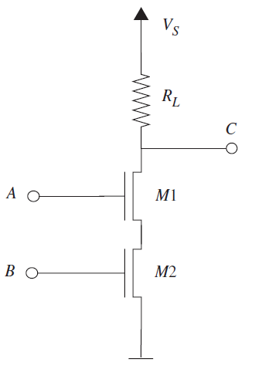
Building a NAND gate using MOSFETs
Consider the circuit to the right where $V_{S}$
On your worksheet, we’ll show that $C=\overline{AB}$
Demonstration also on page 294 of the book
A
C
B

Slide 15
MOSFET modeling
MOSFET models vary greatly in complexity
For example, an “ON” MOSFET has some effective resistance (not an ideal switch)
We will progressively refine our model of the MOSFET
Will add capacitance later today
If we have time in the next 2 weeks, we will also talk about using MOSFETs as analog amplifiers which will necessitate an even better model

Slide 16
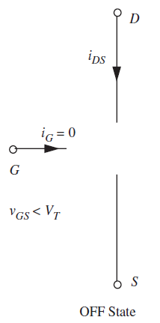
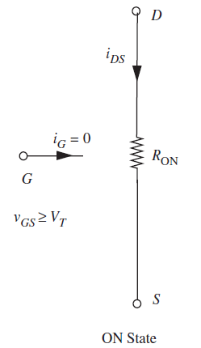
SR Model of the MOSFET
$i_{DS}=\frac{V_{DS}}{R_{ON}}, V_{GS}≥V_{T}$
$$=0,$$
$${ V}_{GS}<V_{T}$$
[Has nothing to do with SR flip-flop]

Slide 17
NAND with the SR Model
What is $V_{C}$ when either of the inputs is low?
Draw the equivalent circuit when both inputs are high. What is $V_{C}?$
$V_{S}$
$0$
$V_{S}/R_{L}$
$V_{S}\frac{{2R}_{ON}}{R_{L}+{2R}_{ON}}$
$V_{S}\frac{R_{L}}{R_{L}+{2R}_{ON}}$
Q2

Slide 18
NAND with the SR Model
Assume static discipline requires ${0<V}_{OL}<0.5$V and $4.5V<V_{OH}<5V$
Assume $R_{L}$ is $100kΩ$
Choose a $V_{S}$ such that the static discipline for $V_{OH}$ is met:
A. $5V$
B. $4.5V$
C. $0.5V$
D. $0V$
O_{High}: $V_{C}=V_{S}$
O_{Low}: $V_{C}=V_{S}\frac{{2R}_{ON}}{R_{L}+{2R}_{ON}}$
Q3

Slide 19
NAND with the SR Model
Assume static discipline requires ${0<V}_{OL}<0.5$V and $4.5V<V_{OH}<5V$
Assume $R_{L}=10kΩ$ and $Vs=5V$
Choose an $R_{ON}$ and $R_{L}$ such that $V_{OL}$ meets the static discipline
O_{High}: $V_{C}=V_{S}$
O_{Low}: $V_{C}=V_{S}\frac{{2R}_{ON}}{R_{L}+{2R}_{ON}}$
Note: $R_{L}$ is usually called a “Pull-up resistor”
Q4

Slide 20
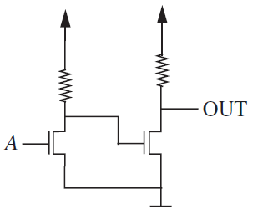
Another SR Model Example
Replace the left MOSFET with the equivalent circuit when A is high
What is $V_{GS}$ on the right NMOS if A is high?
A. $5V$
B. $5\frac{1}{1+9.5}$
C. $5\frac{1}{1+11}$
D. $0$
$$5V$$
$$5V$$
$$9.5kΩ$$
$$11kΩ$$
$$R_{on}=1kΩ$$
$$V_{T}=1V$$
Q5

Slide 21
Another SR Model Example
When A is on, $V_{GS,right}=5\frac{1}{1+9.5}=0.476V$
What is $V_{OUT}$ when A is high?
A. $5V$
B. $5\frac{1}{1+9.5}$
C. $5\frac{1}{1+11}$
D. $0$
$$5V$$
$$5V$$
$$9.5kΩ$$
$$11kΩ$$
$$R_{on}=1kΩ$$
$$V_{T}=1V$$
Q6

Slide 22
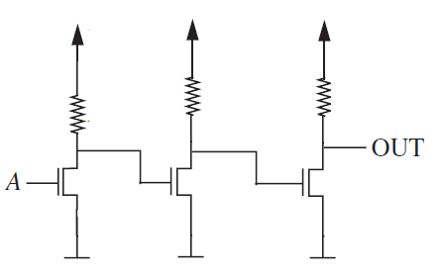
The power of digital circuits
At each stage, circuit restores the signal
Can think of each MOSFET as diverting the 5V or 0V power supply into the next gate
Tolerant to noise and manufacturing error
$$5V$$
$$5V$$
$$5V$$
$$9.5kΩ$$
$$11kΩ$$
$$10kΩ$$
0.48V
5V
0.45V

Slide 23
The power of digital circuits
How much noise could we tolerate on the input of the 2nd gate?
On the input of the 3rd gate?
$$5V$$
$$5V$$
$$5V$$
$$9.5kΩ$$
$$11kΩ$$
$$10kΩ$$
0.48V
5V
0.45V
$$R_{on}=1kΩ$$
$$V_{T}=1V$$
G1
G2
A
OUT

Slide 24
The power of digital circuits (literally)
Like all circuits, digital circuits consume power
Amount of power will be dependent on state of our MOSFET switches

Slide 25
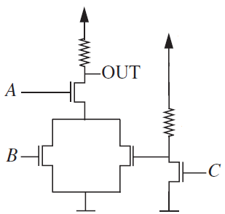
Power Example
What is the power dissipation when A=1, B=1, C=0?
First, draw circuit with ON MOSFETS replaced with resistors
Then, calculate $P_{s}$
$$5V$$
$$10kΩ$$
$$5V$$
$$10kΩ$$
$$R_{on}=1kΩ$$
$$V_{T}=1V$$
Q7

Slide 26
Power Example
In general, power consumption will depend on which inputs are high and which are low
“Worst case analysis” is when we pick the set of inputs which consumes the most power
$$5V$$
$$10kΩ$$
$$5V$$
$$10kΩ$$
$$R_{on}=1kΩ$$
$$V_{T}=1V$$

Slide 27
Static Power
Using only NMOS to implement our gates will result in a gate which constantly eats up power
If you wire such a gate up on a breadboard, it will hum along using power all day
Later today, we will see a technique called CMOS to avoid this static power dissipation
But first, let’s discuss delay

Slide 28
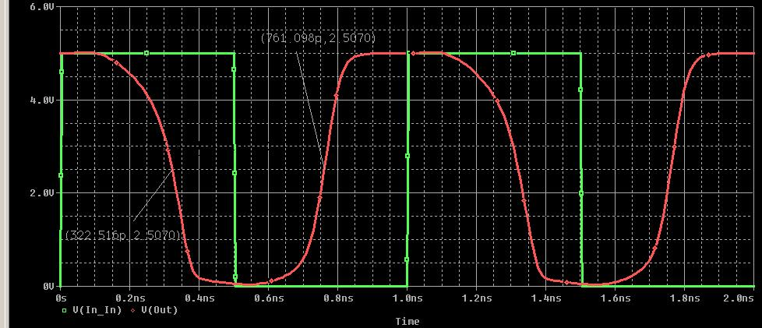
The SRC Model of an NMOS Transistor
So far, our NMOS implementation of logic gates allow for instantaneous switching
In real life, of course, an NMOS implementation will take some non-zero time to switch
Green: Inverter Input
Red: Inverter Output
Simulation by Wade Barnes

Slide 29
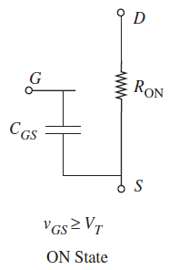
The SRC Model
The SRC Model is almost identical to the SR model, except that each gate node has a capacitance
Like SR model: open when OFF and resistive when ON
Note that now $i_{G}$ is non-zero!

Slide 30
The SRC Model
Useful for modeling:
Gate delay: Takes time to charge up
Dynamic power: $i_{G}≠0$

Slide 31
SRC Model
Consider our familiar pair of inverters
We’re going to focus on the behavior of our left inverter
Let’s assume that both MOSFETs have a gate capacitance of $1pF$ or ${10}^{−12}F$
$$5V$$
$$5V$$
$$9.5kΩ$$
$$11kΩ$$

Slide 32
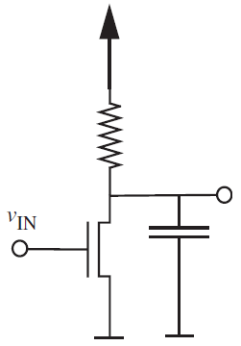
SRC Model of our 2 Inverters
$$5V$$
$$5V$$
$$5V$$
$$9.5kΩ$$
$$11kΩ$$
$$9.5kΩ$$
$$V_{G1}$$
$$1pF$$
We decide to ignore the function of the gate on the right, keeping it in mind only because we know we’ll have to charge it

Slide 33
Analysis of SRC Model
When the gate voltage $V_{IN}$ has been less than $V_{T}$ (i.e. the gate capacitor is not charged) for a long time, what is $V_{G1}$?
$0V$
$5V$
$5\frac{1}{1+9.5}$ $V$
$5\frac{1}{\left(1+9.5\right){10}^{−12}}$ $V$
$$5V$$
$$9.5kΩ$$
$$V_{G1}$$
$$1pF$$
$$R_{on}=1kΩ$$
$$V_{T}=1V$$
Q8

Slide 34
Analysis of SRC Model
Now assume $V_{in}$ has been low for a long time and thus $V_{G1}=5V$
If the logic gate upstream of $V_{in}$ rises above 1V, the SRC model of the left MOSFET says it should instantly switch to “ON”
Draw the equivalent circuit on the MOSFET worksheet
$$5V$$
$$9.5kΩ$$
$$V_{G1}$$
$$1pF$$
$$R_{on}=1kΩ$$
$$V_{T}=1V$$
Q9

Slide 35
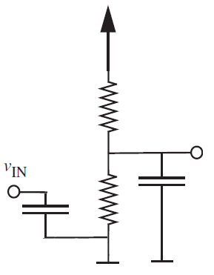
Analysis of SRC Model
If $V_{G1}=5V$, and the $1kΩ$ resistor suddenly appears at t=0
What is $V_{G1}(∞)$?
$0V$
$5V$
$5\frac{1}{1+9.5}$ $V$
$5\frac{1}{\left(1+9.5\right){10}^{−12}}$ $V$
$$5V$$
$$9.5kΩ$$
$$V_{G1}$$
$$1pF$$
$$1pF$$
$$1kΩ$$
$$R_{on}=1kΩ$$
$$V_{T}=1V$$
Q10

Slide 36
Timing Analysis of the SRC model
What is the time constant for the discharge of $V_{G1}$?
${10}^{−12}$
${10}^{−12}×1000$
${10}^{−12}×(9500+1200)$
${10}^{−12}×(9500∥1200)$
${2×10}^{−12}×(9500+1200)$
$$5V$$
$$9.5kΩ$$
$$V_{G1}$$
$$1pF$$
$$1pF$$
$$1kΩ$$
$$R_{on}=1kΩ$$
$$V_{T}=1V$$
Q11

Slide 37
Timing Analysis of the SRC model
Since $V_{G1}\left(0\right)=5V$, $V_{G1}\left(∞\right)=0.476V$, and $τ≈1ns$, then:
$V_{G1}\left(t\right)=\left(5−0.476\right)e^{−t/τ}+0.476$
How long will it take for the next inverter in the chain to turn on?
$$5V$$
$$9.5kΩ$$
$$V_{G1}$$
$$1pF$$
$$1pF$$
$$1kΩ$$
$$R_{on}=1kΩ$$
$$V_{T}=1V$$
$${τ=10}^{−12}×\left(9500∥1200\right)=1.06×{10}^{−9}$$

Slide 38
Timing Analysis of the SRC model
$\left(5−0.476\right)e^{−t_{fall}/τ}+0.476=1$
$−τ\ln\left(0.1158\right)=t_{fall}$
So $t_{fall}=2.2ns$
We call this the “Fall Time”: gives time for $V_{G1}$ to fall from 5V to 1V
$$5V$$
$$9.5kΩ$$
$$V_{G1}$$
$$1pF$$
$$1pF$$
$$1kΩ$$
$$R_{on}=1kΩ$$
$$V_{T}=1V$$

Slide 39
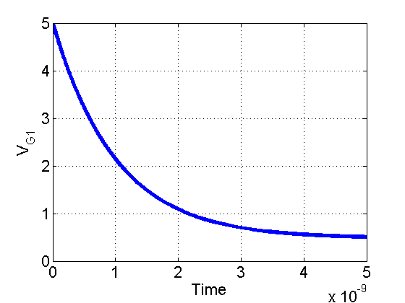
Fall Time
$\left(5−0.476\right)e^{−t/τ}+0.476=1$
$τ≈{10}^{−9}$
Gives: $t_{fall}=2.2ns$
$$5V$$
$$9.5kΩ$$
$$V_{G1}$$
$$1pF$$
$$1pF$$
$$1kΩ$$
$$R_{on}=1kΩ$$
$$V_{T}=1V$$

Slide 40
Timing Analysis of the SRC model
How do we find the Rise Time?
Have to replace by new equivalent circuit where:
Capacitor is initially discharged (0.476 V)
Switch is open
$$5V$$
$$9.5kΩ$$
$$V_{G1}$$
$$1pF$$
$$1pF$$
$$1kΩ$$
$$R_{on}=1kΩ$$
$$V_{T}=1V$$

Slide 41
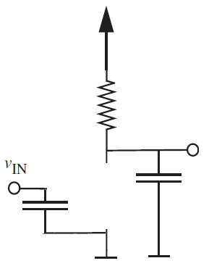
Timing Analysis of the SRC model
How do we find the Rise Time?
Have to replace by new equivalent circuit where:
Capacitor is initially discharged (0.476 V)
Switch is open
$V_{G1}=\left(0.476−5\right)e^{−t/τ}+5$
$τ={10}^{−12}×9500≈10ns$
$$5V$$
$$9.5kΩ$$
$$V_{G1}$$
$$1pF$$
$$1pF$$
$$R_{on}=1kΩ$$
$$V_{T}=1V$$

Slide 42
Timing Analysis of the SRC model
$V_{G1}=\left(0.476−5\right)e^{−t/τ}+5$
$$τ={10}^{−12}×9500≈10ns$$
$\left(0.476−5\right)e^{−t_{rise}/τ}+5=1$
$$−τ\ln\left(0.884\right)=t_{rise}$$
$t_{rise}=1.2ns$
$$5V$$
$$9.5kΩ$$
$$V_{G1}$$
$$1pF$$
$$1pF$$
$$R_{on}=1kΩ$$
$$V_{T}=1V$$

Slide 43
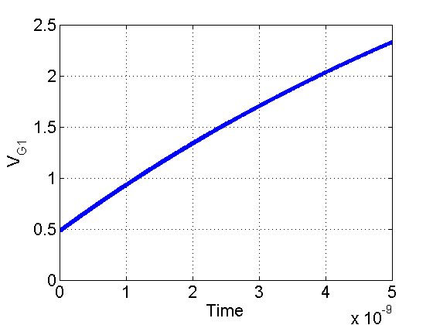
Timing Analysis of the SRC model
$V_{G1}=\left(0.476−5\right)e^{−t/τ}+5$
$τ≈{10}^{−12}s$
$t_{rise}=1.2ns$
$$5V$$
$$9.5kΩ$$
$$V_{G1}$$
$$1pF$$
$$1pF$$
$$R_{on}=1kΩ$$
$$V_{T}=1V$$

Slide 44
Propagation Delay
Rise and Fall Time are also called “Propagation Delays”
Gives “delay time” between when the logical input changes and the logical output changes
Book calls them $t_{pd,1→0}$ and $t_{pd,0→1}$

Slide 45
Reminder of Where We Started
Wanted to study gate delay of:
So used SRC model:
$$5V$$
$$5V$$
$$5V$$
$$9.5kΩ$$
$$11kΩ$$
$$9.5kΩ$$
$$V_{G1}$$
$$1pF$$
Which implements:
G1
OUT
A
Giving delay of LEFT gate!

Slide 46
Using Propagation Delays
$t_{rise}=t_{pd,0→1}=1.2ns$
$t_{fall}=t_{pd,1→0}=2.2ns$
Suppose A has been zero a long time and switches to 1
How long does it take for $G_{1}$ to go to 0?
How long does it take for $OUT$ to go to $1$?
1
0
1
0
0
1
A
G1
OUT

Slide 47
Propagation Delays
In general $t_{pd,0→1}$ is not equal to $t_{pd,1→0}$
Thus, we usually just take the maximum and call that the propagation delay of the gate
$t_{pd}=2.2ns$
Means that no matter what input you give the gate, output will be correct within $2.2ns$
A
G1
OUT

Slide 48
Bonus Question for CS61C Veterans
Assume now that the rise and fall times of both gates are $2.2ns$
Assume that we have a register driving “A” and a register receiving “OUT”
Assume the registers operate instantaneously
What is the minimum clock time if this very boring buffer is our longest pipeline stage?
A
G1
OUT

Slide 49
This is where we stopped

Slide 50
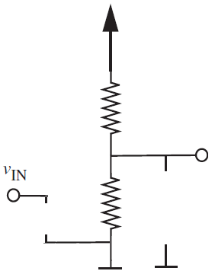
Power in the SRC Model
Static power in the SRC Model is exactly as SR Model, compare:
We’re also interested in the dynamic power while capacitance is charging
Algebra is a bit involved. We’ll outline the concept. Book has a very thorough treatment in sections 11.1 through 11.3

Slide 51
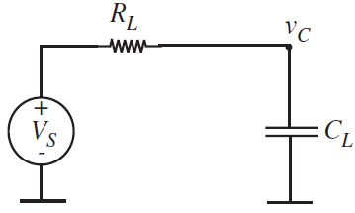
Dynamic Power in NMOS Circuits
When our inverter is going from low to high, we have the circuit on the left:
In general, looks like circuit on the right:
$$5V$$
$$9.5kΩ$$
$$V_{G1}$$
$$1pF$$
$$1pF$$

Slide 52
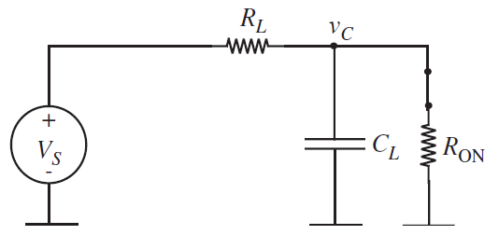
Dynamic Power in NMOS Circuits
When our inverter is going from high to low, we have the circuit on the left:
In general, looks like circuit on the right:
$$5V$$
$$9.5kΩ$$
$$V_{G1}$$
$$1pF$$
$$1pF$$
$$1kΩ$$

Slide 53
Dynamic Power
Worst case is that inverter is driven by a sequence of 1s and 0s
Circuit constantly switching behavior
Gate capacitor constantly charging and discharging
$$V_{in}=0$$
Charges up towards $V_{S}$
$$V_{in}=1$$
Discharges down towards $V_{s}\frac{R_{ON}}{R_{ON}+R_{L}}$

Slide 54
Problem Setup
$V_{in}$ is
0 for some time $T_{1}$
Dissipates some energy $w_{1}$
1 for some time $T_{2}$
Dissipates some energy $w_{2}$
$P=\frac{w_{1}+w_{2}}{T_{1}+T_{2}}$
See 11.1 through 11.3 for derivation
$$V_{in}=0$$
Charges up towards $V_{S}$
$$V_{in}=1$$
Discharges down towards $V_{s}\frac{R_{ON}}{R_{ON}+R_{L}}$

Slide 55
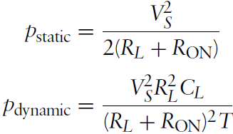
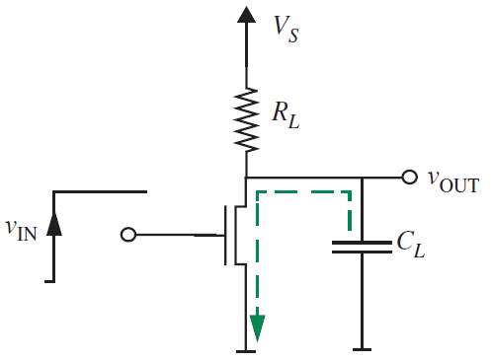
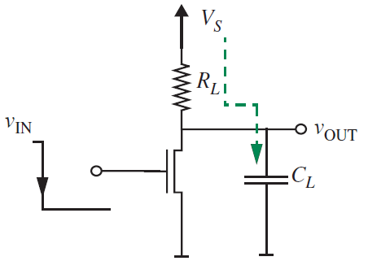
Solution

Slide 56
Avoiding Static Power Loss
Next we will talk about CMOS, which stands for Complementary MOS
So far, all of our transistors have been NMOS transistors, where they are on if $V_{GS}≥V_{T}$
Next, we will discuss a new type of FET transistor called a PMOS
Only difference is that they will be on when $V_{GS}≤V_{T}$

Slide 57
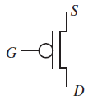
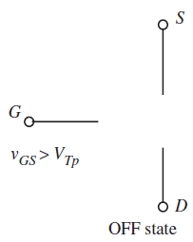
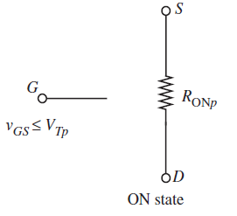
PMOS Transistor
Drawn with a bubble at the input:
Usually drawn with source on top and drain on bottom (for reasons that will become clear)
Just as before, have ON and OFF states, now on when $V_{GS}≤V_{T}$

Slide 58
Anything logical we can do with NMOS…
…we can do with PMOS
Example, we can build an inverter, try it for 60 seconds or so on the worksheet using a PMOS, 5V source, ground, and resistor
Assume input signal is 0V or 5V and $V_{T}=−1V$
5V
S
A
G
D
OUT
Here: $R_{L}$ acts as a pulldown resistor
R_{L}
Q13

Slide 59
Analysis of PMOS Logic
We could go through and repeat everything we did for NMOS, but it would be almost exactly the same thing
Instead, we’re now going to use NMOS and PMOS in a clever way

Slide 60
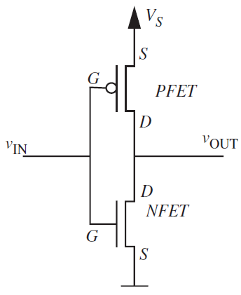
CMOS Inverter
Two complementary implementations of the same logic function
When $V_{IN}$ is high:
Path to ground is closed
Path to $V_{S}$ is open

Slide 61
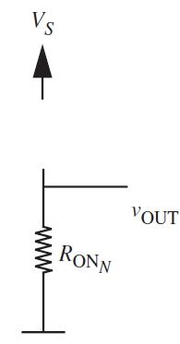
CMOS Inverter
When $V_{IN}$ is high:
Path to ground is closed
Path to $V_{S}$ is open
Huge resistance on open PMOS acts as a pull-up resistor

Slide 62
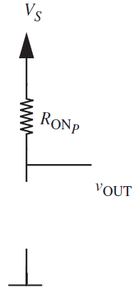
CMOS Inverter
When $V_{IN}$ is low:
Path to ground is open
Path to $V_{S}$ is closed
Huge resistance on open NMOS acts as a pull-down resistor

Slide 63
Static Power in CMOS
What is the static power consumed by this CMOS inverter when IN=0?
When IN=1?
In reality, as gate insulator gets thinner, there is a significant leakage component
IN=0
IN=1

Slide 64
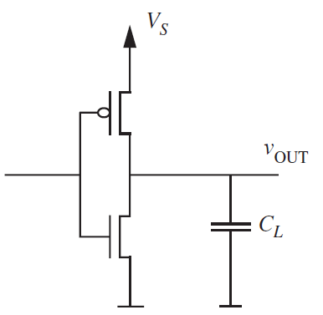
Dynamic Power in CMOS
Load power: Since our CMOS gates will be driving capacitive loads, they will still draw power when switching (since power is provided to the load)

Slide 65
Dynamic Power in CMOS
Leakage Power: Unless you’re careful about timing, both MOSFETs could be closed at the same time
Power flows directly from $V_{S}$ to ground
Even if timing is perfect, both transistors will at some point be “weakly on” – subthreshold leakage

Slide 66
Dynamic Power
These days, subthreshold leakage is a big issue
Thresholds have been reduced to decrease switching times
Reduced thresholds mean leakier MOSFETs
In this class, we won’t analyze this case, but be aware that in the world of digital integrated circuits, it plays a big role

Slide 67
CMOS
CMOS Summary:
No need for a pull-up or pull-down resistor
Though you can avoid this even with purely NMOS logic (see HW7)
Greatly reduced static power dissipation vs. our simple NMOS only logic
In reality, thin gate oxides lead to some static non-zero $i_{G}$, so static power is not zero
Dynamic power is still hugely significant
Uses twice the number of transistors as our simple purely NMOS logic

Slide 68
Implementation of Complex Gates Using NMOS and CMOS
In class today, we’ve discussed analysis of NMOS and CMOS circuits
Haven’t discussed how to design them
Luckily, it is easy

Slide 69
That’s it for today

Slide 70
Extra Slides

Slide 71
SR Model of the PMOS MOSFET
$i_{DS}=\frac{V_{DS}}{R_{ONp}}, V_{GS}≤V_{T}$
$$=0,$$
$${ V}_{GS}>V_{T}$$
No, has nothing to do with SR flip-flop

