Slide 1
EE40 Lecture 16 Josh Hug
8/02\/2010

Slide 2
Logistics
HW7 due tomorrow
HW8 will be due Friday
Mini-midterm 3 next Wednesday
80/160 points will be a take-home set of design problems which will utilize techniques we’ve covered in class
Handed out Friday
Due next Wednesday
Other 80/160 will be an in class midterm covering HW7 and HW8
Final will include Friday and Monday lecture
Design problems will provide practice

Slide 3
Project 2
Active filter lab and Booster lab due this week
For Booster lab, ignore circuit simulation, though it may be instructive to try the Falstad simulator
Project 2 due next Wednesday

Slide 4
Design Problems
ALL WORK MUST BE DONE COMPLETELY SOLO!
Maximum allowed time will be 5 hours
Will be written so that it can be completed in approximately 2 hours
Allowed resources:
May use any textbook (incl. Google Books)
Anything posted on the EE40 website
Only allowed websites are Google Books, wikipedia, and EE40 websites
Not allowed to use other websites like facebook answers, yahoo answers, etc. even if you are reading other people’s responses
When in doubt, email me or text me
We will be very serious about cheating on this!

Slide 5
Example Design Problem
Design a circuit which will sum three sinusoidal input voltages and attenuate any frequencies above 10,000 Hz by at least 20 dB

Slide 6
Project 2
For those of you who want to demo Project 2, we’ll be doing demos in lab on Wednesday
Either at 1 PM after mini-midterm
Or at 2 PM during usual lab period
Opinions?

Slide 7
Interactive Lecture Question
Did you like the interactive worksheet intensive MOSFET lecture?
Yes, it was extremely useful and I highly prefer this type of lecture
Yes, it was useful, but the usual 1-way lecture is fine
No real opinion
Didn’t like it
Hated it

Slide 8
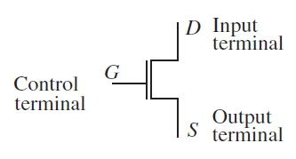
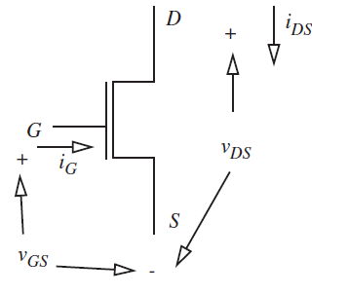
MOSFET Model
Schematically, we represent the MOSFET as a three terminal device
Can represent all the voltages and currents between terminals as shown to the right

Slide 9
MOSFET modeling
MOSFET models vary greatly in complexity
S Model: Good for explaining MOSFETs to someone with no EE knowledge
SR Model: Includes effective resistance of a MOSFET. Good for understanding how to choose pull-up resistance
SR Model: Include gate capacitance. Good for understanding dynamic power and gate delay

Slide 10
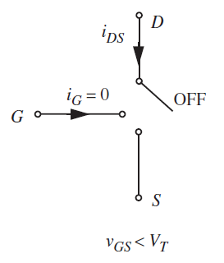
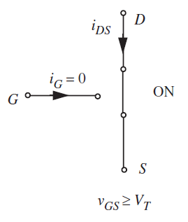
S Model of the MOSFET
The simplest model basically says that the MOSFET is:
Open for $V_{GS}<V_{T}$
Closed for $V_{GS}>V_{T}$

Slide 11
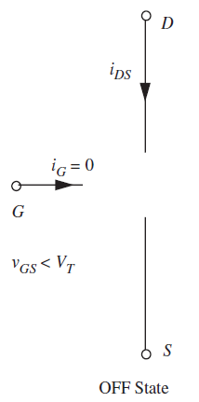
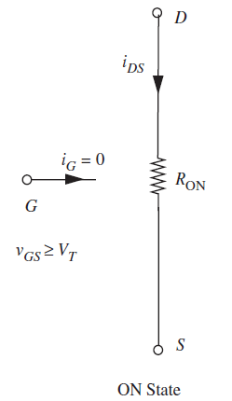
SR Model of the MOSFET
$i_{DS}=\frac{V_{DS}}{R_{ON}}, V_{GS}≥V_{T}$
$$=0,$$
$${ V}_{GS}<V_{T}$$
[Has nothing to do with SR flip-flop]

Slide 12
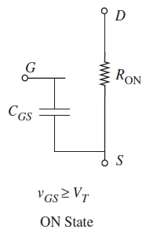
The SRC Model
The SRC Model is almost identical to the SR model, except that each gate node has a capacitance
Like SR model: open when OFF and resistive when ON
Note that now $i_{G}$ is non-zero!

Slide 13
The SRC Model
Useful for modeling:
Gate delay: Takes time to charge up
Dynamic power: $i_{G}≠0$

Slide 14
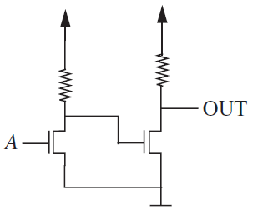
SRC Model
Consider our familiar pair of inverters
We’re going to focus on the behavior of our left inverter
Let’s assume that both MOSFETs have a gate capacitance of $1pF$ or ${10}^{−12}F$
$$5V$$
$$5V$$
$$9.5kΩ$$
$$11kΩ$$

Slide 15
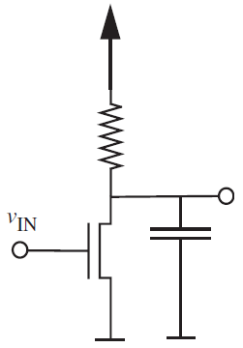
SRC Model of our 2 Inverters
$$5V$$
$$5V$$
$$5V$$
$$9.5kΩ$$
$$11kΩ$$
$$9.5kΩ$$
$$V_{G1}$$
$$1pF$$
We decide to ignore the function of the gate on the right, keeping it in mind only because we know we’ll have to charge it

Slide 16
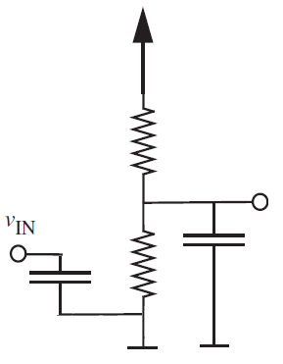
Timing Analysis of the SRC model
Since $V_{G1}\left(0\right)=5V$, $V_{G1}\left(∞\right)=0.476V$, and $τ≈1ns$, then:
$V_{G1}\left(t\right)=\left(5−0.476\right)e^{−t/τ}+0.476$
How long will it take for the next inverter in the chain to turn on?
$$5V$$
$$9.5kΩ$$
$$V_{G1}$$
$$1pF$$
$$1pF$$
$$1kΩ$$
$$R_{on}=1kΩ$$
$$V_{T}=1V$$
$${τ=10}^{−12}×\left(9500∥1000\right)=1.06×{10}^{−9}$$

Slide 17
Timing Analysis of the SRC model
$\left(5−0.476\right)e^{−t_{fall}/τ}+0.476=1$
$−τ\ln\left(0.1158\right)=t_{fall}$
So $t_{fall}=2.2ns$
We call this the “Fall Time”: gives time for $V_{G1}$ to fall from 5V to 1V
$$5V$$
$$9.5kΩ$$
$$V_{G1}$$
$$1pF$$
$$1pF$$
$$1kΩ$$
$$R_{on}=1kΩ$$
$$V_{T}=1V$$

Slide 18
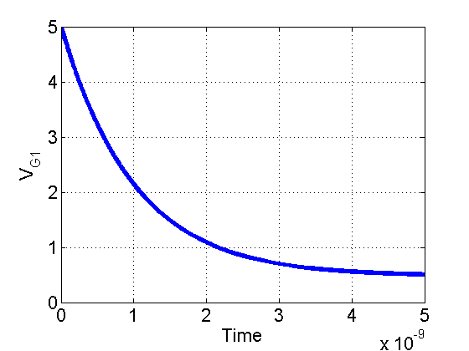
Fall Time
$\left(5−0.476\right)e^{−t/τ}+0.476=1$
$τ≈{10}^{−9}$
Gives: $t_{fall}=2.2ns$
$$5V$$
$$9.5kΩ$$
$$V_{G1}$$
$$1pF$$
$$1pF$$
$$1kΩ$$
$$R_{on}=1kΩ$$
$$V_{T}=1V$$

Slide 19
Timing Analysis of the SRC model
How do we find the Rise Time?
Have to replace by new equivalent circuit where:
Capacitor is initially discharged (0.476 V)
Switch is open
$$5V$$
$$9.5kΩ$$
$$V_{G1}$$
$$1pF$$
$$1pF$$
$$1kΩ$$
$$R_{on}=1kΩ$$
$$V_{T}=1V$$

Slide 20
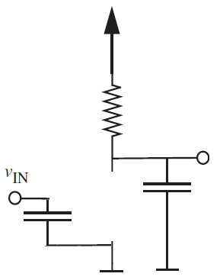
Timing Analysis of the SRC model
How do we find the Rise Time?
Have to replace by new equivalent circuit where:
Capacitor is initially discharged (0.476 V)
Switch is open
$V_{G1}=\left(0.476−5\right)e^{−t/τ}+5$
$τ={10}^{−12}×9500≈10ns$
$$5V$$
$$9.5kΩ$$
$$V_{G1}$$
$$1pF$$
$$1pF$$
$$R_{on}=1kΩ$$
$$V_{T}=1V$$

Slide 21
Timing Analysis of the SRC model
$V_{G1}=\left(0.476−5\right)e^{−t/τ}+5$
$$τ={10}^{−12}×9500≈10ns$$
$\left(0.476−5\right)e^{−t_{rise}/τ}+5=1$
$$−τ\ln\left(0.884\right)=t_{rise}$$
$t_{rise}=1.2ns$
$$5V$$
$$9.5kΩ$$
$$V_{G1}$$
$$1pF$$
$$1pF$$
$$R_{on}=1kΩ$$
$$V_{T}=1V$$

Slide 22
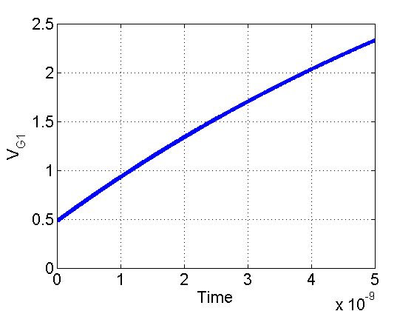
Timing Analysis of the SRC model
$V_{G1}=\left(0.476−5\right)e^{−t/τ}+5$
$τ≈{10}^{−12}s$
$t_{rise}=1.2ns$
$$5V$$
$$9.5kΩ$$
$$V_{G1}$$
$$1pF$$
$$1pF$$
$$R_{on}=1kΩ$$
$$V_{T}=1V$$

Slide 23
Propagation Delay
Rise and Fall Time are also called “Propagation Delays”
Gives “delay time” between when the logical input changes and the logical output changes
Book calls them $t_{pd,1→0}$ and $t_{pd,0→1}$

Slide 24
Reminder of Where We Started
Wanted to study gate delay of:
So used SRC model:
$$5V$$
$$5V$$
$$5V$$
$$9.5kΩ$$
$$11kΩ$$
$$9.5kΩ$$
$$V_{G1}$$
$$1pF$$
Which implements:
G1
OUT
A
Giving delay of LEFT gate!

Slide 25
Propagation Delays
In general $t_{pd,0→1}$ is not equal to $t_{pd,1→0}$
Thus, we usually just take the maximum and call that the propagation delay of the gate
$t_{pd}=2.2ns$
Means that no matter what input you give the gate, output will be correct within $2.2ns$
A
G1
OUT

Slide 26
Propagation Delay
Is our analysis still correct if we add more output gates?
No, gate capacitance increases! Takes 3 times as long.
OUT₁
A
OUT₂
G1
$$−τ\ln\left(0.884\right)=t_{rise}$$
OUT₃

Slide 27
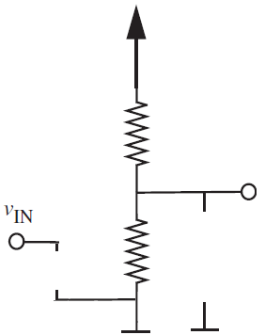
Power in the SRC Model
Static power in the SRC Model is exactly as SR Model, compare:
We’re also interested in the dynamic power while capacitance is charging
Algebra is a bit involved. We’ll outline the concept. Book has a very thorough treatment in sections 11.1 through 11.3

Slide 28
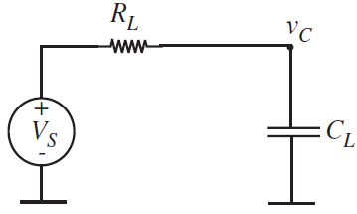
Dynamic Power in NMOS Circuits
When our inverter is going from low to high, we have the circuit on the left:
In general, looks like circuit on the right:
$$5V$$
$$9.5kΩ$$
$$V_{G1}$$
$$1pF$$
$$1pF$$

Slide 29
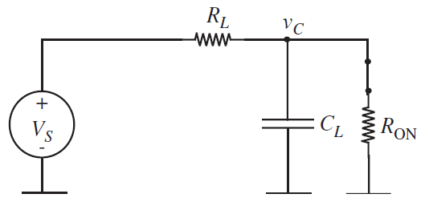
Dynamic Power in NMOS Circuits
When our inverter is going from high to low, we have the circuit on the left:
In general, looks like circuit on the right:
$$5V$$
$$9.5kΩ$$
$$V_{G1}$$
$$1pF$$
$$1pF$$
$$1kΩ$$

Slide 30
Dynamic Power
Worst case is that inverter is driven by a sequence of 1s and 0s
Circuit constantly switching behavior
Gate capacitor constantly charging and discharging
$$V_{in}=0$$
Charges up towards $V_{S}$
$$V_{in}=1$$
Discharges down towards $V_{s}\frac{R_{ON}}{R_{ON}+R_{L}}$

Slide 31
Problem Setup
$V_{in}$ is
0 for some time $T_{1}$
Dissipates some energy $w_{1}$
1 for some time $T_{2}$
Dissipates some energy $w_{2}$
$P=\frac{w_{1}+w_{2}}{T_{1}+T_{2}}$
See 11.1 through 11.3 for derivation
$$V_{in}=0$$
Charges up towards $V_{S}$
$$V_{in}=1$$
Discharges down towards $V_{s}\frac{R_{ON}}{R_{ON}+R_{L}}$

Slide 32
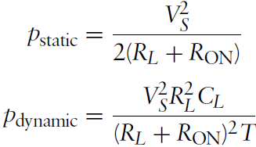
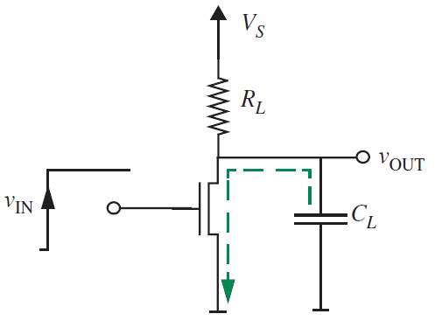
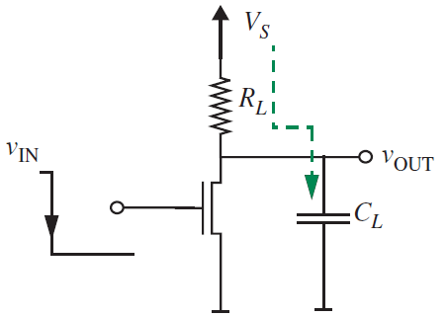
Solution

Slide 33
Avoiding Static Power Loss
Next we will talk about CMOS, which stands for Complementary MOS
So far, all of our transistors have been NMOS transistors, where they are on if $V_{GS}≥V_{T}$
Next, we will discuss a new type of FET transistor called a PMOS
Only difference is that they will be on when $V_{GS}≤V_{T}$

Slide 34
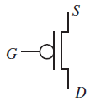
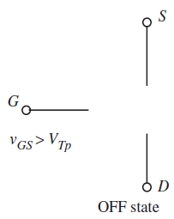
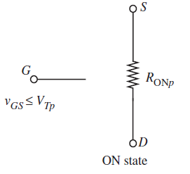
PMOS Transistor
Drawn with a bubble at the input:
Usually drawn with source on top and drain on bottom (for reasons that will become clear)
Just as before, have ON and OFF states, now on when $V_{GS}≤V_{T}$

Slide 35
Anything logical we can do with NMOS…
…we can do with PMOS
Example, we can build an inverter, try it for a minute or so on the worksheet using a PMOS, 5V source, ground, and resistor
Assume input signal is 0V or 5V and $V_{T}=−1V$
5V
S
A
G
D
OUT
Here: $R_{L}$ acts as a pulldown resistor
R_{L}
Q13

Slide 36
Analysis of PMOS Logic
We could go through and repeat everything we did for NMOS, but it would be almost exactly the same thing
Instead, we’re now going to use NMOS and PMOS together in a new clever way

Slide 37
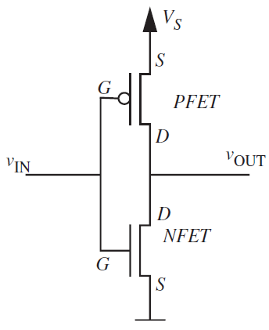
CMOS Inverter
Two complementary implementations of the same logic function
When $V_{IN}$ is high:
Path to ground is closed
Path to $V_{S}$ is open

Slide 38
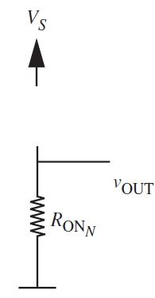
CMOS Inverter
When $V_{IN}$ is high:
Path to ground is closed
Path to $V_{S}$ is open
Huge resistance on open PMOS acts as a pull-up resistor

Slide 39
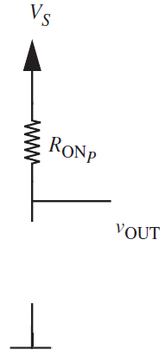
CMOS Inverter
When $V_{IN}$ is low:
Path to ground is open
Path to $V_{S}$ is closed
Huge resistance on open NMOS acts as a pull-down resistor

Slide 40
Static Power in CMOS
What is the static power consumed by this CMOS inverter when IN=0?
When IN=1?
In reality, there is a substantial static power component
IN=0
IN=1

Slide 41
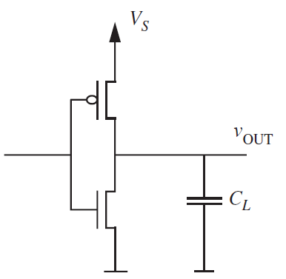
Static Power in CMOS
Gate Power: As gate oxides get smaller, gate current grows
Subthreshold Leakage Power: As thresholds are reduced (to increase speed),
transistors are never fully OFF, so current
always flows from $V_{s}$ to $V_{low}$

Slide 42
Dynamic Power in CMOS
Load power: Since our CMOS gates will be driving capacitive loads, they will still draw power when switching (since power is provided to the load)
STL: Both transistors are again weakly on
at intermediate values

Slide 43
Power in CMOS
Though subthreshold leakage is a significant component to MOSFET power (>50%), it involves a more complex MOSFET model we haven’t studied
We’ll instead focus on dynamic load power
Still accounts for vast portion of chip power consumption

Slide 44
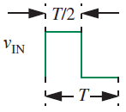
Load Power Analysis
Assume our inverter is driven by a square wave
Capacitor will be constantly charging and discharging
$$V_{in}$$

Slide 45
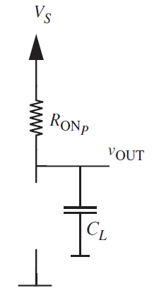
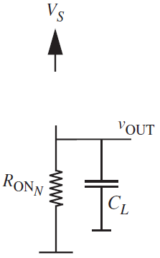
Load Power Analysis
When input is low, capacitor charges to $V_{S}$, energy stored is
$\frac{1}{2}C_{L}V_{S}^{2}$
When input is high, capacitor charges to $0$, energy stored is
$0$
$$V_{in}=V_{s}$$
$$V_{in}=0$$

Slide 46
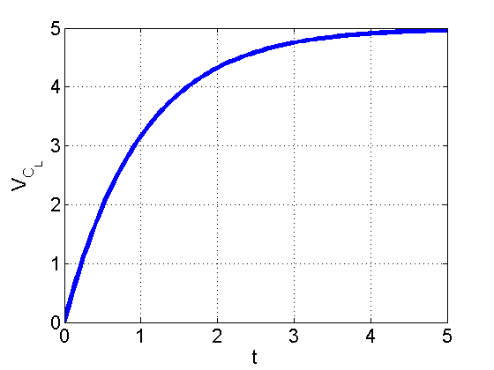
Rising Case
From homework, how much energy is dissipated in the resistor as $C_{L}$ charges to $V_{S}$?
$$V_{in}=0$$

Slide 47
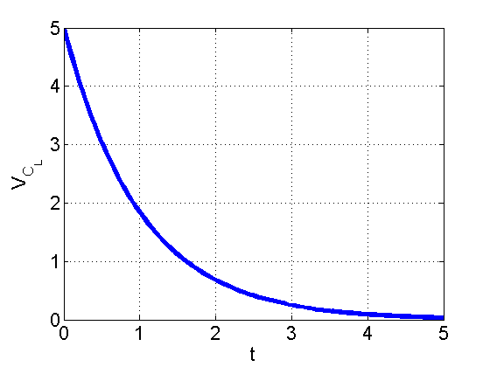
Falling Case
If capacitor starts with $\frac{1}{2}C_{L}V_{S}^{2}$ Joules of energy, and it all gets dissipated through resistor, then energy dissipated is $\frac{1}{2}C_{L}V_{S}^{2}$
$$V_{in}=0$$

Slide 48
Dynamic Load Power
Thus, if clock cycle is long enough, each switching event consumes $\frac{1}{2}C_{L}V_{S}^{2}$ joules of energy
In $T$ seconds, we consume $C_{L}V_{S}^{2}$
Power is $\frac{C_{L}V_{S}^{2}}{T}=C_{L}V_{S}^{2}f$

Slide 49
CMOS
CMOS Summary:
No need for a pull-up or pull-down resistor
Though you can avoid this even with purely NMOS logic (see HW7)
Greatly reduced static power dissipation vs. our simple NMOS only logic
In reality, MOSFETs are never truly off, and static leakage power consumes >50% of chip power
Dynamic power is still hugely significant
Uses twice the number of transistors as our simple purely NMOS logic

Slide 50
Preview of Tradeoffs in Digital Circuits
Processor can do more work per second if $f$ is high
Increasing $V_{S}$ and lowering $V_{T}$ give faster rise and fall times, letting us increase $f$
Dynamic power (and heat) in CMOS scales as $C_{L}V_{S}^{2}f$
Subthreshold leakage power (and heat) gets larger as $V_{T}$ gets smaller and as heat increases
Smarter hardware takes more transistors
More area means fewer chips per wafer
More transistors means more power consumption

Slide 51
Implementation of Complex Gates Using NMOS and CMOS
In class, we’ve discussed analysis of NMOS and CMOS circuits
Haven’t discussed how to design them
Luckily, it is isn’t very hard

Slide 52
Design of NMOS Circuits
Gates can be designed which use only NMOS transistors and a pull-up resistor
Easy to pick parameters to satisfy static discipline
The basic idea is to construct an NMOS network which:
Provides a path from $V_{low}$ to $V_{out}$ ONLY when logical function is false
When path from $V_{low}$ to $V_{out}$ is not available, then $V_{out}=V_{high}$ through pull-up resistor
Examples on board

Slide 53
Example on Board

Slide 54
CMOS Design
In the CMOS case, things are almost exactly the same
NMOS network which connects $V_{low}$ to $V_{out}$ only when function is false
Same network as in NMOS only logic
PMOS network which connects $V_{high}$ to $V_{out}$ only when function is true
Examples on board

Slide 55
This is where we stopped

Slide 56
Model Corner Cases
What happens if:
$V_{in}=0.99V$
$V_{in}=1.01V$
$V_{in}=1V$
Real MOSFET model is more complicated
Switch can be semi-on
$i_{DS}$ saturates for large $V_{DS}$ [not really a resistor]
$$V_{t,n}=1V$$
$$V_{t,p}=−1V$$

Slide 57
Real MOSFET Model
If we have time this week, we’ll discuss a more realistic model of the MOSFET
Useful for understanding invalid input voltages in logic circuits
More importantly, tells us how we can utilize MOSFETs in analog circuits
Op-amps are built from transistors

Slide 58
Nonlinear Elements
This more realistic MOSFET model is nonlinear
MOSFETs are three terminal devices, and it will be tough to begin our nonlinear adventure
Functionality is similar to what we’ve seen before (op-amps)
Analysis is tough
We’ll instead turn to diodes
Interesting new function
Analysis is easier
If we have time, we will talk on Friday or Monday about analog MOSFET circuits

Slide 59
Diode Physical Behavior and Equation
Schematic Device
Symbol
I
N
P
I
−
+
−
$$V_{D}$$
+
$$V_{D}$$
Quantitative I-V characteristics:
$$I=I_{O}(e^{V_{D}/nV_{T}}−1)$$
$$V_{T}=\frac{kT}{q}=0.026V$$
$n:1$ to $2$
$I_{O}:{10}^{−15}A$ to ${10}^{−12}A$
Qualitative I-V characteristics:
I
V positive, high conduction
V_{D}
V negative, low conduction
Allows significant current flow in only one direction

Slide 60
The pn Junction I vs. V Equation
I-V characteristic of PN junctions
In EECS 105, 130, and other courses you will learn why the I vs. V relationship for PN junctions is of the form
$$V_{T}=\frac{kT}{q}=0.026V$$
$$I=I_{O}(e^{V_{D}/nV_{T}}−1)$$
where I₀ is a constant related to device area and materials used to make the diode,
k is Boltzman constant, and T is absolute temperature.
a typical value for I₀ is
We note that in forward bias, I increases exponentially and is in the μA-mA range for voltages typically in the range of 0.6-0.8V. In reverse bias, the current is essentially zero.

Slide 61
Solving diode circuits
How do we solve this circuit?
KCL at the top right node:
$$\frac{V−V_{Th}}{R_{Th}}=I_{O}\left(e^{\frac{V}{0.026}}−1\right)$$
R_{Th}
I
+
V
–
Quantitative I-V characteristics:
$$I=I_{O}(e^{V_{D}/V_{T}}−1)$$
V_{Th}
+
−
n=1
No algebraic solution!

Slide 62
Load Line Analysis Method
Graph the I-V relationships for the non-linear element and for the rest of the circuit
The operating point of the circuit is found from the intersection of these two curves.
R_{Th}
I
I
+
V
–
V_{Th}
+
−
V_{Th}/R_{Th}
operating point
V
V_{Th}
$$\frac{V−V_{Th}}{R_{Th}}=I_{O}\left(e^{\frac{V}{0.026}}−1\right)$$
The I-V characteristic of all of the circuit except the non-linear element is called the load line

Slide 63
Load Line Example: Power Conversion Circuits
Converting AC to DC
Potential applications: Charging a battery
Can we use phasors?
Example on board
V_{I}=V_{m} cos (ωt)
R
V_{o}

Slide 64
Piecewise Linear Model
Circuit symbol
I-V characteristic
Switch model
I_{D}
I_{D} (A)
I_{D}
+
V_{D}
–
+
V_{D}
–
+
−
V_{Don}
forward bias
reverse bias
V_{D} (V)
V_{Don}
For a Si pn diode, V_{Don} ≅ 0.7 V
RULE 1: When I_{D} > 0, V_{D} = V_{Don}
RULE 2: When V_{D} < V_{Don}, I_{D} = 0
Diode behaves like a voltage source in series with a switch:
closed in forward bias mode
open in reverse bias mode

Slide 65
How to Analyze Diode Circuits with Piecewise Linear Model
A diode has only two states:
forward biased: I_{D} > 0, V_{D} = 0.7 V
reverse biased: I_{D} = 0, V_{D} < 0.7 V
Procedure:
Guess the state(s) of the diode(s)
Check to see if KCL and KVL are obeyed.
If KCL and KVL are not obeyed, refine your guess
Repeat steps 1-3 until KCL and KVL are obeyed.
Example:
If v_{s}(t) > 0.7 V, diode is forward biased (else KVL is disobeyed – try it)
+
v_{R}(t)
–
v_{s}(t)
+
−
If v_{s}(t) < 0.7 V, diode is reverse biased (else KVL is disobeyed – try it)

Slide 66
Diode Logic: AND Gate
Diodes can be used to perform logic functions:
AND gate
output voltage is high only if
both A and B are high
Inputs A and B vary between 0 Volts (“low”) and V_{cc} (“high”)
Between what voltage levels does C vary?
V_{cc}
R_{AND}
V_{OUT}
5
A
C
EOC
B
Slope =1
Shift 0.7V Up
0
0
5
V_{IN}

Slide 67
Diode Logic: OR Gate
Diodes can be used to perform logic functions:
OR gate
output voltage is high if
either (or both) A and B are high
Inputs A and B vary between 0 Volts (“low”) and V_{cc} (“high”)
Between what voltage levels does C vary?
A
V_{OUT}
B
C
5
EOC
R_{OR}
Slope =1
Shift 0.7V Down
0
0
0.7V
5
V_{IN}

Slide 68
Diode Logic: Incompatibility and Decay
Diode Only Gates are Basically Incompatible:
AND gate
output voltage is high only if
both A and B are high
OR gate
output voltage is high if
either (or both) A and B are high
V_{cc}
A
R_{AND}
B
C_{OR}
A
C_{AND}
R_{OR}
B
Signal Decays with each stage (Not regenerative)

Slide 69
That’s all for today
Next time, more Diodes and a little more on the more realistic model of MOSFETs

