Slide 1
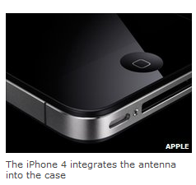
EE40 Lecture 3 Josh Hug
6/25/2010
“Users [are] reporting a drop in signal strength when the phone is held.” -BBC
“If you ever experience this on your iPhone 4, avoid gripping it in the lower left corner in a way that covers both sides of the black strip in the metal band, or simply use one of many available cases.”-Apple

Slide 2
Logistical Notes
Office Hours – Room reservation has been put in, but no word from the people yet. I’ve got someone looking into it
HW1 due today at 5 PM in the box in 240 Cory
No i>Clicker today [couldn’t get hardware today]

Slide 3
Nodal Analysis: Example
R
1
R
5
R
I
3
1
V
V
R
R
1
2
4
2
Using the basic method
5 unknowns
2 KCL equations
3 KVL equations

Slide 4
Nodal Analysis: Example
R
1
c
a
R
5
R
I
3
1
V
V
R
R
1
2
4
2
b
One equation, one unknown
With Node Voltage:
$$\frac{V_{a}−V_{2}}{R_{5}}$$
$$+\frac{V_{a}}{R_{4}}$$
$$+\frac{V_{a}+V_{1}}{R_{1}}=0$$
$${−I}_{1}$$
$$G_{5}\left(V_{a}−V_{2}\right)+G_{4}V_{a}−I_{1}+G_{1}\left(V_{a}+V_{1}\right)=0$$
$$V_{a}\left(G_{5}+G_{4}+G_{1}\right)=G_{5}V_{2}+I_{1}−G_{1}V_{1}$$

Slide 5
Nodal Analysis: Example
R
1
c
a
R
5
R
I
3
1
V
V
R
R
1
2
4
2
b
$$V_{a}\left(G_{5}+G_{4}+G_{1}\right)=G_{5}V_{2}+I_{1}−G_{1}V_{1}$$
$$V_{a}=\frac{G_{5}V_{2}+I_{1}−G_{1}V_{1}}{G_{5}+G_{4}+G_{1}}$$
It’s fine to leave your
answer in terms of conductances on HW and exams
$$V_{a}=\frac{R_{4}\left(I_{1}R_{1}R_{5}−R_{5}V_{1}+R_{1}V_{2}\right)}{R_{4}R_{5}+R_{1}\left(R_{4}+R_{5} \right)}$$

Slide 6
Dependent Sources
In practice, we’ll want to use controllable sources
Called “dependent sources” since their output is dependent on something external to the source itself
v_{s}
+
v_{s}(x)
+
_
_
independent
dependent
In theory, a dependent source could be a function of anything in the universe
Intensity of light incident on the source
Number of fish within 3 miles

Slide 7
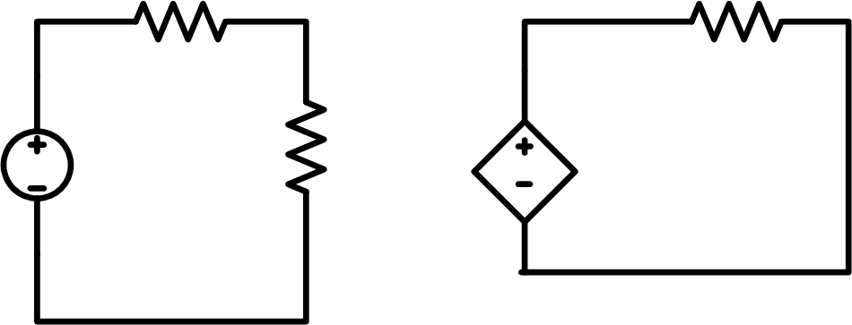
Dependent Sources
Since we’re building electrical circuits, dependent sources have been developed which are functions of other electrical quantities
10Ω
100Ω
$${3V}_{40}$$
5V
40Ω
$$I_{100}=\frac{3V_{40}}{100Ω}=\frac{3×4V}{100Ω}=0.12A$$

Slide 8
Dependent Sources
Dependent sources allow us to decouple the controller from the controlled
Acceleration of the engine affect by gas pedal
Gas pedal not affected by engine acceleration
This is in contrast to our circuits so far where everything is connected

Slide 9
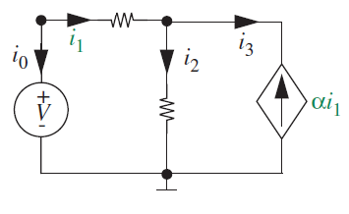
Dependent Sources With Feedback
Dependent sources can be coupled to their controller
This is useful for when the controller needs feedback from the thing being controlled
Can be a little tricky to analyze

Slide 10
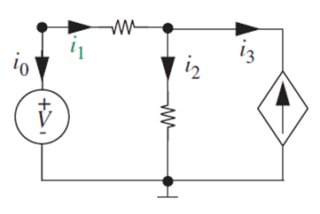
Node Voltage With Dependent Source
$$\frac{V_{a}−100}{100}+\frac{V_{a}}{20}−4i_{1}=0$$
$$i_{1}=−\frac{V_{a}−100}{100}$$
There are two ways to proceed:
Direct substitution (almost always better)
Indirect substitution (tough part of the reading)
100Ω
$$V_{a}$$
$$4i_{1}$$
100V
20Ω

Slide 11
Direct Substitution Method for Dependent Sources
$$\frac{V_{a}−100}{100}+\frac{V_{a}}{20}−4i_{1}=0$$
$$i_{1}=−\frac{V_{a}−100}{100}$$
$$\frac{V_{a}−100}{100}+\frac{V_{a}}{20}+4\frac{V_{a}−100}{100}=0$$
$$V_{a}−100+{5V}_{a}+4V_{a}−400=0$$
$$10V_{a}=500$$
$$V_{a}=50$$

Slide 12
Node Voltage With Dependent Source
$$\frac{V_{a}−100}{100}+\frac{V_{a}}{20}−4i_{1}=0$$
$$i_{1}=−\frac{V_{a}−100}{100}$$
There are two ways to proceed:
Direct substitution (almost always better)
Indirect substitution (tough part of the reading)
100Ω
$$V_{a}$$
?
$$i=g\left(i\right)$$
$$I=f\left(i\right)=f(g\left(i\right))$$
?
$$4i_{1}$$
100V
20Ω
?

Slide 13
Indirect Substitution Method for Dependent Sources
$$\frac{V_{a}−100}{100}+\frac{V_{a}}{20}−4i_{1}=0$$
$$\frac{V_{a}−100}{100}+\frac{V_{a}}{20}−I=0$$
100Ω
$$V_{a}$$
Node voltage vs. dummy source
$$4i_{1}$$
$$V_{a}=\frac{100+100I}{6}$$
I
100V
20Ω
Node voltage vs. controlling current
Real source vs. dummy source
$$i_{1}=\frac{100−V_{a}}{100}$$
$$\frac{I}{4}=i_{1}$$
$$\frac{I}{4}=\frac{100−\frac{100+100I}{6}}{100}$$
$$I=2A$$

Slide 14
Summary So Far
Dependent sources model controllable electrical sources
Node voltage can be used with dependent sources
Controlling input can be seemingly difficult to deal with, e.g. $\frac{V_{a}−100}{100}+\frac{V_{a}}{20}−4i_{1}=0$
Direct Substitution: Replace controlling input with expression in terms of
The node voltages you’re trying to solve for
Known currents if controlling input driven by current source
Indirect Substitution: Treat dependent source as a new variable and solve (better in rare cases)

Slide 15
Useful Resistive Circuits
Wheatstone Bridge
Used for measuring unknown resistances
Strain Gauge
Used for measuring weight

Slide 16
Wheatstone Bridge
Named for Charles Wheatstone
Used for measuring resistance of an unknown resistor
R₁
R₂
Parts:
Known resistors R₁ and R₂
Adjustable resistor R₃
Unknown resistance R_{x}
+
V
–
R₃
R_{x}
Basic concept:
If $\frac{R_{1}}{R_{3}}=\frac{R_{2}}{R_{x}}$, then no current will flow in the middle branch
Invented 1833 by Samuel Christie
Hit the charts when remixed by Wheatstone in 1843

Slide 17
Finding the value of R_{x}
Adjust R₃ until there is no current in the detector
Then,
R₂
R₁
R_{x} = R₃
Derivation:
i₁ = i₃ and i₂ = i_{x}
i₃R₃ = i_{x}R_{x} and i₁R₁ = i₂R₂
i₁R₃ = i₂R_{x}
KCL =>
KVL =>
R₁
R₂
+
V
–
R₃
R_{x}
R₃
R₁
R_{x}
R₂
=

Slide 18
Strain Gauge Intuition
Resistance is a function of wire length and area
Weight stretches a wire, changing its shape
Can theoretically get weight of a load by seeing how resistance varies when a load is added

Slide 19
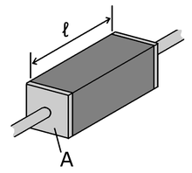
Resistivity
Wire resistance: $R=ρ\frac{l}{A}$
$ρ$ is resistivity, measured in Ω·m
Can think of as how tightly molecular lattice holds on to electrons
Material | $$ρ$$
Copper | 1.68x10⁻⁸
Aluminum | 2.82x10⁻⁸
Nichrome | 1.1x10⁻⁶
Glass | 10¹⁰

Slide 20
Wire Gauge
Gauge | Diameter [mm] | Area [mm²]
10 | 2.58 | 5.26
14 | 1.62 | 2.08
16 | 1.29 | 1.31
Resistance of 30m, 16 gauge extension cord?
$$1.68×{10}^{−8}Ωm\frac{30m}{1.31×{10}^{−6}m^{2}}$$
0.384Ω
If carrying 10 amps, how much power dissipated?
$$P=VI=I^{2}R=38.4 W$$

Slide 21
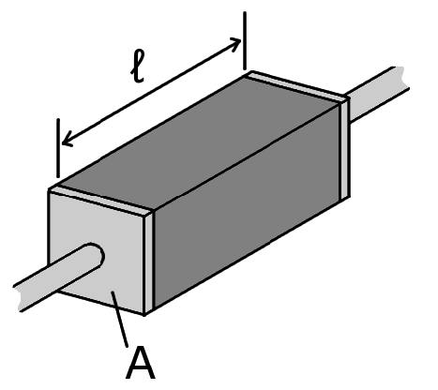
Basic Principle
Pull on resistor:
L=L₀+ΔL
A=A₀-ΔA
V=LA [constant]
Length wins the battle to control resistance
R=R₀+ΔR
$$R=ρ\frac{l}{A}$$
$$ε=\frac{ΔL}{L_{0}}$$
Define strain
$${R=R}_{0}+∆R=ρ\frac{L_{0}+∆L}{A_{0}−∆A}$$
$$\frac{ΔR}{R_{0}}=GF×ε$$
Where the Gauge Factor relates to how length/area change. GF~2

Slide 22
Using Strain to Measure Weight
We’ll attempt to design a circuit which can measure ε
Convert $\frac{ΔR}{R_{0}}$ into a voltage
We’ll leave it to the mechanical engineers to map ε back to load
$$\frac{ΔR}{R_{0}}=GF×ε$$
ε
Our Circuit
$$\frac{ΔR}{R_{0}}$$
V_{x}(ε)
Microcontroller

Slide 23
Using Strain to Measure Weight
ε
Our Circuit
$$\frac{ΔR}{R_{0}}$$
V_{x}(ε)
Microcontroller
ADC
vx
vx_to_delRr0(vx)
calc_eps(delRr0)
delRr0
weight
eps2weight(eps)
eps

Slide 24
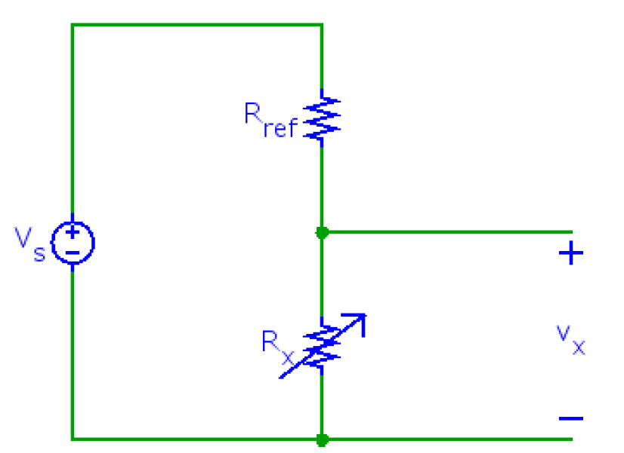
One Possible Design
Here, R_{x} is a variable resistor, where R_{x} is dependent on strain
As strain varies, so will v_{x}

Slide 25
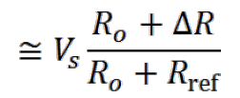
One Possible Design
v_{x} is what μController sees
$$ΔR=\frac{−R_{0}V_{s}+R_{0}V_{x}+R_{ref}V_{x}}{V_{s}}$$
$$ε=\frac{ΔR}{R_{0}}×\frac{1}{GF}$$
$$weight=f(ε)$$
μController calculates ε from known quantities V_{x}, V_{s}, R₀, R_{ref}, GF, and then weight from ε

Slide 26
Better Circuits
This will work, but:
$V_{x}≠0$ for $ε=0$
As source voltage varies (e.g. battery gets old), calibration changes – “zero drift”

Slide 27
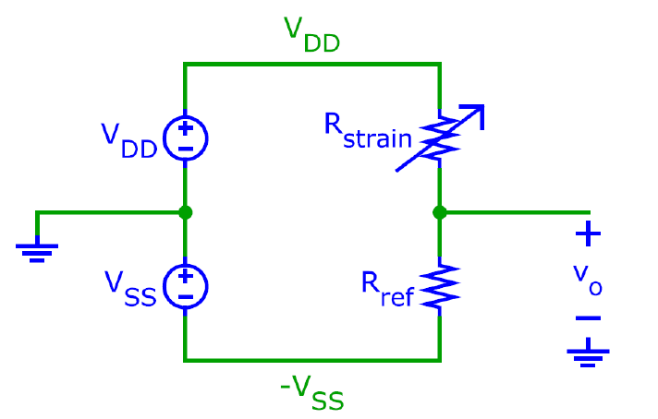
Improvement #1: Half Bridge
Works, but requires balanced sources

Slide 28
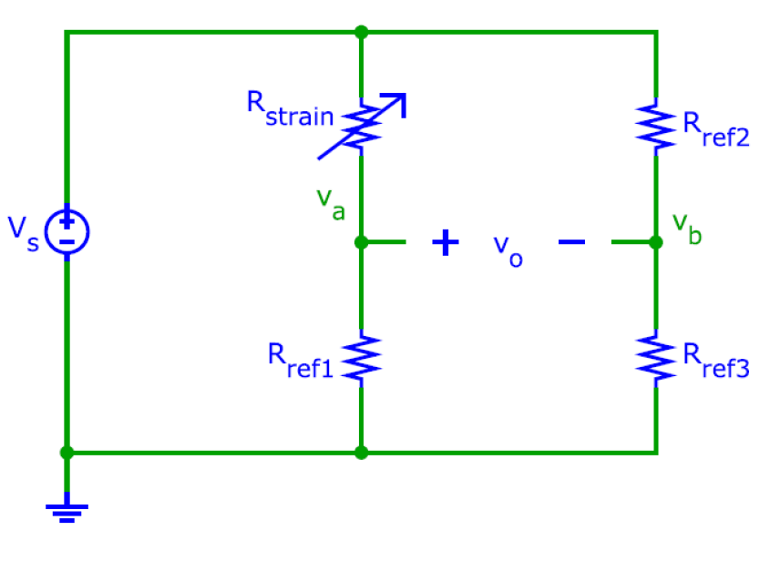
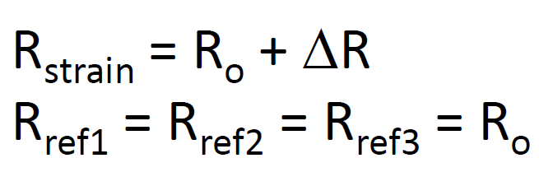
Improvement #2: Full Bridge
Want $v_{0}$
Use voltage divider
$$v_{a}=v_{s}\frac{R_{0}}{R_{0}+ΔR+R_{0}}$$
$$v_{b}=v_{s}\frac{R_{0}}{R_{0}+R_{0}}=\frac{v_{s}}{2}$$
Works, but requires resistors with value equal to R₀

Slide 29
Strain Gauge Summary
We can map strain (weight) to resistance
Simplest design (voltage divider) works, but is subject to zero-drift
More complex circuits give different design tradeoffs
Wheatstone-bridge provides arguably the best design
We will explore these tradeoffs in lab on Wednesday

Slide 30
Useful Resistive Circuit Summary
The Wheatstone bridge (and other designs) provide us with a way to measure an unknown resistance
There are resistors which vary with many useful parameters, e.g.
Incident light
Temperature
Strain
And then… there are always toasters

Slide 31
Back to Circuit Analysis
Next we’ll discuss a few more circuit analysis concepts
Superposition
Equivalent Resistance
Deeper explanation of equivalent resistance
For circuits with dependent sources
Thevenin/Norton Equivalent Circuits
Simulation

Slide 32
Superposition
Principle of Superposition:
In any linear circuit containing multiple independent sources, the current or voltage at any point in the network may be calculated as the algebraic sum of the individual contributions of each source acting alone.
A linear circuit is one constructed only of linear elements (linear resistors, and linear capacitors and inductors, linear dependent sources) and independent sources.
Linear means I-V characteristic of all parts are straight when plotted

Slide 33
Superposition
Procedure:
Determine contribution due to one independent source
Set all other sources to 0:
Replace independent voltage source by short circuit
independent current source by open circuit
Repeat for each independent source
Sum individual contributions to obtain desired voltage
or current

Slide 34
Easy Example
Find V_{o}
12 Ω
4 V
+ –
+
V_{o}
–
4 A
4 Ω
12 Ω
4 V
+ –
+
V_{o}
–
4 Ω
Voltage Divider: -1V

Slide 35
Easy Example
Find V_{o}
12 Ω
4 V
+ –
+
V_{o}
–
4 A
4 Ω
12 Ω
+
V_{o}
–
4 A
4 Ω
Current Divider: -(3A*4Ω)=-12V

Slide 36
Easy Example
Find V_{o}
12 Ω
4 V
+ –
+
V_{o}
–
4 A
4 Ω
V₀=-12V-1V=-13V
Due to voltage source
Due to current source

Slide 37
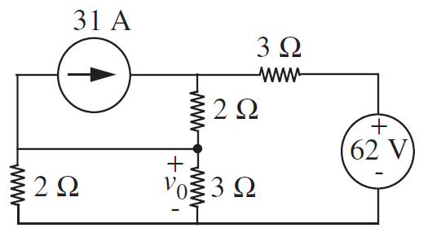
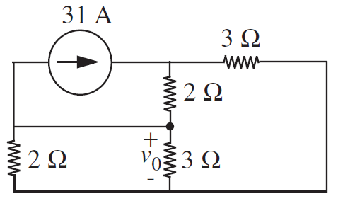
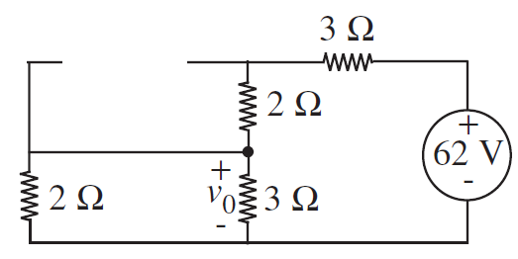
Hard Example

Slide 38
Example
Equivalent resistance:
3+2+(3||2) = 5+(3*2)/(3+2)=6.2V
Current is 10A
50V loss through top 5Ω, leaving 12V across v₀

Slide 39
Example
V_{T}
V_{o}
$$\frac{V_{o}}{3}+\frac{V_{o}}{2}+31+\frac{V_{o}−V_{T}}{2}=0$$
This will work…
But algebra is easier if we pick a better ground
$$−31+\frac{V_{T}−V_{o}}{2}+\frac{V_{T}}{3}=0$$

Slide 40
Example
V_{T}
V_{B}
$$\frac{V_{B}}{2}+\frac{V_{B}}{3}+\frac{V_{B}−V_{T}}{3}=0$$
$$V_{B}=\frac{2}{7}V_{T}$$
$$−31+\frac{V_{T}}{2}+\frac{\left(V_{T}−V_{B}\right)}{3}=0$$
$$V_{B}=12V$$
$$V_{o}=−12V$$

Slide 41
Example
V_{o}=-12V
V_{o}=12V
$$V_{o}=−12V+12V=0V$$

Slide 42
Note on Dependent Sources
You can use superposition in circuits with dependent sources
However, DON’T remove the dependent sources! Just leave them there.

Slide 43
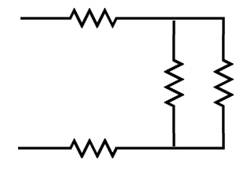
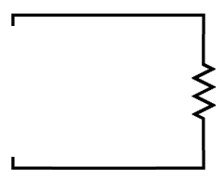
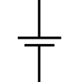
Equivalent Resistance Review
If you add a source to any two terminals in a purely resistive circuit
The added source will “see” the resistive circuit as a single resistor
10Ω
1A
1A
10Ω
10Ω
25Ω
25V
10Ω
25V

Slide 44
Alternate Viewpoint
10Ω
10Ω
10Ω
10Ω
We can think of the circuit above as a two terminal circuit element with an I-V characteristic
Slope: 1/25Ω
v
i

Slide 45
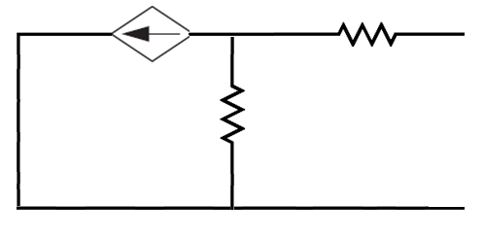
Equivalent Resistance
Let’s consider the IV characteristic of the following circuit:
αV₂
R₁
I
+
V₂
R₂
V
-
$$\frac{V_{2}−V}{R_{1}}+\frac{V_{2}}{R_{2}}+αV_{2}=0$$

Slide 46
Equivalent Resistance
αV₂₎
R₁
I
+
V₂
R₂
V
-
$$\frac{V_{2}−V}{R_{1}}+\frac{V_{2}}{R_{2}}+αV_{2}=0$$
$$V_{2}=\frac{R_{2}V}{R_{1}+R_{2}+αR_{1}R_{2}}$$
$$I=\frac{V−\frac{R_{2}V}{R_{1}+R_{2}+αR_{1}R_{2}}}{R_{1}}$$
$$\frac{I}{V}=\frac{1+αR_{2}}{R_{1}+R_{2}+αR_{1}R_{2}}$$

Slide 47
Equivalent Resistance
αV₂
R₁
I
+
V₂
R₂
V
-
v
$$\frac{I}{V}=\frac{1+αR_{2}}{R_{1}+R_{2}+αR_{1}R_{2}}$$
i
Slope: $\frac{1+αR_{2}}{R_{1}+R_{2}+αR_{1}R_{2}}$
= 1/R_{eq}
This circuit just acts like a resistor!

Slide 48
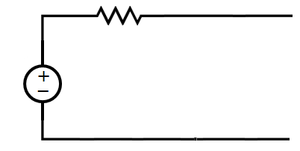
Equivalent Resistance Summary So Far
Purely resistive networks have an I-V characteristic that looks just like their equivalent resistance
Purely resistive networks which also include dependent sources also act like resistors
Let’s see what happens with a circuit with an independent source
5Ω
I
10V
V

Slide 49
Equivalent Resistance Summary So Far
5Ω
I
10V
V
$$I=\frac{V−10}{5}=\frac{V}{5}−2$$
Doesn’t match our basic I-V characteristics… good!
v
i

Slide 50
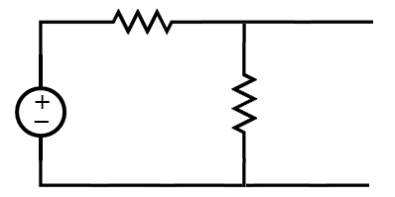
Interestingly…
10Ω
I
20V
10Ω
V
$$I=\frac{V−20}{10}+\frac{V}{10}$$
$$=\frac{V}{5}−2$$
v
i

Slide 51
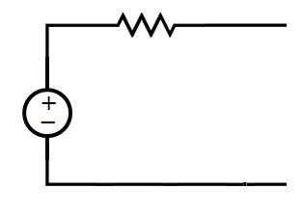
Equivalent Circuits
10Ω
20V
10Ω
Has the exact same I-V characteristic as:
5Ω
10V

Slide 52
Thevenin Equivalents
We saw before that we can replace a network of resistors (and dependent sources) with a single equivalent resistance
Now, we have that we can replace any circuit we can build so far with a single voltage source and resistor
Not proven, but it’s true, trust me
This two element network is known as a Thevenin equivalent
Generalization of the idea of equivalent resistance
Again: Discovered twice, named after the second guy!

Slide 53
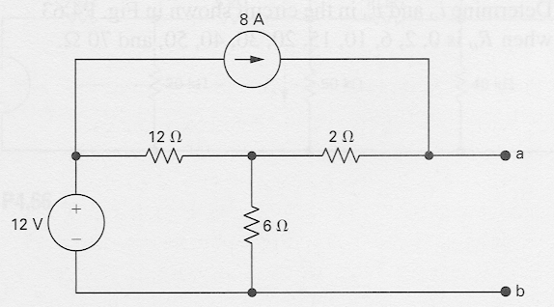
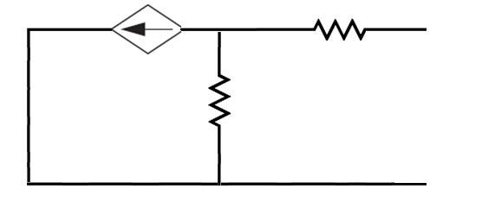
Why is this useful?
Can swap out elements and not have to resolve a big circuit again
Captures the fundamental operation of the circuit as a whole (at chosen two terminals only!)

Slide 54
Thevenin Algorithm for Independently Sourced Circuits
What you’re ultimately doing is finding the I-V characteristic of the circuit
You can do this by attaching a made up V, and calculating I as on slides 49 and 50
Often called a “Test Voltage”
This is equivalent to:
Finding the “open circuit” voltage
Finding the “short circuit” current

Slide 55
Calculating a Thévenin Equivalent
Calculate the open-circuit voltage, v_{oc}
Calculate the short-circuit current, i_{sc}
Note that i_{sc} is in the direction of the open-circuit voltage drop across the terminals a,b !
a
network
of
sources
and
resistors
+
v_{oc}
–
b
a
network
of
sources
and
resistors
i_{sc}
b

Slide 56
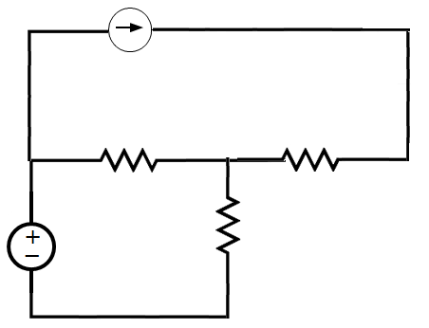
Example – On the Board
8A
2Ω
12Ω
12V
6Ω
Find the Thevenin Equivalent circuit, by finding
1. V_{OC}
2. I_{SC}

Slide 57
Finding Thevenin Resistance Directly
If there are no dependent sources in the circuit, we can find the Thevenin Resistance directly
Algorithm is easy:
Set all independent sources to zero
Voltage source becomes short circuit
Current source becomes open circuit
Leave dependent sources intact
Find equivalent resistance between terminals of interest

Slide 58
Norton Equivalent Circuit
Any network of voltage sources, current sources, and resistors can also be replaced by an equivalent circuit consisting of an independent current source in parallel with a resistor without affecting the operation of the rest of the circuit.
Norton equivalent circuit
a
a
network
of
sources
and
resistors
+
v_{L}
–
i_{L}
+
v_{L}
–
i_{L}
R_{L}
≡
i_{N}
R_{N}
R_{L}
b
b

Slide 59
Example – On the Board
8A
2Ω
12Ω
12V
6Ω
Find the Thevenin Equivalent resistance directly

Slide 60
Finding I_{N} and R_{N}
We can derive the Norton equivalent circuit from a Thévenin equivalent circuit simply by making a source transformation:
R_{Th}
a
a
+
v_{L}
–
i_{L}
+
v_{L}
–
i_{L}
v_{Th}
–
+
R_{L}
i_{N}
R_{N}
R_{L}
b
b

Slide 61
Circuit Simulation
Automated equation solvers use our algorithm:
Choose a ground node
Assign node voltage labels to all nodes
Write out a system of N-1 linear equations
Solve (using standard linear algebra techniques)
One pretty handy tool is falstad.com’s circuit simulator
Let’s try a live demo

Slide 62
Extra Slides

Slide 63
Delta-Wye Conversion

Slide 64
Equivalent Resistances
Are there any circuit elements in parallel?
Are there any circuit elements in series?
R₁
R₂
V
+
R₃
−
No
R₄
R₅
Are there any circuit elements in parallel?
No
What do we do?
Be clever and find I-V characteristic directly
Apply weirder transformation rules than series or parallel

Slide 65
Y-Delta Conversion
These two resistive circuits are equivalent for voltages and currents external to the Y and Δ circuits. Internally, the voltages and currents are different.
R_{b}R_{c}
R_{a} + R_{b} + R_{c}
R_{a}R_{c}
R_{a} + R_{b} + R_{c}
R_{a}R_{b}
R_{a} + R_{b} + R_{c}
R₁ =
R₂ =
R₃ =

Slide 66
Δ-Y and Y-Δ Conversion Formulas
Delta-to-Wye conversion
Wye-to-Delta conversion
R_{b}R_{c}
R_{a} + R_{b} + R_{c}
R₁R₂ + R₂R₃ + R₃R₁
R₁
R₁ =
R_{a} =
R_{a}R_{c}
R_{a} + R_{b} + R_{c}
R₁R₂ + R₂R₃ + R₃R₁
R₂
R₂ =
R_{b} =
R_{a}R_{b}
R_{a} + R_{b} + R_{c}
R₁R₂ + R₂R₃ + R₃R₁
R₃
R₃ =
R_{c} =

Slide 67
Circuit Simplification Example
Find the equivalent resistance R_{ab}:
2Ω
2Ω
a
a
18Ω
6Ω
12Ω
≡
9Ω
4Ω
b
9Ω
4Ω
R_{a}R_{b}
R_{a} + R_{b} + R_{c}
b
R₃ =
=6
R_{b}=18
R_{a}=12
R_{c}=6
R2=2
3

Slide 68
General Versions of Thevenin Slides

Slide 69
Equivalent Resistance Summary So Far
Purely resistive networks have an I-V characteristic that look just like their equivalent resistance
Networks which include dependent sources also act like resistors
Let’s see what happens with a circuit with a source
R₁
I
V_{s}
V

Slide 70
Equivalent Resistance Summary So Far
R₁
I
V_{s}
V
$$I=\frac{V−V_{s}}{R_{1}}$$
Doesn’t match our basic I-V characteristics… good!
v
i

Slide 71
Interestingly…
R₁
I
V_{s}
R₂
V
$$I=\frac{V−V_{s}}{R_{1}}+\frac{V}{R_{2}}$$
v
i

Slide 72
R₁
V_{s}
R₂
Has the exact same I-V characteristic as:
R_{eq}
V_{s}

Slide 73
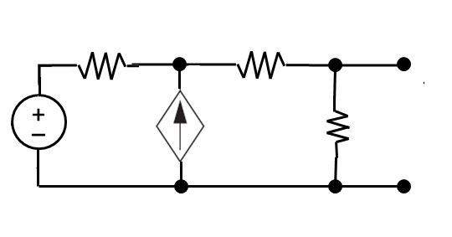
I
2 Ω
1 Ω
+
V_{o}
–
30 V
4 Ω

