Slide 1

7/12/2010
Lecture 8
Capacitors and Inductors
Congratulations to Paul the Octopus on getting 8/8 world cup predictions correct

Slide 2
So far…
All circuits we’ve dealt with have reacted instantaneously
  Change a resistance, voltage, or current, and everything else reacts instantly
Obviously this isn’t a complete model for electronic device. Why?

Slide 3
For the next 2 weeks
We’ll be talking about elements with memory
  Capacitors
  Inductors
Our first 6 lectures taught us how we can take a circuit schematic containing memoryless elements and convert them into algebraic equations
In the next 2 lectures we’ll talk about how to convert circuits with memory into differential equations
The next 3 after that will be about how we can use algebraic equations for circuits with memory if we have AC sources

Slide 4
Announcements
Midterm #2 will be on the 28th
  Elements with memory
Make sure you do pre-lab before lab tomorrow
  Who has finished it?

Slide 5

The Capacitor
The basic idea is pretty simple
  Imagine you have two parallel metal plates, both of which have equal and opposite excess charges
  Plates are separated by an insulating layer (air, glass, wood, etc)
The charges would love to balance out
Insulator blocks them (just as the ground blocks you from falling into the center of the earth)

Slide 6


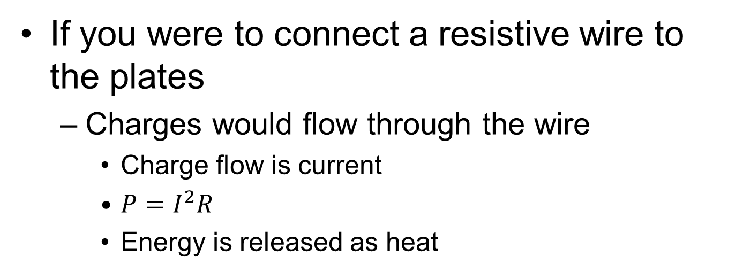
The Capacitor
If you were to connect a resistive wire to the plates
  Charges would flow through the wire
    Charge flow is current
    $P=I^{2}R$
    Energy is released as heat

Slide 7
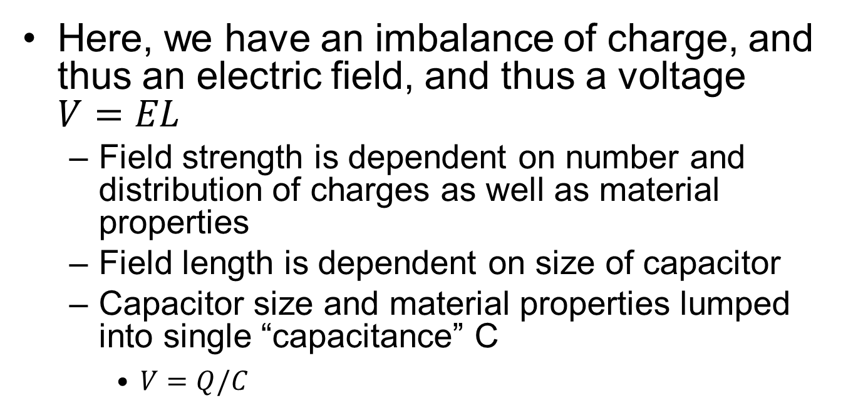
The Capacitor
Remember that a voltage is the electrical potential between two points in space
Here, we have an imbalance of charge, and thus an electric field, and thus a voltage $V=EL$
  Field strength is dependent on number and distribution of charges as well as material properties
  Field length is dependent on size of capacitor
  Capacitor size and material properties lumped into single “capacitance” C
    $V=Q/C$

Slide 8
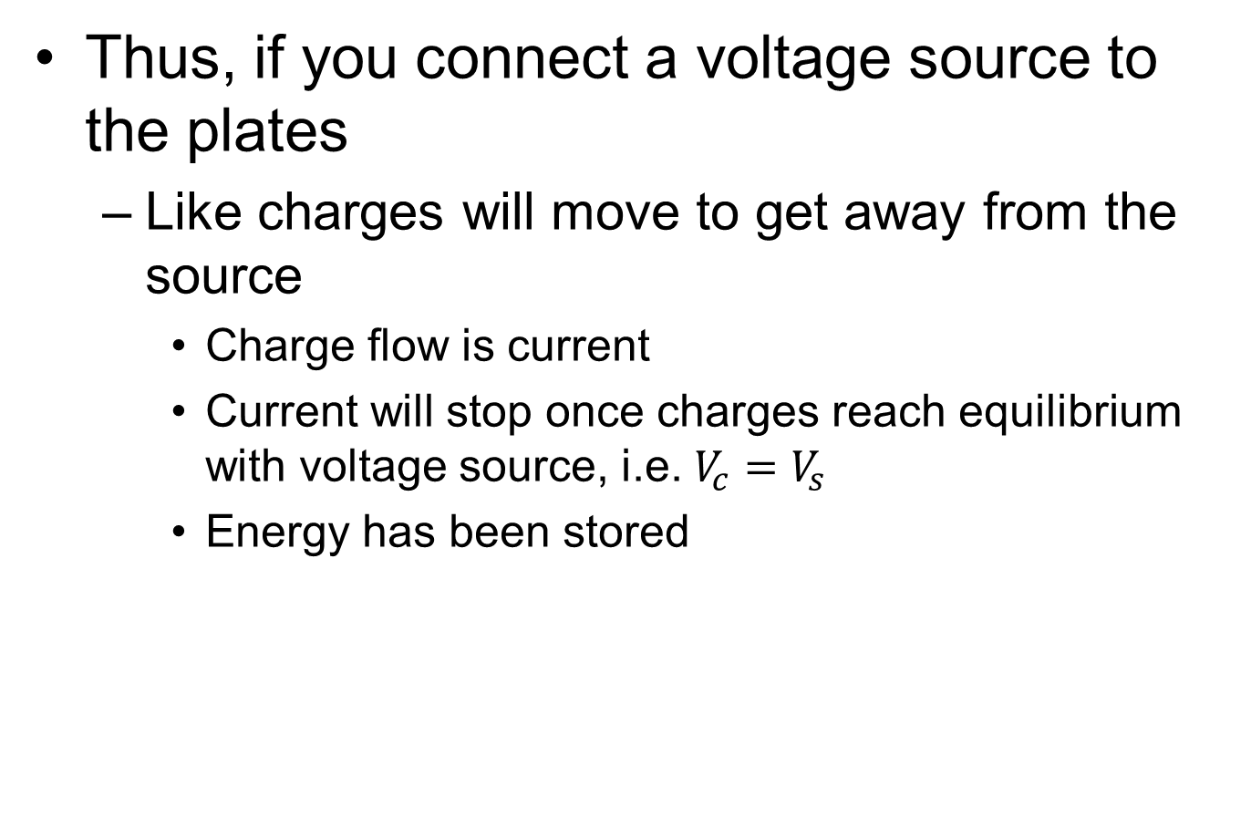
The Capacitor
Thus, if you connect a voltage source to the plates
  Like charges will move to get away from the source
    Charge flow is current
    Current will stop once charges reach equilibrium with voltage source, i.e. $V_{c}=V_{s}$
    Energy has been stored
+
-
+
-
+
-

Slide 9

The Capacitor
Lots of current
Zero current
+
-
+
-
+
-
Zero V_{C}
V_{C}=V_{S}
$$I=C\frac{dV}{dt}$$
Lots of current [the other way]
Zero current
V_{C}=V_{S}
Zero V_{C}

Slide 10
iClicker
Lots of current
Zero current
Acts like a:
Short circuit
Open circuit
Resistor
Voltage source
Current source
+
-
+
-
Zero V_{C}
V_{C}=V_{S}
Lots of current
Zero current
High V_{C}
Zero V_{C}

Slide 11
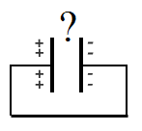
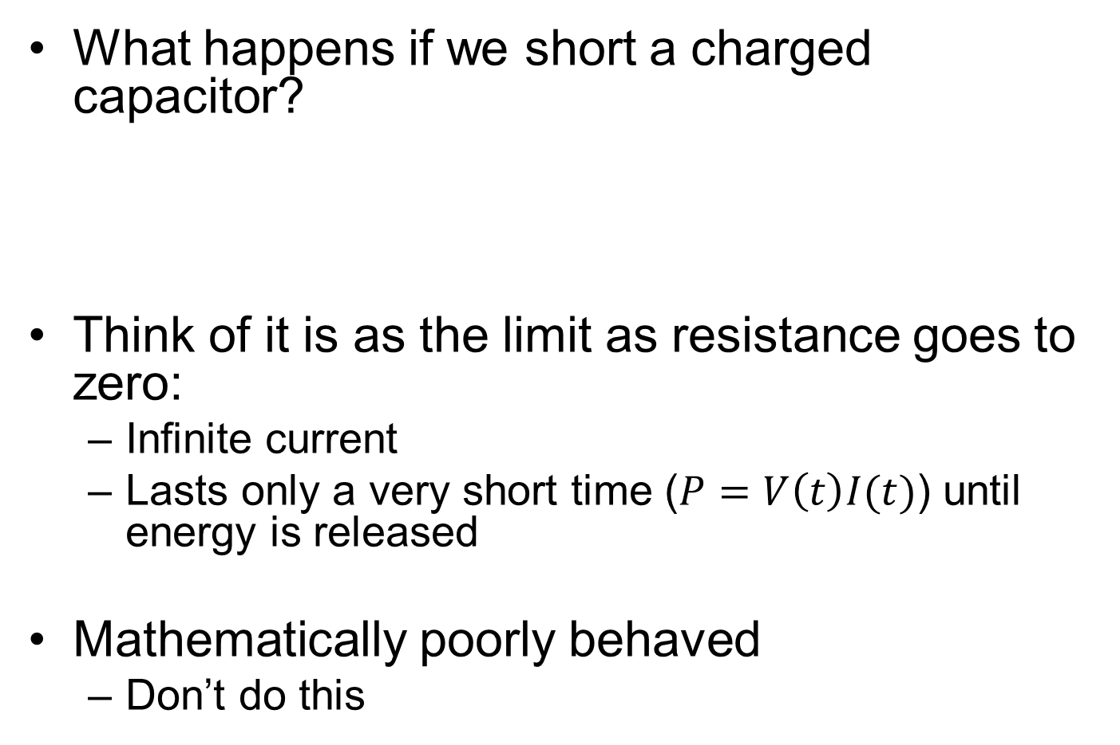
Extreme Corner Case
What happens if we short a charged capacitor?
Think of it is as the limit as resistance goes to zero:
  Infinite current
  Lasts only a very short time ($P=V\left(t\right)I(t)$) until energy is released
Mathematically poorly behaved
  Don’t do this

Slide 12

How much energy is stored?
$P(t)=V(t)I(t)$
$P(t)=V_{C}\left(t\right)C\frac{dV_{c}(t)}{dt}$
$E=\int_{0}^{t}{P\left(t\right)dt}$
$=\frac{1}{2}CV_{C}{\left(t\right)}^{2}$
Strictly speaking we shouldn’t use t as our integration variable and also the limit that we’re integrating to, but you know what I mean…

Slide 13
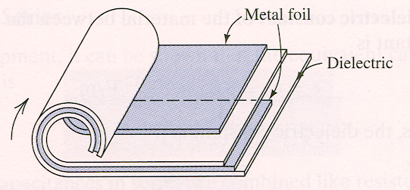
Practical Capacitors
A capacitor can be constructed by interleaving the plates with two dielectric layers and rolling them up, to achieve a compact size.
To achieve a small volume, a very thin dielectric with a high dielectric constant is desirable. However, dielectric materials break down and become conductors when the electric field (units: V/cm) is too high.
  Real capacitors have maximum voltage ratings
  An engineering trade-off exists between compact size and high voltage rating

Slide 14
Capacitors
Useful for
  Storing Energy
  Filtering
  Modeling unwanted capacitive effects, particularly delay

Slide 15
Capacitor
Symbol:
Units: Farads (Coulombs/Volt)
Current-Voltage relationship:
C
or
C
C
Electrolytic (polarized)
capacitor
These have high capacitance and cannot
support voltage drops of the wrong polarity
(typical range of values: 1 pF to 1 μF; for “supercapa-
citors” up to a few F!)
i_{c}
+
v_{c}
–
Note: v_{c} must be a continuous function of time since the
charge stored on each plate cannot change suddenly

Slide 16
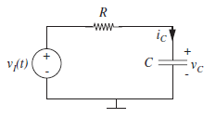
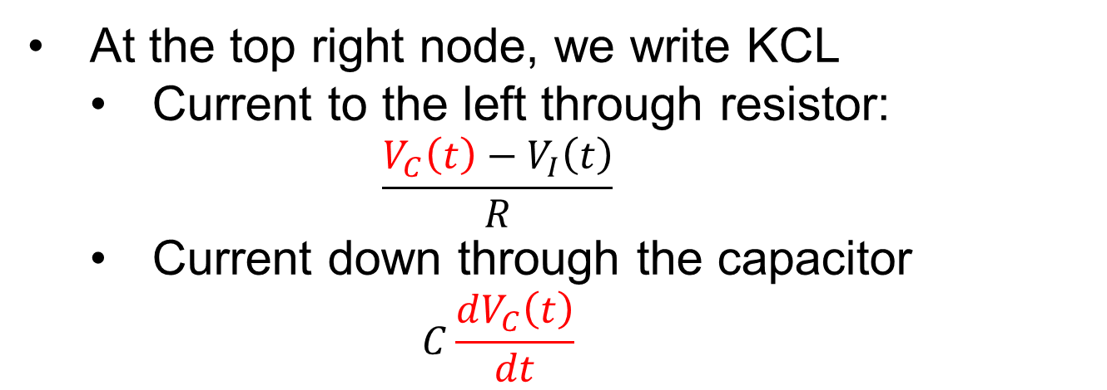
Node Voltage with Capacitors
i_{c}
+
v_{c}
–
At the top right node, we write KCL
  Current to the left through resistor:
    $$\frac{V_{C}\left(t\right)−V_{I}\left(t\right)}{R}$$
  Current down through the capacitor
    $$C\frac{dV_{C}\left(t\right)}{dt}$$

Slide 17

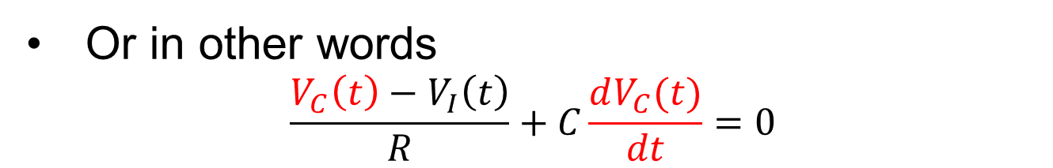
Node Voltage with Capacitors
i_{c}
+
v_{c}
–
Or in other words
$$\frac{V_{C}\left(t\right)−V_{I}\left(t\right)}{R}+C\frac{dV_{C}(t)}{dt}=0$$
Or more compactly:
$$\frac{V_{C}−V_{I}}{R}+CV_{C}^{′}=0$$

Slide 18
ODEs
$$\frac{V_{C}−V_{I}}{R}+CV_{C}^{′}=0$$
Later today, we’ll talk about how to solve ODEs…
For now, let’s talk about inductors

Slide 19

Inductors
Capacitors are a piece of cake to understand, just rely on Coulomb’s Law
Inductors, by contrast, involve magnetic fields, and rely instead on Faraday’s Law
  Comprehension comes with greater difficulty
Thus, we’ll treat inductors as mathematical objects and leave the derivation to Physics 7B (or page 467 of the book)

Slide 20
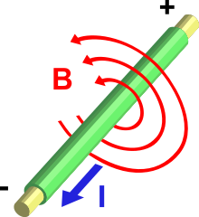
Two Fundamental Principles
The flow of current induces a magnetic field (Ampere’s Law)
A change in magnetic field through a loop of wire induces a voltage (Faraday’s Law)
+ −
(Wikipedia)

Slide 21
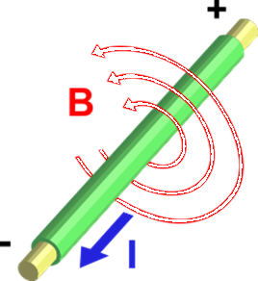
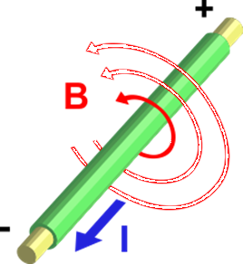
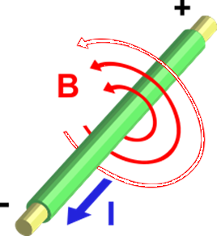
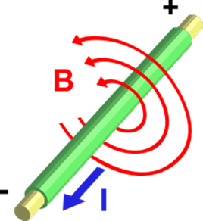
Inductor Basics (1)
When we connect a voltage source to a wire, current clearly takes a little time to get moving
Thus, the magnetic field builds to some maximum strength over time
+ −

Slide 22
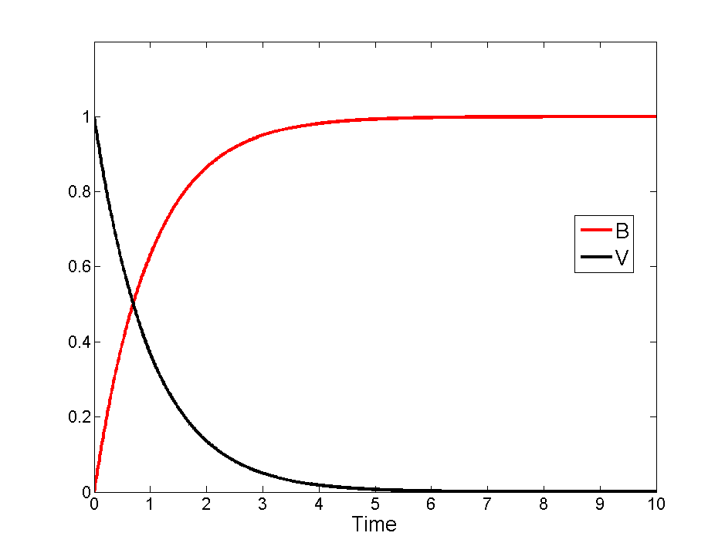
Inductor Basics (2)
+ −
Current in a wire causes induces a voltage in any nearby circuit

Slide 23
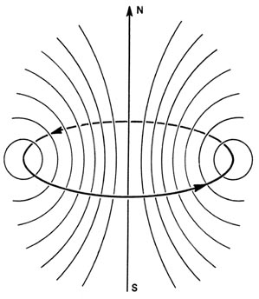
Inductors Basics (3)
If we make a loop, the entire loop of wire will all contribute to the magnetic field through the loop
What’s more, this field will go through the loop producing the current!
  Self induced voltage
  Self inductance
From: Dr. Richard F.W. Bader Professor of Chemistry / McMaster University

Slide 24
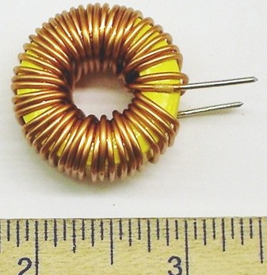
Inductors Basics (4)
More loops
  More magnetic field generated
  More circuit to receive magnetic field
Inductors are literally just loops of wire
Just like capacitors are just two conductors separated by an insulator (or a gap)
Just like resistors are just stuff with wires stuck to the ends
University of Surrey
http://personal.ee.surrey.ac.uk/Personal/H.M/UGLabs/components/inductors.htm

Slide 25
Inductors
Capacitors hold a voltage in the form of stored charge
Inductors hold a current in the form of stored magnetic field [dude…]
For webcast viewers, see drawings on board/notes for more comparison to capacitor

Slide 26
Symbol:
Units: Henrys (Volts • second / Ampere)
Current in terms of voltage:
L
(typical range of values: μH to 10 H)
i_{L}
+
v_{L}
–
Note: i_{L} must be a continuous function of time

Slide 27
Summary
Capacitor
v cannot change instantaneously
i can change instantaneously
Do not short-circuit a charged
capacitor (-> infinite current!)
In steady state (not time-varying), a capacitor behaves like an open circuit.
Inductor
i cannot change instantaneously
v can change instantaneously
Do not open-circuit an inductor with current (-> infinite voltage!)
In steady state, an inductor behaves like a short circuit.

Slide 28
Ordinary Differential Equations
Inductors, too, give us a simple 1st order relationship between voltage and current
Node Voltage with memoryless circuits gave us algebraic equations
Node voltage with elements with memory will give us Ordinary Differential Equations (ODEs)
Next week will be a bunch of setting up and solving 1st and 2nd order linear ODEs
Higher order and especially nonlinear ODEs are tough to solve. For example…

Slide 29
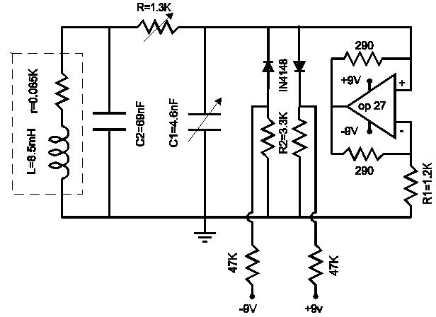



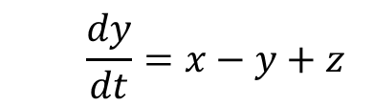


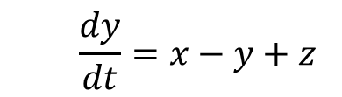
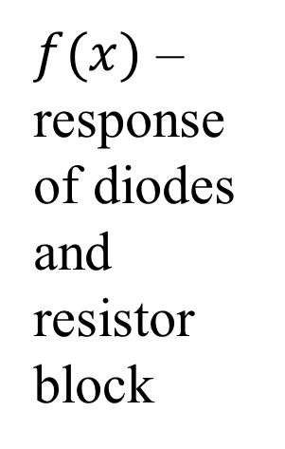


Chua’s Circuit
$f(x)$ – response of diodes and resistor block
  ODEs are:
  $$\frac{dx}{dt}=α(y−x−f\left(x\right))$$
$$x=v_{C1}$$
  $$\frac{dx}{dt}=α(y−x−f\left(x\right))$$
$$y=v_{C2}$$
  $$\frac{dy}{dt}=x−y+z$$
  $$\frac{dy}{dt}=x−y+z$$
$$z=i_{I}$$
  $$\frac{dz}{dt}=−βy$$
  $$\frac{dz}{dt}=−βy$$

Slide 30
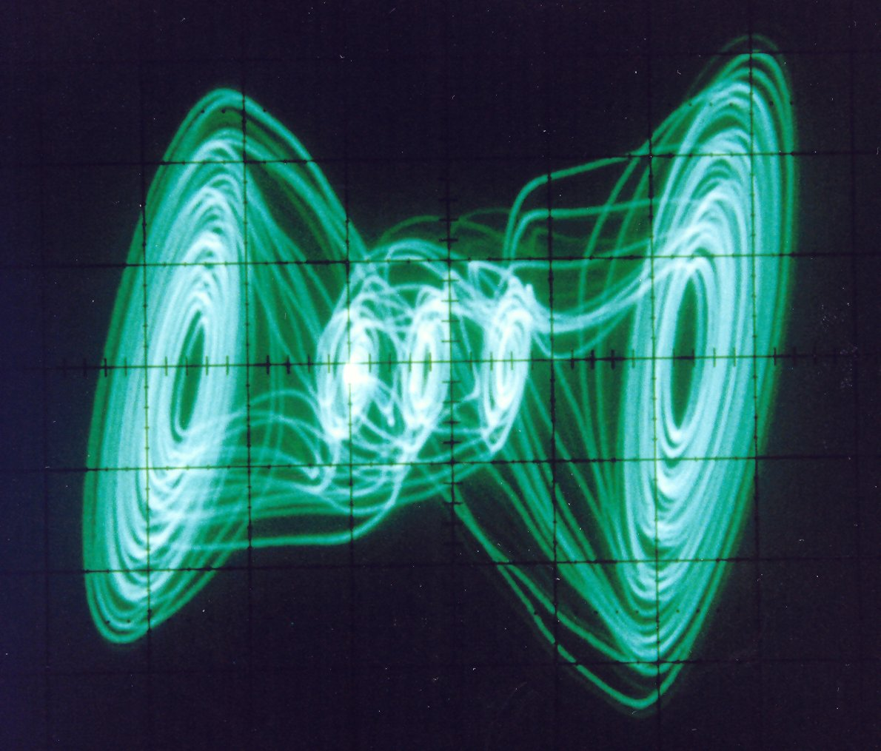
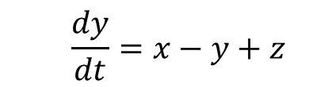


Chua’s Circuit
Despite simplicity of ODEs
Exhibits chaos!
  $$\frac{dx}{dt}=α(y−x−f\left(x\right))$$
  $$\frac{dy}{dt}=x−y+z$$
  $$\frac{dz}{dt}=−βy$$
Invented by current UC Berkeley EECS professor Leon Chua in 1983

